Slide 1
Beyond classical search
Miguel Leon

Slide 2
Outline
Beyond Classical Search
Local search
Random Search (RS)
Hill Climbing
Improvements of Hill-Climbing
Simulated Annealing (SA)
Problems with Local Search algorithms
Artificial Intelligence Concepts for Assignment 3
Machine Learning, Supervised Learning and Classification
Number of attributes and Feature selection
K-Nearest Neighbours (KNN)
How to compare 2 different search algorithms.

Slide 3
Search algorithms
We have seen algorithms that systematically explore the search space.
Normally, the solution to the problem was built by creating the path until the end goal.
Some problems do not need the path to the goal. For example, the 8-queen problem.
If the path to the goal does not matter, we might consider a different class of algorithms, ones that do not worry about paths at all

Slide 4
Local search algorithms
Local search algorithms operate using a single current node.
They generally move to neighbour nodes.
Local search algorithm are not systematic. (Do not do a complete search of the search space).
They have two advantages:
Use of a low amount of memory.
They can often find reasonable solutions in large or infinite (continuous) search spaces for which systematic algorithms are not suitable
Local search algorithms are useful for solving pure optimization problems, in which the aim is to find the best state according to an objective function.

Slide 5
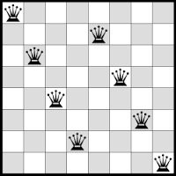
8-queen problem
Objective function? Also called fitness function (How good/bad is a solution?)

Slide 6
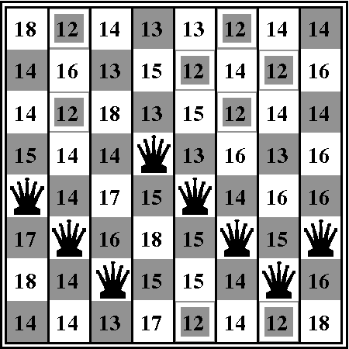
8-Queen problem
h is the number of pairs of queens that are attacking each other, either directly or indirectly.
h = 17

Slide 7
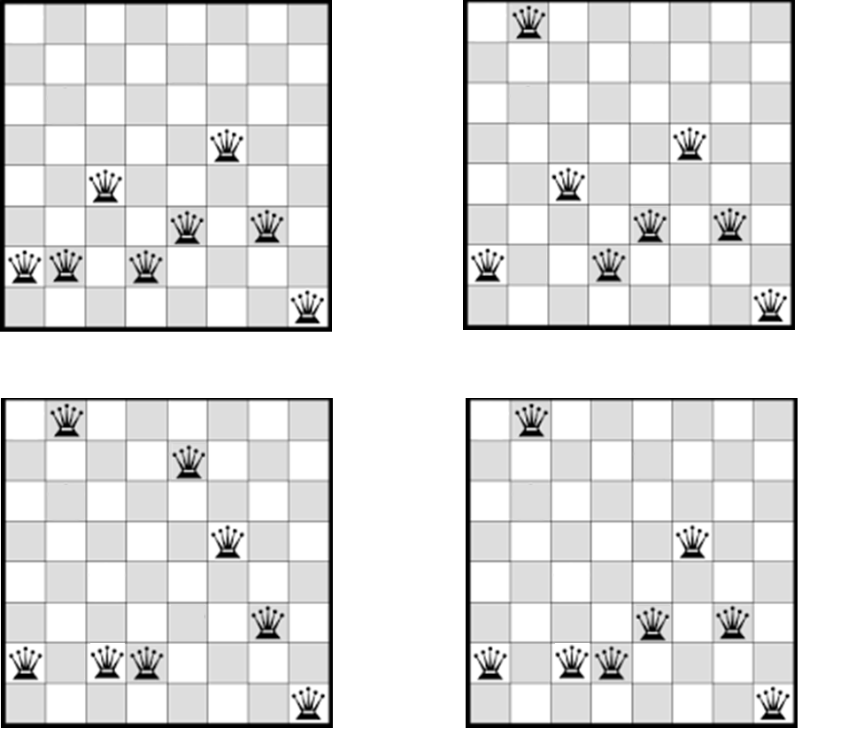
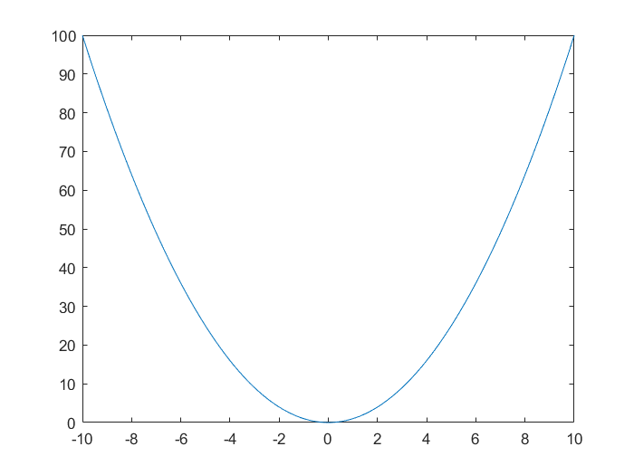
Random Search
Random Search (RS) is the simplest algorithm to perform search.
RS will select a random position and make a perturbation.
This algorithm will not properly converge, since it will randomly move.
Not a good convergence A good Convergence

Slide 8
Hill Climbing Search
In many optimization problems in engineering applications, we want to find a good possible solution, but we don’t care the path to goal
In such cases, we can try to use a simple local search strategy: hill climbing. It only selects among the children of a current node and moves to the child with the best evaluation, terminates when no child improves over the current state.
CurrentNode ← Random combination from the search space
Loop:
Generate and evaluate successors of CurrentNode
Neighbour ← Best successor of CurrentNode
If Neighbour is not better than Current, then terminate and return CurrentNode as the solution
CurrentNode ← Neighbour, go to step 1

Slide 9
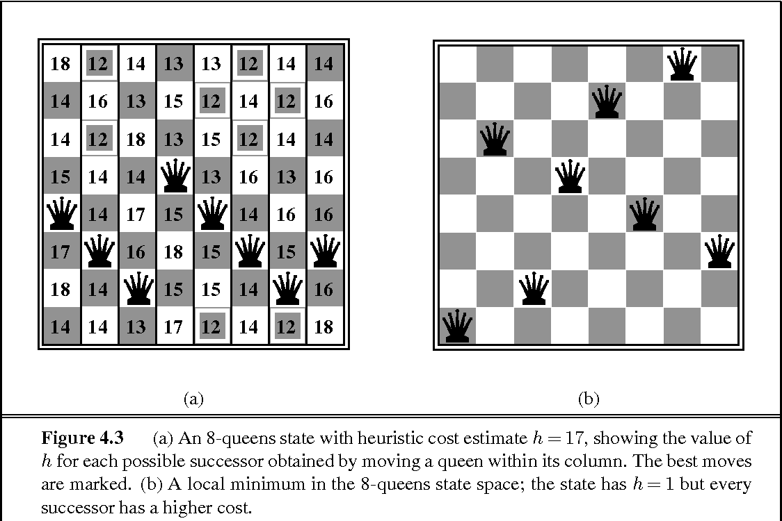
Hill Climbing search: 8-queen problem

Slide 10
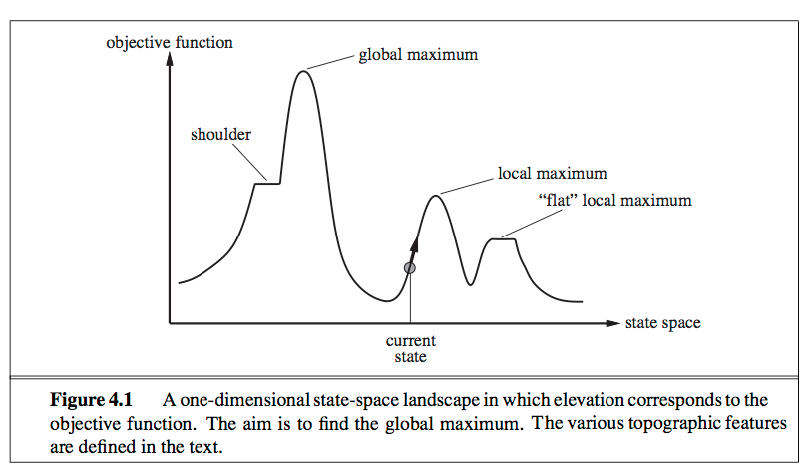
Hill Climbing Search
Issue: depending on initial state, can get stuck in local maxima

Slide 11
Hill-Climbing issues
Local Maxima is a peak that is higher than each of its neighboring states but lower than the global maximum.
Hill-Climbing will get stuck into local optima.
Ridges result in a sequence of local maxima.
Greedy algorithms, as Hill Climbing, will have dificulties to navigate
Plateaux are flat areas of the sate-space landscape. It can be a flat local maximum or a shoulder.
Hill climbing search can get lost in a plateau.

Slide 12
Improvements of Hill climbing
Stochastic Hill Climbing
A neighbourhing state, which improves the current solution is selected at random.
First-Choice Hill Climbing
Similar as stochastic hill climbing, but it chooses the first solution that improves the current solution.
Random-Restart Hill Climbing
If the first try of Hill Climbing do not succed, it will restart the search from a different point.
Variable Neighbour Search
If the algorithm get stuck, it will increase the number of variables to change. Hill Climbing only change one (in theory).

Slide 13
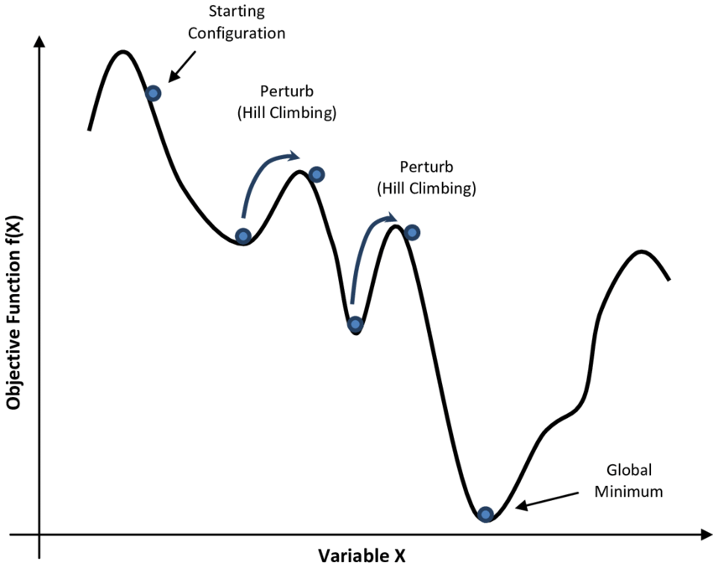
Simulated annealing
Simulated annealing (SA) adds the possibility to get a solution that is worse.
It adds a temperature parameter (T) which will help to calculate the probability to accept solutions that are worse.
The temperature will decrease with the time.

Slide 14
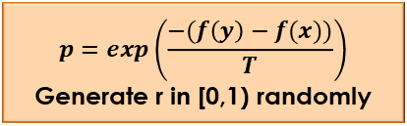
Simulated annealing – Flow chart (Optional)
Generate a random candidate solution, Y, based on the current solution, X. A neighbouring state.
Start
Generate a random initial
Solution, X
Is Y better than X?
No
$$p=exp\left(\frac{−(f\left(y\right)−f(x))}{T}\right)$$
Generate r in [0,1) randomly
Yes
Yes
X = Y
r < p ?
No
Yes
Is stop condition of inner loop met?
No
Decrease the temperature T
Is stop condition of outter loop met?
Output the solution X
Yes
No
End

Slide 15
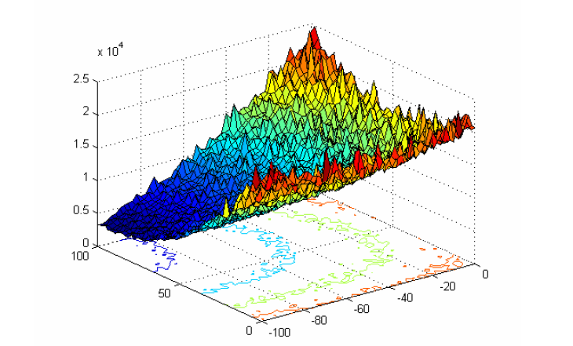
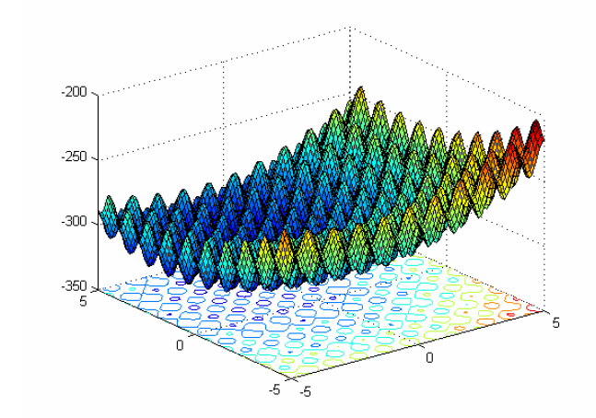
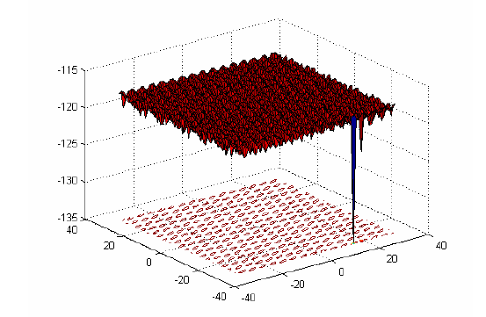
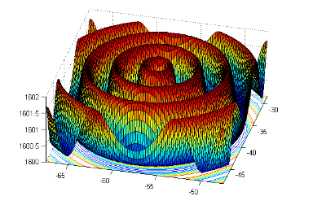
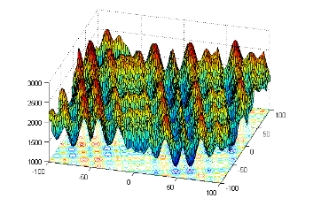
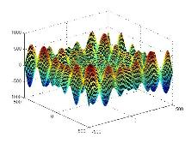
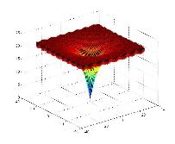
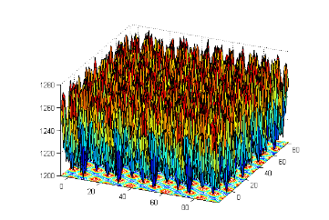
Problems with Local Search algorithms
What happen if we have the following search spaces?:

Slide 16
Problems with Local Search algorithms
What happen if we have the following search spaces?
Local search algorithms will get stuck into local optima.
Solution: Population-based algorithms (More than one solution at the same time)
There are different types:
Evolutionary Algorithms:
Genetic Algorithms
Differential Evolution
Genetic Programing
....
Swarm Intelligence:
Particle Swarm Optimization
Ant Colony Optimization
...
....

Slide 17
EXTRA reading
Norvig, Peter, and Russell, Stuart Jonathan, Artificial intelligence: A modern approach, Pearson Education, 2010 - ISBN: 9780132071482
4 Beyond Classical Search ------------------------------------------- Pag. 120
4.1 Local Search Algorithms and Optimization Problems ---- Pag. 120
4.2 Local Search in Continuous Spaces (Optional)------------- Pag. 129

Slide 18
Machine learning - Definition
Definition:
”A computer program is said to learn from experience E with respect to some class of task T and performance measure P if its performance at tasks in T, as measured by P, improves with experience E” (Tom M. Mitchel)

Slide 19
Machine learning - types
Supervised learning: The agent observes some example input-output pairs and learns a function that maps from input to output
Unsupervised Learning: The agent learn patterns in the input even though no explicit feedback is supplied.
Semi-supervised Learning: Something between Supervised and Unsupervised Learning.
Reinforcement Learning: The agent learn from a series of rewards and punishments.

Slide 20
Supervised learning - Data
The data of a supervised learning problem is labeled.
Two types of Supervised Learning problems:
Classification: Discrete valued output (0 or 1). You can have more than two classes.
Regression: Predict continuous valued output.
Dataset
Attributes
One case
ID_case | Attribute 1 | Attribute 2 | ... | Attribute N | Output
case_1 |  |  | ...
case_2 |  |  | ...
case_3000 |  |  | ...
.... |  |  | ...
case_10000 |  |  | ...
Labels

Slide 21
Division of the data
Training data
Learning data
Validation data
Testing data

Slide 22
Supervised learning - examples
CLASSIFICATION
Problem: Brest cancer (Malignant, benign)
Task (T):
Classify a tumor (e.g. brest cancer) as malignant or benign.
Experience (E):
Watching other cases of tumor and if they are malignant or benign.
Performance measure (P):
Fraction of tumors correctly classified as malignant/benign.
1(Y)
Malignant?
0(N)
Tumor size

Slide 23
Importance of number of attributes or features
So far we are using one attribute (tumor size).
Could we add new attributes?:
Attributes about the pacient.
E.g. Age
Attributes related to the cells.
Clump thikness
Age
Tumor size

Slide 24
K-Nearest-Neighbor
K-Nearest-Neighbor (KNN) is a nonparametric method.
The model (algorithm) will be composed of all the training examples.
When classifying a new example, the following steps are followed:
Calculate the distance between the new example and all the examples in the model.
Take the K closest training examples.
Perform a voting with the class of the selected training examples.
The new example will be classified as the class with more votes.

Slide 25
K-nearest-neighbor examples
K = 3
K = 5

Slide 26
How to compare 2 search algorithms
Each run of the algorithm will have a different performance.
It is needed to run the algorithm several times.
Then, the average result of the different times is used as the final score of the algorithm.

