Slide 1
What is an LLM, and how does it work?
By the end of this session, you will be able to:
Explain how an LLM generates text.
Describe tokens, context, embeddings, and attention.
Explain next-token prediction.
Improve a prompt for better answers.
Recognise limitations and hallucinations.
Evaluate AI responses critically.
Run and modify a simple LLM example in Google Colab.
When ChatGPT answers a question, is it looking up a complete answer — or generating one token at a time?
Dr. Farshid Keivanian

Slide 2
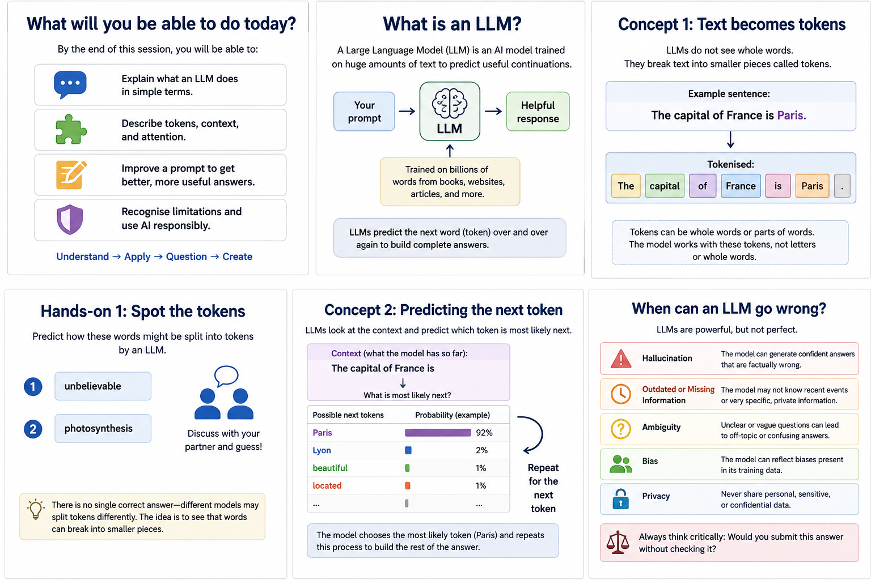
What is a Large Language Model?
A Large Language Model (LLM) is an AI model trained on very large amounts of text to learn patterns in language.
When you give it a prompt, it:
breaks the text into smaller units called tokens,
represents those tokens numerically,
uses the surrounding context to interpret them,
predicts a suitable next token, and
repeats this process to generate a response.
An LLM generates text one token at a time, using patterns learned during training and the context of your prompt.
Use this as the timing guide

Slide 3
What is a Large Language Model?
Key idea
A base LLM does not normally look up a complete stored answer.
Think: If an LLM predicts the next token, why can an answer sound convincing even when it is wrong?
Use this as the timing guide

Slide 4
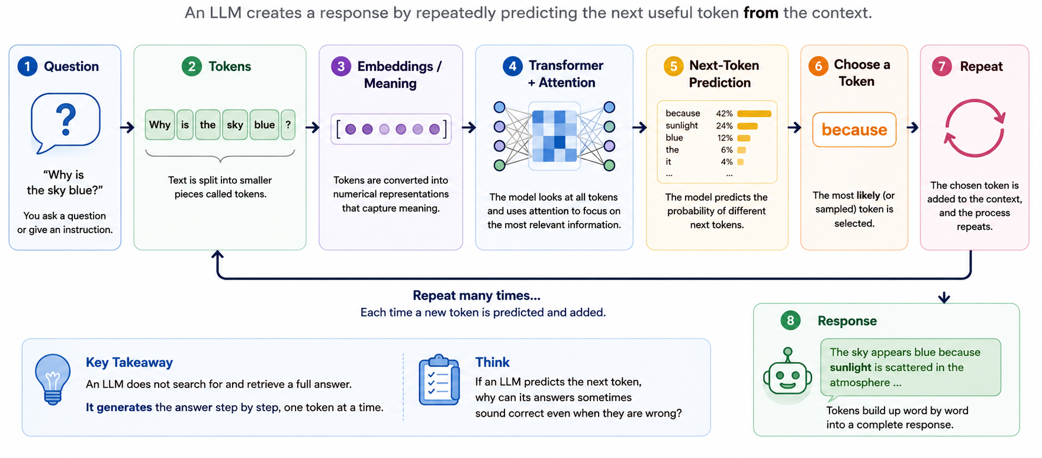
How Does an LLM Turn a Question into an Answer?
Tokens are converted into numerical vectors that help the model represent meaning and relationships.
The model uses attention to weigh relevant earlier tokens in the context.
Use this as the timing guide

Slide 5
Concept 1: Text becomes tokens
LLMs process text as tokens rather than directly as sentences.
Tokens can be:
a whole word,
part of a word,
punctuation,
or another text unit.

Slide 6
Concept 2: Predicting the next token

Slide 7
Why Does an LLM Break Text into Tokens?
Why doesn’t an LLM treat the whole sentence as one token? Why does it break the sentence into smaller tokens?
Because there are almost unlimited possible sentences.
If every complete sentence were one token, the model would need a separate token for every sentence it might ever encounter—including sentences it has never seen before.
Instead, the model breaks text into smaller, reusable pieces called tokens.

Slide 8
Why Does an LLM Break Text into Tokens?
For example:
Sentence:
The capital of France is Paris.
Instead of one huge token:
[The capital of France is Paris.]
It uses smaller tokens:
[The] [capital] [of] [France] [is] [Paris] [.]
These smaller pieces can be reused in millions of different sentences.

Slide 9
Why Does an LLM Break Text into Tokens?
Analogy:
Think of LEGO. We don't create a completely new LEGO piece for every object we want to build. We use smaller reusable pieces and combine them in different ways. Tokens work in a similar way.

Slide 10
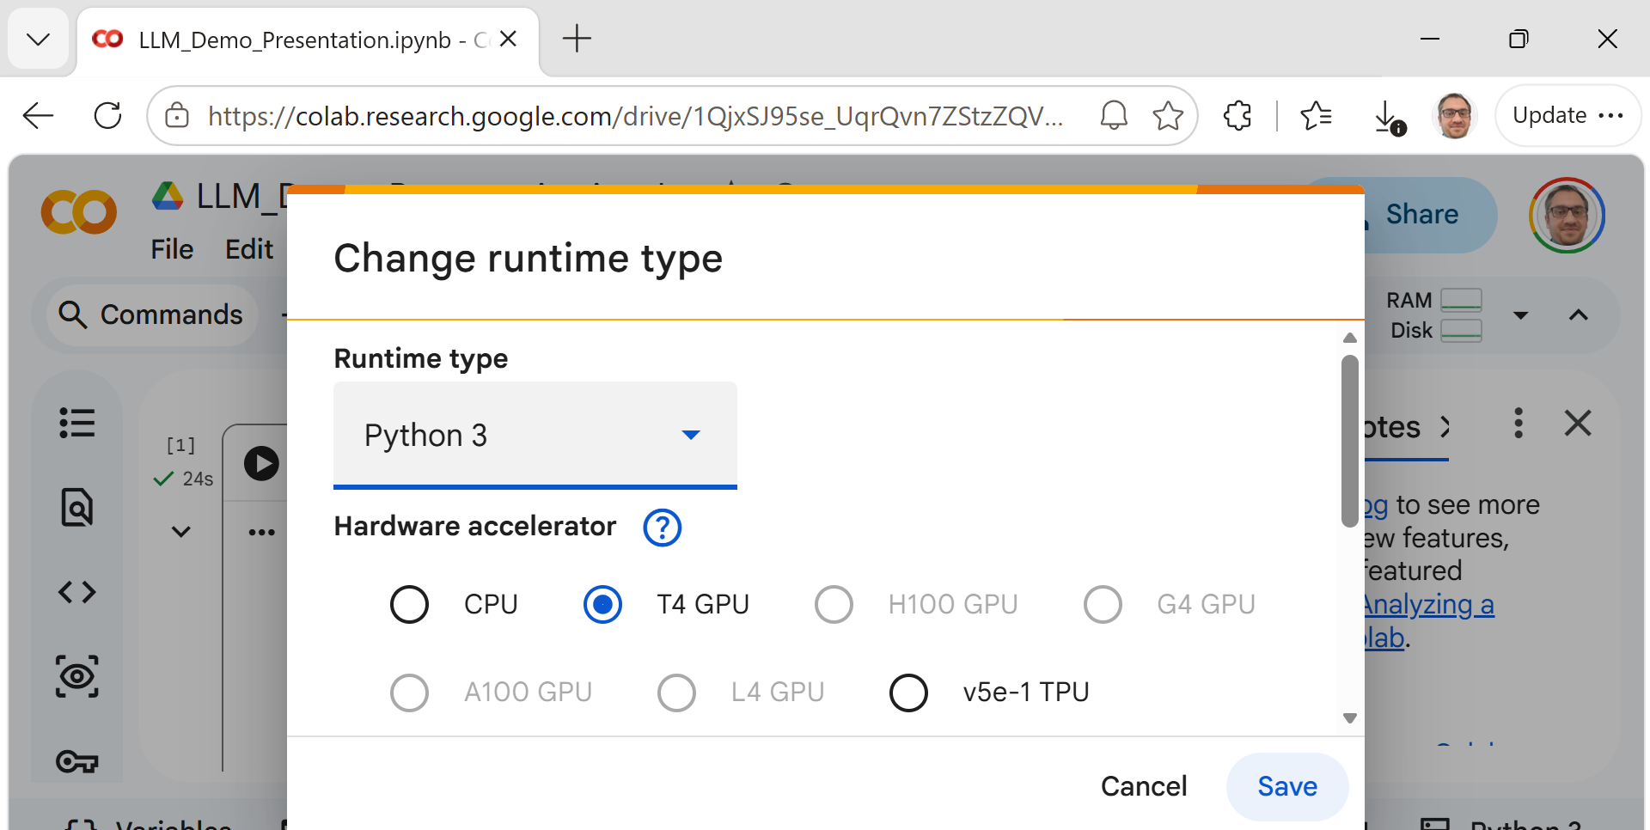
Let’s make an LLM generate text
In Google Colab, select:
Runtime → Change runtime type → Hardware accelerator → T4 GPU → Save
https://colab.research.google.com/drive/1QjxSJ95se_UqrQvn7ZStzZQV1TtfcJyL?usp=sharing

Slide 11
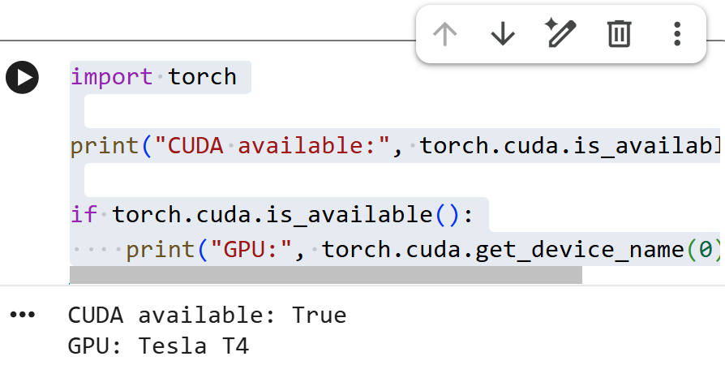
Let’s make an LLM generate text
Cell 1 – Check GPU
import torch
print("CUDA available:", torch.cuda.is_available())
if torch.cuda.is_available():
print("GPU:", torch.cuda.get_device_name(0))
https://colab.research.google.com/drive/1QjxSJ95se_UqrQvn7ZStzZQV1TtfcJyL?usp=sharing

Slide 12
Let’s make an LLM generate text
Why GPU rather than CPU?
Phi-3 Mini has billions of parameters. CPU inference can be very slow, whereas a T4 GPU makes the classroom demonstration much more practical.
Once the T4 is enabled, use:
https://colab.research.google.com/drive/1QjxSJ95se_UqrQvn7ZStzZQV1TtfcJyL?usp=sharing

Slide 13
Let’s make an LLM generate text
Cell 2 – Imported the LLM tools (Import the required classes)
from transformers import AutoModelForCausalLM, AutoTokenizer, pipeline
These components allowed us to load the tokenizer, load the pretrained model, and create a text-generation pipeline.
https://colab.research.google.com/drive/1QjxSJ95se_UqrQvn7ZStzZQV1TtfcJyL?usp=sharing

Slide 14
Let’s make an LLM generate text
Cell 3 — Define the model (Selected Phi-3)
model_name = "microsoft/Phi-3-mini-4k-instruct"
We used a pretrained instruction-following LLM rather than training a model ourselves.
https://colab.research.google.com/drive/1QjxSJ95se_UqrQvn7ZStzZQV1TtfcJyL?usp=sharing

Slide 15
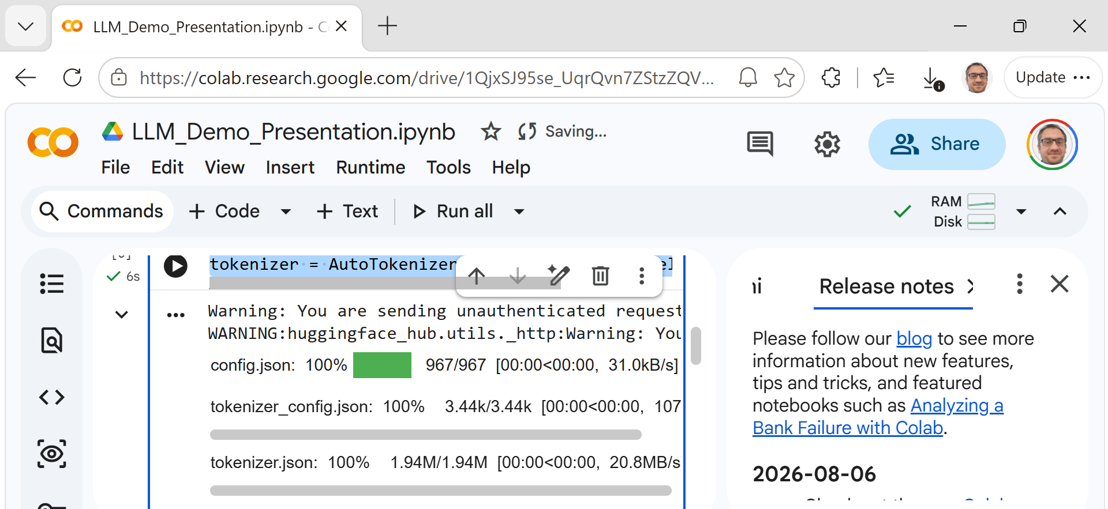
Let’s make an LLM generate text
Cell 4 — Load tokenizer
tokenizer = AutoTokenizer.from_pretrained(model_name)
The tokenizer converts our text into tokens that the model can process.
https://colab.research.google.com/drive/1QjxSJ95se_UqrQvn7ZStzZQV1TtfcJyL?usp=sharing

Slide 16
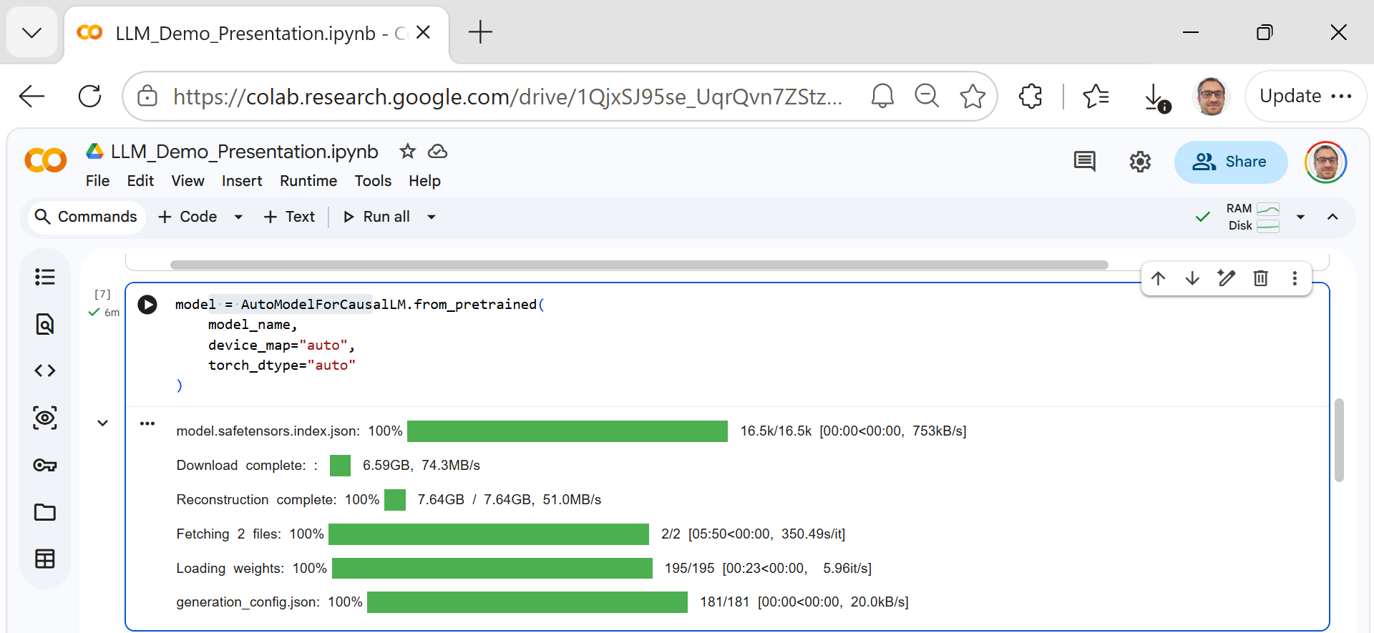
Let’s make an LLM generate text
Cell 5 — Load the model onto the available hardware (Load Phi-3)
model = AutoModelForCausalLM.from_pretrained(
model_name,
device_map="auto",
torch_dtype="auto"
)
device_map="auto" allows the framework to choose the appropriate available device, while torch_dtype="auto" uses a suitable numerical representation for the model.
https://colab.research.google.com/drive/1QjxSJ95se_UqrQvn7ZStzZQV1TtfcJyL?usp=sharing

Slide 17
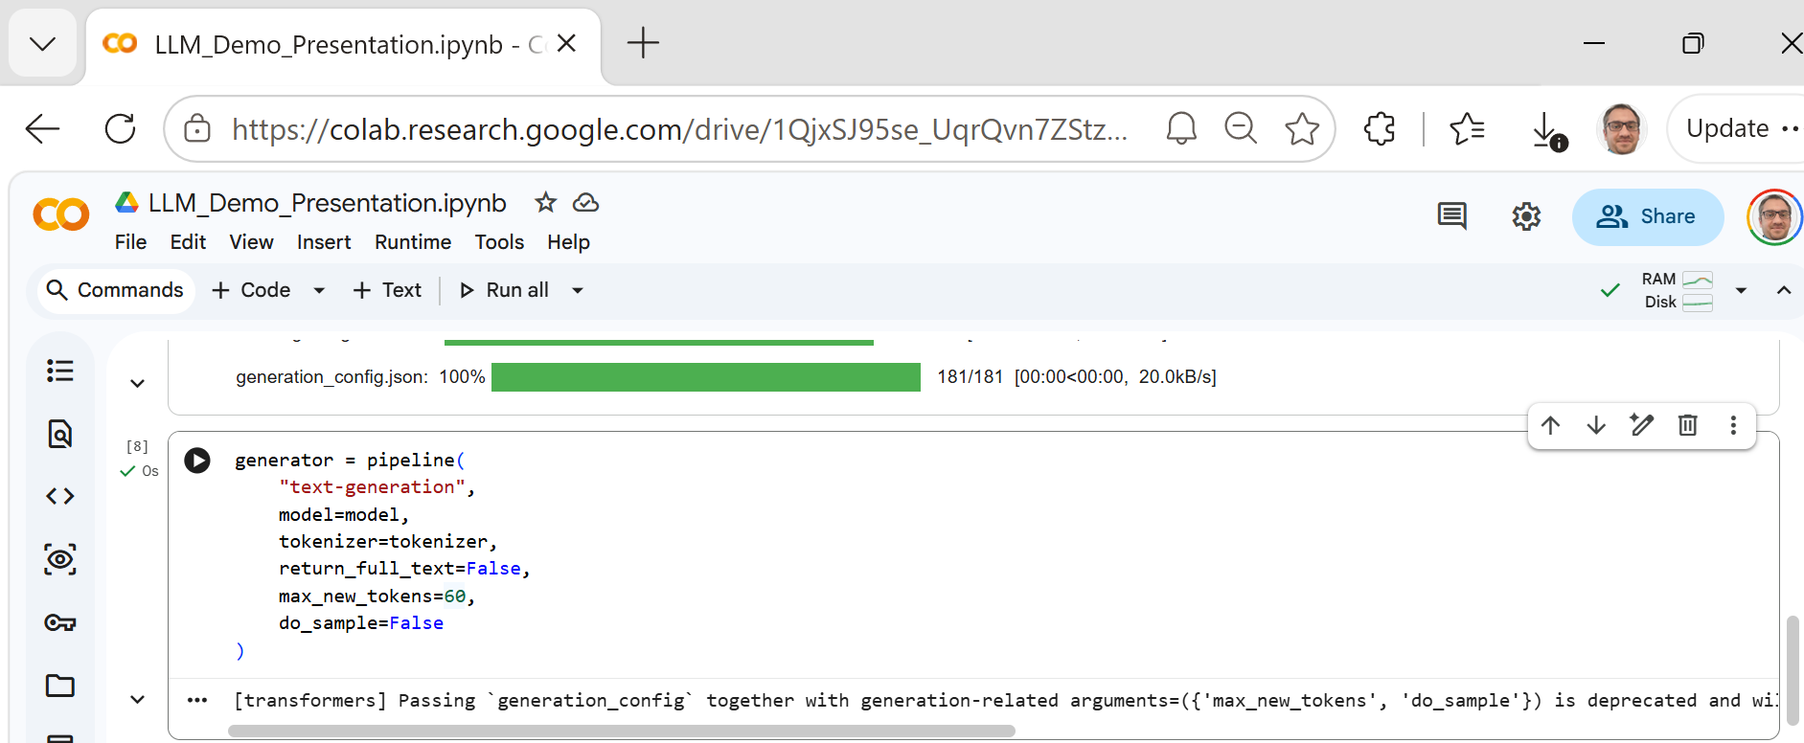
Let’s make an LLM generate text
Cell 6 — Create a text-generation pipeline
generator = pipeline(
"text-generation",
model=model,
tokenizer=tokenizer,
return_full_text=False,
max_new_tokens=100,
do_sample=False
)
We limited the generated response to 100 new tokens and used deterministic generation rather than random sampling.
https://colab.research.google.com/drive/1QjxSJ95se_UqrQvn7ZStzZQV1TtfcJyL?usp=sharing

Slide 18
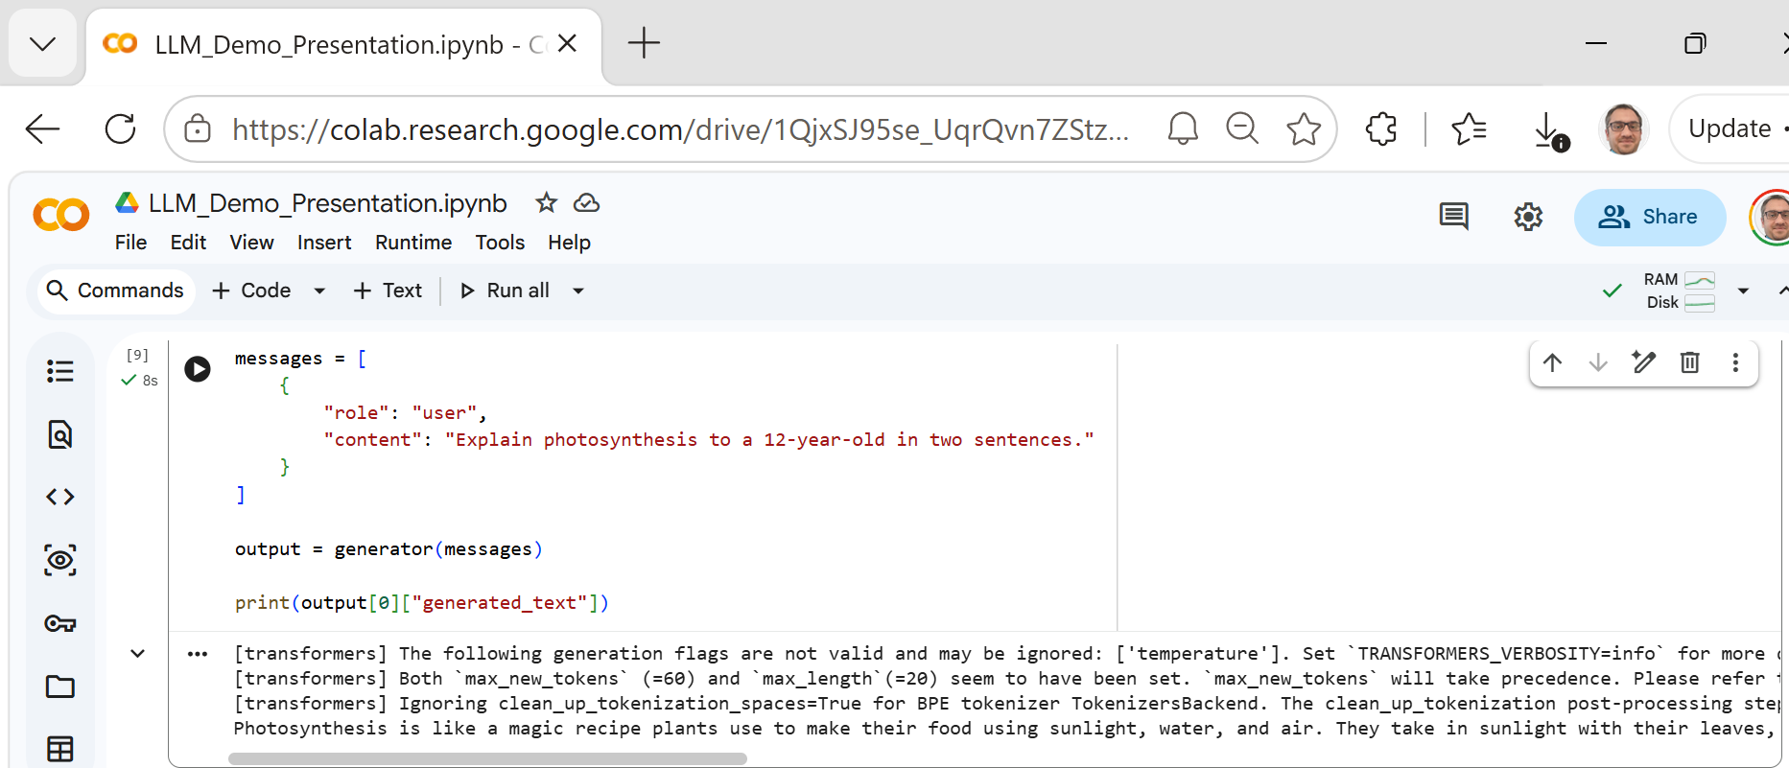
Let’s make an LLM generate text
Cell 7 — Give the LLM prompt
(Test it)
messages = [
{
"role": "user",
"content": "Explain photosynthesis to a 12-year-old in two sentences."
}
]
output = generator(messages)
print(output[0]["generated_text"])
https://colab.research.google.com/drive/1QjxSJ95se_UqrQvn7ZStzZQV1TtfcJyL?usp=sharing

Slide 19
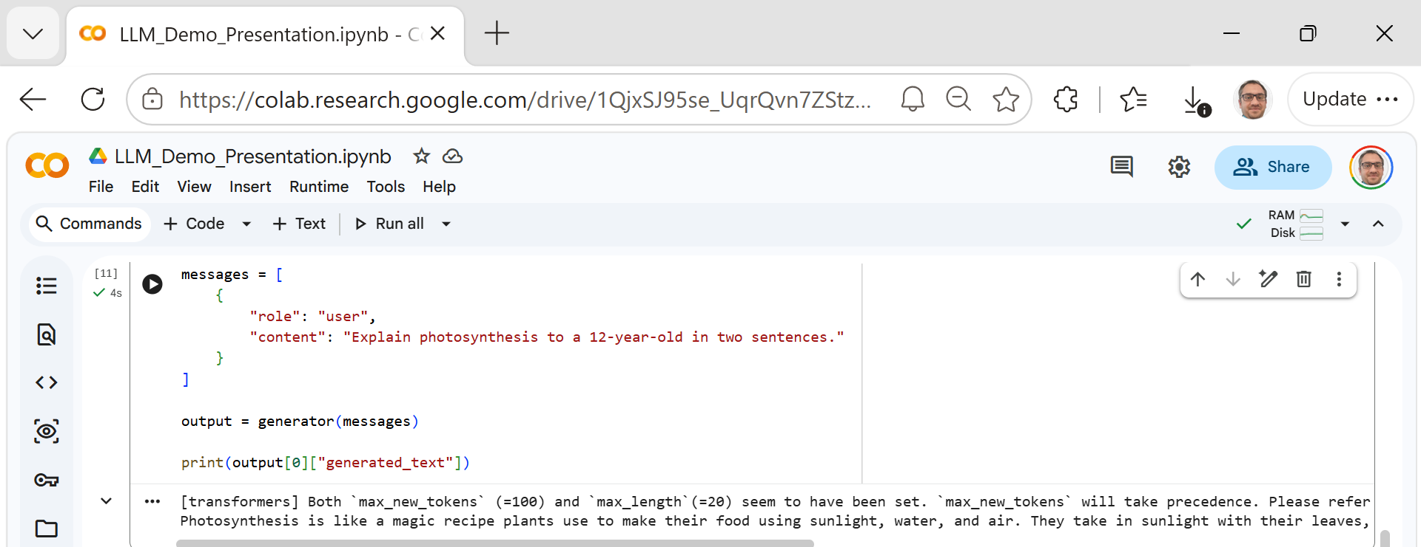
Let’s make an LLM generate text
Great — the experiment worked successfully. The final text beginning with “Photosynthesis is like a magic recipe plants use to make their food using sunlight, water, and air. They take in sunlight with their leaves, grab water from the ground, and use air to create sugar, which is their food, and oxygen, which we breathe.” is the response generated by Phi-3. The messages above it are warnings rather than failures.
What we did: Running an LLM in Google Colab
We used Google Colab with a T4 GPU to load and run Microsoft's Phi-3 Mini 4K Instruct language model.

Slide 20
Let’s make an LLM generate text
Notice that I am not programming the answer. I am giving the model an instruction, and the model generates the response token by token.

Slide 21
Let’s make an LLM generate text
The important lesson is not the Python syntax. The demonstration connects directly to your earlier slides:
Human prompt → Tokenisation → Model processes context → Predicts next tokens → Generated response
The model wasn't given the photosynthesis answer in our Python code. We provided an instruction, and the pretrained LLM generated an appropriate continuation based on that context.

Slide 22
Hands-on activity after the code
Your turn: Change one thing
Students work in pairs.
Given this: "Explain photosynthesis to a 12-year-old in two sentences."
Your task: Change only one part of the prompt.
For example: "Explain photosynthesis to a university student in two sentences."
or: "Explain photosynthesis to a 12-year-old using an analogy."
Then answer: What changed in the response, and why?
5 minutes

Slide 23
Concept 3: Context and attention
Explain attention as “Which earlier words matter most right now?” Use a simple ambiguous sentence.

Slide 24
Practical example 2 — Prompt engineering
Same model. Better instructions. Better result.
Start with:
Prompt A: Tell me about cybersecurity.
Then:
Prompt B: Explain three common cybersecurity risks to first-year university students.
Use no more than 120 words.
Which prompt would probably give us the more useful answer? Why?
Then run both.

Slide 25
Hands-on activity after the code
Five-minute activity
Explain large language models to first-year IT students. Use one simple analogy, one example, and one limitation. Keep the answer under 100 words.

Slide 26
When can an LLM go wrong?

Slide 27
Final Challenge: Build a Mini AI Study Assistant
Your challenge for the next session
Create an AI assistant that helps a first-year student understand a difficult topic.
Your assistant must:
accept a topic from the student;
explain it in simple language;
give one real-world example;
generate three quiz questions;
identify one point the student should verify;
keep the response concise.
So you create your prompt.

Slide 28
Final Challenge: Build a Mini AI Study Assistant
Example:
You are a study assistant for first-year IT students.
Explain the following topic in simple language:
[TOPIC]
Include:
- a short explanation
- one everyday analogy
- one practical example
- three quiz questions
- one point the student should verify

Slide 29
Final Challenge: Build a Mini AI Study Assistant
Keep the response under 250 words.
Then students test it with something such as:
Cloud computing
or:
Network security
or:
Database normalisation

