Slide 1
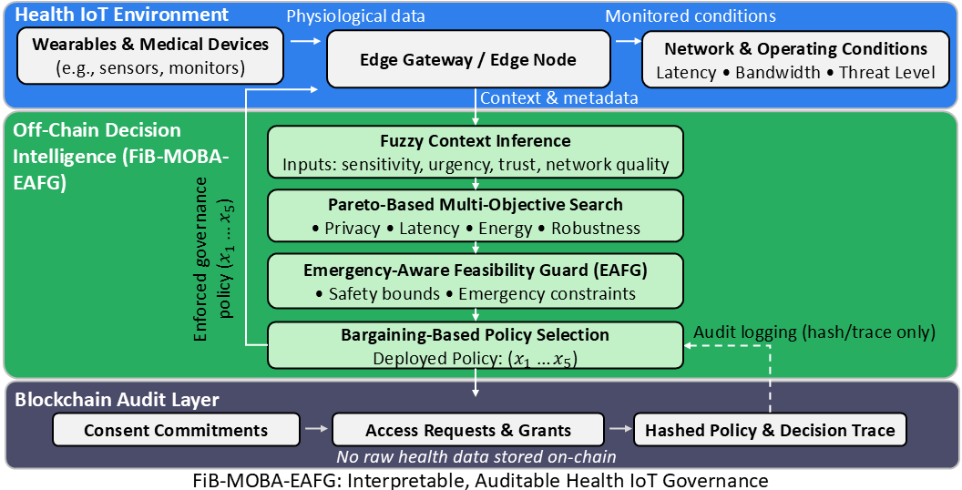
Interpretable
Blockchain-Audited
Governance for Health IoT
A simple presentation of our accepted and published paper for SISTC colleagues
Published • Electronics 2026
Farshid Keivanian
with Yining Hu and Saman Shojae Chaeikar
Sydney International School of Technology and Commerce / UTS
Paper focus
How to decide safe, fast, auditable access to sensitive Health IoT data when privacy, latency, cost, and robustness all compete.
Microsoft Teams research briefing • Sydney
1
Notes:
[Talk Track] Good morning everyone, and thank you for inviting me. Today I will present our recently accepted and published paper on Health IoT data governance. In simple terms, the paper asks a practical question: when devices continuously send sensitive health data, how do we decide who can access what, how fast, and under which safety rules, while still keeping an auditable record? My goal today is to explain the idea clearly, show the main results, and suggest areas where we can collaborate further at SISTC. [Sources] - User-provided paper details and Figure 1 supplied in chat. - Publication metadata supplied by the user: accepted 15 February 2026, published 18 February 2026.

Slide 2
Why this problem matters
Context
1
Sensitive data
2
Fast access in emergencies
3
Accountability across organisations
Wearables and medical devices stream private physiological data all the time.
Governance cannot slow down urgent care when clinicians need timely access.
We need a clear trail of consent, requests, grants, and the reason a policy was chosen.
Core tension
We want privacy risk ↓, latency ↓, resource cost ↓, and robustness ↑ at the same time. In practice, improving one often hurts another.
FiB-MOBA-EAFG • Health IoT governance
2
Notes:
[Talk Track] I start from a simple motivation. First, Health IoT data are extremely sensitive. Second, healthcare settings still need fast decisions, especially in urgent cases. Third, institutions need accountability: they must know who accessed data, under which consent, and why a specific policy was selected. The real challenge is that these goals compete. If we push privacy harder, we may increase delay or cost. If we push speed too hard, we may weaken safety. So the problem is naturally a trade-off problem, not a single-metric problem. [Sources] - User-provided abstract and introduction text describing privacy, latency, resource cost, robustness, emergencies, consent, and auditability.

Slide 3
Main idea: separate decision intelligence from blockchain audit
Architecture
Layer 1
Edge devices collect health data and observe operating context such as network quality and threat level.
Layer 2
An off-chain engine decides the policy using fuzzy context, Pareto search, a safety guard, and bargaining-based selection.
Layer 3
Blockchain logs consent, access events, and hashes of the policy and decision trace.
Key message: raw health data stay off-chain.
FiB-MOBA-EAFG • Health IoT governance
3
Notes:
[Talk Track] This slide shows the architecture in one picture. At the top, devices and edge gateways collect data and context. In the middle, the decision logic runs off-chain. That is important because we do not want to put heavy optimization or sensitive data on blockchain. At the bottom, blockchain is used for accountability only. It stores consent commitments, access events, and hashes of the selected policy and trace. So the design cleanly separates intelligence from auditability: decision-making stays flexible and efficient, while audit records stay immutable. [Sources] - User-provided Figure 1 and the paper section “System Overview” / “On-Chain Audit Logging”.

Slide 4
How I did it
Method
1. Sense the context
2. Generate many policy options
3. Remove unsafe options
4. Choose one balanced policy
5. Record the decision trace
Inputs: data sensitivity, urgency, trust, network quality
Pareto-based multi-objective search explores trade-offs
Emergency-aware feasibility guard filters bad choices
Bargaining picks a single deployable policy
Blockchain stores consent, access events, and hashes only
Result: instead of a black-box score or a fixed rule, the system outputs one explainable policy that is feasible for the current situation.
FiB-MOBA-EAFG • Health IoT governance
4
Notes:
[Talk Track] In simple terms, this is the workflow. First, the system reads the context. Second, it generates many candidate policies instead of jumping to one answer immediately. Third, it removes unsafe options using explicit emergency-aware safety rules. Fourth, from the remaining feasible options, it chooses one balanced policy using bargaining. Finally, it records the decision trace in a blockchain-friendly way. I like to describe this as a choose-many, filter-hard, choose-one pipeline. That makes the logic easier to inspect than a black-box model. [Sources] - User-provided methodology sections on fuzzy context inference, Pareto-based search, emergency-aware feasibility guard, bargaining-based selection, and on-chain audit logging.

Slide 5
What the system actually decides
Policy controls
Five policy controls
Four goals
x1
Access granularity
summary data ↔ detailed records
Privacy risk
Lower is better
x2
Protection strength
lighter ↔ stronger encryption / anonymisation
Latency
Lower is better
x3
Sharing frequency
less often ↔ more often
Energy / resource cost
Lower is better
x4
Device-trust threshold
more permissive ↔ more strict
Robustness
Higher is better
x5
Retention level
shorter ↔ longer retention
Different scenarios need different balance points. That is why the framework is context-aware.
FiB-MOBA-EAFG • Health IoT governance
5
Notes:
[Talk Track] This slide makes the method concrete. The policy is not abstract; it adjusts five real governance controls, such as how detailed the data are, how strong the protection is, how often sharing occurs, how strict the device trust threshold is, and how long data are retained. At the same time, the system tries to balance four goals: lower privacy risk, lower latency, lower resource cost, and higher robustness. The important idea is that there is no single best setting for every situation. Home monitoring, clinic telehealth, and emergency triage need different balance points. [Sources] - User-provided “Decision Variables (Policy Vector)” and “Objectives and Constraints” sections.

Slide 6
How the paper was evaluated
Experiments
Three operating scenarios
S1 Home RPM
S2 Clinic Telehealth
S3 Emergency Triage
Low bandwidth
More conservative sharing
Balanced routine
monitoring workload
Low latency
Fast access still under safety bounds
Methods compared
Protocol
•
Rule-based baseline
•
20 stochastic trials per scenario
•
Weighted-sum scalarisation
•
Network and device behaviour were perturbed across runs
•
Knee-point selector
Budget-matched random-search ablations tested whether structured Pareto search really adds value
•
•
FiB-MOBA-EAFG (proposed method)
Main evaluation question: can the method improve privacy and robustness without breaking practical edge-latency constraints?
FiB-MOBA-EAFG • Health IoT governance
6
Notes:
[Talk Track] To evaluate the method, the paper used three scenarios: home remote patient monitoring, clinic telehealth, and emergency triage. The paper compared our framework against rule-based, weighted-sum, and knee-point baselines. It also added budget-matched random-search ablations so that we could test whether the gains come from structured Pareto exploration, not just from the final selector. Each scenario was run over twenty stochastic trials, with varying network and device conditions, to see how the selected policies behave under uncertainty. [Sources] - User-provided “Scenarios”, “Baselines and Ablations”, and “Metrics and Experimental Protocol” sections.

Slide 7
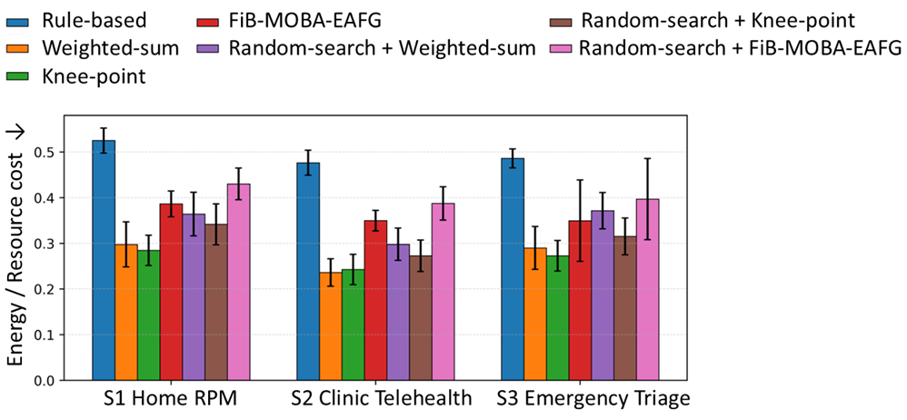
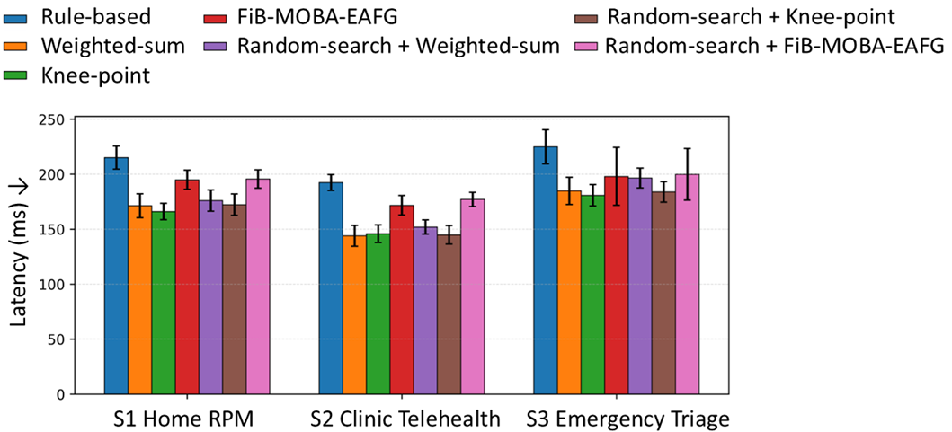
Results 1: resource cost and latency
Figures 2–3
Take-away: simpler scalarised baselines often achieved lower cost and lower latency, but our method deliberately accepted some extra cost to gain better safety, privacy posture, and robustness.
FiB-MOBA-EAFG • Health IoT governance
7
Notes:
[Talk Track] Here I usually make one balanced point. If we look only at speed or energy, the scalarised baselines often look attractive. That is expected, because they tend to choose more aggressive operating points. Our method is not trying to win a one-metric race. Instead, it accepts some additional latency and resource cost in order to maintain stronger privacy posture and robustness. Importantly, in the emergency scenario it still improved latency relative to the rule-based baseline, so it remained compatible with the modeled edge constraints. [Sources] - User-provided Figures 2 and 3 plus Tables 1–3 and the “Main Results Across Scenarios” section.

Slide 8
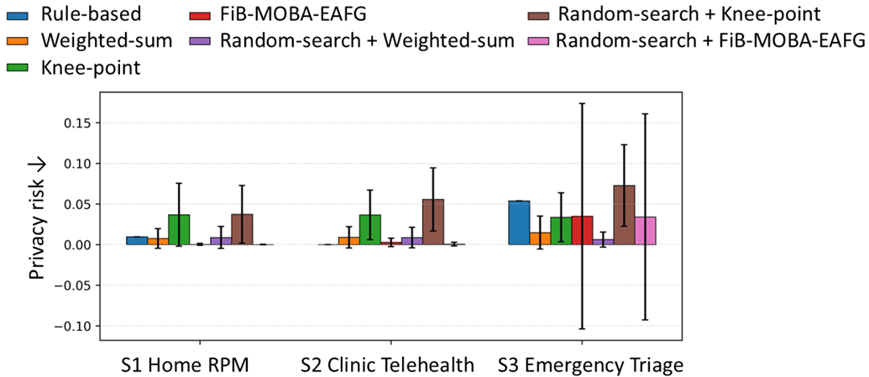
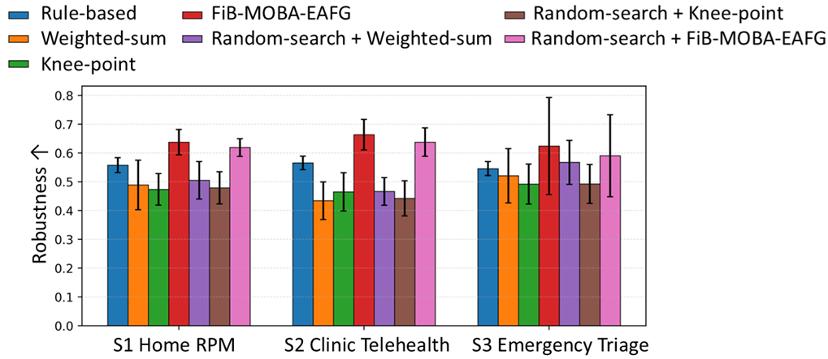
Results 2: privacy and robustness
Figures 4–5
Main message: FiB-MOBA-EAFG consistently pushed decisions toward very low privacy risk and the strongest robustness across the three modeled scenarios.
FiB-MOBA-EAFG • Health IoT governance
8
Notes:
[Talk Track] This is the most important results slide. The proposed method kept privacy risk near zero or very low across scenarios, and it achieved the strongest robustness overall. When I present this slide, I also make a careful clarification: near-zero privacy risk in the paper means a very conservative policy within the modeled policy space. It does not mean zero information disclosure in the real world. The stronger point is that the framework repeatedly selected safer and more resilient policies than the scalarised alternatives. [Sources] - User-provided Figures 4 and 5 plus Tables 1–3 and the privacy-risk interpretation in the paper.

Slide 9
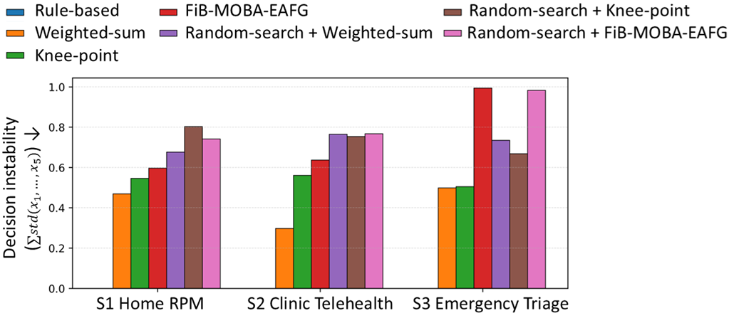
Results 3: selection stability
Figure 6
How to read this figure
•
Rule-based has zero instability because it always chooses the same fixed rule.
•
Adaptive optimisation methods vary when conditions and candidate sets change.
•
In our method, that variation is bounded by explicit feasibility and emergency constraints.
•
So this is adaptation, not uncontrolled behaviour.
Practical reading: the method stays within safety bounds while still responding to changing context.
FiB-MOBA-EAFG • Health IoT governance
9
Notes:
[Talk Track] A fair question is whether the method is stable. The deterministic rule-based baseline shows zero instability because it never adapts. Our optimisation-based methods, including the proposed one, do vary across trials. But that variability should be interpreted carefully. It reflects different feasible trade-off surfaces under different conditions, not random behaviour without limits. In our framework, all selected policies still pass the explicit safety guard. So I describe this as bounded adaptivity: the policy can change, but only inside acceptable safety conditions. [Sources] - User-provided Figure 6 and the “Decision repeatability” discussion in the paper.

Slide 10
What is new here—and what remains to do
Contributions
What is new
Current limitations
•
Blockchain is used for accountability, not heavy runtime decision-making.
•
The evaluation is simulation-based, not a live clinical deployment.
•
Fuzzy context reasoning keeps the priority logic human-readable.
•
Latency, energy, privacy risk, and robustness use modeled proxies.
•
Feasibility-guarded bargaining selects one deployable policy from Pareto candidates.
•
Next steps need a small edge prototype, richer privacy leakage modeling, and stability-aware refinements.
•
Budget-matched ablations suggest structured Pareto search adds real value over random search.
So the paper gives a strong framework and evidence base; the next step is prototype validation with colleagues and students.
FiB-MOBA-EAFG • Health IoT governance
10
Notes:
[Talk Track] If I had to summarise the novelty briefly, I would say this work combines interpretable context reasoning, structured multi-objective search, explicit safety filtering, single-policy bargaining-based selection, and blockchain auditability in one coherent governance framework. At the same time, I want to be transparent about the limitations. The results are simulation-based, and the objective measures are modeled proxies, not live hospital measurements. That is why I see this paper as a strong framework contribution and a foundation for a prototype phase rather than the final deployment story. [Sources] - User-provided conclusions, statistical-significance section, and limitations/future-work discussion.

Slide 11
Where I would value collaboration from SISTC colleagues
Collaboration
Prototype & deployment
Governance rules
Build a small edge gateway + permissioned blockchain demo for realistic validation.
Refine consent logic, emergency rules, and policy thresholds with domain feedback.
Security & AI
Students & funding
Add anomaly indicators, trust signals, and stronger attack simulations.
Create honours/Masters topics, joint supervision, and pilot grant ideas.
Specific help I would welcome: access to testbeds, feedback on policy rules, industry use cases, and co-supervision opportunities.
FiB-MOBA-EAFG • Health IoT governance
11
Notes:
[Talk Track] This is the slide where I invite collaboration. I think there are four practical directions. First, we can build a small prototype and test it on real edge infrastructure. Second, colleagues can help refine governance rules and safety thresholds. Third, there is room to strengthen the security side with anomaly indicators, trust signals, and richer adversarial testing. Fourth, this is well suited for student projects, joint supervision, and pilot grant proposals. So I am not only presenting a finished paper; I am also presenting a research platform we can extend together. [Sources] - Collaboration suggestions derived from the user’s request plus the paper’s future-work directions on prototype validation, anomaly indicators, richer privacy models, and stability-aware selection.

Slide 12
Thank you
Three take-aways
•
Health IoT governance is naturally a multi-objective decision problem.
•
The paper keeps intelligence off-chain and uses blockchain for auditability.
•
The proposed method improved privacy–robustness trade-offs in the modeled scenarios and opens a clear path for prototype collaboration.
Keivanian, F., Shojae Chaeika, S., Hu, Y. Blockchain-Enabled Governance for Health IoT Data Access... Electronics, 2026, 15(4), 864 https://doi.org/10.3390/electronics15040864
Discussion welcome
farshid.k@sistc.edu.au
keivanian@gmail.com
Questions and suggestions for next-step collaboration
12
Notes:
[Talk Track] To close, I would emphasise three points. First, this paper treats Health IoT governance as a real trade-off problem, not a simple access-control rule. Second, it uses blockchain in a disciplined way for accountability, while keeping decision intelligence off-chain. Third, the framework looks promising enough to justify a prototype phase and broader collaboration. I would be very happy to discuss how we can adapt this into student projects, a lab demo, or a small funded pilot with SISTC colleagues. [Sources] - Summary based on user-provided paper, title slide information, and collaboration directions requested by the user.

