Slide 1
ITEC100 – Domain 2: Manage Data Cells and Ranges
Tutor: Dr. Farshid Keivanian

Slide 2
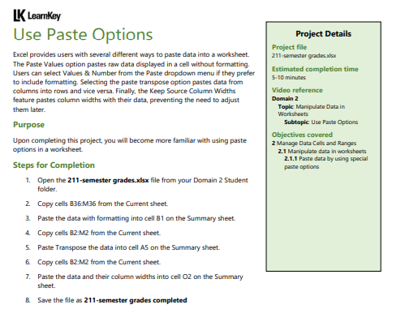
Domain 2 – Lesson 1
To complete the steps outlined in the project:
Open the Workbook:
Open the file 211-semester grades.xlsx from your Domain 2 Student folder.
Copy and Paste Data with Formatting:
Copy the data from cells B36:M36 on the Current sheet.
Go to the Summary sheet.
Paste the data with formatting into cell B1 on the Summary sheet.

Slide 3
Domain 2 – Lesson 1
Transpose Data:
Return to the Current sheet and copy cells B2:M2.
Go to the Summary sheet and paste the data transposed into cell A5.
Copy and Paste Data with Column Widths:
Go back to the Current sheet and copy cells B2:M2.
Go to the Summary sheet.
Paste the data along with the column widths into cell O2.

Slide 4
Domain 2 – Lesson 1
Save the Workbook:
Save the workbook as 211-semester grades completed.xlsx
These steps should guide you through the process of using different paste options in Excel as outlined in your project.

Slide 5
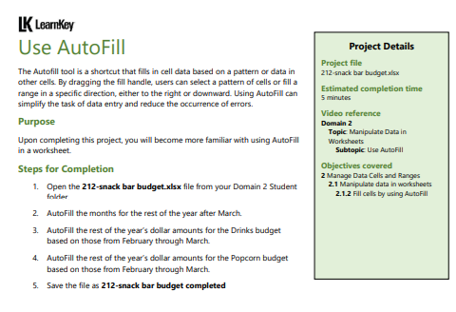
Domain 2 – Lesson 1
To complete the task as outlined in the image, follow these steps using the attached Excel file:
Open the File:
Open the 212-snack bar budget.xlsx file.
AutoFill Months:
Locate the cell with the month of March.
Click and drag the fill handle (a small square at the bottom-right corner of the selected cell) to the right across the adjacent cells to fill the rest of the months for the year after March.

Slide 6
Domain 2 – Lesson 1
3. AutoFill Dollar Amounts for Drinks:
Locate the cell with the dollar amount for drinks in March.
Click and drag the fill handle to the right across the adjacent cells to fill the rest of the year's dollar amounts for drinks.
4. AutoFill Dollar Amounts for Popcorn:
Locate the cell with the dollar amount for popcorn in March.
Click and drag the fill handle to the right across the adjacent cells to fill the rest of the year's dollar amounts for popcorn.

Slide 7
Domain 2 – Lesson 1
5. Save the File:
Save the completed file as 212-snack bar budget completed.xlsx.
These steps will fulfill the requirements outlined in the project guide.

Slide 8
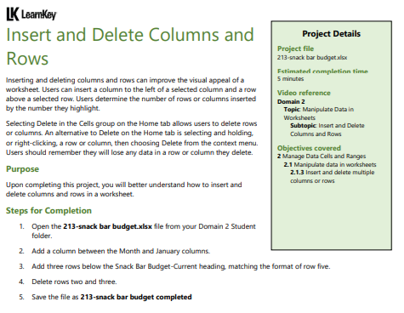
Domain 2 – Lesson 1
The steps to complete the tasks described in the "Insert and Delete Columns and Rows" project:
Open the file:
Open the 213-snack bar budget.xlsx file from your Domain 2 Student folder.
Add a column between the Month and January columns:
Select column C (January).
Right-click on the column header and choose Insert. This will insert a blank column between the Month and January columns.

Slide 9
Domain 2 – Lesson 1
3. Add three rows below the Snack Bar Budget centered heading:
Select row 3.
Right-click on the row header and choose Insert. Repeat this two more times to add a total of three rows below the heading.
4. Delete rows two and three:
Select rows 2 and 3.
Right-click on the selected rows and choose Delete to remove them from the worksheet.

Slide 10
Domain 2 – Lesson 1
5. Save the file:
Save the file as 213-snack bar budget completed.
These steps should help you complete the project as outlined in the instructions.

Slide 11
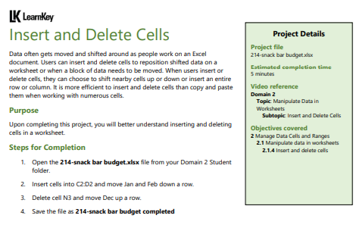
Domain 2 – Lesson 1
Here are the steps to complete the project as described in the attached document:
Open the File:
Open the 214-snack bar budget.xlsx file from your Domain 2 Student folder.
Insert Two Cells in Columns C and D:
Select the range C2:D2.
Right-click and select Insert from the context menu.
In the Insert dialog box, choose Shift cells down and click OK.
This will insert two new cells above the current data in columns C and D.

Slide 12
Domain 2 – Lesson 1
3. Move Jan and Feb Data Down:
Move the data for January and February down to the newly created cells.
Cut and paste the January data into the new cell in column C, and the February data into the new cell in column D.

Slide 13
Domain 2 – Lesson 1
4. Delete Cell N3:
Select cell N3 (which should contain the December data).
Right-click and select Delete.
In the Delete dialog box, choose Shift cells up and click OK.
This will move the December data to be even with the rest of the months.
5. Save the File:
Save the file as 214-snack bar budget completed.
These steps will ensure that you correctly follow the instructions provided in the project guide.

Slide 14
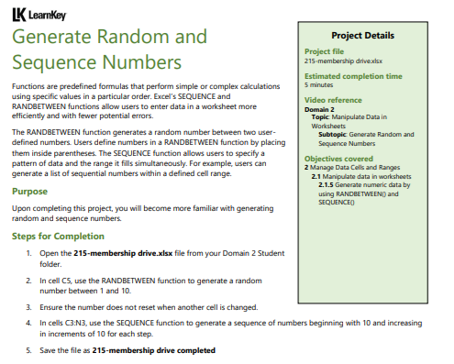
Domain 2 – Lesson 1
Steps for Completion:
Open the File:
Open the 215-membership drive.xlsx file that you uploaded.
Use the RANDBETWEEN Function:
Go to cell C5 in the worksheet.
Enter the formula =RANDBETWEEN(1, 10) to generate a random number between 1 and 10 in this cell.

Slide 15
Domain 2 – Lesson 1
3. Ensure the Number Does Not Reset:
To ensure the number does not reset when another cell is changed, you can copy the value and paste it as a value rather than a formula. To do this:
After the number is generated, right-click on cell C5, select Copy.
Then, right-click again and choose Paste Special > Values. This will paste the generated number as a fixed value.

Slide 16
Domain 2 – Lesson 1
4. Use the SEQUENCE Function:
Select the cell range C3:N3.
Enter the formula =SEQUENCE(1, 11, 10, 10) to generate a sequence of numbers beginning with 10 and increasing in increments of 10 across the selected cells.
5. Save the File:
Save the file with the new name 215-membership drive completed.xlsx.
Once you follow these steps, you will have successfully completed the task.

Slide 17
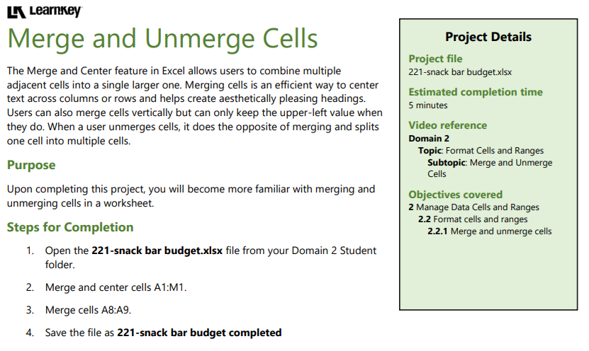
Domain 2 – Lesson 2
The steps to complete the task of merging and unmerging cells in the provided Excel file
Steps for Completion:
Open the File:
Open the 221-snack bar budget.xlsx file that you uploaded.

Slide 18
Domain 2 – Lesson 2
Merge and Center Cells A1:M1:
Select the range A1:M1 on the worksheet.
Use the "Merge & Center" button, typically found in the "Home" tab under the "Alignment" group, to merge these cells and center the content within the merged cell.

Slide 19
Domain 2 – Lesson 2
The steps to complete the task of modifying cell alignment and orientation in the provided Excel file:
Steps for Completion:
Open the File:
Open the 222-snack bar budget.xlsx file that you uploaded.
Center Align the Months in Cells B3:M3:
Select the range B3:M3 on the worksheet.
Use the "Center" alignment option, typically found in the "Home" tab under the "Alignment" group, to center the text horizontally within these cells.

Slide 20
Domain 2 – Lesson 2
3. Increase Indent in Cell A3:
Select cell A3.
Use the "Increase Indent" button (found in the "Home" tab under the "Alignment" group) once to add more space between the text and the left border of the cell.
4. Decrease Indent in Cell A3:
While still selecting cell A3, use the "Decrease Indent" button once to remove the previously added indent.

Slide 21
Domain 2 – Lesson 2
5. Change the Orientation of the Months in Cells B3:M3:
Select the range B3:M3 again.
Use the "Orientation" button in the "Home" tab under the "Alignment" group to set the text orientation to "Angle Counterclockwise" by 30 degrees.
6. Save the File:
Save the file with the new name 222-snack bar budget completed.xlsx
Following these steps will ensure that the task is completed successfully.

Slide 22
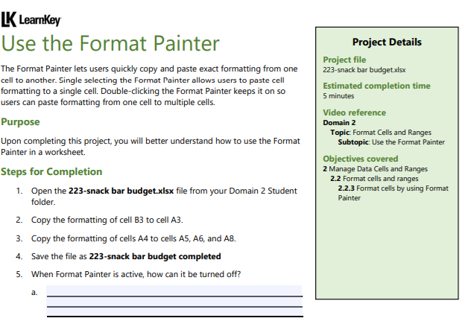
Domain 2 – Lesson 2
Steps to complete the task of using the Format Painter in the provided Excel file:
Steps for Completion:
Open the File:
Open the 223-snack bar budget.xlsx file that you uploaded.
Copy the Formatting of Cell B3 to Cell A3:
Select cell B3.
Click on the "Format Painter" button, which is located in the "Home" tab under the "Clipboard" group.
Then, click on cell A3 to apply the formatting from cell B3 to A3.

Slide 23
Domain 2 – Lesson 2
3. Copy the Formatting of Cells A4 to Cells A5, A6, and A8:
Select cell A4.
Double-click the "Format Painter" button to keep it active.
Then, click on cells A5, A6, and A8 one by one to apply the formatting from cell A4 to these cells.
After formatting the last cell, click the "Format Painter" button again or press the "Esc" key to turn it off

Slide 24
Domain 2 – Lesson 2
4. Save the File:
Save the file with the new name 223-snack bar budget completed.xlsx.
5. Turning Off the Format Painter:
When the Format Painter is active, you can turn it off by either:
Clicking the "Format Painter" button again.
Pressing the "Esc" key on your keyboard.
Following these steps will ensure that the task is completed successfully.

Slide 25
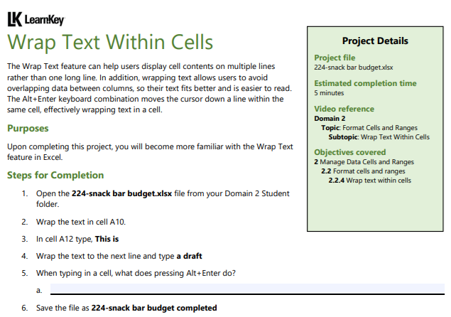
Domain 2 – Lesson 2
The steps to complete the task of wrapping text within cells in the provided Excel file:
Steps for Completion:
Open the File:
Open the 224-snack bar budget.xlsx file that you uploaded.
Wrap the Text in Cell A10:
Select cell A10.
Go to the "Home" tab, and click on the "Wrap Text" button in the "Alignment" group. This will allow the text within the cell to wrap onto multiple lines if it's too long to fit within the column width.

Slide 26
Domain 2 – Lesson 2
3. Type Text in Cell A12:
Click on cell A12 and type the following text: This is.
4. Wrap the Text to the Next Line in Cell A12 and Add More Text:
After typing This is, press Alt + Enter to move to a new line within the same cell.
Then, type a draft to complete the text within cell A12

Slide 27
Domain 2 – Lesson 2
5. Function of Alt + Enter:
When typing in a cell, pressing Alt + Enter inserts a line break within the same cell, allowing you to start a new line of text within the same cell.
6. Save the File:
Save the file with the new name 224-snack bar budget completed.xlsx.
Following these steps will ensure that the task is completed successfully.

Slide 28
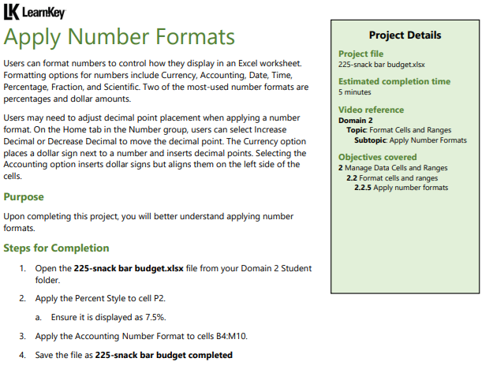
Domain 2 – Lesson 3
The steps to complete the task of applying number formats in the provided Excel file:
Steps for Completion:
Open the File:
Open the 225-snack bar budget.xlsx file that you uploaded.

Slide 29
Domain 2 – Lesson 3
2. Apply the Percent Style to Cell P2:
Select cell P2.
Go to the "Home" tab, and click on the "Percent Style" button in the "Number" group.
Ensure that the value in the cell is displayed as 7.5%. If not, you may need to adjust the number of decimal places by clicking on the "Increase Decimal" or "Decrease Decimal" buttons, also found in the "Number" group.

Slide 30
Domain 2 – Lesson 3
3. Apply the Accounting Number Format to Cells B4:M10:
Select the range B4:M10.
In the "Home" tab, click on the dropdown menu in the "Number" group and choose "Accounting".
This will apply the Accounting format, which aligns dollar signs ($) and formats the numbers appropriately.
4. Save the File:
Save the file with the new name 225-snack bar budget completed.xlsx.
Following these steps will ensure that the task is completed successfully.

Slide 31
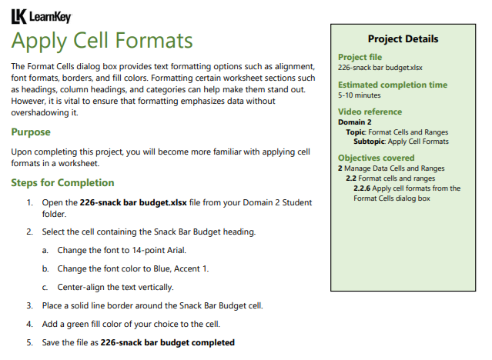
Domain 2 – Lesson 3
The steps to complete the task of applying cell formats in the provided Excel file:
Steps for Completion:
Open the File:
Open the 226-snack bar budget.xlsx file that you uploaded.
Select the Cell Containing the Snack Bar Budget Heading:
Identify and select the cell in the worksheet that contains the "Snack Bar Budget" heading.

Slide 32
Domain 2 – Lesson 3
3. Apply the Following Formatting to the Selected Cell:
Change the Font to 14-Point Arial:
With the cell selected, go to the "Home" tab.
In the "Font" group, select "Arial" from the font dropdown menu and set the font size to 14 points.
Change the Font Color to Blue, Accent 1:
In the "Home" tab, click on the "Font Color" dropdown (represented by an "A" with a color underline).
Choose "Blue, Accent 1" from the theme colors.
Center-Align the Text Vertically:
With the cell still selected, click on the "Align Text" button in the "Alignment" group in the "Home" tab.
Choose the vertical alignment option to center the text within the cell.

Slide 33
Domain 2 – Lesson 3
4. Place a Solid Line Border Around the Snack Bar Budget Cell:
With the cell selected, go to the "Home" tab.
In the "Font" group, click on the "Borders" dropdown menu.
Choose the "Outside Borders" option, which applies a solid line around the selected cell.
5. Add a Green Fill Color to the Cell:
In the "Home" tab, click on the "Fill Color" dropdown (paint bucket icon) in the "Font" group.
Choose a green fill color of your choice for the cell.

Slide 34
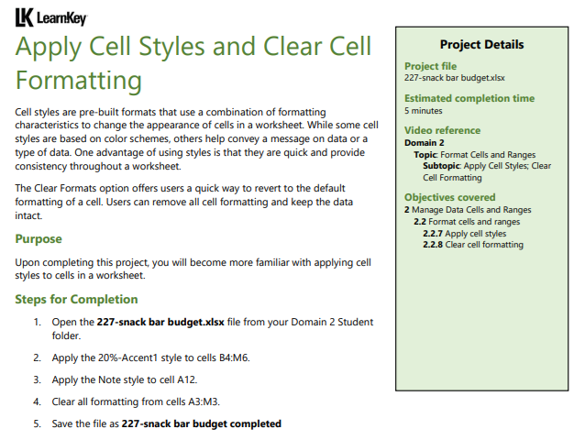
Domain 2 – Lesson 3
The steps to complete the task of applying cell styles and clearing cell formatting in the provided Excel file:
Steps for Completion:
Open the File:
Open the 227-snack bar budget.xlsx file that you uploaded.
Apply the 20% - Accent1 Style to Cells B4:M6:
Select the range B4:M6.
Go to the "Home" tab.
In the "Styles" group, click on "Cell Styles."
From the dropdown, select the style named "20% - Accent1."

Slide 35
Domain 2 – Lesson 3
3. Apply the Note Style to Cell A12:
Select cell A12.
Again, go to the "Home" tab.
In the "Styles" group, click on "Cell Styles."
From the dropdown, select the style named "Note."
4. Clear All Formatting from Cells A3:M3:
Select the range A3:M3.
In the "Home" tab, go to the "Editing" group and click on "Clear."
From the dropdown menu, select "Clear Formats" to remove all formatting from these cells.

Slide 36
Domain 2 – Lesson 3
5. Save the File:
Save the file with the new name 227-snack bar budget completed.xlsx.
Following these steps will ensure that the task is completed successfully.

Slide 37
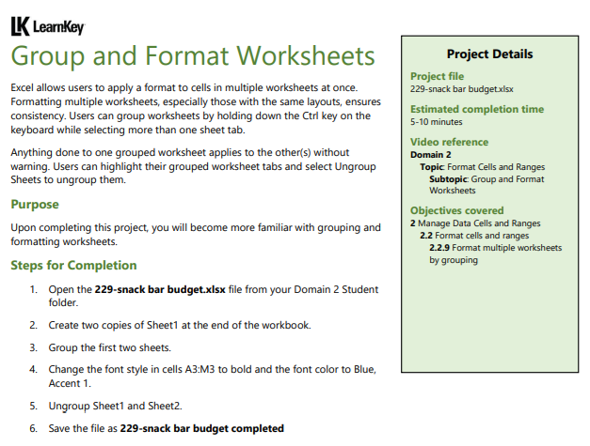
Domain 2 – Lesson 3
The steps to complete the task of grouping and formatting worksheets in the provided Excel file:
Steps for Completion:
Open the File:
Open the 229-snack bar budget.xlsx file that you uploaded.

Slide 38
Domain 2 – Lesson 3
2. Create Two Copies of Sheet1 at the End of the Workbook:
Right-click on the Sheet1 tab at the bottom of the Excel window.
Select "Move or Copy."
In the dialog box, check the "Create a copy" option.
Select "(move to end)" and click "OK."
Repeat this step to create a second copy of Sheet1.

Slide 39
Domain 2 – Lesson 3
3. Group the First Two Sheets:
Click on the Sheet1 tab (the original one).
Hold down the Ctrl key and click on the first copied sheet (Sheet1 (2)). Both sheets should now be selected (grouped).

Slide 40
Domain 2 – Lesson 3
4. Change the Font Style in Cells A3:M3 to Bold and the Font Color to Blue, Accent 1:
While the two sheets are still grouped, select the range A3:M3.
Go to the "Home" tab.
Click on the "Bold" button in the "Font" group to make the text bold.
Then, click on the "Font Color" dropdown in the "Font" group and choose "Blue, Accent 1" from the theme colors.

Slide 41
Domain 2 – Lesson 3
5. Ungroup Sheet1 and Sheet1 (2):
Right-click on any of the grouped sheet tabs.
Select "Ungroup Sheets" from the context menu.
6. Save the File:
Save the file with the new name 229-snack bar budget completed.xlsx.
Following these steps will ensure that the task is completed successfully.

Slide 42
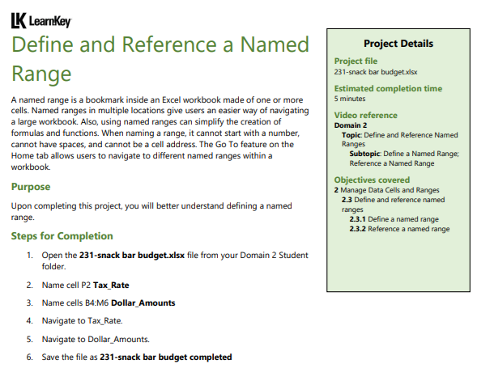
Domain 2 – Lesson 4
The steps to complete the task of defining and referencing a named range in the provided Excel file:
Steps for Completion:
Open the File:
Open the 231-snack bar budget.xlsx file that you uploaded.
Name Cell P2 as Tax_Rate:
Select cell P2.
Go to the "Formulas" tab on the Excel ribbon.
Click on "Define Name" in the "Defined Names" group.
In the "New Name" dialog box, enter Tax_Rate as the name.
Ensure that the "Refers to" field correctly references =Sheet1!$P$2 (or the corresponding sheet name).
Click "OK."

Slide 43
Domain 2 – Lesson 4
3. Name Cells B4:M6 as Dollar_Amounts:
Select the range B4:M6.
Go to the "Formulas" tab.
Click on "Define Name" in the "Defined Names" group.
In the "New Name" dialog box, enter Dollar_Amounts as the name.
Ensure that the "Refers to" field correctly references =Sheet1!$B$4:$M$6.
Click "OK."
4. Navigate to Tax_Rate:
Click on the dropdown arrow next to the "Name Box" (located to the left of the formula bar).
Select Tax_Rate from the list to navigate directly to cell P2.

Slide 44
Domain 2 – Lesson 4
5. Navigate to Dollar_Amounts:
Again, click on the dropdown arrow next to the "Name Box."
Select Dollar_Amounts from the list to navigate directly to the range B4:M6.
6. Save the File:
Save the file with the new name 231-snack bar budget completed.xlsx.
Following these steps will ensure that the task is completed successfully.

Slide 45
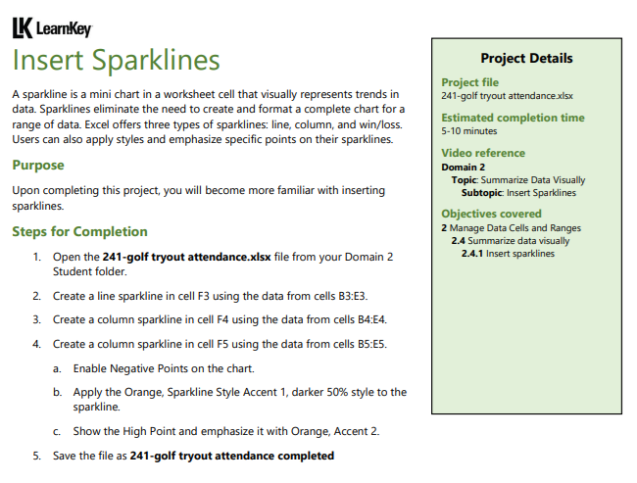
Domain 2 – Lesson 4
The steps to complete the task of inserting sparklines in the provided Excel file:
Steps for Completion:
Open the File:
Open the 241-golf tryout attendance.xlsx file that you uploaded.
Create a Line Sparkline in Cell F3 Using the Data from Cells B3:E3:
Select cell F3.
Go to the "Insert" tab on the Excel ribbon.
Click on "Line" in the "Sparklines" group.
In the "Create Sparklines" dialog box, select the data range B3:E3.
Click "OK" to insert the line sparkline in cell F3

Slide 46
Domain 2 – Lesson 4
3. Create a Column Sparkline in Cell F4 Using the Data from Cells B4:E4:
Select cell F4.
Go to the "Insert" tab.
Click on "Column" in the "Sparklines" group.
In the "Create Sparklines" dialog box, select the data range B4:E4.
Click "OK" to insert the column sparkline in cell F4.
4. Create a Column Sparkline in Cell F5 Using the Data from Cells B5:E5:
Select cell F5.
Go to the "Insert" tab.
Click on "Column" in the "Sparklines" group.
In the "Create Sparklines" dialog box, select the data range B5:E5.
Click "OK" to insert the column sparkline in cell F5

Slide 47
Domain 2 – Lesson 4
5. Enable Negative Points on the Chart:
Select the sparklines in cells F4 and F5.
Go to the "Sparkline" tab on the ribbon.
Check the "Negative Points" box in the "Show" group to highlight any negative data points.
6. Apply the Orange, Sparkline Style Accent 1, Darker 50% Style to the Sparklines:
Select the sparklines in cells F3, F4, and F5.
Go to the "Sparkline" tab.
In the "Style" group, choose the style named "Orange, Sparkline Style Accent 1, Darker 50%."

Slide 48
Domain 2 – Lesson 4
7. Show the High Point and Emphasize It with Orange, Accent 2:
While still in the "Sparkline" tab, check the "High Point" box in the "Show" group to display the highest data point on the sparklines.
Then, in the "Marker Color" dropdown, select "High Point" and choose "Orange, Accent 2" to emphasize it.
8. Save the File:
Save the file with the new name 241-golf tryout attendance completed.xlsx.
Following these steps will ensure that the task is completed successfully.

Slide 49
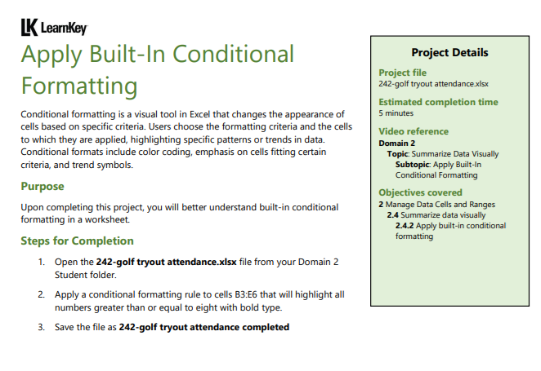
Domain 2 – Lesson 4
The steps to complete the task of applying built-in conditional formatting in the provided Excel file:
Steps for Completion:
Open the File:
Open the 242-golf tryout attendance.xlsx file that you uploaded.

Slide 50
Domain 2 – Lesson 4
Apply a Conditional Formatting Rule to Cells B3:E6:
Select the range B3:E6.
Go to the "Home" tab on the Excel ribbon.
Click on "Conditional Formatting" in the "Styles" group.
From the dropdown menu, select "New Rule."
In the "New Formatting Rule" dialog box, choose "Format only cells that contain."
Under "Format only cells with," set the rule as follows:
Cell Value: Greater than or equal to 8.
Click the "Format" button to specify the formatting.
In the "Format Cells" dialog box, go to the "Font" tab.
Set the font style to "Bold."
Click "OK" to apply the formatting and close the dialog box.
Click "OK" again to close the "New Formatting Rule" dialog box.

Slide 51
Domain 2 – Lesson 4
3. Save the File:
Save the file with the new name 242-golf tryout attendance completed.xlsx.
Following these steps will ensure that the task is completed successfully.

Slide 52
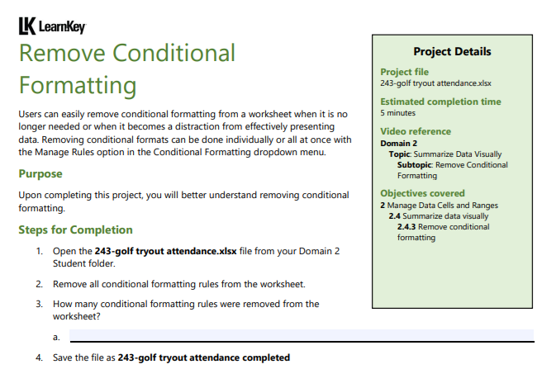
Domain 2 – Lesson 4
The steps to complete the task of removing conditional formatting in the provided Excel file:
Steps for Completion:
Open the File:
Open the 243-golf tryout attendance.xlsx file that you uploaded.
Remove All Conditional Formatting Rules from the Worksheet:
Click anywhere on the worksheet to ensure it is active.
Go to the "Home" tab on the Excel ribbon.
In the "Styles" group, click on "Conditional Formatting."
From the dropdown menu, select "Clear Rules" and then choose "Clear Rules from Entire Sheet."

Slide 53
Domain 2 – Lesson 4
3. Count How Many Conditional Formatting Rules Were Removed:
To check how many rules were removed, you can go back to "Conditional Formatting" and select "Manage Rules."
In the "Conditional Formatting Rules Manager" window, you should see that no rules are listed, indicating that all rules have been successfully removed.
If there were any rules before you cleared them, count them beforehand.
4. Save the File:
Save the file with the new name 243-golf tryout attendance completed.xlsx.
Following these steps will ensure that the task is completed successfully.

Slide 54

Submit the screenshot of the “Domain 2 Post Assessment" score via the week 2 submission box. Make sure your name is visible in the screenshots.
Thank you
Dr. Farshid Keivanian

