Slide 1
ITEC100 – Week 6
Tutor: Dr. Farshid Keivanian

Slide 2
Overview Weeks 6 - 10
We will be working on Assessment 2 in Weeks 6 (this week - 10). Here is our schedule:
Weeks 6-8: Working on 3 Skill Review Tests and 3 Practice Exams (marked). Submit the screenshot properly in weekly tutorial activity.
W6: Complete 'Skill Reviews 1-2’
W7: Complete 'Skill Review 3, Practice Exam 1’
W8: Complete 'Practice Exams 2-3’
Complete them following the order.
Ensure to redeem the code to take Skill Reviews & Practice Exams.

Slide 3
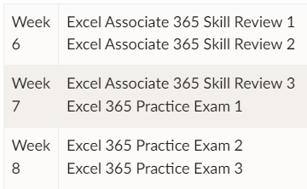
Overview Weeks 6 - 10
1. Please submit the practice tests in correct order as instructed in tutorial activity pages. A summary is provided below:
2. Please take a screenshot of the whole Screen making sure the test name, your name and your score is clearly visible.
Please don't use your phone for taking screenshots.
To take a clear screenshot, you can use the Snipping Tool in Windows. It can be found by typing the app name in the Windows search bar.

Slide 4
Overview Weeks 6 - 10
Weeks 9-10: Taking the Excel Associate Exam (on campus)
Week 9 tutorial session - On campus
Week 10 tutorial session - On campus (reserved for those who may not complete the exam due to possible technical issues in week)

Slide 5
Overview Weeks 6 - 10
Some tips:
I recommend using Training Mode first wherever it is available
Ensure you do AT LEAST one Practice Exam on the PC in your Tutorial room. Because you MUST do the real Excel Exam on those PCs - and CANNOT do the real Excel Exam on your own device.

Slide 6
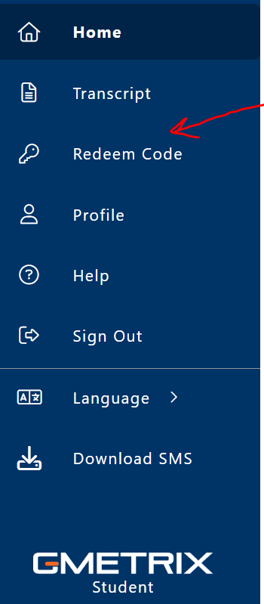
Unlock the New Tasks on Gmetrix for Week 6 to 8
In order to do your tasks for the week 6, 7, and 8, you must get the Access Code and use it in "Redeem code" section on Gmetrix (Fig.1). Then all the new features and the new tasks will be unlocked for you.
Access Code already provided on the announcement on Canvas titled "[ITEC100] Access Code for Gmetrix Practice Tests".
Therefore, just copy the provided Access code and paste it in the 'Redeem code" section on Gmetrix (Fig.1) to unlock the new tasks.

Slide 7
Unlock the New Tasks on Gmetrix for Week 6 to 8
Please redeem the Access Code during the Lab Tutorial to get access to Gmetrix Practice Tests :
To redeem the access key, you should sign in to Gmetrix using the username and password you created earlier.
Please note the access code provided earlier, was for using the Excel course on Gmetrix, but this one is for the Practice Tests which should be done in week 6 to 8 tutorials.

Slide 8
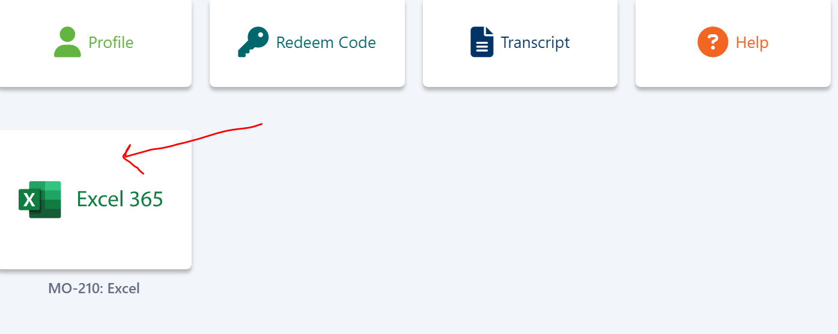
Unlock the New Tasks on Gmetrix for Week 6 to 8
After that simply click on "Excel 365" (Fig.2) to see the populated tasks. You can find information about what you have to submit for week 6 and week 7 in the relevant published announcement.

Slide 9
Certiport Account
You also need to register a Certiport account this week (to prepare for the upcoming Excel Exam in Week 9 in your Tutorial). Please follow these instructions:
In order to create an account on Certiport, please follow the below instructions:
1. Go to https://app.certiport.com/portal/signupLinks to an external site.
2. Create an account with new username (Your student number/student email) and password. Please advised that this username and password is different with your username and password in Geometrix.
3. Email your username, password and any security questions and answers (or you can text them) to yourself for future reference.

Slide 10
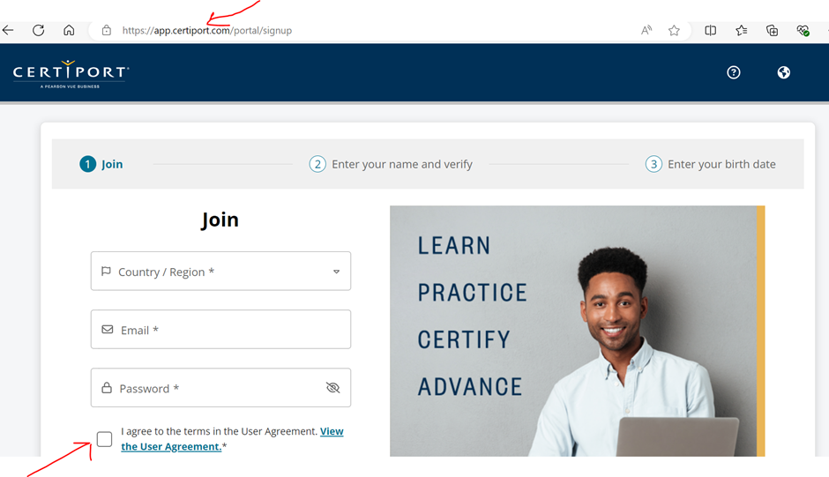
Certiport Account
4. Tick the box shown below in the screenshot and click join

Slide 11
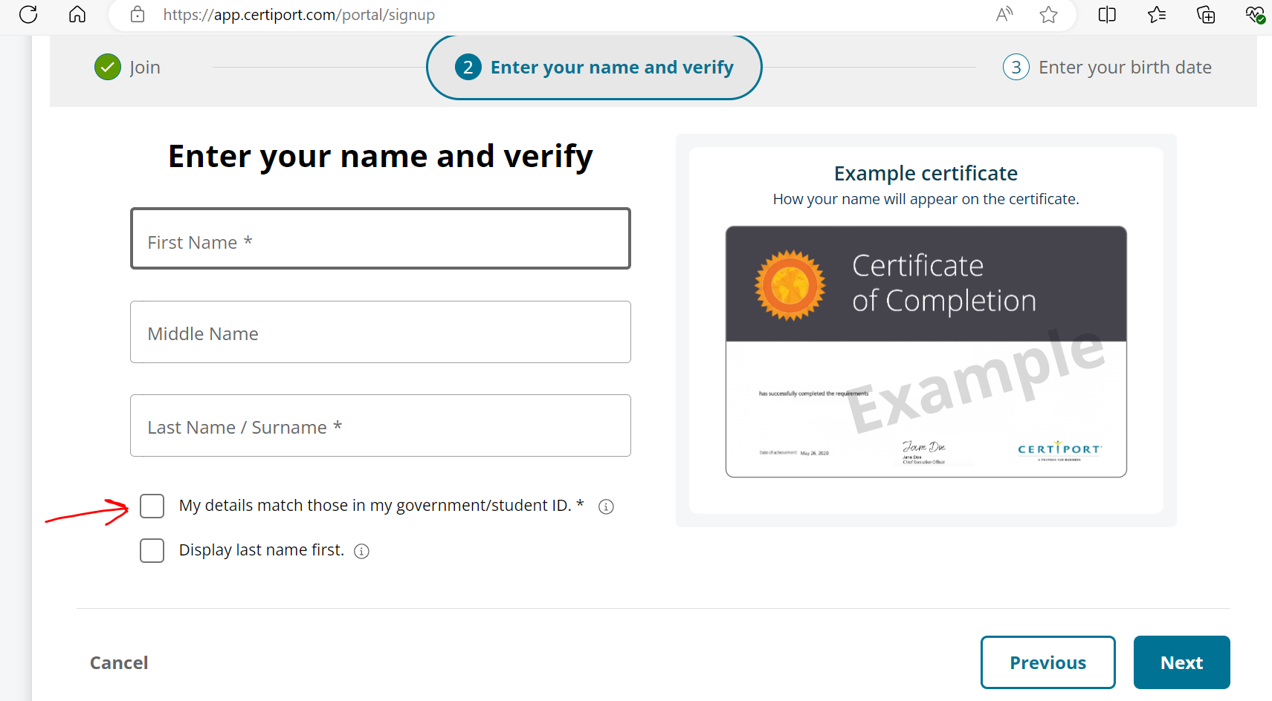
Certiport Account
5. Enter your Name and Surname displayed on your student card as these names will be displayed in your certificate.
6. Tick both boxes and press "Next".

Slide 12
Certiport Account
7. Go to https://app.certiport.com/portal/ and log into your Certiport account with your username and password that you have created in step 2.
8. Your account in Certiport as a "Test Candidate" ready to use for Week 8 and Week 9 and onwards. You will be provided with the relevant instruction in week 8 and week 9 about what you have to do with your Certiport account.
9. Now you have to go back to Gmetrix and practise there.

Slide 13
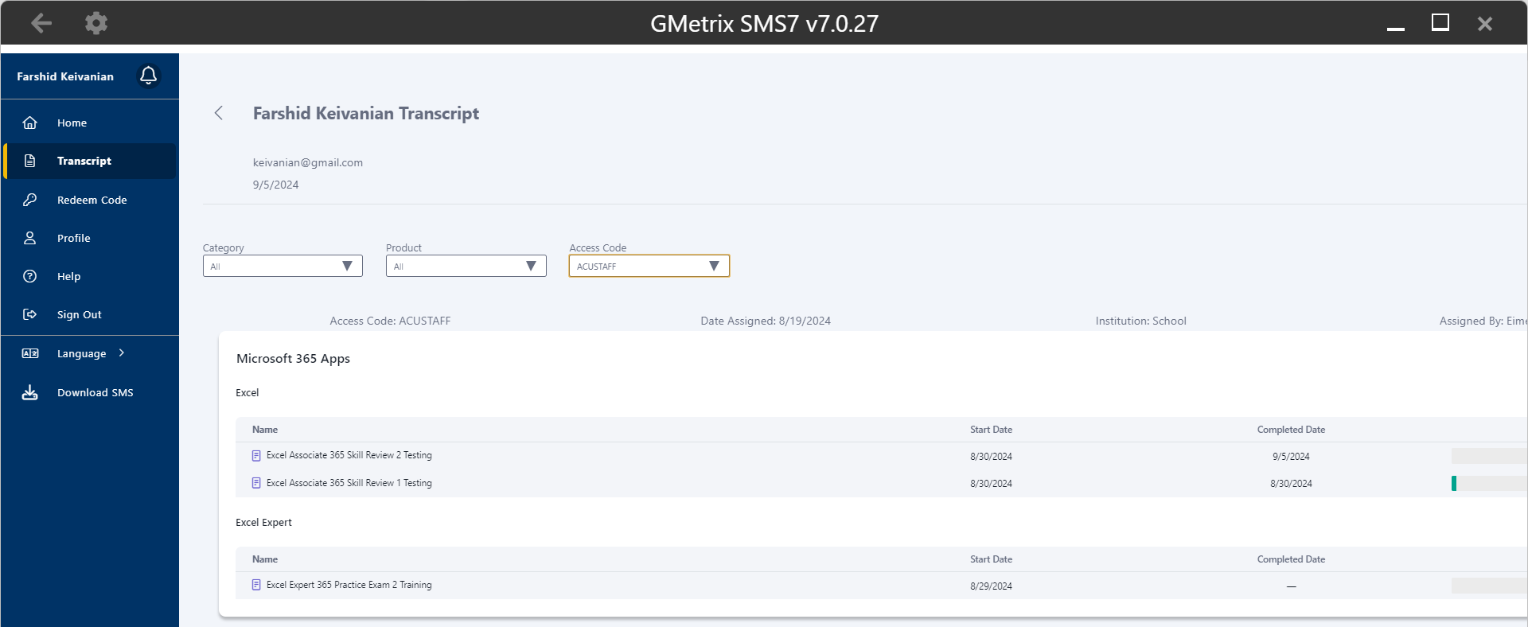
Excel Associate 365 Review 1 and 2 Testing

Slide 14

Submit the Excel Associate 365 'Skill Reviews 1 and 2. Make sure your name, data, and score is visible in the screenshots.
Thank you
Dr. Farshid Keivanian

