Slide 1
ITEC100 – Week 7
Tutor: Dr. Farshid Keivanian

Slide 2
Overview Weeks 6 - 10
Submit the screenshot properly in weekly tutorial activity.
W6: Complete 'Skill Reviews 1-2’
W7: Complete 'Skill Review 3, Practice Exam 1’
W8: Complete 'Practice Exams 2-3’ & Certiport Exam check list and management
W9: Test
Ensure to redeem the code to take Skill Reviews & Practice Exams.

Slide 3
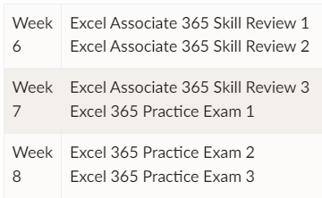
Overview Weeks 6 - 10
1. Please submit the practice tests in correct order as instructed in tutorial activity pages. A summary is provided below:
2. Please take a screenshot of the whole Screen making sure the test name, your name and your score is clearly visible.
Please don't use your phone for taking screenshots.
To take a clear screenshot, you can use the Snipping Tool in Windows. It can be found by typing the app name in the Windows search bar.

Slide 4
Overview Weeks 6 - 10
Some tips:
I recommend using Training Mode first wherever it is available
Ensure you do AT LEAST one Practice Exam on the PC in your Tutorial room. Because you MUST do the real Excel Exam on those PCs - and CANNOT do the real Excel Exam on your own device.

Slide 5
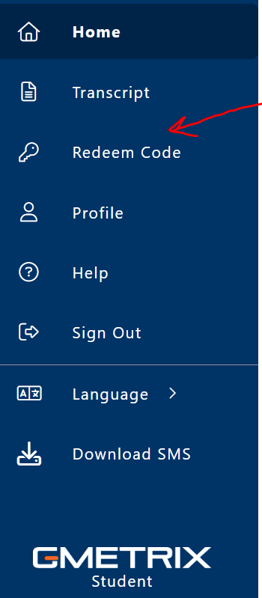
Unlock the New Tasks on Gmetrix for Week 6 to 8
In order to do your tasks for the week 6, 7, and 8, you must get the Access Code and use it in "Redeem code" section on Gmetrix (Fig.1). Then all the new features and the new tasks will be unlocked for you.
Access Code already provided on the announcement on Canvas titled "[ITEC100] Access Code for Gmetrix Practice Tests".
Therefore, just copy the provided Access code and paste it in the 'Redeem code" section on Gmetrix (Fig.1) to unlock the new tasks.

Slide 6
Unlock the New Tasks on Gmetrix for Week 6 to 8
Please redeem the Access Code during the Lab Tutorial to get access to Gmetrix Practice Tests :
To redeem the access key, you should sign in to Gmetrix using the username and password you created earlier.
Please note the access code provided earlier, was for using the Excel course on Gmetrix, but this one is for the Practice Tests which should be done in week 6 to 8 tutorials.

Slide 7
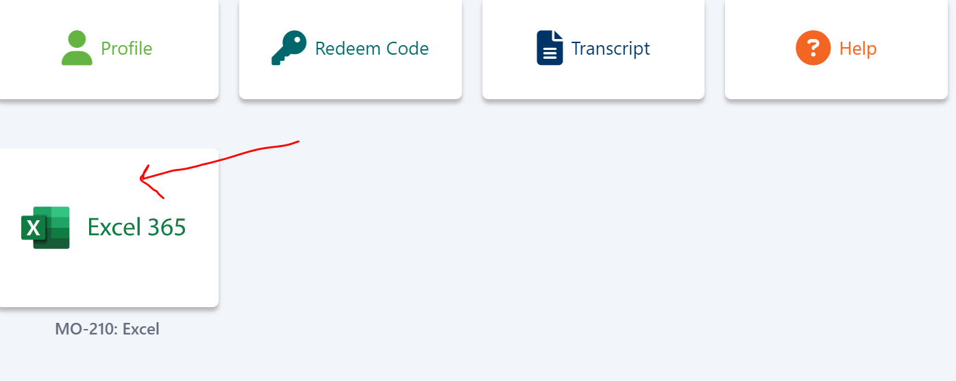
Unlock the New Tasks on Gmetrix for Week 6 to 8
After that simply click on "Excel 365" (Fig.2) to see the populated tasks. You can find information about what you have to submit for week 6 and week 7 in the relevant published announcement.

Slide 8
Certiport Account
You also need to register a Certiport account this week (to prepare for the upcoming Excel Exam in Week 9 in your Tutorial). Please follow these instructions:
In order to create an account on Certiport, please follow the below instructions:
1. Go to https://app.certiport.com/portal/signupLinks to an external site.
2. Create an account with new username (Your student number/student email) and password. Please advised that this username and password is different with your username and password in Geometrix.
3. Email your username, password and any security questions and answers (or you can text them) to yourself for future reference.

Slide 9
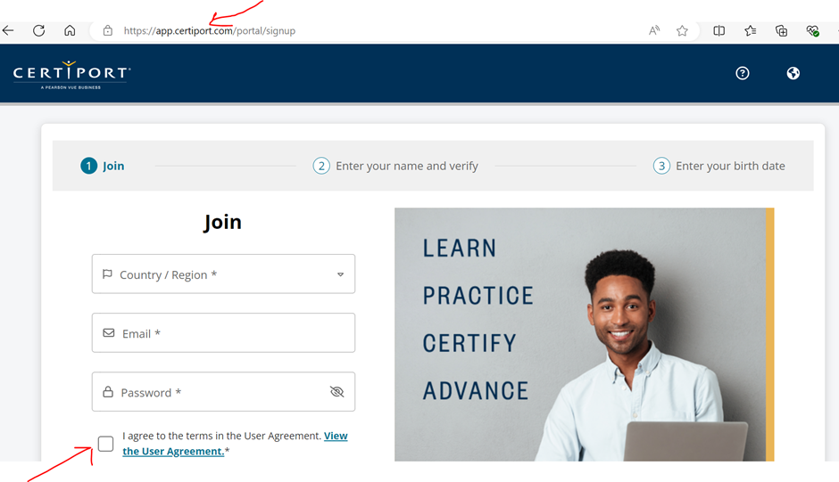
Certiport Account
4. Tick the box shown below in the screenshot and click join

Slide 10
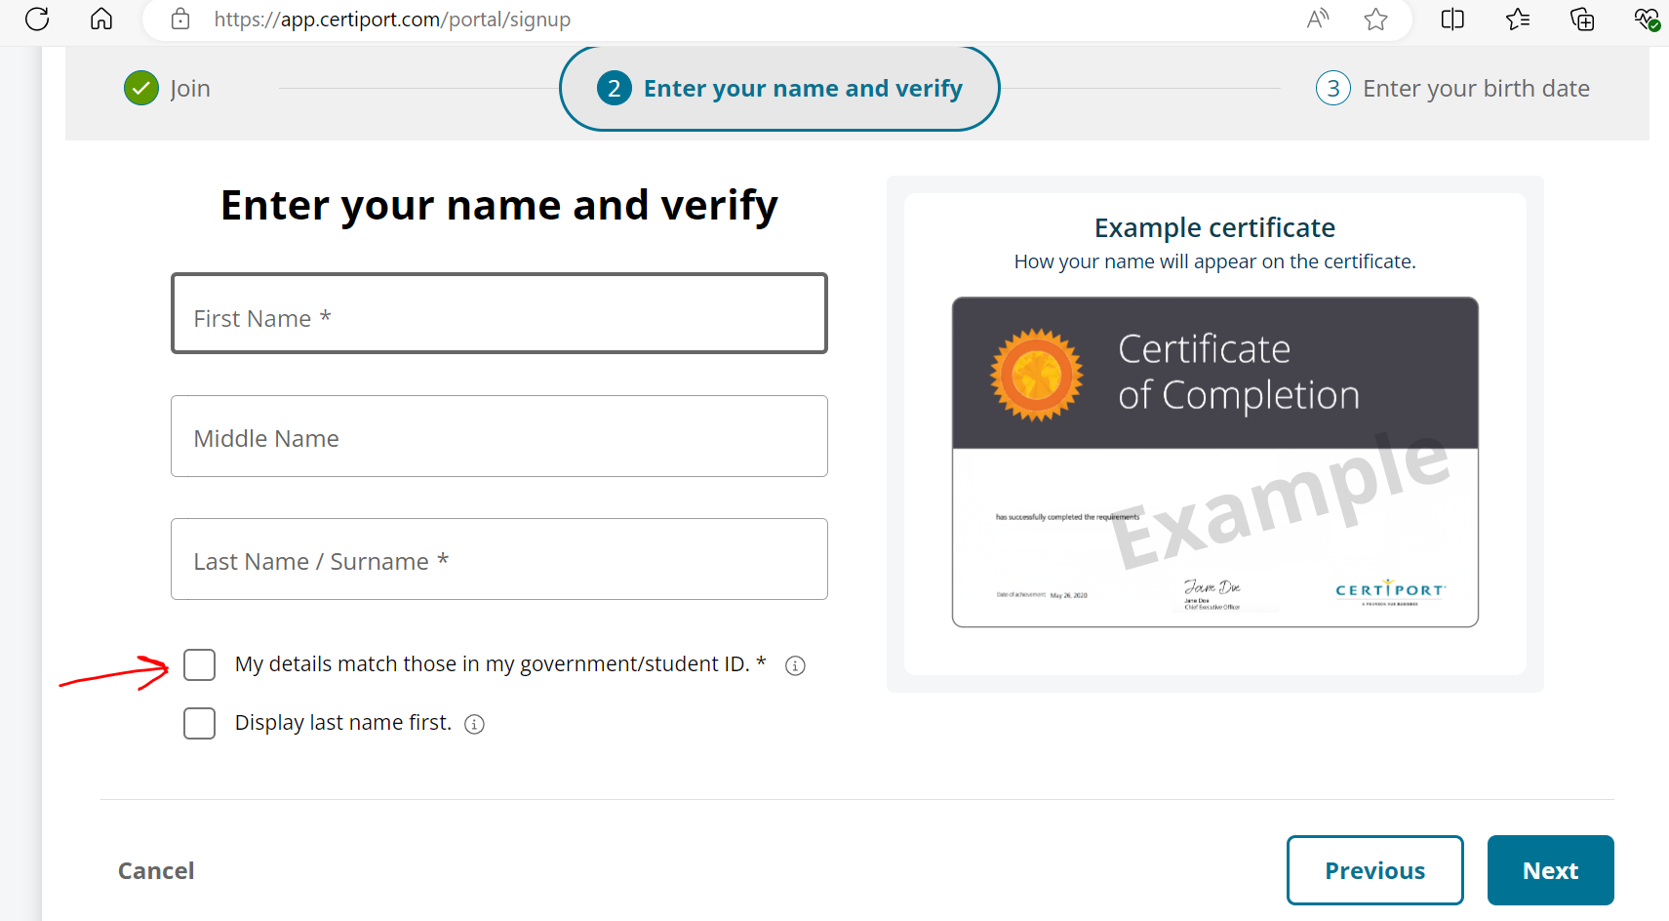
Certiport Account
5. Enter your Name and Surname displayed on your student card as these names will be displayed in your certificate.
6. Tick both boxes and press "Next".

Slide 11
Certiport Account
7. Go to https://app.certiport.com/portal/ and log into your Certiport account with your username and password that you have created in step 2.
8. Your account in Certiport as a "Test Candidate" ready to use for Week 8 and Week 9 and onwards. You will be provided with the relevant instruction in week 8 and week 9 about what you have to do with your Certiport account.
9. Now you have to go back to Gmetrix and practise there.

Slide 12
Review
Access the Lab: Make sure to attend the lab session scheduled for this week. The practice exam can only be accessed on the lab PCs, and personal devices are not allowed.
Redeem the New Code:
Open the Certiport platform on the lab PC.
Log in to your account using your credentials. If you don't have an account yet, follow the instructions provided in the previous email announcement to create one.
Navigate to the section for redeeming codes and enter the new code provided during the lab session.
Complete the Practice Exam: After redeeming the code, proceed to take Practice Exam 3 in testing mode. This will familiarize you with the exam environment and help you prepare for the final exam.
Email Communication:
If you cannot attend the lab or encounter any issues with redeeming the code or accessing the exam, please send an email to me as soon as possible so that alternative arrangements can be made.

Slide 13
Q&A
Good morning sir, I wanted to know that in week 6 submission, do I need to do that in mode training or testing? I have done the training one should I submit that one or do I have do the testing mode and submit? Thank you, Babina Shrestha
Good morning,
For Week 6, you only need to complete Practice Exam 1 and 2 in training mode, so you're good to go with what you've done. However, Practice Exam 3 should be done in testing mode when we get to that point.
Great job on completing the training mode! If you have any other questions, feel free to reach out.
Best regards, Farshid Keivanian

Slide 14

Submit the Excel Associate 365 'Skill Review 3 Test Mode, Practice Exam 1’. Make sure your name, data, and score is visible in the screenshots.
Thank you
Dr. Farshid Keivanian

