Slide 1
ITEC100 – Domain 4: Perform Operations Using Formulas and Functions
Tutor: Dr. Farshid Keivanian

Slide 2
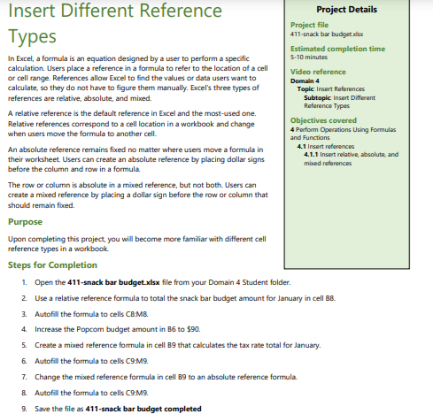
Domain 4 – Lesson 1
Step-by-Step Solution:
Open the File:
Open the file named 411-snack bar budget.xlsx from your Domain 4 Student folder.
Apply Relative Reference:
Use a relative reference formula to calculate the total snack bar budget amount for January in cell B8.
Example: If the total budget for January is calculated by summing up the values from B3 to B7, enter the formula =SUM(B3:B7) in cell B8.

Slide 3
Domain 4 – Lesson 1
3. Autofill Formula:
Autofill the formula in cell B8 across to cells C8.
How to do this: Click on cell B8, hover over the small square at the bottom-right corner of the cell (the fill handle), and drag it across to M8.
4. Increase Popcorn Budget:
Increase the Popcorn budget in cell B6 to $90.

Slide 4
Domain 4 – Lesson 1
5. Create Mixed Reference Formula:
Create a mixed reference formula in cell B9 that calculates the tax rate total for January.
Example: If the tax rate is in cell F1, use a mixed reference formula like =B8*$F$1 in cell B9. Here, $F$1 is an absolute reference, while B8 is a relative reference.
6. Change Mixed Reference:
Change the mixed reference formula in cell B9 to an absolute reference formula.
How to do this: Modify the formula to =$B$8*$F$1.

Slide 5
Domain 4 – Lesson 1
7. Autofill the Absolute Reference Formula:
Autofill the formula in cell B9 to cells C9
.
How to do this: Click on cell B9, hover over the fill handle, and drag it across to M9.
8. Save the File:
Save the file as 411-snack bar budget completed.
By following these steps, you will have successfully completed the project on inserting different reference types in Excel.

Slide 6
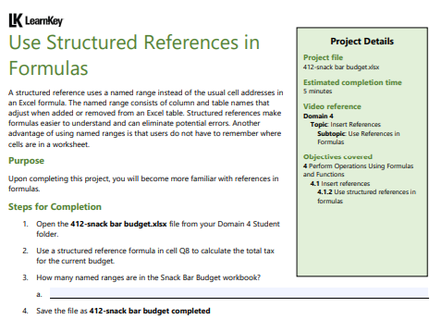
Domain 4 – Lesson 1
Step-by-Step Solution:
Open the File:
Open the file named 412-snack bar budget.xlsx from your Domain 4 Student folder.
Use Structured Reference Formula:
Use a structured reference formula in cell Q8 to calculate the total tax for the current budget.
Example: Assuming the table is named "BudgetTable" and the tax rate is a column within this table, you would enter a formula like =SUM(BudgetTable[TaxRate]*BudgetTable[Amount]) in cell Q8. The exact formula depends on how the table and columns are named.

Slide 7
Domain 4 – Lesson 1
3. Count Named Ranges:
Identify how many named ranges are in the Snack Bar Budget workbook.
How to do this: You can check the named ranges by going to the "Formulas" tab and clicking on "Name Manager" in Excel. Count the number of named ranges listed.
4. Save the File:
Save the file as 412-snack bar budget completed.
By following these steps, you will successfully complete the project on using structured references in formulas in Excel.

Slide 8
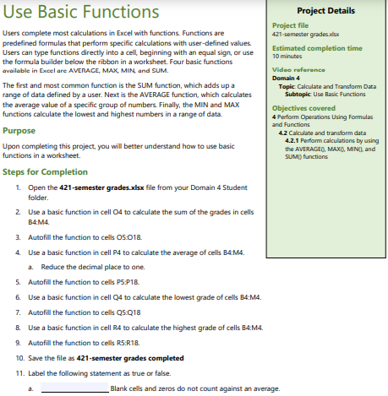
Domain 4 – Lesson 2
Step-by-Step Solution:
Open the File:
Open the file named 421-semester grades.xlsx from your Domain 4 Student folder.
Use SUM Function:
Use a basic function (SUM) in cell Q4 to calculate the sum of the grades in cells B4.
Example: Enter the formula =SUM(B4:M4) in cell Q4.

Slide 9
Domain 4 – Lesson 2
3. Autofill SUM Formula:
Autofill the formula in cell Q4 down to cells Q5.
How to do this: Click on cell Q4, hover over the small square at the bottom-right corner of the cell (the fill handle), and drag it down to Q18.
4. Use AVERAGE Function:
Use a basic function (AVERAGE) in cell P4 to calculate the average of cells B4.
Example: Enter the formula =AVERAGE(B4:M4) in cell P4.

Slide 10
Domain 4 – Lesson 2
5. Autofill AVERAGE Formula:
Autofill the formula in cell P4 down to cells P5.
How to do this: Click on cell P4, hover over the fill handle, and drag it down to P18.
6. Use MIN Function:
Use a basic function (MIN) in cell O4 to calculate the lowest grade of cells B4.
Example: Enter the formula =MIN(B4:M4) in cell O4.
7. Autofill MIN Formula:
Autofill the formula in cell O4 down to cells O5.
How to do this: Click on cell O4, hover over the fill handle, and drag it down to O18.

Slide 11
Domain 4 – Lesson 2
8. Use MAX Function:
Use a basic function (MAX) in cell R4 to calculate the highest grade of cells B4.
Example: Enter the formula =MAX(B4:M4) in cell R4.
9. Autofill MAX Formula:
Autofill the formula in cell R4 down to cells R5.
How to do this: Click on cell R4, hover over the fill handle, and drag it down to R18.
10. Save the File:
Save the file as 421-semester grades completed

Slide 12
Domain 4 – Lesson 2
11. Review the Following Statement:
Blank cells and zeros do not count against an average.
Ensure this setting is true or false depending on the project instructions.
By following these steps, you will successfully complete the project on using basic functions in Excel.

Slide 13
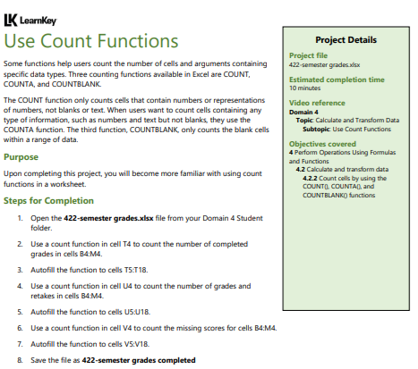
Domain 4 – Lesson 2
Step-by-Step Solution:
Open the File:
Open the file named 422-semester grades.xlsx from your Domain 4 Student folder.
Use COUNT Function:
Use a COUNT function in cell T4 to count the number of completed grades in cells B4.
Example: Enter the formula =COUNT(B4:M4) in cell T4.

Slide 14
Domain 4 – Lesson 2
3. Autofill COUNT Formula:
Autofill the formula in cell T4 down to cells T5.
How to do this: Click on cell T4, hover over the small square at the bottom-right corner of the cell (the fill handle), and drag it down to T18.
4. Use COUNTA Function:
Use a COUNTA function in cell U4 to count the number of grades and retakes in cells B4.
Example: Enter the formula =COUNTA(B4:M4) in cell U4.

Slide 15
Domain 4 – Lesson 2
5. Autofill COUNTA Formula:
Autofill the formula in cell U4 down to cells U5.
How to do this: Click on cell U4, hover over the fill handle, and drag it down to U18.
6. Use COUNTBLANK Function:
Use a COUNTBLANK function in cell V4 to count the missing scores for cells B4.
Example: Enter the formula =COUNTBLANK(B4:M4) in cell V4.

Slide 16
Domain 4 – Lesson 2
7. Autofill COUNTBLANK Formula:
Autofill the formula in cell V4 down to cells V5
.
How to do this: Click on cell V4, hover over the fill handle, and drag it down to V18.
8. Save the File:
Save the file as 422-semester grades completed.
By following these steps, you will successfully complete the project on using count functions in Excel.

Slide 17
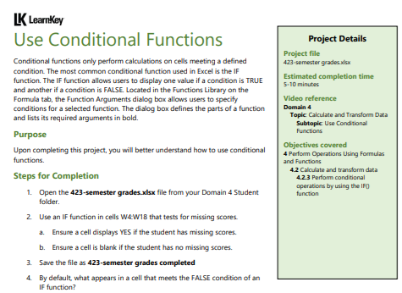
Domain 4 – Lesson 2
Step-by-Step Solution:
Open the File:
Open the file named 423-semester grades.xlsx from your Domain 4 Student folder.
Use IF Function:
Use an IF function in cells W4
that tests for missing scores.
Example: Enter the formula =IF(COUNTBLANK(B4:M4) > 0, "YES", "") in cell W4.
This formula checks if there are any missing scores in the range B4
. If there are missing scores, it displays "YES". If there are no missing scores, it leaves the cell blank.

Slide 18
Domain 4 – Lesson 2
3. Ensure the IF Function Displays "YES":
The formula should display "YES" if the student has missing scores. Ensure this is working correctly by verifying the output in cells W4.
4. Ensure the IF Function Leaves the Cell Blank:
The formula should leave the cell blank if there are no missing scores. Ensure this is working correctly by verifying the output in cells W4

Slide 19
Domain 4 – Lesson 2
5. Save the File:
Save the file as 423-semester grades completed.
6. Question to Consider:
By default, what appears in a cell that meets the FALSE condition of an IF function?
Answer: By default, the IF function can leave the cell blank or display an alternative value if specified (e.g., "" for blank or another text).
By following these steps, you will successfully complete the project on using conditional functions in Excel.

Slide 20
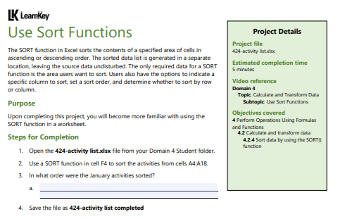
Domain 4 – Lesson 2
Step-by-Step Solution:
Open the File:
Open the file named 424-activity list.xlsx from your Domain 4 Student folder.
Use SORT Function:
Use a SORT function in cell F4 to sort the activities from cells A4.
Example: To sort the activities alphabetically or in ascending order by date, enter the formula =SORT(A4:A18) in cell F4.
If you need to sort by a specific criterion, like date, adjust the formula accordingly, e.g., =SORT(A4:A18, 1, TRUE) where the 1 specifies the first column and TRUE indicates ascending order.

Slide 21
Domain 4 – Lesson 2
3. Determine the Order of January Activities:
After sorting, check in what order the January activities were sorted. This will depend on the sorting criteria you applied (e.g., alphabetical, by date, etc.).
4. Save the File:
Save the file as 424-activity list completed.
By following these steps, you will successfully complete the project on using sort functions in Excel.

Slide 22
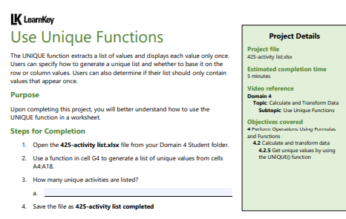
Domain 4 – Lesson 2
Step-by-Step Solution:
Open the File:
Open the file named 425-activity list.xlsx from your Domain 4 Student folder.
Use UNIQUE Function:
Use a function in cell G4 to generate a list of unique values from cells A4.
Example: Enter the formula =UNIQUE(A4:A18) in cell G4. This function will extract all unique activities from the list in cells A4
and display them starting in cell G4.

Slide 23
Domain 4 – Lesson 2
3. Count the Number of Unique Activities:
Determine how many unique activities are listed.
How to do this: After using the UNIQUE function, count the number of items generated in the list starting from cell G4.
4. Save the File:
Save the file as 425-activity list completed.
By following these steps, you will successfully complete the project on using unique functions in Excel.

Slide 24
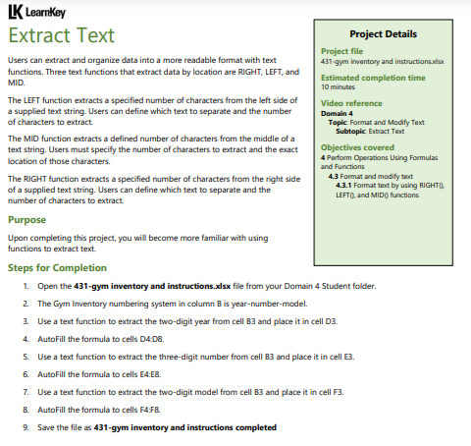
Domain 4 – Lesson 3
Step-by-Step Solution:
Open the File:
Open the file named 431-gym inventory and instructions.xlsx from your Domain 4 Student folder.
Extract Two-Digit Year:
Use a text function to extract the two-digit year from cell B3 and place it in cell D3.
Example: Enter the formula =RIGHT(B3, 2) in cell D3. This will extract the last two characters (representing the year) from the string in cell B3.

Slide 25
Domain 4 – Lesson 3
3. Autofill the Formula:
Autofill the formula in cell D3 down to cells D4.
How to do this: Click on cell D3, hover over the small square at the bottom-right corner of the cell (the fill handle), and drag it down to D8.
4. Extract Three-Digit Month and Place:
Use a text function to extract the three-digit month from cell B3 and place it in cell E3.
Example: If the month is in the middle of the text, use the formula =MID(B3, 4, 3) in cell E3. This will extract three characters starting from the 4th position (assuming the month is located there).

Slide 26
Domain 4 – Lesson 3
5. Autofill the Formula:
Autofill the formula in cell E3 down to cells E4.
How to do this: Click on cell E3, hover over the fill handle, and drag it down to E8.
6. Extract Two-Digit Model Number:
Use a text function to extract the two-digit model from cell B3 and place it in cell F3.
Example: Enter the formula =LEFT(B3, 2) in cell F3. This will extract the first two characters from the string in cell B3.

Slide 27
Domain 4 – Lesson 3
7. Autofill the Formula:
Autofill the formula in cell F3 down to cells F4
.
How to do this: Click on cell F3, hover over the fill handle, and drag it down to F8.
8. Save the File:
Save the file as 431-gym inventory and instructions completed.
By following these steps, you will successfully complete the project on extracting text using the LEFT, RIGHT, and MID functions in Excel.

Slide 28
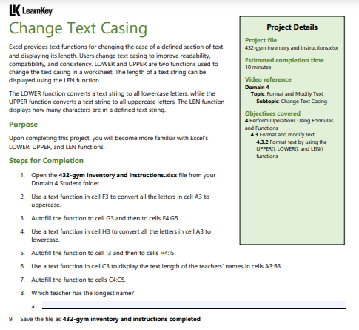
Domain 4 – Lesson 3
Step-by-Step Solution:
Open the File:
Open the file named 432-gym inventory and instructions.xlsx from your Domain 4 Student folder.
Convert Text to Uppercase:
Use a text function in cell F3 to convert all the letters in cell A3 to uppercase.
Example: Enter the formula =UPPER(A3) in cell F3. This will convert all the text in cell A3 to uppercase.

Slide 29
Domain 4 – Lesson 3
3. Autofill the Uppercase Formula:
Autofill the formula in cell F3 down to cells F4.
How to do this: Click on cell F3, hover over the small square at the bottom-right corner of the cell (the fill handle), and drag it down to G5.
4. Convert Text to Lowercase:
Use a text function in cell H3 to convert all the letters in cell A3 to lowercase.
Example: Enter the formula =LOWER(A3) in cell H3. This will convert all the text in cell A3 to lowercase.

Slide 30
Domain 4 – Lesson 3
5. Autofill the Lowercase Formula:
Autofill the formula in cell H3 down to cells H4
How to do this: Click on cell H3, hover over the fill handle, and drag it down to I5.
6. Display Text Length:
Use a text function in cell C3 to display the text length of the teachers’ names in cells A3
Example: Enter the formula =LEN(A3) in cell C3. This will display the number of characters in the text in cell A3.

Slide 31
Domain 4 – Lesson 3
7. Autofill the LEN Formula:
Autofill the formula in cell C3 down to cells C4
.
How to do this: Click on cell C3, hover over the fill handle, and drag it down to C5.
8. Determine the Longest Name:
Review the text lengths displayed in column C to determine which teacher has the longest name.

Slide 32
Domain 4 – Lesson 3
9. Save the File:
Save the file as 432-gym inventory and instructions completed.
By following these steps, you will successfully complete the project on changing text casing and using the LEN function in Excel.

Slide 33
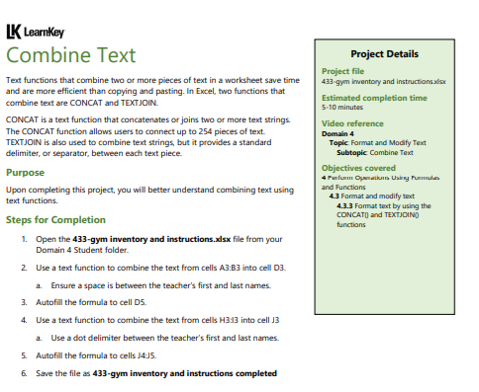
Domain 4 – Lesson 3
Step-by-Step Solution:
Open the File:
Open the file named 433-gym inventory and instructions.xlsx from your Domain 4 Student folder.
Combine Text from Cells A3 and B3:
Use a text function to combine the text from cells A3 and B3 into cell D3.
Example: Enter the formula =CONCAT(A3, B3) or =TEXTJOIN("", TRUE, A3, B3) in cell D3. The CONCAT function simply joins the texts, while TEXTJOIN allows you to specify a delimiter, but in this case, no delimiter is used.

Slide 34
Domain 4 – Lesson 3
3. Add a Space Between the Teacher’s First and Last Names:
Modify the function in cell D3 to include a space between the first and last names.
Example: Update the formula to =CONCAT(A3, " ", B3) or =TEXTJOIN(" ", TRUE, A3, B3).
4. Autofill the Combined Text Formula:
Autofill the formula in cell D3 down to cells D4.
How to do this: Click on cell D3, hover over the small square at the bottom-right corner of the cell (the fill handle), and drag it down to D5.

Slide 35
Domain 4 – Lesson 3
5. Combine Text from Cells H3 and I3 with a Dot Delimiter:
Use a text function to combine the text from cells H3 and I3 into cell J3, with a dot (.) delimiter between the teacher’s first and last names.
Example: Enter the formula =TEXTJOIN(".", TRUE, H3, I3) in cell J3.
6. Autofill the Dot-Delimited Text Formula:
Autofill the formula in cell J3 down to cells J4.
How to do this: Click on cell J3, hover over the fill handle, and drag it down to J5.

Slide 36
Domain 4 – Lesson 3
7. Save the File:
Save the file as 433-gym inventory and instructions completed.
By following these steps, you will successfully complete the project on combining text using the CONCAT and TEXTJOIN functions in Excel.

Slide 37

Submit the screenshot of the “Domain 4 Post Assessment" score via the week 4 submission box. Make sure your name is visible in the screenshots.
Thank you
Dr. Farshid Keivanian

