Slide 1
ITEC100 – Domain 3: Manage Tables and Table Data
Tutor: Dr. Farshid Keivanian

Slide 2
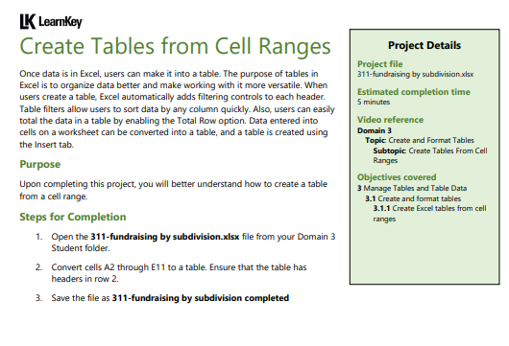
Domain 3 – Lesson 1
Step-by-Step Instructions:
Open the Excel File:
Begin by opening the Excel file named 311-fundraising by subdivision.xlsx from your Domain 3 Student folder.
Select the Cell Range:
Highlight the cells from A2 to E11. This is the range of data you want to convert into a table.

Slide 3
Domain 3 – Lesson 1
3. Insert the Table:
Go to the Insert tab in the Excel ribbon at the top of the screen.
Click on Table in the Tables group.
4. Confirm Table Settings:
A dialog box will appear asking you to confirm the range of cells for the table.
Ensure the checkbox for "My table has headers" is checked. This will use row 2 as the table headers.
Click OK to create the table.

Slide 4
Domain 3 – Lesson 1
5. Save the File:
After the table is created, save your work by selecting File > Save As.
Name the file 311-fundraising by subdivision completed and choose the location where you want to save it.
These steps will help you convert the selected cell range into a table in Excel, making it easier to sort, filter, and analyze your data.

Slide 5
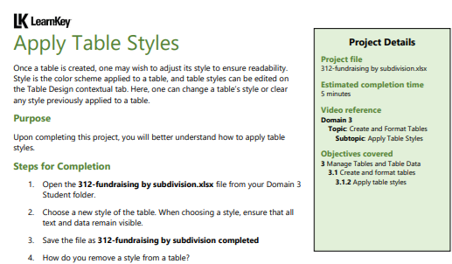
Domain 3 – Lesson 1
Step-by-Step Instructions:
Open the Excel File:
Begin by opening the Excel file named 312-fundraising by subdivision.xlsx from your Domain 3 Student folder.
Select the Table:
Click anywhere within the table you want to style. This will activate the Table Design tab in the Excel ribbon.

Slide 6
Domain 3 – Lesson 1
3. Choose a New Table Style:
Go to the Table Design tab at the top of the screen.
In the Table Styles group, you will see various style options. Click the drop-down arrow to see more styles.
Browse through the available styles and select one that ensures all text and data remain visible. Click on the style to apply it to your table.
4. Save the File:
After applying the new style, save your work by selecting File > Save As.
Name the file 312-fundraising by subdivision completed and choose the location where you want to save it.

Slide 7
Domain 3 – Lesson 1
5. Remove a Table Style (Optional):
To remove a style from a table, go to the Table Design tab.
In the Table Styles group, click on the More button (downward arrow) to open the full list of styles.
At the bottom of the list, click on Clear to remove any style applied to the table.
These steps will guide you in applying and removing table styles in Excel, helping you enhance the readability of your data.

Slide 8
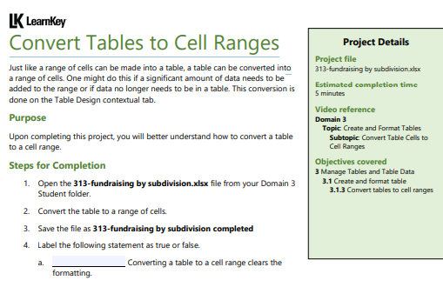
Domain 3 – Lesson 1
Step-by-Step Instructions:
Open the Excel File:
Begin by opening the Excel file named 313-fundraising by subdivision.xlsx from your Domain 3 Student folder.
Select the Table:
Click anywhere within the table you want to convert into a range of cells. This will activate the Table Design tab in the Excel ribbon.

Slide 9
Domain 3 – Lesson 1
3. Convert the Table to a Range:
Go to the Table Design tab at the top of the screen.
In the Tools group, click on Convert to Range. A prompt will appear asking if you want to convert the table to a normal range.
Click Yes to confirm.
4. Save the File:
After converting the table to a range, save your work by selecting File > Save As.
Name the file 313-fundraising by subdivision completed and choose the location where you want to save it.

Slide 10
Domain 3 – Lesson 1
5. Label the Statement:
Consider the statement: "Converting a table to a cell range clears the formatting."
Label this statement as false. Converting a table to a range does not clear the formatting; the cell styles and formatting remain intact, but the table features like filtering and structured references are removed.
These steps will help you successfully convert a table to a range of cells in Excel and understand the effects of this conversion.

Slide 11
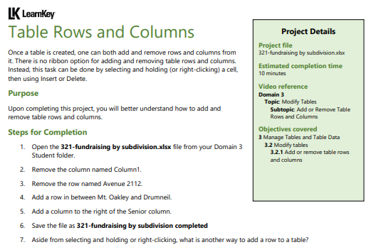
Domain 3 – Lesson 2
Step-by-Step Instructions:
Open the Excel File:
Begin by opening the Excel file named 321-fundraising by subdivision.xlsx from your Domain 3 Student folder.
Remove the Column Named "Column1":
Locate the column named Column1 in your table.
Click on the header of Column1 to select the entire column.
Right-click on the selected column header and choose Delete from the context menu. This will remove the column from the table.

Slide 12
Domain 3 – Lesson 2
3. Remove the Row Named "Avenue 2112":
Locate the row that contains "Avenue 2112" in your table.
Click on the row number to the left to select the entire row.
Right-click on the selected row number and choose Delete from the context menu. This will remove the row from the table.
4. Add a Row Between "Mt. Oakley" and "Drumneil":
Locate the rows for Mt. Oakley and Drumneil.
Click on the row number of Drumneil to select the row.
Right-click on the selected row and choose Insert from the context menu. A new blank row will be added above Drumneil and below Mt. Oakley.

Slide 13
Domain 3 – Lesson 2
5. Add a Column to the Right of the "Senior" Column:
Locate the Senior column in your table.
Click on the header of the column immediately to the right of Senior to select it (or click on any cell in that column).
Right-click on the selected column header or cell and choose Insert from the context menu. A new blank column will be added to the right of the Senior column.
6. Save the File:
After making these changes, save your work by selecting File > Save As.
Name the file 321-fundraising by subdivision completed and choose the location where you want to save it.

Slide 14
Domain 3 – Lesson 2
7. Alternative Method for Adding a Row:
Aside from selecting and holding or right-clicking, another way to add a row to a table is by clicking on the last cell in the last row of the table and pressing the Tab key. This will automatically add a new row at the bottom of the table.
These steps will guide you through adding and removing rows and columns in an Excel table, ensuring you can manage your data effectively.

Slide 15
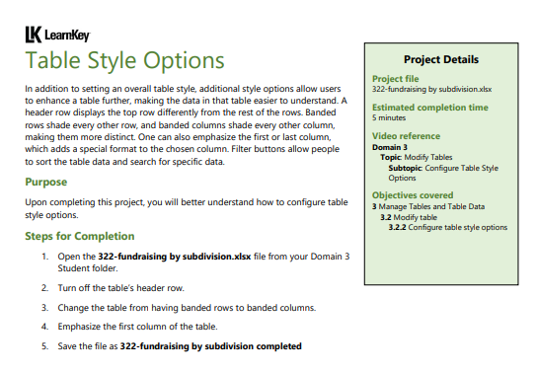
Domain 3 – Lesson 2
Step-by-Step Instructions:
Open the Excel File:
Begin by opening the Excel file named 322-fundraising by subdivision.xlsx from your Domain 3 Student folder.
Turn Off the Table's Header Row:
Click anywhere within the table to activate the Table Design tab in the Excel ribbon.
In the Table Style Options group, uncheck the Header Row option. This will turn off the header row, making the top row look like the rest of the rows in the table.

Slide 16
Domain 3 – Lesson 2
3. Change the Table from Banded Rows to Banded Columns:
In the same Table Style Options group, uncheck the Banded Rows option.
Then, check the Banded Columns option. This will apply shading to every other column instead of every other row, making the columns more distinct.
4. Emphasize the First Column of the Table:
Still in the Table Style Options group, check the First Column option. This will apply a special format to the first column, typically making it bold or adding a different background color.

Slide 17
Domain 3 – Lesson 2
5. Save the File:
After making these changes, save your work by selecting File > Save As.
Name the file 322-fundraising by subdivision completed and choose the location where you want to save it.
These steps will help you configure various table style options in Excel, enhancing the table's readability and presentation.

Slide 18
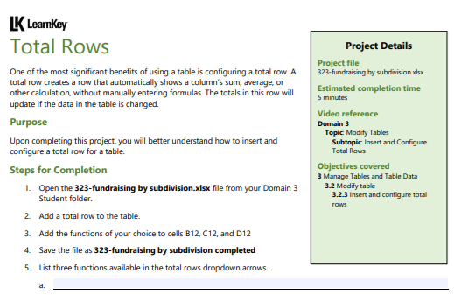
Domain 3 – Lesson 2
Step-by-Step Instructions:
Open the Excel File:
Begin by opening the Excel file named 323-fundraising by subdivision.xlsx from your Domain 3 Student folder.
Add a Total Row to the Table:
Click anywhere within the table to activate the Table Design tab in the Excel ribbon.
In the Table Design tab, check the box next to Total Row in the Table Style Options group. This will add a new row at the bottom of your table that is designated as the Total Row.

Slide 19
Domain 3 – Lesson 2
3. Add Functions to Cells B12, C12, and D12:
Click on cell B12 (the corresponding cell in the Total Row).
Click the drop-down arrow that appears in the cell and choose the function of your choice (e.g., Sum, Average, Count, etc.).
Repeat this process for cells C12 and D12, selecting the functions you prefer for each column.
4. Save the File:
After configuring the total row, save your work by selecting File > Save As.
Name the file 323-fundraising by subdivision completed and choose the location where you want to save it.

Slide 20
Domain 3 – Lesson 2
5. List Three Functions Available in the Total Row's Dropdown Arrows:
Three common functions available in the Total Row's dropdown arrows include:
Sum: Adds up all the values in the column.
Average: Calculates the average of the values in the column.
Count: Counts the number of non-empty cells in the column.
These steps will guide you in adding and configuring a total row in an Excel table, making it easier to perform calculations and analyze your data.

Slide 21
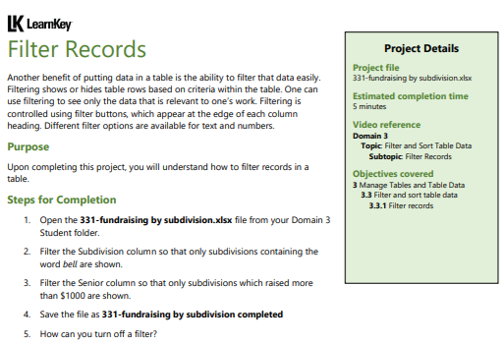
Domain 3 – Lesson 2
Step-by-Step Instructions:
Open the Excel File:
Begin by opening the Excel file named 331-fundraising by subdivision.xlsx from your Domain 3 Student folder.
Filter the Subdivision Column to Show Only Subdivisions Containing "bell":
Click on the filter button (downward arrow) at the edge of the Subdivision column header.
In the drop-down menu, go to the Text Filters option and select Contains....
A dialog box will appear. Type bell in the field provided and click OK. This will filter the table to display only those subdivisions containing the word "bell."

Slide 22
Domain 3 – Lesson 2
3. Filter the Senior Column to Show Only Subdivisions That Raised More Than $1000:
Click on the filter button (downward arrow) at the edge of the Senior column header.
In the drop-down menu, go to the Number Filters option and select Greater Than....
In the dialog box that appears, enter 1000 in the field provided and click OK. This will filter the table to display only those subdivisions that raised more than $1000.

Slide 23
Domain 3 – Lesson 2
4. Save the File:
After applying the filters, save your work by selecting File > Save As.
Name the file 331-fundraising by subdivision completed and choose the location where you want to save it.
5. How to Turn Off a Filter:
To turn off a filter, click on the filter button (downward arrow) in the column header where the filter is applied.
In the drop-down menu, you can choose Clear Filter From [Column Name]. This will remove the filter and display all the data in that column again.

Slide 24
Domain 3 – Lesson 2
These steps will help you filter records in an Excel table to focus on specific data that meets your criteria and also guide you on how to clear the filters when needed.

Slide 25
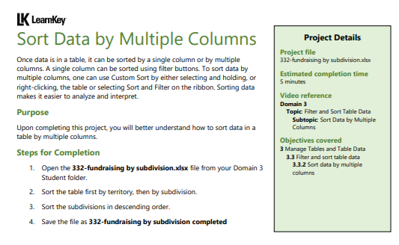
Domain 3 – Lesson 2
Step-by-Step Instructions:
Open the Excel File:
Begin by opening the Excel file named 332-fundraising by subdivision.xlsx from your Domain 3 Student folder.
Access the Custom Sort Dialog:
Click anywhere within the table to activate the Table Design tab and make sure the entire table is selected.
Go to the Data tab in the Excel ribbon.
Click on Sort in the Sort & Filter group. This will open the Sort dialog box, where you can sort data by multiple columns.

Slide 26
Domain 3 – Lesson 2
3. Sort the Table First by Territory:
In the Sort dialog box, under the Column drop-down menu, select Territory as the first column to sort by.
Ensure that the Sort On option is set to Values and the Order is set to A to Z (ascending) or Z to A (depending on your preference).
4. Then Sort by Subdivision:
Next, click the Add Level button in the Sort dialog box.
In the new row that appears, choose Subdivision from the Column drop-down menu.
Ensure that the Sort On option is set to Values.
For the Order, select Z to A (descending) since you want the subdivisions sorted in descending order.

Slide 27
Domain 3 – Lesson 2
5. Apply the Sort:
After setting up the sort criteria, click OK to apply the sorting to your table.
6. Save the File:
After sorting the data, save your work by selecting File > Save As.
Name the file 332-fundraising by subdivision completed and choose the location where you want to save it.
These steps will guide you in sorting your data by multiple columns in an Excel table, allowing you to organize and analyze your data more effectively.

Slide 28

Submit the screenshot of the “Domain 3 Post Assessment" score via the week 3 submission box. Make sure your name is visible in the screenshots.
Thank you
Dr. Farshid Keivanian

