Slide 1
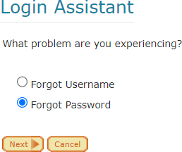
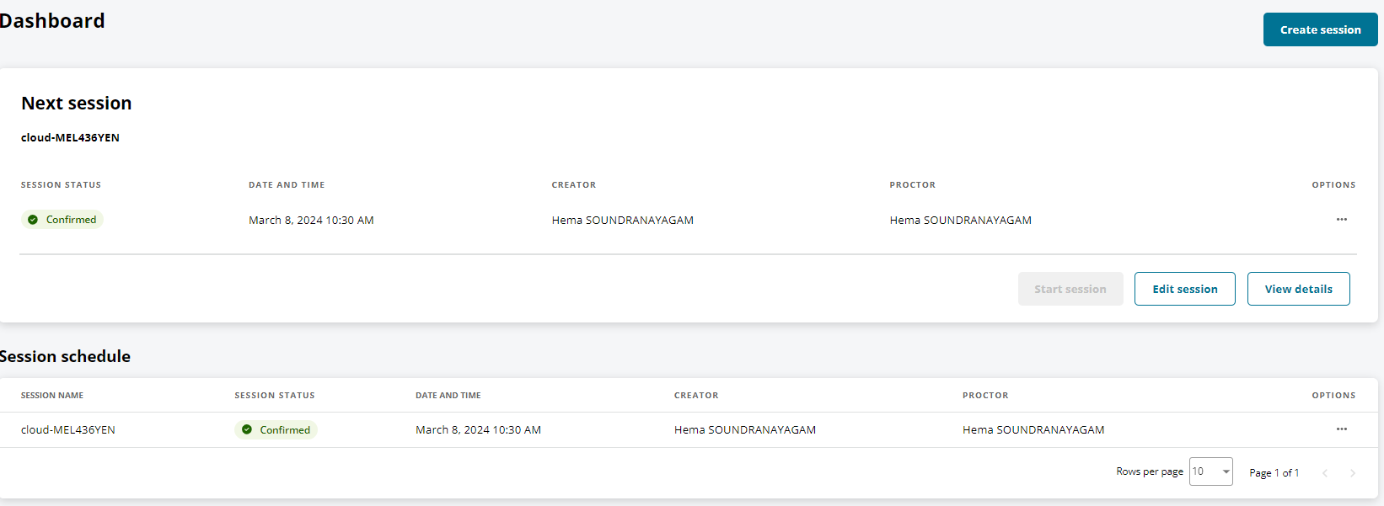
Certiport Exam check list and management
Steps | Task
1 | Make sure you have registered with Certiport as a proctor and sent your username to Hema. Hema will add you to the Certiport system as a proctor. https://www.certiport.com/portal/Pages/Registration.aspx
2 | In week 8, check if all of your students have registered with Certiport using the link below. They will need to use the ACU email that has this format Sxxxxxx@myacu.edu.au. Username should be their student ID Sxxxxxxxx.
3 | Using your attendance list, record each student’s Certiport username and send ( firstname, lastname and Certiport username) to Hema. If they forget their password, they will need to use the login assistant. They will then need to enter their date of birth and security question.
4 | Ask them to email their username and password to their ACU email address. Sometimes students tend to forget their username and password so this step is very important. In addition, students may create multiple accounts which creates further login issues.
5 | In week 8, Hema will send you an email with the session link. Confirm the link 24 hours prior to the exam start time, otherwise the link will disappear. In week 9, If your exam is scheduled for Monday 10 am, confirm it on Sunday 10 am. The dashboard will show the confirmation.
6 | You will get a confirmation email.

Slide 2
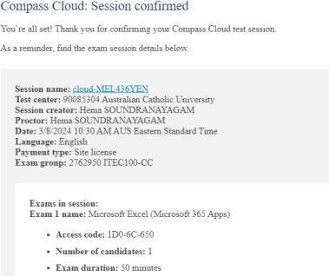
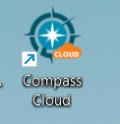
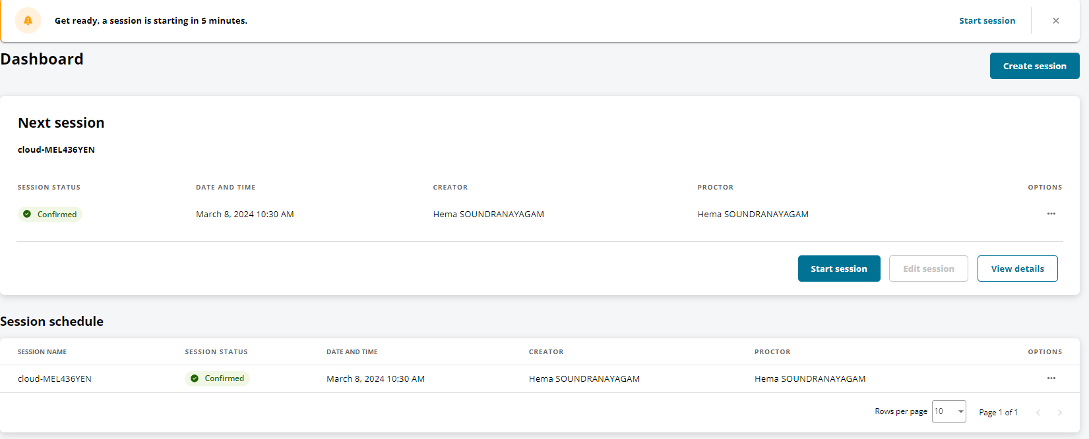
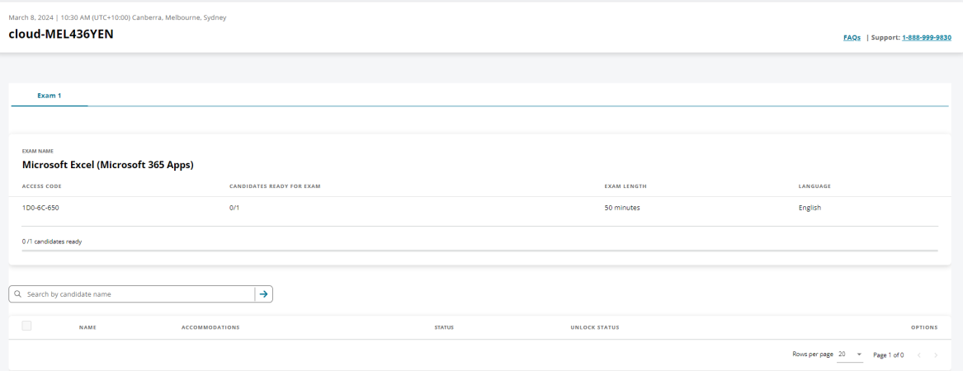
7 | In week 8, ask the students to login to compass-cloud with their username and password (this should be in their email box) to check if the cloud icon is working.
8 | In week 9 ( exam day ), go to your email box. Get the access code from the email and write it on the board for them. Click on the session link 5 min before the exam time( start session will only appear at this point). This will take you to the dashboard.
9 | Click start session. You will see this screen.
10 | After few minutes, you will see the students

Slide 3
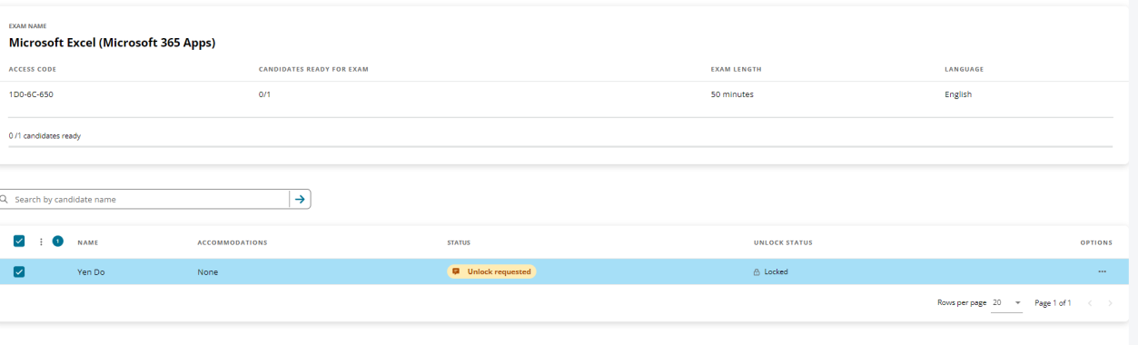
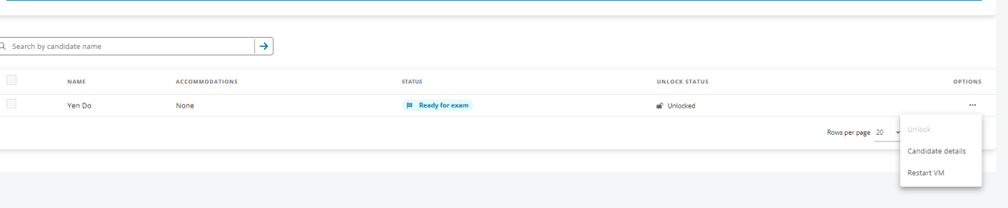
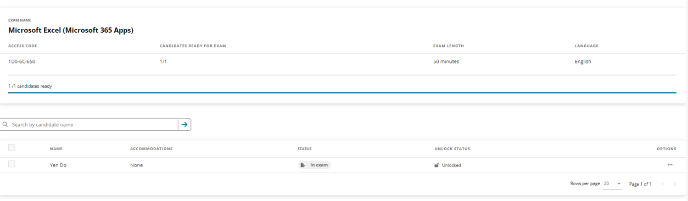
11 | Click on 3 dots and click unlock
12 | The screen will show the student taking the exam.

