Slide 1
ITEC100 – Week 8
Tutor: Dr. Farshid Keivanian

Slide 2
Overview Weeks 8 and 9
Submit the screenshot properly in weekly tutorial activity.
W7: Complete 'Skill Review 3, Practice Exam 1’
W8: Complete 'Practice Exams 2-3’ & Certiport Exam check list and management
W9 (Starting on 30th September 2024): Test on Friday 4th October 2024
Also please don't forget to make sure you can login to CertiportLinks to an external site. and EMAIL YOURSELF YOUR CERTIPORT USERNAME AND PASSWORD. Please arrive 5 minutes early.

Slide 3
Overview Weeks 8 and 9
Next Week is Semester Break:
Monday 23rd of September and will finish on Sunday 29th of September 2024.
Have registered with Certiport using the provided link https://app.certiport.com/portal/signup ? You will need to use the ACU email that has this format Sxxxxxx@myacu.edu.au. Username should be your student ID Sxxxxxxxx.
Username is your student ID
Please do not create multiple accounts!

Slide 4
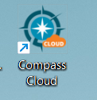
Overview Weeks 8 and 9
Have you login to compass-cloud with your username and password (this should be in your email box) to check if the cloud icon is working.
The exam is 7 projects, each project has 5 tasks

Slide 5
Overview Weeks 8 and 9
Make sure to create your CERTIPORT ACCOUNT by the end of week 8 (by the end of Sunday 22nd of September 2024). Any delay on creating CERTIPORT account may result in MISSING the EXAM. MAKE SURE YOUR NAME MATCHES YOUR ID.
For more details on creating CERTIPORT ACCOUNT follow these steps:

Slide 6
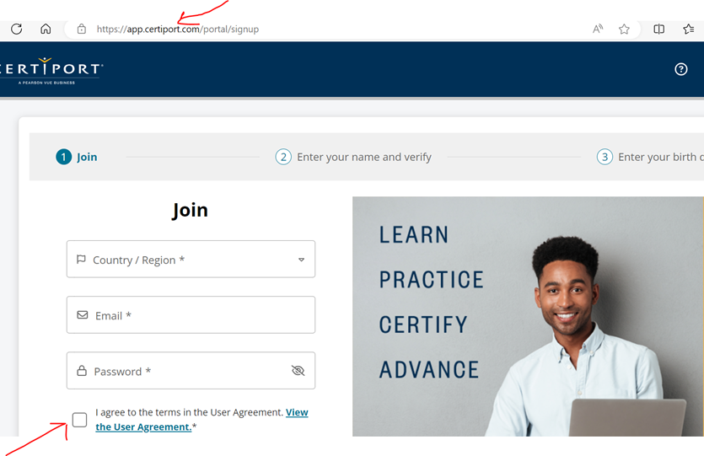
Overview Weeks 6 - 10
Go to https://app.certiport.com/portal/signupLinks to an external site.
Create an account with new username (Your student number/student email) and password. Please advised that this username and password is different with your username and password in Geometrix.
Email your username, password and any security questions and answers (or you can text them) to yourself for future reference.
Tick the box shown below in the screenshot and click join (Fig.1)

Slide 7
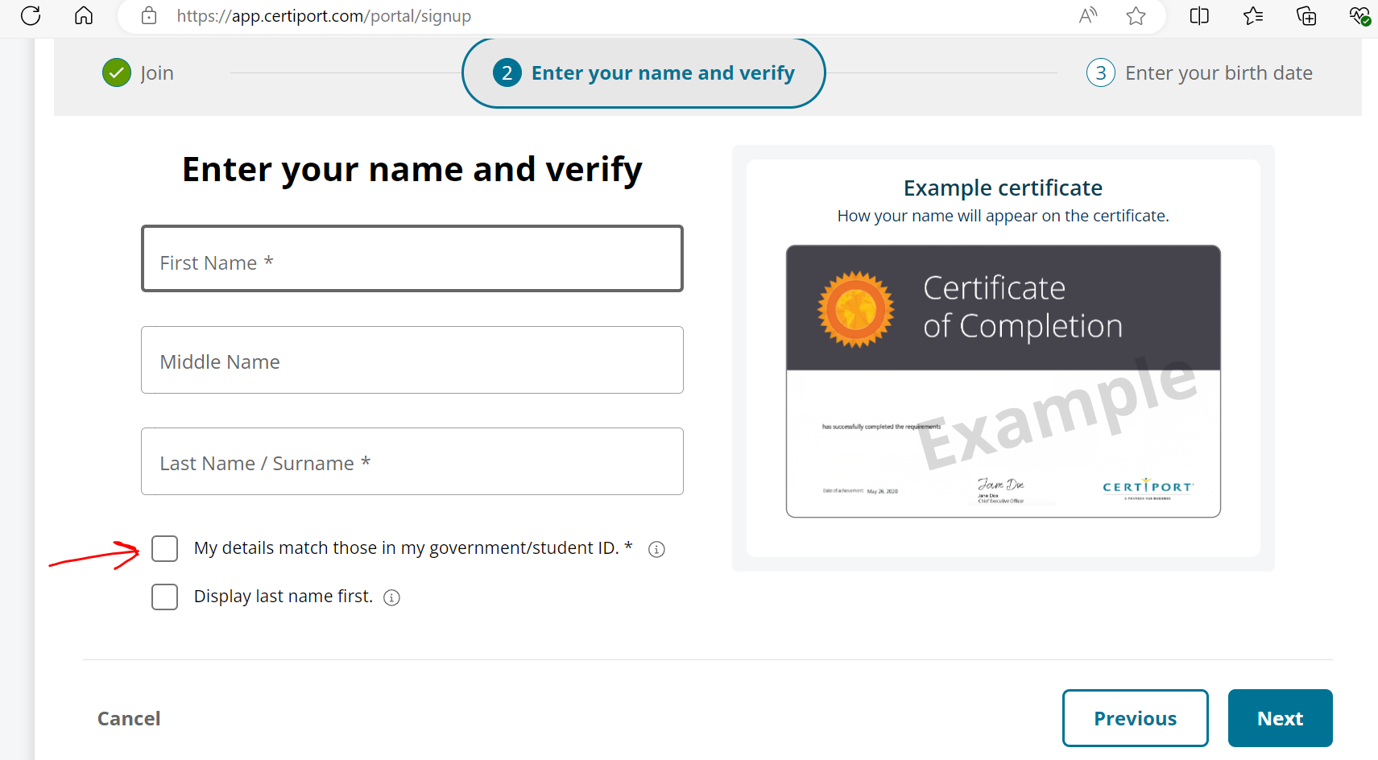
Overview Weeks 6 - 10
5. Enter your Name and Surname displayed on your student card (Fig.2) as these names will be displayed in your certificate.
6. Tick both boxes in (Fig.2) and press "Next".
7. Go to https://app.certiport.com/portal/Links to an external site. and log into your Certiport account with your username and password that you have created in step 2.
8. Your account in Certiport as a "Test Candidate" ready to use for Week 9 and onwards. You will be provided with the relevant instruction in week 9 about what you have to do with your Certiport account.
9. Now you have to go back to Gmetrix and practise there.

Slide 8
Q&A
Good morning, sir, I wanted to know that in week 6 submission, do I need to do that in mode training or testing? I have done the training one should I submit that one or do I have do the testing mode and submit? Thank you, Babina Shrestha
Good morning,
For Week 6, you only need to complete Practice Exam 1 and 2 in training mode, so you're good to go with what you've done. However, Practice Exam 3 should be done in testing mode when we get to that point.
Great job on completing the training mode! If you have any other questions, feel free to reach out.
Best regards, Farshid Keivanian

Slide 9

A) Submit the Practice Exams 2 and 3. Make sure your name, data, and score is visible in the screenshots. B) Create a Certiport account with your ACU email address (the ACU email that has this format Sxxxxxx@myacu.edu.au.) Your Username must be your student ID Sxxxxxxxx. The guideline already provided on the Canvas how to create a Certiport account. C) Email your username and password to your ACU email address. In the case of missing your username and password, you can find them. D) Email your Certiport username, Firstname, Lastname, and Student number to me

