Slide 1
ITEC100 – Domain 5: Manage Charts
Tutor: Dr. Farshid Keivanian

Slide 2
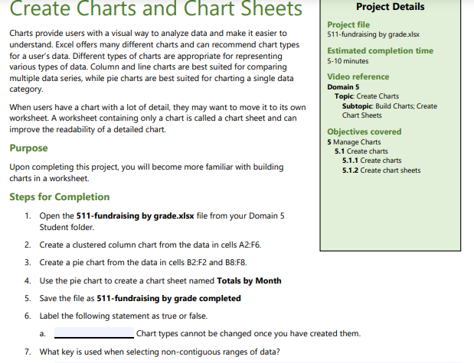
Domain 5 – Lesson 1
Create Charts and Modify Charts
1. Open the File:
Open the 511-fundraising by grade.xlsx file from your designated folder.
2. Create a Clustered Column Chart:
Highlight the data in cells A2.
Go to the Insert tab on the Ribbon.
In the Charts group, click on the Insert Column or Bar Chart icon.
Select Clustered Column from the dropdown options.
A clustered column chart will be created in your worksheet.

Slide 3
Domain 5 – Lesson 1
Create Charts and Modify Charts
3. Create a Pie Chart:
Highlight the data in cells B2
and B8
(these should correspond to the months and the total values).
Go to the Insert tab on the Ribbon.
In the Charts group, click on the Pie Chart icon.
Select the desired pie chart type (e.g., 2-D Pie).
A pie chart will be created using the selected data.
4. Create a Chart Sheet Named 'Totals by Month':
Right-click on the newly created pie chart.
Select Move Chart from the context menu.
In the Move Chart dialog box, select the New sheet option.
Enter the name "Totals by Month" in the text box.
Click OK to move the pie chart to a new sheet named "Totals by Month."

Slide 4
Domain 5 – Lesson 1
Create Charts and Modify Charts
5. Save the File:
Save the Excel file with the name 511-fundraising by grade completed.xlsx in your designated folder.
6. Label the Statement as True or False:
The statement is: "Chart types cannot be changed once you have created them."
This statement is False. In Excel, you can change the chart type after creating a chart by selecting the chart and then choosing a new chart type from the Change Chart Type option in the Design tab.
7. Key Used for Selecting Non-Contiguous Ranges of Data:
The key used when selecting non-contiguous ranges of data in Excel is the Ctrl key. Hold down the Ctrl key while selecting multiple ranges of data.

Slide 5
Domain 5 – Lesson 1
Create Charts and Modify Charts
Summary:
By following these steps, you will complete the required tasks, including creating charts, moving charts to their own sheets, and saving the workbook with a new name. You also now know that you can change chart types after creation and that the Ctrl key is used to select non-contiguous ranges of data.

Slide 6
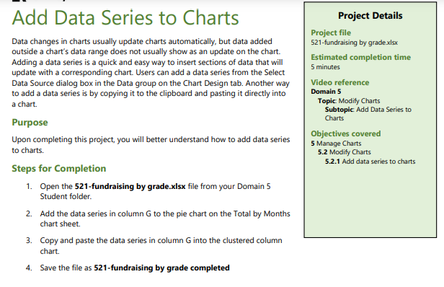
Domain 5 – Lesson 1
Add Data Series to Charts
1. Open the File:
Open the 521-fundraising by grade.xlsx file from your designated folder.
2. Add the Data Series in Column G to the Pie Chart:
Highlight the data in column G (likely containing the data for June) that you want to add to the pie chart.
Right-click on the existing pie chart and select Select Data.
In the Select Data Source dialog box, click Add to add a new series.
For the Series name, select the column G header (which should be the month name, like "June").
For the Series values, select the data range in column G that corresponds to each grade level (e.g., G2).
Click OK to add the data to the pie chart.

Slide 7
Domain 5 – Lesson 1
Add Data Series to Charts
3. Copy and Paste the Data Series in Column G to the Clustered Column Chart:
Highlight the data in column G (the same data used in step 2).
Copy this data by pressing Ctrl + C.
Select the clustered column chart.
Paste the data into the chart by pressing Ctrl + V. This will add the new series to the clustered column chart.
4. Save the File:
Save the Excel file with the name 521-fundraising by grade completed.xlsx in your designated folder.

Slide 8
Domain 5 – Lesson 1
Add Data Series to Charts
By following these steps, you will successfully add the data from column G to both the pie chart and the clustered column chart, and save the workbook with the updated name.

Slide 9
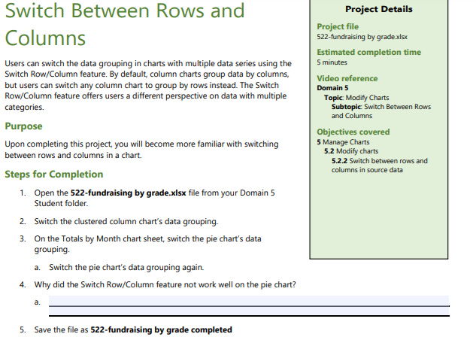
Domain 5 – Lesson 1
Switch Between Rows and Columns
1. Open the File:
Open the 522-fundraising by grade.xlsx file from your designated folder.
2. Switch the Clustered Column Chart’s Data Grouping:
Select the clustered column chart in the worksheet.
Go to the Chart Tools on the Ribbon and click on the Design tab.
In the Data group, click on Switch Row/Column. This will change how the data is grouped, giving you a different perspective on the data.

Slide 10
Domain 5 – Lesson 1
Switch Between Rows and Columns
3. Switch the Pie Chart’s Data Grouping on the 'Totals by Month' Chart Sheet:
Go to the sheet named 'Totals by Month' where the pie chart is located.
Select the pie chart.
Go to the Chart Tools on the Ribbon and click on the Design tab.
Click on Switch Row/Column to attempt to change the data grouping.
4. Switch the Pie Chart’s Data Grouping Again:
Select the pie chart again.
Click on Switch Row/Column once more to try changing the data grouping back.

Slide 11
Domain 5 – Lesson 1
Switch Between Rows and Columns
5. Explain Why the Switch Row/Column Feature Did Not Work Well on the Pie Chart:
The Switch Row/Column feature does not work well on pie charts because pie charts are designed to represent one series of data as slices of a whole. Pie charts do not handle multiple data series or row/column switching in the same way that column or line charts do. The pie chart is best suited to display the proportion of a single data series, so switching rows and columns can lead to confusing or unintended results.
6. Save the File:
Save the Excel file with the name 522-fundraising by grade completed.xlsx in your designated folder.

Slide 12
Domain 5 – Lesson 1
Switch Between Rows and Columns
By following these steps, you will successfully switch the data grouping in the clustered column chart, attempt to switch the data grouping in the pie chart, and save the workbook with the updated name.

Slide 13
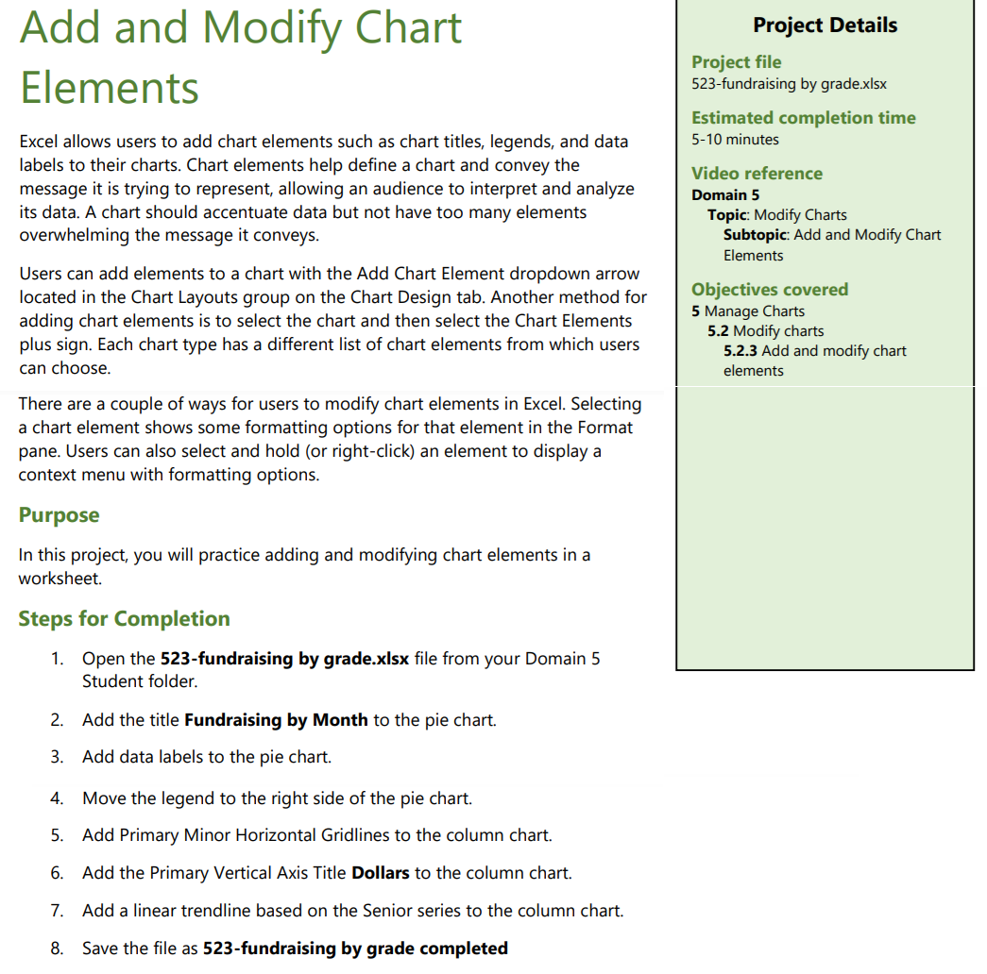
Domain 5 – Lesson 1
Add and Modify Chart
1. Open the File:
Open the 523-fundraising by grade.xlsx file from your designated folder.
2. Add the Title "Fundraising by Month" to the Pie Chart:
Click on the pie chart to select it.
Go to the Chart Tools on the Ribbon and click on the Design tab.
In the Chart Layouts group, click on Add Chart Element.
Hover over Chart Title and select Above Chart.
Click on the title box that appears above the chart, and type "Fundraising by Month".

Slide 14
Domain 5 – Lesson 1
Add and Modify Chart
3. Add Data Labels to the Pie Chart:
With the pie chart still selected, go to the Chart Tools on the Ribbon.
Click on the Design tab.
In the Chart Layouts group, click on Add Chart Element.
Hover over Data Labels and choose the desired position (e.g., Outside End).
The data labels will now be displayed on the pie chart.

Slide 15
Domain 5 – Lesson 1
Add and Modify Chart
4. Move the Legend to the Right Side of the Pie Chart:
Click on the pie chart to select it.
Go to the Chart Tools on the Ribbon and click on the Design tab.
In the Chart Layouts group, click on Add Chart Element.
Hover over Legend and select Right.
The legend will move to the right side of the pie chart.

Slide 16
Domain 5 – Lesson 1
Add and Modify Chart
5. Add Primary Minor Horizontal Gridlines to the Column Chart:
Click on the column chart to select it.
Go to the Chart Tools on the Ribbon and click on the Design tab.
In the Chart Layouts group, click on Add Chart Element.
Hover over Gridlines and then check Primary Minor Horizontal.
The primary minor horizontal gridlines will be added to the column chart.

Slide 17
Domain 5 – Lesson 1
Add and Modify Chart
6. Add the Primary Vertical Axis Title "Dollars" to the Column Chart:
Click on the column chart to select it.
Go to the Chart Tools on the Ribbon and click on the Design tab.
In the Chart Layouts group, click on Add Chart Element.
Hover over Axis Titles and select Primary Vertical.
Click on the vertical axis title that appears on the left side of the chart and type "Dollars".

Slide 18
Domain 5 – Lesson 1
Add and Modify Chart
7. Add a Linear Trendline Based on the Senior Series to the Column Chart:
Click on the Senior data series in the column chart to select it.
Right-click on the selected data series and choose Add Trendline.
In the Format Trendline pane, select Linear.
The linear trendline will be added to the Senior series in the column chart.
8. Save the File:
Save the Excel file with the name 523-fundraising by grade completed.xlsx in your designated folder.

Slide 19
Domain 5 – Lesson 1
Add and Modify Chart
By following these steps, you will successfully add and modify the necessary chart elements in both the pie and column charts and save the workbook with the updated name.

Slide 20
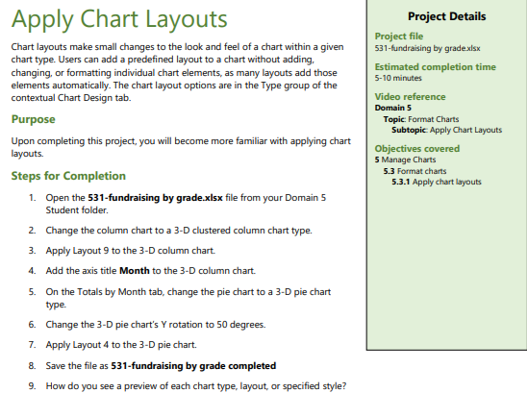
Domain 5 – Lesson 2
Apply Chart Layouts
1. Open the File:
Open the 531-fundraising by grade.xlsx file from your designated folder.
2. Change the Column Chart to a 3-D Clustered Column Chart:
Select the existing column chart in the worksheet.
Go to the Chart Tools on the Ribbon and click on the Design tab.
Click on Change Chart Type in the Type group.
Select 3-D Clustered Column from the list of options and click OK.

Slide 21
Domain 5 – Lesson 2
Apply Chart Layouts
3. Apply Layout 9 to the 3-D Column Chart:
With the 3-D clustered column chart still selected, go to the Chart Tools on the Ribbon and click on the Design tab.
In the Chart Layouts group, click on Quick Layout.
Select Layout 9 from the dropdown list.
4. Add the Axis Title "Month" to the 3-D Column Chart:
With the 3-D clustered column chart still selected, go to the Chart Tools on the Ribbon and click on the Design tab.
In the Chart Layouts group, click on Add Chart Element.
Hover over Axis Titles, then select Primary Horizontal.
Click on the horizontal axis title that appears and type "Month".

Slide 22
Domain 5 – Lesson 2
Apply Chart Layouts
5. Change the Pie Chart on the 'Totals by Month' Sheet to a 3-D Pie Chart:
Go to the sheet named 'Totals by Month' where the pie chart is located.
Select the pie chart.
Go to the Chart Tools on the Ribbon and click on the Design tab.
Click on Change Chart Type in the Type group.
Select 3-D Pie from the list of options and click OK.
6. Change the 3-D Pie Chart’s Y Rotation to 50 Degrees:
With the 3-D pie chart selected, right-click on the chart and select 3-D Rotation.
In the Format Chart Area pane that appears, adjust the Y Rotation to 50 degrees.
Close the pane once the change is made.

Slide 23
Domain 5 – Lesson 2
Apply Chart Layouts
7. Apply Layout 4 to the 3-D Pie Chart:
With the 3-D pie chart still selected, go to the Chart Tools on the Ribbon and click on the Design tab.
In the Chart Layouts group, click on Quick Layout.
Select Layout 4 from the dropdown list.
8. Save the File:
Save the Excel file with the name 531-fundraising by grade completed.xlsx in your designated folder.

Slide 24
Domain 5 – Lesson 2
Apply Chart Layouts
Additional Task: How do you see a preview of each chart type, layout, or specified style?
Answer: You can see a preview of each chart type, layout, or specified style by hovering over the options in the respective dropdown menus on the Ribbon. As you hover over different options, Excel provides a live preview of how the chart will look if the option is selected.

Slide 25
Domain 5 – Lesson 2
Apply Chart Layouts
By following these steps, you will successfully apply the required chart layouts and modifications to both the column and pie charts, and save the workbook with the updated name.

Slide 26
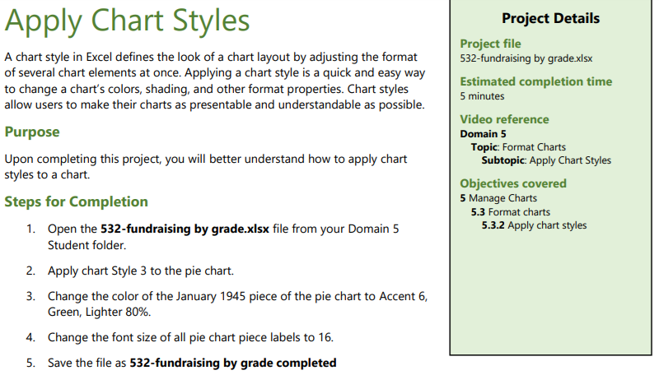
Domain 5 – Lesson 2
Apply Chart Styles
1. Open the File:
Open the 532-fundraising by grade.xlsx file from your designated folder.
2. Apply Chart Style 3 to the Pie Chart:
Click on the pie chart to select it.
Go to the Chart Tools on the Ribbon and click on the Design tab.
In the Chart Styles group, look for Style 3 (typically the third style in the list).
Click on Style 3 to apply it to the pie chart.

Slide 27
Domain 5 – Lesson 2
Apply Chart Styles
3. Change the Color of the January 1945 Piece of the Pie Chart to Accent 6, Green, Lighter 80%:
Click on the January 1945 piece of the pie chart to select it. Make sure only this piece is selected.
Right-click on the selected pie piece and choose Format Data Point.
In the Format Data Point pane, go to the Fill & Line options (paint bucket icon).
Under Fill, select Solid fill.
Click on the color dropdown and choose More Colors.
In the color selection, go to the Custom tab and enter the following values to get Accent 6, Green, Lighter 80%:
Red: 204
Green: 255
Blue: 204
Click OK to apply the color.

Slide 28
Domain 5 – Lesson 2
Apply Chart Styles
4. Change the Font Size of All Pie Chart Piece Labels to 16:
Click on one of the data labels in the pie chart to select all data labels.
Right-click on the selected data labels and choose Font.
In the Font dialog box, set the Font size to 16.
Click OK to apply the font size change.
5. Save the File:
Save the Excel file with the name 532-fundraising by grade completed.xlsx in your designated folder.

Slide 29
Domain 5 – Lesson 2
Apply Chart Styles
By following these steps, you will successfully apply the specified chart style, change the color of a specific pie chart piece, adjust the font size of the data labels, and save the workbook with the updated name.

Slide 30
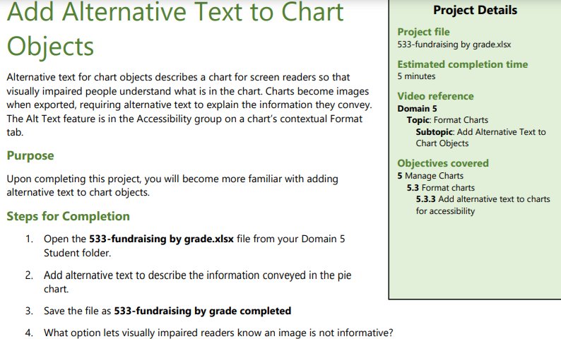
Domain 5 – Lesson 2
Add Alternative Text to Chart
1. Open the File:
Open the 533-fundraising by grade.xlsx file from your designated folder.
2. Add Alternative Text to the Pie Chart:
Click on the pie chart to select it.
Right-click on the chart and choose Edit Alt Text from the context menu.
In the Alt Text pane that appears on the right, enter a description that explains the information conveyed by the pie chart. For example, you might type: "This pie chart shows the fundraising amounts by grade across different months."
After entering the description, close the Alt Text pane.

Slide 31
Domain 5 – Lesson 2
Add Alternative Text to Chart
3. Save the File:
Save the Excel file with the name 533-fundraising by grade completed.xlsx in your designated folder.
Additional Question:
What option lets visually impaired readers know an image is not informative?
In the Alt Text pane, there is an option to check a box labeled "Mark as decorative." This option lets screen readers know that the image is purely decorative and does not convey important information, so it can be skipped.

Slide 32
Domain 5 – Lesson 2
Add Alternative Text to Chart
By following these steps, you will successfully add alternative text to the pie chart to make it accessible to visually impaired users and save the workbook with the updated name.

Slide 33

Submit the screenshot of the “Domain 5 Post Assessment" score via the week 5 submission box. Make sure your name is visible in the screenshots.
Thank you
Dr. Farshid Keivanian

