Slide 1



HC1041:Information Technology for Business
Lecture 11
Title: Business Intelligence and Knowledge Management

Slide 2


Topics Covered….
Data Mining and Online Analysis
More Customer Intelligence
Dashboards
Knowledge Management
Employee Knowledge Networks Autocategorization

Slide 3
Open-Ended Question
Considering the role of data mining and online analytical processing (OLAP) in business intelligence, how do you think these technologies can transform decision-making processes in organizations? Can you provide an example of an industry where data mining has significantly impacted business outcomes?"
Data mining and OLAP technologies transform decision-making by providing deep insights into large datasets, enabling organizations to identify patterns, predict trends, and make informed decisions. For example, in the retail industry, data mining helps companies understand customer preferences and buying behaviors, leading to personalized marketing strategies and inventory management. Walmart, for instance, uses data mining to optimize its supply chain and ensure products are available when and where customers need them.

Slide 4
Open-Ended Question
Can someone explain how data warehouses and the ETL process contribute to effective data mining?
Data warehouses consolidate historical transactions and other data, providing a central repository for analysis. The ETL (Extract, Transform, Load) process extracts data from various sources, transforms it into a suitable format, and loads it into the warehouse. This structured data environment enables effective data mining by ensuring data is clean, consistent, and ready for complex queries.

Slide 5
Open-Ended Question
What are some key objectives of data mining, and how do they support business decision-making?
Key objectives of data mining include sequence or path analysis, classification, clustering, and forecasting. These objectives help businesses understand the relationships between events, categorize data into meaningful groups, uncover hidden patterns, and predict future trends. For example, clustering can identify customer segments with similar behaviors, allowing for targeted marketing efforts.

Slide 6
Open-Ended Question
How does OLAP differ from traditional databases, and what advantages does it offer for business intelligence?
OLAP differs from traditional databases by providing multidimensional data views and fast query response times. Unlike relational databases, OLAP allows users to explore data across multiple dimensions and drill down into specific details. This enables businesses to perform complex analyses quickly and intuitively, making it easier to identify trends, compare metrics, and make data-driven decisions.

Slide 7
Open-Ended Question
Can you discuss a real-world application of OLAP in a business context and its impact?"
A real-world application of OLAP is seen in the retail chain Ruby Tuesday. OLAP analysis revealed that one location was underperforming due to longer customer wait times. By identifying and addressing this issue, the company improved customer satisfaction and increased revenue. OLAP applications provide valuable insights that can lead to operational improvements and better customer experiences.

Slide 8
Open-Ended Question
What ethical and societal issues might arise from the increasing use of data mining and OLAP in business intelligence?"
The increasing use of data mining and OLAP raises ethical and societal issues such as data privacy, security, and potential biases in decision-making. Businesses must ensure they handle customer data responsibly, comply with data protection regulations, and implement measures to prevent misuse or unauthorized access. Additionally, they should be aware of and address any biases in their data and algorithms to avoid unfair or discriminatory practices.

Slide 9
Data Mining and Online Analysis
Data warehouse: a large database containing historical transactions and other data
Data warehouses are useless without software tools to process the data into meaningful information
Business intelligence (BI): information gleaned with information analysis tools
– Also called business analytics
A data warehouse is a large database containing historical transactions and other data.
Data warehouses are ineffective without software tools to process the data into meaningful information.
Business intelligence (BI), also called business analytics, refers to the information gleaned from data analysis tools.

Slide 10
Data Mining and Online Analysis
Data warehouse: a large database containing historical transactions and other data
Data warehouses are useless without software tools to process the data into meaningful information
Business intelligence (BI): information gleaned with information analysis tools
– Also called business analytics
Practical Example:
Retail Industry: Companies like Walmart use data warehouses to store vast amounts of sales data. BI tools then analyze this data to identify trends, optimize inventory, and improve customer service. For example, BI can highlight which products are bestsellers during certain seasons, allowing Walmart to stock accordingly.

Slide 11
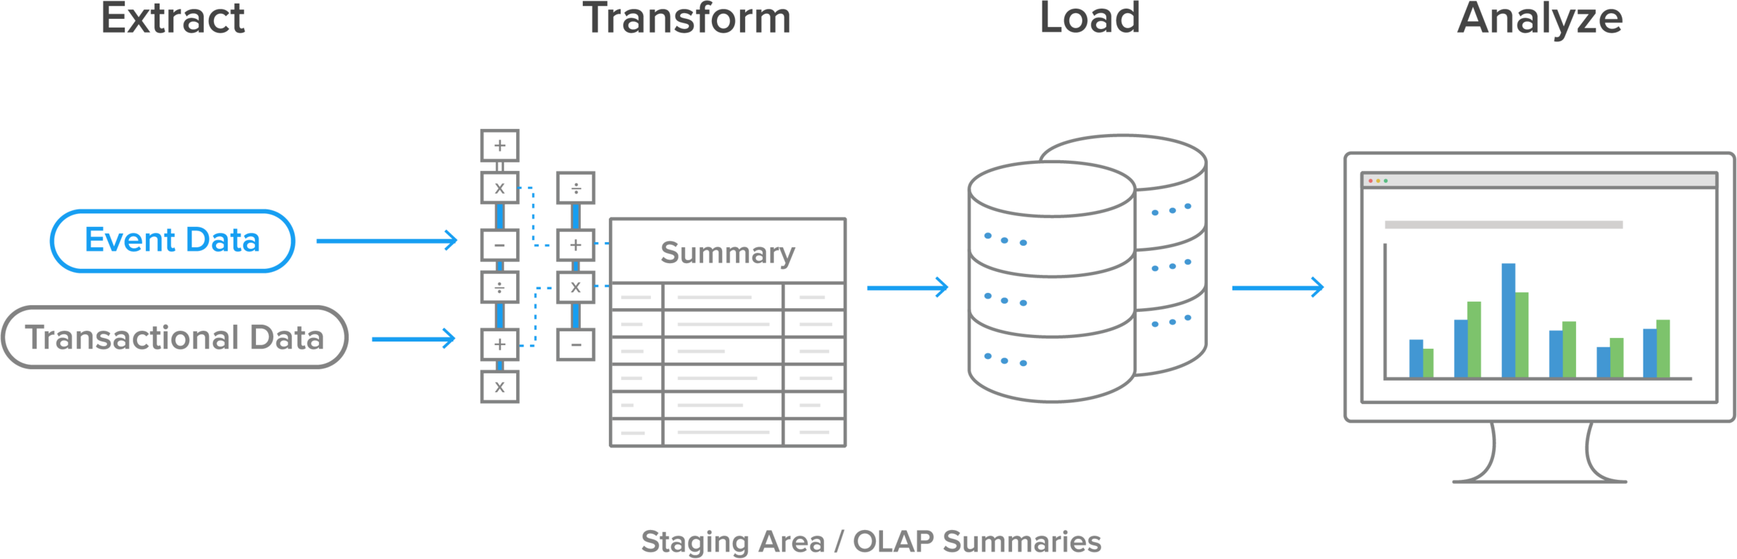
Data Mining and Online Analysis
Data warehouse: The ETL Process
The ETL (Extract, Transform, Load) process involves:
Extracting data from various sources (event data and transactional data).
Transforming it into a suitable format.
Loading it into the data warehouse.
Analyzing it using BI tools.

Slide 12
Data Mining and Online Analysis
Data warehouse: The ETL Process
Practical Example:
Healthcare Industry: Hospitals extract patient data from various departments (e.g., emergency, outpatient, inpatient). This data is transformed to ensure consistency and loaded into a data warehouse. BI tools then analyze this data to track patient outcomes and improve healthcare services.

Slide 13
Data Mining
Data mining: the process of selecting, exploring, and modeling large amounts of data
– Used to discover relationships that can support decision making
Data-mining tools may use complex statistical analysis applications
Data-mining queries are more complex than traditional queries
Data-warehousing techniques and data-mining tools facilitate the prediction of future outcomes
Data mining is the process of selecting, exploring, and modeling large amounts of data to discover relationships that support decision-making.
It often uses complex statistical analysis applications and queries that are more intricate than traditional queries.
Data warehousing techniques and data mining tools facilitate the prediction of future outcomes.

Slide 14
Data Mining
Data mining: the process of selecting, exploring, and modeling large amounts of data
– Used to discover relationships that can support decision making
Data-mining tools may use complex statistical analysis applications
Data-mining queries are more complex than traditional queries
Data-warehousing techniques and data-mining tools facilitate the prediction of future outcomes
Practical Example:
Banking Industry: Banks use data mining to detect fraudulent activities. By analyzing transaction patterns, they can identify unusual activities that may indicate fraud, allowing them to take preventive measures.

Slide 15
Open-Ended Question
Considering the role of data mining and online analytical processing (OLAP) in business intelligence, how do you think these technologies can transform decision-making processes in organizations? Can you provide an example of an industry where data mining has significantly impacted business outcomes?
Model Answer: Data mining and OLAP technologies transform decision-making by providing deep insights into large datasets, enabling organizations to identify patterns, predict trends, and make informed decisions. For example, in the retail industry, data mining helps companies understand customer preferences and buying behaviors, leading to personalized marketing strategies and inventory management. Walmart, for instance, uses data mining to optimize its supply chain and ensure products are available when and where customers need them.

Slide 16

Data Mining (cont'd.)
Objectives of data mining
Sequence or path analysis: finding patterns where one event leads to another
Classification: finding whether certain facts fall into predefined groups
Clustering: finding groups of related facts not previously known
Forecasting: discovering patterns that can lead to reasonable predictions

Slide 17

Data Mining (cont'd.)
Data mining techniques are applied to various fields, including marketing, fraud detection, and targeted marketing to individuals
Predicting customer behavior
Banking: help find profitable customers, detect patterns of fraud, and predict bankruptcies
Mobile phone services vendors: help determine factors that affect customer loyalty
Customer loyalty programs ensure a steady flow of customer data into data warehouses

Slide 18
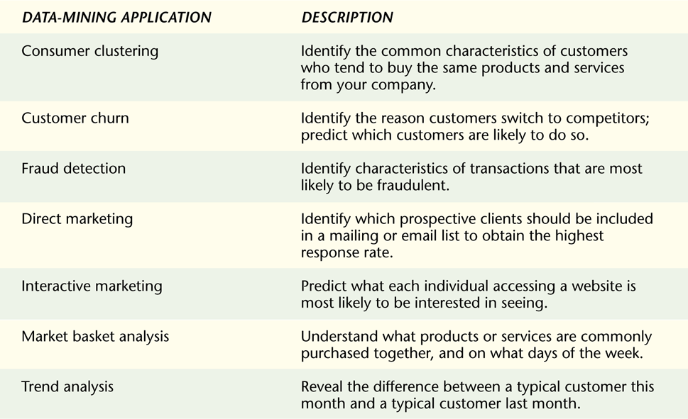

Data Mining (cont'd.)
Potential applications of data mining

Slide 19

Data Mining (cont'd.)
Many industries utilize loyalty programs, e.g., frequent-flier programs and consumer clubs
Huge amounts of data about customers amassed
UPS’ Customer Intelligence Group
Analyzes customer behavior
Predicts customer defections so that a salesperson can intervene to resolve problems

Slide 20

Data Mining (cont'd.)
Identifying profitable customer groups
Financial institutions dismiss high-risk customers
Companies attempt to define narrow groups of potentially profitable customers
Utilizing loyalty programs
Companies develop customized email newsletters targeted to individual customers
Targeted special offers and partner specials provided are tailored to each customer

Slide 21

Data Mining (cont'd.)
Inferring demographics
Predict what customers are likely to purchase in the future
Amazon.com
Determines a customer’s age range based on his or her purchase history
Attempts to determine customer’s gender
Advertises for appropriate age groups based on the inferred customer demographics
Infers holiday gift selections

Slide 22

Online Analytical Processing
Online analytical processing (OLAP): a type of application used to exploit data warehouses
Provides extremely fast response times
Allows a user to view multiple combinations of two dimensions by rotating virtual “cubes” of information
Drilling down: the process of starting with broad information and then retrieving more specific information as numbers or percentages

Slide 23

Online Analytical Processing (cont'd.)
Can use relational or dimensional databases designed for OLAP applications
OLAP application composes tables “on the fly” based on the desired relationships
Dimensional database: data is organized into tables showing information summaries – Also called multidimensional databases
OLAP applications are powerful tools for executives

Slide 24
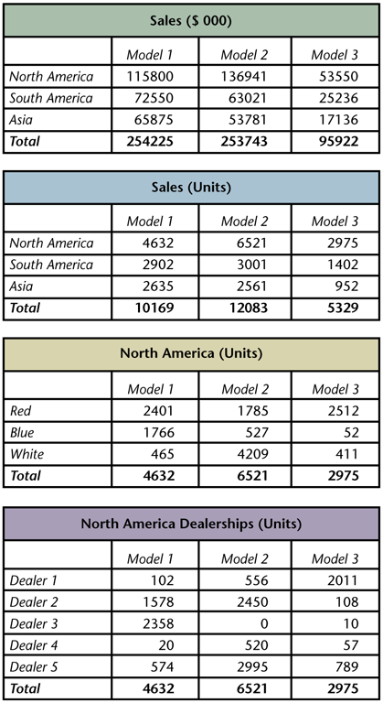

Online Analytical Processing (cont'd.)
Using OLAP tables to compare the sales
of three product
models by continent

Slide 25

Online Analytical Processing (cont'd.)
Case: Ruby Tuesday restaurant chain
One location was performing below average
OLAP analysis showed that customers were waiting longer than normal
Appropriate changes were made
OLAP applications are usually installed on a special server
OLAP applications are faster than relational applications

Slide 26
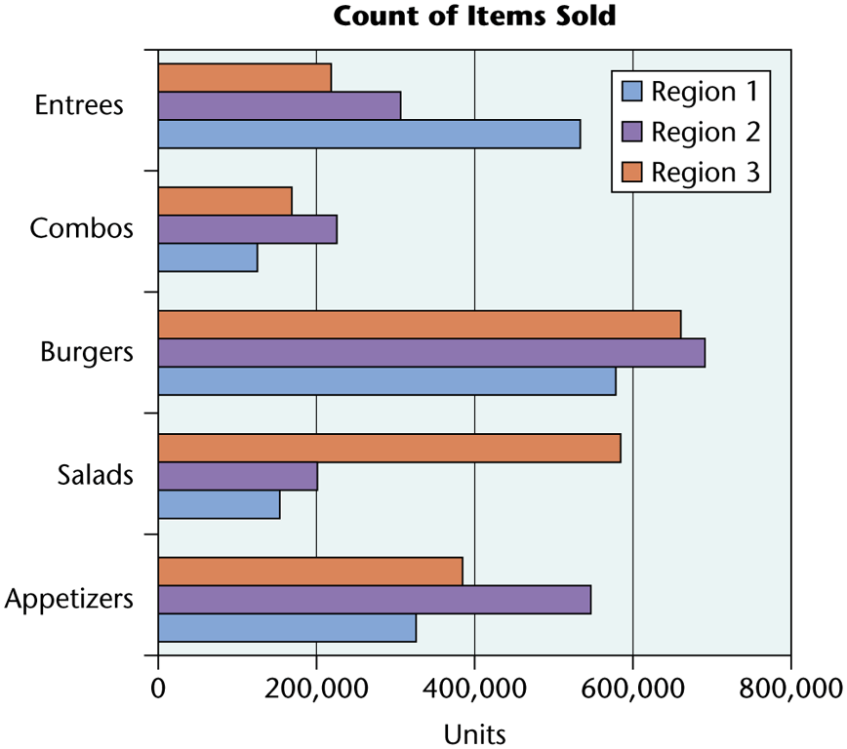

Online Analytical Processing (cont'd.)
Restaurants can use business intelligence software to improve service and increase revenue

Slide 27

Online Analytical Processing (cont'd.)
OLAP is increasingly used by corporations to gain efficiencies
Office Depot used OLAP on a data warehouse to determine cross-selling strategies
Ben & Jerry’s tracks the popularity of ice cream flavors
BI software is becoming easier to use
Intelligent interfaces accept queries in free form
BI software is integrated into Microsoft’s SQL Server database software

Slide 28

More Customer Intelligence
A major effort of business is collecting business intelligence about customers
Data-mining and OLAP software are often integrated into CRM systems
Web has become popular for transactions, making data collection easy
Targeted marketing is more effective than mass marketing
Clickstream software: tracks and stores data about every visit to a website

Slide 29

More Customer Intelligence (cont'd.)
Data from customer activity on a website may not provide a full picture
Third-party companies, e.g., DoubleClick and Engage Software, may be hired to study consumer activity
These companies compile billions of consumer clickstreams to create behavioral models
Can determine consumers’ interests
Capture where, what, when, and how often web pages are visited; ads clicked; etc.

Slide 30

More Customer Intelligence (cont'd.)
Drugstore.com: a Web-based drugstore
Wanted to reach more customers
Razorfish, Inc., to perform customer profiling
Razorfish compiles anonymous information about customers continuously, and also collected and analyzed data from Drugstore.com
Information used by Drugstore.com to develop a marketing strategy to reach new customers

Slide 31

Dashboards
Dashboard: an interface between BI tools and the user
Resembles a car dashboard
Contains visual images to quickly represent specific business metrics of interest to management
Helps management monitor revenue and sales, monitor inventory levels, and pinpoint trends and changes over time

Slide 32

Dashboards (cont’d.)
Key performance indicators (KPIs): a business’ strategic initiatives evaluated to determine the costs, savings, and benefits to be derived from their implementation
It is important to compare captured real data to benchmark or historical values

Slide 33

Examples of Business Intelligence
Business intelligence (BI) can add value to almost any business process, creating a comprehensive view and empowering teams to analyze their own data to find efficiencies and make better day-to-day decisions
Company: HelloFresh
Problem: Digital marketing reporting was time-intensive, manual, and inefficient.
Solution: The BI system saved the marketing team 20 working hours per day by automating reporting processes. It identified marketing opportunities to specific regions and also individualized digital marketing campaigns

Slide 34

Examples of Business Intelligence
Organization: Des Moines Public Schools
Problem: Manual Excel reporting meant administrators couldn’t see up-to-date data like attendance, preventing timely intervention.
Solution: BI used to improve dropout intervention rates and better understand the impact of various teaching methods on individual student outcomes.
Data visualization made it easy for staff to identify individual, at-risk students and get those students the attention they need.

Slide 35

Knowledge Management
Knowledge management focuses on knowing where to find information about the subject
Knowledge management (KM): gathering, organizing, sharing, analyzing, and disseminating knowledge to improve an organization’s performance

Slide 36

Knowledge Management (cont'd.)
Some purposes of KM
Transfer individual knowledge into databases
Filter and separate the most relevant knowledge
Organize knowledge to provide easy access to it, or to push it to employees based on needs
Storage costs continue to decrease, making it cost effective to store more information
The challenge is to develop tools that can quickly find the most relevant information for solving problems

Slide 37

Capturing and Sorting Organizational Knowledge
Knowledge workers: research, prepare, and provide information
There is much overlap in the work they do
Money can be saved by collecting and organizing knowledge gained by workers
Avoid having workers solve the same problem that has already been solved by others
To support KM, organizations should require:
– Workers to create reports of findings
Reports about sessions with clients

Slide 38

Capturing and Sorting Organizational Knowledge (cont'd.)
The biggest challenge for employees is how to find answers to specific questions
Some software tools can help
Bank of Montreal implemented application software providing information to its corporate credit card managers and sales force
Replaced multiple reports with only a few dashboards
Provides purchase volume and number of transactions over a series of months by region/city

Slide 39

Employee Knowledge Networks
In addition to building knowledge bases, some tools direct employees to other employees who have the required expertise
Such experts can provide non-recorded expertise
No need to waste money hiring experts in every department
Learning from past mistakes can save money
Employee knowledge network: a tool that facilitates knowledge sharing through intranets

Slide 40
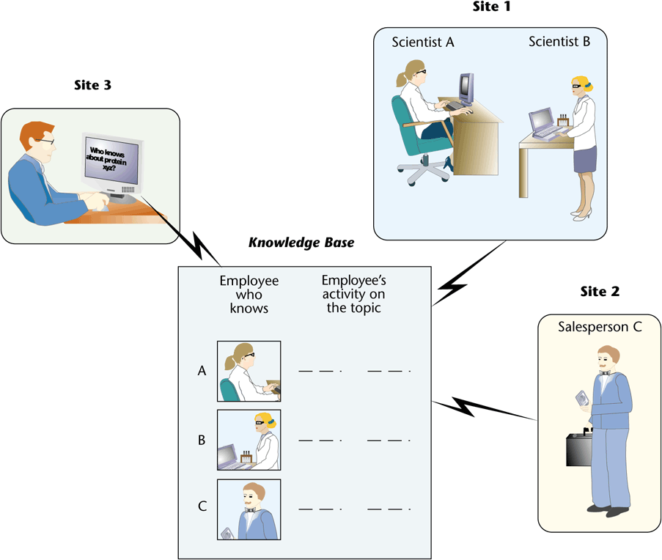

Employee Knowledge Networks
An employee knowledge network can capture information and distribute information not captured in an information system

Slide 41

Employee Knowledge Networks (cont'd.)
Tacit Systems’ ActiveNet tool:
Continually processes business communications (e- mail, documents, etc.) to build a profile of each employee’s topics, expertise, and interests
Profiles are accessible by other employees, but the private information used to create the profiles is not accessible to others
Helps ensure uninhibited brainstorming and communication

Slide 42

Employee Knowledge Networks (cont'd.)
AskMe’s software detects and captures keywords from e-mail and documents created by employees
Creates a knowledge base with names of employees and their interests
Allows free-form search queries on Web
A search returns the names of employees who have created documents, e-mail, or presentations on the subject

Slide 43

Knowledge from the Web
Consumers post opinions of products on web at various locations, such as:
On the vendor’s site
At product evaluation sites such as epinions.com
In blogs
Distilling consumer opinions
Could aid a company’s market research, e.g., learning about their own products and those of their competitors

Slide 44

Knowledge from the Web (cont'd.)
Some companies have developed software to search for this information
Factiva: a software tool that gathers online information from over 10,000 sources
Collects information from newspapers, journals, market data, and newswires
Screens all new information for information specified by a subscribing organization
Helps an organization know what others say about their products and services

Slide 45

Autocategorization
Autocategorization (or automatic taxonomy): automates classification of data into categories for future retrieval
Used by companies to manage data
Used by most search engines
Constantly improved to yield more precise and faster results

Slide 46

Auto-categorization (cont'd.)
U.S. Robotics (USR) wanted to reduce its customer support labor
A survey showed that most clients visited their website before calling support personnel
USR purchased autocategorization software
Accuracy and response was improved, allowing a higher number of support issues to be resolved by the web visit

Slide 47

Key Takeaways
Business intelligence (BI) is any information about organization, its customers, or its suppliers that can help firms make decisions
Data mining is the process of selecting, exploring, and modeling large amounts of data to discover previously unknown relationships
Data mining is useful for predicting customer behavior and detecting fraud
Knowledge management is identifying and classifying useful information from unstructured sources

