Slide 1
Lecture 2
ITEC618
Java Elementary Programming
Programming Concepts

Slide 2
Motivations
In the preceding chapter, you learned how to create, compile, and run a Java program.
Starting from this chapter, you will learn how to solve practical problems programmatically. Through these problems, you will learn Java primitive data types and related subjects, such as variables, constants, data types, operators, expressions, and input and output.

Slide 3
Introducing Programming with an Example
Listing 2.1 Computing the Area of a Circle
This program computes the area of the circle.
ComputeArea
Note: Clicking the green button displays the source code with interactive animation. You can also run the code in a browser. Internet connection is needed for this button.

Slide 4
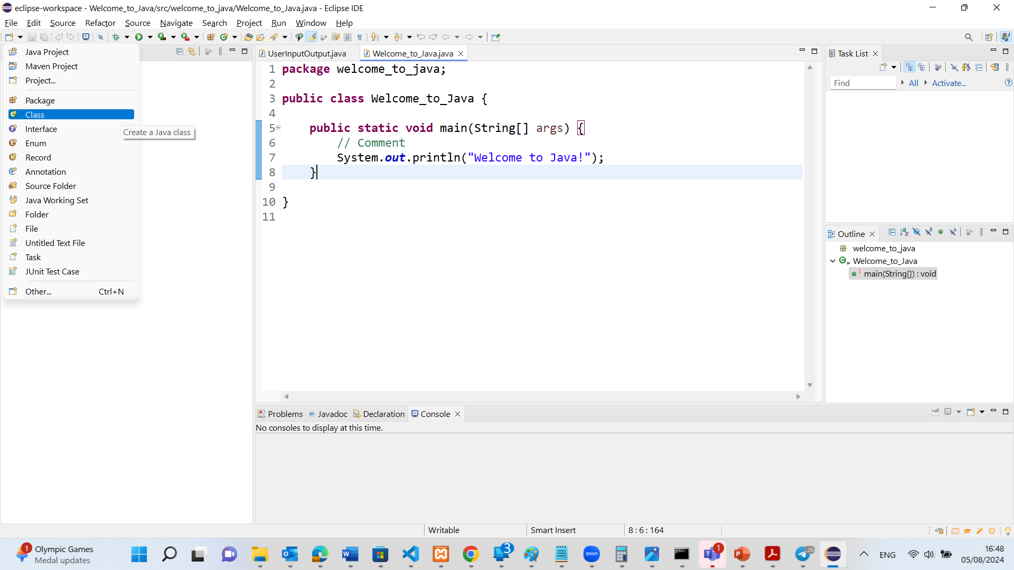
Or online java compiler: https://www.programiz.com/javascript/online-compiler/

Slide 5
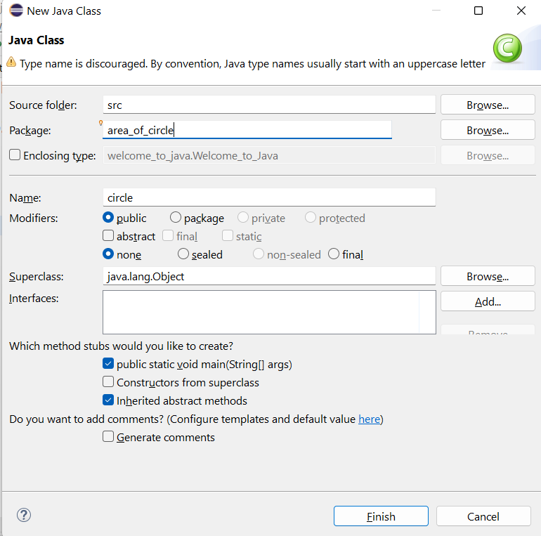

Slide 6
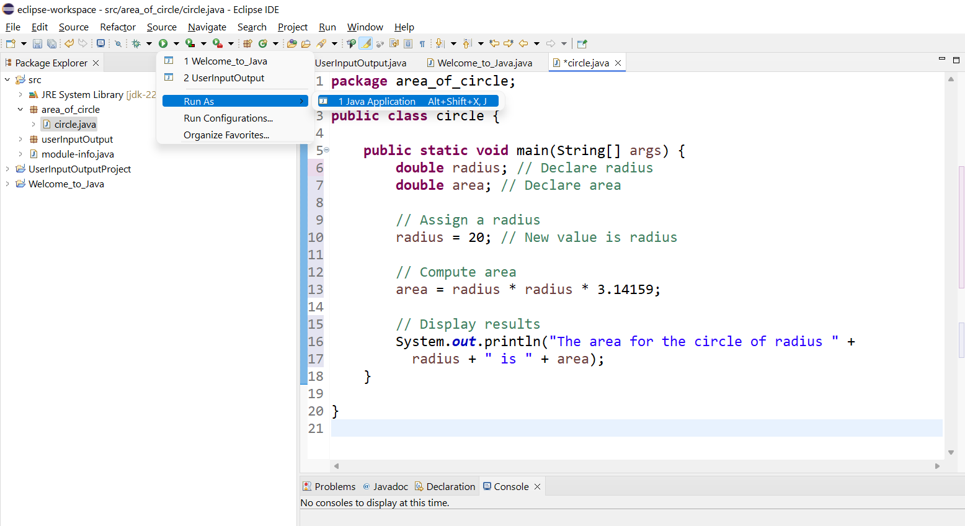

Slide 7
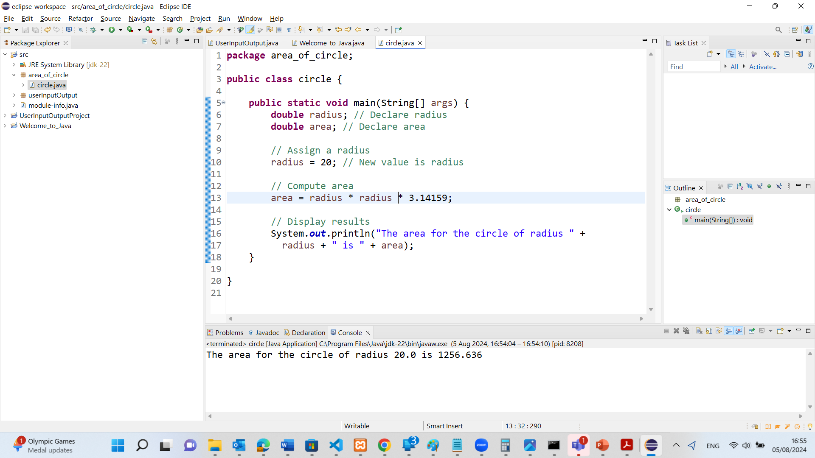
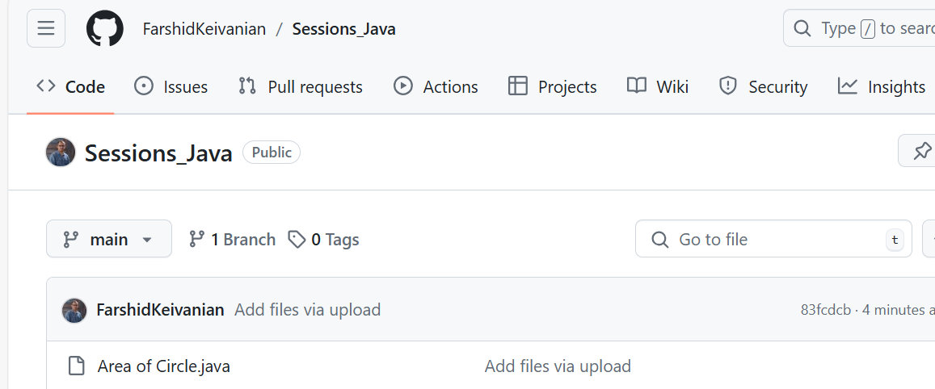
C:\Users\gaming 15\eclipse-workspace\UserInputOutputProject\src\area_of_circle

Slide 8
package area_of_circle;
This line declares that the class circle is part of the area_of_circle package.
A package in Java is used to group related classes. It's a namespace that organizes classes and interfaces.
public class circle {
This line declares a public class named circle.
The keyword public means that this class can be accessed by other classes.
class is used to define a new class.
circle is the name of the class. Note that in Java, class names conventionally start with an uppercase letter (Circle would be more conventional).

Slide 9
public static void main(String[] args) {
This line declares the main method, which is the entry point for any Java application.
public means that this method is accessible from any other class.
static means that this method belongs to the class circle and not to instances of the class.
void means that this method does not return any value.
main is the name of the method.
String[] args is a parameter that takes an array of String objects. It allows the program to accept command-line arguments.
double radius; // Declare radius
This line declares a variable named radius of type double.
double is a data type that can store floating-point numbers.
The comment // Declare radius indicates that this line is used to declare the radius variable.

Slide 10
public static void main(String[] args) {
This line declares the main method, which is the entry point for any Java application.
public means that this method is accessible from any other class.
static means that this method belongs to the class circle and not to instances of the class.
void means that this method does not return any value.
main is the name of the method.
String[] args is a parameter that takes an array of String objects. It allows the program to accept command-line arguments.
double radius; // Declare radius
This line declares a variable named radius of type double.
double is a data type that can store floating-point numbers.
The comment // Declare radius indicates that this line is used to declare the radius variable.

Slide 11
double area; // Declare area
This line declares another variable named area of type double.
The comment // Declare area indicates that this line is used to declare the area variable.
// Assign a radius
This is a comment explaining that the next line of code will assign a value to the radius variable.
radius = 20; // New value is radius
This line assigns the value 20 to the radius variable.
radius now holds the value 20.
The comment // New value is radius indicates that the radius variable has been assigned a new value.

Slide 12
System.out.println("The area for the circle of radius " + radius + " is " + area);
This line prints the result to the console.
System.out.println is a method that prints a line of text to the standard output (the console).
The text to be printed is "The area for the circle of radius " + radius + " is " + area.
+ is the string concatenation operator in Java. It combines the string literals and the values of radius and area into a single string.
This results in a message like: The area for the circle of radius 20.0 is 1256.636.

Slide 13
}
This line closes the main method.
} indicates the end of a block of code in Java.
}
This line closes the circle class.
} indicates the end of a block of code in Java.

Slide 14
Trace a Program Execution
allocate memory for radius
public class ComputeArea {
/** Main method */
public static void main(String[] args) {
double radius;
double area;
// Assign a radius
radius = 20;
// Compute area
area = radius * radius * 3.14159;
// Display results
System.out.println("The area for the circle of radius " +
radius + " is " + area);
}
}
radius
no value

Slide 15
Trace a Program Execution
public class ComputeArea {
/** Main method */
public static void main(String[] args) {
double radius;
double area;
// Assign a radius
radius = 20;
// Compute area
area = radius * radius * 3.14159;
// Display results
System.out.println("The area for the circle of radius " +
radius + " is " + area);
}
}
memory
radius
no value
area
no value
allocate memory for area

Slide 16
Trace a Program Execution
public class ComputeArea {
/** Main method */
public static void main(String[] args) {
double radius;
double area;
// Assign a radius
radius = 20;
// Compute area
area = radius * radius * 3.14159;
// Display results
System.out.println("The area for the circle of radius " +
radius + " is " + area);
}
}
assign 20 to radius
radius
20
area
no value

Slide 17
Trace a Program Execution
public class ComputeArea {
/** Main method */
public static void main(String[] args) {
double radius;
double area;
// Assign a radius
radius = 20;
// Compute area
area = radius * radius * 3.14159;
// Display results
System.out.println("The area for the circle of radius " +
radius + " is " + area);
}
}
memory
radius
20
area
1256.636
compute area and assign it to variable area

Slide 18

Trace a Program Execution
public class ComputeArea {
/** Main method */
public static void main(String[] args) {
double radius;
double area;
// Assign a radius
radius = 20;
// Compute area
area = radius * radius * 3.14159;
// Display results
System.out.println("The area for the circle of radius " +
radius + " is " + area);
}
}
memory
radius
20
area
1256.636
print a message to the console

Slide 19
Reading Input from the Console
1. Create a Scanner object
Scanner input = new Scanner(System.in);
2. Use the method nextDouble() to obtain to a double value. For example,
System.out.print("Enter a double value: ");
Scanner input = new Scanner(System.in);
double d = input.nextDouble();
ComputeAreaWithConsoleInput
ComputeAverage

Slide 20
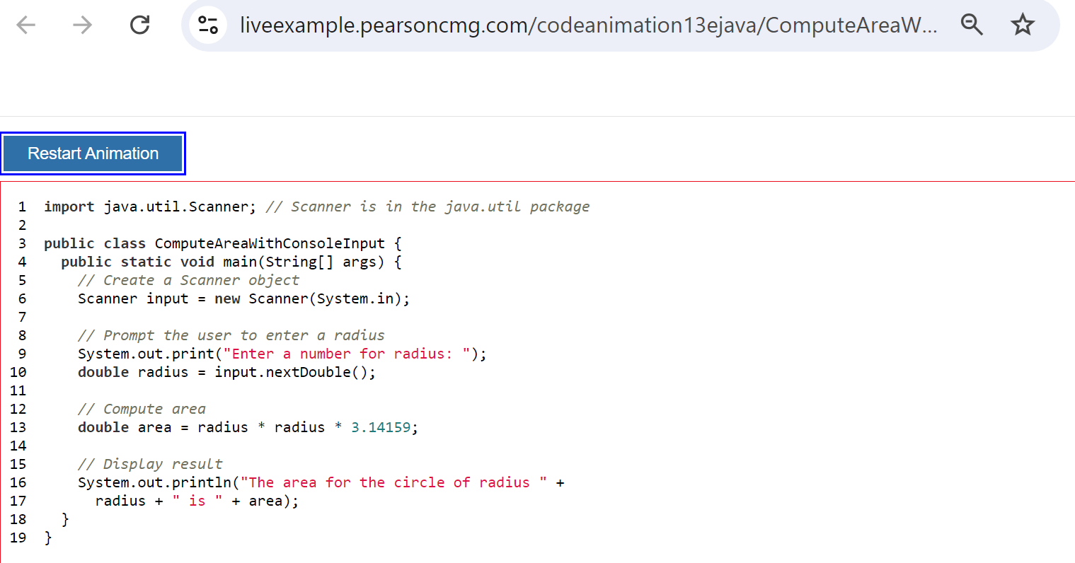
The first line imports the Scanner class from the java.util package. The Scanner class is used to get user input from the console.

Slide 21
The third line declares a public class named ComputeAreaWithConsoleInput. By convention, class names start with an uppercase letter.

Slide 22
The fourth line declares the main method, which is the entry point of any Java application. The main method is where the program starts executing. public means the method is accessible from outside the class, static means it belongs to the class rather than an instance of the class, and void means it does not return any value. String[] args is an array of String arguments that can be passed to the program from the command line.

Slide 23
Line 6 creates a Scanner object named input that is used to read input from the standard input stream (usually the keyboard). System.in is the standard input stream.

Slide 24
The lines 9 and 10 prompt the user to enter a number for the radius of a circle. System.out.print displays the message to the console without a newline. input.nextDouble() reads a double value from the user input and stores it in the variable radius.

Slide 25
The line 13 calculates the area of the circle using the formula π * radius^2. It multiplies the radius by itself and then by 3.14159, which is an approximation of π (pi). The result is stored in the variable area.

Slide 26
The line 16 prints the calculated area to the console. System.out.println prints the message followed by a newline. The message includes the radius and the calculated area.

Slide 27
Implicit Import and Explicit Import
java.util.* ; // Implicit import
java.util.Scanner; // Explicit Import
An implicit import uses a wildcard (*) to import all classes from a package, while an explicit import specifies a particular class to import. Both methods have no performance difference.
No performance difference

Slide 28
Practical Example
Suppose you are working on a Java project at Atlassian in Sydney, a renowned software company in Australia. You need to import classes from the java.util package.
Java Code Example
Implicit Import:
Implicit Import (import java.util.*;): This statement imports all classes from the java.util package, making all utility classes like Scanner, ArrayList, HashMap, etc., available to use in your code.
package com.atlassian.project;
import java.util.*; // Implicit import
public class Example {
public static void main(String[] args) {
Scanner input = new Scanner(System.in);
System.out.print("Enter your name: ");
String name = input.nextLine();
System.out.println("Hello, " + name);
input.close();
}
}

Slide 29
Explicit Import (import java.util.Scanner;): This statement imports only the Scanner class from the java.util package, making just this specific class available in your code.
Explicit Import:
package com.atlassian.project;
import java.util.Scanner; // Explicit import
public class Example {
public static void main(String[] args) {
Scanner input = new Scanner(System.in);
System.out.print("Enter your name: ");
String name = input.nextLine();
System.out.println("Hello, " + name);
input.close();
}
}

Slide 30
Identifiers
An identifier is a sequence of characters that consist of letters, digits, underscores (_), and dollar signs ($).
An identifier must start with a letter, an underscore (_), or a dollar sign ($). It cannot start with a digit.
An identifier cannot be a reserved word. (See Appendix A, “Java Keywords,” for a list of reserved words).
An identifier cannot be true, false, or null.
An identifier can be of any length.

Slide 31
Variables
// Compute the first area
radius = 1.0;
area = radius * radius * 3.14159;
System.out.println("The area is “ + area + " for radius "+radius);
// Compute the second area
radius = 2.0;
area = radius * radius * 3.14159;
System.out.println("The area is “ + area + " for radius "+radius);

Slide 32
Declaring Variables
int x; // Declare x to be an
// integer variable;
double radius; // Declare radius to
// be a double variable;
char a; // Declare a to be a
// character variable;

Slide 33
Assignment Statements
x = 1; // Assign 1 to x;
radius = 1.0; // Assign 1.0 to radius;
a = 'A'; // Assign 'A' to a;

Slide 34
Declaring and Initializing in One Step
int x = 1;
double d = 1.4;

Slide 35
Named Constants
final datatype CONSTANTNAME = VALUE;
final double PI = 3.14159;
final int SIZE = 3;

Slide 36
Naming Conventions
Choose meaningful and descriptive names.
Variables and method names:
Use lowercase. If the name consists of several words, concatenate all in one, use lowercase for the first word, and capitalize the first letter of each subsequent word in the name. For example, the variables radius and area, and the method computeArea.

Slide 37
Naming Conventions, cont.
Class names:
Capitalize the first letter of each word in the name. For example, the class name ComputeArea.
Constants:
Capitalize all letters in constants and use underscores to connect words. For example, the constant PI and MAX_VALUE

Slide 38
Numerical Data Types

Slide 39
Reading Numbers from the Keyboard
Scanner input = new Scanner(System.in);
int value = input.nextInt();
Use Scanner class in Java to read different types of numeric input from the keyboard. The table lists various methods provided by the Scanner class, each designed to read a specific type of numeric data.
Practical Example
Suppose you are working at Atlassian in Sydney, a leading software company in Australia. You need to develop a Java application that reads user input for various numeric types to configure application settings.

Slide 40
Reading Numbers from the Keyboard
package com.atlassian.config;
import java.util.Scanner;
public class UserInput {
public static void main(String[] args) {
Scanner input = new Scanner(System.in);
// Read byte input
System.out.print("Enter a byte value: ");
byte byteValue = input.nextByte();
System.out.println("You entered byte: " + byteValue);
// Read short input
System.out.print("Enter a short value: ");
short shortValue = input.nextShort();
System.out.println("You entered short: " + shortValue);
// Read int input
System.out.print("Enter an int value: ");
int intValue = input.nextInt();
System.out.println("You entered int: " + intValue);
// Read long input
System.out.print("Enter a long value: ");
long longValue = input.nextLong();
System.out.println("You entered long: " + longValue);
// Read float input
System.out.print("Enter a float value: ");
float floatValue = input.nextFloat();
System.out.println("You entered float: " + floatValue);
// Read double input
System.out.print("Enter a double value: ");
double doubleValue = input.nextDouble();
System.out.println("You entered double: " + doubleValue);
// Close the scanner
input.close();
}
}
Scanner input = new Scanner(System.in);
Creates a Scanner object to read input from the standard input stream (keyboard).
byte byteValue = input.nextByte();
Reads a byte value from the keyboard.
short shortValue = input.nextShort();
Reads a short value from the keyboard.
int intValue = input.nextInt();
Reads an int value from the keyboard.
long longValue = input.nextLong();
Reads a long value from the keyboard.
float floatValue = input.nextFloat();
Reads a float value from the keyboard.
double doubleValue = input.nextDouble();
Reads a double value from the keyboard.
Scanner input = new Scanner(System.in);
int value = input.nextInt();

Slide 41
Numeric Operators

Slide 42
Integer Division
+, -, *, /, and %
5 / 2 yields an integer 2.
5.0 / 2 yields a double value 2.5
5 % 2 yields 1 (the remainder of the division)

Slide 43
Remainder Operator
Remainder is very useful in programming. For example, an even number % 2 is always 0 and an odd number % 2 is always 1. So you can use this property to determine whether a number is even or odd. Suppose today is Saturday and you and your friends are going to meet in 10 days. What day is in 10 days? You can find that day is Tuesday using the following expression:

Slide 44
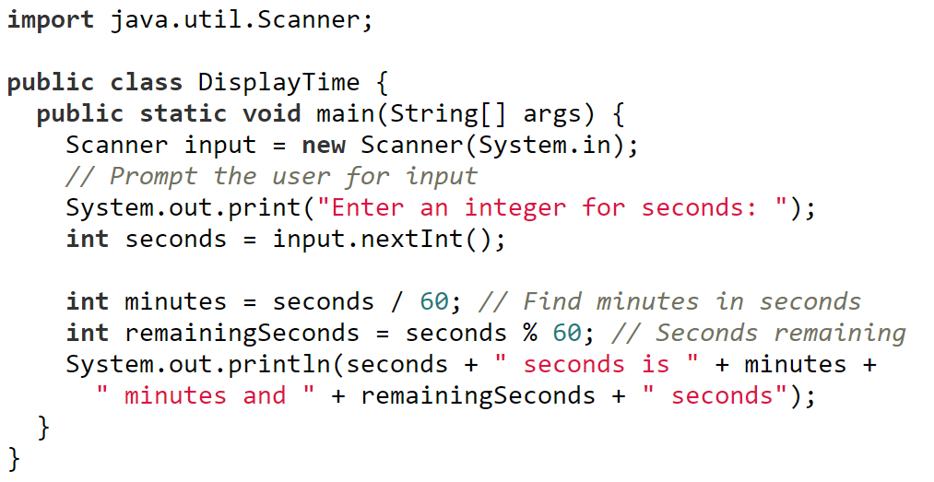
Problem: Displaying Time
Write a program that obtains minutes and remaining seconds from seconds.
DisplayTime
The first line imports the Scanner class from the java.util package. The Scanner class is used to read input from various sources, including user input from the keyboard.

Slide 45
Problem: Displaying Time
Write a program that obtains minutes and remaining seconds from seconds.
DisplayTime
The second line declares a public class named DisplayTime. The class contains the main method, which is the entry point of the program.

Slide 46
Problem: Displaying Time
Write a program that obtains minutes and remaining seconds from seconds.
DisplayTime
The third line declares the main method, which is the entry point for any Java application.

Slide 47
Problem: Displaying Time
Write a program that obtains minutes and remaining seconds from seconds.
DisplayTime
The fourth line creates a Scanner object named input that reads input from the standard input stream (keyboard).

Slide 48
Problem: Displaying Time
Write a program that obtains minutes and remaining seconds from seconds.
The fifth line prints a prompt message to the console, asking the user to enter an integer value for seconds.
System.out.print prints the message without a newline at the end, so the cursor stays on the same line after printing.
DisplayTime

Slide 49
Problem: Displaying Time
Write a program that obtains minutes and remaining seconds from seconds.
The sixth line reads the next integer input from the user and stores it in the seconds variable.
input.nextInt() waits for the user to input an integer and then returns that value.
DisplayTime

Slide 50
Problem: Displaying Time
Write a program that obtains minutes and remaining seconds from seconds.
The seventh line calculates the number of minutes in the given seconds by dividing the seconds by 60.
The result is stored in the minutes variable.
DisplayTime

Slide 51
Problem: Displaying Time
Write a program that obtains minutes and remaining seconds from seconds.
The next line calculates the remaining seconds after dividing by 60 using the modulus operator (%).
The result is stored in the remainingSeconds variable.
DisplayTime

Slide 52
Problem: Displaying Time
Write a program that obtains minutes and remaining seconds from seconds.
Next line prints the result to the console.
It combines the original seconds value with the calculated minutes and remainingSeconds values to form a complete sentence.
System.out.println prints the message with a newline at the end, moving the cursor to the next line after printing.
DisplayTime

Slide 53
Problem: Displaying Time
Write a program that obtains minutes and remaining seconds from seconds.
These lines close the main method and the DisplayTime class, respectively.
DisplayTime

Slide 54
Example Run
If the user enters 125 as the number of seconds, the program will output:
Enter an integer for seconds: 125
125 seconds is 2 minutes and 5 seconds
This program converts a given number of seconds into minutes and remaining seconds, demonstrating basic input handling and arithmetic operations in Java.

Slide 55
NOTE
Calculations involving floating-point numbers are approximated because these numbers are not stored with complete accuracy. For example,
System.out.println(1.0 - 0.1 - 0.1 - 0.1 - 0.1 - 0.1);
displays 0.5000000000000001, not 0.5, and
System.out.println(1.0 - 0.9);
displays 0.09999999999999998, not 0.1. Integers are stored precisely. Therefore, calculations with integers yield a precise integer result.

Slide 56
Exponent Operations
System.out.println(Math.pow(2, 3));
// Displays 8.0
System.out.println(Math.pow(4, 0.5));
// Displays 2.0
System.out.println(Math.pow(2.5, 2));
// Displays 6.25
System.out.println(Math.pow(2.5, -2));
// Displays 0.16

Slide 57
Number Literals
A literal is a constant value that appears directly in the program. For example, 34, 1,000,000, and 5.0 are literals in the following statements:
int i = 34;
long x = 1000000;
double d = 5.0;
A literal is a constant value that is explicitly specified in the source code of a program. In the given example, the numbers 34, 1,000,000, and 5.0 are literals.

Slide 58
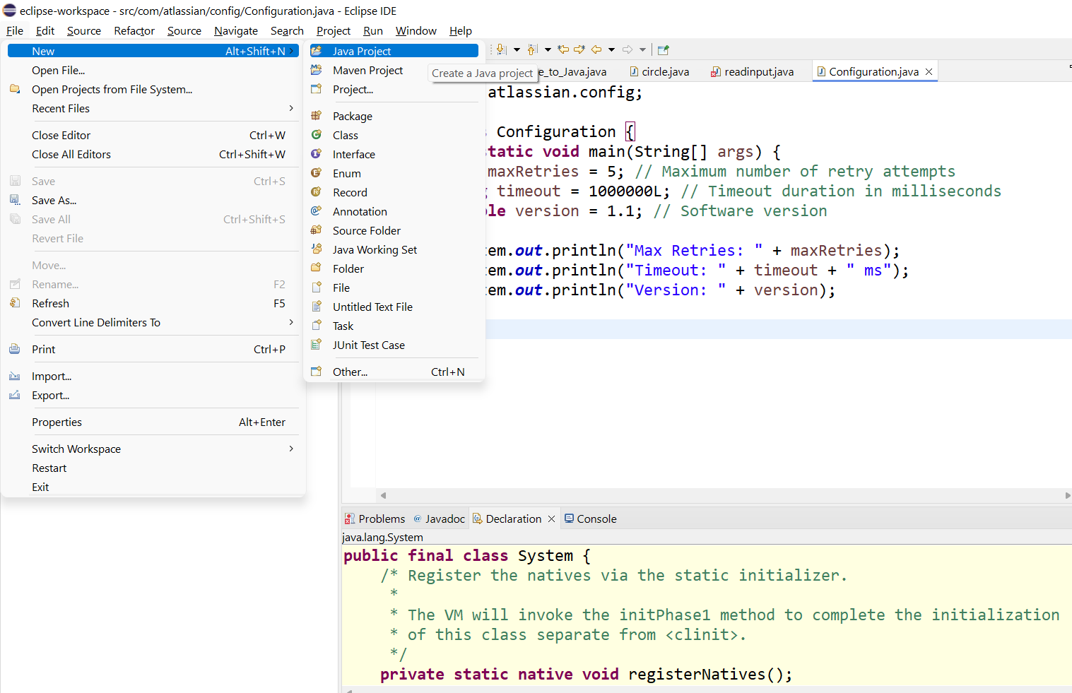

Slide 59
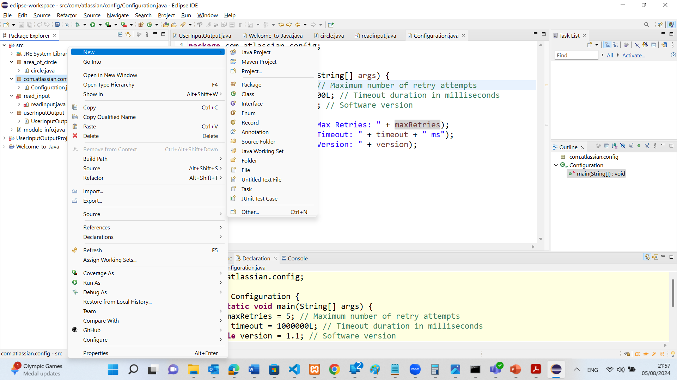

Slide 60
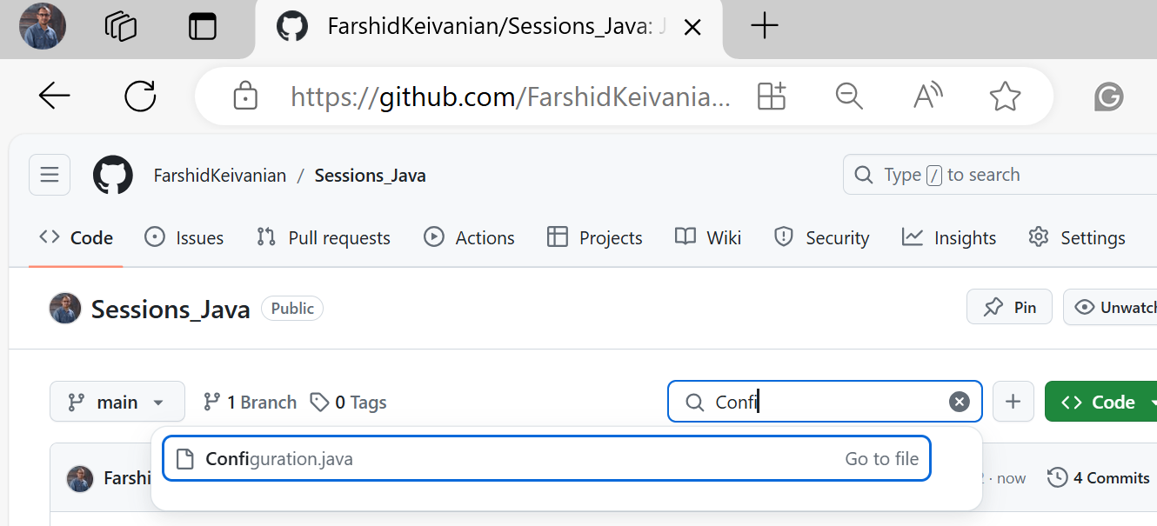
package com.atlassian.config;
public class Configuration {
public static void main(String[] args) {
int maxRetries = 5; // Maximum number of retry attempts
long timeout = 1000000L; // Timeout duration in milliseconds
double version = 1.1; // Software version
System.out.println("Max Retries: " + maxRetries);
System.out.println("Timeout: " + timeout + " ms");
System.out.println("Version: " + version);
}
}
C:\Users\gaming 15\eclipse-workspace\UserInputOutputProject\src\com\atlassian\config

Slide 61
package com.atlassian.config;
public class Configuration {
public static void main(String[] args) {
int maxRetries = 5; // Maximum number of retry attempts
long timeout = 1000000L; // Timeout duration in milliseconds
double version = 1.1; // Software version
System.out.println("Max Retries: " + maxRetries);
System.out.println("Timeout: " + timeout + " ms");
System.out.println("Version: " + version);
}
}
int maxRetries = 5;
This line assigns the integer literal 5 to the variable maxRetries. It represents the maximum number of retry attempts.
long timeout = 1000000L;
This line assigns the long literal 1000000L to the variable timeout. It represents the timeout duration in milliseconds.
double version = 1.1;
This line assigns the double literal 1.1 to the variable version. It represents the software version.

Slide 62
double vs. float
The double type values are more accurate than the float type values. For example,
System.out.println("1.0 / 3.0 is " + 1.0 / 3.0);
Double type
System.out.println("1.0F / 3.0F is " + 1.0F / 3.0F);
Float type

Slide 63
Scientific Notation
Floating-point literals can also be specified in scientific notation, for example, 1.23456e+2, same as 1.23456e2, is equivalent to 123.456, and 1.23456e-2 is equivalent to 0.0123456. E (or e) represents an exponent and it can be either in lowercase or uppercase.

Slide 64
Arithmetic Expressions
is translated to
(3+4*x)/5 – 10*(y-5)*(a+b+c)/x + 9*(4/x + (9+x)/y)

Slide 65
How to Evaluate an Expression
Though Java has its own way to evaluate an expression behind the scene, the result of a Java expression and its corresponding arithmetic expression are the same. Therefore, you can safely apply the arithmetic rule for evaluating a Java expression.

Slide 66
Problem: Displaying Current Time
Write a program that displays current time in GMT in the format hour:minute:second such as 1:45:19.
The currentTimeMillis method in the System class returns the current time in milliseconds since the midnight, January 1, 1970 GMT. (1970 was the year when the Unix operating system was formally introduced.) You can use this method to obtain the current time, and then compute the current second, minute, and hour as follows.
ShowCurrentTime

Slide 67
public class ShowCurrentTime {
public static void main(String[] args) {
// Obtain the total milliseconds since midnight, Jan 1, 1970
long totalMilliseconds = System.currentTimeMillis();
// Obtain the total seconds since midnight, Jan 1, 1970
long totalSeconds = totalMilliseconds / 1000;
// Compute the current second in the minute in the hour
long currentSecond = totalSeconds % 60;
// Obtain the total minutes
long totalMinutes = totalSeconds / 60;
// Compute the current minute in the hour
long currentMinute = totalMinutes % 60;
// Obtain the total hours
long totalHours = totalMinutes / 60;
// Compute the current hour
long currentHour = totalHours % 24;
// Display results
System.out.println("Current time is " + currentHour + ":"
+ currentMinute + ":" + currentSecond + " GMT");
}
}
The line long currentSecond = totalSeconds % 60; computes the current second within the current minute.
totalSeconds: This variable holds the total number of seconds that have elapsed since the Unix epoch (midnight, January 1, 1970).
% 60 (modulus operator): This operation returns the remainder of the division of totalSeconds by 60.

Slide 68
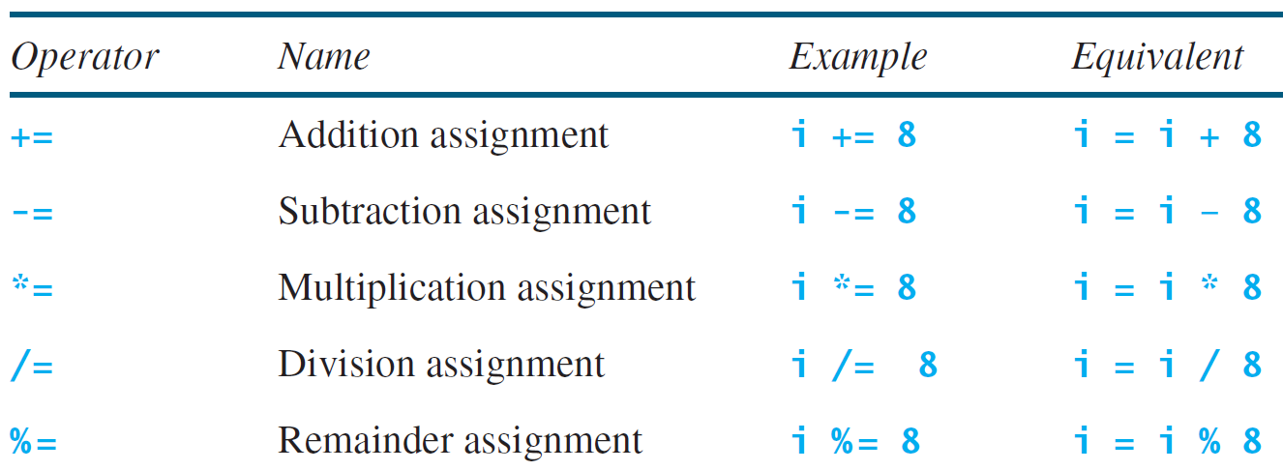
Augmented Assignment Operators

Slide 69
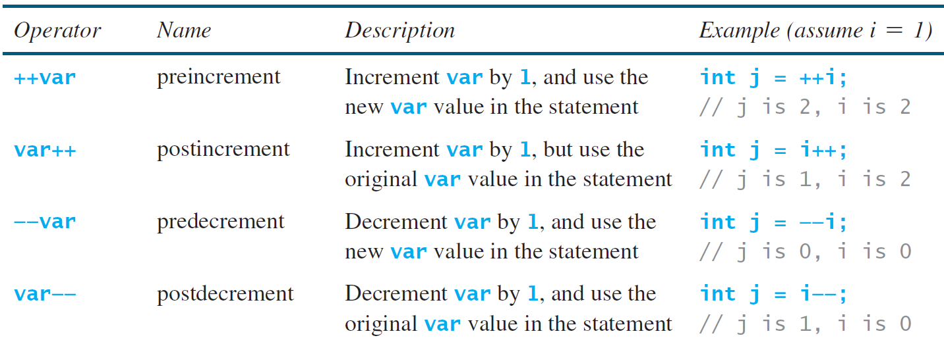
Increment and Decrement Operators
Post-Increment (i++): The post-increment operator increases the value of i by 1, but it returns the original value of i before the increment.

Slide 70
Increment and Decrement Operators, cont.
Pre-Increment (++i): The pre-increment operator increases the value of i by 1 before it is used in the expression.

Slide 71
Assignment Expressions and Assignment Statements
Prior to Java 2, all the expressions can be used as statements. Since Java 2, only the following types of expressions can be statements:
variable op= expression; // Where op is +, -, *, /, or %
++variable;
variable++;
--variable;
variable--;
Prior to Java 2: Any expression could be used as a statement.
Since Java 2: Only specific types of expressions can be used as statements.

Slide 72
Numeric Type Conversion
Consider the following statements:
byte i = 100;
long k = i * 3 + 4;
double d = i * 3.1 + k / 2;
byte i = 100;
A variable i of type byte is initialized with the value 100.

Slide 73
Numeric Type Conversion
Consider the following statements:
byte i = 100;
long k = i * 3 + 4;
double d = i * 3.1 + k / 2;
long k = i * 3 + 4;
Here, i (byte) is multiplied by 3, and then 4 is added to the result.
The result of i * 3 (which is 300) is automatically promoted to int.
The addition of 4 to this int result is still of type int.
Finally, the int result is assigned to the long variable k, involving an implicit type conversion from int to long.

Slide 74
Numeric Type Conversion
Consider the following statements:
byte i = 100;
long k = i * 3 + 4;
double d = i * 3.1 + k / 2;
double d = i * 3.1 + k / 2;
i (byte) is multiplied by 3.1 (double).
The result of i * 3.1 is of type double.
k (long) is divided by 2 (int), resulting in a long division and thus a long result.
The long result of k / 2 is then implicitly converted to double when added to the result of i * 3.1.
The final result, which is double, is assigned to the double variable d.

Slide 75
Conversion Rules
When performing a binary operation involving two operands of different types, Java automatically converts the operand based on the following rules:
1. If one of the operands is double, the other is converted into double.
2. Otherwise, if one of the operands is float, the other is converted into float.
3. Otherwise, if one of the operands is long, the other is converted into long.
4. Otherwise, both operands are converted into int.
If one of the operands is double, the other operand is converted into double.
Example: If you have a double and an int, the int is converted to double before the operation.

Slide 76
Conversion Rules
When performing a binary operation involving two operands of different types, Java automatically converts the operand based on the following rules:
1. If one of the operands is double, the other is converted into double.
2. Otherwise, if one of the operands is float, the other is converted into float.
3. Otherwise, if one of the operands is long, the other is converted into long.
4. Otherwise, both operands are converted into int.
Otherwise, if one of the operands is float, the other operand is converted into float.
Example: If you have a float and an int, the int is converted to float before the operation (assuming neither operand is double).

Slide 77
Conversion Rules
When performing a binary operation involving two operands of different types, Java automatically converts the operand based on the following rules:
1. If one of the operands is double, the other is converted into double.
2. Otherwise, if one of the operands is float, the other is converted into float.
3. Otherwise, if one of the operands is long, the other is converted into long.
4. Otherwise, both operands are converted into int.
Otherwise, if one of the operands is long, the other operand is converted into long.
Example: If you have a long and an int, the int is converted to long before the operation (assuming neither operand is double nor float).

Slide 78
Conversion Rules
When performing a binary operation involving two operands of different types, Java automatically converts the operand based on the following rules:
1. If one of the operands is double, the other is converted into double.
2. Otherwise, if one of the operands is float, the other is converted into float.
3. Otherwise, if one of the operands is long, the other is converted into long.
4. Otherwise, both operands are converted into int.
These rules ensure that the operands are of the same type before performing the operation, following a hierarchy of type promotion: double > float > long > int

Slide 79
Type Casting
Here, an int value 3 is assigned to a double variable d.
Type Widening: Java automatically converts the int to double because double has a larger range and can accommodate the int value without any data loss.
Implicit casting
double d = 3; (type widening)
Explicit casting
int i = (int)3.0; (type narrowing)
int i = (int)3.9; (Fraction part is truncated)
What is wrong? int x = 5 / 2.0;

Slide 80
Type Casting
Example 1: int i = (int)3.0;
Here, a double value 3.0 is explicitly cast to an int.
Type Narrowing: This conversion is done explicitly by the programmer using (int) before the value. This is necessary because converting a double to an int can result in data loss (the fractional part is truncated).
Implicit casting
double d = 3; (type widening)
Explicit casting
int i = (int)3.0; (type narrowing)
int i = (int)3.9; (Fraction part is truncated)
What is wrong? int x = 5 / 2.0;

Slide 81
Type Casting
Example 2: int i = (int)3.9;
Here, a double value 3.9 is explicitly cast to an int.
The fractional part 0.9 is truncated, resulting in i being 3
Implicit casting
double d = 3; (type widening)
Explicit casting
int i = (int)3.0; (type narrowing)
int i = (int)3.9; (Fraction part is truncated)
What is wrong? int x = 5 / 2.0;

Slide 82
Type Casting
Implicit Casting (Type Widening): Automatic conversion by Java when assigning a smaller type to a larger type (e.g., int to double).
Explicit Casting (Type Narrowing): Manual conversion by the programmer when assigning a larger type to a smaller type (e.g., double to int), which can potentially lose data.
Implicit casting
double d = 3; (type widening)
Explicit casting
int i = (int)3.0; (type narrowing)
int i = (int)3.9; (Fraction part is truncated)
What is wrong? int x = 5 / 2.0;

Slide 83
Type Casting
Question: int x = 5 / 2.0;
This line will cause a compilation error because 5 / 2.0 results in a double value, and you're trying to assign it to an int variable x. To fix it:
Implicit casting
double d = 3; (type widening)
Explicit casting
int i = (int)3.0; (type narrowing)
int i = (int)3.9; (Fraction part is truncated)
What is wrong? int x = 5 / 2.0;
int x = (int)(5 / 2.0);

Slide 84
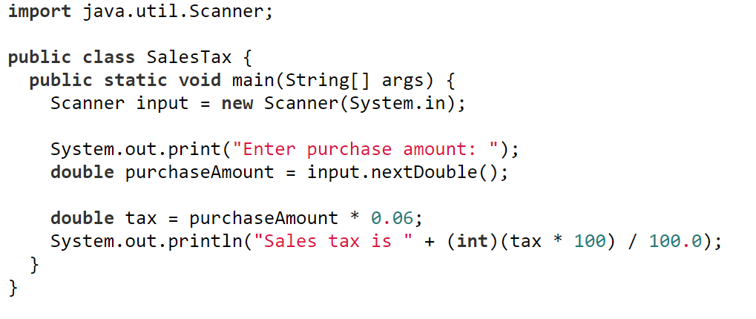
Problem: Keeping Two Digits After Decimal Points
Write a program that displays the sales tax with two digits after the decimal point.
SalesTax
1. Importing Scanner:
The program imports the Scanner class to read input from the user.
2. Main Method:
The main method is the entry point of the program.

Slide 85
Problem: Keeping Two Digits After Decimal Points
Write a program that displays the sales tax with two digits after the decimal point.
SalesTax
3. Creating Scanner Object:
Scanner input = new Scanner(System.in);
Creates a Scanner object to read input from the console.
4. Prompting User Input:
System.out.print("Enter purchase amount: ");
Prompts the user to enter the purchase amount.

Slide 86
Problem: Keeping Two Digits After Decimal Points
Write a program that displays the sales tax with two digits after the decimal point.
SalesTax
5. Reading User Input:
double purchaseAmount = input.nextDouble();
Reads the purchase amount entered by the user as a double.
6. Calculating Sales Tax:
double tax = purchaseAmount * 0.06;
Calculates the sales tax as 6% of the purchase amount.

Slide 87
Problem: Keeping Two Digits After Decimal Points
Write a program that displays the sales tax with two digits after the decimal point.
SalesTax
Printing Sales Tax:
System.out.println("Sales tax is " + (int)(tax * 100) / 100.0);
Converts the sales tax to an integer to truncate the decimal part, then divides by 100.0 to format it back to a double with two decimal places. However, this does not ensure exactly two decimal places.

Slide 88
Casting in an Augmented Expression
In Java, an augmented expression of the form x1 op= x2 is implemented as x1 = (T)(x1 op x2), where T is the type for x1. Therefore, the following code is correct.
int sum = 0;
sum += 4.5; // sum becomes 4 after this statement
sum += 4.5 is equivalent to sum = (int)(sum + 4.5).
A variable sum of type int is declared and initialized to 0.
The augmented assignment operator += adds 4.5 to sum and assigns the result back to sum.
Since sum is of type int, the result of the expression must also be of type int.
int sum = 0;
sum += 4.5; // sum becomes 4 after this statement

Slide 89
Common Errors and Pitfalls
Common Error 1: Undeclared/Uninitialized Variables and Unused Variables
Common Error 2: Integer Overflow
Common Error 3: Round-off Errors
Common Error 4: Unintended Integer Division
Common Error 5: Redundant Input Objects
Common Pitfall 1: Redundant Input Objects

Slide 90
Common Error 1: Undeclared/Uninitialized Variables and Unused Variables
double interestRate = 0.05;
double interest = interestrate * 45;
Issues with this code:
1. Variable Case Sensitivity:
Java is a case-sensitive language, meaning interestRate and interestrate are considered two different variables.
Corrected One:
double interestRate = 0.05;
double interest = interestRate * 45;

Slide 91
Common Error 1: Undeclared/Uninitialized Variables and Unused Variables
double interestRate = 0.05;
double interest = interestrate * 45;
Undeclared/Uninitialized Variable:
In the line double interest = interesrate * 45;, interestrate is not recognized as it is undeclared. The correct variable name should be interestRate.
Corrected One:
double interestRate = 0.05;
double interest = interestRate * 45;

Slide 92
Common Error 2: Integer Overflow
int value = 2147483647 + 1;
// value will actually be -2147483648
Maximum Value for int: The maximum value that can be stored in a 32-bit signed integer (int) in Java is 2147483647.
Overflow Occurrence: When you add 1 to this maximum value (2147483647 + 1), the result exceeds the storage capacity of the int type.
Wrap-Around Effect: Due to overflow, the value wraps around to the minimum value that can be represented by a 32-bit signed integer, which is -2147483648.

Slide 93
Common Error 2: Integer Overflow
int value = 2147483647 + 1;
// value will actually be -2147483648
Corrected code:
long value = 2147483647L + 1L;
// value will be 2147483648

Slide 94
Common Error 2: Integer Overflow
int value = 2147483647 + 1;
// value will actually be -2147483648
if (value > Integer.MAX_VALUE - 1) {
// handle overflow
}
Check for Overflow: Before performing operations, check if the result will exceed the int range.

Slide 95
Common Error 3: Round-off Errors
System.out.println(1.0 - 0.1 - 0.1 - 0.1 - 0.1 - 0.1);
System.out.println(1.0 - 0.9);
Floating-point numbers in programming languages, including Java, are approximations rather than exact values. This can lead to round-off errors, especially when performing arithmetic operations repeatedly or with numbers that cannot be precisely represented in binary form.

Slide 96
Common Error 3: Round-off Errors
System.out.println(1.0 - 0.1 - 0.1 - 0.1 - 0.1 - 0.1);
System.out.println(1.0 - 0.9);
For the first line: You might expect this to output 0.5, since: 1.0−0.1−0.1−0.1−0.1−0.1=0.51.0 - 0.1 - 0.1 - 0.1 - 0.1 - 0.1 = 0.51.0−0.1−0.1−0.1−0.1−0.1=0.5
However, due to round-off errors in the binary representation of 0.1, the result is not exactly 0.5. Instead, it might be something like 0.49999999999999994.

Slide 97
Common Error 3: Round-off Errors
System.out.println(1.0 - 0.1 - 0.1 - 0.1 - 0.1 - 0.1);
System.out.println(1.0 - 0.9);
For the second line:
You might expect this to output 0.1.
However, the result might be something like 0.09999999999999998 due to the inability of binary floating-point representation to exactly represent 0.1.

Slide 98
Common Error 4: Unintended Integer Division
Unintended Integer Division
When performing division operations in Java, it's important to be aware of the types of the operands. If both operands are integers, Java performs integer division, which truncates the decimal part. This can lead to unintended results when the actual intended result should be a floating-point number.

Slide 99
Common Error 4: Unintended Integer Division
To find the issue with example (a):
number1 and number2 are both integers.
number1 + number2 results in 3, which is an integer.
3 / 2 performs integer division, resulting in 1.
The result 1 is then assigned to average, which is a double, resulting in 1.0 being printed.
Issue: The intended average of 1.5 is not achieved due to integer division.

Slide 100
Common Error 4: Unintended Integer Division
To find the issue with example (b):
number1 and number2 are both integers.
number1 + number2 results in 3, which is an integer.
3 / 2.0 involves dividing an integer by a double, promoting the integer to a double before performing the division.
The result of 3 / 2.0 is 1.5, which is correctly assigned to average.
1.5 is then printed as the correct average.

Slide 101
Common Pitfall 1: Redundant Input Objects
Scanner input = new Scanner(System.in);
System.out.print("Enter an integer: ");
int v1 = input.nextInt();
Scanner input1 = new Scanner(System.in);
System.out.print("Enter a double value: ");
double v2 = input1.nextDouble();
In Java, it is unnecessary and inefficient to create multiple Scanner objects for reading input from the same input stream (System.in). The image demonstrates this pitfall with two examples.

Slide 102
Common Pitfall 1: Redundant Input Objects
1. First Scanner Object:
Scanner input = new Scanner(System.in);
This creates a Scanner object input to read from System.in.
System.out.print("Enter an integer: "); prompts the user to enter an integer.
int v1 = input.nextInt(); reads the next integer input from the user.
2. Second Scanner Object:
Scanner input1 = new Scanner(System.in);
This creates another Scanner object input1 to read from System.in.
System.out.print("Enter a double value: "); prompts the user to enter a double value.
double v2 = input1.nextDouble(); reads the next double input from the user.
Scanner input = new Scanner(System.in);
System.out.print("Enter an integer: ");
int v1 = input.nextInt();
Scanner input1 = new Scanner(System.in);
System.out.print("Enter a double value: ");
double v2 = input1.nextDouble();

Slide 103
Common Pitfall 1: Redundant Input Objects
What is a Pitfall?
Redundancy: Creating multiple Scanner objects to read from the same input stream (System.in) is redundant and unnecessary.
Resource Inefficiency: It wastes system resources to create multiple Scanner objects for the same input source.
Potential Issues: It can lead to unexpected behavior or input issues, as multiple Scanner objects may interfere with each other when reading from the same stream.
Scanner input = new Scanner(System.in);
System.out.print("Enter an integer: ");
int v1 = input.nextInt();
Scanner input1 = new Scanner(System.in);
System.out.print("Enter a double value: ");
double v2 = input1.nextDouble();

Slide 104
The Corrected code
Scanner input = new Scanner(System.in);
System.out.print("Enter an integer: ");
int v1 = input.nextInt();
System.out.print("Enter a double value: ");
double v2 = input.nextDouble();
1. Single Scanner Object:
Scanner input = new Scanner(System.in);
Create a single Scanner object input to read from System.in.
2. Reading Multiple Inputs:
System.out.print("Enter an integer: "); prompts the user to enter an integer.
int v1 = input.nextInt(); reads the next integer input from the user.
System.out.print("Enter a double value: "); prompts the user to enter a double value.
double v2 = input.nextDouble(); reads the next double input from the user.

Slide 105
Programming concepts study tips
Attend every lecture.
Attend every lab session. Attempt lab questions and get reward (the minimum 12 hour per week per unit rule). Be aware of deadlines!
At least, review lecture notes/videos before doing lab and quiz questions. Lecture notes are very good with many demo codes (launch by clicking green buttons) for your knowledge consolidation.
Effective and efficient learning by combining both:
Theory (understanding the lecture concepts and knowledge) and
Practice (reading and comprehending lecture demo or others’ program codes and write your own code often for problem solving)
Ask early and often, discuss with classmates, and utilize textbook, unit forum, and lecture consultation hours
Extra practice in the textbook and online (expand to outside class)
Your communication and feedback is important! Contact me immediately so you can get helped quicker.
The Week 2 lab is cancelled this week. I will reschedule a make-up session for Friday from 7 PM to 9 PM on your availability either Week 4 or Week 5. After confirming the exact date with you (students) during the lecture on Tuesday 1-3 pm, I will make a public announcement with the update.

Slide 106
Next week
After class TODO list:
Review the lecture
Read book chapter
Attend lab
Attempt assessment
Program control structures: selections and loops

