Slide 1
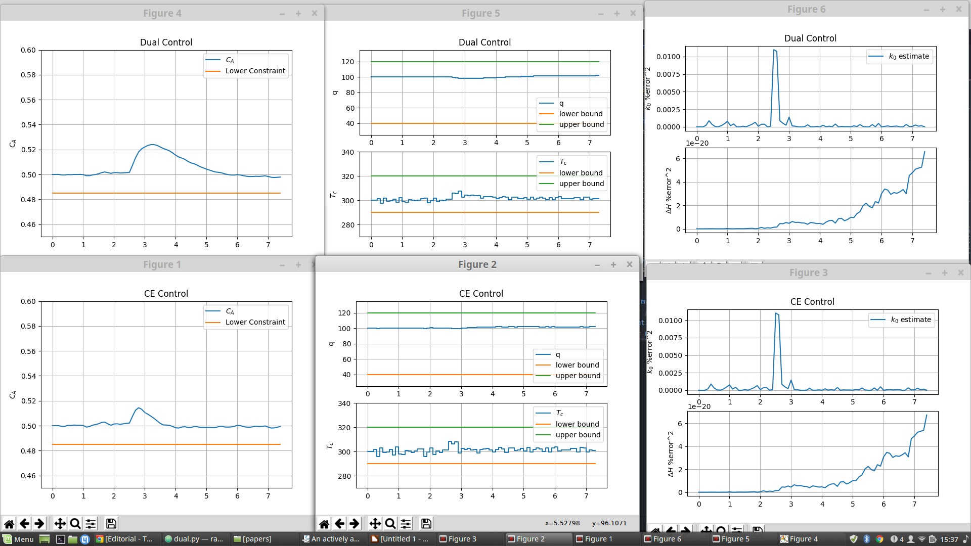
Sudden disturbance (2.5 min)
Dual : W(N) = [20,0;0,0], W(j) = [1,0;0,1]
CE : W(N) = W(j) = [2,0;0,0]

Slide 2
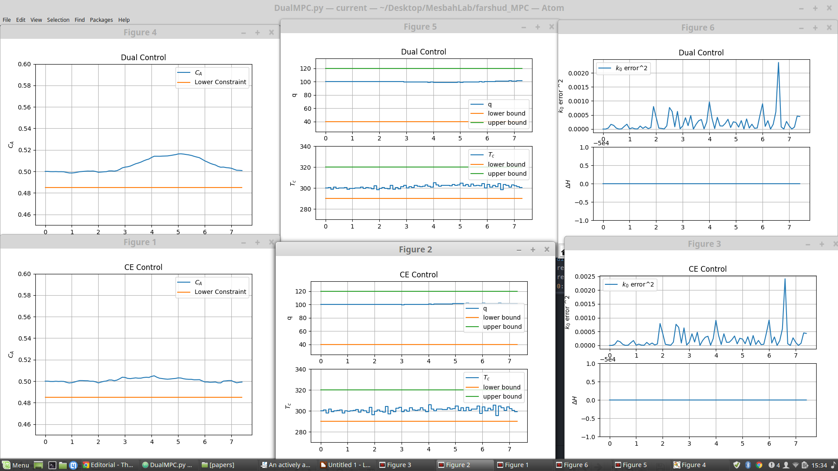
ramped disturbance (2.5-5 min)
W(N) = [20,0;0,0], W(j) = [1,0;0,1]
CE : W(N) = W(j) = [2,0;0,0]

Slide 3
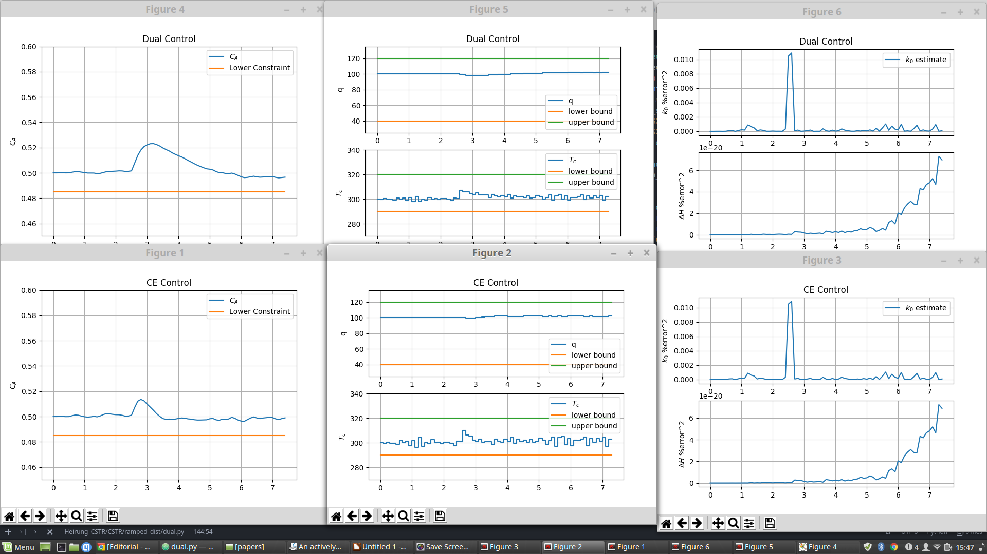
Sudden disturbance dual: W(N) = [1,0;0,1], W(j) = W(N)
CE : W(N) = W(j) = [2,0;0,0]

Slide 4
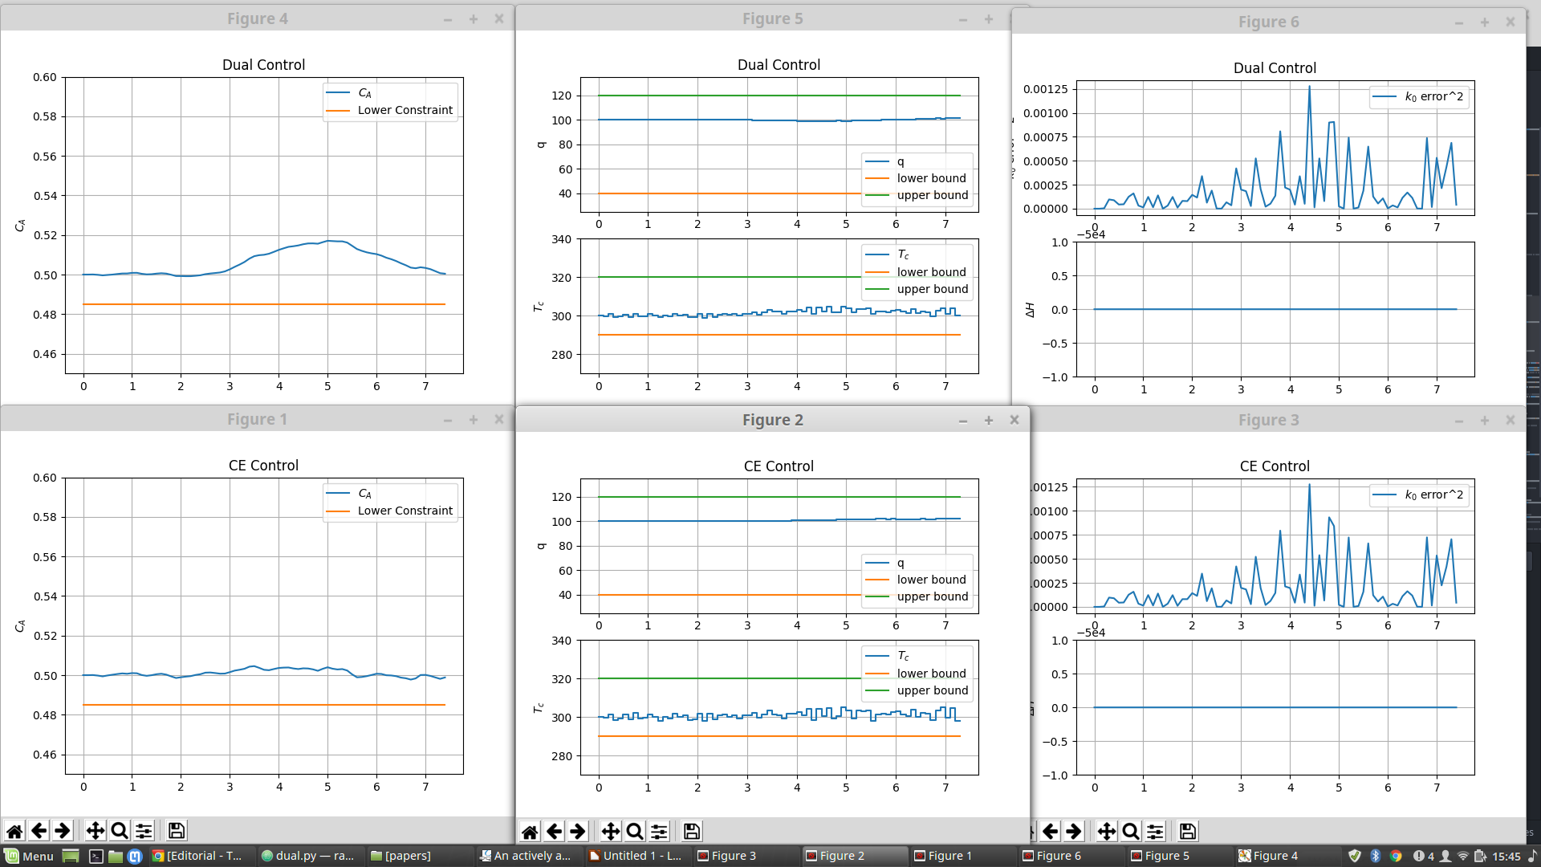
ramped disturbance dual : W(N) = [1,0;0,1], W(j) = W(N)
CE : W(N) = W(j) = [2,0;0,0]

Slide 5
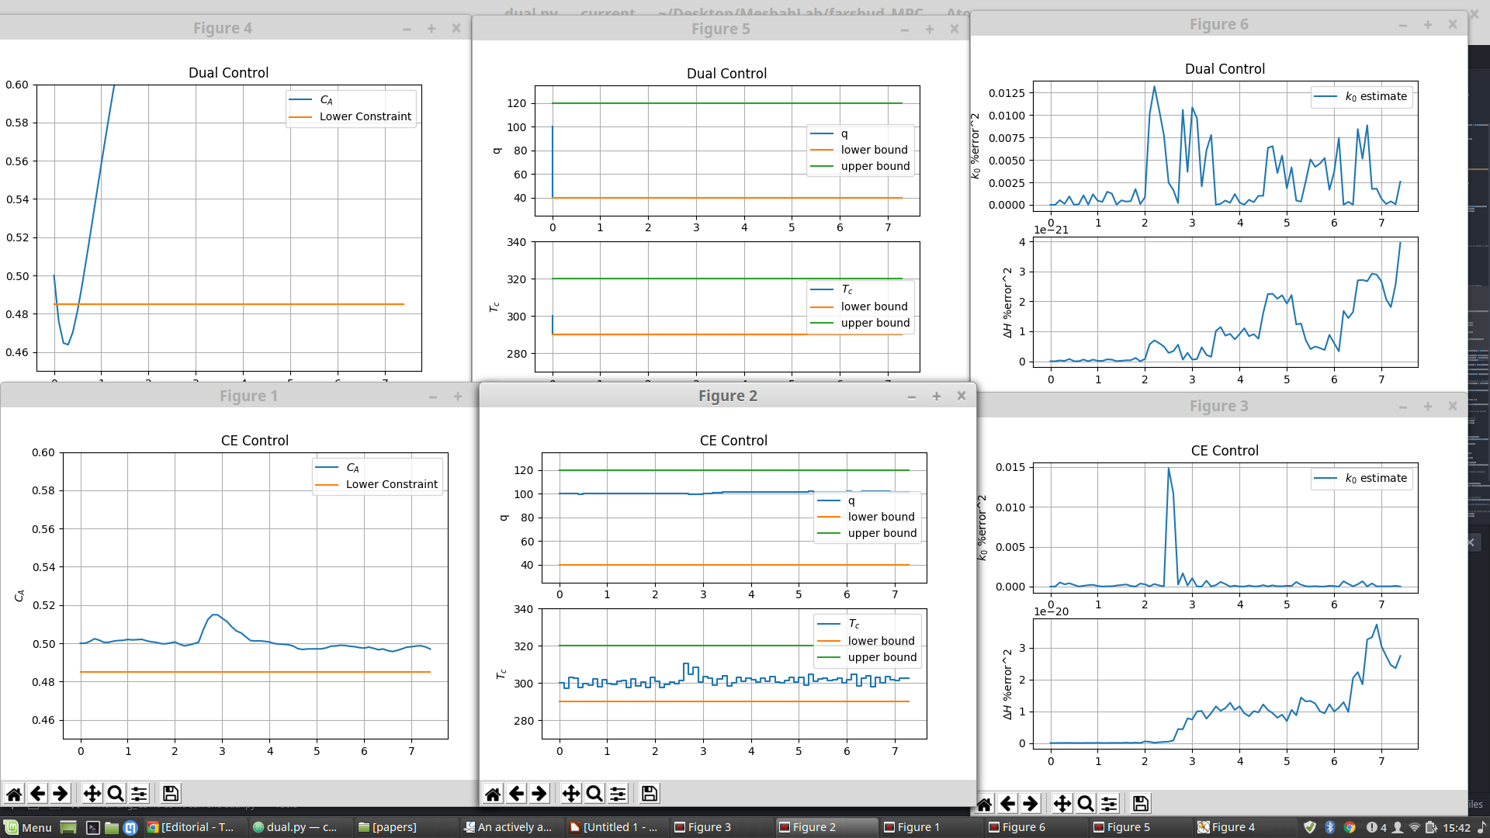
Sudden disturbance
Dual : W(N) = [20,0;0,0], W(j) = W(N)
CE : W(N) = W(j) = [2,0;0,0]

Slide 6
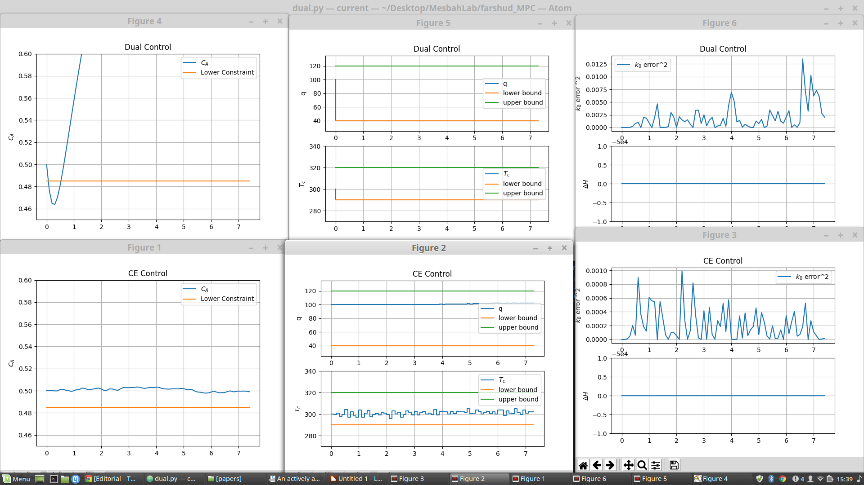
ramped disturbance dual :
W(N) = [20,0;0,0], W(j) = W(N)
CE : W(N) = W(j) = [2,0;0,0]

Slide 7
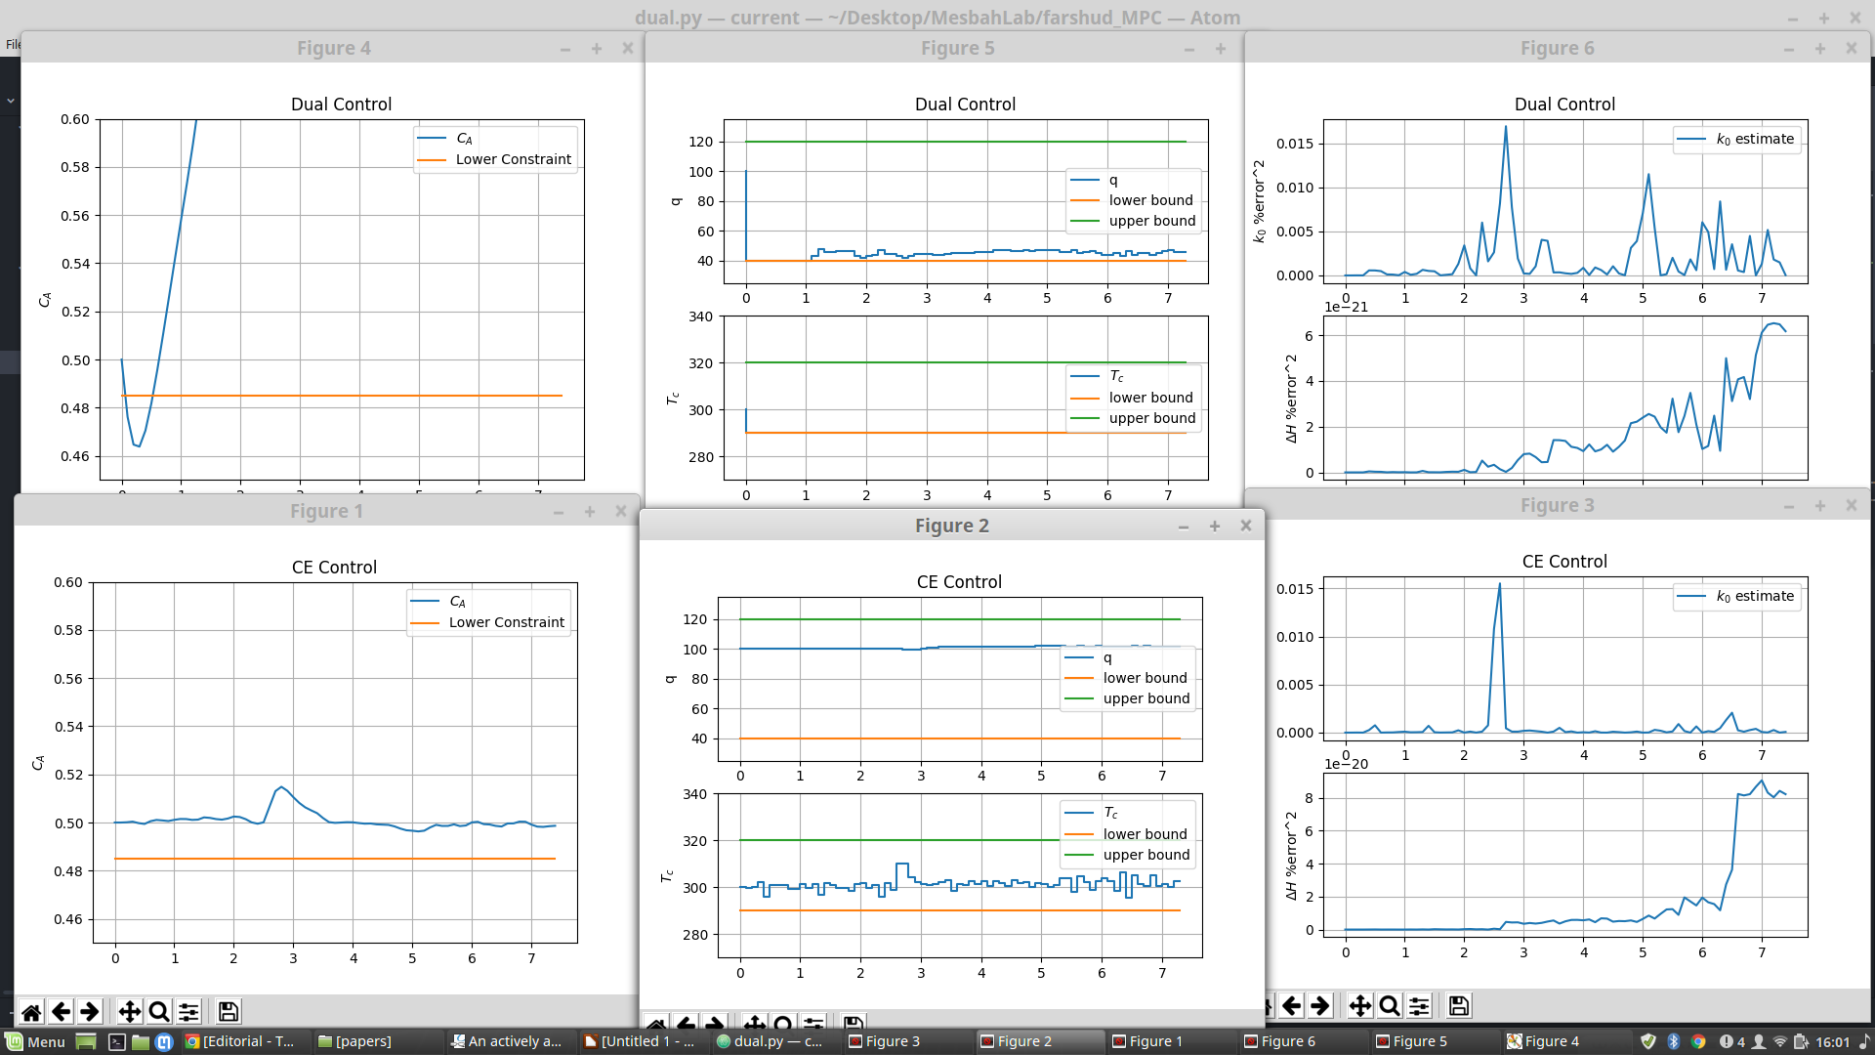
Sudden disturbance
Dual : W(N) = [20,0;0,0], W(j) = [0,0;0,0]
CE : W(N) = W(j) = [2,0;0,0]

Slide 8
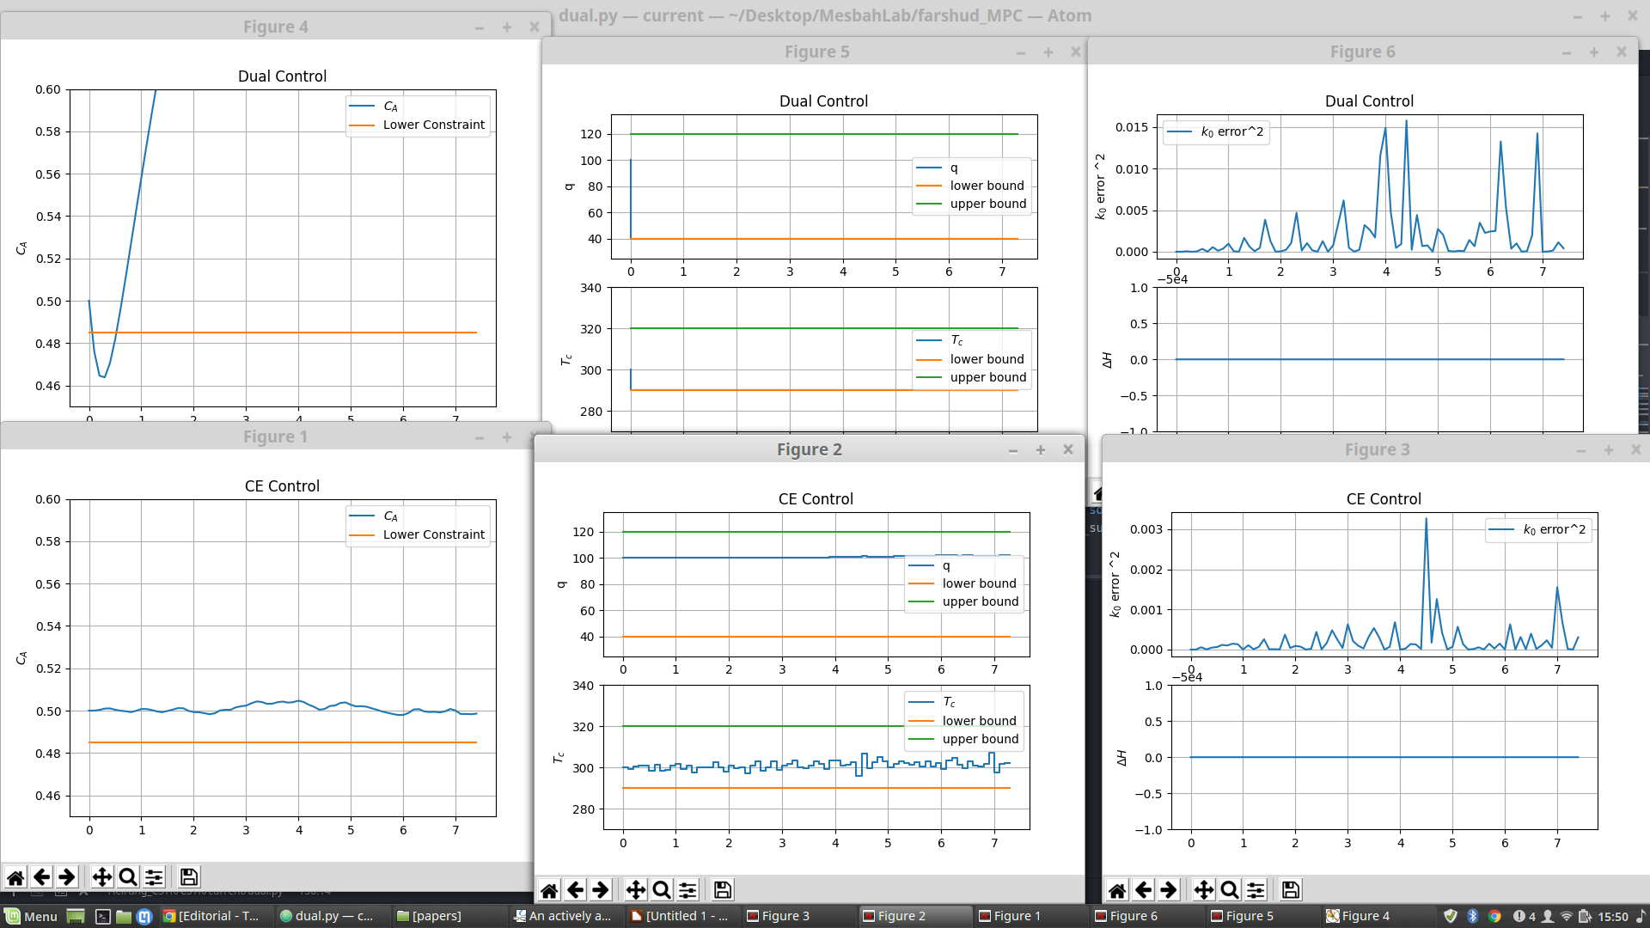
ramped disturbance
Dual : W(N) = [20,0;0,0], W(j) = [0,0;0,0]
CE : W(N) = W(j) = [2,0;0,0]

Slide 9
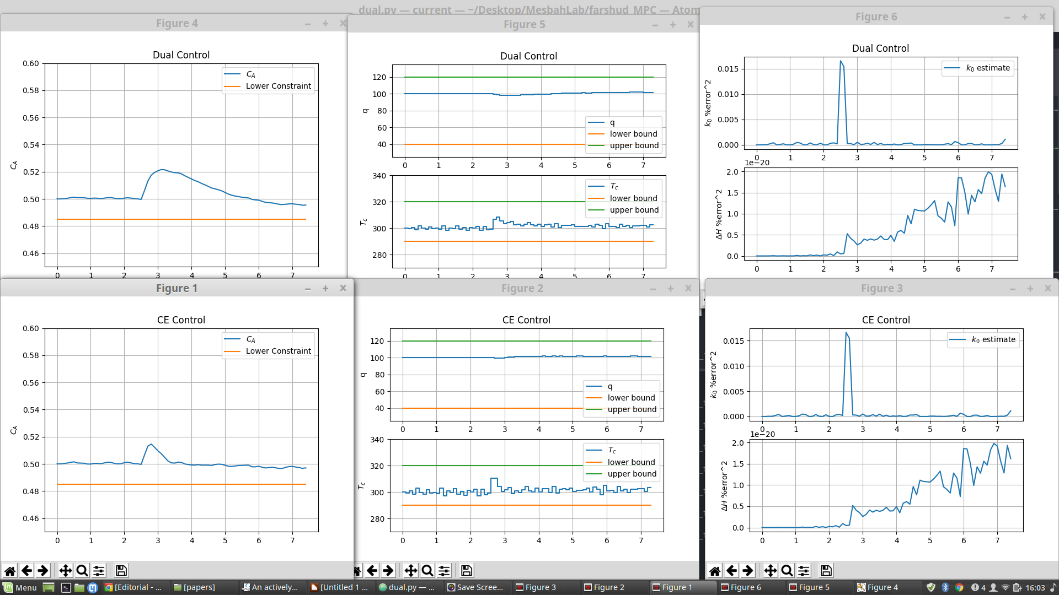
sudden disturbance
Dual : W(N) = [1,0;0,1], W(j) = [0,0;0,0]
CE : W(N) = W(j) = [2,0;0,0]

Slide 10
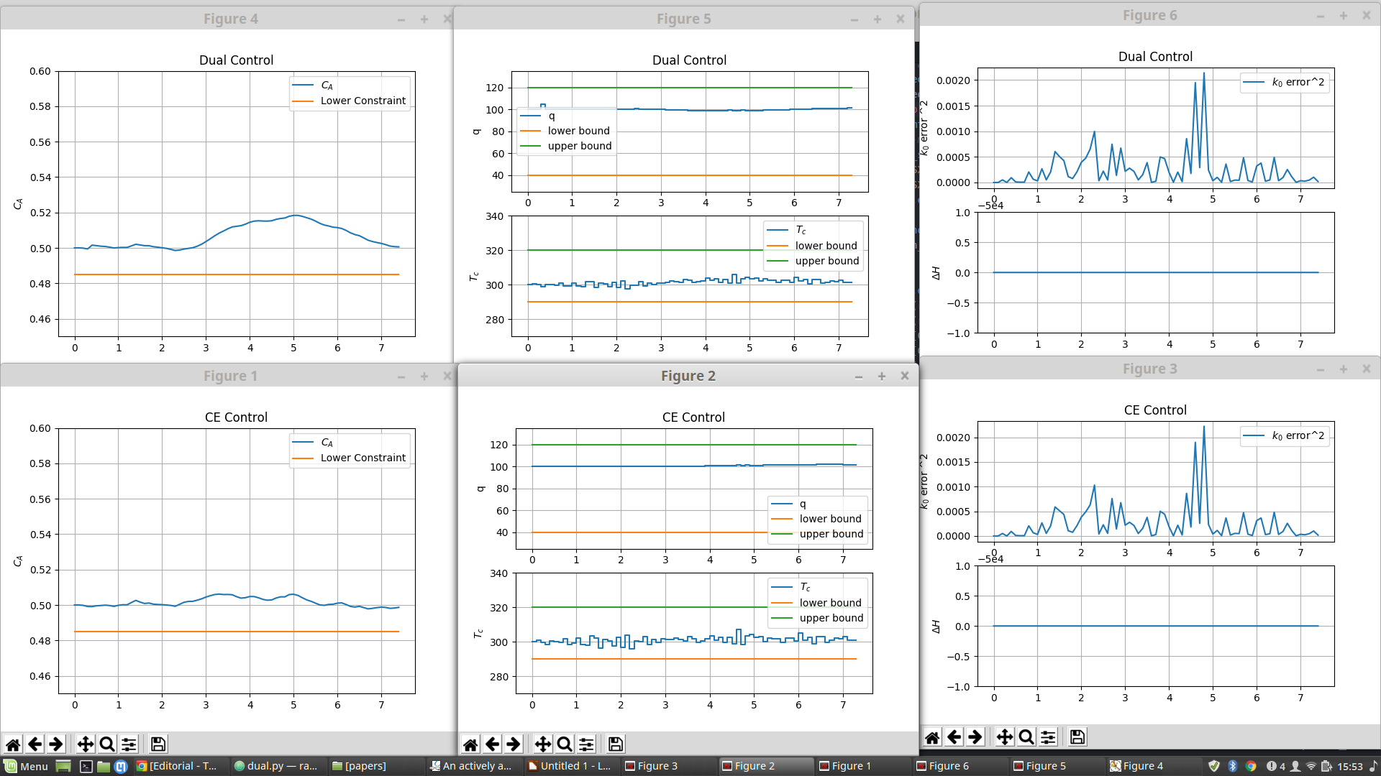
ramped disturbance dual : W(N) = [1,0;0,1], W(j) = [0,0;0,0]
CE : W(N) = W(j) = [2,0;0,0]

Slide 11
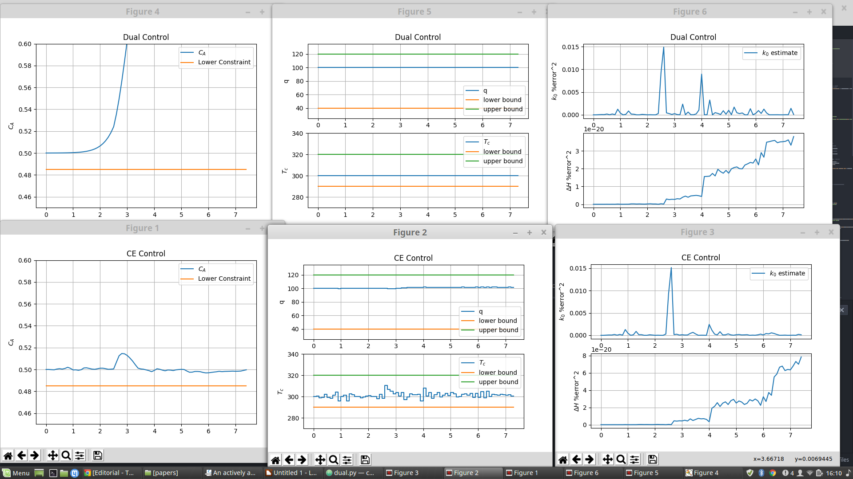
sudden disturbance
Dual : W(N) = [0,0;0,0], W(j) = [0,0;0,0]
CE : W(N) = W(j) = [2,0;0,0]

Slide 12
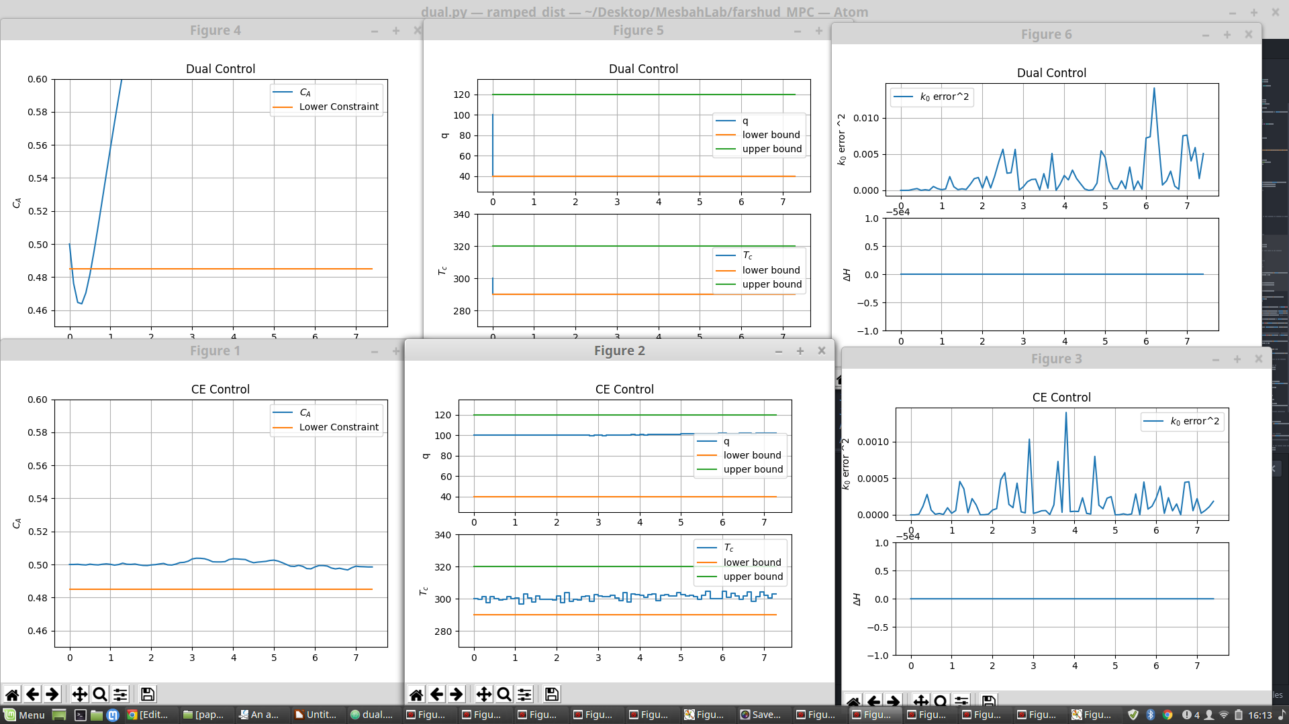
ramped disturbance
Dual : W(N) = [0,0;0,0], W(j) = [0,0;0,0]
CE : W(N) = W(j) = [2,0;0,0]

