Slide 1
CS 388:
Natural Language Processing:
Semantic Parsing
Raymond J. Mooney
University of Texas at Austin

Slide 2
Representing Meaning
Representing the meaning of natural language is ultimately a difficult philosophical question, i.e. the “meaning of meaning”.
Traditional approach is to map ambiguous NL to unambiguous logic in first-order predicate calculus (FOPC).
Standard inference (theorem proving) methods exist for FOPC that can determine when one statement entails (implies) another. Questions can be answered by determining what potential responses are entailed by given NL statements and background knowledge all encoded in FOPC.

Slide 3
Model Theoretic Semantics
Meaning of traditional logic is based on model theoretic semantics which defines meaning in terms of a model (a.k.a. possible world), a set-theoretic structure that defines a (potentially infinite) set of objects with properties and relations between them.
A model is a connecting bridge between language and the world by representing the abstract objects and relations that exist in a possible world.
An interpretation is a mapping from logic to the model that defines predicates extensionally, in terms of the set of tuples of objects that make them true (their denotation or extension).
  The extension of Red(x) is the set of all red things in the world.
  The extension of Father(x,y) is the set of all pairs of objects <A,B> such that A is B’s father.

Slide 4
Truth-Conditional Semantics
Model theoretic semantics gives the truth conditions for a sentence, i.e. a model satisfies a logical sentence iff the sentence evaluates to true in the given model.
The meaning of a sentence is therefore defined as the set of all possible worlds in which it is true.

Slide 5
What is Semantic Parsing?
Mapping a natural-language sentence to a detailed representation of its complete meaning in a fully formal language that:
  Has a rich ontology of types, properties, and relations.
  Supports automated reasoning or execution.

Slide 6

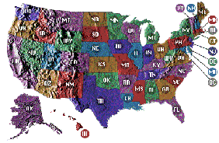
Geoquery:
A Database Query Application
Query application for a U.S. geography database containing about 800 facts [Zelle & Mooney, 1996]
What is the smallest state by area?
Rhode Island
Answer
Semantic Parsing
Query
answer(x1,smallest(x2,(state(x1),area(x1,x2))))

Slide 7
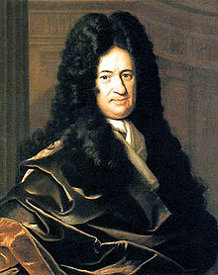
Prehistory 1600’s
Gottfried Leibniz (1685) developed a formal conceptual language, the characteristica universalis, for use by an automated reasoner, the calculus ratiocinator.
“The only way to rectify our reasonings is to make them as tangible as those of the Mathematicians, so that we can find our error at a glance, and when there are disputes among persons, we can simply say: Let us calculate, without further ado, to see who is right.”

Slide 8
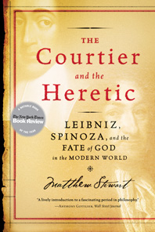
Interesting Book on Leibniz

Slide 9
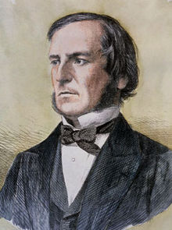
Prehistory 1850’s
George Boole (Laws of Thought, 1854) reduced propositional logic to an algebra over binary-valued variables.
His book is subtitled “on Which are Founded the Mathematical Theories of Logic and Probabilities” and tries to formalize both forms of human reasoning.

Slide 10
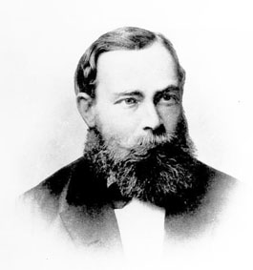
Prehistory 1870’s
Gottlob Frege (1879) developed Begriffsschrift (concept writing), the first formalized quantified predicate logic.

Slide 11
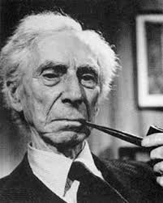
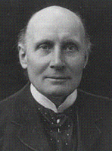
Prehistory 1910’s
Bertrand Russell and Alfred North Whitehead (Principia Mathematica, 1913) finalized the development of modern first-order predicate logic (FOPC).

Slide 12

Interesting Book on Russell

Slide 13
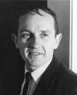
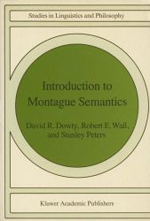
History from Philosophy and Linguistics
Richard Montague (1970) developed a formal method for mapping natural-language to FOPC using Church’s lambda calculus of functions and the fundamental principle of semantic compositionality for
recursively computing the meaning of each syntactic constituent from the meanings of its sub-constituents.
Later called “Montague Grammar” or “Montague Semantics”

Slide 14
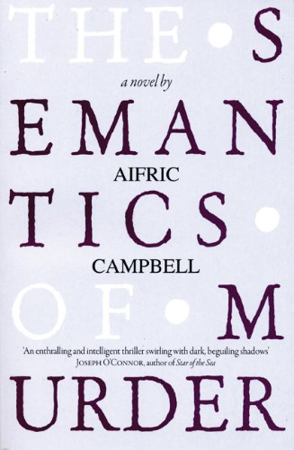
Interesting Book on Montague
See Aifric Campbell’s (2009) novel The Semantics of Murder for a fictionalized account of his mysterious death in 1971 (homicide or homoerotic asphyxiation??).

Slide 15
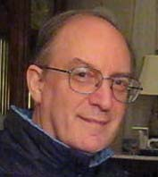
Early History in AI
Bill Woods (1973) developed the first NL database interface (LUNAR) to answer scientists’ questions about moon rooks
using a manually developed Augmented Transition Network (ATN) grammar.

Slide 16
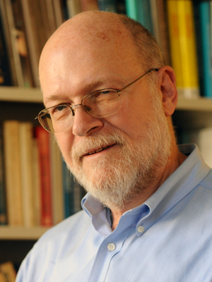
Early History in AI
Dave Waltz (1975) developed the next NL database interface (PLANES) to query a database of aircraft maintenance for the US Air Force.
I learned about this early work as a student of Dave’s at UIUC in the early 1980’s.
(1943-2012)

Slide 17
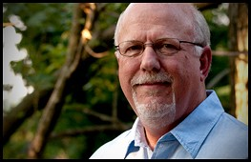
Early Commercial History
Gary Hendrix founded Symantec (“semantic technologies”) in 1982 to commercialize NL database
interfaces based on manually developed semantic grammars, but they switched to other markets when this was not profitable.
Hendrix got his BS and MS at UT Austin working with my former UT NLP colleague, Bob Simmons (1925-1994).

Slide 18
1980’s: The “Fall” of Semantic Parsing
Manual development of a new semantic grammar for each new database did not “scale well” and was not commercially viable.
The failure to commercialize NL database interfaces led to decreased research interest in the problem.

Slide 19
Semantic Parsing
Semantic Parsing: Transforming natural language (NL) sentences into completely formal logical forms or meaning representations (MRs).
Sample application domains where MRs are directly executable by another computer system to perform some task.
  CLang: Robocup Coach Language
  Geoquery: A Database Query Application

Slide 20
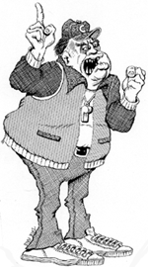
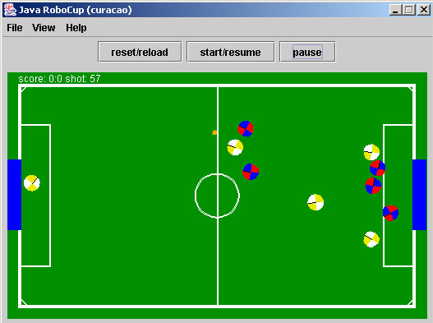
CLang: RoboCup Coach Language
In RoboCup Coach competition teams compete to coach simulated players [http://www.robocup.org]
The coaching instructions are given in a formal language called CLang [Chen et al. 2003]
If the ball is in our goal area then player 1 should intercept it.
Simulated soccer field
Semantic Parsing
(bpos (goal-area our) (do our {1} intercept))
CLang

Slide 21
Procedural Semantics
The meaning of a sentence is a formal representation of a procedure that performs some action that is an appropriate response.
  Answering questions
  Following commands
In philosophy, the “late” Wittgenstein was known for the “meaning as use” view of semantics compared to the model theoretic view of the “early” Wittgenstein and other logicians.

Slide 22
Predicate Logic Query Language
Most existing work on computational semantics is based on predicate logic
What is the smallest state by area?
answer(x₁,smallest(x₂,(state(x₁),area(x₁,x₂))))
x₁ is a logical variable that denotes “the smallest state by area”

Slide 23
Functional Query Language (FunQL)
Transform a logical language into a functional, variable-free language (Kate et al., 2005)
What is the smallest state by area?
answer(x₁,smallest(x₂,(state(x₁),area(x₁,x₂))))
answer(smallest_one(area_1(state(all))))

Slide 24
Learning Semantic Parsers
Manually programming robust semantic parsers is difficult due to the complexity of the task.
Semantic parsers can be learned automatically from sentences paired with their logical form.
NL→MR
Training Exs
Semantic-Parser
Learner
Natural
Language
Meaning
Rep
Semantic
Parser

Slide 25
Engineering Motivation
Most computational language-learning research strives for broad coverage while sacrificing depth.
  “Scaling up by dumbing down”
Realistic semantic parsing currently entails domain dependence.
Domain-dependent natural-language interfaces have a large potential market.
Learning makes developing specific applications more tractable.
Training corpora can be easily developed by tagging existing corpora of formal statements with natural-language glosses.

Slide 26
Cognitive Science Motivation
Most natural-language learning methods require supervised training data that is not available to a child.
  General lack of negative feedback on grammar.
  No POS-tagged or treebank data.
Assuming a child can infer the likely meaning of an utterance from context, NL→MR pairs are more cognitively plausible training data.

Slide 27
Our Semantic-Parser Learners
CHILL+WOLFIE (Zelle & Mooney, 1996; Thompson & Mooney, 1999, 2003)
  Separates parser-learning and semantic-lexicon learning.
  Learns a deterministic parser using ILP techniques.
COCKTAIL (Tang & Mooney, 2001)
  Improved ILP algorithm for CHILL.
SILT (Kate, Wong & Mooney, 2005)
  Learns symbolic transformation rules for mapping directly from NL to LF.
SCISSOR (Ge & Mooney, 2005)
  Integrates semantic interpretation into Collins’ statistical syntactic parser.
WASP (Wong & Mooney, 2006)
  Uses syntax-based statistical machine translation methods.
KRISP (Kate & Mooney, 2006)
  Uses a series of SVM classifiers employing a string-kernel to iteratively build semantic representations.

Slide 28
CHILL
(Zelle & Mooney, 1992-96)
Semantic parser acquisition system using Inductive Logic Programming (ILP) to induce a parser written in Prolog.
Starts with a deterministic parsing “shell” written in Prolog and learns to control the operators of this parser to produce the given I/O pairs.
Requires a semantic lexicon, which for each word gives one or more possible meaning representations.
Parser must disambiguate words, introduce proper semantic representations for each, and then put them together in the right way to produce a proper representation of the sentence.

Slide 29
CHILL Example
U.S. Geographical database
  Sample training pair
    Cuál es el capital del estado con la población más grande?
    answer(C, (capital(S,C), largest(P, (state(S), population(S,P)))))
  Sample semantic lexicon
    cuál : answer(_,_)
    capital: capital(_,_)
    estado: state(_)
    más grande: largest(_,_)
    población: population(_,_)

Slide 30
WOLFIE
(Thompson & Mooney, 1995-1999)
Learns a semantic lexicon for CHILL from the same corpus of semantically annotated sentences.
Determines hypotheses for word meanings by finding largest isomorphic common subgraphs shared by meanings of sentences in which the word appears.
Uses a greedy-covering style algorithm to learn a small lexicon sufficient to allow compositional construction of the correct representation from the words in a sentence.

Slide 31
WOLFIE + CHILL
Semantic Parser Acquisition
NL→MR
Training Exs
WOLFIE
Lexicon Learner
Semantic
Lexicon
CHILL
Parser Learner
Natural
Language
Meaning
Rep
Semantic
Parser

Slide 32
Compositional Semantics
Approach to semantic analysis based on building up an MR compositionally based on the syntactic structure of a sentence.
Build MR recursively bottom-up from the parse tree.
BuildMR(parse-tree)
If parse-tree is a terminal node (word) then
return an atomic lexical meaning for the word.
Else
For each child, subtree_{i}, of parse-tree
Create its MR by calling BuildMR(subtree_{i})
Return an MR by properly combining the resulting MRs
for its children into an MR for the overall parse-tree.

Slide 33
Composing MRs from Parse Trees
What is the capital of Ohio?
S
answer(capital(loc_2(stateid('ohio'))))
NP
answer()
VP
capital(loc_2(stateid('ohio')))
V
∅
NP
capital(loc_2(stateid('ohio')))
WP
answer()
VBZ
DT
N
capital()
PP
What
answer()
∅
∅
loc_2(stateid('ohio'))
is
the
capital
IN
loc_2()
NP
stateid('ohio')
∅
∅
capital()
of
NNP
stateid('ohio')
loc_2()
Ohio
stateid('ohio')

Slide 34
Disambiguation with
Compositional Semantics
The composition function that combines the MRs of the children of a node, can return ⊗ if there is no sensible way to compose the children’s meanings.
Could compute all parse trees up-front and then compute semantics for each, eliminating any that ever generate a ⊗ semantics for any constituent.
More efficient method:
  When filling (CKY) chart of syntactic phrases, also compute all possible compositional semantics of each phrase as it is constructed and make an entry for each.
  If a given phrase only gives ⊗ semantics, then remove this phrase from the table, thereby eliminating any parse that includes this meaningless phrase.

Slide 35

Composing MRs from Parse Trees
What is the capital of Ohio?
S
NP
VP
V
NP
WP
What
VBZ
DT
N
PP
⊗
is
the
capital
IN
loc_2()
NP
riverid('ohio')
of
NNP
riverid('ohio')
loc_2()
Ohio
riverid('ohio')

Slide 36
Composing MRs from Parse Trees
What is the capital of Ohio?
S
NP
VP
⊗
V
∅
NP
capital()
PP
loc_2(stateid('ohio'))
WP
VBZ
DT
N
IN
loc_2()
NP
stateid('ohio')
What
∅
∅
capital()
of
NNP
stateid('ohio')
is
the
capital
loc_2()
∅
∅
capital()
Ohio
stateid('ohio')

Slide 37

WASP
A Machine Translation Approach to Semantic Parsing
Uses statistical machine translation techniques
  Synchronous context-free grammars (SCFG) (Wu, 1997; Melamed, 2004; Chiang, 2005)
  Word alignments (Brown et al., 1993; Och & Ney, 2003)
Hence the name: Word Alignment-based Semantic Parsing

Slide 38
A Unifying Framework for
Parsing and Generation
Natural Languages
Machine
translation

Slide 39
A Unifying Framework for
Parsing and Generation
Natural Languages
Semantic parsing
Machine
translation
Formal Languages

Slide 40
A Unifying Framework for
Parsing and Generation
Natural Languages
Semantic parsing
Machine
translation
Tactical generation
Formal Languages

Slide 41
A Unifying Framework for
Parsing and Generation
Synchronous Parsing
Natural Languages
Semantic parsing
Machine
translation
Tactical generation
Formal Languages

Slide 42
A Unifying Framework for
Parsing and Generation
Synchronous Parsing
Natural Languages
Semantic parsing
Machine
translation
Compiling:
Aho & Ullman
(1972)
Tactical generation
Formal Languages

Slide 43
Synchronous Context-Free Grammars (SCFG)
Developed by Aho & Ullman (1972) as a theory of compilers that combines syntax analysis and code generation in a single phase
Generates a pair of strings in a single derivation

Slide 44
Context-Free Semantic Grammar
QUERY
QUERY → What is CITY
What
is
CITY
CITY → the capital CITY
CITY → of STATE
the
capital
CITY
STATE → Ohio
of
STATE
Ohio

Slide 45
Productions of
Synchronous Context-Free Grammars
Natural language
Formal language
QUERY → What is CITY / answer(CITY)

Slide 46
Synchronous Context-Free
Grammar Derivation
QUERY
QUERY
What
is
CITY
answer ( CITY )
the
capital
CITY
capital ( CITY )
of
STATE
loc_2 ( STATE )
Ohio
stateid ( 'ohio' )
What is the capital of Ohio
answer(capital(loc_2(stateid('ohio'))))
CITY → the capital CITY / capital(CITY)
QUERY → What is CITY / answer(CITY)
CITY → of STATE / loc_2(STATE)
STATE → Ohio / stateid('ohio')

Slide 47
Probabilistic Parsing Model
d₁
CITY
CITY
capital
CITY
capital ( CITY )
of
STATE
loc_2 ( STATE )
Ohio
stateid ( 'ohio' )
CITY → capital CITY / capital(CITY)
CITY → of STATE / loc_2(STATE)
STATE → Ohio / stateid('ohio')

Slide 48
Probabilistic Parsing Model
d₂
CITY
CITY
capital
CITY
capital ( CITY )
of
RIVER
loc_2 ( RIVER )
Ohio
riverid ( 'ohio' )
CITY → capital CITY / capital(CITY)
CITY → of RIVER / loc_2(RIVER)
RIVER → Ohio / riverid('ohio')

Slide 49
Probabilistic Parsing Model
d₁
d₂
CITY
CITY
capital ( CITY )
capital ( CITY )
loc_2 ( STATE )
loc_2 ( RIVER )
stateid ( 'ohio' )
riverid ( 'ohio' )
CITY → capital CITY / capital(CITY)
0.5
CITY → capital CITY / capital(CITY)
0.5
CITY → of STATE / loc_2(STATE)
0.3
λ
CITY → of RIVER / loc_2(RIVER)
0.05
λ
STATE → Ohio / stateid('ohio')
+
0.5
RIVER → Ohio / riverid('ohio')
+
0.5
Pr(d₁|capital of Ohio) = exp( ) / Z
1.3
Pr(d₂|capital of Ohio) = exp( ) / Z
1.05
normalization constant

Slide 50
Overview of WASP
Unambiguous CFG of MRL
Lexical acquisition
Training set, {(e,f)}
Lexicon, L
Parameter estimation
Training
Parsing model parameterized by λ
Testing
Input sentence, e'
Output MR, f'
Semantic parsing

Slide 51
Lexical Acquisition
Transformation rules are extracted from word alignments between an NL sentence, e, and its correct MR, f, for each training example, (e, f)

Slide 52
Word Alignments
Le programme a été mis en application
And the program has been implemented
A mapping from French words to their meanings expressed in English

Slide 53
Lexical Acquisition
Train a statistical word alignment model (IBM Model 5) on training set
Obtain most probable n-to-1 word alignments for each training example
Extract transformation rules from these word alignments
Lexicon L consists of all extracted transformation rules

Slide 54
Word Alignment for Semantic Parsing
The goalie should always stay in our half
( ( true ) ( do our { 1 } ( pos ( half our ) ) ) )
How to introduce syntactic tokens such as parens?

Slide 55
Use of MRL Grammar
The
RULE → (CONDITION DIRECTIVE)
goalie
CONDITION → (true)
should
DIRECTIVE → (do TEAM {UNUM} ACTION)
always
TEAM → our
top-down, left-most derivation of an un-ambiguous CFG
stay
UNUM → 1
in
ACTION → (pos REGION)
n-to-1
our
REGION → (half TEAM)
half
TEAM → our

Slide 56
Extracting Transformation Rules
The
RULE → (CONDITION DIRECTIVE)
goalie
CONDITION → (true)
should
DIRECTIVE → (do TEAM {UNUM} ACTION)
always
TEAM → our
stay
UNUM → 1
in
ACTION → (pos REGION)
our
TEAM
REGION → (half TEAM)
half
TEAM → our
TEAM → our / our

Slide 57
Extracting Transformation Rules
The
RULE → (CONDITION DIRECTIVE)
goalie
CONDITION → (true)
should
DIRECTIVE → (do TEAM {UNUM} ACTION)
always
TEAM → our
stay
UNUM → 1
in
ACTION → (pos REGION)
REGION
TEAM
REGION → (half TEAM)
REGION → (half our)
half
TEAM → our
REGION → TEAM half / (half TEAM)

Slide 58
Extracting Transformation Rules
The
RULE → (CONDITION DIRECTIVE)
goalie
CONDITION → (true)
should
DIRECTIVE → (do TEAM {UNUM} ACTION)
always
TEAM → our
ACTION
stay
UNUM → 1
in
ACTION → (pos (half our))
ACTION → (pos REGION)
REGION
REGION → (half our)
ACTION → stay in REGION / (pos REGION)

Slide 59
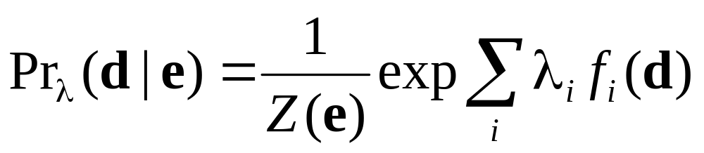
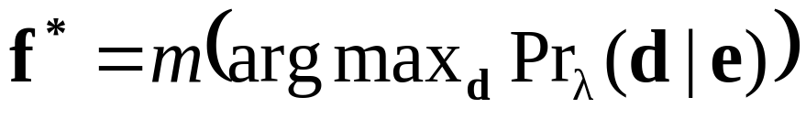
Probabilistic Parsing Model
Based on maximum-entropy model:
Features f_{i} (d) are number of times each transformation rule is used in a derivation d
Output translation is the yield of most probable derivation

Slide 60
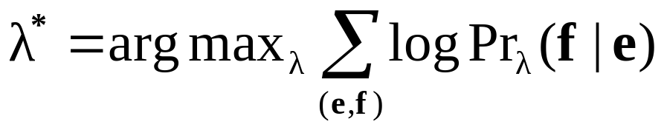
Parameter Estimation
Maximum conditional log-likelihood criterion
Since correct derivations are not included in training data, parameters λ* are learned in an unsupervised manner
EM algorithm combined with improved iterative scaling, where hidden variables are correct derivations (Riezler et al., 2000)

Slide 61
Experimental Corpora
CLang
  300 randomly selected pieces of coaching advice from the log files of the 2003 RoboCup Coach Competition
  22.52 words on average in NL sentences
  14.24 tokens on average in formal expressions
GeoQuery [Zelle & Mooney, 1996]
  250 queries for the given U.S. geography database
  6.87 words on average in NL sentences
  5.32 tokens on average in formal expressions
  Also translated into Spanish, Turkish, & Japanese.
Notes:
It’s test on Clang corpora. It’s also tested on an benchmark corpora of semantic parsing.
- Geoquery example: how many cities are there in the US?

Slide 62
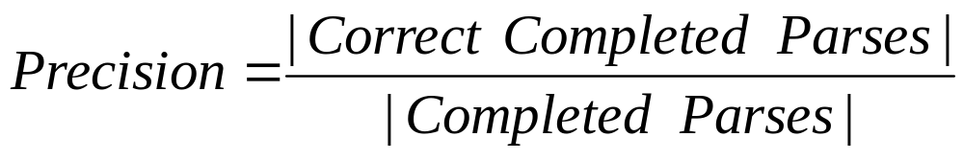
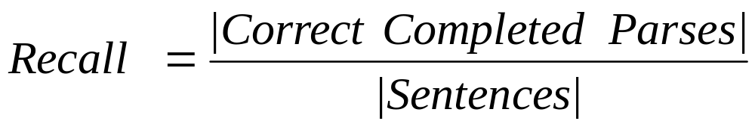
Experimental Methodology
Evaluated using standard 10-fold cross validation
Correctness
  CLang: output exactly matches the correct representation
  Geoquery: the resulting query retrieves the same answer as the correct representation
Metrics
Notes:
Geoquery – using the same evaluation method in previous papers
Why not using partial match:
doesn’t make sense, player 2 instead of player 3, left instead of right
Animation, first show correct, then wrong
Explain what’s precision, what’s recall

Slide 63
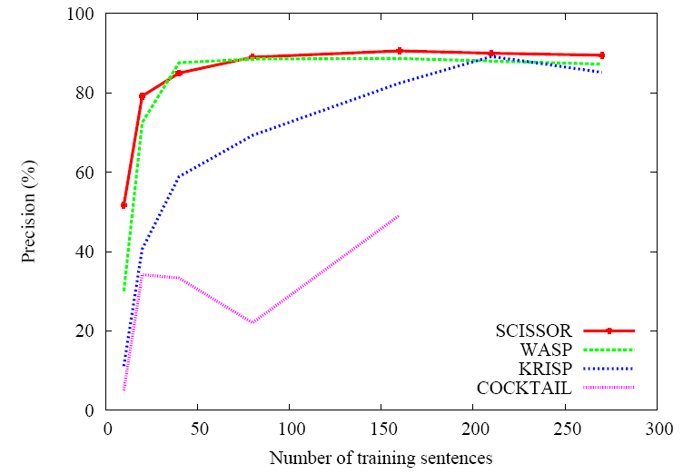
Precision Learning Curve for CLang

Slide 64
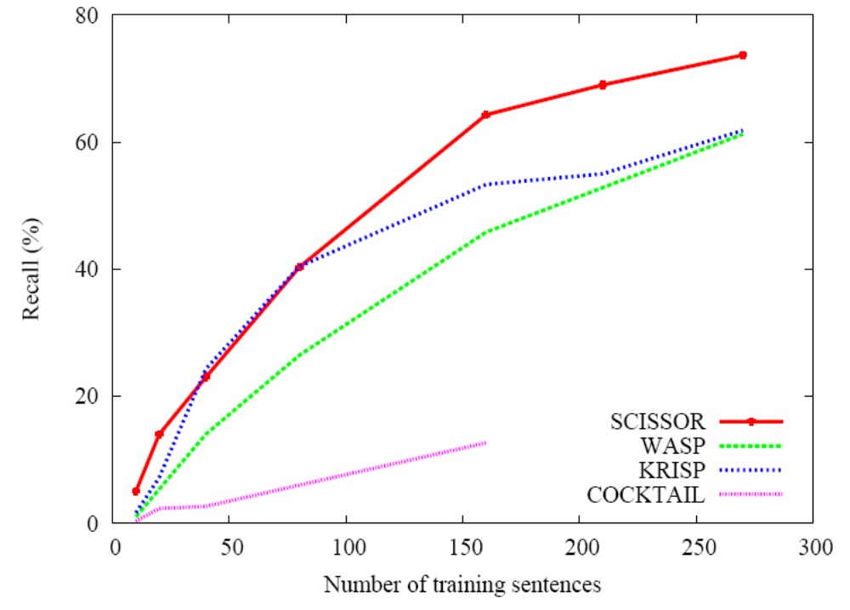
Recall Learning Curve for CLang

Slide 65
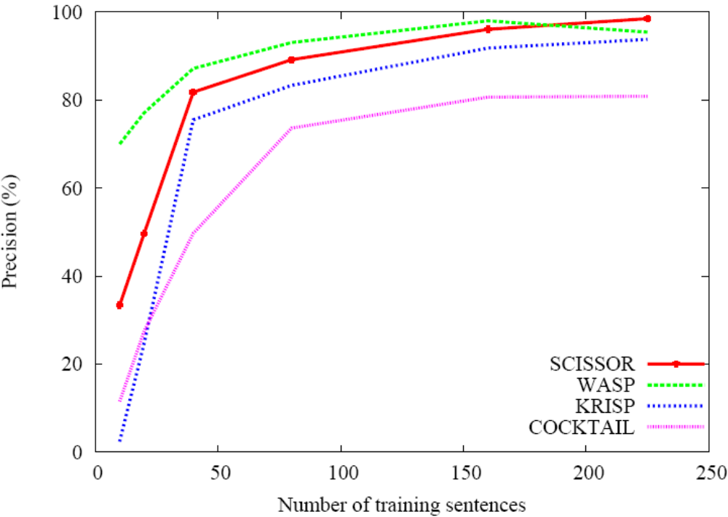
Precision Learning Curve for GeoQuery

Slide 66
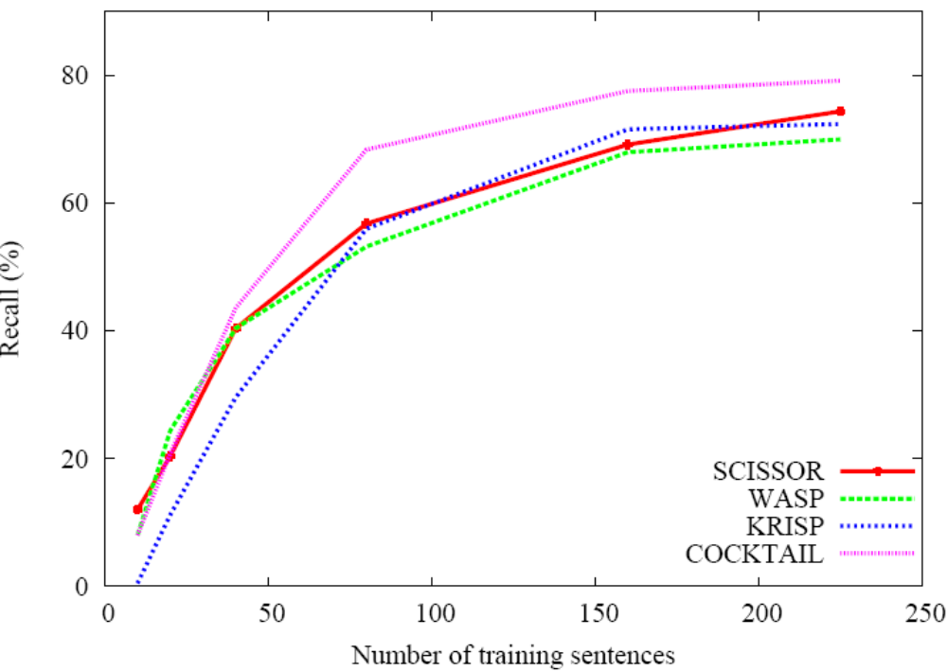
Recall Learning Curve for Geoquery

Slide 67
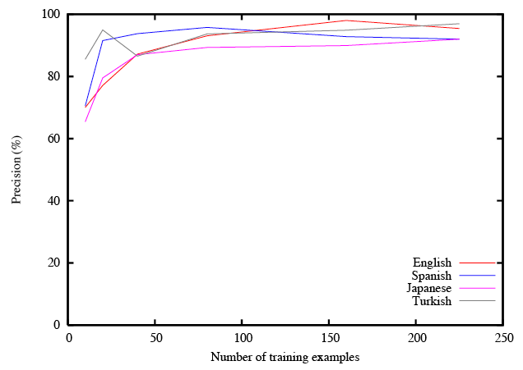
Precision Learning Curve for GeoQuery (WASP)

Slide 68
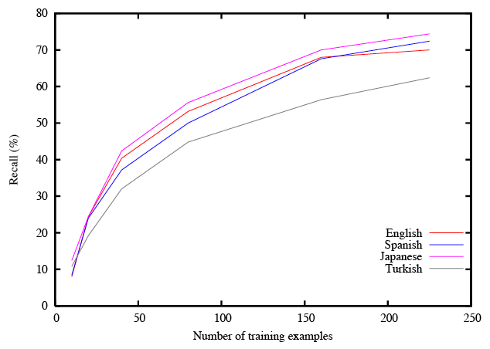
Recall Learning Curve for GeoQuery (WASP)

Slide 69
Tactical Natural Language Generation
Mapping a formal MR into NL
Can be done using statistical machine translation
  Previous work focuses on using generation in interlingual MT (Hajič et al., 2004)
  There has been little, if any, research on exploiting statistical MT methods for generation

Slide 70
Tactical Generation
Can be seen as inverse of semantic parsing
The goalie should always stay in our half
Semantic parsing
Tactical generation
((true) (do our {1} (pos (half our))))

Slide 71
Generation by Inverting WASP
Same synchronous grammar is used for both generation and semantic parsing
Input
Output
Tactical generation:
Semantic parsing:
NL:
MRL:
QUERY → What is CITY / answer(CITY)

Slide 72
Generation by Inverting WASP
Same procedure for lexical acquisition
Chart generator very similar to chart parser, but treats MRL as input
Log-linear probabilistic model inspired by Pharaoh (Koehn et al., 2003), a phrase-based MT system
Uses a bigram language model for target NL
Resulting system is called WASP⁻¹

Slide 73
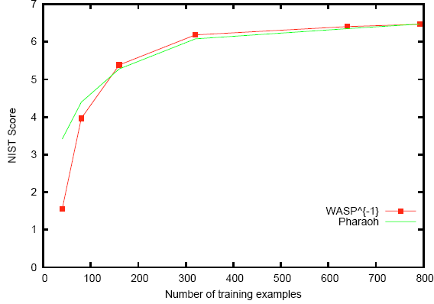
Geoquery (NIST score; English)
Notes:
Here are the learning curves for the Geoquery domain. The x-axis is the number of examples used for training, and the y-axis is the F-measure of a learned parser. The red line with dots is WASP. The other dots and lines are the other systems. We see that WASP performs respectably compared to COCKTAIL, the blue dot, and other systems that use extra supervision, such as SILT, the green line.

Slide 74
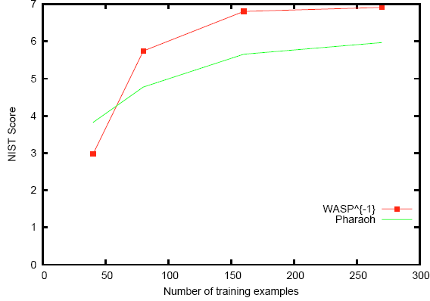
RoboCup (NIST score; English)
contiguous phrases only
Similar human evaluation results in terms of fluency and adequacy
Notes:
In the RoboCup domain, where sentences are much longer, COCKTAIL the deterministic parser breaks down, while WASP is still competitive compared to other systems. In particular, it outperforms SILT, which uses extra supervision.

Slide 75
LSTMs for Semantic Parsing
LSTM encoder/decoder model has effectively been used to map natural language sentences into formal meaning representations (Dong & Lapata, 2016; Kocisky, et al., 2016).
Exploits neural attention and methods for decoding into semantic trees rather than sequences.

Slide 76
Conclusions
Semantic parsing maps NL sentences to completely formal MRs.
Semantic parsers can be effectively learned from supervised corpora consisting of only sentences paired with their formal MRs (and possibly also SAPTs).
Learning methods can be based on:
  Adding semantics to an existing statistical syntactic parser and then using compositional semantics.
  Using SVM with string kernels to recognize concepts in the NL and then composing them into a complete MR using the MRL grammar.
  Using probabilistic synchronous context-free grammars to learn an NL/MR grammar that supports both semantic parsing and generation.

