Slide 1
CS 388:
Natural Language Processing
Machine Translation
Raymond J. Mooney
University of Texas at Austin

Slide 2
Machine Translation
Automatically translate one natural language into another.
Mary didn’t slap the green witch.
Maria no dió una bofetada a la bruja verde.

Slide 3
Ambiguity Resolution is Required for Translation
Syntactic and semantic ambiguities must be properly resolved for correct translation:
  “John plays the guitar.” → “John toca la guitarra.”
  “John plays soccer.” → “John juega el fútbol.”
An apocryphal story is that an early MT system gave the following results when translating from English to Russian and then back to English:
  “The spirit is willing but the flesh is weak.” ⇒ “The liquor is good but the meat is spoiled.”
  “Out of sight, out of mind.” ⇒ “Invisible idiot.”

Slide 4
Word Alignment
Shows mapping between words in one language and the other.
Mary didn’t slap the green witch.
Maria no dió una bofetada a la bruja verde.

Slide 5
Translation Quality
Achieving literary quality translation is very difficult.
Existing MT systems can generate rough translations that frequently at least convey the gist of a document.
High quality translations possible when specialized to narrow domains, e.g. weather forcasts.
Some MT systems used in computer-aided translation in which a bilingual human post-edits the output to produce more readable accurate translations.
Frequently used to aid localization of software interfaces and documentation to adapt them to other languages.

Slide 6
Linguistic Issues Making MT Difficult
Morphological issues with agglutinative, fusion and polysynthetic languages with complex word structure.
Syntactic variation between SVO (e.g. English), SOV (e.g. Hindi), and VSO (e.g. Arabic) languages.
  SVO languages use prepositions
  SOV languages use postpositions
Pro-drop languages regularly omit subjects that must be inferred.

Slide 7
Lexical Gaps
Some words in one language do not have a corresponding term in the other.
    Rivière (river that flows into ocean) and fleuve (river that does not flow into ocean) in French
    Schedenfraude (feeling good about another’s pain) in German.
    Oyakoko (filial piety) in Japanese

Slide 8
Vauquois Triangle
Interlingua
Semantic
Parsing
Semantic
structure
Semantic Transfer
Semantic
structure
Tactical
Generation
SRL &
WSD
Syntactic
structure
Syntactic
structure
Syntactic Transfer
parsing
Direct translation
Words
Words
Source Language
Target Language

Slide 9
Direct Transfer
Morphological Analysis
  Mary didn’t slap the green witch. →
  Mary DO:PAST not slap the green witch.
Lexical Transfer
  Mary DO:PAST not slap the green witch.
  Maria no dar:PAST una bofetada a la verde bruja.
Lexical Reordering
  Maria no dar:PAST una bofetada a la bruja verde.
Morphological generation
  Maria no dió una bofetada a la bruja verde.

Slide 10
Syntactic Transfer
Simple lexical reordering does not adequately handle more dramatic reordering such as that required to translate from an SVO to an SOV language.
Need syntactic transfer rules that map parse tree for one language into one for another.
  English to Spanish:
    NP → Adj Nom ⇒ NP → Nom ADJ
  English to Japanese:
    VP → V NP ⇒ VP → NP V
    PP → P NP ⇒ PP → NP P

Slide 11
Semantic Transfer
Some transfer requires semantic information.
Semantic roles can determine how to properly express information in another language.
In Chinese, PPs that express a goal, destination, or benefactor occur before the verb but those expressing a recipient occur after the verb.
Transfer Rule
  English to Chinese
    VP → V PP[+benefactor] ⇒ VP → PP[+benefactor] V

Slide 12
Statistical MT
Manually encoding comprehensive bilingual lexicons and transfer rules is difficult.
SMT acquires knowledge needed for translation from a parallel corpus or bitext that contains the same set of documents in two languages.
The Canadian Hansards (parliamentary proceedings in French and English) is a well-known parallel corpus.
First align the sentences in the corpus based on simple methods that use coarse cues like sentence length to give bilingual sentence pairs.

Slide 13
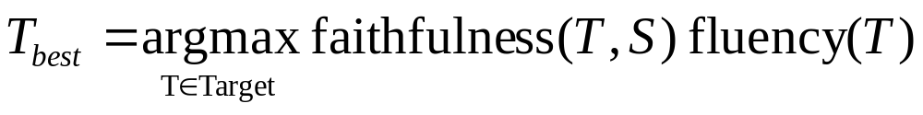
Picking a Good Translation
A good translation should be faithful and correctly convey the information and tone of the original source sentence.
A good translation should also be fluent, grammatically well structured and readable in the target language.
Final objective:

Slide 14
Noisy Channel Model
Based on analogy to information-theoretic model used to decode messages transmitted via a communication channel that adds errors.
Assume that source sentence was generated by a “noisy” transformation of some target language sentence and then use Bayesian analysis to recover the most likely target sentence that generated it.
Translate foreign language sentence F=f₁, f₂, …f_{m} to an
English sentence Ȇ = e₁, e₂, …e_{I} that maximizes P(E | F)

Slide 15
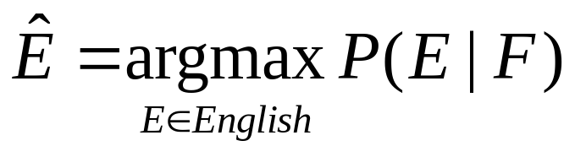
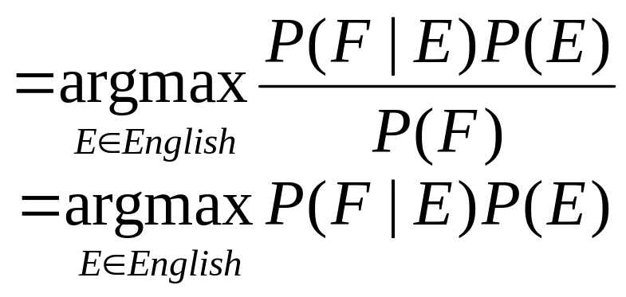
Bayesian Analysis of Noisy Channel
Translation Model Language Model
A decoder determines the most probable
translation Ȇ given F

Slide 16
Language Model
Use a standard n-gram language model for P(E).
Can be trained on a large, unsupervised mono-lingual corpus for the target language E.
Could use a more sophisticated PCFG language model to capture long-distance dependencies.
Terabytes of web data have been used to build a large 5-gram model of English.

Slide 17
Word Alignment
Directly constructing phrase alignments is difficult, so rely on first constructing word alignments.
Can learn to align from supervised word alignments, but human-aligned bitexts are rare and expensive to construct.
Typically use an unsupervised EM-based approach to compute a word alignment from unannotated parallel corpus.

Slide 18
One to Many Alignment
To simplify the problem, typically assume each word in F aligns to 1 word in E (but assume each word in E may generate more than one word in F).
Some words in F may be generated by the NULL element of E.
Therefore, alignment can be specified by a vector A giving, for each word in F, the index of the word in E which generated it.
0 1 2 3 4 5 6
NULL Mary didn’t slap the green witch.
Maria no dió una bofetada a la bruja verde.
1 2 3 3 3 0 4 6 5

Slide 19
IBM Model 1
First model proposed in seminal paper by Brown et al. in 1993 as part of CANDIDE, the first complete SMT system.
Assumes following simple generative model of producing F from E=e₁, e₂, …e_{I}
  Choose length, J, of F sentence: F=f₁, f₂, …f_{J}
  Choose a 1 to many alignment A=a₁, a₂, …a_{J}
  For each position in F, generate a word f_{j} from the aligned word in E: e_{aj}

Slide 20
Sample IBM Model 1 Generation
0 1 2 3 4 5 6
NULL Mary didn’t slap the green witch.
Maria
no
dió
una
bofetada
a
la
bruja
verde.
1 2 3 3 3 0 4 6 5

Slide 21
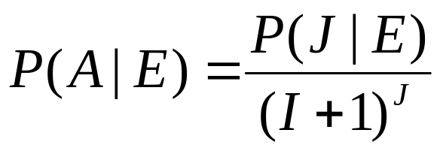
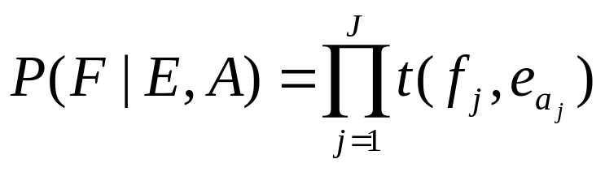
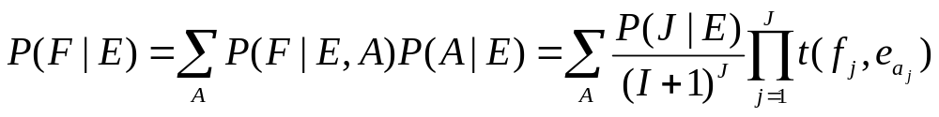
Computing P(F | E) in IBM Model 1
Assume some length distribution P(J | E)
Assume all alignments are equally likely. Since there are (I + 1)^{J} possible alignments:
Assume t(f_{x},e_{y}) is the probability of translating e_{y} as f_{x}, therefore:
Determine P(F | E) by summing over all alignments:

Slide 22
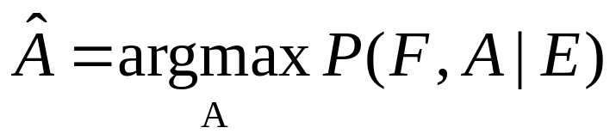
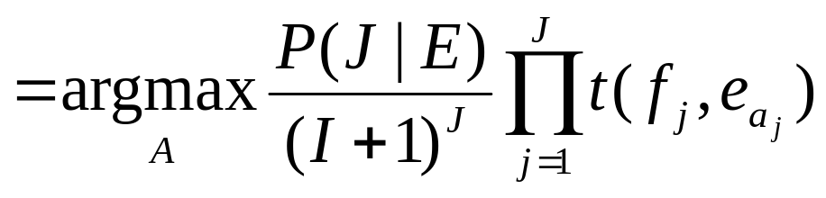
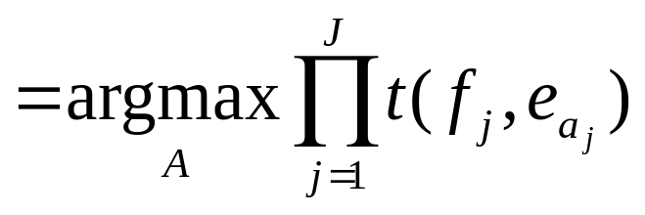
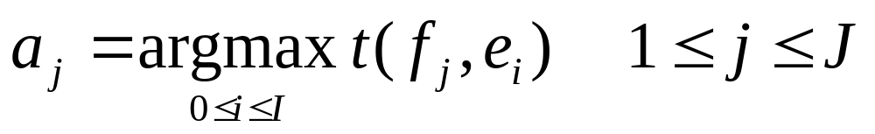
Decoding for IBM Model 1
Goal is to find the most probable alignment given a parameterized model.
Since translation choice for each position j is independent,
the product is maximized by maximizing each term:

Slide 23
HMM-Based Word Alignment
IBM Model 1 assumes all alignments are equally likely and does not take into account locality:
  If two words appear together in one language, then their translations are likely to appear together in the result in the other language.
An alternative model of word alignment based on an HMM model does account for locality by making longer jumps in switching from translating one word to another less likely.

Slide 24
HMM Model
Assumes the hidden state is the specific word occurrence e_{i} in E currently being translated (i.e. there are I states, one for each word in E).
Assumes the observations from these hidden states are the possible translations f_{j} of e_{i.}
Generation of F from E then consists of moving to the initial E word to be translated, generating a translation, moving to the next word to be translated, and so on.

Slide 25
Sample HMM Generation
1 2 3 4 5 6
Mary didn’t slap the green witch.
Maria

Slide 26
Sample HMM Generation
1 2 3 4 5 6
Mary didn’t slap the green witch.
Maria
no

Slide 27
Sample HMM Generation
1 2 3 4 5 6
Mary didn’t slap the green witch.
Maria
no
dió

Slide 28
Sample HMM Generation
1 2 3 4 5 6
Mary didn’t slap the green witch.
Maria
no
dió
una

Slide 29
Sample HMM Generation
1 2 3 4 5 6
Mary didn’t slap the green witch.
Maria
no
dió
una
bofetada

Slide 30
Sample HMM Generation
1 2 3 4 5 6
Mary didn’t slap the green witch.
Maria
no
dió
una
bofetada
a

Slide 31
Sample HMM Generation
1 2 3 4 5 6
Mary didn’t slap the green witch.
Maria
no
dió
una
bofetada
a
la

Slide 32
Sample HMM Generation
1 2 3 4 5 6
Mary didn’t slap the green witch.
Maria
no
dió
una
bofetada
a
la
bruja

Slide 33
Sample HMM Generation
1 2 3 4 5 6
Mary didn’t slap the green witch.
Maria
no
dió
una
bofetada
a
la
bruja
verde.

Slide 34
Sample HMM Generation
1 2 3 4 5 6
Mary didn’t slap the green witch.
Maria
no
dió
una
bofetada
a
la
bruja
verde.

Slide 35
HMM Parameters
Transition and observation parameters of states for HMMs for all possible source sentences are “tied” to reduce the number of free parameters that have to be estimated.
Observation probabilities: b_{j}(f_{i})=P(f_{i} | e_{j}) the same for all states representing an occurrence of the same English word.
State transition probabilities: a_{ij} = s(j−i) the same for all transitions that involve the same jump width (and direction).

Slide 36
Computing P(F | E) in the HMM Model
Given the observation and state-transition probabilities, P(F | E) (observation likelihood) can be computed using the standard forward algorithm for HMMs.

Slide 37
Decoding for the HMM Model
Use the standard Viterbi algorithm to efficiently compute the most likely alignment (i.e. most likely state sequence).

Slide 38
Training Word Alignment Models
Both the IBM model 1 and HMM model can be trained on a parallel corpus to set the required parameters.
For supervised (hand-aligned) training data, parameters can be estimated directly using frequency counts.
For unsupervised training data, EM can be used to estimate parameters, e.g. Baum-Welch for the HMM model.

Slide 39
Sketch of EM Algorithm for
Word Alignment
Randomly set model parameters.
(making sure they represent legal distributions)
Until converge (i.e. parameters no longer change) do:
E Step: Compute the probability of all possible
alignments of the training data using the current
model.
M Step: Use these alignment probability estimates to
re-estimate values for all of the parameters.
Note: Use dynamic programming (as in Baum-Welch)
to avoid explicitly enumerating all possible alignments

Slide 40
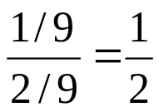
Sample EM Trace for Alignment
(IBM Model 1 with no NULL Generation)
Training
Corpus
green house
casa verde
the house
la casa
verde casa la
green
1/3 | 1/3 | 1/3
1/3 | 1/3 | 1/3
1/3 | 1/3 | 1/3
Translation
Probabilities
Assume uniform
initial probabilities
house
the
Compute
Alignment
Probabilities
P(A, F | E)
green house
casa verde
green house
casa verde
the house
la casa
the house
la casa
1/3 X 1/3 = 1/9
1/3 X 1/3 = 1/9
1/3 X 1/3 = 1/9
1/3 X 1/3 = 1/9
Normalize
to get
P(A | F, E)

Slide 41
Example cont.
green house
casa verde
green house
casa verde
the house
la casa
the house
la casa
1/2
1/2
1/2
1/2
verde casa la
Compute
weighted
translation
counts
green
1/2 | 1/2 | 0
1/2 | 1/2 + 1/2 | 1/2
0 | 1/2 | 1/2
house
the
verde casa la
Normalize
rows to sum
to one to
estimate P(f | e)
green
1/2 | 1/2 | 0
1/4 | 1/2 | 1/4
0 | 1/2 | 1/2
house
the

Slide 42
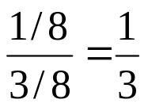
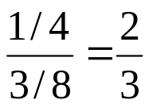
Example cont.
verde casa la
green
1/2 | 1/2 | 0
1/4 | 1/2 | 1/4
0 | 1/2 | 1/2
Translation
Probabilities
house
the
Recompute
Alignment
Probabilities
P(A, F | E)
green house
casa verde
green house
casa verde
the house
la casa
the house
la casa
1/2 X 1/4=1/8
1/2 X 1/2=1/4
1/2 X 1/2=1/4
1/2 X 1/4=1/8
Normalize
to get
P(A | F, E)
Continue EM iterations until translation
parameters converge

Slide 43
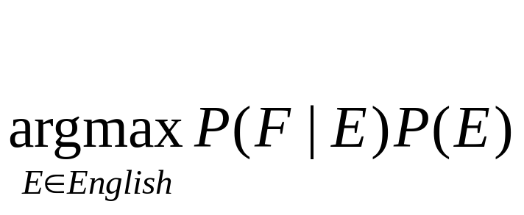
Decoding
Goal is to find a translation that maximizes the product of the translation and language models.
Cannot explicitly enumerate and test the combinatorial space of all possible translations.
The optimal decoding problem for all reasonable model’s (e.g. IBM model 1) is NP-complete.
Heuristically search the space of translations using A*, beam-search, etc. to approximate the solution to this difficult optimization problem.

Slide 44
Evaluating MT
Human subjective evaluation is the best but is time-consuming and expensive.
Automated evaluation comparing the output to multiple human reference translations is cheaper and correlates with human judgements.

Slide 45
Human Evaluation of MT
Ask humans to estimate MT output on several dimensions.
  Fluency: Is the result grammatical, understandable, and readable in the target language.
  Fidelity: Does the result correctly convey the information in the original source language.
    Adequacy: Human judgment on a fixed scale.
      Bilingual judges given source and target language.
      Monolingual judges given reference translation and MT result.
    Informativeness: Monolingual judges must answer questions about the source sentence given only the MT translation (task-based evaluation).

Slide 46
Computer-Aided Translation Evaluation
Edit cost: Measure the number of changes that a human translator must make to correct the MT output.
  Number of words changed
  Amount of time taken to edit
  Number of keystrokes needed to edit

Slide 47
Automatic Evaluation of MT
Collect one or more human reference translations of the source.
Compare MT output to these reference translations.
Score result based on similarity to the reference translations.
  BLEU
  NIST
  TER
  METEOR

Slide 48
BLEU
Determine number of n-grams of various sizes that the MT output shares with the reference translations.
Compute a modified precision measure of the n-grams in MT result.

Slide 49
BLEU Example
Cand 1: Mary no slap the witch green
Cand 2: Mary did not give a smack to a green witch.
Ref 1: Mary did not slap the green witch.
Ref 2: Mary did not smack the green witch.
Ref 3: Mary did not hit a green sorceress.
Cand 1 Unigram Precision: 5/6

Slide 50
BLEU Example
Cand 1: Mary no slap the witch green.
Cand 2: Mary did not give a smack to a green witch.
Ref 1: Mary did not slap the green witch.
Ref 2: Mary did not smack the green witch.
Ref 3: Mary did not hit a green sorceress.
Cand 1 Bigram Precision: 1/5

Slide 51
BLEU Example
Cand 1: Mary no slap the witch green.
Cand 2: Mary did not give a smack to a green witch.
Ref 1: Mary did not slap the green witch.
Ref 2: Mary did not smack the green witch.
Ref 3: Mary did not hit a green sorceress.
Clip match count of each n-gram to maximum
count of the n-gram in any single reference
translation
Cand 2 Unigram Precision: 7/10

Slide 52
BLEU Example
Cand 1: Mary no slap the witch green.
Cand 2: Mary did not give a smack to a green witch.
Ref 1: Mary did not slap the green witch.
Ref 2: Mary did not smack the green witch.
Ref 3: Mary did not hit a green sorceress.
Cand 2 Bigram Precision: 4/9

Slide 53
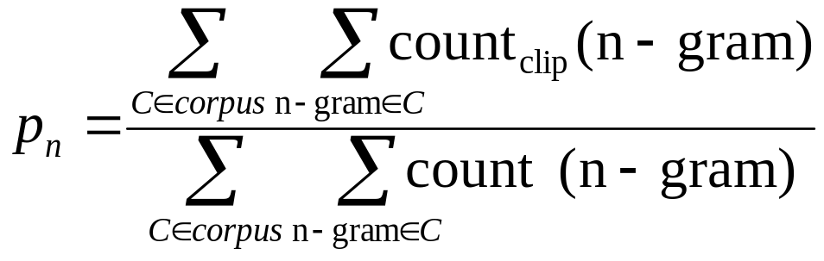
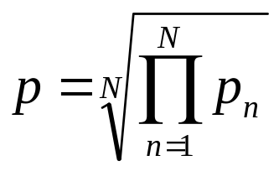
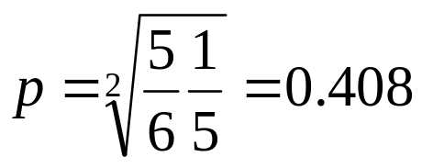
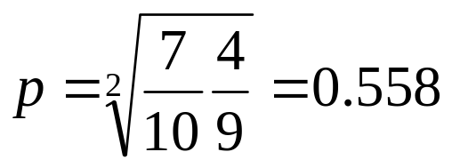
Modified N-Gram Precision
Average n-gram precision over all n-grams up to size N (typically 4) using geometric mean.
Cand 1:
Cand 2:

Slide 54
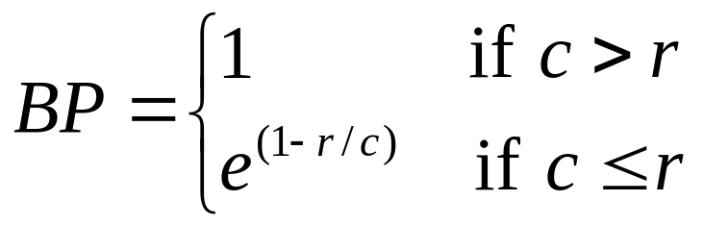
Brevity Penalty
Not easy to compute recall to complement precision since there are multiple alternative gold-standard references and don’t need to match all of them.
Instead, use a penalty for translations that are shorter than the reference translations.
Define effective reference length, r, for each sentence as the length of the reference sentence with the largest number of n-gram matches. Let c be the candidate sentence length.

Slide 55
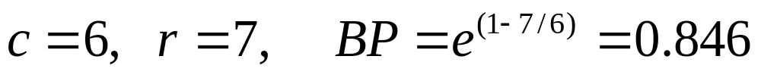
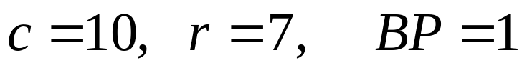

BLEU Score
Final BLEU Score: BLEU = BP × p
Cand 1: Mary no slap the witch green.
  Best Ref: Mary did not slap the green witch.
  Cand 2: Mary did not give a smack to a green witch.
  Best Ref: Mary did not smack the green witch.

Slide 56
BLEU Score Issues
BLEU has been shown to correlate with human evaluation when comparing outputs from different SMT systems.
However, it is does not correlate with human judgments when comparing SMT systems with manually developed MT (Systran) or MT with human translations.
Other MT evaluation metrics have been proposed that claim to overcome some of the limitations of BLEU.

Slide 57
Syntax-Based
Statistical Machine Translation
Recent SMT methods have adopted a syntactic transfer approach.
Improved results demonstrated for translating between more distant language pairs, e.g. Chinese/English.

Slide 58
Synchronous Grammar
Multiple parse trees in a single derivation.
Used by (Chiang, 2005; Galley et al., 2006).
Describes the hierarchical structures of a sentence and its translation, and also the correspondence between their sub-parts.
Notes:
Learning for Parsing and Generation Using Statistical Machine Translation
8/07/2007
Yuk Wah Wong

Slide 59
Synchronous Productions
Has two RHSs, one for each language.
Chinese:
English:
X → X 是甚麼 / What is X
Notes:
Learning for Parsing and Generation Using Statistical Machine Translation
8/07/2007
Yuk Wah Wong

Slide 60
Syntax-Based MT Example
Input: 俄亥俄州的首府是甚麼？
Notes:
Learning for Parsing and Generation Using Statistical Machine Translation
8/07/2007
Yuk Wah Wong

Slide 61
Syntax-Based MT Example
X
X
Input: 俄亥俄州的首府是甚麼？
Notes:
Learning for Parsing and Generation Using Statistical Machine Translation
8/07/2007
Yuk Wah Wong

Slide 62
Syntax-Based MT Example
X
X
X 是甚麼
What is X
Input: 俄亥俄州的首府是甚麼？
X → X 是甚麼 / What is X
Notes:
Learning for Parsing and Generation Using Statistical Machine Translation
8/07/2007
Yuk Wah Wong

Slide 63
Syntax-Based MT Example
X
X
X 是甚麼
What is X
X 首府
the capital X
Input: 俄亥俄州的首府是甚麼？
X → X 首府 / the capital X
Notes:
Learning for Parsing and Generation Using Statistical Machine Translation
8/07/2007
Yuk Wah Wong

Slide 64
Syntax-Based MT Example
X
X
X 是甚麼
What is X
X 首府
the capital X
X 的
of X
Input: 俄亥俄州的首府是甚麼？
X → X 的 / of X
Notes:
Learning for Parsing and Generation Using Statistical Machine Translation
8/07/2007
Yuk Wah Wong

Slide 65
Syntax-Based MT Example
X
X
X 是甚麼
What is X
X 首府
the capital X
X 的
of X
俄亥俄州
Ohio
Input: 俄亥俄州的首府是甚麼？
X → 俄亥俄州 / Ohio
Notes:
Learning for Parsing and Generation Using Statistical Machine Translation
8/07/2007
Yuk Wah Wong

Slide 66
Syntax-Based MT Example
X
X
X 是甚麼
What is X
X 首府
the capital X
X 的
of X
俄亥俄州
Ohio
Input: 俄亥俄州的首府是甚麼？
Output: What is the capital of Ohio?
Notes:
Learning for Parsing and Generation Using Statistical Machine Translation
8/07/2007
Yuk Wah Wong

Slide 67
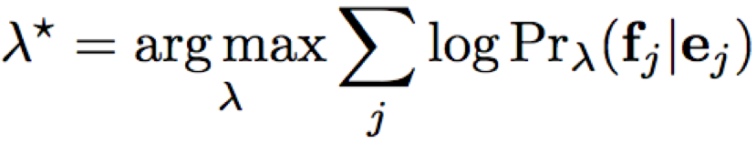
Synchronous Derivations and Translation Model
Need to make a probabilistic version of synchronous grammars to create a translation model for P(F | E).
Each synchronous production rule is given a weight λ_{i} that is used in a maximum-entropy (log linear) model.
Parameters are learned to maximize the conditional log-likelihood of the training data.

Slide 68
Neural Machine Translation (NMT)
Encoder/Decoder framework maps sentence in source language to a "deep vector" then another LSTM maps this vector to a sentence in the target language
Encoder
LSTM
Decoder
LSTM
F₁, F₂,…,F_{n}
h_{n}
E₁, E₂,…,E_{m}
Train model "end to end" on sentence-aligned parallel corpus.

Slide 69
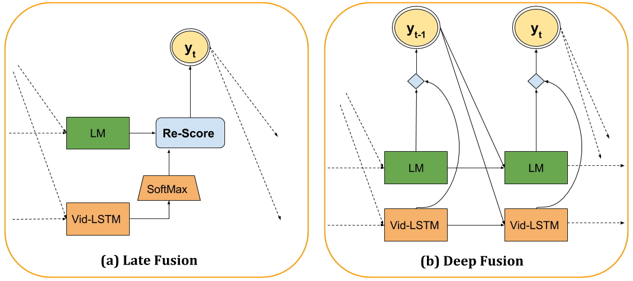
NMT with Language Model
Vanilla LSTM approach does not use a language model so does not exploit monolingual data for the target language.
Can integrate an LSTM language model using “deep fusion.”
Decoder predicts the next word from a concatenation of the hidden states of both the translation and language LSTM models.
Softmax
Concatenate
TM
TM

Slide 70
Conclusions
MT methods can usefully exploit various amounts of syntactic and semantic processing along the Vauquois triangle.
Statistical MT methods can automatically learn a translation system from a parallel corpus.
Typically use a noisy-channel model to exploit both a bilingual translation model and a monolingual language model.
Neural LSTM methods are currently the state-of-the-art.

