Slide 1
CS 388:
Natural Language Processing:
Word Sense Disambiguation
Raymond J. Mooney
University of Texas at Austin

Slide 2
Lexical Ambiguity
Most words in natural languages have multiple possible meanings.
  “pen” (noun)
    The dog is in the pen.
    The ink is in the pen.
  “take” (verb)
    Take one pill every morning.
    Take the first right past the stoplight.
Syntax helps distinguish meanings for different parts of speech of an ambiguous word.
  “conduct” (noun or verb)
    John’s conduct in class is unacceptable.
    John will conduct the orchestra on Thursday.

Slide 3
Motivation for
Word Sense Disambiguation (WSD)
Many tasks in natural language processing require disambiguation of ambiguous words.
  Question Answering
  Information Retrieval
  Machine Translation
  Text Mining
  Phone Help Systems
Understanding how people disambiguate words is an interesting problem that can provide insight in psycholinguistics.

Slide 4
Sense Inventory
What is a “sense” of a word?
  Homonyms (disconnected meanings)
    bank: financial institution
    bank: sloping land next to a river
  Polysemes (related meanings with joint etymology)
    bank: financial institution as corporation
    bank: a building housing such an institution
Sources of sense inventories
  Dictionaries
  Lexical databases

Slide 5
WordNet
A detailed database of semantic relationships between English words.
Developed by famous cognitive psychologist George Miller and a team at Princeton University.
About 144,000 English words.
Nouns, adjectives, verbs, and adverbs grouped into about 109,000 synonym sets called synsets.

Slide 6
WordNet Synset Relationships
Antonym: front → back
Attribute: benevolence → good (noun to adjective)
Pertainym: alphabetical → alphabet (adjective to noun)
Similar: unquestioning → absolute
Cause: kill → die
Entailment: breathe → inhale
Holonym: chapter → text (part to whole)
Meronym: computer → cpu (whole to part)
Hyponym: plant → tree (specialization)
Hypernym: apple → fruit (generalization)

Slide 7
EuroWordNet
WordNets for
  Dutch
  Italian
  Spanish
  German
  French
  Czech
  Estonian

Slide 8
WordNet Senses
WordNets senses (like many dictionary senses) tend to be very fine-grained.
“play” as a verb has 35 senses, including
  play a role or part: “Gielgud played Hamlet”
  pretend to have certain qualities or state of mind: “John played dead.”
Difficult to disambiguate to this level for people and computers. Only expert lexicographers are perhaps able to reliably differentiate senses.
Not clear such fine-grained senses are useful for NLP.
Several proposals for grouping senses into coarser, easier to identify senses (e.g. homonyms only).

Slide 9
Senses Based on Needs of Translation
Only distinguish senses that are translate to different words in some other language.
  play: tocar vs. jugar
  know: conocer vs. saber
  be: ser vs. estar
  leave: salir vs dejar
  take: llevar vs. tomar vs. sacar
May still require overly fine-grained senses
  river in French is either:
    fleuve: flows into the ocean
    rivière: does not flow into the ocean

Slide 10
Learning for WSD
Assume part-of-speech (POS), e.g. noun, verb, adjective, for the target word is determined.
Treat as a classification problem with the appropriate potential senses for the target word given its POS as the categories.
Encode context using a set of features to be used for disambiguation.
Train a classifier on labeled data encoded using these features.
Use the trained classifier to disambiguate future instances of the target word given their contextual features.

Slide 11
Feature Engineering
The success of machine learning requires instances to be represented using an effective set of features that are correlated with the categories of interest.
Feature engineering can be a laborious process that requires substantial human expertise and knowledge of the domain.
In NLP it is common to extract many (even thousands of) potentially features and use a learning algorithm that works well with many relevant and irrelevant features.

Slide 12
Contextual Features
Surrounding bag of words.
POS of neighboring words
Local collocations
Syntactic relations
Experimental evaluations indicate that all of these features are useful; and the best results comes from integrating all of these cues in the disambiguation process.

Slide 13
Surrounding Bag of Words
Unordered individual words near the ambiguous word.
Words in the same sentence.
May include words in the previous sentence or surrounding paragraph.
Gives general topical cues of the context.
May use feature selection to determine a smaller set of words that help discriminate possible senses.
May just remove common “stop words” such as articles, prepositions, etc.

Slide 14
POS of Neighboring Words
Use part-of-speech of immediately neighboring words.
Provides evidence of local syntactic context.
P_{-i} is the POS of the word i positions to the left of the target word.
P_{i} is the POS of the word i positions to the right of the target word.
Typical to include features for:
P₋₃, P₋₂, P₋₁, P₁, P₂, P₃

Slide 15
Local Collocations
Specific lexical context immediately adjacent to the word.
For example, to determine if “interest” as a noun refers to “readiness to give attention” or “money paid for the use of money”, the following collocations are useful:
  “in the interest of”
  “an interest in”
  “interest rate”
  “accrued interest”
C_{i,j} is a feature of the sequence of words from local position i to j relative to the target word.
  C_{-2,1} for “in the interest of” is “in the of”
Typical to include:
  Single word context: C_{-1,-1} , C_{1,1}, C_{-2,-2}, C_{2,2}
  Two word context: C_{-2,-1}, C_{-1,1} ,C_{1,2}
  Three word context: C_{-3,-1}, C_{-2,1}, C_{-1,2}, C_{1,3}

Slide 16
Syntactic Relations
(Ambiguous Verbs)
For an ambiguous verb, it is very useful to know its direct object.
  “played the game”
  “played the guitar”
  “played the risky and long-lasting card game”
  “played the beautiful and expensive guitar”
  “played the big brass tuba at the football game”
  “played the game listening to the drums and the tubas”
May also be useful to know its subject:
  “The game was played while the band played.”
  “The game that included a drum and a tuba was played on Friday.”

Slide 17
Syntactic Relations
(Ambiguous Nouns)
For an ambiguous noun, it is useful to know what verb it is an object of:
  “played the piano and the horn”
  “wounded by the rhinoceros’ horn”
May also be useful to know what verb it is the subject of:
  “the bank near the river loaned him $100”
  “the bank is eroding and the bank has given the city the money to repair it”

Slide 18
Syntactic Relations
(Ambiguous Adjectives)
For an ambiguous adjective, it useful to know the noun it is modifying.
  “a brilliant young man”
  “a brilliant yellow light”
  “a wooden writing desk”
  “a wooden acting performance”

Slide 19
Using Syntax in WSD
Produce a parse tree for a sentence using a syntactic parser.
For ambiguous verbs, use the head word of its direct object and of its subject as features.
For ambiguous nouns, use verbs for which it is the object and the subject as features.
For ambiguous adjectives, use the head word (noun) of its NP as a feature.
S
NP
VP
ProperN
V
NP
John
played
DET
N
the
piano

Slide 20
Evaluation of WSD
“In vitro”:
  Corpus developed in which one or more ambiguous words are labeled with explicit sense tags according to some sense inventory.
  Corpus used for training and testing WSD and evaluated using accuracy (percentage of labeled words correctly disambiguated).
    Use most common sense selection as a baseline.
“In vivo”:
  Incorporate WSD system into some larger application system, such as machine translation, information retrieval, or question answering.
  Evaluate relative contribution of different WSD methods by measuring performance impact on the overall system on final task (accuracy of MT, IR, or QA results).

Slide 21
Lexical Sample vs. All Word Tagging
Lexical sample:
  Choose one or more ambiguous words each with a sense inventory.
  From a larger corpus, assemble sample occurrences of these words.
  Have humans mark each occurrence with a sense tag.
All words:
  Select a corpus of sentences.
  For each ambiguous word in the corpus, have humans mark it with a sense tag from an broad-coverage lexical database (e.g. WordNet).

Slide 22
SenseEval
Standardized international “competition” on WSD.
Organized by the Association for Computational Linguistics (ACL) Special Interest Group on the Lexicon (SIGLEX).
After 2007, evolved in broader “SemEval” competition.

Slide 23
Senseval 1: 1998
Datasets for
  English
  French
  Italian
Lexical sample in English
  Noun: accident, behavior, bet, disability, excess, float, giant, knee, onion, promise, rabbit, sack, scrap, shirt, steering
  Verb: amaze, bet, bother, bury, calculate, consumer, derive, float, invade, promise, sack, scrap, sieze
  Adjective: brilliant, deaf, floating, generous, giant, modest, slight, wooden
  Indeterminate: band, bitter, hurdle, sanction, shake
Total number of ambiguous English words tagged: 8,448

Slide 24
Senseval 1 English Sense Inventory
Senses from the HECTOR lexicography project.
Multiple levels of granularity
  Coarse grained (avg. 7.2 senses per word)
  Fine grained (avg. 10.4 senses per word)

Slide 25
Senseval Metrics
Fixed training and test sets, same for each system.
System can decline to provide a sense tag for a word if it is sufficiently uncertain.
Measured quantities:
  A: number of words assigned senses
  C: number of words assigned correct senses
  T: total number of test words
Metrics:
  Precision = C/A
  Recall = C/T

Slide 26
Senseval 1 Overall English Results
 | Fine grained precision (recall) | Course grained precision (recall)
Human Lexicographer Agreement | 97% (96%) | 97% (97%)
Most common sense baseline | 57% (50%) | 63% (56%)
Best system | 77% (77%) | 81% (81%)

Slide 27
Senseval 2: 2001
More languages: Chinese, Danish, Dutch, Czech, Basque, Estonian, Italian, Korean, Spanish, Swedish, Japanese, English
Includes an “all-words” task as well as lexical sample.
Includes a “translation” task for Japanese, where senses correspond to distinct translations of a word into another language.
35 teams competed with over 90 systems entered.

Slide 28
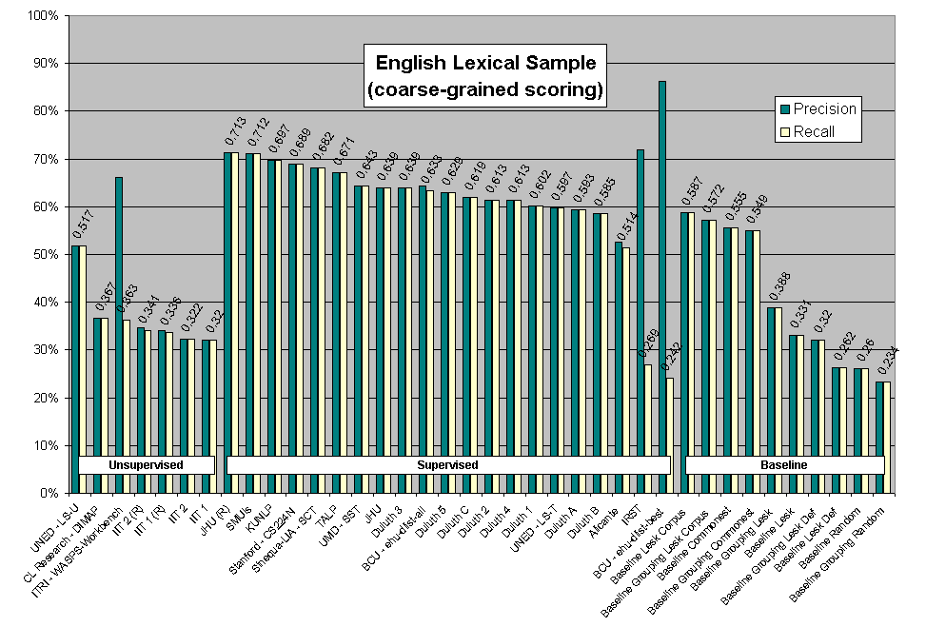
Senseval 2 Results

Slide 29
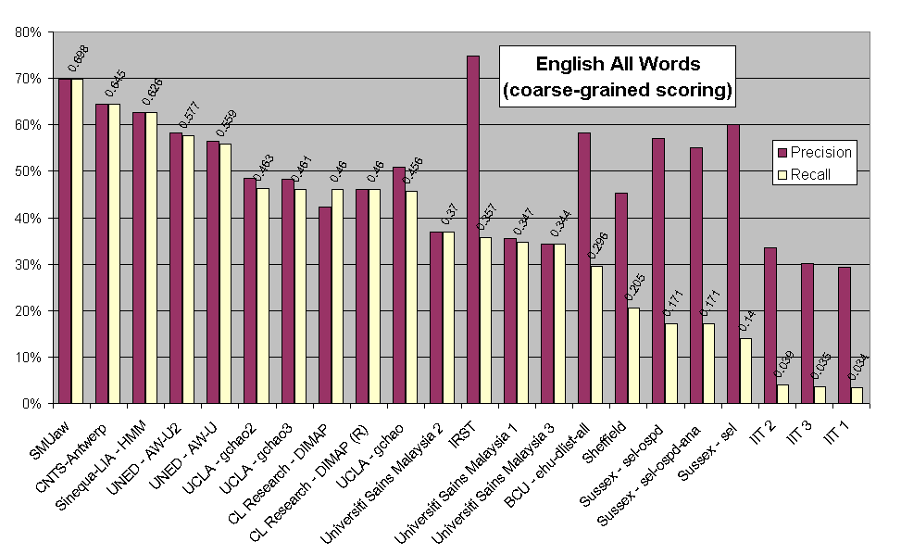
Senseval 2 Results

Slide 30
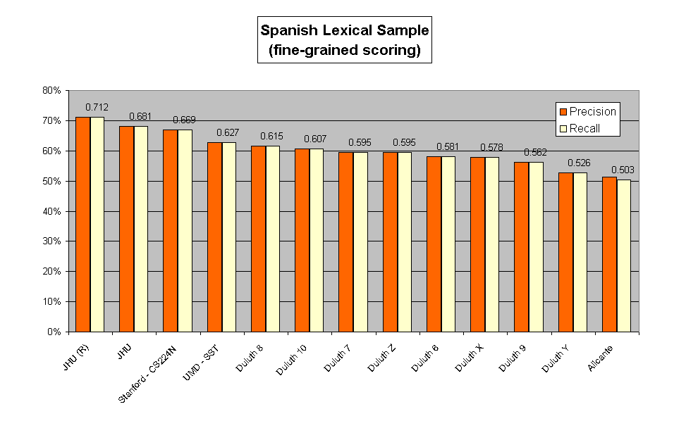
Senseval 2 Results

Slide 31
Issues in WSD
What is the right granularity of a sense inventory?
Integrating WSD with other NLP tasks
  Syntactic parsing
  Semantic role labeling
  Semantic parsing
Does WSD actually improve performance on some real end-user task?
  Information retrieval
  Information extraction
  Machine translation
  Question answering

