Slide 1
CS 388:
Natural Language Processing:
Information Extraction
Raymond J. Mooney
University of Texas at Austin

Slide 2
Information Extraction (IE)
Identify specific pieces of structured information (data) in a unstructured or semi-structured textual document.
Transform unstructured information in a corpus of documents or web pages into a structured database.
Applied to different types of text:
  Newspaper articles
  Web pages
  Scientific articles
  Newsgroup messages
  Classified ads
  Medical notes

Slide 3
Sample Job Posting
Subject: US-TN-SOFTWARE PROGRAMMER
Date: 17 Nov 1996 17:37:29 GMT
Organization: Reference.Com Posting Service
Message-ID: <56nigp$mrs@bilbo.reference.com>
SOFTWARE PROGRAMMER
Position available for Software Programmer experienced in generating software for PC-Based Voice Mail systems. Experienced in C Programming. Must be familiar with communicating with and controlling voice cards; preferable Dialogic, however, experience with others such as Rhetorix and Natural Microsystems is okay. Prefer 5 years or more
experience with PC Based Voice Mail, but will consider as little as 2 years. Need to find a Senior level person who can come on board and pick up code with very little training.
Present Operating System is DOS. May go to OS-2 or UNIX in future.
Please reply to:
Kim Anderson
AdNET
(901) 458-2888 fax
kimander@memphisonline.com
Subject: US-TN-SOFTWARE PROGRAMMER
Date: 17 Nov 1996 17:37:29 GMT
Organization: Reference.Com Posting Service
Message-ID: <56nigp$mrs@bilbo.reference.com>
SOFTWARE PROGRAMMER
Position available for Software Programmer experienced in generating software for PC-Based Voice Mail systems. Experienced in C Programming. Must be familiar with communicating with and controlling voice cards; preferable Dialogic, however, experience with others such as Rhetorix and Natural Microsystems is okay. Prefer 5 years or more
experience with PC Based Voice Mail, but will consider as little as 2 years. Need to find a Senior level person who can come on board and pick up code with very little training.
Present Operating System is DOS. May go to OS-2 or UNIX in future.
Please reply to:
Kim Anderson
AdNET
(901) 458-2888 fax
kimander@memphisonline.com

Slide 4
Extracted Job Template
computer_science_job
id: 56nigp$mrs@bilbo.reference.com
title: SOFTWARE PROGRAMMER
salary:
company:
recruiter:
state: TN
city:
country: US
language: C
platform: PC \ DOS \ OS-2 \ UNIX
application:
area: Voice Mail
req_years_experience: 2
desired_years_experience: 5
req_degree:
desired_degree:
post_date: 17 Nov 1996

Slide 5
Named Entity Recognition
Specific type of information extraction in which the goal is to extract formal names of particular types of entities such as people, places, organizations, etc.
Usually a preprocessing step for subsequent task-specific IE, or other tasks such as question answering.

Slide 6
Named Entity Recognition Example
U.S. Supreme Court quashes 'illegal' Guantanamo trials
Military trials arranged by the Bush administration for detainees at Guantanamo Bay are illegal, the United States Supreme Court ruled Thursday. The court found that the trials — known as military commissions — for people detained on suspicion of terrorist activity abroad do not conform to any act of Congress. The justices also rejected the government's argument that the Geneva Conventions regarding prisoners of war do not apply to those held at Guantanamo Bay. Writing for the 5-3 majority, Justice Stephen Breyer said the White House had overstepped its powers under the U.S. Constitution. "Congress has not issued the executive a blank cheque," Breyer wrote.
President George W. Bush said he takes the ruling very seriously and would find a way to both respect the court's findings and protect the American people.

Slide 7
Named Entity Recognition Example
people places organizations
U.S. Supreme Court quashes 'illegal' Guantanamo trials
Military trials arranged by the Bush administration for detainees at Guantanamo Bay are illegal, the United States Supreme Court ruled Thursday. The court found that the trials — known as military commissions — for people detained on suspicion of terrorist activity abroad do not conform to any act of Congress. The justices also rejected the government's argument that the Geneva Conventions regarding prisoners of war do not apply to those held at Guantanamo Bay. Writing for the 5-3 majority, Justice Stephen Breyer said the White House had overstepped its powers under the U.S. Constitution. "Congress has not issued the executive a blank cheque," Breyer wrote.
President George W. Bush said he takes the ruling very seriously and would find a way to both respect the court's findings and protect the American people.

Slide 8
Relation Extraction
Once entities are recognized, identify specific relations between entities
  Employed-by
  Located-at
  Part-of
Example:
  Michael Dell is the CEO of Dell Computer Corporation and lives in Austin Texas.

Slide 9
Early Information Extraction
FRUMP (Dejong, 1979) was an early information extraction system that processed news stories and identified various types of events (e.g. earthquakes, terrorist attacks, floods).
Used “sketchy scripts” of various events to identify specific pieces of information about such events.
Able to summarize articles in multiple languages.
Relied on “brittle” hand-built symbolic knowledge structures that were hard to build and not very robust.

Slide 10
MUC
DARPA funded significant efforts in IE in the early to mid 1990’s.
Message Understanding Conference (MUC) was an annual event/competition where results were presented.
Focused on extracting information from news articles:
  Terrorist events
  Industrial joint ventures
  Company management changes
Information extraction of particular interest to the intelligence community (CIA, NSA).
Established standard evaluation methodolgy using development (training) and test data and metrics: precision, recall, F-measure.

Slide 11
Medline Corpus
TI - Two potentially oncogenic cyclins, cyclin A and cyclin D1, share common properties of subunit configuration, tyrosine phosphorylation and physical association with the Rb protein
AB - Originally identified as a ‘mitotic cyclin’, cyclin A exhibits properties of growth factor sensitivity, susceptibility to viral subversion and association with a tumor-suppressor protein, properties which are indicative of an S-phase-promoting factor (SPF) as well as a candidate proto-oncogene …
Moreover, cyclin D1 was found to be phosphorylated on tyrosine residues in vivo and, like cyclin A, was readily phosphorylated by pp60c-src in vitro.
In synchronized human osteosarcoma cells, cyclin D1 is induced in early G1 and becomes associated with p9Ckshs1, a Cdk-binding subunit.
Immunoprecipitation experiments with human osteosarcoma cells and Ewing’s sarcoma cells demonstrated that cyclin D1 is associated with both p34cdc2 and p33cdk2, and that cyclin D1 immune complexes exhibit appreciable histone H1 kinase activity …

Slide 12
Medline Corpus:
Named Entity Recognition (Proteins)
TI - Two potentially oncogenic cyclins, cyclin A and cyclin D1, share common properties of subunit configuration, tyrosine phosphorylation and physical association with the Rb protein
AB - Originally identified as a ‘mitotic cyclin’, cyclin A exhibits properties of growth factor sensitivity, susceptibility to viral subversion and association with a tumor-suppressor protein, properties which are indicative of an S-phase-promoting factor (SPF) as well as a candidate proto-oncogene …
Moreover, cyclin D1 was found to be phosphorylated on tyrosine residues in vivo and, like cyclin A, was readily phosphorylated by pp60c-src in vitro.
In synchronized human osteosarcoma cells, cyclin D1 is induced in early G1 and becomes associated with p9Ckshs1, a Cdk-binding subunit.
Immunoprecipitation experiments with human osteosarcoma cells and Ewing’s sarcoma cells demonstrated that cyclin D1 is associated with both p34cdc2 and p33cdk2, and that cyclin D1 immune complexes exhibit appreciable histone H1 kinase activity …

Slide 13
Medline Corpus: Relation Extraction
Protein Interactions
TI - Two potentially oncogenic cyclins, cyclin A and cyclin D1, share common properties of subunit configuration, tyrosine phosphorylation and physical association with the Rb protein
AB - Originally identified as a ‘mitotic cyclin’, cyclin A exhibits properties of growth factor sensitivity, susceptibility to viral subversion and association with a tumor-suppressor protein, properties which are indicative of an S-phase-promoting factor (SPF) as well as a candidate proto-oncogene …
Moreover, cyclin D1 was found to be phosphorylated on tyrosine residues in vivo and, like cyclin A, was readily phosphorylated by pp60c-src in vitro.
In synchronized human osteosarcoma cells, cyclin D1 is induced in early G1 and becomes associated with p9Ckshs1, a Cdk-binding subunit.
Immunoprecipitation experiments with human osteosarcoma cells and Ewing’s sarcoma cells demonstrated that cyclin D1 is associated with both p34cdc2 and p33cdk2, and that cyclin D1 immune complexes exhibit appreciable histone H1 kinase activity …

Slide 14
Web Extraction
Many web pages are generated automatically from an underlying database.
Therefore, the HTML structure of pages is fairly specific and regular (semi-structured).
However, output is intended for human consumption, not machine interpretation.
An IE system for such generated pages allows the web site to be viewed as a structured database.
An extractor for a semi-structured web site is sometimes referred to as a wrapper.
Process of extracting from such pages is sometimes referred to as screen scraping.

Slide 15
Amazon Book Description
….
</td></tr>
</table>
<b class="sans">The Age of Spiritual Machines : When Computers Exceed Human Intelligence</b><br>
<font face=verdana,arial,helvetica size=-1>
by <a href="/exec/obidos/search-handle-url/index=books&field-author=
Kurzweil%2C%20Ray/002-6235079-4593641">
Ray Kurzweil</a><br>
</font>
<br>
<a href="http://images.amazon.com/images/P/0140282025.01.LZZZZZZZ.jpg">
<img src="http://images.amazon.com/images/P/0140282025.01.MZZZZZZZ.gif" width=90
height=140 align=left border=0></a>
<font face=verdana,arial,helvetica size=-1>
<span class="small">
<span class="small">
<b>List Price:</b> <span class=listprice>$14.95</span><br>
<b>Our Price: <font color=#990000>$11.96</font></b><br>
<b>You Save:</b> <font color=#990000><b>$2.99 </b>
(20%)</font><br>
</span>
<p> <br>
….
</td></tr>
</table>
<b class="sans">The Age of Spiritual Machines : When Computers Exceed Human Intelligence</b><br>
<font face=verdana,arial,helvetica size=-1>
by <a href="/exec/obidos/search-handle-url/index=books&field-author=
Kurzweil%2C%20Ray/002-6235079-4593641">
Ray Kurzweil</a><br>
</font>
<br>
<a href="http://images.amazon.com/images/P/0140282025.01.LZZZZZZZ.jpg">
<img src="http://images.amazon.com/images/P/0140282025.01.MZZZZZZZ.gif" width=90
height=140 align=left border=0></a>
<font face=verdana,arial,helvetica size=-1>
<span class="small">
<span class="small">
<b>List Price:</b> <span class=listprice>$14.95</span><br>
<b>Our Price: <font color=#990000>$11.96</font></b><br>
<b>You Save:</b> <font color=#990000><b>$2.99 </b>
(20%)</font><br>
</span>
<p> <br>…

Slide 16
Extracted Book Template
Title: The Age of Spiritual Machines :
When Computers Exceed Human Intelligence
Author: Ray Kurzweil
List-Price: $14.95
Price: $11.96
:
:

Slide 17
IE as Sequence Labeling
Can treat IE as a sequence labeling problem.
Can apply a sliding window classifier using various classification algorithms.
Can apply sequence models:
  HMM
  CRF
  LSTM

Slide 18
Pattern-Matching Rule Extraction
Another approach to building IE systems is to use pattern-matching rules for each field to identify the strings to extract for that field.
When building web extraction systems (wrappers) manually, it is common to write regular expression patterns (in a language like Perl) to identify the desired regions of the text.
Works well when a fairly fixed local context is sufficient to identify extractions, as in extracting from web pages generated by a program or very stylized text like classified ads.

Slide 19
Regular Expressions
Language for composing complex patterns from simpler ones.
  An individual character is a regex.
  Union: If e₁ and e₂ are regexes, then (e₁ | e₂ ) is a regex that matches whatever either e₁ or e₂ matches.
  Concatenation: If e₁ and e₂ are regexes, then e₁ e₂ is a regex that matches a string that consists of a substring that matches e₁ immediately followed by a substring that matches e₂
  Repetition (Kleene closure): If e₁ is a regex, then e₁* is a regex that matches a sequence of zero or more strings that match e₁

Slide 20
Enhanced Regex’s (Perl)
Special terms for common sets of characters, such as alphabetic or numeric or general “wildcard”.
Special repetition operator (+) for 1 or more occurrences.
Special optional operator (?) for 0 or 1 occurrences.
Special repetition operator for specific range of number of occurrences: {min,max}.
  A{1,5} One to five A’s.
  A{5,} Five or more A’s
  A{5} Exactly five A’s

Slide 21
Perl Regex’s
Character classes:
  \w (word char) Any alpha-numeric (not: \W)
  \d (digit char) Any digit (not: \D)
  \s (space char) Any whitespace (not: \S)
  . (wildcard) Anything
Anchor points:
  \b (boundary) Word boundary
  ^ Beginning of string
  $ End of string

Slide 22
Perl Regex Examples
U.S. phone number with optional area code:
  /\b(\(\d{3}\)\s?)?\d{3}-\d{4}\b/
Email address:
  /\b\S+@\S+(\.com|\.edu|\.gov|\.org|\.net)\b/

Slide 23
Simple Extraction Patterns
Specify an item to extract for a slot using a regular expression pattern.
  Price pattern: “\b\$\d+(\.\d{2})?\b”
May require preceding (pre-filler) pattern to identify proper context.
  Amazon list price:
    Pre-filler pattern: “<b>List Price:</b> <span class=listprice>”
    Filler pattern: “\$\d+(\.\d{2})?\b”
May require succeeding (post-filler) pattern to identify the end of the filler.
  Amazon list price:
    Pre-filler pattern: “<b>List Price:</b> <span class=listprice>”
    Filler pattern: “.+”
    Post-filler pattern: “</span>”

Slide 24
Adding NLP Information to Patterns
If extracting from automatically generated web pages, simple regex patterns usually work.
If extracting from more natural, unstructured, human-written text, some NLP may help.
  Part-of-speech (POS) tagging
    Mark each word as a noun, verb, preposition, etc.
  Syntactic parsing
    Identify phrases: NP, VP, PP
  Semantic word categories (e.g. from WordNet)
    KILL: kill, murder, assassinate, strangle, suffocate
Extraction patterns can use POS or phrase tags.
  Crime victim:
    Prefiller: [POS: V, Hypernym: KILL]
    Filler: [Phrase: NP]

Slide 25
Pattern-Match Rule Learning
Writing accurate patterns for each slot for each application requires laborious software engineering.
Alternative is to use rule induction methods.
RAPIER system (Califf & Mooney, 1999) learns three regex-style patterns for each slot:
  Pre-filler pattern
  Filler pattern
  Post-filler pattern
RAPIER allows use of POS and WordNet categories in patterns to generalize over lexical items.

Slide 26
RAPIER Pattern Induction Example
If goal is to extract the name of the city in which a posted job is located, the least-general-generalization constructed by RAPIER is:
“…located in Atlanta, Georgia…”
“…offices in Kansas City, Missouri…”
Rapier
Pattern Induction
Prefiller: “in” as Prep
Filler: 1 to 2 PropNouns
Postfiller: PropNoun which is a State

Slide 27
Evaluating IE Accuracy
Always evaluate performance on independent, manually-annotated test data not used during system development.
Measure for each test document:
  Total number of correct extractions in the solution template: N
  Total number of slot/value pairs extracted by the system: E
  Number of extracted slot/value pairs that are correct (i.e. in the solution template): C
Compute average value of metrics adapted from IR:
  Recall = C/N
  Precision = C/E
  F-Measure = Harmonic mean of recall and precision

Slide 28
IE Experiment in Bioinformatics
Large scale comparison of IE methods on identifying names of human proteins in biomedical journal abstracts (Bunescu et al. 2004).
Goal is to mine the large body of biomedical literature to extract a useful database of all known protein interactions.
Biologists can use this “protein network” to better understand the overall biochemical functioning of an organism.

Slide 29
Non-Learning Protein Extractors
Dictionary-based extraction
  Uses a “gazetteer” of known human protein names.
KEX (Fukuda et al., 1998)
  General protein-name identifier not specialized for human.

Slide 30
Learning Methods for Protein Extraction
Rule-based pattern induction
  Rapier (Califf & Mooney, 1999)
  BWI (Freitag & Kushmerick, 2000)
Token classification (BIO chunking approach):
  K-nearest neighbor
  Transformation-Based Rule Learning Abgene (Tanabe & Wilbur, 2002)
  Support Vector Machine (maximum-margin Perceptron)
  Maximum entropy (discriminative version of Naïve Bayes)

Slide 31
Biomedical Corpora
AIMed: 750 abstracts that contain the word human were randomly chosen from Medline for testing protein name extraction. They were manually tagged by experts to annotate a total of 5,206 human protein references (Bunescu et al., 2005).
Notes:
Extra slide 1

Slide 32
Experimental Method
10-fold cross-validation: Average results over 10 trials with different training and (independent) test data.
For methods which produce confidence in extractions, vary threshold for extraction in order to explore recall-precision trade-off.
Use standard methods from information-retrieval to generate a complete precision-recall curve.
Maximizing F-measure assumes a particular cost-benefit trade-off between incorrect and missed extractions.

Slide 33
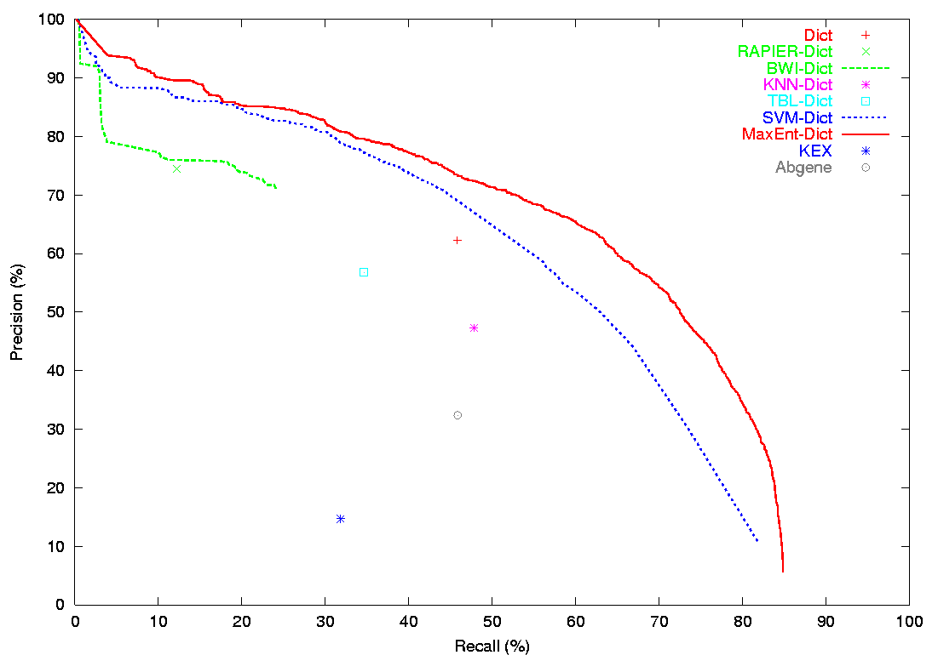
Protein Name Extraction Results
AIMed Corpus
Notes:
Show PR curves.

Slide 34
Relation Extraction
Biomedical corpora => Interactions between Proteins.
interaction
protein
protein
Cyclin D1 is induced in early G1 and becomes associated with p9Ckshs1, a Cdk binding subunit.
Newspaper corpora => relationships (e.g. Role, Part, Location, Near, Social) between predefined types of entities (e.g. Person, Organization, Facility, Location, Geo-Political).
location
location
people
facility
people
Protesters seized several pumping stations, holding 127 Shell workers hostage.

Slide 35
Relation Extraction as
Classification
For a given relation, classify each pair of type-consistent entities that are in the same sentence as having that relation or not.
  Location: Classify each pair of People and Facility.
??
??
location
location
people
facility
people
Protesters seized several pumping stations, holding 127 Shell workers hostage.

Slide 36
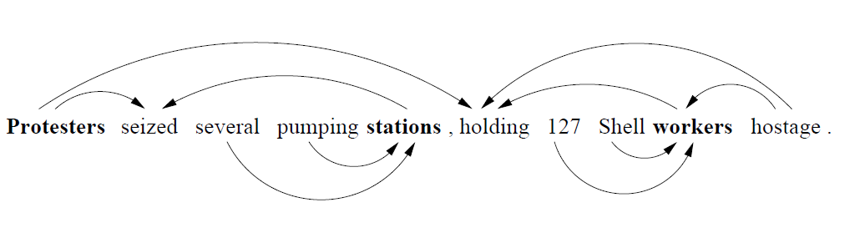
Sequence to Classify
Word sequence between the entities
Dependency path between the entities
??
??
location
location
people
facility
people
Protesters seized several pumping stations, holding 127 Shell workers hostage.

Slide 37
Classifying for Relations
String kernel on word sequences or dependency paths (Bunescu & Mooney, 2005; 2006).
LSTMs (Xu et al., 2015; Li et al., 2015) or CNNs (dos Santos et al., 2015) on word sequences and/or dependency paths.
Joint entity and relation extraction using LSTMs (Miwa & Bansal, 2016).

Slide 38
Text Mining with IE
Automatically extract information from a large corpus to build a large database or knowledge-base of useful information.
For example, we have used our trained protein interaction extractor to mine biomedical journal abstracts:
  Input: 753,459 Medline abstracts that reference “human”
  Output: Database of 6,580 interactions between 3,737 human proteins

Slide 39
Open Information Extraction
Unsupervised approach to extraction in which the set of relations to extract are not predefined.
Use dependency parses to extract specific lexical relations between entities and cluster these paths to define an ontology of extracted relations.

