Slide 1
Story Understanding and Script Learning
Raymond J. Mooney
University of Texas at Austin
1
1
Notes:
1
1

Slide 2
AI–NLP in the 70’s and early 80’s
Focused on knowledge representation and complex inference.
Focused on story understanding and interpreting characters goals and plans (Charniak, Schank et al.)
Focused on dialog understanding that inferred participants goals and plans.
Required extensive manual symbolic knowledge engineering.
Only worked on a small number of specially concocted illustrative examples.
Brittle and difficult to generalize to robust, reliable performance on unseen examples.

Slide 3
Conceptual Dependency
Semantic representation developed by Schank in his UT thesis in 1969.
Represents meaning using a frame-like representation based on a set of semantic primitives with slots for semantic roles.
PTRANS: Physical transfer, e.g. go, drive
ATRANS: Abstract transfer of ownership, e.g. give, sell.
MTRANS: Mental transfer of information, e.g. tell, email.
INGEST: Take into the body, e.g. eat, drink.

Slide 4
Conceptual Dependency Example
John sold a Prius to Mary for $20K.
(ATRANS (AGENT John)
(OBJECT (CAR (MODEL Prius)
(FROM John) (TO Mary))
(ATRANS (AGENT Mary)
(OBJECT (MONEY (AMOUNT 20000)
(UNITS US-dollars))
(FROM Mary) (TO John))

Slide 5
Conceptual Dependency Motivation and Issues
Motivation: Reduce sentences to canonical form that supports question answering without inference.
Did Mary buy a car from John?
Did Mary give John money?
Issues:
Correct and comprehensive set of primitives is unclear
Hard to encode complex verbs like “bet”
No guidance in representing objects.
Makes semantic parsing difficult.
Only eliminates some kinds of inference.
Does Mary own a Prius?
Does John own a Prius?

Slide 6
Scripts
Knowledge of stereotypical sequences of actions used to improve text understanding (Schank & Abelson, 1977).
Used to improve text understanding by enabling:
Inference of unstated but implicit events
Resolution of syntactic and semantic ambiguities
Resolution of co-references

Slide 7
Restaurant Script
(Ptrans (agent (Person X)) (object (Person X)) (to (restaurant Y))
(Ptrans (agent (Person Z)) (object (Menu U))
(from (Person Z)) (to (Person X))
(Mtrans (agent (Person X)) (to (Person Z))
(object (Goal (agent (Person X))
(object (Ingest (agent (Person X))
(object (Food W))))))
:
(Ptrans (agent (Person Z)) (object (Food W)) (from (Person Z))
(to (Person X)))
:
(Atrans (agent (Person X)) (object (Money V)) (to (Person Z)))
:

Slide 8
Drawing Inferences
John drove to Olive Garden. He ordered lasagna. He left a big tip and went home.
What did John eat?
Answer is never explicitly stated in the text
Human readers naturally make such inferences when reading and later cannot even remember what was stated vs. inferred (Brewer & Nakamura, 1984).

Slide 9
Resolving Ambiguities
John was really hungry so he went to his favorite rib joint. He ordered a rack…
Scripts can potentially provide context to resolve many types of ambiguities.

Slide 10
Resolving Co-References
Mary walked into the hotel restaurant. The waitress brought the breakfast menu. She ordered a full stack of pancakes…..
Knowledge of script roles can provide crucial evidence to aid co-reference decisions.

Slide 11
Manually Written Scripts
SAM (Script Applier Mechanism) was the first story-understanding system to use scripts (Cullingford, 1978).
FRUMP (Fast Reading, Understanding and Memory Program) was a follow-up system that used less detailed “sketchy scripts” to process UPI newswire articles and extract info about natural disasters, crimes, terrorist events, etc. (DeJong, 1979).

Slide 12
Early Script Learning
My Ph.D. thesis research involved learning scripts (Mooney & DeJong, 1985).
Used hand-coded symbolic knowledge to “deeply understand” short, concocted stories by understanding the plans and goals of the characters.
GENESIS learned new plan schemata (e.g. kidnapping) from a single example using explanation-based learning to improve its future understanding.

Slide 13
GENESIS Trace Inititial Schema Learning
Input: Fred is Mary's father and is a millionaire. John approached Mary and pointed a gun at her. She was wearing blue jeans. He told her if she did not get in his car then he would shoot her. He drove her to his hotel and locked her in his room. John called Fred and told him John was holding Mary captive. John told Fred if Fred gave him 250000 dollars at Trenos then John would release Mary. Fred paid him the ransom and the kidnapper released Mary. Valerie is Fred's wife and he told her that someone had kidnapped Mary.
Thematic goal achieved: John is happy that John has the $250000.
Explanation suitable for generalization. Pruning...Generalizing...Packaging...
Creating New Schema: (CaptureBargain ?x55 ?a34 ?b9 ?c4 ?r5 ?y5 ?l11)
?b9 is a person. ?c4 is a location. ?r5 is a room. ?c4 is in ?r5. ?x55 is a character. ?b9 is free. ?x55 captures ?b9 and locks him/her in ?r5. ?a34 is a character. ?x55 contacts ?a34 and tells it that ?b9 is ?x55's captive. ?y5 is a valuable. ?x55 wants to have ?y5 more than it wants ?b9 to be ?x55's captive. ?a34 has a positive relationship with ?b9. ?a34 has ?y5. ?x55 and ?a34 carry out a bargain in which ?x55 releases ?b9 and ?a34 gives ?x55 ?y5 at ?l11.
Unknown word 'ransom' refers to ?y5 in CaptureBargain
Unknown word 'kidnapper' refers to ?x55 in CaptureBargain
Having: ?x55 captured ?b9. suggest CaptureBargain
Having: ?x55 contacted ?a34 and told it that ?b9 was ?x55's captive. suggest CaptureBargain
Having: ?x55 and ?a34 carried out a bargain in which ?x55 released ?b9 and ?a34 gave ?x55 ?y5 at ?l11. suggest CaptureBargain
Unknown word '?x55 kidnap ?b9' refers to CaptureBargain

Slide 14
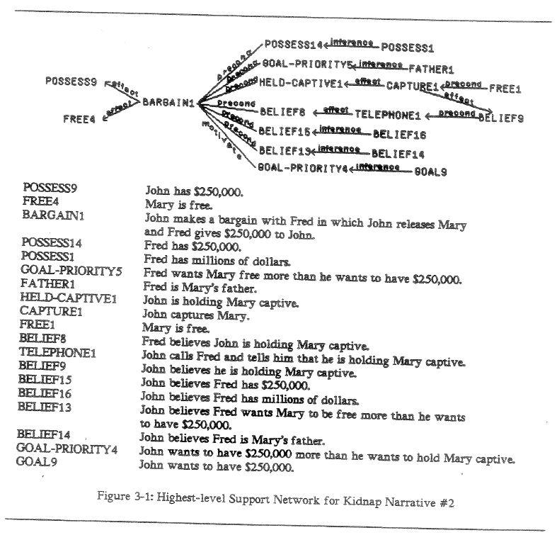
Explanation Graph of Story

Slide 15
GENESIS Trace Question Answering
Ready for questions:
>Summarize
Mary was free. John captured Mary and locked her in a room. John contacted Fred and told him that Mary was John's captive. John wanted to have $250000 more than he wanted Mary to be John's captive. Fred had a positive relationship with Mary. Fred had the $250000. John and Fred carried out a bargain in which John released Mary and Fred gave John the $250000 at Trenos.
>Why did John approach Mary?
So John could aim the gun at Mary.
>Why did John aim the gun at Mary?
So John could threaten to shoot Mary with the gun unless Mary went from John in to the car.
>Why did Mary get into the car?
Because Mary wanted not to be shot and because Mary believed that if Mary did not go from John into the car then John would shoot Mary with the gun.
>Why did John threaten to shoot Mary unless she got in the car?
So John could drive Mary to the hotel in the car.
>Why did John drive Mary to the hotel?
So John could move Mary from the hotel into the room.

Slide 16
GENESIS Trace Question Answering (Cont.)
>Why did John move Mary into the room?
So John could confine Mary in the room.
>Why did John confine Mary in the room?
So John could call Fred and could tell him that Mary was John's captive and so John and Fred could carry out a bargain in which John released Mary and Fred gave John the $250000 at Trenos.
>Why did John tell Fred that John was holding Mary captive?
So John and Fred could carry out a bargain in which John released Mary and Fred gave John the $250000 at Trenos.
>Why did Fred give John the money?
Because Fred believed that if Fred gave John the $250000 at Trenos then John would release Mary and because Fred wanted Mary to be free more than he wanted to have the $250000.
>Why did Fred have $250000?
Because Fred had millions of dollars.
>Why did Fred believe that John was holding Mary captive?
Because John called Fred and told him that Mary was John's captive.

Slide 17
GENESIS Trace Question Answering (Cont.)
>Why did Fred want Mary free?
Because Fred was Mary's father.
>Why did John release Mary?
Because John wanted to have the $250000 more than he wanted Mary to be John's captive and because John believed that if John released Mary then Fred would give John the $250000 at Trenos.

Slide 18
GENESIS Trace Using the Learned Schema
Input: Ted is Alice's husband. He won 100000 dollars in the lottery. Bob imprisoned Alice in his basement. Bob got 75000 dollars and released Alice.
Thematic goal achieved: Ted is happy that Ted has the $100000.
Thematic goal achieved: Bob is happy that Bob has the $75000.
Ready for questions:
>Summarize
Alice was free. Bob captured Alice and locked her in a basement. Bob contacted Ted and told him that Alice was Bob's captive. Bob wanted to have $75000 more than he wanted Alice to be Bob's captive. Ted had a positive relationship with Alice. Ted had the $75000. Bob and Ted carried out a bargain in which Bob released Alice and Ted gave Bob the $75000.
>Why did Bob lock Alice in his basement?
So Bob could contact Ted and could tell him that Alice was Bob's captive and so Bob and Ted could carry out a bargain in which Bob released Alice and Ted gave Bob the $75000.
>Why did Bob release Alice?
Because Bob wanted to have the $75000 more than he wanted Alice to be Bob's captive and because Bob believed that if Bob released Alice then Ted would give Bob the $75000.

Slide 19
GENESIS Trace Question Answering (Cont.)
>How did Bob get the money?
Bob kidnapped Alice.
>Who gave Bob the money?
Ted gave Bob the $75000.
>Why did Ted give him the money?
Because Ted believed that if Ted gave Bob the $75000 then Bob would release Alice and because Ted wanted Alice to be free more than he wanted to have the $75000.
>Why did Ted want Alice free?
Because Ted was Alice's husband.
>Why did Ted believe that Bob was holding Alice captive?
Because Bob contacted Ted and told him that Alice was Bob's captive.

Slide 20
Resurrection: Statistical Script Learning
Script learning was finally revived after the statistical NLP revolution by Chambers and Jurafsky (2008).
After dependency parsing, and co-reference preprocessing, they learned probabilistic models for “narrative chains”:
Knowledge of how a fixed “protagonist” serves as a particular argument of an ordered sequence of verbs in a text.

Slide 21
Background: Statistical Script Learning
Millions
of
Documents
NLP Pipeline
• Syntax
• Coreference
Millions of
Event Sequences
Train a
Statistical Model

Slide 22
Background: Statistical Script Inference
NLP Pipeline
• Syntax
• Coreference
Single
Event Sequence
New Test
Document
Inferred Probable
Events
Query Trained
Statistical Model

Slide 23
LSTM
LSTMs have recently demonstrated impressive performance on several NLP tasks:
Machine Translation (Sutskever et al., NIPS-14)
Image to text description (several, CVPR-15)
Video to text description (Venugopalan et al., NAACL-15)
We apply them to Statistical Script Learning:
Model sequences of events.
Infer new events by argmax-ing

Slide 24
LSTM Scripts
Build LSTM Models of Event Sequences.
Break events up into event components.
Train LSTM to predict sequences of components.
At each timestep, input either a verb, preposition, or verbal argument.
Learn to predict component at next timestep.

Slide 25
LSTM Script Example
“Jim sat down. He ordered a hamburger.”
[Parse, Coreference]
sit_down(jim) ; order(he, hamburger)
sit_down [verb]
jim [subj, ent1]
ø [dobj]
order [verb]
he [subj, ent1]
hamburger [dobj]

Slide 26
LSTM Script Example
Learned Output: Next Event Component
jim
ø
order
he
hamburger
</S>
`
`
`
`
`
`
`
`
`
`
`
`
sit_down
jim
ø
order
he
hamburger
Input: Verbs with Nouns

Slide 27
LSTM Script Example
`
`
`
`
`
`
`
`
`
`
`
`
`
`
`
`
`
`
sit_down
[verb]
jim
[subj]
ø
[dobj]
order
[verb]
he
[subj]
hamburger
[dobj]
Input: Verbs with Nouns, Positional Info

Slide 28
LSTM Script Example
`
`
`
`
`
`
`
`
`
`
`
`
`
`
`
`
`
`
`
`
`
`
`
`
sit_down
ø
jim
e1
ø
ø
order
ø
he
e1
hamburger
SINGLETON
Input: Verbs with Nouns, Positional Info, and Coref Info

Slide 29
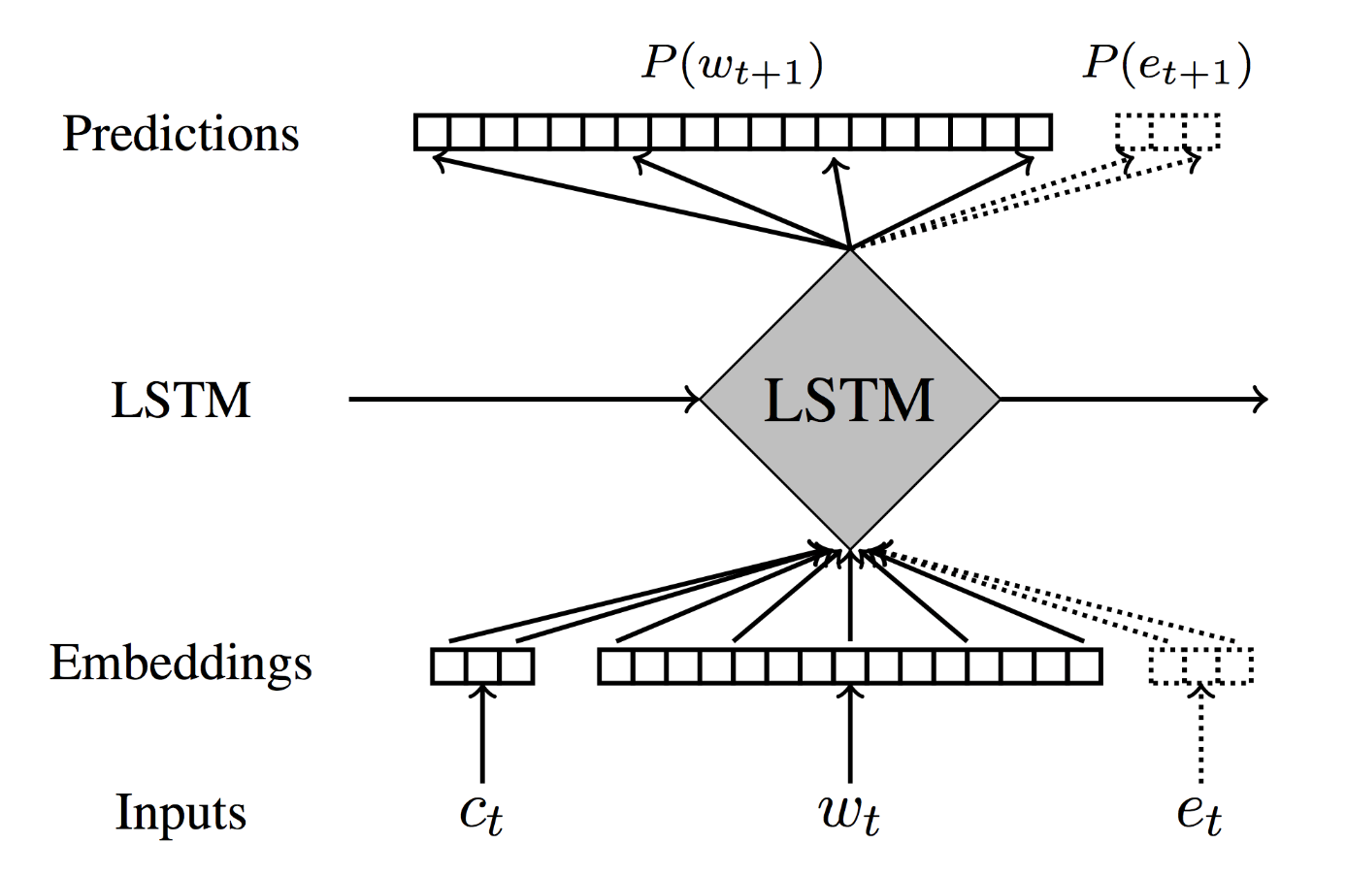
LSTM Script Model
At timestep t:
Raw inputs Learned embeddings LSTM units Predictions of next component.

Slide 30
Events in LSTM Model
Events actually have 5 components:
Verb
Subject
Direct Object
Prepositional Object
Preposition
To infer an event, perform a 5-step beam search to optimize joint probability of components.

Slide 31
Experimental Evaluation
Train on English Wikipedia.
Run Stanford Parser, Coref; extract sequences of events.
Train LSTM using Batch Stochastic Gradient Descent with Momentum.
Minimize cross-entropy loss of predictions.
Backpropagate error through layers and through time.

Slide 32
Narrative Cloze Evaluation
Narrative cloze: given an unseen document, hold out an event and try to guess it, given the arguments and other events in the document.
Recall at k: How often is the right answer in the top k guesses? (Jans et al. 2012)
We evaluate on 10,000 randomly selected held-out events from a test set.

Slide 33
Systems Evaluated
Unigram: Always guess most common event.
Bigram: Variation of Pichotta & Mooney (2014)
Uses event co-occurrence counts.
Previosuly best-published system on task.
LSTM: LSTM script system.

Slide 34
Results: Predicting Verbs & Coreference Info
Recall at 25 for inferring Verbs & Coref info

Slide 35
Results: Predicting Verbs & Nouns
Recall at 25 for inferring Verbs & Nouns

Slide 36
Human Evaluations
Solicit judgments on individual inferences on Amazon Mechanical Turk.
Have annotators rate inferences from 1-5 (or mark “Nonsense,” scored 0).
More interpretable.

Slide 37
Results: Crowdsourced Eval
“Unlikely”
“Neutral”
“Likely”
“Nonsense”
“Very Unlikely”

Slide 38
Generating “Stories”
Can use trained models to “generate stories”:
Start with <S> beginning-of-sequence pseudo-event.
Sample from distribution of initial event components (verbs first).
Take sample as first-step input, sample from distribution of next components (subjects).
Continue until </S> end-of-sequence token.

Slide 39
Generated “Story”
Generated event tuples
English Descriptions
(bear, ., ., kingdom, into)
(attend, she, brown, graduation, after)
(earn, she, master, university, from)
(admit, ., she, university, to)
(receive,she,bachelor,university,from)
(involve, ., she, production, in)
(represent, she, company, ., .)
Born into a kingdom,…
…she attended Brown after graduation
She earned her Masters from the University
She was admitted to a University
She had received a bachelors from a University
She was involved in the production
She represented the company.

Slide 40
Event Sequence Inference
NLP Pipeline
• Syntax
• Coreference
Single
Event Sequence
New Test
Document
Inferred Probable
Events
Query Trained
Statistical Model

Slide 41
Event Sequence Inference
New Test
Document
Single
Event Sequence
Inferred Probable
Events
Query Trained
Statistical Model

Slide 42
Event Sequence Inference
New Test
Document
Single
Text Sequence
Inferred Probable
Events
Query Trained
Statistical Model

Slide 43
Event Sequence Inference
New Test
Document
Single
Text Sequence
Inferred Probable
Text
Query Trained
Statistical Model

Slide 44
Event Sequence Inference
New Test
Document
Single
Text Sequence
Parse Events
from Text
Inferred Probable
Text
Query Trained
Statistical Model

Slide 45
Event Sequence Inference
Single
Text Sequence
New Test
Document
What if we use
raw text
as our
event representation?
Parse Events
from Text
Inferred Probable
Text
Query Trained
Statistical Model

Slide 46
Sentence-Level Neural Language Models
“Skip-Thought Vectors” (Kiros et al., NIPS 2015)
Use LSTMs to encode whole sentences into lower-dimensional vectors.
Vectors trained to predict previous and next sentences.
How well can such sentence-level language models infer events?

Slide 47
LSTM Event System (Pichotta & Mooney, AAAI 2016)
Predict an event from a sequence of events.
jumped(jim, from plane);
opened(he, parachute)
LSTM
landed(jim, on ground)
Optionally use another LSTM to translate event to text
LSTM
“Jim landed on the ground.”

Slide 48
LSTM Text System (Pichotta & Mooney, ACL 2016)
Predict text from text.
“Jim jumped from the plane and
opened his parachute.”
≈ [Kiros et al. 2015]
LSTM
“Jim landed on the ground.”
Parser
landed(jim, on ground)

Slide 49
Predicting Events: Evaluation
Narrative Cloze [Chambers & Jurafsky 2008]: Hold out an event from a document, judge systems’ ability to infer it.
Accuracy: “What percentage of the time does the top inference exactly match the gold standard answer?”
Partial credit: “What is the average percentage of the components of the top inference that match the gold standard?”

Slide 50
Predicting Events: Systems
Most Common: Always guess the most common event.
e1 -> e2: events to events.
t1 -> t2 -> e2: text to text to events.

Slide 51
Results: Predicting Events

Slide 52
Predicting Text: Evaluation
Compare system predicted text to actual text from document using machine translation metrics.
BLEU: Geometric mean of modified n-gram precisions.
Word-level analog to Narrative Cloze.

Slide 53
Predicting Text: Systems
t1 -> t1: Copy/paste a sentence as its predicted successor.
e1 -> e2 -> t2: events to events to text.
t1 -> t2: text to text.

Slide 54
Results: Predicting Text

Slide 55
Discussion of Results
Raw text models predict events about as well as event models.
Raw text models predict tokens better than event models.

Slide 56
Example Inference
Input: “White died two days after Curly Bill shot him.”
Gold: “Before dying, White testified that he thought the pistol had accidentally discharged and that he did not believe that Curly Bill shot him on purpose.”
Inferred: “He was buried at <UNK> Cemetery.”

Slide 57
Future Work
Human evaluation of script inferences for the LSTM text model and compare to event model.
Try a bi-directional LSTM that conditions on subsequent events as well as prior events when making predictions.
Demonstrate use of these scripts to improve co-reference and question answering.

Slide 58
Conclusions
Scripts, knowledge of stereotypical event sequences, have a long history in text understanding.
Recent statistical methods can learn scripts from raw text using only standard NLP pre-processing.
We have introduced an LSTM approach that gives more accurate inferences than previous methods, even without NLP pre-processing.

