Slide 1
CS 388: Natural Language Processing: Neural Networks
Raymond J. Mooney
University of Texas at Austin

Slide 2
Neural Network Learning
Learning approach based on modeling adaptation in biological neural systems.
Perceptron: Initial algorithm for learning simple neural networks (single layer) developed in the 1950’s.
Backpropagation: More complex algorithm for learning multi-layer neural networks developed in the 1980’s.

Slide 3
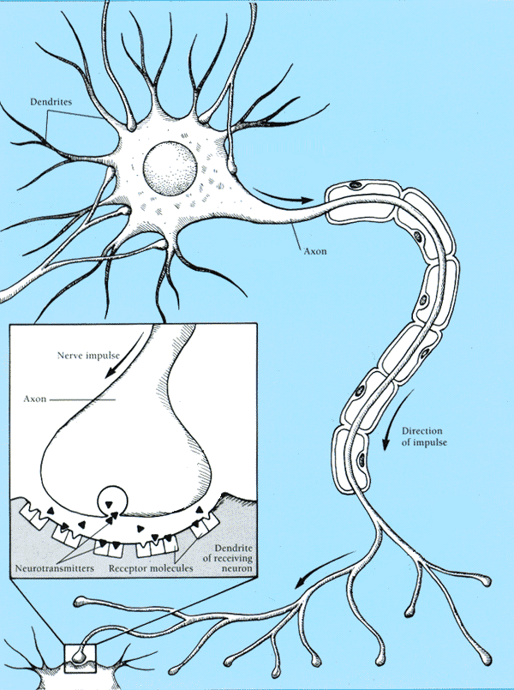
Real Neurons
Cell structures
Cell body
Dendrites
Axon
Synaptic terminals

Slide 4
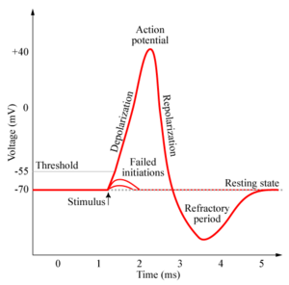
Neural Communication
Electrical potential across cell membrane exhibits spikes called action potentials.
Spike originates in cell body, travels down
axon, and causes synaptic terminals to
release neurotransmitters.
Chemical diffuses across synapse to
dendrites of other neurons.
Neurotransmitters can be excititory or
inhibitory.
If net input of neurotransmitters to a neuron from other neurons is excititory and exceeds some threshold, it fires an action potential.

Slide 5
Simple Artificial Neuron Model (Linear Threshold Unit)
Model network as a graph with cells as nodes and synaptic connections as weighted edges from node i to node j, w_{ji}
Model net input to cell as
Cell output is:
1
w₁₂
w₁₅
w₁₆
w₁₃
w₁₄
2
3
4
5
6
o_{j}
1
(T_{j} is threshold for unit j)
0
T_{j}
net_{j}

Slide 6
Perceptron Training
Assume supervised training examples giving the desired output for a unit given a set of known input activations.
Learn synaptic weights so that unit produces the correct output for each example.
Perceptron uses iterative update algorithm to learn a correct set of weights.

Slide 7
Perceptron Learning Rule
Update weights by:
where η is the “learning rate”
t_{j} is the teacher specified output for unit j.
Equivalent to rules:
If output is correct do nothing.
If output is high, lower weights on active inputs
If output is low, increase weights on active inputs
Also adjust threshold to compensate:

Slide 8
Perceptron Learning Algorithm
Iteratively update weights until convergence.
Each execution of the outer loop is typically called an epoch.
Initialize weights to random values
Until outputs of all training examples are correct
For each training pair, E, do:
Compute current output o_{j} for E given its inputs
Compare current output to target value, t_{j ,} for E
Update synaptic weights and threshold using learning rule

Slide 9
Perceptron as a Linear Separator
Since perceptron uses linear threshold function, it is searching for a linear separator that discriminates the classes.
o₃
??
Or hyperplane in
n-dimensional space
o₂

Slide 10
Concept Perceptron Cannot Learn
Cannot learn exclusive-or, or parity function in general.
o₃
1
+
–
??
–
+
0
o₂
1

Slide 11
Perceptron Convergence and Cycling Theorems
Perceptron convergence theorem: If the data is linearly separable and therefore a set of weights exist that are consistent with the data, then the Perceptron algorithm will eventually converge to a consistent set of weights.
Perceptron cycling theorem: If the data is not linearly separable, the Perceptron algorithm will eventually repeat a set of weights and threshold at the end of some epoch and therefore enter an infinite loop.
By checking for repeated weights+threshold, one can guarantee termination with either a positive or negative result.

Slide 12
Perceptron as Hill Climbing
The hypothesis space being search is a set of weights and a threshold.
Objective is to minimize classification error on the training set.
Perceptron effectively does hill-climbing (gradient descent) in this space, changing the weights a small amount at each point to decrease training set error.
For a single model neuron, the space is well behaved with a single minima.
training
error
0
weights

Slide 13
Threshold to “Bias”
Threshold can be converted to an additional “bias” weight on an additional constant 1 input (o₀=1)
Where sum now includes i=0 and w_{j0}=b_{j}

Slide 14
Multi-Layer Feed-Forward Networks
Multi-layer networks can represent arbitrary functions, but an effective learning algorithm for such networks was thought to be difficult.
A typical multi-layer network consists of an input, hidden and output layer, each fully connected to the next, with activation feeding forward.
The weights determine the function computed. Given an arbitrary number of hidden units, any boolean function can be computed with a single hidden layer.
output
hidden
activation
input

Slide 15
Hill-Climbing in Multi-Layer Nets
Since “greed is good” perhaps hill-climbing can be used to learn multi-layer networks in practice although its theoretical limits are clear.
However, to do gradient descent, we need the output of a unit to be a differentiable function of its input and weights.
Standard linear threshold function is not differentiable at the threshold.
o_{i}
1
0
T_{j}
net_{j}

Slide 16
Differentiable Output Function
Need non-linear output function to move beyond linear functions.
A multi-layer linear network is still linear.
Standard solution is to use the non-linear, differentiable sigmoidal “logistic” function:
1
0
T_{j}
net_{j}
Can also use tanh or Gaussian output function

Slide 17
Gradient Descent
Define objective to minimize error:
where D is the set of training examples, K is the set of output units, t_{kd} and o_{kd} are, respectively, the teacher and current output for unit k for example d.
The derivative of a sigmoid unit with respect to net input is:
Learning rule to change weights to minimize error is:

Slide 18
Backpropagation Learning Rule
Each weight changed by:
where η is a constant called the learning rate
t_{j} is the correct teacher output for unit j
δ_{j} is the error measure for unit j

Slide 19
Error Backpropagation
First calculate error of output units and use this to change the top layer of weights.
Current output: o_{j}=0.2
Correct output: t_{j}=1.0
Error δ_{j} = o_{j}(1–o_{j})(t_{j}–o_{j})
0.2(1–0.2)(1–0.2)=0.128
output
Update weights into j
hidden
input

Slide 20
Error Backpropagation
Next calculate error for hidden units based on errors on the output units it feeds into.
output
hidden
input

Slide 21
Error Backpropagation
Finally update bottom layer of weights based on errors calculated for hidden units.
output
hidden
Update weights into j
input

Slide 22
Backpropagation Training Algorithm
Create the 3-layer network with H hidden units with full connectivity
between layers. Set weights to small random real values.
Until all training examples produce the correct value (within ε), or
mean squared error ceases to decrease, or other termination criteria:
Begin epoch
For each training example, d, do:
Calculate network output for d’s input values
Compute error between current output and correct output for d
Update weights by backpropagating error and using learning rule
End epoch

Slide 23
Comments on Training Algorithm
Not guaranteed to converge to zero training error, may converge to local optima or oscillate indefinitely.
However, in practice, does converge to low error for many large networks on real data.
Many epochs (thousands) may be required, hours or days of training for large networks.
To avoid local-minima problems, run several trials starting with different random weights (random restarts).
Take results of trial with lowest training set error.
Build a committee of results from multiple trials (possibly weighting votes by training set accuracy).

Slide 24
Hidden Unit Representations
Trained hidden units can be seen as newly constructed features that make the target concept linearly separable in the transformed space.
On many real domains, hidden units can be interpreted as representing meaningful features such as vowel detectors or edge detectors, etc..
However, the hidden layer can also become a distributed representation of the input in which each individual unit is not easily interpretable as a meaningful feature.

Slide 25
Over-Training Prevention
Running too many epochs can result in over-fitting.
Keep a hold-out validation set and test accuracy on it after every epoch. Stop training when additional epochs actually increase validation error.
To avoid losing training data for validation:
Use internal 10-fold CV on the training set to compute the average number of epochs that maximizes generalization accuracy.
Train final network on complete training set for this many epochs.
error
on test data
on training data
0
# training epochs

Slide 26
Determining the Best Number of Hidden Units
Too few hidden units prevents the network from adequately fitting the data.
Too many hidden units can result in over-fitting.
Use internal cross-validation to empirically determine an optimal number of hidden units.
error
on test data
on training data
0
# hidden units

Slide 27
Recurrent Neural Networks (RNN)
Add feedback loops where some units’ current outputs determine some future network inputs.
RNNs can model dynamic finite-state machines, beyond the static combinatorial circuits modeled by feed-forward networks.

Slide 28
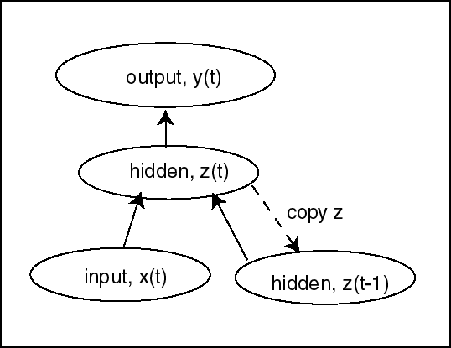
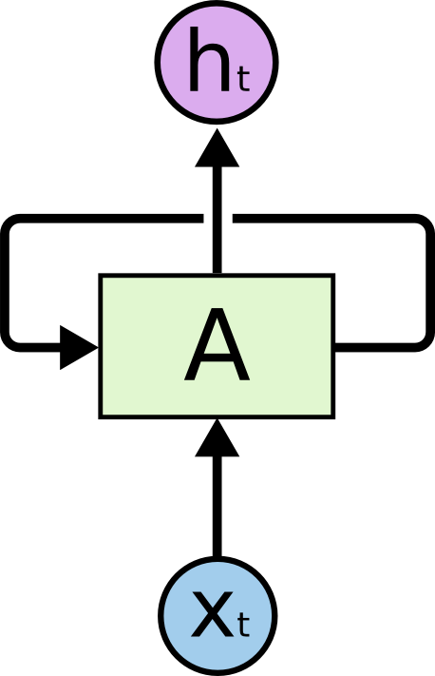
Simple Recurrent Network (SRN)
Initially developed by Jeff Elman (“Finding structure in time,” 1990).
Additional input to hidden layer is the state of the hidden layer in the previous time step.
http://colah.github.io/posts/2015-08-Understanding-LSTMs/

Slide 29

Unrolled RNN
Behavior of RNN is perhaps best viewed by “unrolling” the network over time.
time

Slide 30
Training RNN’s
RNNs can be trained using “backpropagation through time.”
Can viewed as applying normal backprop to the unrolled network.
y₀
y₁
y₂
y_{t}
training outputs
B
B
B
B
training inputs
backpropagated errors

Slide 31
Conclusions
“Feed forward” neural networks are a powerful machine learning technique for feature-vector classification.
Training becomes increasingly difficult as the number of neural layers increases.
Perceptron for training a single layer network
Backpropagation for multi-layer networks
Recurrent neural networks can perform sequence modeling and labeling, but backpropagation thru time has problems training unrolled networks that are “deep in time.”

