Slide 1
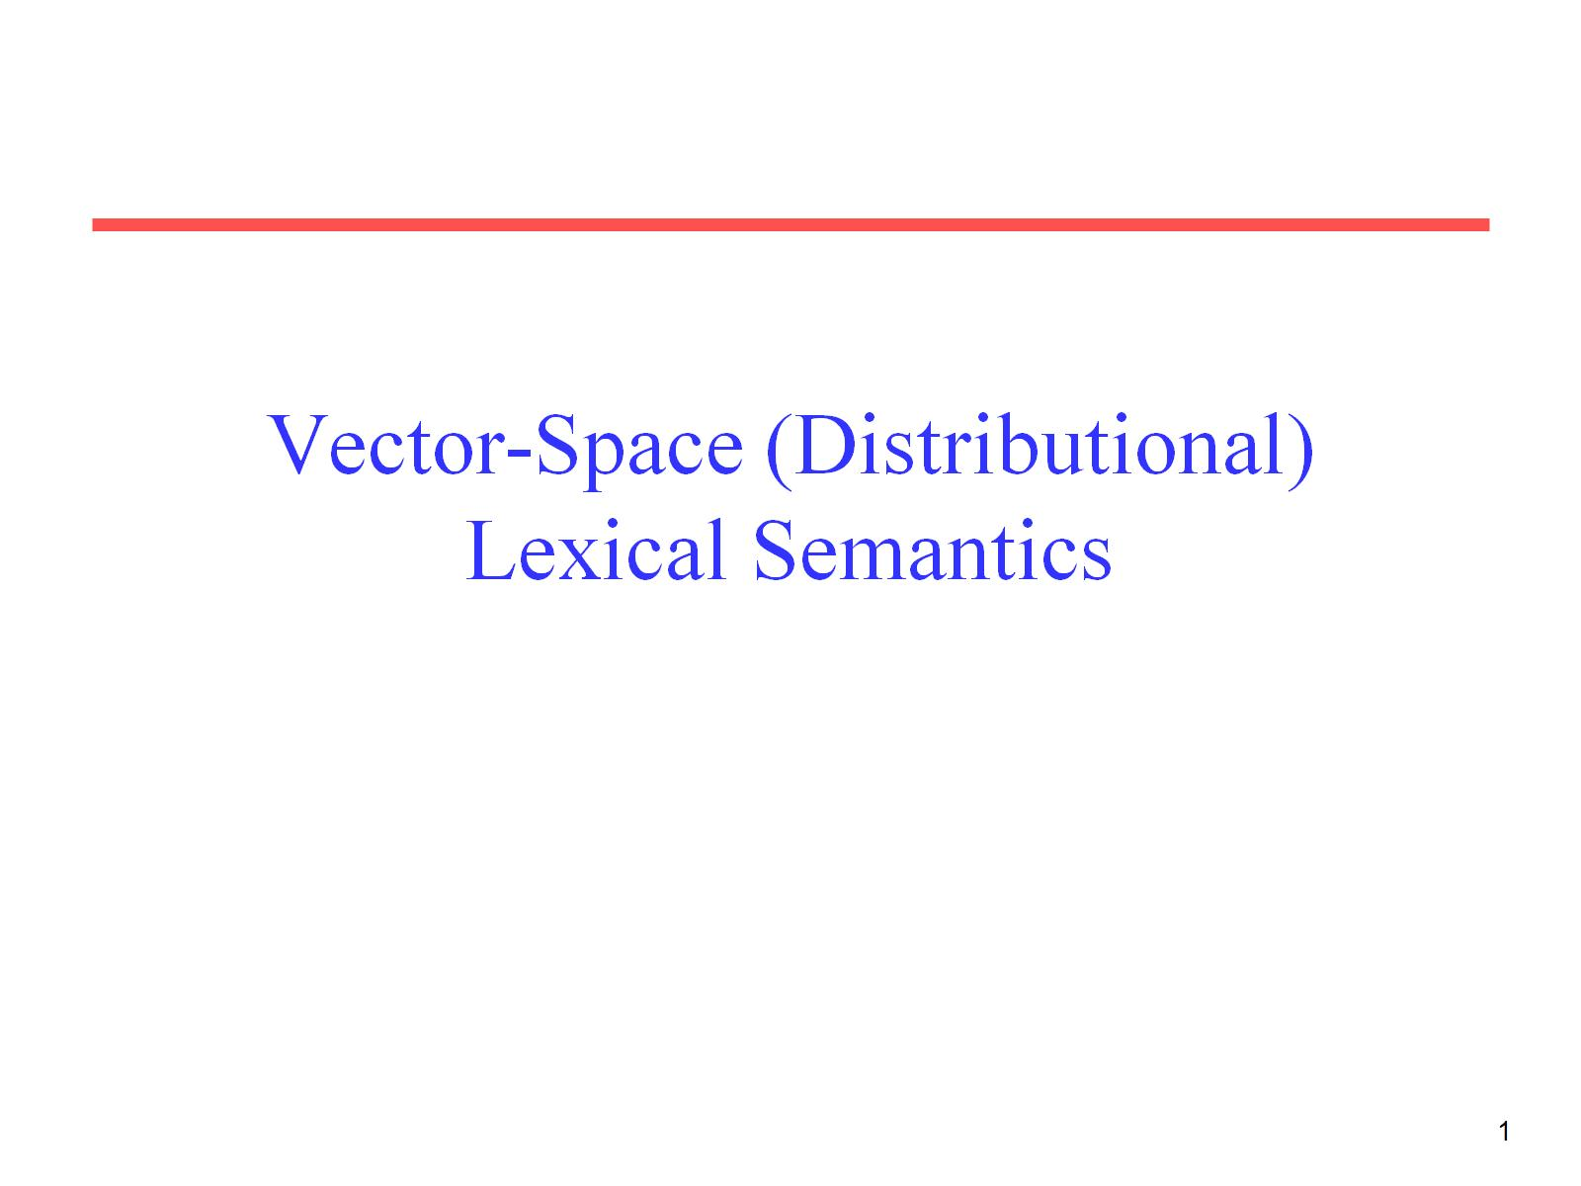
Vector-Space (Distributional) Lexical Semantics

Slide 2
Information Retrieval System
Document
corpus
IR
System
Query String
1. Doc1
2. Doc2
3. Doc3
.
.
Ranked
Documents

Slide 3
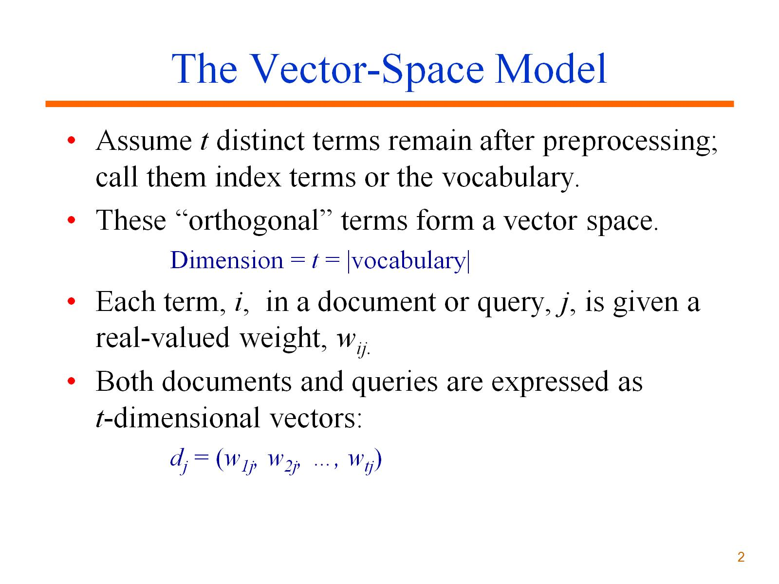
The Vector-Space Model

Slide 4
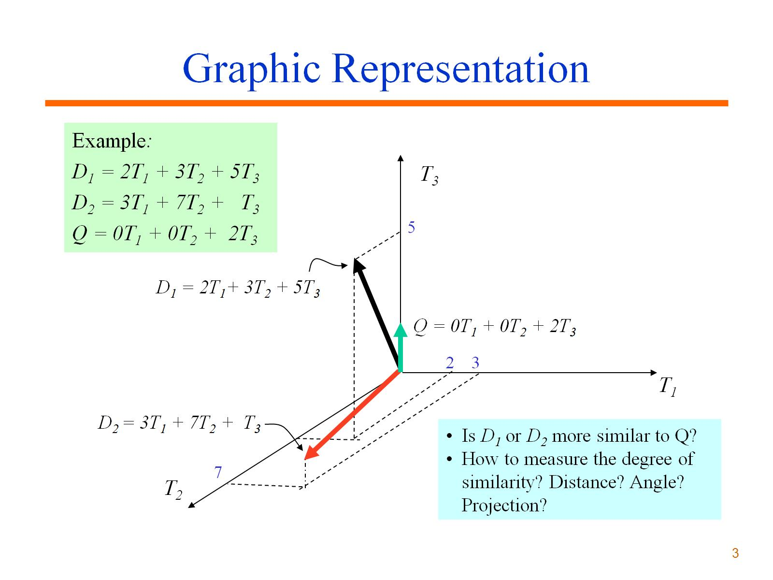
Graphic Representation

Slide 5
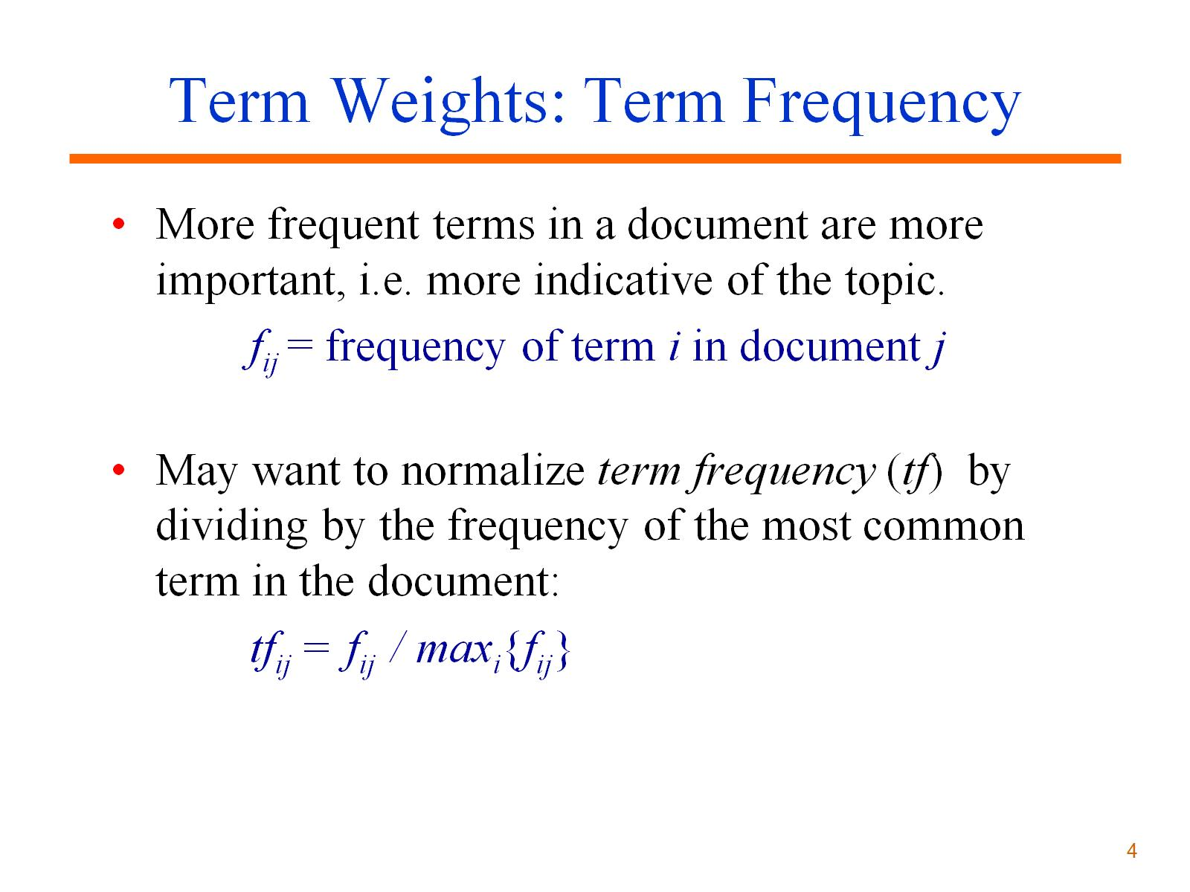
Term Weights: Term Frequency

Slide 6
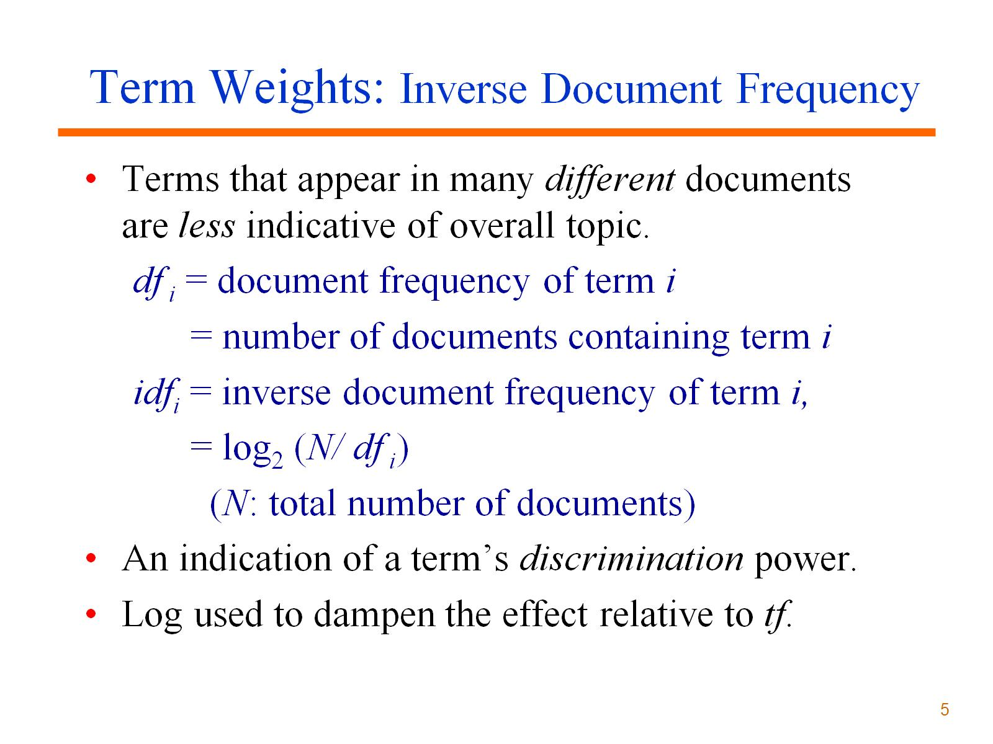
Term Weights: Inverse Document Frequency

Slide 7
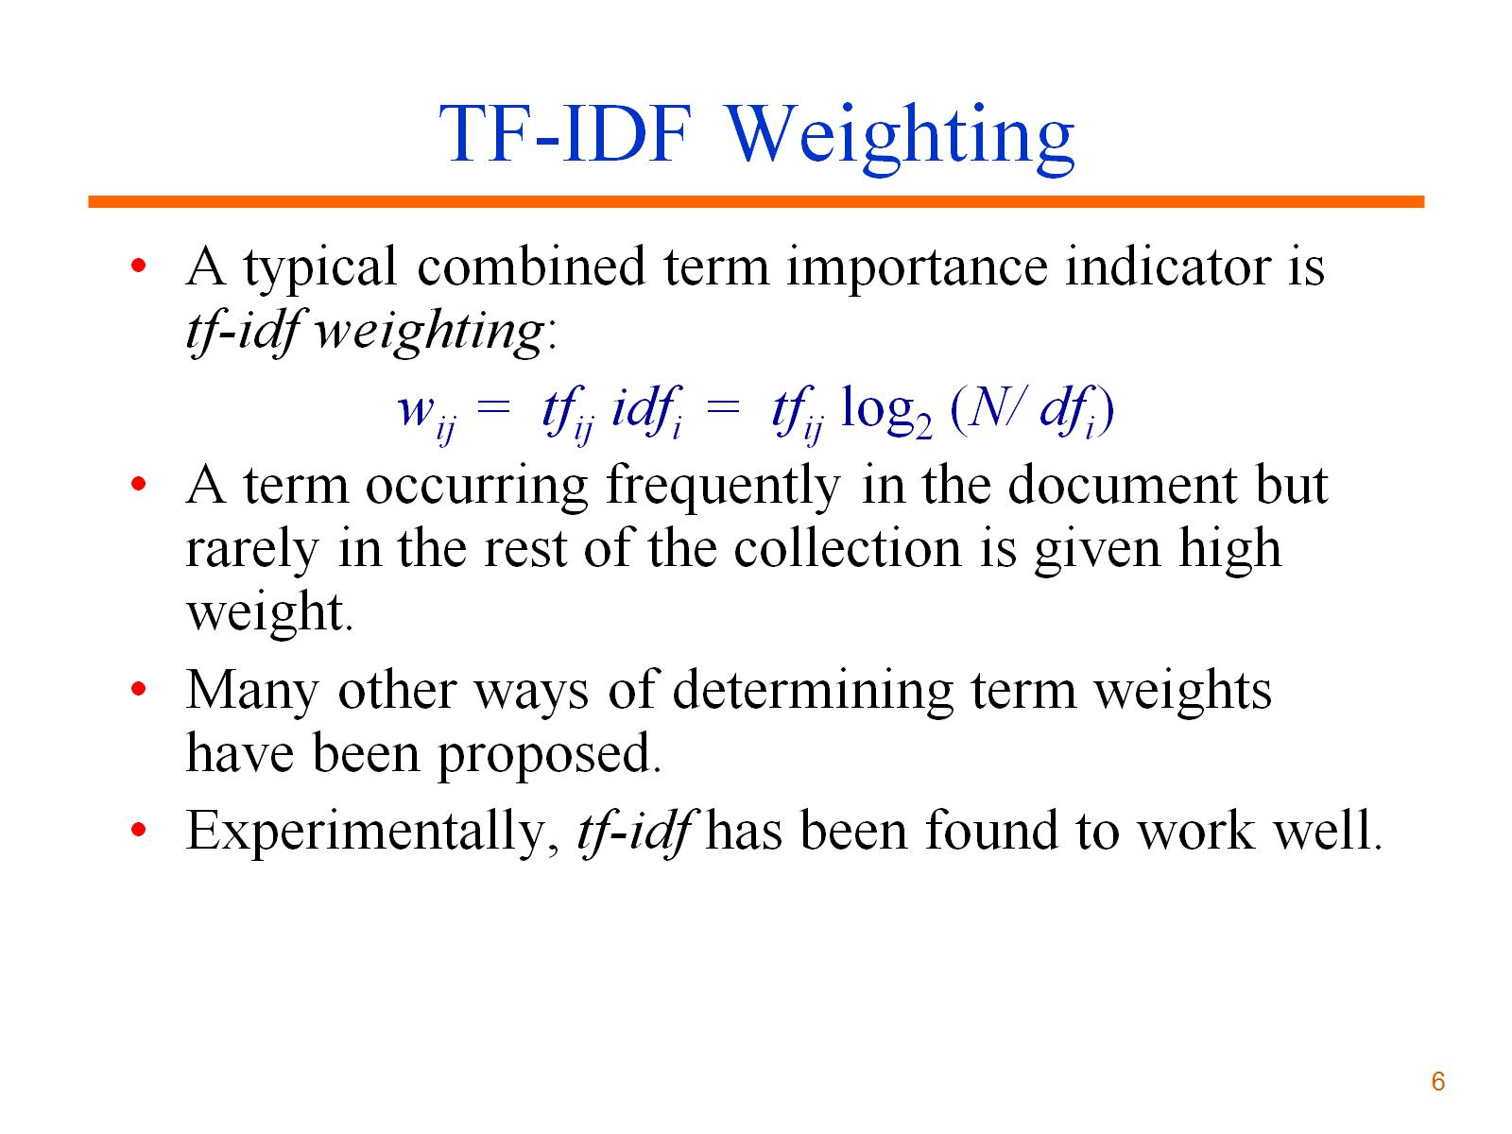
TF-IDF Weighting

Slide 8
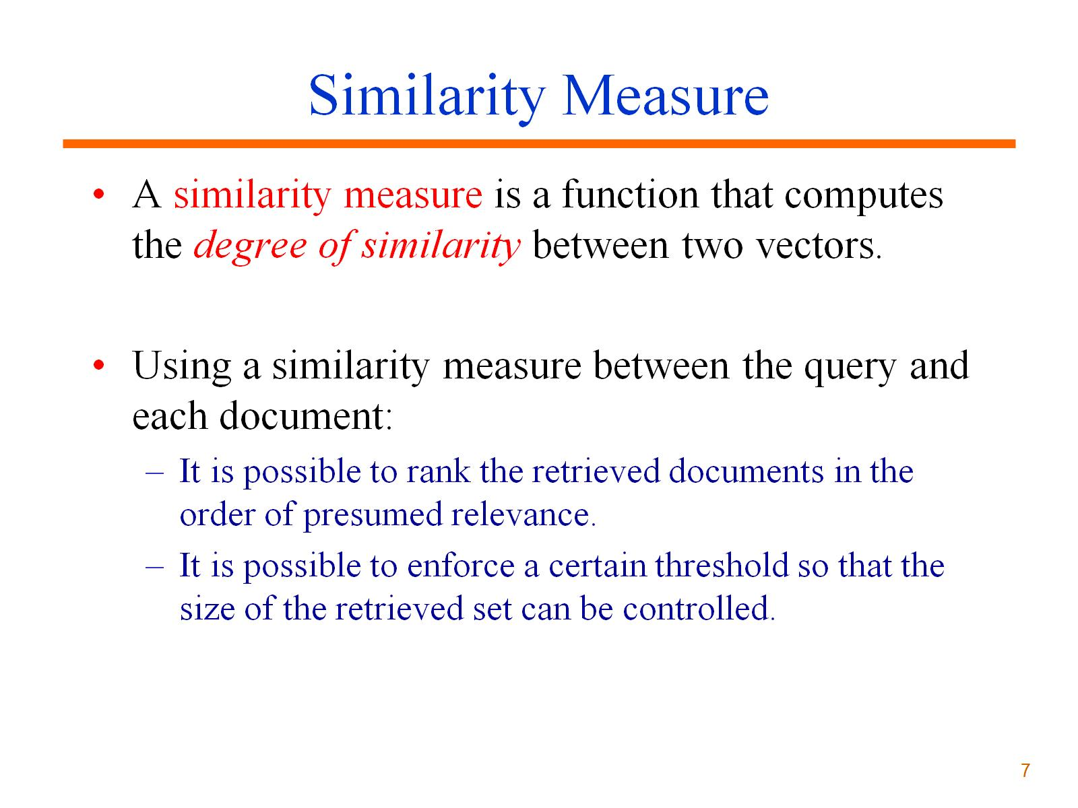
Similarity Measure

Slide 9
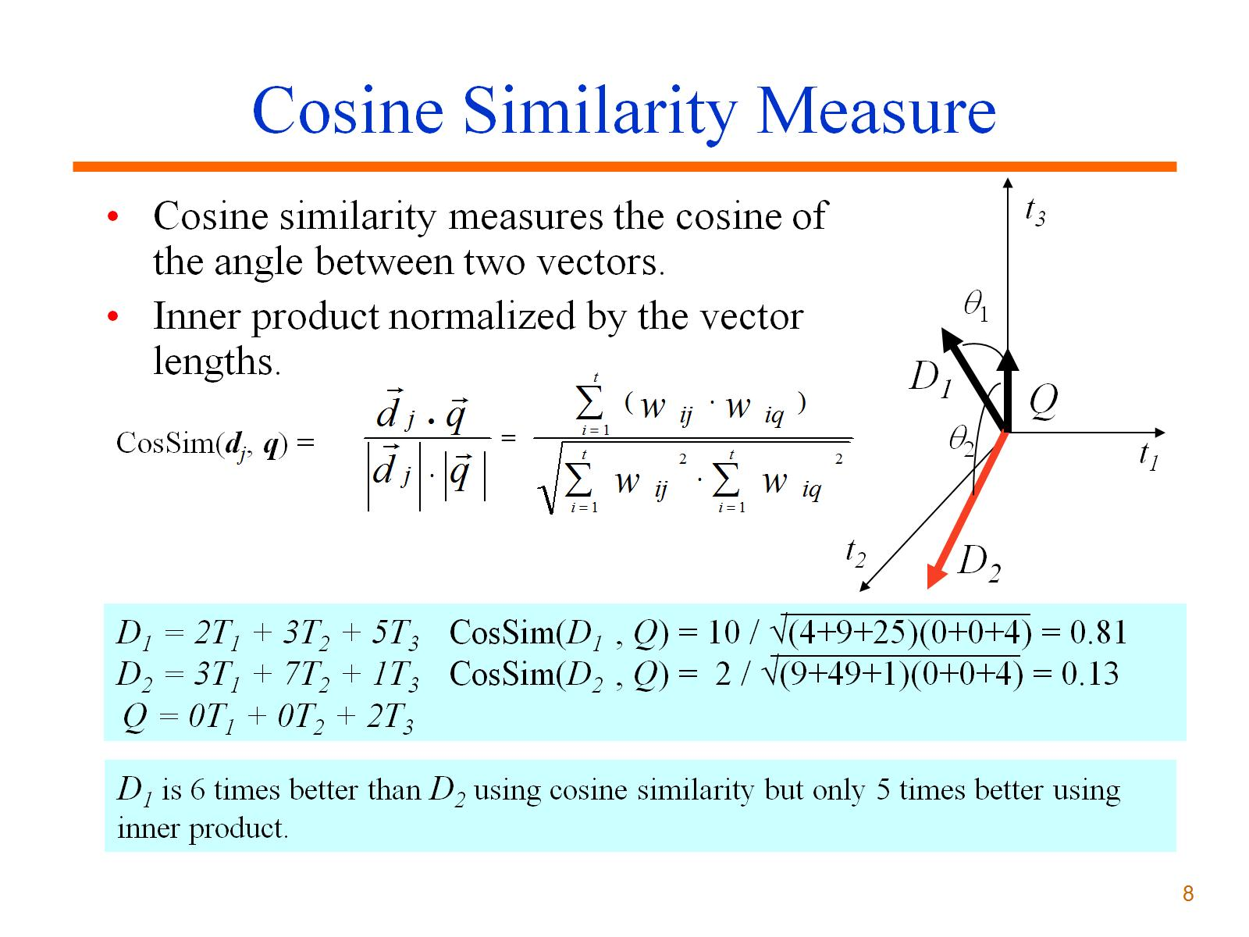
Cosine Similarity Measure

Slide 10
Vector-Space (Distributional) Lexical Semantics
Represent word meanings as points (vectors) in a (high-dimensional) Euclidian space.
Dimensions encode aspects of the context in which the word appears (e.g. how often it co-occurs with another specific word).
“You will know a word by the company that it keeps.” (J.R. Firth, 1957)
Semantic similarity defined as distance between points in this semantic space.

Slide 11
Sample Lexical Vector Space
bottle
cup
dog
water
cat
computer
robot
woman
rock
man

Slide 12
Simple Word Vectors
For a given target word, w, create a bag-of-words “document” of all of the words that co-occur with the target word in a large corpus.
Window of k words on either side.
All words in the sentence, paragraph, or document.
For each word, create a (tf-idf weighted) vector from the “document” for that word.
Compute semantic relatedness of words as the cosine similarity of their vectors.

Slide 13
Other Contextual Features
Use syntax to move beyond simple bag-of-words features.
Produced typed (edge-labeled) dependency parses for each sentence in a large corpus.
For each target word, produce features for it having specific dependency links to specific other words (e.g. subj=dog, obj=food, mod=red)

Slide 14
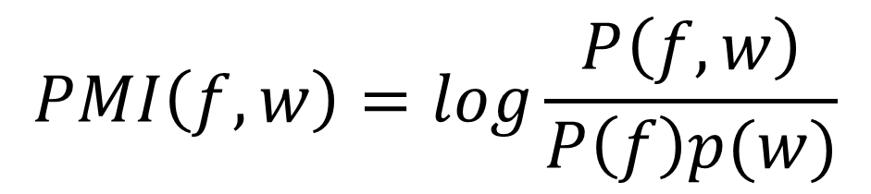
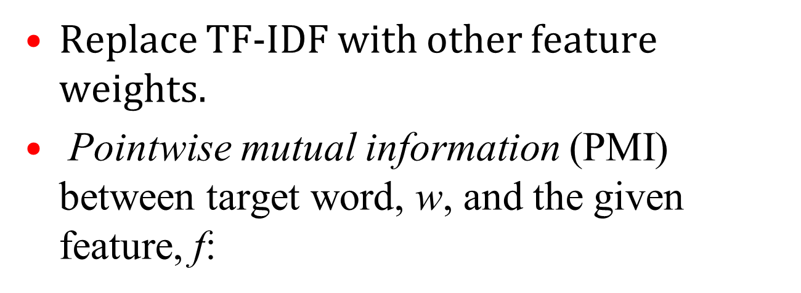
Other Feature Weights
Replace TF-IDF with other feature weights.
Pointwise mutual information (PMI) between target word, w, and the given feature, f:
$$PMI\left(f,w\right)=log\frac{P\left(f,w\right)}{P\left(f\right)p(w)}$$

Slide 15
Dimensionality Reduction
Word-based features result in extremely high-dimensional spaces that can easily result in over-fitting.
Reduce the dimensionality of the space by using various mathematical techniques to create a smaller set of k new dimensions that most account for the variance in the data.
Singular Value Decomposition (SVD) used in Latent Semantic Analysis (LSA)
Principle Component Analysis (PCA)

Slide 16
Sample Dimensionality Reduction

Slide 17
Sample Dimensionality Reduction

Slide 18
Neural Word2Vec (Mikolov et al., 2013)
Learn an “embedding” of words that supports effective prediction of surrounding “skip gram” of words.

Slide 19
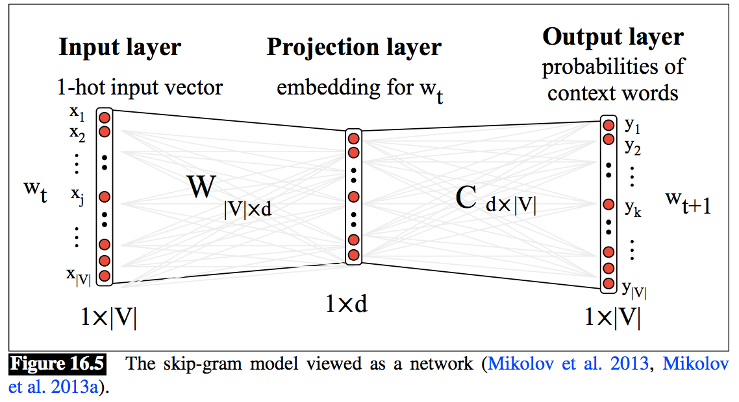
Skip-Gram Word2Vec Network Architecture
Softmax classifier

Slide 20

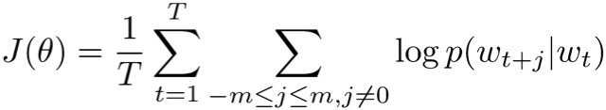
Word2Vec Math
Softmax classifier predicts surrounding words from a word embedding.
Train to maximize the probability of skip-gram predictions.

Slide 21
Evaluation of Vector-Space Lexical Semantics
Have humans rate the semantic similarity of a large set of word pairs.
(dog, canine): 10; (dog, cat): 7; (dog, carrot): 3; (dog, knife): 1
Compute vector-space similarity of each pair.
Compute correlation coefficient (Pearson or Spearman) between human and machine ratings.

Slide 22
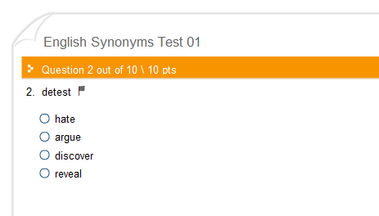
TOEFL Synonymy Test
LSA shown to be able to pass TOEFL synonymy test.

Slide 23
Vector-Space Word Sense Induction (WSI)
Create a context-vector for each individual occurrence of the target word, w.
Cluster these vectors into k groups.
Assume each group represents a “sense” of the word and compute a vector for this sense by taking the mean of each cluster.

Slide 24
Sample Word Sense Induction
Occurrence vectors for “bat”
flew
cave
vampire
hit
ate
baseball
player
wooden

Slide 25
Sample Word Sense Induction
Occurrence vectors for “bat”
flew
cave
+
vampire
hit
ate
baseball
+
player
wooden

Slide 26
Word Sense and Vector Semantics
Having one vector per word ignores the impact of homonymous senses.
Similarity of ambiguous words violates the triangle inequality.
club
A
B
bat
C
association
C ≤ A + B

Slide 27
Multi-Prototype Vector Space Models (Reisinger & Mooney, 2010)
Do WSI and create a multiple sense-specific vectors for ambiguous words.
Similarity of two words is the maximum similarity of sense vectors of each.
club-1
club-2
bat-1
association
bat-2
mouse-1

Slide 28
Vector-Space Word Meaning in Context
Compute a semantic vector for an individual occurrence of a word based on its context.
Combine a standard vector for a word with vectors representing the immediate context.

Slide 29
Example Using Dependency Context
fired
fired
nsubj
dobj
nsubj
dobj
boss
secretary
hunter
gun
Compute vector for nsubj-boss by summing contextual vectors for all word occurrences that have “boss” as a subject.
Compute vector for dobj-secretary by summing contextual vectors for all word occurrences that have “secretary” as a direct object.
Compute “in context” vector for “fire” in “boss fired secretary” by adding nsubj-boss and dobj-secretary vectors to the general vector for “fire”

Slide 30
Compositional Vector Semantics
Compute vector meanings of phrases and sentences by combining (composing) the vector meanings of its words.
Simplest approach is to use vector addition or component-wise multiplication to combine word vectors.
Evaluate on human judgements of sentence-level semantic similarity (semantic textual similarity, STS, SemEval competition).

Slide 31
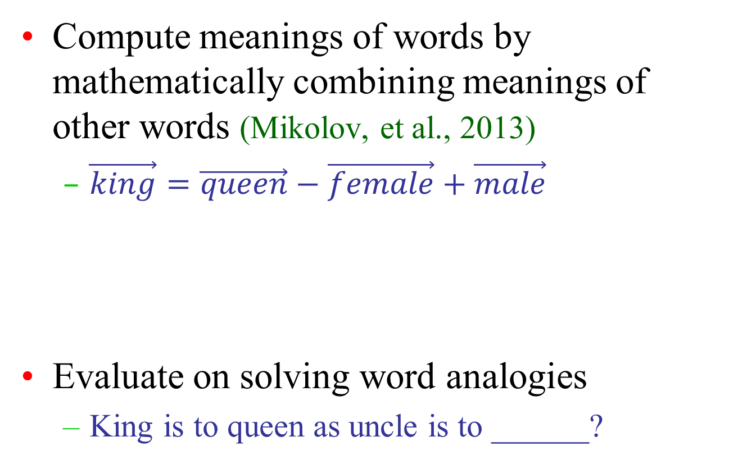
Other Vector Semantics Computations
Compute meanings of words by mathematically combining meanings of other words (Mikolov, et al., 2013)
$\vec{king}=\vec{queen}−\vec{female}+\vec{male}$
Evaluate on solving word analogies
King is to queen as uncle is to ______?

Slide 32
Sentence-Level Neural Language Models
“Skip-Thought Vectors” (Kiros et al., NIPS 2015)
Use LSTMs to encode whole sentences into lower-dimensional vectors.
Vectors trained to predict previous and next sentences.
S
E
N
T.
V
E
C
T
O
R
“Jim jumped from the plane and
opened his parachute.”
“Jim landed on the ground.”
Encoder
LSTM
Decoder
LSTM

Slide 33
Conclusions
A word’s meaning can be represented as a vector that encodes distributional information about the contexts in which the word tends to occur.
Lexical semantic similarity can be judged by comparing vectors (e.g. cosine similarity).
Vector-based word senses can be automatically induced by clustering contexts.
Contextualized vectors for word meaning can be constructed by combining lexical and contextual vectors.

