Slide 1
Natural Language Semantics Combining Logical and Distributional Methods using Probabilistic Logic
Raymond J. Mooney
Katrin Erk
Islam Beltagy, Stephen Roller, Pengxiang Cheng
University of Texas at Austin
1
1
Notes:
1
1

Slide 2
Logical AI Paradigm
Represents knowledge and data in a binary symbolic logic such as FOPC.
+ Rich representation that handles arbitrary sets of objects, with properties, relations, logical connectives, and quantifiers.
− Unable to handle uncertain knowledge and probabilistic reasoning.

Slide 3
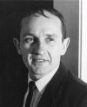
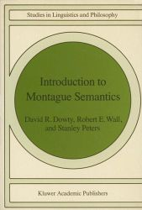
Logical Semantics for Language
Richard Montague (1970) developed a formal method for mapping natural-language to FOPC using Church’s lambda calculus of functions and the fundamental principle of semantic compositionality for
recursively computing the meaning of each syntactic constituent from the meanings of its sub-constituents.
Later called “Montague Grammar” or “Montague Semantics”

Slide 4
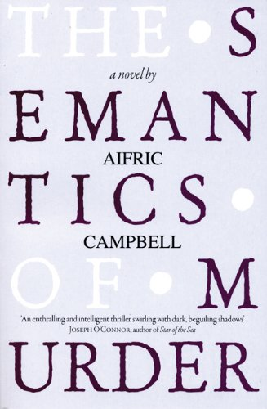
Interesting Book on Montague
See Aifric Campbell’s (2009) novel The Semantics of Murder for a fictionalized account of his mysterious death in 1971 (homicide or homoerotic asphyxiation??).

Slide 5
Semantic Parsing
Mapping a natural-language sentence to a detailed representation of its complete meaning in a fully formal language that:
Has a rich ontology of types, properties, and relations.
Supports automated reasoning or execution.

Slide 6

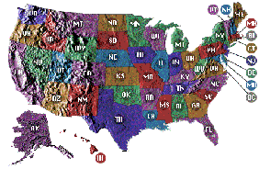
Geoquery: A Database Query Application
Query application for a U.S. geography database containing about 800 facts [Zelle & Mooney, 1996]
What is the smallest state by area?
Rhode Island
Answer
Semantic Parsing
Query
answer(x1,smallest(x2,(state(x1),area(x1,x2))))

Slide 7
Composing Meanings from Parse Trees
What is the capital of Ohio?
S
answer(capital(loc_2(stateid('ohio'))))
NP
answer()
VP
capital(loc_2(stateid('ohio')))
V
∅
NP
capital(loc_2(stateid('ohio')))
WP
answer()
VBZ
DT
N
capital()
PP
What
answer()
∅
∅
loc_2(stateid('ohio'))
is
the
capital
IN
loc_2()
NP
stateid('ohio')
∅
∅
capital()
of
NNP
stateid('ohio')
loc_2()
Ohio
stateid('ohio')

Slide 8
Distributional (Vector-Space) Lexical Semantics
Represent word meanings as points (vectors) in a (high-dimensional) Euclidian space.
Dimensions encode aspects of the context in which the word appears (e.g. how often it co-occurs with another specific word).
Semantic similarity defined as distance between points in this semantic space.
Many specific mathematical models for computing dimensions and similarity
1st model (1990): Latent Semantic Analysis (LSA)

Slide 9
Sample Lexical Vector Space (reduced to 2 dimensions)
bottle
cup
dog
water
cat
computer
robot
woman
rock
man

Slide 10
Issues with Distributional Semantics
How to compose meanings of larger phrases and sentences from lexical representations? (many recent proposals involving matrices, tensors, etc…)
None of the proposals for compositionality capture the full representational or inferential power of FOPC (Grefenstette, 2013).
My impassioned reaction to this work:
“You can’t cram the meaning of a whole
%&!$# sentence into a single $&!#* vector!”

Slide 11
Limits of Distributional Representations
How would a distributional approach represent and answer complex questions requiring aggregation of data?
Given IMDB or FreeBase data, answer the question:
Did Woody Allen make more movies with Diane Keaton or Mia Farrow?
Answer: Mia Farrow (12 vs. 7)

Slide 12
Using Distributional Semantics with Standard Logical Form
Recent work on unsupervised semantic parsing (Poon & Domingos, 2009) and work by Lewis and Steedman (2013) automatically create an ontology of predicates by clustering based using distributional information.
But they do not allow gradedness and uncertainty in the final semantic representation and inference.

Slide 13
Probabilistic AI Paradigm
Represents knowledge and data as a fixed set of random variables with a joint probability distribution.
+ Handles uncertain knowledge and probabilistic reasoning.
− Unable to handle arbitrary sets of objects, with properties, relations, quantifiers, etc.

Slide 14
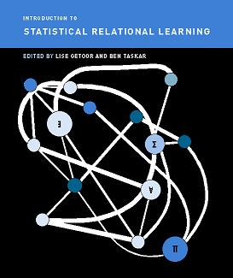
Statistical Relational Learning (SRL)
SRL methods attempt to integrate methods from predicate logic (or relational databases) and probabilistic graphical models to handle structured, multi-relational data.

Slide 15
SRL Approaches (A Taste of the “Alphabet Soup”)
Stochastic Logic Programs (SLPs)
(Muggleton, 1996)
Probabilistic Relational Models (PRMs)
(Koller, 1999)
Bayesian Logic Programs (BLPs)
(Kersting & De Raedt, 2001)
Markov Logic Networks (MLNs) (Richardson & Domingos, 2006)
Probabilistic Soft Logic (PSL) (Kimmig et al., 2012)

Slide 16
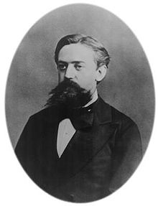
Formal Semantics for Natural Language using Probabilistic Logical Form
Represent the meaning of natural language in a formal probabilistic logic (Beltagy et al., 2013, 2014, 2015)
“Montague meets Markov”

Slide 17
Markov Logic Networks [Richardson & Domingos, 2006]
Set of weighted clauses in first-order predicate logic.
Larger weight indicates stronger belief that the clause should hold.
MLNs are templates for constructing Markov networks for a given set of constants
MLN Example: Friends & Smokers
17

Slide 18
Example: Friends & Smokers
Two constants: Anna (A) and Bob (B)
18

Slide 19
Example: Friends & Smokers
Two constants: Anna (A) and Bob (B)
Friends(A,B)
Friends(A,A)
Smokes(A)
Smokes(B)
Friends(B,B)
Cancer(A)
Cancer(B)
Friends(B,A)
19

Slide 20
Example: Friends & Smokers
Two constants: Anna (A) and Bob (B)
Friends(A,B)
Friends(A,A)
Smokes(A)
Smokes(B)
Friends(B,B)
Cancer(A)
Cancer(B)
Friends(B,A)
20

Slide 21
Example: Friends & Smokers
Two constants: Anna (A) and Bob (B)
Friends(A,B)
Friends(A,A)
Smokes(A)
Smokes(B)
Friends(B,B)
Cancer(A)
Cancer(B)
Friends(B,A)
21

Slide 22
Probability of a possible world
a possible world
Weight of formula i
No. of true groundings of formula i in x
A possible world becomes exponentially less likely as the total weight of all the grounded clauses it violates increases.
22

Slide 23
MLN Inference
Infer probability of a particular query given a set of evidence facts.
P(Cancer(Anna) | Friends(Anna,Bob), Smokes(Bob))
Use standard algorithms for inference in graphical models such as Gibbs Sampling or belief propagation.

Slide 24
Strengths of MLNs
Fully subsumes first-order predicate logic
Just give ∞ weight to all clauses
Fully subsumes probabilistic graphical models.
Can represent any joint distribution over an arbitrary set of discrete random variables.
Can utilize prior knowledge in both symbolic and probabilistic forms.
Existing open-source software (Alchemy, Tuffy)

Slide 25
Weaknesses of MLNs
Inherits computational intractability of general methods for both logical and probabilistic inference and learning.
Inference in FOPC is semi-decidable
Inference in general graphical models is P-space complete
Just producing the “ground” Markov Net can produce a combinatorial explosion.
Current “lifted” inference methods do not help reasoning with many kinds of nested quantifiers.

Slide 26
Semantic Representations
Formal Semantics
Uses first-order logic
Deep
Brittle
Distributional Semantics
Statistical method
Robust
Shallow
Combine both logical and distributional semantics
Represent meaning using a probabilistic logic
Markov Logic Network (MLN)
Probabilistic Soft Logic (PSL)
Generate soft inference rules from distributional semantics.
26

Slide 27
System Architecture [Garrette et al. 2011, 2012; Beltagy et al., 2013, 2014, 2015]
Sent1
BOXER
LF1
Dist. Rule
Constructor
Rule Base
Sent2
LF2
Vector Space
MLN/PSL Inference
BOXER (Bos, et al. 2004) : CCG-based parser maps sentences to logical form
Distributional Rule constructor: generates relevant soft inference rules based on distributional similarity
MLN/PSL: probabilistic inference
Result: degree of entailment or semantic similarity score (depending on the task)
result
27

Slide 28
Recognizing Textual Entailment (RTE)
Premise: “A man is cutting a pickle”
∃x,y,z [man(x) ∧ cut(y) ∧ agent(y, x) ∧ pickle(z) ∧ patient(y, z)]
Hypothesis: “A guy is slicing a cucumber”
∃x,y,z[guy(x) ∧ slice(y) ∧ agent(y, x) ∧ cucumber(z) ∧ patient(y, z)]
Inference: Pr(Hypothesis | Premise)
Degree of entailment
28

Slide 29
Distributional Lexical Rules
For all pairs of words (a, b) where a is in S1 and b is in S2 add a soft rule relating the two:
∀x a(x) → b(x) | wt(a, b)
wt(a, b) = f(cos(a, b))
Premise: “A man is cutting a pickle”
Hypothesis: “A guy is slicing a cucumber”
∀x man(x) → guy(x) | wt(man, guy)
∀x cut(x) → slice(x) | wt(cut, slice)
∀x pickle(x) → cucumber(x) | wt(pickle, cucumber)
∀x man(x) → cucumber(x) | wt(man, cucumber)
∀x pickle(x) → guy(x) | wt(pickle, guy)
→ →
29

Slide 30
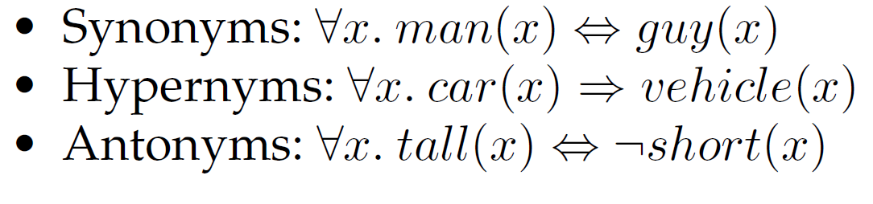
Rules from WordNet
Extract “hard” rules from WordNet:

Slide 31


Rules from Paraphrase Databases (PPDB)
Translate paraphrase rules to logic:
“person riding a bike” ↔ “biker”
Learn a scaling factor that maps PPDB weights to MLN weights to maximize performance on training data.

Slide 32
Entailment Rule Construction
Alternative to constructing rules for all word pairs.
Construct a specific rule just sufficient to allow entailing Hypothesis from Premise.
Uses a version of resolution theorem proving.
Construct a weight for this rule using distributional information.

Slide 33
Sample Lexical Entailment Rule Construction
Premise: “A groundhog sat on a hill.”
∃x,y,z [groundhog(x) ∧ sat(y) ∧ agent(y, x) ∧ on(y,z) ∧ hill(z)]
Hypothesis: “A woodchuck sat on a hill”
∃x,y,z [woodchuck(x) ∧ sat(y) ∧ agent(y, x) ∧ on(y,z) ∧ hill(z)]
Constructed Rule:
∀x [groundhog(x) → woodchuck(x)]

Slide 34
Sample Phrasal Entailment Rule Construction
Premise: “A person solved a problem.”
∃x,y,z [person(x) ∧ solved(y) ∧ agent(y, x) ∧ patient(y,z) ∧ _______problem(z)]
Hypothesis: “A person found a solution to a problem”
∃x,y,z,w [person(x) ∧ found(y) ∧ agent(y, x) ∧ patient(y,w) ∧ ________solution(w) ∧ to(y,z) ∧ problem(z)]
Constructed Rule:
∀x,y [solved(y) ∧ patient(y,x) → ∃w,z (found(y) ∧ patient(y,w) ∧ _____solution(w) ∧ to(y,z)) ]

Slide 35
Entailment Rule Classifier
Use distributional information to recognize lexical relationships (e.g. synonymy, hypernymy, meronomy) (Baroni et al, 2012; Roller et al, 2014).
Train a supervised classifier to recognize semantic relationships using distributional (and other) features of the words.
For phrasal entailment rules, use features from the compositional distributional representation of the phrases (Paperno, et al., 2014).
For SICK RTE, classify rules as entails, contradicts, or neutral.

Slide 36
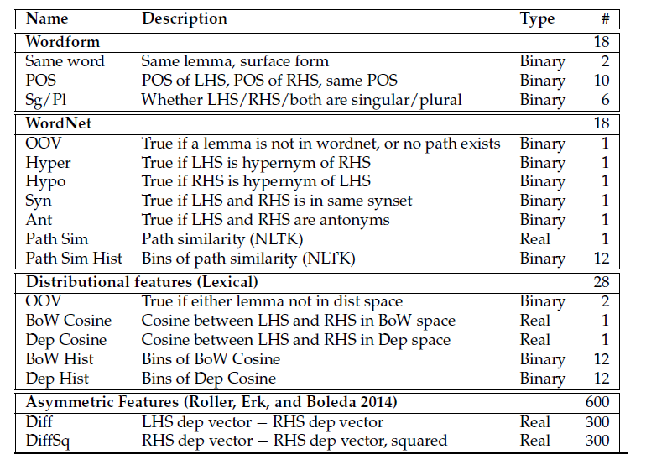
Lexical Rule Features

Slide 37
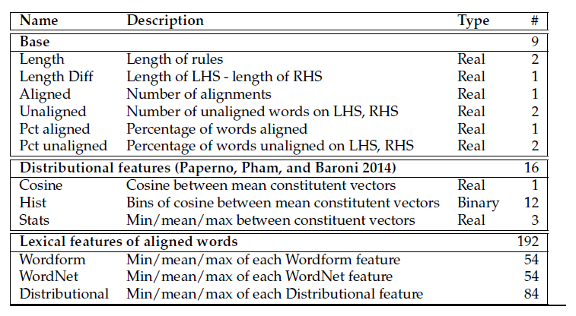
Phrasal Rule Features

Slide 38
Employing Multiple CCG Parsers
Boxer relies on C&C CCG parser which frequently makes mistakes.
EasyCCG (Lewis & Steedman, 2014) is a newer CCG parser that makes fewer (different) mistakes.
MultiParse integrates both parse results into the RTE inference process.

Slide 39
Experimental Evaluation SICK RTE Task
SICK (Sentences Involving Compositional Knowledge)
SemEval Task from 2014.
RTE task is to classify pairs of sentences as:
Entailment
Contradiction
Neutral

Slide 40
SICK RTE Results
System Components Enabled | Test Accuracy
MLN Logic | 73.37
MLN Logic + PPDB | 76.33
MLN Logic + PPDB + WordNet | 78.40
MLN Logic + PPDB + WordNet + MultiParse | 80.37
MLN Logic + Distributional Rules | 82.99
+ MultiParse | 83.89
+ WordNet | 84.27
+ Remember Training Entailment Rules | 85.06
+ PPDB | 84.94
Competition Winner (Lai & Hockenmaier, 2014) | 84.58

Slide 41
Future Work
Improve inference efficiency for MLNs by exploiting latest in “lifted inference”
Improve logical form construction using the latest methods in semantic parsing.
Improve entailment rule classifier.
Improve distributional representation of phrases.
Enable question answering by developing efficient constructive existential theorem proving in MLNs.

Slide 42
Conclusions
Traditional logical and distributional approaches to natural language semantics have complementary strengths and weaknesses.
These competing approaches can be combined using a probabilistic logic (e.g. MLNs) as a uniform semantic representation.
Allows easy integration of additional knowledge sources and parsers.
State-of-the-Art results for SICK RTE Challenge.

Slide 43
Questions?
See recent in-review journal paper available on Arxiv:
Representing Meaning with a Combination of Logical Form and Vectors. I.Beltagy, S.Roller, P. Cheng, K. Erk & R.J. Mooney. arXiv preprint:1505.06816 [cs.CL], 2015.

