Slide 1
CS 388:
Natural Language Processing
Introduction
Raymond J. Mooney
University of Texas at Austin

Slide 2
Natural Language Processing
NLP is the branch of computer science focused on developing systems that allow computers to communicate with people using everyday language.
Also called Computational Linguistics
  Also concerns how computational methods can aid the understanding of human language

Slide 3
Related Areas
Artificial Intelligence
Formal Language (Automata) Theory
Machine Learning
Linguistics
Psycholinguistics
Cognitive Science
Philosophy of Language

Slide 4
Communication
The goal in the production and comprehension of natural language is communication.
Communication for the speaker:
  Intention: Decide when and what information should be transmitted (a.k.a. content selection, strategic generation). May require planning and reasoning about agents’ goals and beliefs.
  Generation: Translate the information to be communicated (in internal logical representation or “language of thought”) into string of words in desired natural language (a.k.a. surface realization, tactical generation).
  Synthesis: Output the string in desired modality, text or speech.

Slide 5
Communication (cont)
Communication for the hearer:
  Perception: Map input modality to a string of words, e.g. optical character recognition (OCR) or speech recognition.
  Analysis: Determine the information content of the string.
    Syntactic interpretation (parsing): Find the correct parse tree showing the phrase structure of the string.
    Semantic Interpretation: Extract the (literal) meaning of the string (logical form).
    Pragmatic Interpretation: Consider effect of the overall context on altering the literal meaning of a sentence.
  Incorporation: Decide whether or not to believe the content of the string and add it to the KB.

Slide 6
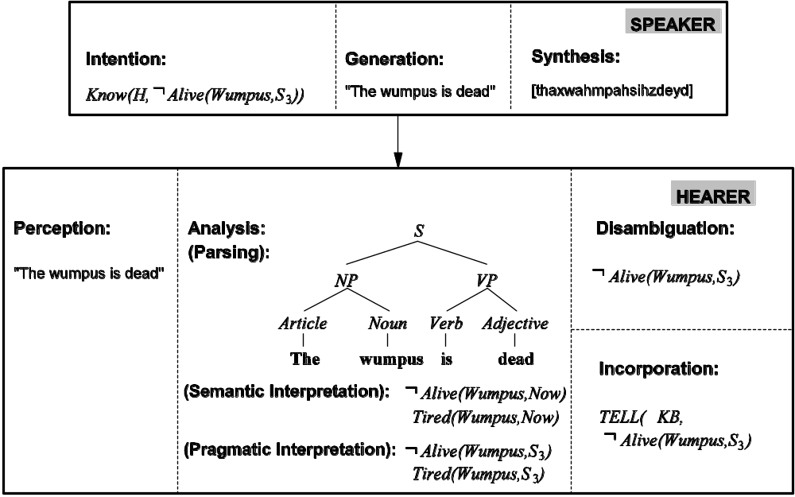
Communication (cont)

Slide 7
Syntax, Semantic, Pragmatics
Syntax concerns the proper ordering of words and its affect on meaning.
  The dog bit the boy.
  The boy bit the dog.
  * Bit boy dog the the.
  Colorless green ideas sleep furiously.
Semantics concerns the (literal) meaning of words, phrases, and sentences.
  “plant” as a photosynthetic organism
  “plant” as a manufacturing facility
  “plant” as the act of sowing
Pragmatics concerns the overall communicative and social context and its effect on interpretation.
  The ham sandwich wants another beer. (co-reference, anaphora)
  John thinks vanilla. (ellipsis)

Slide 8
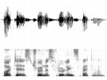
Modular Comprehension
Pragmatics
Acoustic/
Phonetic
Syntax
Semantics
sound
waves
words
parse
trees
literal
meaning
meaning
(contextualized)

Slide 9
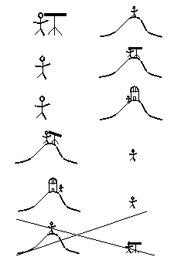
Ambiguity
Natural language is highly ambiguous and must be disambiguated.
  I saw the man on the hill with a telescope.
  I saw the Grand Canyon flying to LA.
  Time flies like an arrow.
  Horse flies like a sugar cube.
  Time runners like a coach.
  Time cars like a Porsche.

Slide 10
Ambiguity is Ubiquitous
Speech Recognition
  “recognize speech” vs. “wreck a nice beach”
  “youth in Asia” vs. “euthanasia”
Syntactic Analysis
  “I ate spaghetti with chopsticks” vs. “I ate spaghetti with meatballs.”
Semantic Analysis
  “The dog is in the pen.” vs. “The ink is in the pen.”
  “I put the plant in the window” vs. “Ford put the plant in Mexico”
Pragmatic Analysis
  From “The Pink Panther Strikes Again”:
  Clouseau: Does your dog bite?
  Hotel Clerk: No.
  Clouseau: [bowing down to pet the dog] Nice doggie.
  [Dog barks and bites Clouseau in the hand]
  Clouseau: I thought you said your dog did not bite!
  Hotel Clerk: That is not my dog.

Slide 11
Ambiguity is Explosive
Ambiguities compound to generate enormous numbers of possible interpretations.
In English, a sentence ending in n prepositional phrases has over 2^{n} syntactic interpretations (cf. Catalan numbers).
  “I saw the man with the telescope”: 2 parses
  “I saw the man on the hill with the telescope.”: 5 parses
  “I saw the man on the hill in Texas with the telescope”: 14 parses
  “I saw the man on the hill in Texas with the telescope at noon.”: 42 parses
  “I saw the man on the hill in Texas with the telescope at noon on Monday” 132 parses

Slide 12
Humor and Ambiguity
Many jokes rely on the ambiguity of language:
  Groucho Marx: One morning I shot an elephant in my pajamas. How he got into my pajamas, I’ll never know.
  She criticized my apartment, so I knocked her flat.
  Noah took all of the animals on the ark in pairs. Except the worms, they came in apples.
  Policeman to little boy: “We are looking for a thief with a bicycle.” Little boy: “Wouldn’t you be better using your eyes.”
  Why is the teacher wearing sun-glasses. Because the class is so bright.

Slide 13
Why is Language Ambiguous?
Having a unique linguistic expression for every possible conceptualization that could be conveyed would make language overly complex and linguistic expressions unnecessarily long.
Allowing resolvable ambiguity permits shorter linguistic expressions, i.e. data compression.
Language relies on people’s ability to use their knowledge and inference abilities to properly resolve ambiguities.
Infrequently, disambiguation fails, i.e. the compression is lossy.

Slide 14
Natural Languages vs. Computer Languages
Ambiguity is the primary difference between natural and computer languages.
Formal programming languages are designed to be unambiguous, i.e. they can be defined by a grammar that produces a unique parse for each sentence in the language.
Programming languages are also designed for efficient (deterministic) parsing, i.e. they are deterministic context-free languages (DCFLs).
  A sentence in a DCFL can be parsed in O(n) time where n is the length of the string.

Slide 15
Natural Language Tasks
Processing natural language text involves many various syntactic, semantic and pragmatic tasks in addition to other problems.

Slide 16
Syntactic Tasks

Slide 17
Word Segmentation
Breaking a string of characters (graphemes) into a sequence of words.
In some written languages (e.g. Chinese) words are not separated by spaces.
Even in English, characters other than white-space can be used to separate words [e.g. , ; . - : ( ) ]
Examples from English URLs:
  jumptheshark.com ⇒ jump the shark .com
  myspace.com/pluckerswingbar
  ⇒ myspace .com pluckers wing bar
  ⇒ myspace .com plucker swing bar
⊗

Slide 18
Morphological Analysis
Morphology is the field of linguistics that studies the internal structure of words. (Wikipedia)
A morpheme is the smallest linguistic unit that has semantic meaning (Wikipedia)
  e.g. “carry”, “pre”, “ed”, “ly”, “s”
Morphological analysis is the task of segmenting a word into its morphemes:
  carried ⇒ carry + ed (past tense)
  independently ⇒ in + (depend + ent) + ly
  Googlers ⇒ (Google + er) + s (plural)
  unlockable ⇒ un + (lock + able) ?
  ⇒ (un + lock) + able ?

Slide 19
Part Of Speech (POS) Tagging
Annotate each word in a sentence with a part-of-speech.
Useful for subsequent syntactic parsing and word sense disambiguation.
I ate the spaghetti with meatballs.
Pro V Det N Prep N
John saw the saw and decided to take it to the table.
PN V Det N Con V Part V Pro Prep Det N

Slide 20
Phrase Chunking
Find all non-recursive noun phrases (NPs) and verb phrases (VPs) in a sentence.
  [NP I] [VP ate] [NP the spaghetti] [PP with] [NP meatballs].
  [NP He ] [VP reckons ] [NP the current account deficit ] [VP will narrow ] [PP to ] [NP only # 1.8 billion ] [PP in ] [NP September ]

Slide 21
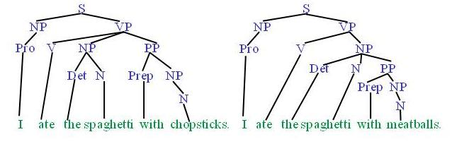
Syntactic Parsing
Produce the correct syntactic parse tree for a sentence.

Slide 22
Semantic Tasks

Slide 23
Word Sense Disambiguation (WSD)
Words in natural language usually have a fair number of different possible meanings.
  Ellen has a strong interest in computational linguistics.
  Ellen pays a large amount of interest on her credit card.
For many tasks (question answering, translation), the proper sense of each ambiguous word in a sentence must be determined.

Slide 24
Semantic Role Labeling (SRL)
For each clause, determine the semantic role played by each noun phrase that is an argument to the verb.
  agent patient source destination instrument
  John drove Mary from Austin to Dallas in his Toyota Prius.
  The hammer broke the window.
Also referred to a “case role analysis,” “thematic analysis,” and “shallow semantic parsing”

Slide 25
Semantic Parsing
A semantic parser maps a natural-language sentence to a complete, detailed semantic representation (logical form).
For many applications, the desired output is immediately executable by another program.
Example: Mapping an English database query to Prolog:
  How many cities are there in the US?
  answer(A, count(B, (city(B), loc(B, C),
  const(C, countryid(USA))),
  A))

Slide 26
Textual Entailment
Determine whether one natural language sentence entails (implies) another under an ordinary interpretation.

Slide 27
Textual Entailment Problems from PASCAL Challenge
TEXT | HYPOTHESIS | ENTAIL MENT
Eyeing the huge market potential, currently led by Google, Yahoo took over search company Overture Services Inc last year. | Yahoo bought Overture. | TRUE
Microsoft's rival Sun Microsystems Inc. bought Star Office last month and plans to boost its development as a Web-based device running over the Net on personal computers and Internet appliances. | Microsoft bought Star Office. | FALSE
The National Institute for Psychobiology in Israel was established in May 1971 as the Israel Center for Psychobiology by Prof. Joel. | Israel was established in May 1971. | FALSE
Since its formation in 1948, Israel fought many wars with neighboring Arab countries. | Israel was established in 1948. | TRUE

Slide 28
Pragmatics/Discourse Tasks

Slide 29
Anaphora Resolution/
Co-Reference
Determine which phrases in a document refer to the same underlying entity.
  John put the carrot on the plate and ate it.
  Bush started the war in Iraq. But the president needed the consent of Congress.
Some cases require difficult reasoning.
    Today was Jack's birthday. Penny and Janet went to the store. They were going to get presents. Janet decided to get a kite. "Don't do that," said Penny. "Jack has a kite. He will make you take it back."

Slide 30
Ellipsis Resolution
Frequently words and phrases are omitted from sentences when they can be inferred from context.
  "Wise men talk because they have something to say;
  fools talk because they have to say something.“ (Plato)
  "Wise men talk because they have something to say;
  fools, because they have to say something.“ (Plato)

Slide 31
Other Tasks

Slide 32
Information Extraction (IE)
Identify phrases in language that refer to specific types of entities and relations in text.
Named entity recognition is task of identifying names of people, places, organizations, etc. in text.
people organizations places
  Michael Dell is the CEO of Dell Computer Corporation and lives in Austin Texas.
Relation extraction identifies specific relations between entities.
  Michael Dell is the CEO of Dell Computer Corporation and lives in Austin Texas.

Slide 33
Question Answering
Directly answer natural language questions based on information presented in a corpora of textual documents (e.g. the web).
  When was Barack Obama born? (factoid)
    August 4, 1961
  Who was president when Barack Obama was born?
    John F. Kennedy
  How many presidents have there been since Barack Obama was born?
    9

Slide 34
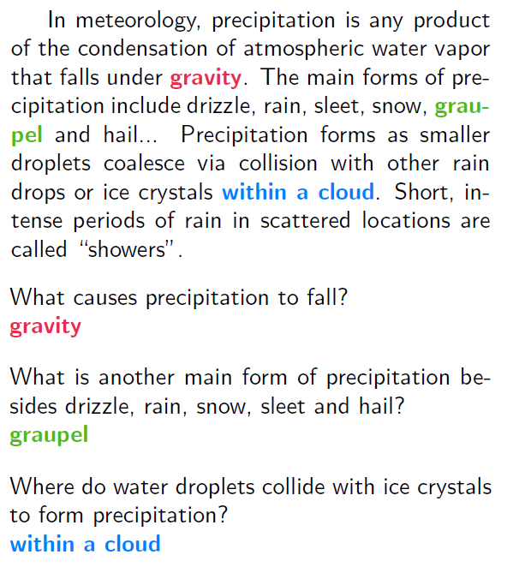
Reading Comprehension
Read a passage of text and answer questions about it.
Example from Stanford SQuAD dataset.

Slide 35
Text Summarization
Produce a short summary of a longer document or article.
  Article: With a split decision in the final two primaries and a flurry of superdelegate endorsements, Sen. Barack Obama sealed the Democratic presidential nomination last night after a grueling and history-making campaign against Sen. Hillary Rodham Clinton that will make him the first African American to head a major-party ticket. Before a chanting and cheering audience in St. Paul, Minn., the first-term senator from Illinois savored what once seemed an unlikely outcome to the Democratic race with a nod to the marathon that was ending and to what will be another hard-fought battle, against Sen. John McCain, the presumptive Republican nominee….
  Summary: Senator Barack Obama was declared the presumptive Democratic presidential nominee.

Slide 36
Machine Translation (MT)
Translate a sentence from one natural language to another.
  Hasta la vista, bebé ⇒
  Until we see each other again, baby.

Slide 37
Ambiguity Resolution is Required for Translation
Syntactic and semantic ambiguities must be properly resolved for correct translation:
  “John plays the guitar.” → “John toca la guitarra.”
  “John plays soccer.” → “John juega el fútbol.”
An apocryphal story is that an early MT system gave the following results when translating from English to Russian and then back to English:
  “The spirit is willing but the flesh is weak.” ⇒ “The liquor is good but the meat is spoiled.”
  “Out of sight, out of mind.” ⇒ “Invisible idiot.”

Slide 38
Resolving Ambiguity
Choosing the correct interpretation of linguistic utterances requires knowledge of:
  Syntax
    An agent is typically the subject of the verb
  Semantics
    Michael and Ellen are names of people
    Austin is the name of a city (and of a person)
    Toyota is a car company and Prius is a brand of car
  Pragmatics
  World knowledge
    Credit cards require users to pay financial interest
    Agents must be animate and a hammer is not animate

Slide 39
Manual Knowledge Acquisition
Traditional, “rationalist,” approaches to language processing require human specialists to specify and formalize the required knowledge.
Manual knowledge engineering, is difficult, time-consuming, and error prone.
“Rules” in language have numerous exceptions and irregularities.
  “All grammars leak.”: Edward Sapir (1921)
Manually developed systems were expensive to develop and their abilities were limited and “brittle” (not robust).

Slide 40
Automatic Learning Approach
Use machine learning methods to automatically acquire the required knowledge from appropriately annotated text corpora.
Variously referred to as the “corpus based,” “statistical,” or “empirical” approach.
Statistical learning methods were first applied to speech recognition in the late 1970’s and became the dominant approach in the 1980’s.
During the 1990’s, the statistical training approach expanded and came to dominate almost all areas of NLP.

Slide 41
Learning Approach
Machine
Learning
Manually Annotated
Training Corpora
Linguistic
Knowledge
NLP System
Raw Text
Automatically
Annotated Text

Slide 42
Advantages of the Learning Approach
Large amounts of electronic text are now available.
Annotating corpora is easier and requires less expertise than manual knowledge engineering.
Learning algorithms have progressed to be able to handle large amounts of data and produce accurate probabilistic knowledge.
The probabilistic knowledge acquired allows robust processing that handles linguistic regularities as well as exceptions.

Slide 43
The Importance of Probability
Unlikely interpretations of words can combine to generate spurious ambiguity:
  “The a are of I” is a valid English noun phrase (Abney, 1996)
    “a” is an adjective for the letter A
    “are” is a noun for an area of land (as in hectare)
    “I” is a noun for the letter I
  “Time flies like an arrow” has 4 parses, including those meaning:
    Insects of a variety called “time flies” are fond of a particular arrow.
    A command to record insects’ speed in the manner that an arrow would.
Some combinations of words are more likely than others:
  “vice president Gore” vs. “dice precedent core”
Statistical methods allow computing the most likely interpretation by combining probabilistic evidence from a variety of uncertain knowledge sources.

Slide 44
Human Language Acquisition
Human children obviously learn languages from experience.
However, it is controversial to what extent prior knowledge of “universal grammar” (Chomsky, 1957) facilitates this acquisition process.
Computational studies of language learning may help us to understand human language learning, and to elucidate to what extent language learning must rely on prior grammatical knowledge due to the “poverty of the stimulus.”
Existing empirical results indicate that a great deal of linguistic knowledge can be effectively acquired from reasonable amounts of real linguistic data without specific knowledge of a “universal grammar.”

Slide 45
Pipelining Problem
Assuming separate independent components for speech recognition, syntax, semantics, pragmatics, etc. allows for more convenient modular software development.
However, frequently constraints from “higher level” processes are needed to disambiguate “lower level” processes.
  Example of syntactic disambiguation relying on semantic disambiguation:
    At the zoo, several men were showing a group of students various types of flying animals. Suddenly, one of the students hit the man with a bat.

Slide 46
Pipelining Problem (cont.)
If a hard decision is made at each stage, cannot backtrack when a later stage indicates it is incorrect.
  If attach “with a bat” to the verb “hit” during syntactic analysis, then cannot reattach it to “man” after “bat” is disambiguated during later semantic or pragmatic processing.

Slide 47
Increasing Module Bandwidth
If each component produces multiple scored interpretations, then later components can rerank these interpretations.
Pragmatics
Acoustic/
Phonetic
Syntax
Semantics
sound
waves
meaning
(contextualized)
words
parse
trees
literal
meanings
Problem: Number of interpretations grows combinatorially.
Solution: Efficiently encode combinations of interpretations.
    Word lattices
    Compact parse forests

Slide 48
Global Integration/
Joint Inference
Integrated interpretation that combines phonetic/syntactic/semantic/pragmatic constraints.
Integrated
Interpretation
sound
waves
meaning
(contextualized)
Difficult to design and implement.
Potentially computationally complex.

Slide 49
Early History: 1950’s
Shannon (the father of information theory) explored probabilistic models of natural language (1951).
Chomsky (the extremely influential linguist) developed formal models of syntax, i.e. finite state and context-free grammars (1956).
First computational parser developed at U Penn as a cascade of finite-state transducers (Joshi, 1961; Harris, 1962).
Bayesian methods developed for optical character recognition (OCR) (Bledsoe & Browning, 1959).

Slide 50
History: 1960’s
Work at MIT AI lab on question answering (BASEBALL) and dialog (ELIZA).
Semantic network models of language for question answering (Simmons, 1965).
First electronic corpus collected, Brown corpus, 1 million words (Kucera and Francis, 1967).
Bayesian methods used to identify document authorship (The Federalist papers) (Mosteller & Wallace, 1964).

Slide 51
History: 1970’s
“Natural language understanding” systems developed that tried to support deeper semantic interpretation.
  SHRDLU (Winograd, 1972) performs tasks in the “blocks world” based on NL instruction.
  Schank et al. (1972, 1977) developed systems for conceptual representation of language and for understanding short stories using hand-coded knowledge of scripts, plans, and goals.
Prolog programming language developed to support logic-based parsing (Colmeraurer, 1975).
Initial development of hidden Markov models (HMMs) for statistical speech recognition (Baker, 1975; Jelinek, 1976).

Slide 52
History: 1980’s
Development of more complex (mildly context sensitive) grammatical formalisms, e.g. unification grammar, HPSG, tree-adjoning grammar.
Symbolic work on discourse processing and NL generation.
Initial use of statistical (HMM) methods for syntactic analysis (POS tagging) (Church, 1988).

Slide 53
History: 1990’s
Rise of statistical methods and empirical evaluation causes a “scientific revolution” in the field.
Initial annotated corpora developed for training and testing systems for POS tagging, parsing, WSD, information extraction, MT, etc.
First statistical machine translation systems developed at IBM for Canadian Hansards corpus (Brown et al., 1990).
First robust statistical parsers developed (Magerman, 1995; Collins, 1996; Charniak, 1997).
First systems for robust information extraction developed (e.g. MUC competitions).

Slide 54
History: 2000’s
Increased use of a variety of ML methods, SVMs, logistic regression (i.e. max-ent), CRF’s, etc.
Continued developed of corpora and competitions on shared data.
  TREC Q/A
  SENSEVAL/SEMEVAL
  CONLL Shared Tasks (NER, SRL…)
Increased emphasis on unsupervised, semi-supervised, and active learning as alternatives to purely supervised learning.
Shifting focus to semantic tasks such as WSD, SRL, and semantic parsing.

Slide 55
History: 2010’s
Grounded Language: Connecting language to perception and action.
  Image and video description
  Visual question answering (VQA)
  Human-Robot Interaction (HRI) in NL
Deep Learning: Neural network learning with many layers or recurrence.
  Long Short Term Memory (LSTM) recurrent neural networks using encoder/decoder sequence-to-sequence mapping.
  Neural Machine Translation (NMT)
  Spreading to syntactic/semantic parsing and most other NLP tasks.

Slide 56
Relevant Scientific Conferences
Association for Computational Linguistics (ACL)
North American Association for Computational Linguistics (NAACL)
International Conference on Computational Linguistics (COLING)
Empirical Methods in Natural Language Processing (EMNLP)
Conference on Computational Natural Language Learning (CoNLL)
International Association for Machine Translation (IMTA)

