Slide 1
CS 388:
Natural Language Processing:
Syntactic Parsing
Raymond J. Mooney
University of Texas at Austin

Slide 2
Phrase Chunking
Find all non-recursive noun phrases (NPs) and verb phrases (VPs) in a sentence.
  [NP I] [VP ate] [NP the spaghetti] [PP with] [NP meatballs].
  [NP He ] [VP reckons ] [NP the current account deficit ] [VP will narrow ] [PP to ] [NP only # 1.8 billion ] [PP in ] [NP September ]

Slide 3
Phrase Chunking as Sequence Labeling
Tag individual words with one of 3 tags
  B (Begin) word starts new target phrase
  I (Inside) word is part of target phrase but not the first word
  O (Other) word is not part of target phrase
Sample for NP chunking
  He reckons the current account deficit will narrow to only # 1.8 billion in September.
Begin Inside Other

Slide 4
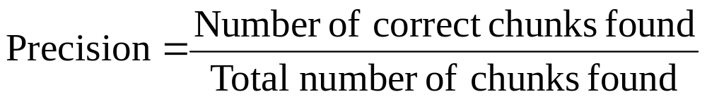
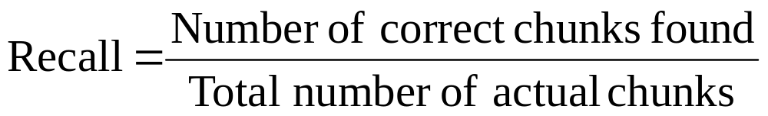
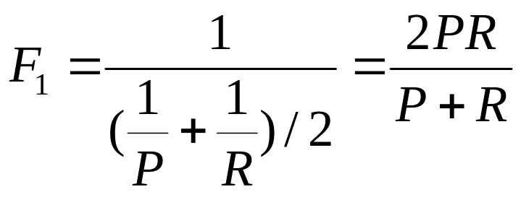
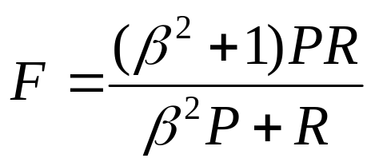
Evaluating Chunking
Per token accuracy does not evaluate finding correct full chunks. Instead use:
Take harmonic mean to produce a single evaluation metric called F measure.

Slide 5
Current Chunking Results
Best system for NP chunking: F₁=96%
Typical results for finding range of chunk types (CONLL 2000 shared task: NP, VP, PP, ADV, SBAR, ADJP) is F₁=92−94%

Slide 6
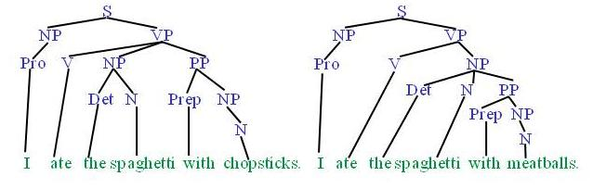
Syntactic Parsing
Produce the correct syntactic parse tree for a sentence.

Slide 7
Context Free Grammars (CFG)
N a set of non-terminal symbols (or variables)
Σ a set of terminal symbols (disjoint from N)
R a set of productions or rules of the form A→β, where A is a non-terminal and β is a string of symbols from (Σ∪ N)*
S, a designated non-terminal called the start symbol

Slide 8
Simple CFG for ATIS English
Grammar
Lexicon
S → NP VP
S → Aux NP VP
S → VP
NP → Pronoun
NP → Proper-Noun
NP → Det Nominal
Nominal → Noun
Nominal → Nominal Noun
Nominal → Nominal PP
VP → Verb
VP → Verb NP
VP → VP PP
PP → Prep NP
Det → the | a | that | this
Noun → book | flight | meal | money
Verb → book | include | prefer
Pronoun → I | he | she | me
Proper-Noun → Houston | NWA
Aux → does
Prep → from | to | on | near | through

Slide 9
Sentence Generation
Sentences are generated by recursively rewriting the start symbol using the productions until only terminals symbols remain.
S
Derivation
or
Parse Tree
VP
Verb NP
book
Det Nominal
the
Nominal PP
Noun
Prep NP
flight
through
Proper-Noun
Houston

Slide 10
Parsing
Given a string of terminals and a CFG, determine if the string can be generated by the CFG.
  Also return a parse tree for the string
  Also return all possible parse trees for the string
Must search space of derivations for one that derives the given string.
  Top-Down Parsing: Start searching space of derivations for the start symbol.
  Bottom-up Parsing: Start search space of reverse deivations from the terminal symbols in the string.

Slide 11
Parsing Example
S
VP
Verb NP
book that flight
book
Det Nominal
that
Noun
flight

Slide 12
Top Down Parsing
S
NP VP
Pronoun

Slide 13
Top Down Parsing
S
NP VP
Pronoun
X
book

Slide 14
Top Down Parsing
S
NP VP
ProperNoun

Slide 15
Top Down Parsing
S
NP VP
ProperNoun
X
book

Slide 16
Top Down Parsing
S
NP VP
Det Nominal

Slide 17
Top Down Parsing
S
NP VP
Det Nominal
X
book

Slide 18
Top Down Parsing
S
Aux NP VP

Slide 19
Top Down Parsing
S
Aux NP VP
X
book

Slide 20
Top Down Parsing
S
VP

Slide 21
Top Down Parsing
S
VP
Verb

Slide 22
Top Down Parsing
S
VP
Verb
book

Slide 23
Top Down Parsing
S
VP
Verb
X
book
that

Slide 24
Top Down Parsing
S
VP
Verb NP

Slide 25
Top Down Parsing
S
VP
Verb NP
book

Slide 26
Top Down Parsing
S
VP
Verb NP
book
Pronoun

Slide 27
Top Down Parsing
S
VP
Verb NP
book
Pronoun
X
that

Slide 28
Top Down Parsing
S
VP
Verb NP
book
ProperNoun

Slide 29
Top Down Parsing
S
VP
Verb NP
book
ProperNoun
X
that

Slide 30
Top Down Parsing
S
VP
Verb NP
book
Det Nominal

Slide 31
Top Down Parsing
S
VP
Verb NP
book
Det Nominal
that

Slide 32
Top Down Parsing
S
VP
Verb NP
book
Det Nominal
that
Noun

Slide 33
Top Down Parsing
S
VP
Verb NP
book
Det Nominal
that
Noun
flight

Slide 34
Bottom Up Parsing
book that flight

Slide 35
Bottom Up Parsing
Noun
book that flight

Slide 36
Bottom Up Parsing
Nominal
Noun
book that flight

Slide 37
Bottom Up Parsing
Nominal
Nominal Noun
Noun
book that flight

Slide 38
Bottom Up Parsing
Nominal
Nominal Noun
X
Noun
book that flight

Slide 39
Bottom Up Parsing
Nominal
Nominal PP
Noun
book that flight

Slide 40
Bottom Up Parsing
Nominal
Nominal PP
Noun
Det
book that flight

Slide 41
Bottom Up Parsing
Nominal
Nominal PP
NP
Noun
Det
Nominal
book that flight

Slide 42
Bottom Up Parsing
Nominal
Nominal PP
NP
Noun
Det
Nominal
book that
Noun
flight

Slide 43
Bottom Up Parsing
Nominal
Nominal PP
NP
Noun
Det
Nominal
book that
Noun
flight

Slide 44
Bottom Up Parsing
Nominal
Nominal PP
S
NP
VP
Noun
Det
Nominal
book that
Noun
flight

Slide 45
Bottom Up Parsing
Nominal
Nominal PP
S
NP
VP
Noun
Det
Nominal
X
book that
Noun
flight

Slide 46
Bottom Up Parsing
Nominal
Nominal PP
X
NP
Noun
Det
Nominal
book that
Noun
flight

Slide 47
Bottom Up Parsing
NP
Verb
Det
Nominal
book that
Noun
flight

Slide 48
Bottom Up Parsing
VP
NP
Verb
Det
Nominal
book that
Noun
flight

Slide 49
Bottom Up Parsing
S
VP
NP
Verb
Det
Nominal
book that
Noun
flight

Slide 50
Bottom Up Parsing
S
X
VP
NP
Verb
Det
Nominal
book that
Noun
flight

Slide 51
Bottom Up Parsing
VP
VP
PP
NP
Verb
Det
Nominal
book that
Noun
flight

Slide 52
Bottom Up Parsing
VP
VP
PP
X
NP
Verb
Det
Nominal
book that
Noun
flight

Slide 53
Bottom Up Parsing
VP
NP
NP
Verb
Det
Nominal
book that
Noun
flight

Slide 54
Bottom Up Parsing
VP
NP
Verb
Det
Nominal
book that
Noun
flight

Slide 55
Bottom Up Parsing
S
VP
NP
Verb
Det
Nominal
book that
Noun
flight

Slide 56
Top Down vs. Bottom Up
Top down never explores options that will not lead to a full parse, but can explore many options that never connect to the actual sentence.
Bottom up never explores options that do not connect to the actual sentence but can explore options that can never lead to a full parse.
Relative amounts of wasted search depend on how much the grammar branches in each direction.

Slide 57
Dynamic Programming Parsing
To avoid extensive repeated work, must cache intermediate results, i.e. completed phrases.
Caching (memoizing) critical to obtaining a polynomial time parsing (recognition) algorithm for CFGs.
Dynamic programming algorithms based on both top-down and bottom-up search can achieve O(n³) recognition time where n is the length of the input string.

Slide 58
Dynamic Programming Parsing Methods
CKY (Cocke-Kasami-Younger) algorithm based on bottom-up parsing and requires first normalizing the grammar.
Earley parser is based on top-down parsing and does not require normalizing grammar but is more complex.
More generally, chart parsers retain completed phrases in a chart and can combine top-down and bottom-up search.

Slide 59
CKY
First grammar must be converted to Chomsky normal form (CNF) in which productions must have either exactly 2 non-terminal symbols on the RHS or 1 terminal symbol (lexicon rules).
Parse bottom-up storing phrases formed from all substrings in a triangular table (chart).

Slide 60
ATIS English Grammar Conversion
Original Grammar
Chomsky Normal Form
S → NP VP
S → Aux NP VP
S → VP
NP → Pronoun
NP → Proper-Noun
NP → Det Nominal
Nominal → Noun
Nominal → Nominal Noun
Nominal → Nominal PP
VP → Verb
VP → Verb NP
VP → VP PP
PP → Prep NP
S → NP VP
S → X1 VP
X1 → Aux NP
S → book | include | prefer
S → Verb NP
S → VP PP
NP → I | he | she | me
NP → Houston | NWA
NP → Det Nominal
Nominal → book | flight | meal | money
Nominal → Nominal Noun
Nominal → Nominal PP
VP → book | include | prefer
VP → Verb NP
VP → VP PP
PP → Prep NP

Slide 61
CKY Parser
Book the flight through Houston
j= 1 2 3 4 5
i=
0
1
2
3
4
Cell[i,j]
contains all
constituents
(non-terminals)
covering words
i +1 through j

Slide 62
CKY Parser
Book the flight through Houston
S, VP, Verb,
Nominal,
Noun
None
NP
Det
Nominal,
Noun

Slide 63
CKY Parser
Book the flight through Houston
S, VP, Verb,
Nominal,
Noun
VP
None
NP
Det
Nominal,
Noun

Slide 64
CKY Parser
Book the flight through Houston
S, VP, Verb,
Nominal,
Noun
S
VP
None
NP
Det
Nominal,
Noun

Slide 65
CKY Parser
Book the flight through Houston
S, VP, Verb,
Nominal,
Noun
S
VP
None
NP
Det
Nominal,
Noun

Slide 66
CKY Parser
Book the flight through Houston
S, VP, Verb,
Nominal,
Noun
S
VP
None
None
NP
Det
None
Nominal,
Noun
None
Prep

Slide 67
CKY Parser
Book the flight through Houston
S, VP, Verb,
Nominal,
Noun
S
VP
None
None
NP
Det
None
Nominal,
Noun
None
Prep
PP
NP
ProperNoun

Slide 68
CKY Parser
Book the flight through Houston
S, VP, Verb,
Nominal,
Noun
S
VP
None
None
NP
Det
None
Nominal,
Noun
None
Nominal
Prep
PP
NP
ProperNoun

Slide 69
CKY Parser
Book the flight through Houston
S, VP, Verb,
Nominal,
Noun
S
VP
None
None
NP
NP
Det
None
Nominal,
Noun
None
Nominal
Prep
PP
NP
ProperNoun

Slide 70
CKY Parser
Book the flight through Houston
S, VP, Verb,
Nominal,
Noun
S
VP
None
None
VP
NP
NP
Det
None
Nominal,
Noun
None
Nominal
Prep
PP
NP
ProperNoun

Slide 71
CKY Parser
Book the flight through Houston
S, VP, Verb,
Nominal,
Noun
S
VP
None
None
S
VP
NP
NP
Det
None
Nominal,
Noun
None
Nominal
Prep
PP
NP
ProperNoun

Slide 72
CKY Parser
Book the flight through Houston
S, VP, Verb,
Nominal,
Noun
S
VP
VP
None
None
S
VP
NP
NP
Det
None
Nominal,
Noun
None
Nominal
Prep
PP
NP
ProperNoun

Slide 73
CKY Parser
Book the flight through Houston
S, VP, Verb,
Nominal,
Noun
S
S
VP
VP
None
None
S
VP
NP
NP
Det
None
Nominal,
Noun
None
Nominal
Prep
PP
NP
ProperNoun

Slide 74
CKY Parser
Book the flight through Houston
Parse
Tree
#1
S, VP, Verb,
Nominal,
Noun
S
S
VP
VP
None
None
S
VP
NP
NP
Det
None
Nominal,
Noun
None
Nominal
Prep
PP
NP
ProperNoun

Slide 75
CKY Parser
Book the flight through Houston
Parse
Tree
#2
S, VP, Verb,
Nominal,
Noun
S
S
VP
VP
None
None
S
VP
NP
NP
Det
None
Nominal,
Noun
None
Nominal
Prep
PP
NP
ProperNoun

Slide 76
Complexity of CKY (recognition)
There are (n(n+1)/2) = O(n²) cells
Filling each cell requires looking at every possible split point between the two non-terminals needed to introduce a new phrase.
There are O(n) possible split points.
Total time complexity is O(n³)

Slide 77
Complexity of CKY (all parses)
Previous analysis assumes the number of phrase labels in each cell is fixed by the size of the grammar.
If compute all derivations for each non-terminal, the number of cell entries can expand combinatorially.
Since the number of parses can be exponential, so is the complexity of finding all parse trees.

Slide 78
Effect of CNF on Parse Trees
Parse trees are for CNF grammar not the original grammar.
A post-process can repair the parse tree to return a parse tree for the original grammar.

Slide 79
Syntactic Ambiguity
Just produces all possible parse trees.
Does not address the important issue of ambiguity resolution.

Slide 80
Issues with CFGs
Addressing some grammatical constraints requires complex CFGs that do no compactly encode the given regularities.
Some aspects of natural language syntax may not be captured at all by CFGs and require context-sensitivity (productions with more than one symbol on the LHS).

Slide 81
Agreement
Subjects must agree with their verbs on person and number.
  I am cold. You are cold. He is cold.
  * I are cold * You is cold. *He am cold.
Requires separate productions for each combination.
  S → NP1stPersonSing VP1stPersonSing
  S → NP2ndPersonSing VP2ndPersonSing
  NP1stPersonSing → …
  VP1stPersonSing → …
  NP2ndPersonSing → …
  VP2ndPersonSing → …

Slide 82
Other Agreement Issues
Pronouns have case (e.g. nominative, accusative) that must agree with their syntactic position.
  I gave him the book. * I gave he the book.
  He gave me the book. * Him gave me the book.
Many languages have gender agreement.
  Los Angeles * Las Angeles
  Las Vegas * Los Vegas

Slide 83
Subcategorization
Specific verbs take some types of arguments but not others.
  Transitive verb: “found” requires a direct object
    John found the ring. * John found.
  Intransitive verb: “disappeared” cannot take one
    John disappeared. * John disappeared the ring.
  “gave” takes both a direct and indirect object
    John gave Mary the ring. * John gave Mary. * John gave the ring.
  “want” takes an NP, or non-finite VP or S
    John wants a car. John wants to buy a car. John wants Mary to take the ring. * John wants.
Subcategorization frames specify the range of argument types that a given verb can take.

Slide 84
Conclusions
Syntax parse trees specify the syntactic structure of a sentence that helps determine its meaning.
  John ate the spaghetti with meatballs with chopsticks.
  How did John eat the spaghetti? What did John eat?
CFGs can be used to define the grammar of a natural language.
Dynamic programming algorithms allow computing a single parse tree in cubic time or all parse trees in exponential time.

