Slide 1
Ensembling Diverse Approaches to Question Answering
Raymond J. Mooney
Dept. of Computer Science
University of Texas at Austin

Slide 2
Diverse Types of Q/A
Factoid querying of open-domain raw text.
Compositional querying of manually curated structured database / knowledge-graph.
Compositional querying of knowledge base/graph automatically constructed from raw text.
Reading comprehension querying of specific documents.
Visual question answering from images and/or videos.

Slide 3
Open Domain Factoid Q/A
Document
corpus
Question
Q/A
System
Answer
String
NIST TREC Q/A track initiated in 1998.
“Which museum in Florence was damaged by a major bomb explosion in 1993?”
Combine IR passage retrieval with limited NLP processing (NER, SRL, Question Classification).

Slide 4
Limitations of Factoid Q/A
Question must query a specific fact that is explicitly stated somewhere in the document corpus.
Does not allow aggregating or accumulating information across multiple information sources.
Does not require “deep compositional” semantics, nor inferential reasoning to generate answer.

Slide 5
Learning Semantic Parsers for KB Q/A
Semantic parsers can be automatically learned from various forms of supervision:
Questions + logical forms
Questions + answers (latent logical form)

Slide 6
Recent Structured Query Datasets
Freebase queries (limited compositionality)
Free917 (Cai & Yates, 2013)
“How many works did Mozart dedicate to Joseph Haydn?”
WebQuestions (Berant et al., 2013)
“What music did Beethoven compose?”
Wikipedia table questions (more compositionality, must generalize to new test tables)
WikiTableQuestions (Pasupat & Liang, 2015)
“How many runners took 2 minutes at the most to run 1500 meters?”

Slide 7
Limitations of Traditional Semantic Parsing
Requires fixed, predetermined semantic ontology of types and relations.
Requires pre-assembled database or knowledge base/graph.
Not easily generalized to open-domain Q/A

Slide 8
Q/A for AKBC (Automated Knowledge Base Construction)
Document
corpus
IE System
KB
Question
Q/A
System
Answer
String

Slide 9
Issues with AKBC Q/A
KB may contain uncertainty and errors due to imperfect extraction.
Can create ontology automatically using Unsupervised Semantic Parsing (USP)
Use relational clustering of words and phrases to automatically induce a “latent” set of semantic predicates for types and relations from dependency-parsed text (Poon & Domingos, 2008; Titov & Klementiev, 2011; Lewis & Steedman, 2013).

Slide 10
Reading Comprehension Q/A
Answer questions that test comprehension of a specific document.
Use standardized tests of reading comprehension to evaluate performance (Hirschman et al. 1999; Rilo & Thelen, 2000; Ng et al. 2000; Charniak et al. 2000).

Slide 11
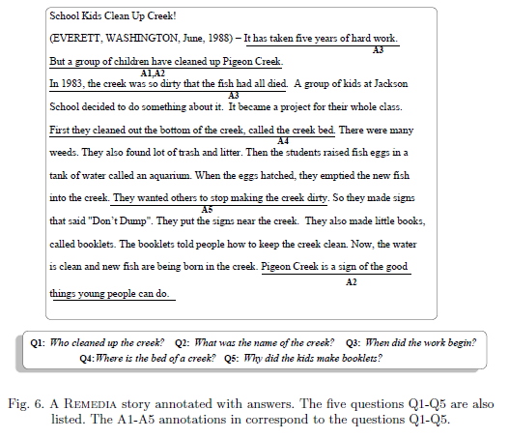
Sample Reading Comprehension Test

Slide 12
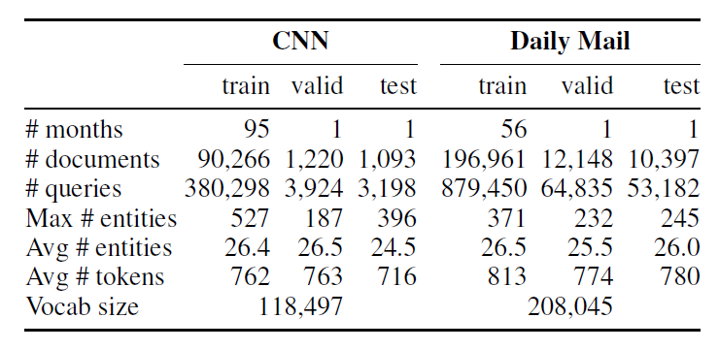
Large Scale Reading Comprehension Data
DeepMind’s large-scale data for reading comprehension Q/A (Hermann et al., 2015).
News articles used as source documents.
Questions constructed automatically from article summary sentences.

Slide 13
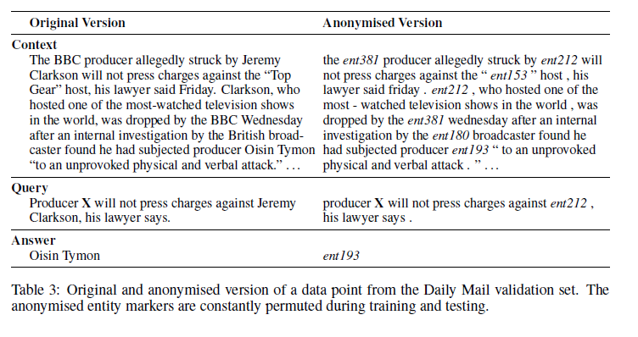
Sample DeepMind Reading Comprehension Test

Slide 14
Deep LSTM Reader
DeepMind uses LSTM recurrent neural net (RNN) to encode document and query into a vector that is then used to predict the answer.
Document
LSTM
Encoder
Answer
Extractor
Embedding
Answer
Question
Incorporated various forms of attention to focus the reader on answering the question while reading the document.

Slide 15
Visual Question Answering (VQA)
Answer natural language questions about information in images.
VaTech/MSR group has put together VQA dataset with ~750K questions over ~250K images (Antol et al., 2016).

Slide 16
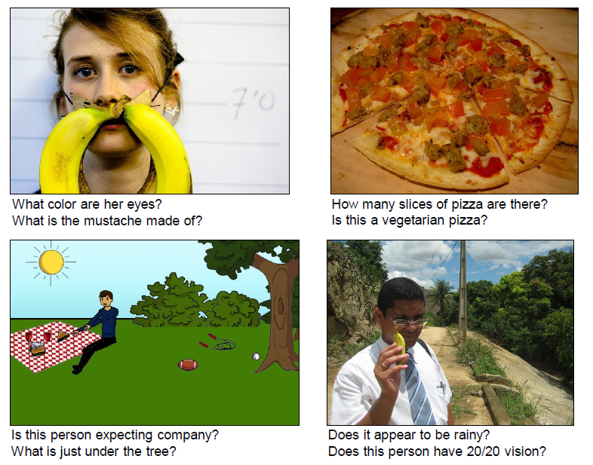
VQA Examples

Slide 17
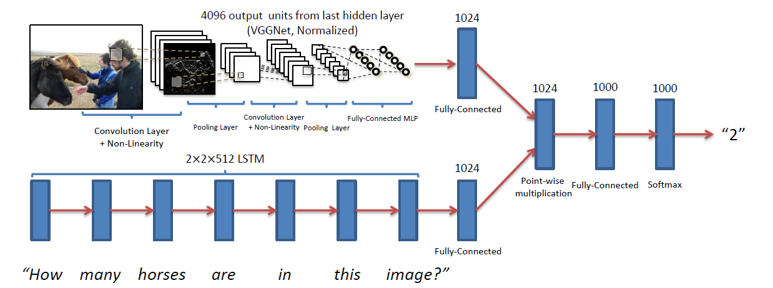
LSTM System for VQA

Slide 18
Hybrid RNN/Semantic-Parsing for Q/A
Recent approach composes neural-network for a specific question (Andreas et al. 2016).
Combines syntactic parse with lexically-based component neural networks.
Test on multiple types of Q/A
Visual Question Answering
Geographical database queries

Slide 19
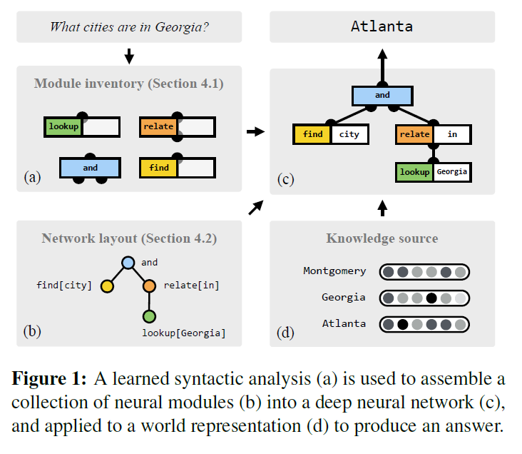
Compositional Neural Nets for Q/A (Andreas et al., 2016)

Slide 20
Ensembling for Q/A
Ensembling multiple methods is a proven approach to generating robust, general-purpose systems.
Using supervised learning to train a meta-classifier to optimally combine multiple outputs, i.e. stacking (Wolpert, 1992), is particularly effective.

Slide 21

Stacking in IBM Watson
Stacking was used to combine evidence for each answer from many different components in the IBM Watson Jeopardy system (Ferrucci et al. 2010) .
Meta-classifier was trained to correctly answer years of prior Jeopardy questions.

Slide 22
Stacking with Auxiliary Features for KBP Slot Filling
For each proposed slot-fill, e.g. spouse(Barack, Michelle),
combine multiple system confidences and additional features
System 1
conf 1
Slot Type
Provenance Features
conf 2
System 2
SVM
MetaClassifier
System N-1
conf N-1
conf N
Accept?
System N
(Rajani & Mooney, ACL 2015)

Slide 23
Ensembling Systems
With and Without Prior Performance Data
Stacking restricts us to ensembling systems for which we have training data from previous years.
Use unsupervised ensembling to first combine confidence scores for “new” systems.
Employ constrained optimization approach of Weng et al. (2013) .
Then use stacking to combine result of the resulting unsupervised ensemble with supervised systems.

Slide 24
Combining Supervised and Unsupervised Methods using Stacking
Sup System 1
conf 1
Slot Type
Provenance Features
conf 2
Sup System 2
conf N
SVM
MetaClassifier
Sup System N
Unsup System 1
Unsup System 2
Calibrated conf
Accept?
Unsup System M
Constrained Optimization (Weng et al., 2013)

Slide 25
New Auxiliary Provenance Features
Query Document Similarity Features
KBP SF queries come with a “query document” to disambiguate the query entity.
For each system, compute cosine similarity between its provenance document and the query document.
Provenance Document Similarity Features
For each system, compute the average cosine similarity between its provenance document and the provenance document of all other systems.

Slide 26
KBP 2015 Cold Start Slot Filling
Ensembling Track Results
Approach | Precision | Recall | F1
Combined supervised and unsupervised with new features | 0.4679 | 0.4314 | 0.4489
Combined supervised and unsupervised without new features | 0.4789 | 0.3588 | 0.4103
Only supervised stacking approach (ACL 2015) | 0.5084 | 0.2855 | 0.3657
Top ranked CSSF 2015 system | 0.3989 | 0.3058 | 0.3462
Constrained optimization on all systems (Weng et al., 2013) | 0.1712 | 0.3998 | 0.2397

Slide 27
Stacking for General Q/A
A promising approach to building a general Q/A system is to stack a variety of the approaches we have reviewed
Possibly using auxiliary provenance features.

Slide 28
Conclusions
There are many diverse types of question-answering scenarios.
There are many diverse approaches to each of these Q/A scenarios.
Ensembling these diverse approaches is a promising approach to building a general purpose Q/A system.

