Slide 1
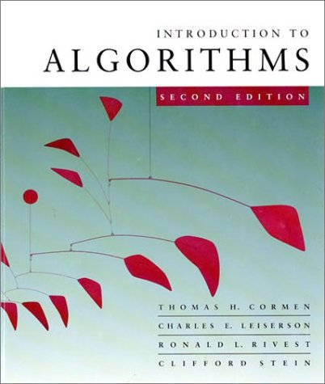
Introduction to Algorithms
6.046J
Lecture 1
Md Habibul Basar Faruq

Slide 2
What is course about?
The theoretical study of design and analysis of computer algorithms
Basic goals for an algorithm:
always correct
always terminates
This class: performance
  Performance often draws the line between
what is possible and what is impossible.

Slide 3
Design and Analysis of Algorithms
Analysis: predict the cost of an algorithm in terms of resources and performance
Design: design algorithms which minimize the cost

Slide 4
Our Machine Model
Generic Random Access Machine (RAM)
Executes operations sequentially
Set of primitive operations:
  Arithmetic. Logical, Comparisons, Function calls
Simplifying assumption: all ops cost 1 unit
  Eliminates dependence on the speed of our computer, otherwise impossible to verify and to compare

Slide 5
The problem of sorting
Input: sequence ⟨a₁, a₂, …, a_{n}⟩ of numbers.
Output: permutation ⟨a'₁, a'₂, …, a'_{n}⟩ such
that a'₁ ≤ a'₂ ≤ … ≤ a'_{n} .
Example:
Input: 8 2 4 9 3 6
Output: 2 3 4 6 8 9

Slide 6
Insertion sort
INSERTION-SORT (A, n) ⊳ A[1 . . n]
for j ← 2 to n
do key ← A[ j]
i ← j – 1
while i > 0 and A[i] > key
do A[i+1] ← A[i]
i ← i – 1
A[i+1] = key
“pseudocode”
1
i
j
n
A:
key
sorted

Slide 7
Example of insertion sort
8
2
4
9
3
6

Slide 8
Example of insertion sort
8
2
4
9
3
6

Slide 9
Example of insertion sort
8
2
4
9
3
6
2
8
4
9
3
6

Slide 10
Example of insertion sort
8
2
4
9
3
6
2
8
4
9
3
6

Slide 11
Example of insertion sort
8
2
4
9
3
6
2
8
4
9
3
6
2
4
8
9
3
6

Slide 12
Example of insertion sort
8
2
4
9
3
6
2
8
4
9
3
6
2
4
8
9
3
6

Slide 13
Example of insertion sort
8
2
4
9
3
6
2
8
4
9
3
6
2
4
8
9
3
6
2
4
8
9
3
6

Slide 14
Example of insertion sort
8
2
4
9
3
6
2
8
4
9
3
6
2
4
8
9
3
6
2
4
8
9
3
6

Slide 15
Example of insertion sort
8
2
4
9
3
6
2
8
4
9
3
6
2
4
8
9
3
6
2
4
8
9
3
6
2
3
4
8
9
6

Slide 16
Example of insertion sort
8
2
4
9
3
6
2
8
4
9
3
6
2
4
8
9
3
6
2
4
8
9
3
6
2
3
4
8
9
6

Slide 17
Example of insertion sort
8
2
4
9
3
6
2
8
4
9
3
6
2
4
8
9
3
6
2
4
8
9
3
6
2
3
4
8
9
6
2
3
4
6
8
9
done

Slide 18
Running time
The running time depends on the input: an already sorted sequence is easier to sort.
Major Simplifying Convention: Parameterize the running time by the size of the input, since short sequences are easier to sort than long ones.
  T_{A}(n) = time of A on length n inputs
Generally, we seek upper bounds on the running time, to have a guarantee of performance.

Slide 19
Kinds of analyses
Worst-case: (usually)
  T(n) = maximum time of algorithm on any input of size n.
Average-case: (sometimes)
  T(n) = expected time of algorithm over all inputs of size n.
  Need assumption of statistical distribution of inputs.
Best-case: (NEVER)
  Cheat with a slow algorithm that works fast on some input.

Slide 20
Machine-independent time
What is insertion sort’s worst-case time?
BIG IDEAS:
Ignore machine dependent constants,
otherwise impossible to verify and to compare algorithms
Look at growth of T(n) as n → ∞ .
“Asymptotic Analysis”

Slide 21
Θ-notation
DEF:
Θ(g(n)) = { f (n) : there exist positive constants c₁, c₂, and n₀ such that 0 ≤ c₁ g(n) ≤ f (n) ≤ c₂ g(n) for all n ≥ n₀ }
Basic manipulations:
Drop low-order terms; ignore leading constants.
Example: 3n³ + 90n² – 5n + 6046 = Θ(n³)

Slide 22
Asymptotic performance
When n gets large enough, a Θ(n²) algorithm always beats a Θ(n³) algorithm.
.
Asymptotic analysis is a useful tool to help to structure our thinking toward better algorithm
We shouldn’t ignore asymptotically slower algorithms, however.
Real-world design situations often call for a careful balancing
T(n)
n
n₀

Slide 23
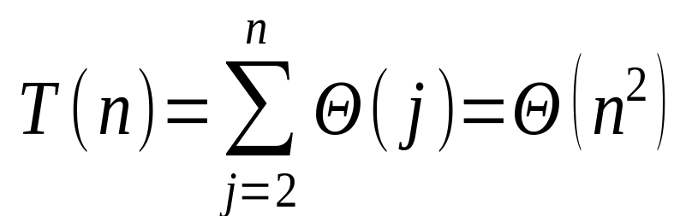
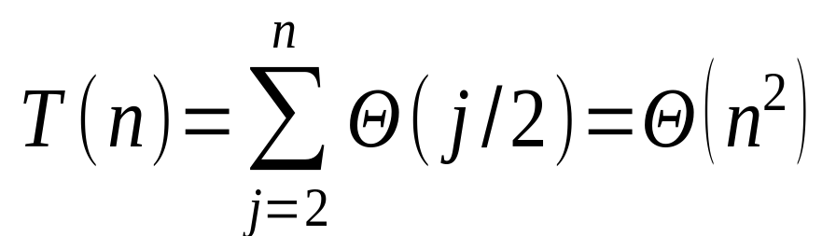
Insertion sort analysis
Worst case: Input reverse sorted.
[arithmetic series]
Average case: All permutations equally likely.
Is insertion sort a fast sorting algorithm?
Moderately so, for small n.
Not at all, for large n.

Slide 24
Example 2: Integer Multiplication
Let X = A B and Y = C D where A,B,C and D are n/2 bit integers
Simple Method: XY = (2^{n/2}A+B)(2^{n/2}C+D)
Running Time Recurrence
T(n) < 4T(n/2) + 100n
Solution T(n) = θ(n²)

Slide 25
Better Integer Multiplication
Let X = A B and Y = C D where A,B,C and D are n/2 bit integers
Karatsuba:
XY = (2^{n/2}+2^{n})AC+2^{n/}2(A-B)(C-D) + (2^{n/2}+1) BD
Running Time Recurrence
T(n) < 3T(n/2) + 100n
Solution: θ(n) = O(n ^{log 3})

Slide 26
Example 3:Merge sort
MERGE-SORT A[1 . . n]
If n = 1, done.
Recursively sort A[ 1 . . ⎡n/2⎤ ] and A[ ⎡n/2⎤+1 . . n ] .
“Merge” the 2 sorted lists.
Key subroutine: MERGE

Slide 27
Merging two sorted arrays
20
13
7
2
12
11
9
1

Slide 28
Merging two sorted arrays
20
13
7
2
12
11
9
1
1

Slide 29
Merging two sorted arrays
20
13
7
2
12
11
9
1
20
13
7
2
12
11
9
1

Slide 30
Merging two sorted arrays
20
13
7
2
12
11
9
1
20
13
7
2
12
11
9
1
2

Slide 31
Merging two sorted arrays
20
13
7
2
12
11
9
1
20
13
7
2
12
11
9
20
13
7
12
11
9
1
2

Slide 32
Merging two sorted arrays
20
13
7
2
12
11
9
1
20
13
7
2
12
11
9
20
13
7
12
11
9
1
2
7

Slide 33
Merging two sorted arrays
20
13
7
2
12
11
9
1
20
13
7
2
12
11
9
20
13
7
12
11
9
20
13
12
11
9
1
2
7

Slide 34
Merging two sorted arrays
20
13
7
2
12
11
9
1
20
13
7
2
12
11
9
20
13
7
12
11
9
20
13
12
11
9
1
2
7
9

Slide 35
Merging two sorted arrays
20
13
7
2
12
11
9
1
20
13
7
2
12
11
9
20
13
7
12
11
9
20
13
12
11
9
20
13
12
11
1
2
7
9

Slide 36
Merging two sorted arrays
20
13
7
2
12
11
9
1
20
13
7
2
12
11
9
20
13
7
12
11
9
20
13
12
11
9
20
13
12
11
1
2
7
9
11

Slide 37
Merging two sorted arrays
20
13
7
2
12
11
9
1
20
13
7
2
12
11
9
20
13
7
12
11
9
20
13
12
11
9
20
13
12
11
20
13
12
1
2
7
9
11

Slide 38
Merging two sorted arrays
20
13
7
2
12
11
9
1
20
13
7
2
12
11
9
20
13
7
12
11
9
20
13
12
11
9
20
13
12
11
20
13
12
1
2
7
9
11
12

Slide 39
Merging two sorted arrays
20
13
7
2
12
11
9
1
20
13
7
2
12
11
9
20
13
7
12
11
9
20
13
12
11
9
20
13
12
11
20
13
12
1
2
7
9
11
12
Time = Θ(n) to merge a total of n elements (linear time).

Slide 40
Analyzing merge sort
T(n)
Θ(1)
2T(n/2)
Θ(n)
MERGE-SORT A[1 . . n]
If n = 1, done.
Recursively sort A[ 1 . . ⎡n/2⎤ ] and A[ ⎡n/2⎤+1 . . n ] .
“Merge” the 2 sorted lists
Sloppiness: Should be T( ⎡n/2⎤ ) + T( ⎣n/2⎦ ) , but it turns out not to matter asymptotically.

Slide 41
Recurrence for merge sort
Θ(1) if n = 1;
T(n) =
2T(n/2) + Θ(n) if n > 1.
We shall usually omit stating the base case when T(n) = Θ(1) for sufficiently small n, but only when it has no effect on the asymptotic solution to the recurrence.
Lecture 2 provides several ways to find a good upper bound on T(n).

Slide 42
Recursion tree
Solve T(n) = 2T(n/2) + cn, where c > 0 is constant.

Slide 43
Recursion tree
Solve T(n) = 2T(n/2) + cn, where c > 0 is constant.
T(n)

Slide 44
Recursion tree
Solve T(n) = 2T(n/2) + cn, where c > 0 is constant.
cn
T(n/2)
T(n/2)

Slide 45
Recursion tree
Solve T(n) = 2T(n/2) + cn, where c > 0 is constant.
cn
cn/2
cn/2
T(n/4)
T(n/4)
T(n/4)
T(n/4)

Slide 46
Recursion tree
Solve T(n) = 2T(n/2) + cn, where c > 0 is constant.
cn
cn/2
cn/2
cn/4
cn/4
cn/4
cn/4
…
Θ(1)

Slide 47
Recursion tree
Solve T(n) = 2T(n/2) + cn, where c > 0 is constant.
cn
cn/2
cn/2
h = lg n
cn/4
cn/4
cn/4
cn/4
…
Θ(1)

Slide 48
Recursion tree
Solve T(n) = 2T(n/2) + cn, where c > 0 is constant.
cn
cn
cn/2
cn/2
h = lg n
cn/4
cn/4
cn/4
cn/4
…
Θ(1)

Slide 49
Recursion tree
Solve T(n) = 2T(n/2) + cn, where c > 0 is constant.
cn
cn
cn/2
cn/2
cn
h = lg n
cn/4
cn/4
cn/4
cn/4
…
Θ(1)

Slide 50
Recursion tree
Solve T(n) = 2T(n/2) + cn, where c > 0 is constant.
cn
cn
cn/2
cn/2
cn
h = lg n
cn/4
cn/4
cn/4
cn/4
cn
…
…
Θ(1)

Slide 51
Recursion tree
Solve T(n) = 2T(n/2) + cn, where c > 0 is constant.
cn
cn
cn/2
cn/2
cn
h = lg n
cn/4
cn/4
cn/4
cn/4
cn
…
…
Θ(1)
#leaves = n
Θ(n)

Slide 52
Recursion tree
Solve T(n) = 2T(n/2) + cn, where c > 0 is constant.
cn
cn
cn/2
cn/2
cn
h = lg n
cn/4
cn/4
cn/4
cn/4
cn
…
…
Θ(1)
#leaves = n
Θ(n)
Total = Θ(n lg n)

Slide 53
Conclusions
Θ(n lg n) grows more slowly than Θ(n²).
Therefore, merge sort asymptotically beats insertion sort in the worst case.
In practice, merge sort beats insertion sort for n > 30 or so.

