Slide 1
For all purpose
PROJECT PORTFOLIO
For Presenration
Faruq Abdurrahman Fachrudin
2024 Sep 25

Slide 2
Introduction
I am a data enthusiast with expertise in building automated data pipelines and providing data-driven insights. My portfolio includes projects like analyzing customer churn for e-commerce, developing dashboards for retail transaction performance, and launching sales dashboards using Tableau. Recently, I completed an ETL Data Automation project using Airflow, MySQL, and PostgreSQL, where I automated data extraction, transformation, and report generation. This project helped streamline data processing and ensured timely insights delivery. I am passionate about solving complex data challenges and continually refining my skills in Python, SQL, and various data tools.
1

Slide 3
Project Overview
Project
ETL Data Automation using Airflow, MySQL, and PostgreSQL
Description
This project automates a simple ETL process using Apache Airflow to extract data from MySQL, transform and store it in Parquet format within a staging area, and load it into PostgreSQL daily at 7 AM. Once the ETL process is complete, a basic analysis job runs, and the results are emailed at 9 AM. The workflow involves three DAGs: the ETL DAG, the aggregation DAG, and the report delivery DAG, all designed to improve data processing efficiency and decision-making.
2

Slide 4
Project Background
This project aims to automate the ETL process to enhance data processing efficiency and reliability. Previously manual and error-prone, the process is now streamlined using Apache Airflow, MySQL, and PostgreSQL, ensuring regular data analysis and timely result distribution for faster, data-driven decision-making.
Who Benefits
This project benefits companies or teams that require automated data transfer between database platforms, along with scheduled analysis that can be accessed daily
3

Slide 5
Problem Statement
The main challenge of this project is to automate the daily transfer of data from MySQL to PostgreSQL, ensuring that the most recent data is always available for analysis. Additionally, the project must ensure timely delivery of automated reports based on that analysis.
Project Objectives
Building a scheduled ETL pipeline with Apache Airflow to extract data daily at 7 AM, load it into the staging area in PostgreSQL, perform data aggregation, and send reports via email every day at 9 AM.
4

Slide 6
Data Platform Understanding
Data Extraction and Loading Process
Data is extracted from MySQL and loaded into PostgreSQL in the staging area using Parquet format. This process enhances storage efficiency and data access. After loading, PostgreSQL tables store the final results from the aggregation process to facilitate reporting.
Data Flow Diagram
The data flow begins with extraction from MySQL, followed by storage in the PostgreSQL staging area in Parquet format. The data is then processed through aggregation to generate more valuable insights. After analysis, reports are sent via email to stakeholders.
5

Slide 7
Data Understanding
Data Source and Type
The Store Sales Forecasting dataset from Kaggle consists of 2121 entries with 21 columns, including Order ID, Order Date, Customer ID, Sales, Quantity, Discount, and Profit. Each extraction retrieves the entire dataset without missing values. The data is stored in Parquet format in the staging area for efficiency and quick access.
Data Quality Issues
The dataset has no missing values, but we still check for possible duplicates. If found, we will remove duplicate entries based on Order ID to maintain data uniqueness.
6

Slide 8
Transformation & Consideration
ETL Process
Data is extracted from MySQL using MySqlHook, executing a query to retrieve data from the stores_sales_forecasting table. The data is saved in Parquet format in the staging area due to its efficiency in storage and access speed. Parquet format supports compression and columnar storage, allowing for faster data retrieval. After being in the staging area, we add the extracted_at column and load the data into PostgreSQL for further analysis.
Tool Selection
Apache Airflow was chosen for automating this process due to its capability to efficiently manage and schedule ETL workflows. Airflow allows the creation of DAGs to organize task sequences and monitor execution. Using Parquet format as temporary storage reduces file size and speeds up processing time, which is crucial for efficient analysis.
7

Slide 9
Data Modeling (Business)
Data Modeling
Once the ETL process is complete, the aggregation job is executed to store the analysis results into a new PostgreSQL table. The aggregation model includes total calculations for Sales, Quantity, Discount, and Profit using aggregation functions like SUM(). The stores_sales_forecasting_result table is designed to store aggregation results with relevant columns, facilitating access for further analysis. The use of appropriate data types and indexing on frequently used columns also enhances query performance.
Report Delivery
After the analysis is complete, the aggregation results report is sent via email to stakeholders using the email operator in Apache Airflow. This automation process ensures that the latest and relevant information is available to decision-makers, enhancing responsiveness and efficiency in responding to market changes.
8

Slide 10
Conclusion & Recommendation
Conclusion
This project successfully established an efficient automated ETL pipeline, enabling data extraction and loading from MySQL to PostgreSQL, along with sending up-to-date reports to stakeholders. Challenges faced, such as connection management, were addressed using Apache Airflow and Parquet format for storage efficiency.
Recommendation
It is recommended to add monitoring features for real-time performance tracking and optimize the process to handle larger data volumes in the future.
9

Slide 11
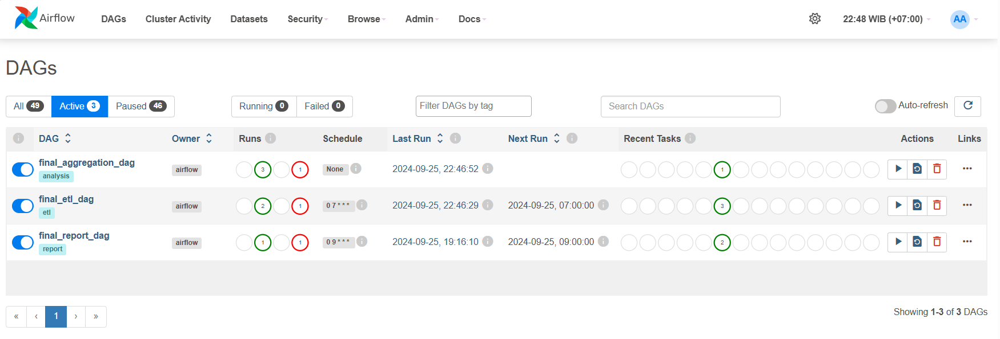
Documentation
Airflow

Slide 12
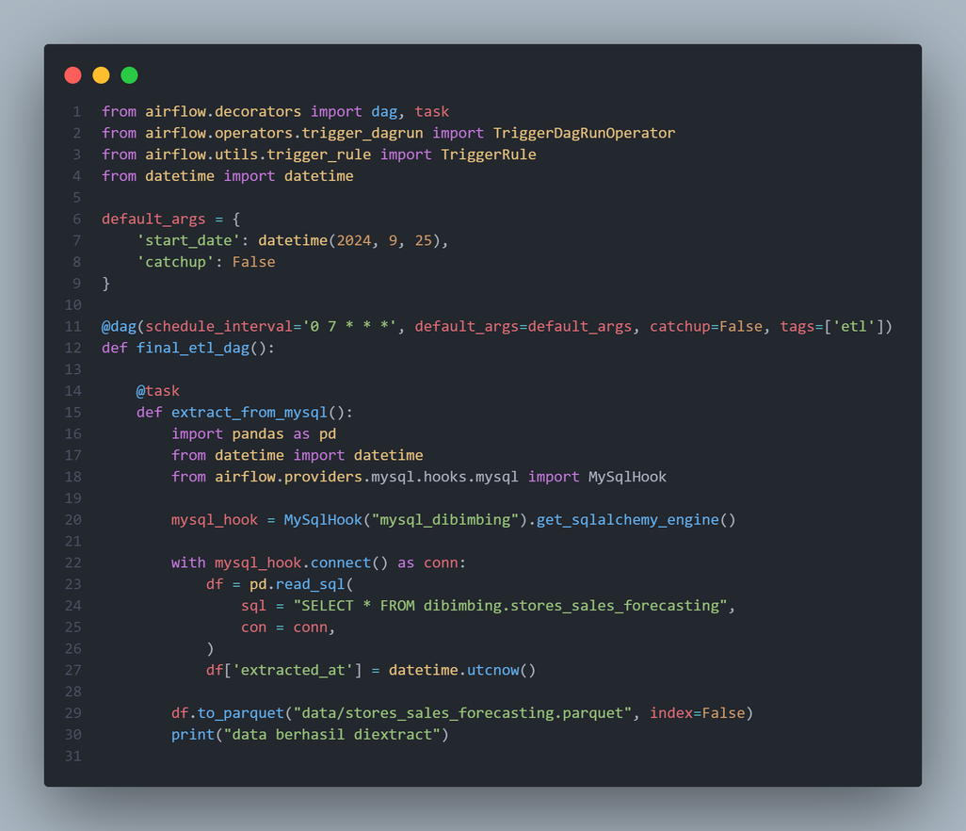
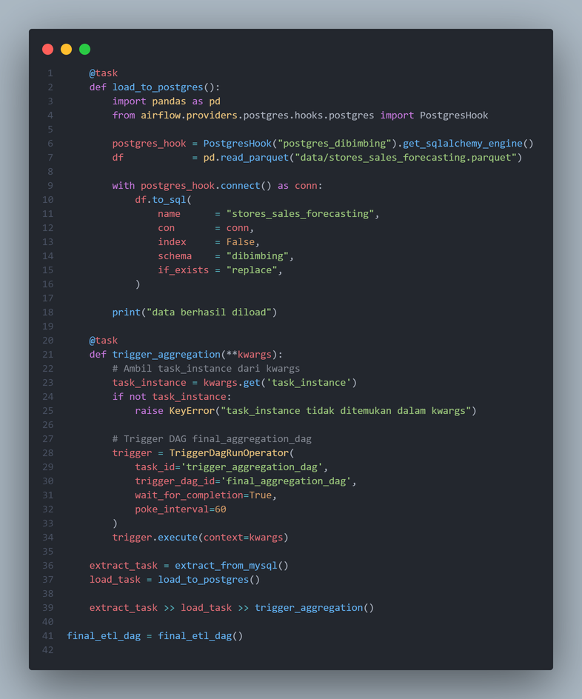
Documentation
There are three DAGs: final_etl_dag, final_aggregation_dag, and final_report_dag. The final_etl_dag is responsible for the extraction, transformation, and loading (ETL) of data. Next, the final_aggregation_dag is designed to aggregate the processed data. Finally, the final_report_dag compiles and sends reports based on the analyzed data.
final_etl_dag

Slide 13
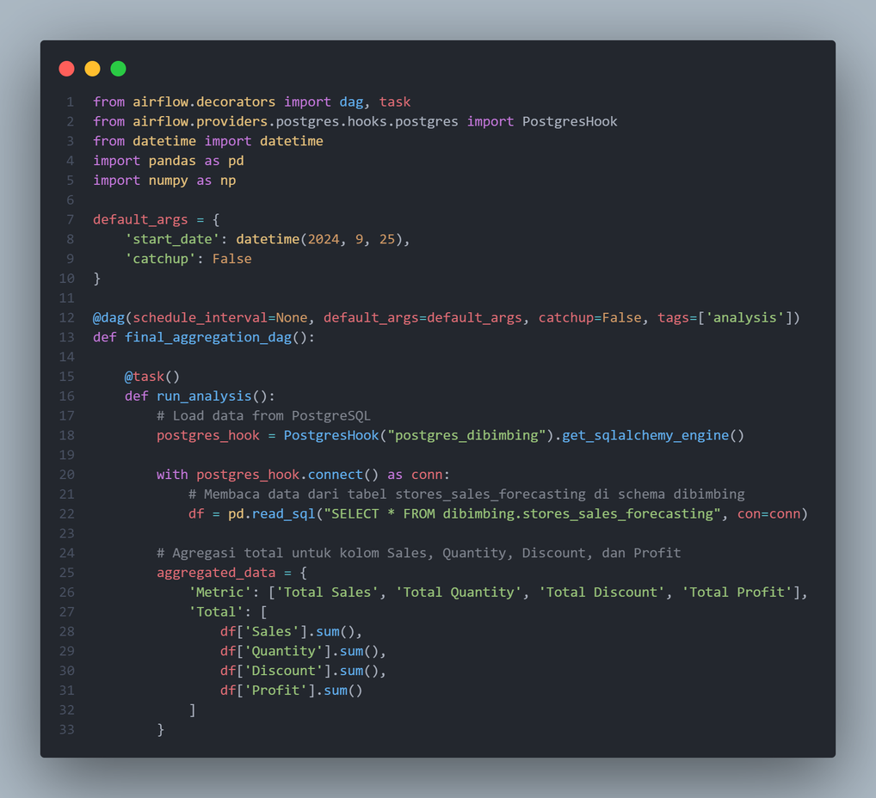
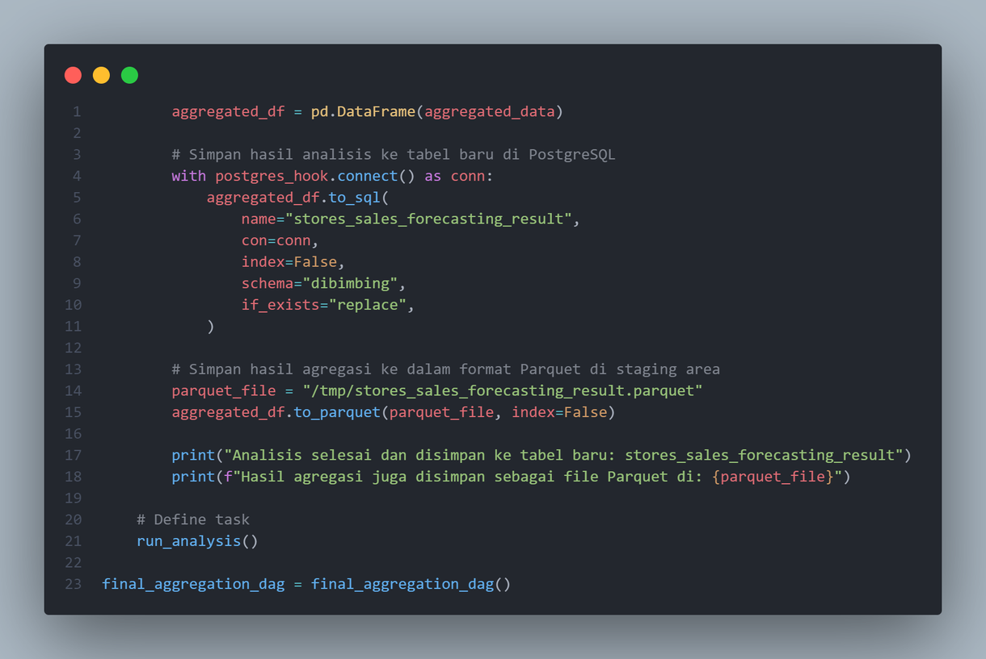
Documentation
final_aggregation_dag

Slide 14
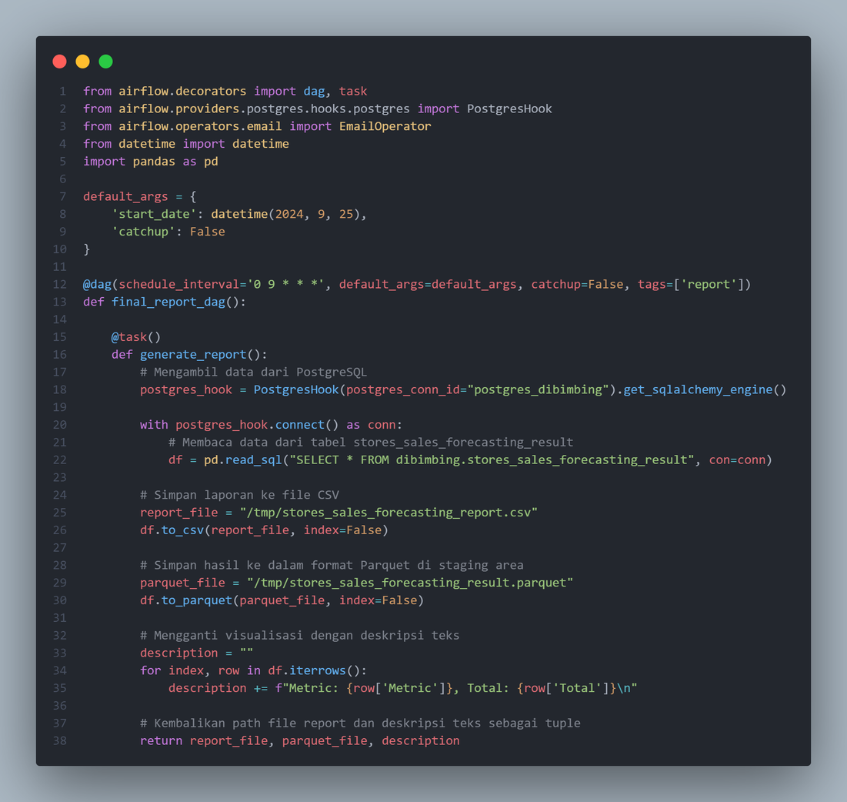
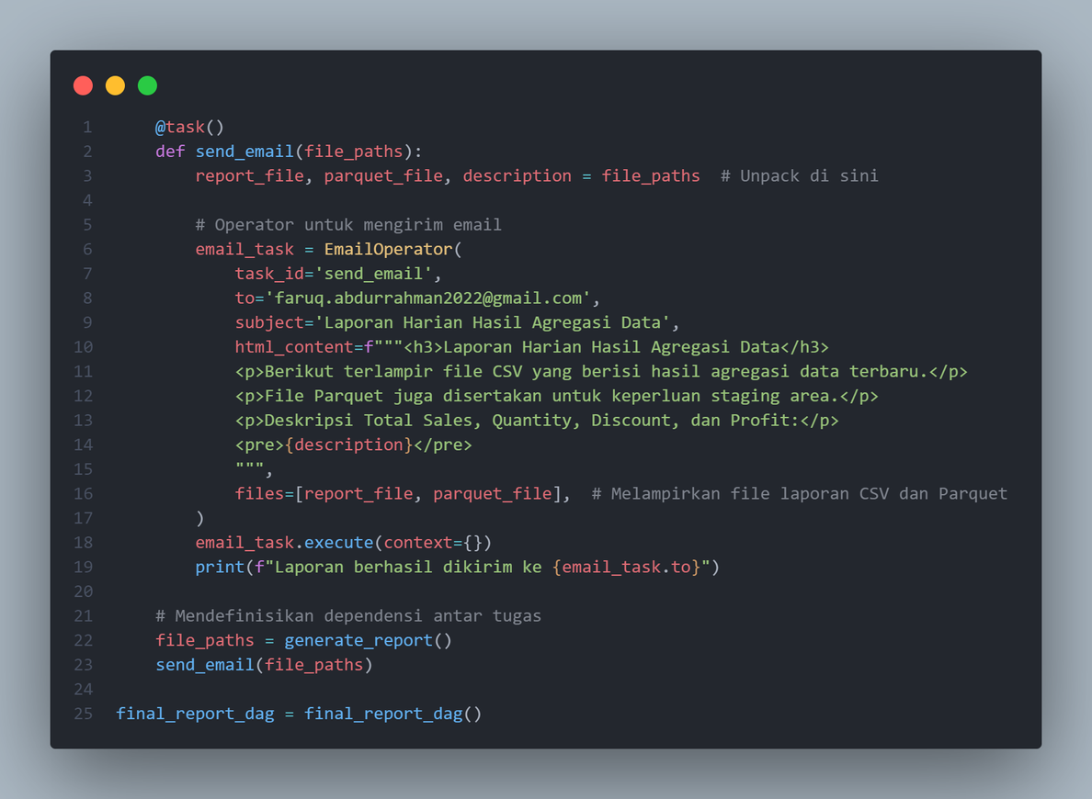
Documentation
final_report_dag

Slide 15
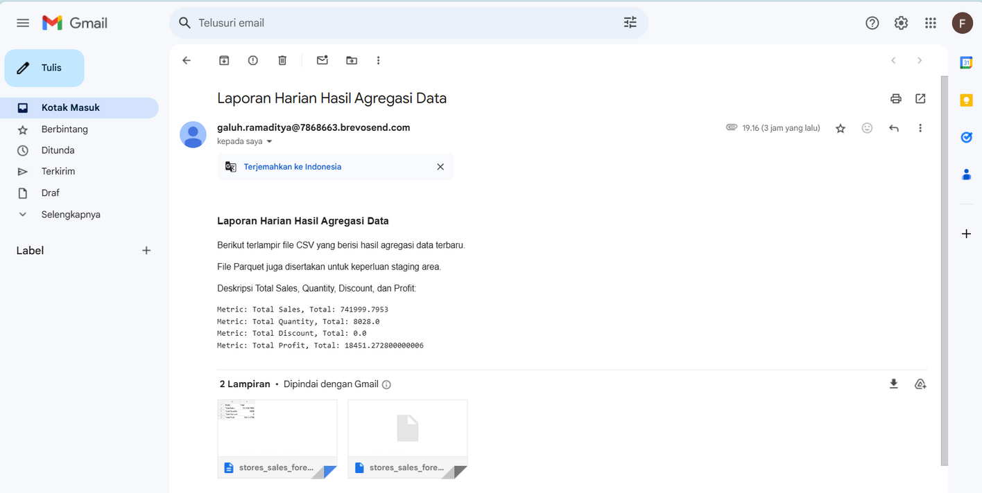
Documentation
Result

Slide 16
THANK YOU

