Slide 1


Slide 2
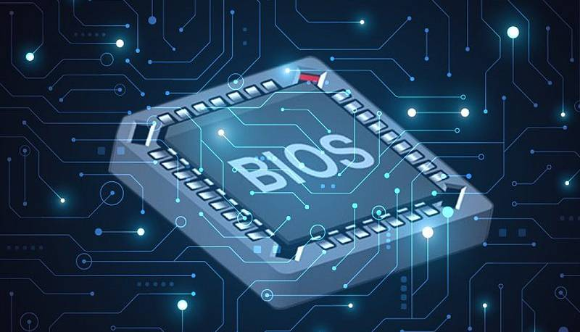
BIOS
The Foundation Of Computer Start Up

Slide 3
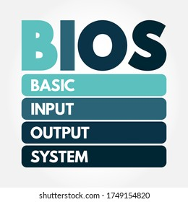
Definition: BIOS stands for Basic Input/Output System.
Purpose: It is firmware that initializes hardware during the booting process before handing control to the operating
system.

Slide 4
Functions
Hardware Initialization: Detects
and configures hardware components
(CPU, RAM, disk drives).
Bootloader: Locates and loads the
operating system from storage devices.
POST (Power-On Self-Test): Checks
the system for hardware failures
during startup.
CMOS (Complementary Metal-Oxide-
Semiconductor):is a small memory chip that
stores system settings, such as date, time,
used by the BIOS during startup.

Slide 5
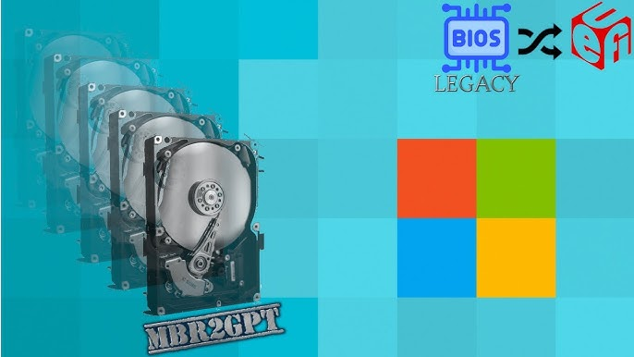
Types Of BIOS
UEFI
Legacy BIOS
UEFI (Unified Extensible Firmware Interface): Modern replacement for BIOS, offering faster boot times, support for larger hard drives, and enhanced security features.
Traditional BIOS interface with limited features.

Slide 6

Importance Of BIOS
System Stability: Ensures that
hardware is functioning correctly before
the OS(operating system) starts.
User Configuration: Provides a means for users to adjust system settings to optimize performance.

Slide 7
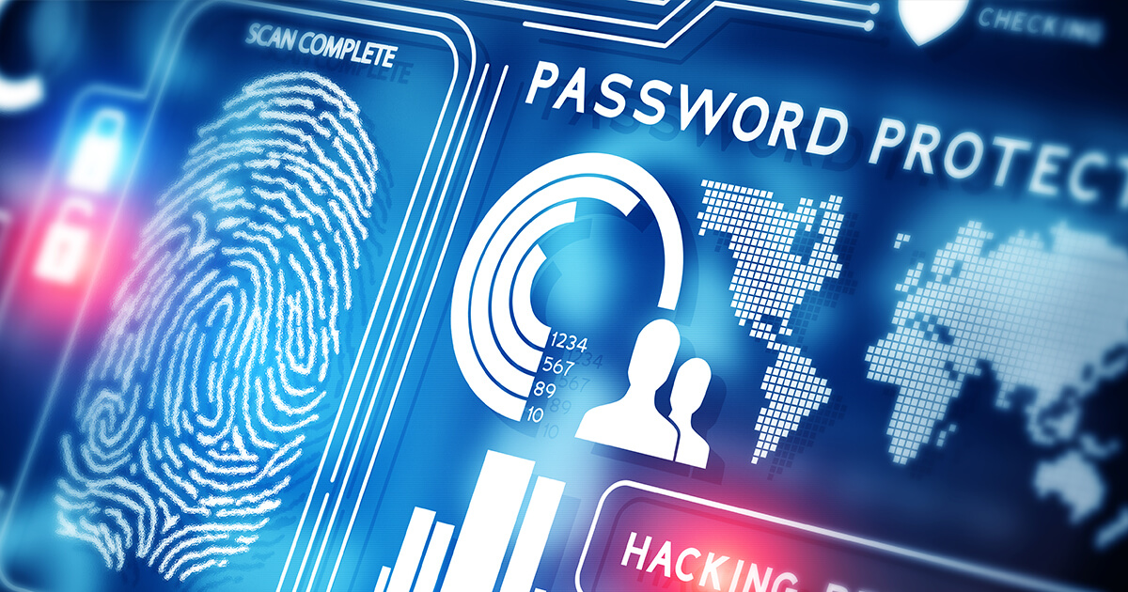
BIOS Security Feature
Password Protection: Prevents
unauthorized access to BIOS settings.
Secure Boot: Ensures that only trusted software is loaded during the startup process.

Slide 8

Conclusion
In summary, BIOS is essential for starting
up a computer by initializing hardware and
loading the operating system. It ensures that all
components work together and provides users with
a way to configure system settings.

Slide 9


Slide 10


