Slide 1
AI-Based Insurance Fraud Investigation Agent
Combining Machine Learning, Investigation Tools, and an LLM Agent
Qwen + LangGraph + Random Forest

Slide 2
Problem Statement
Insurance fraud investigation requires checking multiple sources.
Claim, policy, payment, and agent records contain disconnected signals.
A fraud score alone does not explain why a claim is suspicious.
Goal: build an AI-assisted investigation system that predicts risk and explains evidence.

Slide 3
Project Objective
Build an end-to-end insurance fraud investigation workflow.
Integrate multiple data sources into a unified investigation context.
Train a machine-learning model to estimate fraud probability.
Give an LLM Agent investigation tools.
Produce an evidence-based final assessment.

Slide 4
Machine Learning Approach
Started with a claim-only Random Forest baseline.
Expanded to a multi-source dataset combining claims, policies, payments, and agent information.
Evaluated progressively richer feature sets.
Also tested relationship-specific features linking exact agent/customer/policy records.
Used a held-out test set of 200 claims.

Slide 5
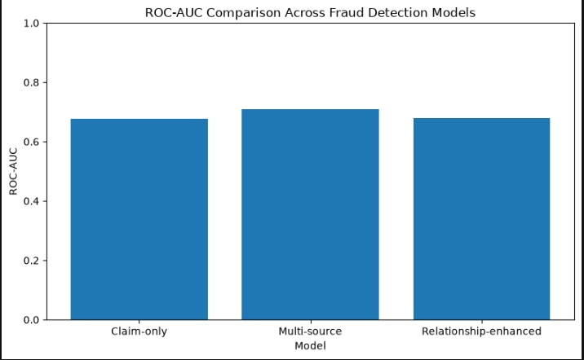
Model Results
Claim-only RF: ROC-AUC 0.6783 | Fraud Recall 10.81% | F1 0.1905
Multi-source RF: ROC-AUC 0.7096 | Fraud Recall 40.54% | F1 0.4348
Relationship-enhanced RF: ROC-AUC 0.6801 | Fraud Recall 37.84% | F1 0.4000
Selected model: Multi-source Random Forest.
Key finding: cross-source information improved fraud detection over the claim-only baseline.

Slide 6
System Architecture
User / Investigator → Qwen LLM Agent + LangGraph
↓
Investigation Context → Claim / Policy / Payment / Agent / Evidence Tools
↓
Fraud Prediction Tool → Multi-Source Random Forest
↓
Evidence + ML Prediction → Final Investigation Assessment

Slide 7
Investigation Tools
Claim Tool — retrieves claim details.
Policy Tool — retrieves policy information.
Payment Tool — checks payment history and anomalies.
Agent Tool — checks agent / ghost-broking history.
Evidence Tool — calculates verified fraud indicators.
Investigation Context Tool — combines relevant evidence.
Fraud Prediction Tool — returns ML fraud probability.

Slide 8
Agent + ML Integration
LangGraph orchestrates the investigation workflow.
Qwen provides reasoning and explanation.
The Agent retrieves evidence through tools.
The ML model provides quantitative fraud probability.
The Agent distinguishes ML prediction from overall investigation assessment.

Slide 9
Example Investigation
Example claim: CLM000001
ML fraud probability: 21%
ML prediction: NON-FRAUD
Risk indicators included a cancelled policy, bounced payment, and suspicious agent history.
The Agent recommends further review rather than treating the ML score as the complete decision.

Slide 10
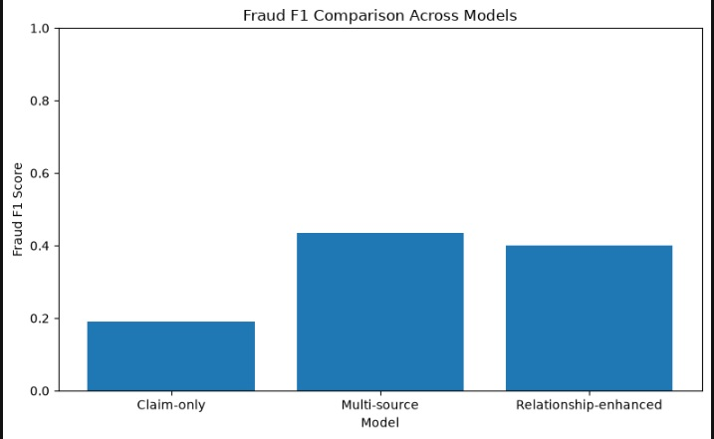
Agent Evaluation
Development sample: 10 claims.
Accuracy: 90%
Fraud Precision: 100%
Fraud Recall: 80%
Fraud F1: 88.89%
Context Tool Usage: 100%
Prediction Tool Usage: 100%
Note: development-sample evaluation, not the 200-claim held-out ML test.

Slide 11
End-to-End Workflow
1. Submit a claim ID.
2. Agent retrieves investigation context.
3. Claim, policy, payment, and agent evidence is assembled.
4. Fraud Prediction Tool obtains ML probability.
5. Qwen analyzes supporting and mitigating evidence.
6. Agent produces evidence, prediction, recommendation, and final classification.

Slide 12
Key Findings
Multi-source information improved baseline fraud detection.
More features did not automatically produce a better model.
The Agent adds an explainable investigation layer around ML.
The system separates quantitative ML prediction from broader evidence-based assessment.
This is a decision-support prototype, not autonomous claims adjudication.

Slide 13
Limitations & Future Work
Dataset size limits generalization.
Fraud-class imbalance makes recall an important improvement area.
Agent evaluation uses a small development sample.
Future work: larger datasets, threshold optimization, calibration, stronger relationship modeling, and broader held-out Agent evaluation.
Human investigator review should remain part of the final decision.

Slide 14
Conclusion
Built an end-to-end AI-assisted insurance fraud investigation system.
Combines multi-source data, Random Forest, investigation tools, Qwen, and LangGraph.
The system gathers evidence and explains the investigation rather than only outputting a score.
Core pipeline successfully tested end-to-end.

