Slide 1

ZigBee Overview
A Brief Introduction to ZigBee Produced By: Farzan Rahmani
Notes:
ZigBee is a wireless communication standard based on the IEEE 802.15.4 standard for low-data-rate, low-power wireless networks. It was developed to address the need for simple and reliable wireless communication between devices that require low power consumption, such as sensors, switches, and controllers. ZigBee operates in the unlicensed 2.4GHz, 900MHz, and 868MHz frequency bands, and supports mesh networking, enabling devices to communicate with each other through multiple paths.
ZigBee is widely used in the Internet of Things (IoT) applications, such as home automation, industrial control, and healthcare monitoring, because of its low power consumption, low cost, and high reliability. ZigBee devices can be easily integrated with other communication protocols, such as Wi-Fi, Bluetooth, and cellular networks, to provide a complete solution for wireless connectivity.

Slide 2

What is ZigBee?
Wireless communication protocol
Designed for low-power consumption and low data rates
Low-cost and reliable
Frequently used in IoT applications
Short Physical range
Based on the IEEE* 802.15.4 standard
Simple and reliable wireless communication
Devices such as such as sensors, switches, and controllers
Can be easily integrated with other communication protocols, such as Wi-Fi, Bluetooth, and …
Zigbee was conceived in 1998, standardized in 2003, and revised in 2006.
IEEE: Institute of Electrical and Electronics Engineers
Notes:
The Institute of Electrical and Electronics Engineers is a 501 professional association for electronics engineering, electrical engineering, and other related disciplines with its corporate office in New York City and its operations center in Piscataway, New Jersey. Headquarters: Piscataway, New Jersey, United States
Founders: American Institute of Electrical Engineers, Institute of Radio Engineers
Founded: January 1, 1963

Slide 3
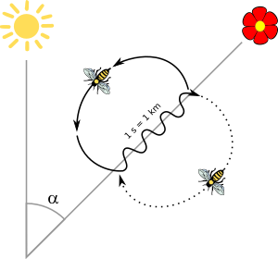
Why its name is ZigBee? Zig + Bee Zigzag + Honey Bee
The communication method of honey bees
New food source
Zigzag movement
Food source location
Direction of food movement
Distance to the source
The name refers to the waggle dance of honey bees after their return to the beehive.

Slide 4
Why was ZigBee Created?
To create a standard for wireless communication between devices such as sensors, switches, and controllers.
To enable low-cost, low-power devices to communicate with each other
To provide a reliable and secure wireless solution for various industries
Integrated with other communication protocols to provide a complete solution for wireless connectivity.
Notes:
ZigBee was created to address the need for a wireless communication standard that could provide reliable and low-power connectivity for devices in a range of applications. The development of ZigBee was driven by the desire to create a wireless protocol that could:
Operate with low power consumption: ZigBee was designed to operate with very low power consumption, enabling devices to run on batteries for long periods of time.
Support a large number of devices: ZigBee was designed to support a large number of devices, allowing them to communicate with each other in a mesh network.
Be easy to deploy and maintain: ZigBee was designed to be easy to deploy and maintain, with simple network configuration and management.
Provide reliable communication: ZigBee was designed to provide reliable communication, even in environments with high levels of interference.
Support different types of applications: ZigBee was designed to support a range of applications, including home automation, industrial control, and healthcare monitoring.
Overall, ZigBee was developed to meet the specific requirements of low-power, low-data-rate wireless communication for IoT devices, with a focus on reliability, scalability, and ease of use.

Slide 5
Applications of ZigBee
Smart homes and buildings automation to control lights, door locks, and other devices.
Industrial control systems monitoring and automation to monitor and control equipment and machinery.
Healthcare monitoring and tracking systems for patient monitoring, asset tracking, and remote diagnosis.
Environmental monitoring systems for monitoring temperature, humidity, and air quality.
Asset tracking and inventory management systems
Smart grid systems to control and monitor energy usage in homes and buildings.
Agriculture for monitoring soil moisture, temperature, and other parameters to optimize crop yields.
Transportation for vehicle-to-vehicle and vehicle-to-infrastructure communication.
Notes:
ZigBee is a popular wireless communication technology that has a wide range of applications in different industries. Here are some common applications of ZigBee:
Home automation: ZigBee is widely used in home automation systems to control lights, HVAC systems, door locks, and other devices.
Industrial automation: ZigBee is used in industrial automation systems to monitor and control equipment and machinery.
Healthcare: ZigBee is used in healthcare applications for patient monitoring, asset tracking, and remote diagnosis.
Smart grid: ZigBee is used in smart grid systems to control and monitor energy usage in homes and buildings.
Building automation: ZigBee is used in building automation systems to control lighting, HVAC, and security systems.
Environmental monitoring: ZigBee is used in environmental monitoring systems for monitoring temperature, humidity, and air quality.
Agriculture: ZigBee is used in agriculture applications for monitoring soil moisture, temperature, and other parameters to optimize crop yields.
Transportation: ZigBee is used in transportation applications for vehicle-to-vehicle and vehicle-to-infrastructure communication.

Slide 6
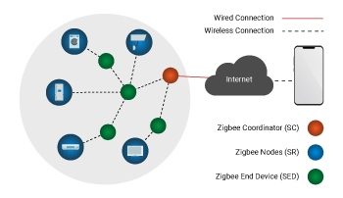
ZigBee Device Types
Coordinator: manages the network, can be connected to the internet
Router: extends the range of the network by relaying messages
End Device: consumes the least energy and communicates with coordinator or router
Notes:
ZigBee Coordinator: The ZigBee Coordinator is the central device in the network, responsible for initiating and managing the network. There is only one Coordinator in the network, and it is responsible for assigning network addresses to other devices, defining network parameters, and controlling network traffic.
ZigBee Router: ZigBee Routers are intermediate devices that route data between devices in the network. They can also act as endpoints that can receive or transmit data.
ZigBee End Device: ZigBee End Devices are devices that can only communicate with other devices in the network through Routers or the Coordinator. End Devices typically have limited processing power and memory, and are designed to consume very low power.

Slide 7
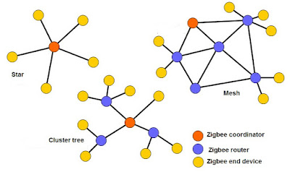
ZigBee Network Architecture
Star Topology: one central device controls multiple end devices
Mesh Topology: multiple devices can connect with each other forming a mesh network
Tree Topology: combination of star and mesh networks for larger area coverage
Notes:
ZigBee supports different types of network topologies that allow for flexible deployment of devices in various applications. The main ZigBee topologies are: 1.Star Topology: In a star topology, all devices communicate with a central node, which is typically the ZigBee coordinator. This topology is suitable for applications where devices are located in close proximity to the coordinator.
2.Mesh Topology: In a mesh topology, devices are interconnected through multiple pathways, and data can be routed through any available path. This topology provides greater network reliability and is suitable for applications where devices are spread out over a larger area.
3.Tree Topology: In a tree topology, devices are organized in a hierarchical structure with the ZigBee coordinator at the root and other devices branching out from it. This topology is suitable for applications where devices are located at different distances from the coordinator.

Slide 8
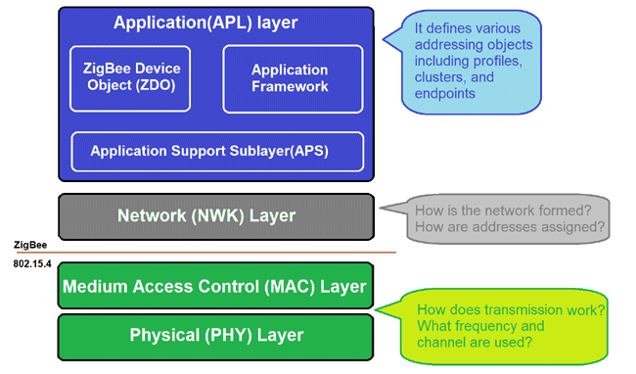
ZigBee Layers
Application layer
Network layer
MAC layer
PHY layer
The ZigBee protocol is organized into layers, which provide different functionalities and services. Here are the layers of the ZigBee protocol:
Notes:
Application layer: This layer defines the application-level functionality and services, such as device discovery, device pairing, and data transfer. It provides an interface between the ZigBee network and the application running on top of it.
Network layer: This layer provides the network management functionality, such as routing and addressing. It is responsible for discovering the optimal path for data transmission and maintaining the network topology.
MAC layer: This layer provides the interface between the physical layer and the network layer. It is responsible for managing the communication between the nodes, including channel access, data framing, and error detection.
PHY layer: This layer provides the physical interface between the ZigBee device and the radio frequency (RF) transceiver. It is responsible for transmitting and receiving data over the air.
Each layer in the ZigBee protocol has its own set of functions and services, which work together to provide reliable, low-power wireless communication for a variety of applications.

Slide 9
Security Features of ZigBee
Cryptography-based security protocols for data confidentiality
AES-128 encryption mechanism to secure communication between nodes
Different levels of access control to prevent unauthorized access to the network
Notes:
ZigBee network also supports multiple security features, including encryption, authentication, and access control, to ensure the confidentiality and integrity of data transmitted over the network. The ZigBee Alliance, which is responsible for the development of the ZigBee standard, provides guidelines and specifications for implementing security in ZigBee networks. AES-128bit: The Advanced Encryption Standard, also known by its original name Rijndael, is a specification for the encryption of electronic data established by the U.S. National Institute of Standards and Technology in 2001 secured by 128 bit symmetric encryption keys

Slide 10
ZigBee vs Other Wireless Protocols
Feature | Zigbee | Bluetooth | Wi-Fi
Frequency | 2.4 GHz, 868 MHz, 915 MHz | 2.4 GHz | 2.4 GHz, 5 GHz
Range | Up to 100 meters (outdoor) | Up to 100 meters (outdoor) | Up to 100 meters (outdoor)
Data Rate | 20-250 kbps | 1-3 Mbps | Up to 6.9 Gbps
Power Consumption | Low power consumption | Moderate power consumption | High power consumption
Security | Built-in security | Built-in security | WPA2 and other security standards
Notes:
Wi-Fi: Wi-Fi is a high-speed wireless protocol that is commonly used for internet connectivity. Unlike ZigBee, Wi-Fi is not designed for low-power applications, and it consumes much more power than ZigBee. Wi-Fi also has a shorter range and does not support mesh networking.
Bluetooth: Bluetooth is a short-range wireless protocol that is commonly used for connecting devices such as smartphones and headphones. Bluetooth consumes more power than ZigBee and is not designed for large-scale deployments. Bluetooth also has a limited number of devices that can be connected in a network.
Z-Wave: Z-Wave is a wireless protocol that is similar to ZigBee and is designed for home automation applications. Z-Wave operates on a different frequency than ZigBee and supports a smaller number of devices than ZigBee. Z-Wave also has a shorter range than ZigBee.
LoRaWAN: LoRaWAN is a wireless protocol that is designed for long-range communication in low-power IoT applications. Unlike ZigBee, LoRaWAN operates in licensed frequency bands and supports a larger range than ZigBee. However, LoRaWAN has a lower data rate than ZigBee and does not support mesh networking.

Slide 11

ZigBee vs Wi-Fi
Wi-Fi: Wi-Fi is a high-speed wireless protocol that is commonly used for internet connectivity. Unlike ZigBee, Wi-Fi is not designed for low-power applications, and it consumes much more power than ZigBee. Wi-Fi also has a shorter range and does not support mesh networking.

Slide 12
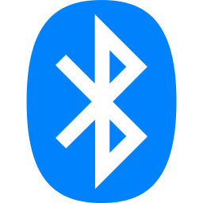
ZigBee vs Bluetooth
Bluetooth: Bluetooth is a short-range wireless protocol that is commonly used for connecting devices such as smartphones and headphones. Bluetooth consumes more power than ZigBee and is not designed for large-scale deployments. Bluetooth also has a limited number of devices that can be connected in a network.

Slide 13

ZigBee vs Z-Wave
Z-Wave: Z-Wave is a wireless protocol that is similar to ZigBee and is designed for home automation applications. Z-Wave operates on a different frequency than ZigBee and supports a smaller number of devices than ZigBee. Z-Wave also has a shorter range than ZigBee.

Slide 14
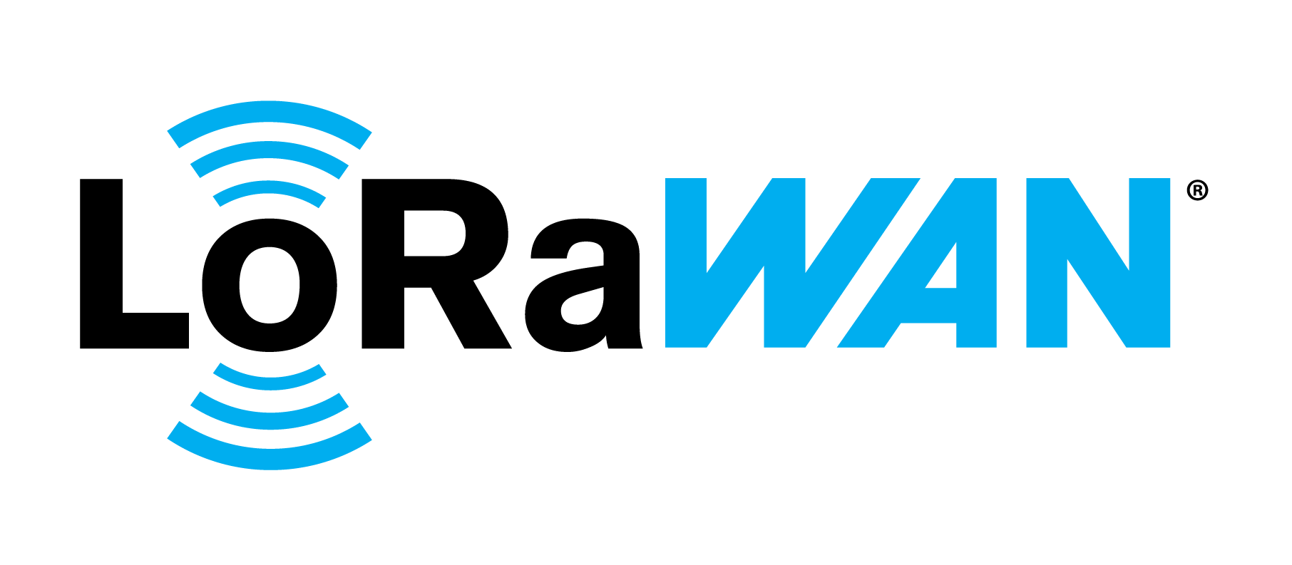
ZigBee vs LoRaWAN
LoRaWAN: LoRaWAN is a wireless protocol that is designed for long-range communication in low-power IoT applications. Unlike ZigBee, LoRaWAN operates in licensed frequency bands and supports a larger range than ZigBee. However, LoRaWAN has a lower data rate than ZigBee and does not support mesh networking.

Slide 15
Resources
https://en.wikipedia.org/wiki/Zigbee
https://www.techtarget.com/iotagenda/definition/ZigBee
https://www.digi.com/solutions/by-technology/zigbee-wireless-standard
https://www.conrad.de/de/ratgeber/technik-einfach-erklaert/zigbee-standard.html
https://www.homeandsmart.de/zigbee-funkprotokoll-hausautomation
https://www.sciencedirect.com/topics/engineering/zigbee-protocol

Slide 16
Thank you for your time and attention 🙂
I hope you found it informative and valuable. If you have any questions or feedback, I would be happy to address them now. Thank you again for your attention.

