Slide 1
HW2
A Step by Step Backpropagation Example

Slide 2
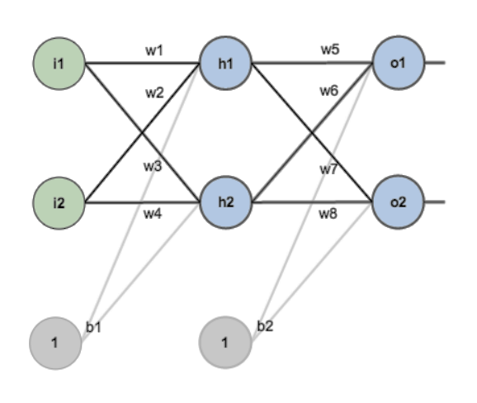
For this example, we’re going to use a neural network with two inputs, two hidden neurons, two output neurons. Additionally, the hidden and output neurons will include a bias.

Slide 3
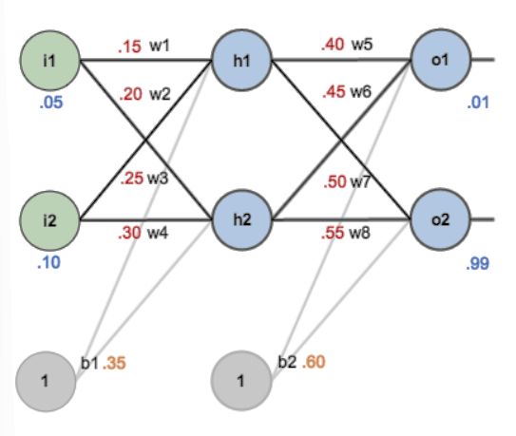

Slide 4
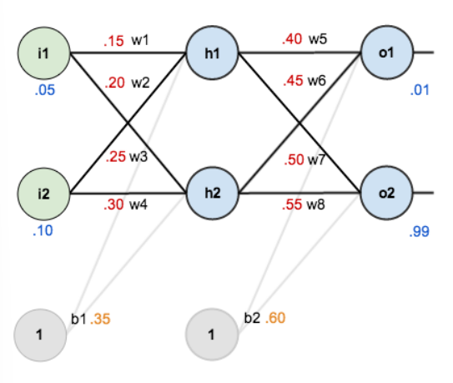
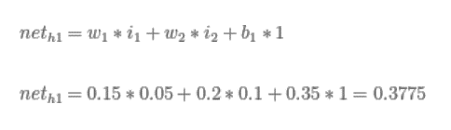


Forward Pass

Slide 5
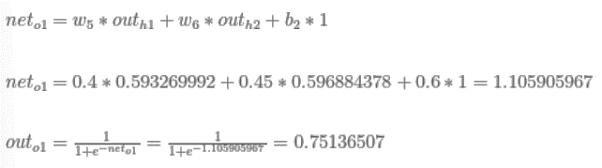

Forward Pass

Slide 6



Calculating the Total Error

Slide 7
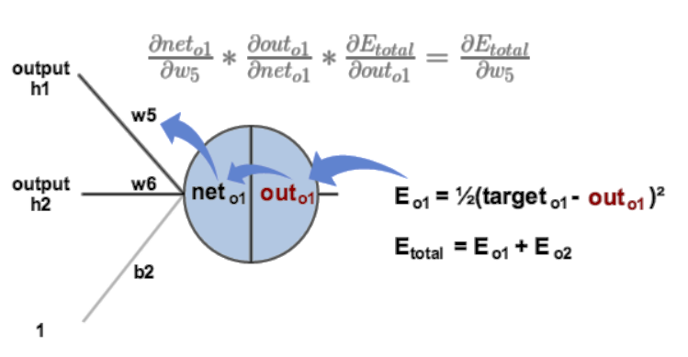
Backwards Pass(output layer)

Slide 8

$f\left(g\left(u\left(x\right)\right)\right)$
$\frac{∂f}{∂x}=\frac{∂f}{∂g}∗\frac{∂g}{∂u}∗\frac{∂u}{∂x}$

Slide 9

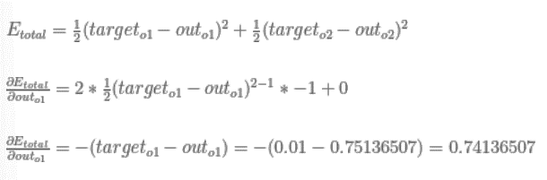
Backwards Pass

Slide 10
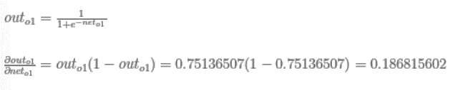
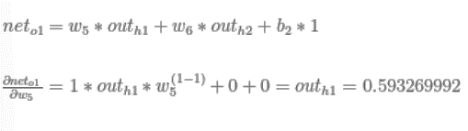
Backwards Pass

Slide 11

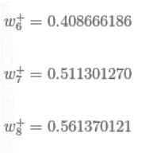

Backwards Pass

Slide 12
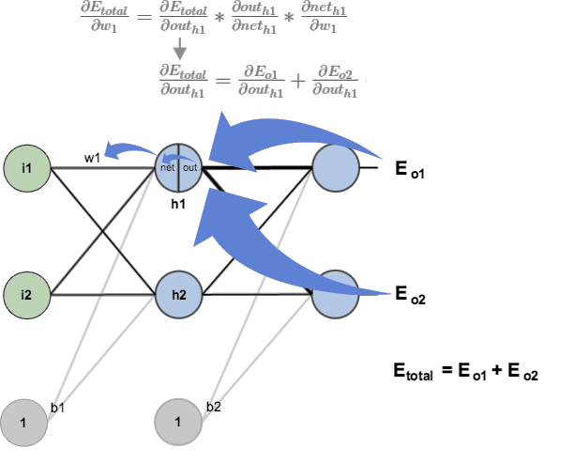
Backwards Pass(hidden layer)

Slide 13



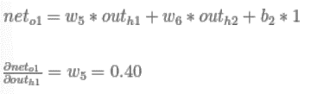
Backwards Pass
Calculate earlier:

Slide 14

Backwards Pass

Slide 15
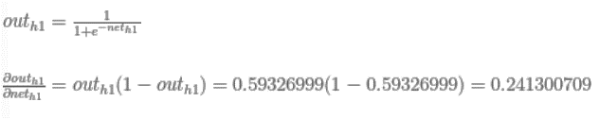
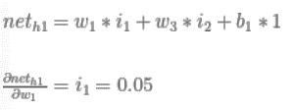

Backwards Pass

Slide 16
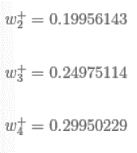
Backwards Pass

