Slide 1
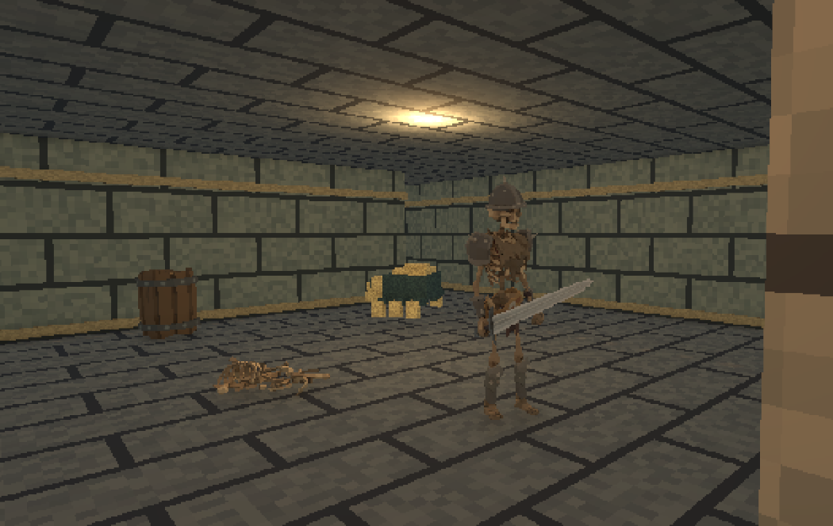
LOOMROOM
A dungeon crawl on a bedroom table
First-person roguelike dungeon crawler
PUBLISHER PITCH / OCTOBER 2026
Notes:
Pitch claim grounded in LoomRoom’s GameDesign.md: first-person dungeon crawler framed by a miniature table, Dungeon Master, and bedroom setting. The cover figure is a project character model and is used as a mood image, not presented as a screenshot.

Slide 2

A long descent, played on a small table
The player descends through a dungeon while the Dungeon Master watches from the bedroom
A dungeon crawler staged as a miniature adventure.
Fight through authored rooms, find stronger gear, and build a character over a multi-floor run.
The framing device
The bedroom table and Dungeon Master give the descent a story-shaped context.
LOOMROOM
02
Notes:
This is the central positioning claim. The room and table are project framing. The game design describes 90% of play in the dungeon; avoid presenting the bedroom layer as equally large. Image is a concept asset for the Dungeon Master, not a final in-game screenshot.

Slide 3
The run is built around earned upgrades
An easy-to-follow loop connects moment-to-moment combat to long-run character growth
EXPLORE
FIGHT
RECOVER
DESCEND
EXPLORE
›
FIGHT
›
RECOVER
›
DESCEND
Find branches, landmarks, secrets and stairs.
Read enemy wind-ups, manage stamina and choose an opening.
Compare loot, equip upgrades and restore health or mana.
Keep gear and skills as the next floor raises the pressure.
PROGRESS CARRIES BETWEEN FLOORS
Equipment / character level / skills / health and mana / supplies
LOOMROOM
03
Notes:
The loop is stated in Docs/GameDesign.md. The visual sequence is an editable native diagram, not a decorative image. Full-run persistence is described as intended design, although AdventureSave and descent functionality exist in project code.

Slide 4


Every attack spends a defensive resource
Attack, block, move or cast: the next choice depends on stamina and positioning
OR
Left hand: shield or spell
SWORD
SHIELD
FIREBALL
Swords favor reliable handling. Maces trade speed for stagger and guard pressure.
Fireball pressures enemies at range. Heal trades mana and time for recovery.
LOOMROOM
04
Notes:
Weapons and shield images are authored project art, while Fireball is a texture from the project’s spell pack. GameDesign.md specifies one-handed swords and maces, shield or spell in left hand, stamina-driven attacks and blocks. This slide presents the intended systems; the current design scope and precise implementation should be confirmed against a playable build.

Slide 5
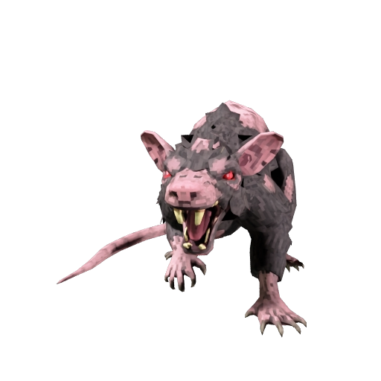
Enemies ask the player to change tactics
Readable wind-ups and recovery openings make each encounter a positioning problem
A guarded caster changes the approach.
•
Circle the shielded enemy or wait for its recovery.
•
Use a doorway or pillar to control the approach.
•
Keep stamina for the next block.
Wind-up / reach / recovery
LOOMROOM
05
Notes:
The rat image is a Meshy project character asset. Enemy behavior and fairness rules are described in GameDesign.md. Present the tactical encounter as target design; verify the exact enemy mix and behaviors in the current build before a live publisher meeting.

Slide 6
Loot and skill growth shape a run
A deliberately small combat roster supports meaningful equipment choices
CLASSES
EQUIPMENT
SKILLS
Warrior
Wizard
Cleric
Weapons
Shields and armor
Rings and amulets
Food and potions
Swords / Maces / Blocking
Sorcery / Thaumaturgy
Athletics / Trading
Different starting gear, resources and proficiencies.
Clear improvements to Attack, Armor Class and attributes.
Skills rise through successful use. No spendable skill points.
LOOMROOM
06
Notes:
Content from GameDesign.md, including proposed three starting classes and seven skills. The detailed balance values are still tuning proposals, so this slide avoids exact percentages or claims of final balance.

Slide 7

The table makes the world feel watched
A bedroom-scale frame gives the dungeon a memorable place in the world
THE ADVENTURE HAS A PLACE
THE DUNGEON MASTER WATCHES
A rat gnaws through the crypt while the Dungeon Master watches the board.
LOOMROOM
07
Notes:
The game design states that a small supporting tabletop and Dungeon Master layer occurs between runs while about 90% of gameplay is in the dungeon. The project has bedroom and boss-stage assets. Images are textured art assets, not assembled scene screenshots.

Slide 8
The full descent is a production target
The current design document outlines 20 floors across six biome blocks and a finale
01–03
04–06
07–09
10–12
13–15
16–18
19–20
Cellars
Crypt
Caves
Ruins
Fortress
Depths
Finale
DESIGN TARGET
Docs describe the full run. The current Dungeon1 asset is configured for four floors across two stages, so the 20-floor plan still requires production.
Biome changes enemy families, room themes and loot bands. Depth sets the available equipment band.
LOOMROOM
08
Notes:
The game design’s intended full-run layout is six three-floor biome blocks plus a two-floor finale. The current Unity asset Assets/Game/Levels/Dungeon1/Dungeon1.asset has two stages of two floors each. This slide expressly distinguishes design target from the configured current game data.

Slide 9
A familiar dungeon loop gets a distinctive frame
Comparable games help explain the design space; they do not predict LoomRoom’s sales
BARONY
First-person dungeon survival and class-driven runs.
Design reference
INSCRYPTION
A tabletop frame that gives a game-within-a-game atmosphere.
Mood reference
LOOMROOM
First-person action roguelike progression, staged on a bedroom table.
Own proposition
Genre comparables are positioning references, not performance forecasts.
LOOMROOM
09
Notes:
Barony is named in GameDesign.md as the reference for dungeon loop, classes and baseline equipment stats. Inscryption is the design reference for the tabletop frame. No market size, sales, wishlist or revenue claims are made because this workspace contains no verified market research or traction data.

Slide 10
The project has a working combat and dungeon foundation
Current evidence from project documentation and Unity assets
Implemented
Runtime scripts cover player combat, enemies, dungeon generation, loot and run progression.
Test record
A project audit records a clean compile and Play-mode smoke test of a generated dungeon, kills and XP.
Playable proof needed
A publisher build should show the core loop and the current quality bar in one short session.
The 20-floor run remains a design target; the current configured dungeon has four floors.
LOOMROOM
10
Notes:
Project audit dated 2026-10-09 reports compiling cleanly and a Play-mode smoke test of a generated dungeon, kills and XP credit. This is not a claim that every mechanic is complete or a final quality playable is ready. Verify and attach a publisher build and gameplay capture before external circulation.

Slide 11
A credible plan starts with proof and scope
Proposed production gates, with dates and cost to be set from a bottom-up estimate
01
Pitch build
One polished slice that proves combat, loot and the table framing.
02
Vertical slice
Prove a representative floor, one class contrast and a boss encounter.
03
Content production
Build and tune the approved floor and biome scope.
04
Release readiness
QA, accessibility, localization, ports and launch preparation.
Schedule depends on a locked scope, current build assessment and staffing plan.
LOOMROOM
11
Notes:
These are proposed production gates, not an approved schedule. No team size, budget, build milestone dates, platforms or release window were supplied or found in project documentation. Derive dates from a production plan and developer burn rate before submitting to publishers.

Slide 12
Seeking a publishing partner for the next stage
LoomRoom needs production planning and commercial support grounded in a strong playable
Publisher partnership
TO COMPLETE BEFORE SUBMISSION
Funding ask [USD budget]
•
Assess the core gameplay build and help define a shippable scope.
Target release [month / year]
•
Co-develop the production budget, schedule and release plan.
Studio and team [names / credits]
•
Plan publishing support for marketing, QA, localization and ports.
Build, gameplay video, platforms and traction
[Contact name] / [email] / [build link]
LOOMROOM
12
Notes:
Direct, specific ask follows Raw Fury’s six questions and Devolver’s requested fields: quick pitch, gameplay video, demo, financial roadmap, publisher support and requested funds. No contact, build URL, budget, platform commitment or release date is asserted. Fill these from team-approved and verified inputs before external circulation.

