Slide 1
A Presentation on ”Comparative Performance of Machine Learning Algorithms for Fake News Detection”
Authors: Arvinder Pal Singh Bali, Mexson Fernandes, Sourabh Choubey,
and Mahima Goel
Affiliations: APIIT, Haryana, India
Published by: Springer Nature Singapore Pte. Ltd. 2019
Presented by:
Md. Abdul Motaleb (St. ID: 1935 369 650)
Kawsin Jannet (St. ID: 1935 117 050)
Sabrina Yeasmin (St. ID: 1935 074 650)
Mohammad Minhazul Alam (St. ID: 1935 365 650)

Slide 2
Automated Fake News Detection – Overview
Goal: Automatic detection of fake news
Types of ‘fake news’:
False news
Fake satire news
Poorly written news
Importance:
Rapid increase of social media use resulted in exponential growth of fake news sources, opinion spams and low quality content
Control is needed for the stability and progress of society

Slide 3
Overview of the Work Done
Three standard datasets explored -
OpenSources, Kaggle, and George McIntire
A total of 163 features extracted
Seven machine learning algorithms compared -
Random Forest (RF), Support Vector Classifier (SVC), Gaussian Naïve Bayes (GNB), AdaBoost (AB), K-Nearest Neighbor (KNN), Multi-Layer Perceptron (MLP), and Gradient Boosting (XGB)
Results Analyzed -
Gradient Boosting outperformed others with Mean Accuracy of 88% and F1-score of 0.91

Slide 4
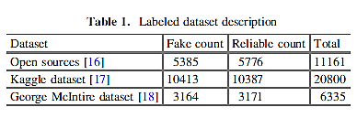
Data Sets: Overview
OpenSources dataset
Total nine million+ articles
Kaggle dataset (https://www.kaggle.com/jruvika/fake-news-detection)
George McIntire dataset
Description below:

Slide 5
Data Features used
N-grams Count Features
Occurrences of n-grams in title and body of an article are extracted
Ratios like - total unique n-gram / total n-gram are calculated
Useful to detect articles not very well written
Term Frequency – Inverse Document Frequency (tf-idf)
Detects key-words of a document
Used to detect the key words from document title and body
Cosine similarity is used to check the correlation between title and body of each document

Slide 6
Data Features used (contd.)
Word Embedding
Assigns a real-valued vector to each word of the corpus
Calculated from aggregated word-word co-occurrence count
Represented 400k words in a 50 dimensional vector space
Sentiment Polarity Score
Open source Natural Language Tool Kit (NLTK) used
Positive, Negative, Neutral and Compound sentiments
Readability standard
An approximation of years of education required to understand a sentence on single reading

Slide 7
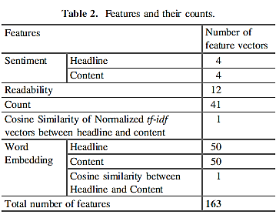
Data Features: Summary

Slide 8
Data Set: Preprocessing
Symbolic characters, date, numbers replaced
URLs removed
Stop words (am, is, by, the, etc.) removed
Texts tokenized and Words stemmed
Unigrams, bigrams, and trigrams created

Slide 9
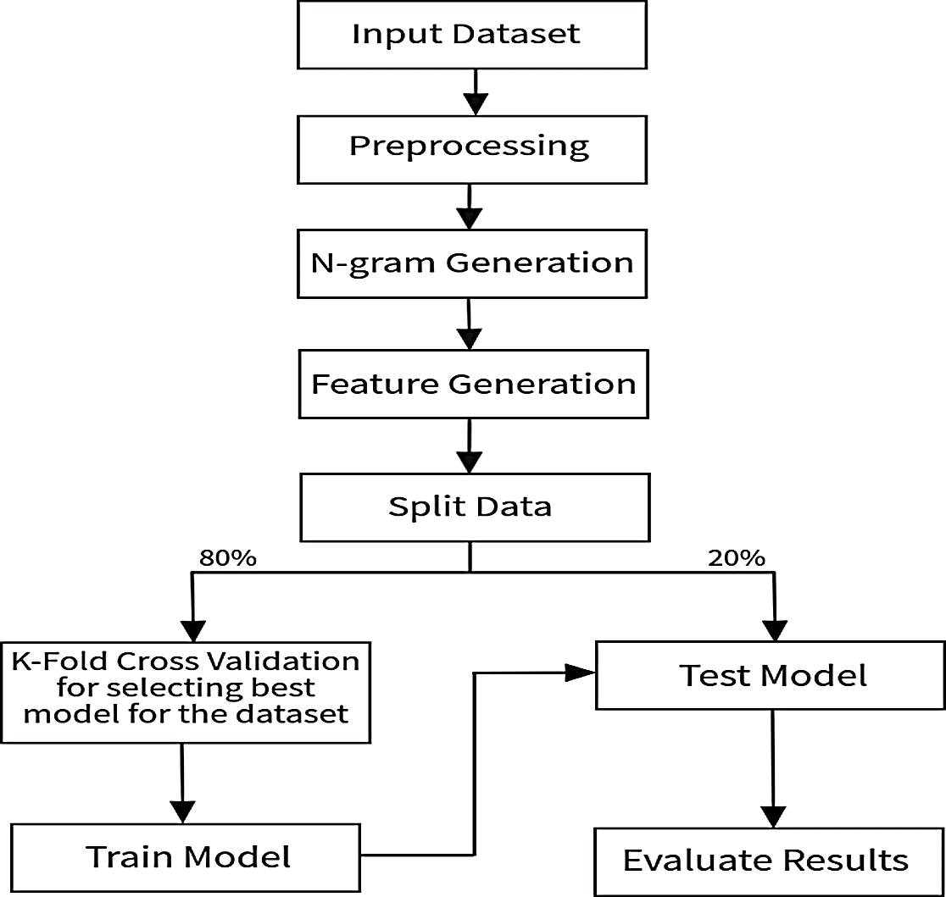
Classification Model
Figure 1: The full classification model

Slide 10
Model Evaluation
Evaluation Criteria
Dataset divided into training and test sets (80-20)
Stratified 10-fold cross validation used for selecting the best model from training sets
The best model for each algorithm is applied on the test set
Accuracy and Standard Deviation
Accuracy of the best model for the K-folds are computed
Standard Deviation of the Accuracies are calculated

Slide 11
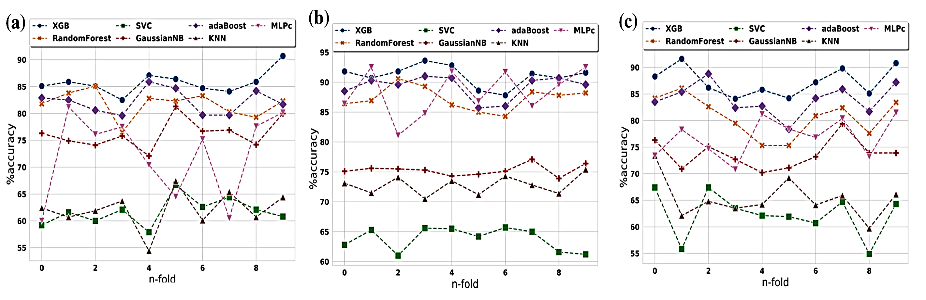
Model Evaluation (contd.)
Data set 1 Data set 2 Data set 3
Figure 2: Model Evaluation

Slide 12
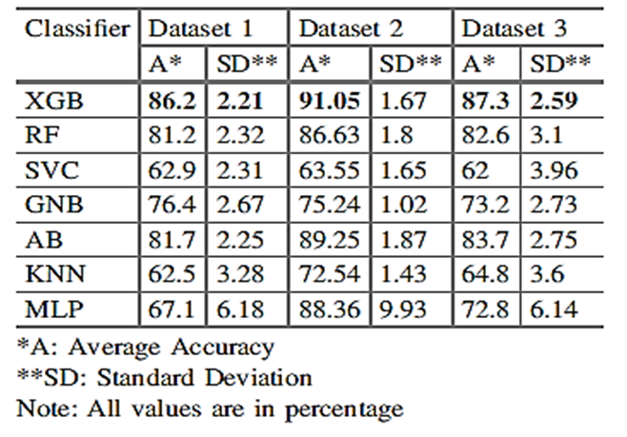
Model Evaluation (contd.)
Table 3: Model Accuracy and Standard Deviation

Slide 13
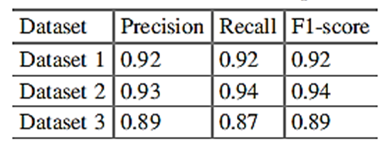
Performance Measures: Gradient Boosting
Gradient Boosting (XGB) was found to be the best classification technique based on Accuracy and Standard Deviation
Precision, Recall and F1-score of Gradient Boosting on the tested datasets are as below -
Table 4: Performance measures of Gradient Boosting

Slide 14
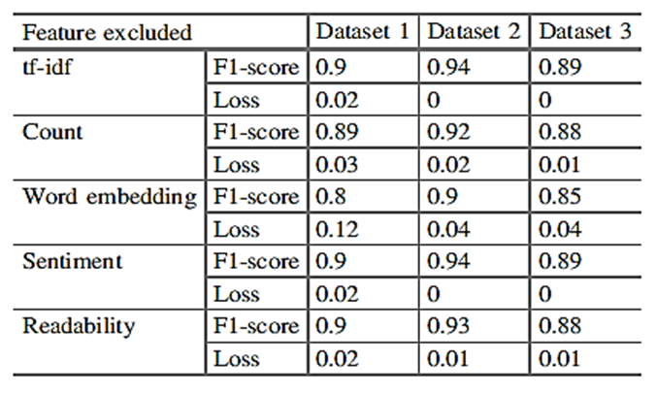
Data Features: Analysis based on output
Table 5: Relevance of selected features

