Slide 1

Educational Data Mining For Students’ Performance Prediction
1
PRESENTED BY-
Abtahi Ahmed
Farzana Akter Nipa
Wasi Uddin Bhuyian
Khaled Md Mushfique
Md Jobayer Sarker Jesan
011202247
011201361
011201286
011201352
011152024
Supervised by - Prof. Dewan Md. Farid
Course teacher - Prof. Swakkhar Shatabda

Slide 2
TABLE OF CONTENTS
01
02
03
04
05
06
2
Introduction
Methodology
Literature Review
Problem Statement, Motivation & Objectives
Overall Approach
Past Papers &
Gap Analysis
Data Preparation
Implementation
Conclusion
Requirements, Survey & Dataset
Experiment Environment, Results & Analysis
Summary, Limitations & Future Work

Slide 3
01
INTRODUCTION
3

Slide 4
PROBLEM STATEMENT
4 - Introduction
Academic struggles in the modern era among students
Challenges in keeping up with the academic curriculum and achieving good grades
Common reasons for poor performance:
Wrong choice of undergraduate program
Lack of foresight into the correlation between student potential and program requirements

Slide 5


MOTIVATION
5 - Introduction
The Potent Weapon of Knowledge: Education becomes the most formidable tool in this modern era.
Modern Dilemma: In the world of diverse professional degrees at fingertips, choosing the right path can be overwhelming.
Lack of Basic Understanding of degrees: Among abundant resources, learners face the challenge of information overload and end up choosing a degree without any thought.
Society Influence: Parents and society has certain pressure on taking some specific courses for career.

Slide 6
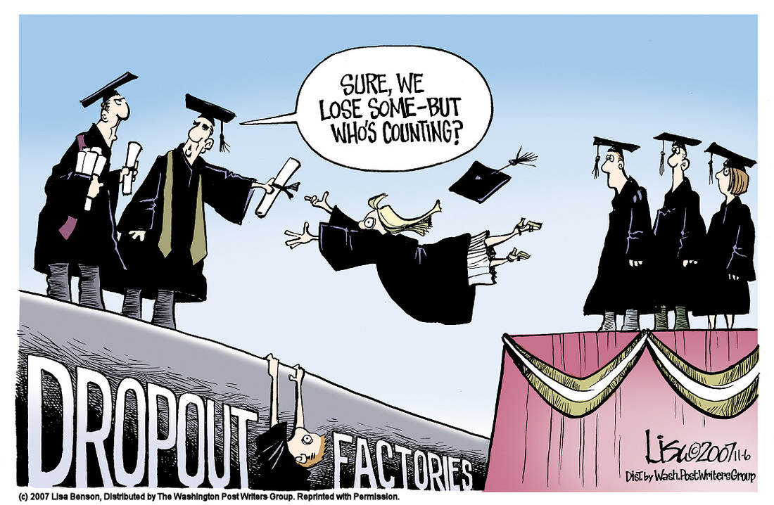
>10%
6 - Introduction
Dropout Rate in Secondary and Tertiary Degrees
High dropout rates among tertiary education students
Low percentage of students completing their undergraduate degrees
Consequences: Waste of resources and potential harm to students' growth and productivity

Slide 7
OBJECTIVES
7 - Introduction
Reduce gaps in the country's education system
Identify features crucial in determining student’s performance
Provide valuable insights for students and stakeholders
Dataset
Collection of students' data
Demographic, social and academic background
Compilation of data for a comprehensive dataset
Ensure lower dropout rates
Promote more efficient use of resources

Slide 8
02
METHODOLOGY
8

Slide 9
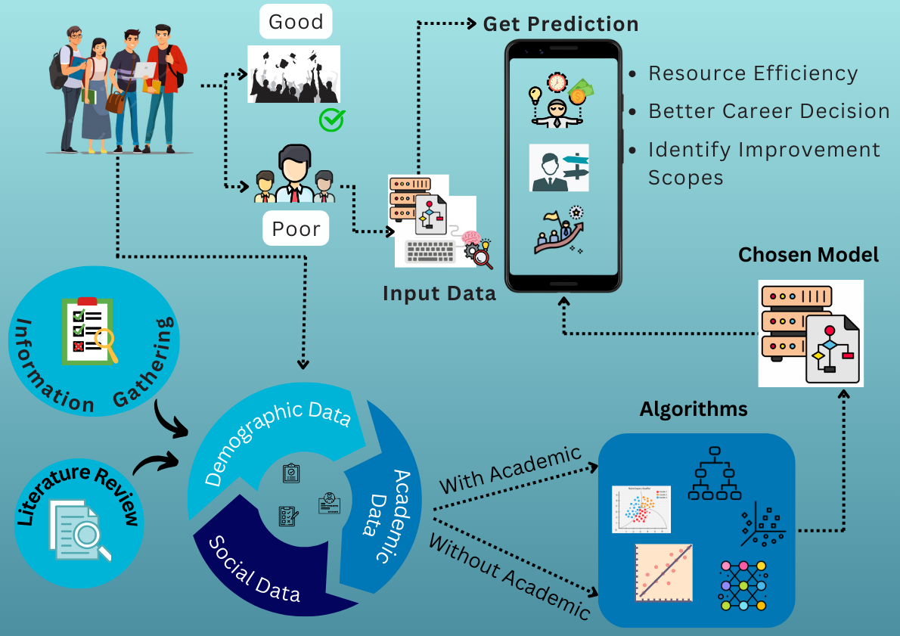
9 - Methodology

Slide 10
03
Literature Review
10

Slide 11
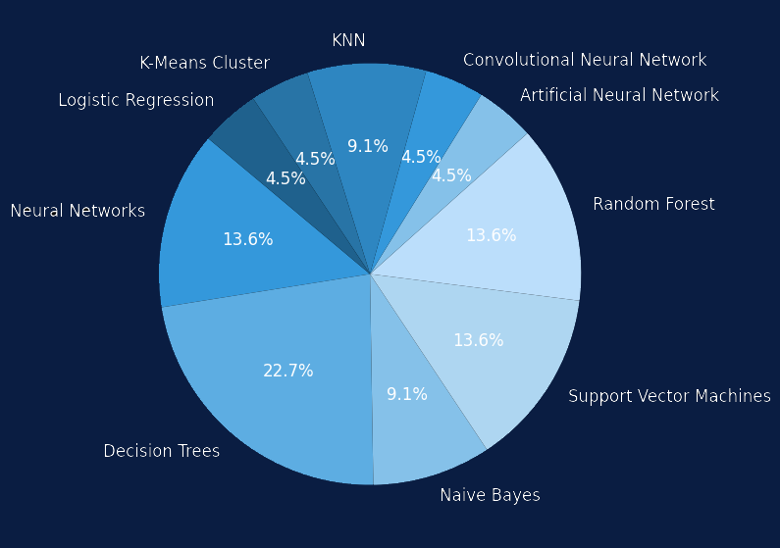
LITERATURE REVIEW
11 - Literature Review
Traditional ML Approaches:
Supervised Learning algorithms.
Decision Tree-based models
87%
Non-Traditional ML Approaches:
Neural Network frameworks
Hybrid approaches
Unnecessary due to complexity
Comprehensive Analysis and Comparison studies
Open University Learning Analytics Dataset(OULAD)

Slide 12
GAP ANALYSIS
Regional Variance
Categorization & Distinction
Information Gathering
12 - Literature Review
Context of Bangladesh
Demographic
Social Academic
In-person interviews
Students’ participation in surveys

Slide 13
04
Data Preparation
13

Slide 14
REQUIREMENTS
Functional
Non-Functional
14 - Data Preparation
Confidentiality
Visual Results
Fairness
Authentication
Generalization
Reliability
Accuracy
Deterministic
Model Complexity
Interpretability and Explainability

Slide 15
SOURCES OF ATTRIBUTES
15 - Data Preparation
Literature Review
Surveys
In person Interviews
Published Dataset

Slide 16
DATA CATEGORIZATION
16 - Data Preparation
Background Information relating to individual and family
Demographic
How people interact with surroundings
Social
Current and past academic results
Academic

Slide 17
ATTRIBUTES
17 - Data Preparation
Demographic | Social | Academic
Commute Time to Campus | Hobbies | Prior Gardes
In Hours | Cooking, Gaming, Watching Movies, Reading, Writing | A, A-, B, B+, B-, etc
Parental Qualifications | Group Study Hours | Under Any Waiver Scheme
Not Graduate, Graduate, Post Graduate | Numerical | Yes/No
Parents Relationship Status | In any Relationship | Studying Frequency
Single, Married, Divorced | Yes/No | On a scale of 1-5

Slide 18
DATASET CHARACTERISTICS
GENDER
37%
63%
AVERAGE COMMUTE TIME
2.35 Hours
AGE
18 - 24 (Median 21)
29
7
22
Economic Status
Mostly from middle class
18 - Data Preparation
DEMOGRAPHIC
SOCIAL
ACADEMIC

Slide 19
05
Implementation
19

Slide 20



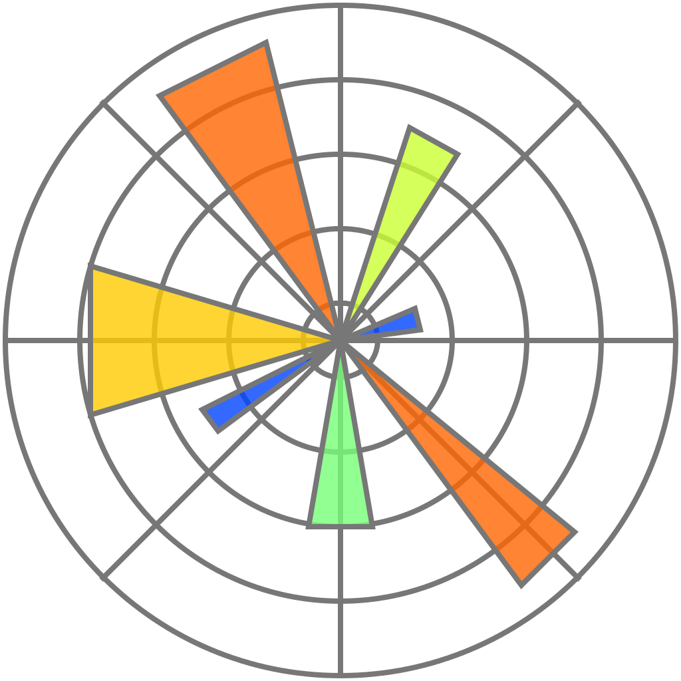


ENVIRONMENT SETUP
20 - Implementation
Google Forms
Python
Google Sheets
Matplotlib
Scikit Learn
Google Colab

Slide 21
RESULTS & ANALYSIS
21 - Implementation
 | WITH ACADEMIC
 | ACCURACY
SVM | 95%
DT | 93.3%
LR | 93.3%
NB | 68.4%
KNN | 56.7%
SVM, DT & LR performed well. Optimize the equations to classify all samples.
95%
NB treats each feature independently without considering interrelationships.
KNN uses majority voting. Performs poorly when many classes. The greater the number of neighbours, the worse.

Slide 22
What about non-academic data only ?
22 - Implementation

Slide 23
IMPACT OF NON-ACADEMIC DATA
23 - Implementation
 | WITHOUT ACADEMIC | WITH ACADEMIC
 | ACCURACY | ACCURACY
SVM | 93% | 95%
DT | 91.7% | 93.3%
LR | 91.7% | 93.3%
NB | 65% | 68.4%
KNN | 55% | 56.7%
Minute difference in performance.
93%
Discarding academic data still gives good results.

Slide 24
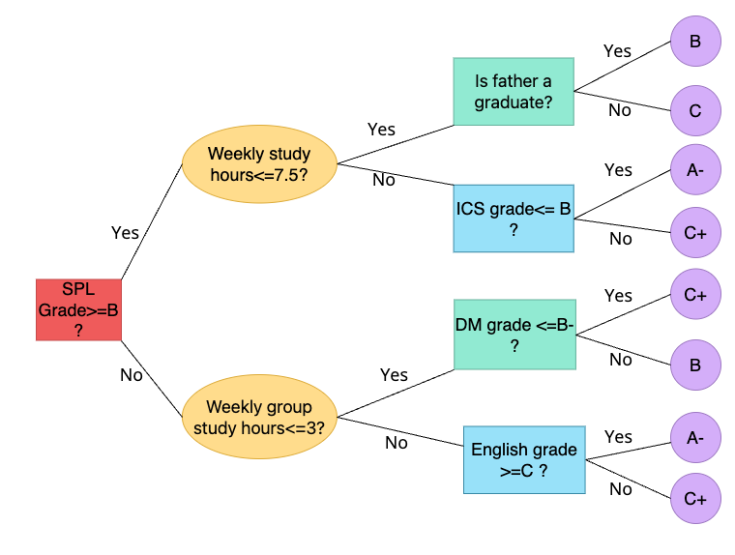
KEY FEATURES
24 - Implementation
Study hours per week
Father’s qualification level
Results of past courses
such as Structured Programming Language, Introduction to Computer Science, Discrete
Maths and English

Slide 25
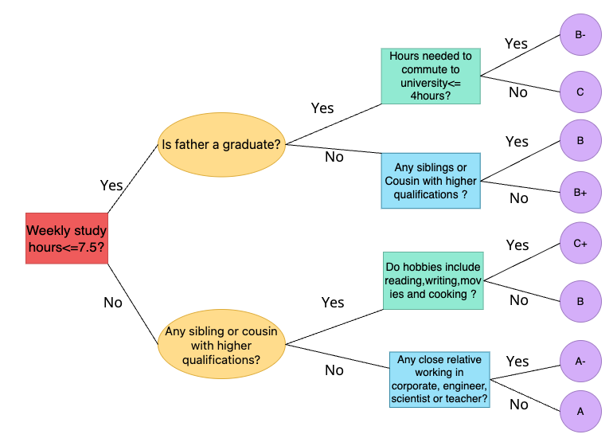
KEY FEATURES
25 - Implementation
Any sibling or cousin with higher qualifications
Any corporate job holder, engineer, scientist or teacher as close relative
Likes reading, writing, watching movies and cooking
How long it takes for the student to commute to and
from the university campus

Slide 26
06
Conclusion
26

Slide 27
SUMMARY
CONTRIBUTION
IMPACT
27 - Conclusion
Undertaking Predictive Analysis
Algorithm Utilization:
Strategic Use of EDM
Comprehensive Dataset Usage:
Emphasizing the Significance
Feature Identification through Surveys:
Power of EDM
Impact on Mental Health
Reducing Dropout Rates

Slide 28
LIMITATIONS
28 - Conclusion
Limited Scope
Exclusions
Focused on a single course with a small student population
Mental and psychological aspects not considered
Impact of student well-being on performance
Dataset Size
Teacher’s Data
Small dataset considering the row:column ratio
Data regarding teachers were not taken into account

Slide 29
FUTURE WORK
29 - Conclusion
Include All Courses
Major Selection Assistance
Use complex algorithms to predict grade of any course at any time
Utilize unsupervised learning like K-Means Clustering to help students choose their majors
Degree Planning
Carve out a pathway for a student to undertake the courses in the optimal sequence

Slide 30
CONFERENCE PAPER
30- Conference Paper
Abtahi Ahmed, Farzana Akter Nipa, Wasi Uddin Bhuyian, Khaled Md Mushfique, and Dewan Md. Farid. Students’ Performance Prediction with Machine Learning. 6th International Conference on Electrical Engineering and Information & Communication Technology (ICEEICT), MIST, Bangladesh, 02-04 May, 2024 (Submitted)

Slide 31
THANK YOU
31

