Slide 1
Project name: Personal Task Tracker Course title: Software development project-II and industrial tour Course code: CSE3116
Submitted by, Supervisor:
Name: Nurul Kabir Rana Lubna Yasmin Pinky
ID: CE-18049 Assistant Professor
Name: Farzana Haque Dept. of CSE MBSTU
ID: CE-18050

Slide 2
Introduction:
Personal task tracker is a great way to stay on top of your tasks and be productive. It is very easy- to- use which lets you manage your tasks within time. It is developed by c++ programming language. This tracker has 7 options like Add Task, View All Task, Delete Task, Add Expense, View All Expense, Exit, Activate Reminder. The user can add tasks by inputting a specific time format and event name. By activating the reminder for each task, the user will get an alarm at that time. Moreover, the user will able to see his daily expense from this system.

Slide 3
Features:
Easy to recognize your daily tasks into subtasks and more.
Prioritize tasks based on day timing schedule.
Daily planning is made clear with it's easy- to- use interface.
Notify you for every priority subtasks.
Easy to modify and insert your subtasks.
Facile to show your daily expenditure.

Slide 4
Personal Task Tracker Design:
View Total Expense
Notify according to the specified time
Sorted Priority Task
Assign Priority Task
Set Time
Assign Daily Expense
Cancellation Details Cancellation Ack.
Fig: 0 level Data Flow Diagram of Personal Task Tracker.
User
Personal Task Tracker

Slide 5
Procedure:
Main Function:
Step 1: Starts with welcome screen
Step 2: Display main menu as below
Add Tasks
View All Tasks
Delete Tasks
Add Todays Expense
View Total Expense
Exit
Activate Reminder
Step 3: Get Choice from user
Choice 1: Call function Add Tasks
Choice 2: Call function View All Tasks
Choice 3: Call function Delete Tasks
Choice 4: Call function Add Todays Expense

Slide 6
Procedure Cont...
Choice 5: Call function View Total expense
Choice 6: Go to step 4
Choice 7: Call function Activate Reminder
Step 4: Stop
Add Task Function:
Step 1: Get today’s Day-Month-Year input form user
Yes: Go to step 2
No: Go to step 1
Step 2: Get how many tasks user want to enter
Step 3: Get Hour and Minute from user
Yes: Go to step 4
No: Use 12 Hour format and minute must be less than 60
Step 4: Enter time format AM or PM
Step 5: Enter event name
Yes: Tasks saved
No: Press k for main menu

Slide 7
Procedure Cont...
View all Task Function:
Step 1: Sort all the tasks according to time
Step 2: If tasks assigned
Yes: Show all the tasks
No: Press k for main menu
Delete Task Function:
Step 1: If press k
Yes: Go to main menu
No: Press d for continue delete
Step 2: Get task number to delete
Yes: Task deleted, press k for main menu
No: Invalid task number
Add Expense Function:
Step 1: Get expense amount

Slide 8
Procedure Cont...
Step 2: Get expense purpose
Step 3: Press k for main menu
View Total Expense Function:
Step 1: Get Choice from user
Choice 1: Daily Expense
Choice 2: Weekly Expense
Choice 3: Monthly Expense
Choice 4: Main Menu
Step 2: If choice is Daily Expense, go to step (a)
Step a: If expense exists,
Yes: Show Total Expense
No: No Expense to Show
Step b: Press k for main menu

Slide 9
Procedure Cont...
Step 3: If choice is Weekly Expense, go to step (c)
Step c: If expense exists,
Yes: Show total weekly expense
No: Weekly expense will be available when week ends
Step d: Press k for main menu
Step 4: If choice is Monthly Expense, go to step (e)
Step e: If expense exists,
Yes: Show total monthly expense
No: Monthly expense will be available when month ends
Step 5: If choice is Main Menu, go to main menu
Activate Reminder Function:
Step 1: If input day, month, year == today’s date

Slide 10
Procedure Cont...
Yes: Go to step 2
No: You have no task
Step 2: When input hour, minute == local time, alarm ringing
Step 3: Press k to go main menu
Exit Function:
Step 1: Stop

Slide 11
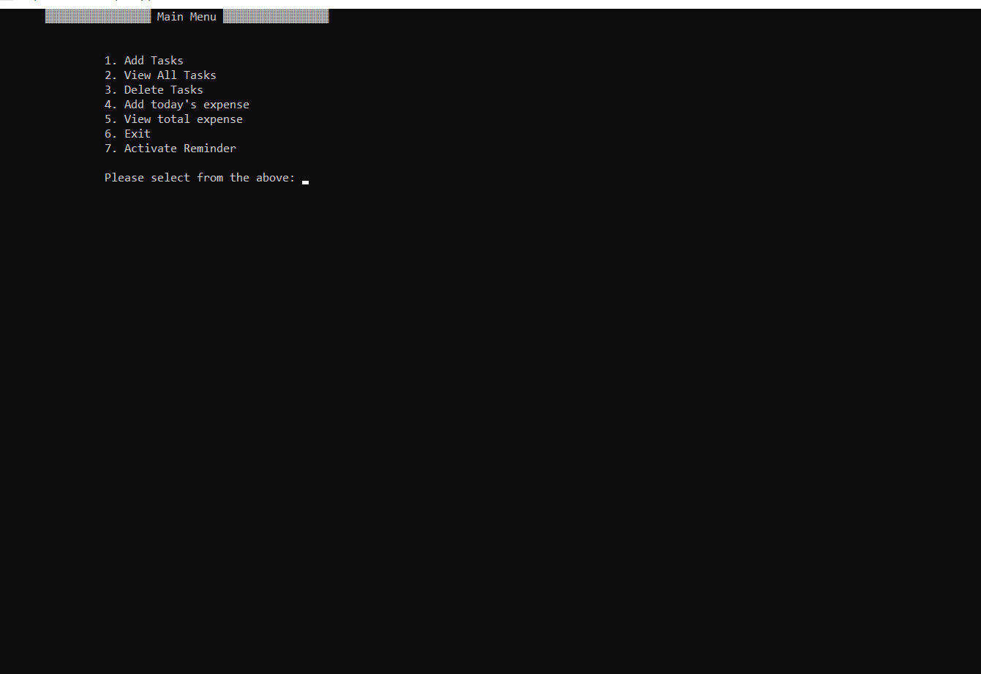
Result:

Slide 12
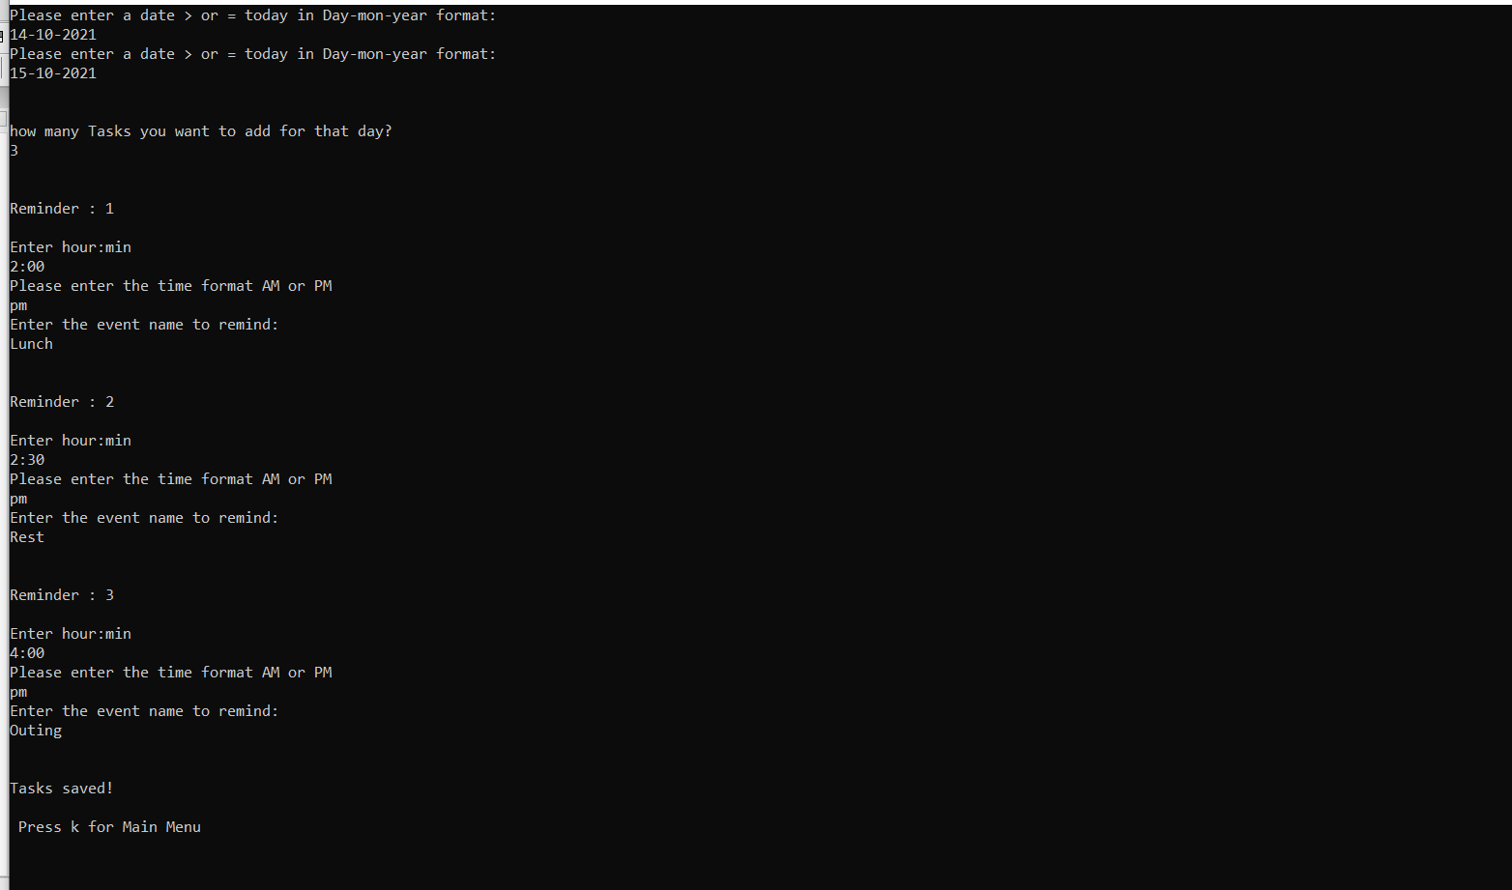
Result Cont...

Slide 13
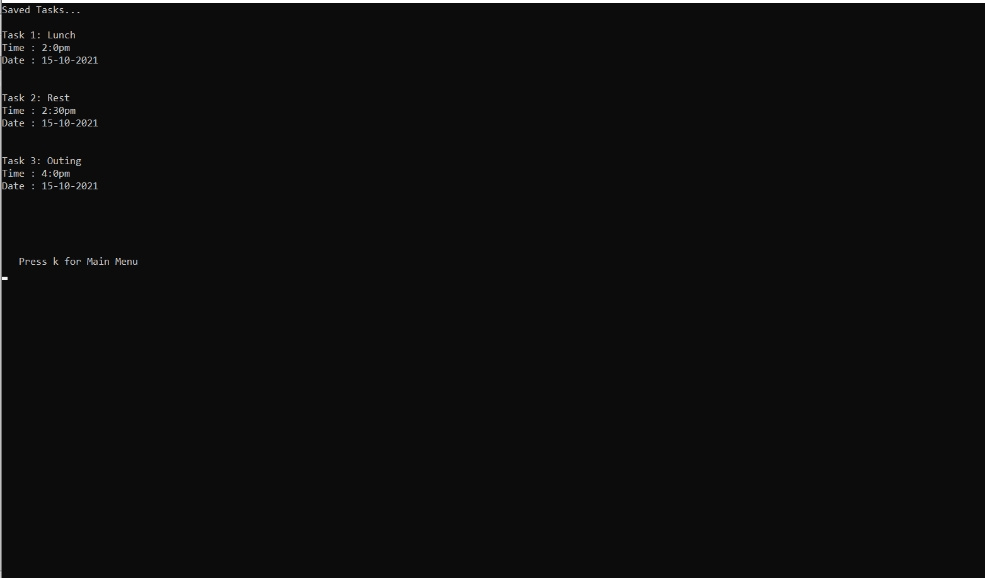
Result Cont...

Slide 14
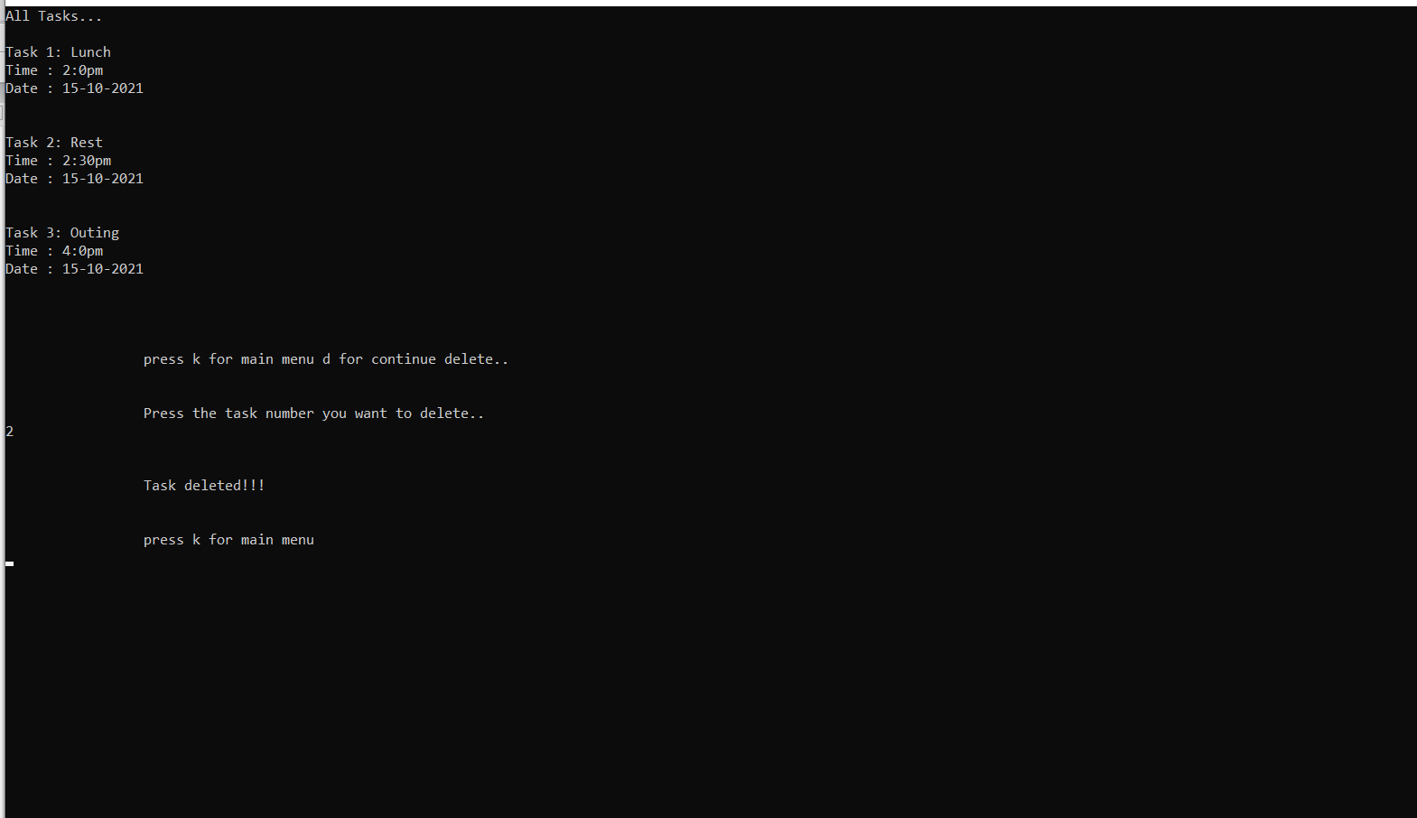
Result Cont...

Slide 15
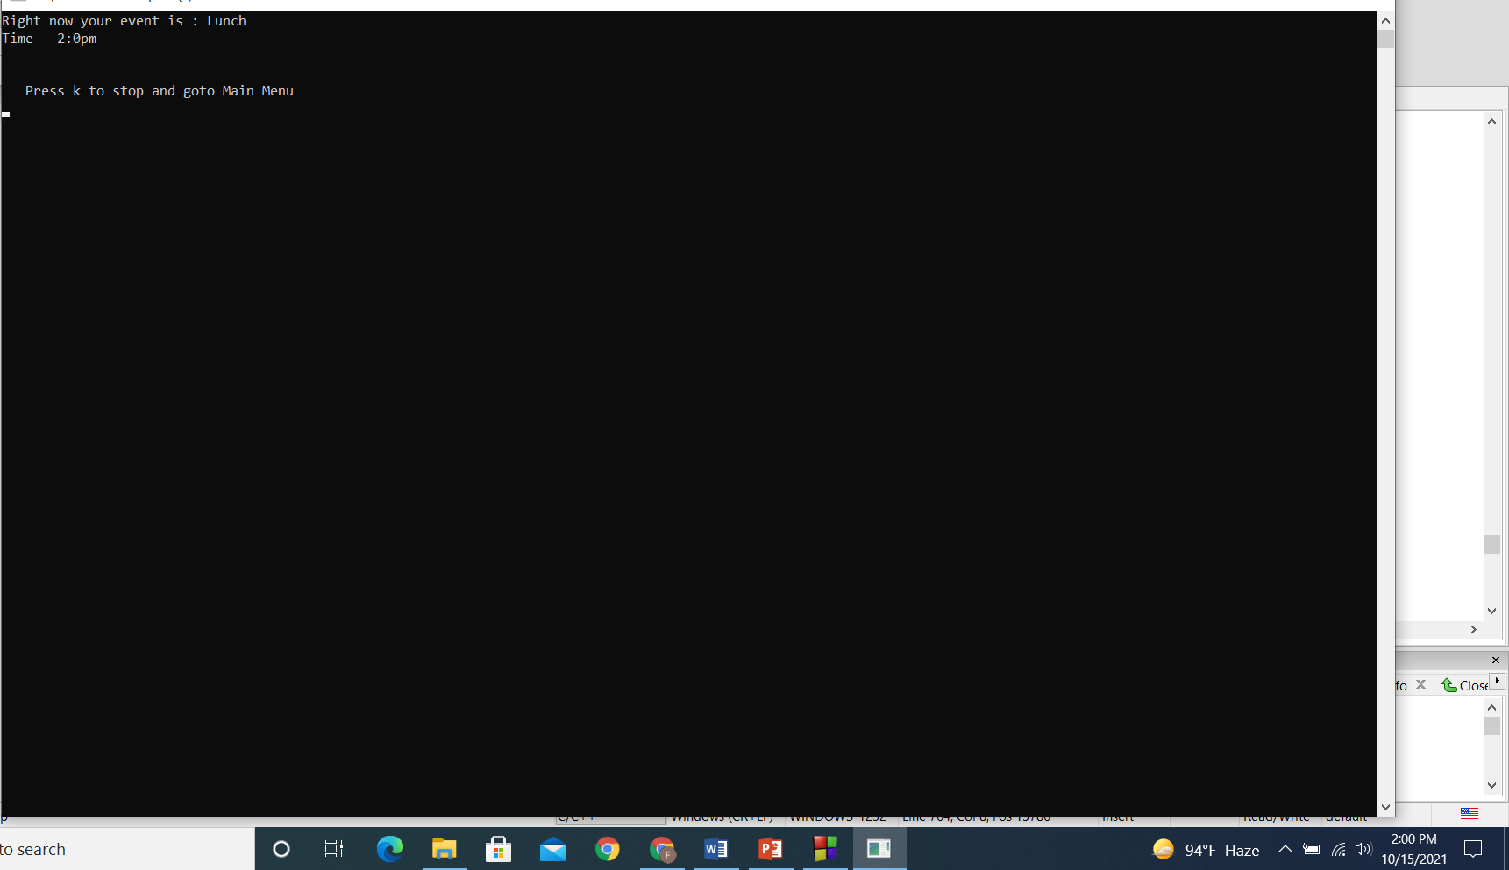
Result Cont...

Slide 16
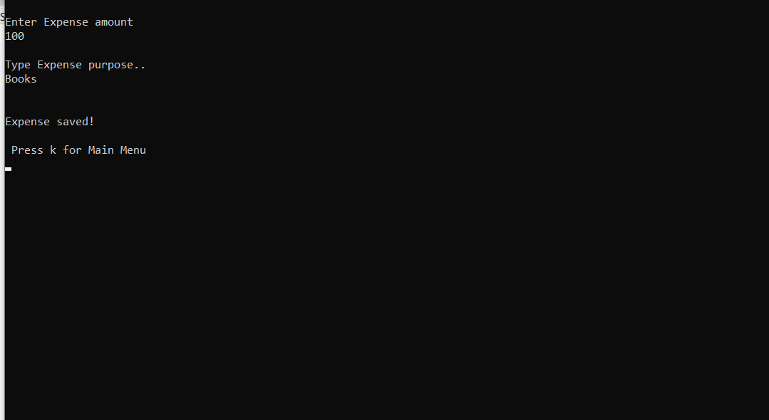
Result Cont...

Slide 17
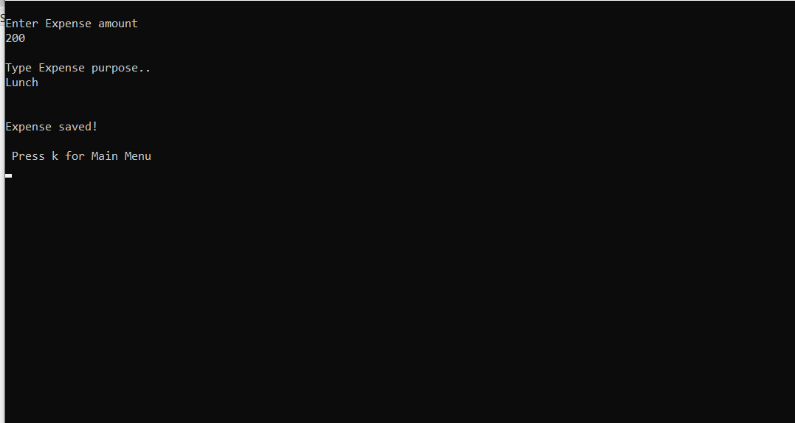
Result Cont...

Slide 18
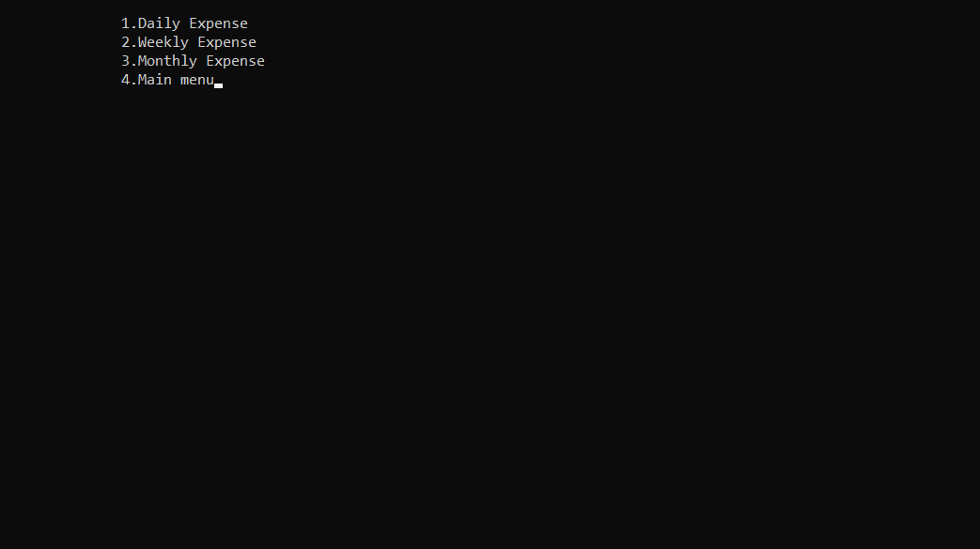
Result Cont...

Slide 19
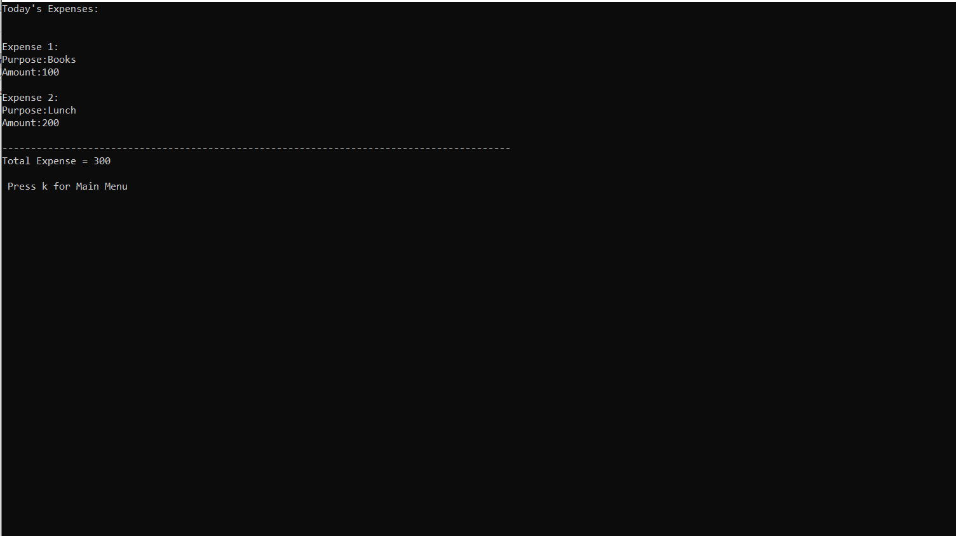
Result Cont...

Slide 20
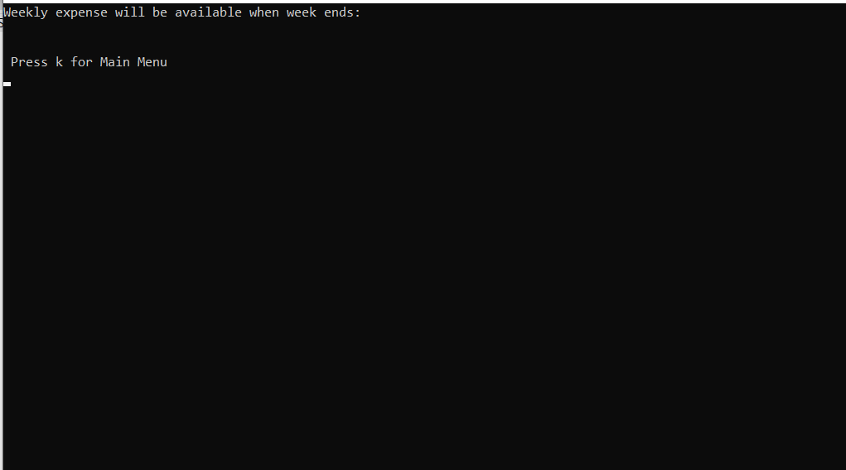
Result Cont...

Slide 21
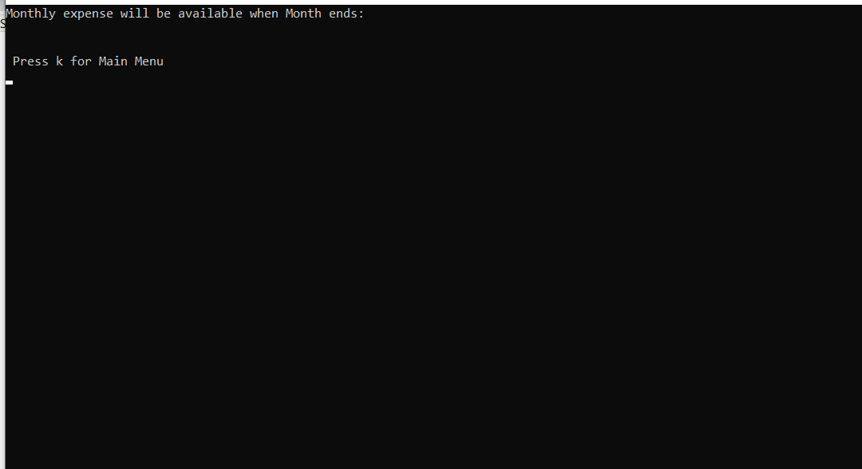
Result Cont...

Slide 22
Shortcomings:
When an alarm goes off, user have to go back to the main menu and activate the reminder for the next task.
Reminder should always be active.
Due to the limitation of PC, it has to make desktop base app instead of making android base app.
At the time the task has been assigned, the system accepts it as valid even after the time has already passed.

Slide 23
Future work:
In order to facilitate the user’s use, the app needs to create an android base app.
To make the representation of the task tracker more attractive, we should use several types of graphical functions.
We have to be more careful about handling the timing of the assigned task.

Slide 24
Thank you

