Slide 1

Mawlana Bhashani Science and Technology University Department of Information and Communication Technology Santosh ,Tangail-1902.

Slide 2
Assignment
Slide 1: Title Slide
Title: Extreme Programming (XP) Overview
Subtitle: Agile Software Development Methodology
Name : Farzana Yeasmin Era
ID : IT-21054
Course : Software Engineering
Date : 17.11.2024

Slide 3
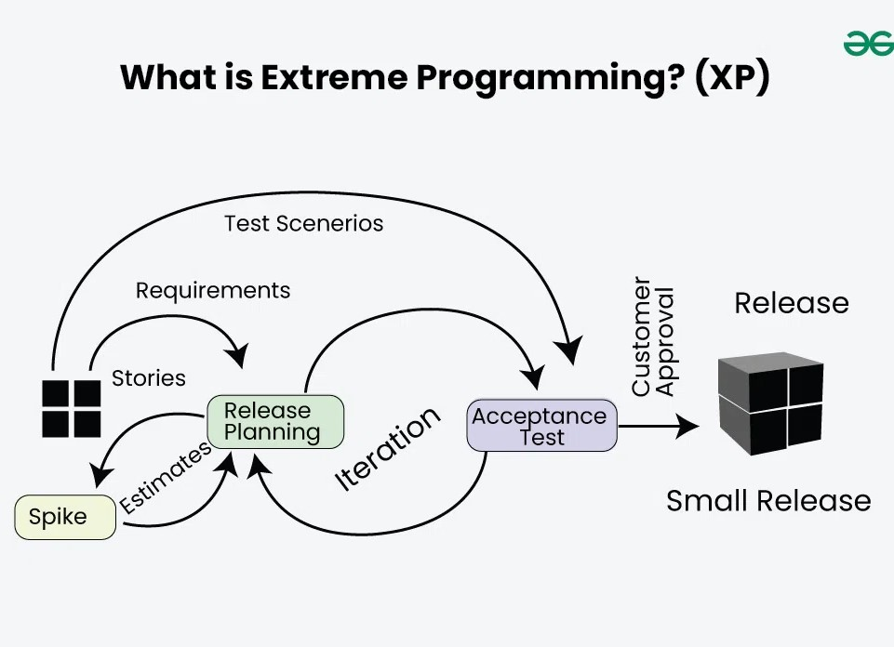
Slide 2: What is Extreme Programming (XP)?
Definition: A software development methodology that emphasizes flexibility, customer satisfaction, and high-quality code.
Key Points:
Focus on delivering small, frequent releases.
Close collaboration between developers and customers.
High emphasis on testing and feedback.

Slide 4
Slide 3: XP Principles
Principles:
Communication: Clear and constant communication among team members.
Simplicity: Focus on the simplest solution that works.
Feedback: Continuous feedback from customers and tests.
Courage: Bold decision-making and refactoring.
Respect: Valuing every team member’s contributions.

Slide 5
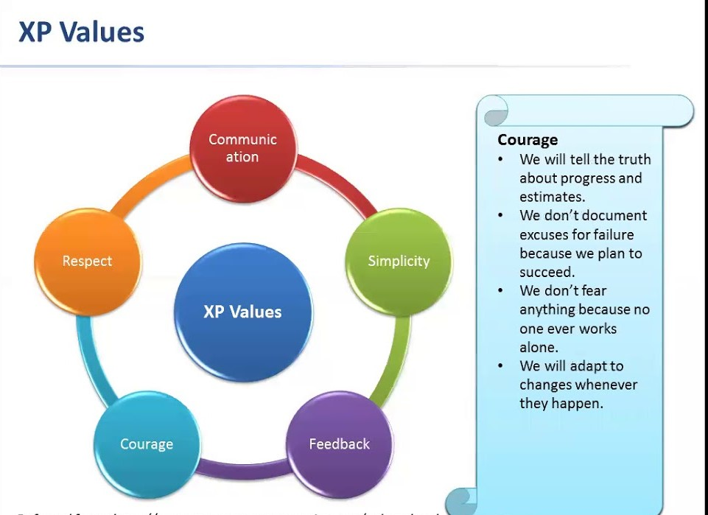
Slide 4: Core Practices of XP
Bullet Points:
1.Pair Programming
2.Test-Driven Development (TDD)
3.Continuous Integration
4.Collective Code Ownership
5.Refactoring
6.Small Releases
7.On-Site Customer
8.Simple Design
9.40-Hour Work Week
10.Coding Standards

Slide 6
Slide 5: Pair Programming
Description: Two developers work together on the same task—one writes the code, the other reviews and suggests improvements.
Benefits:
Improved code quality.
Knowledge sharing.
Reduces defects early.
Diagram: Show two developers working side-by-side with one keyboard (illustrating the collaboration).

Slide 7
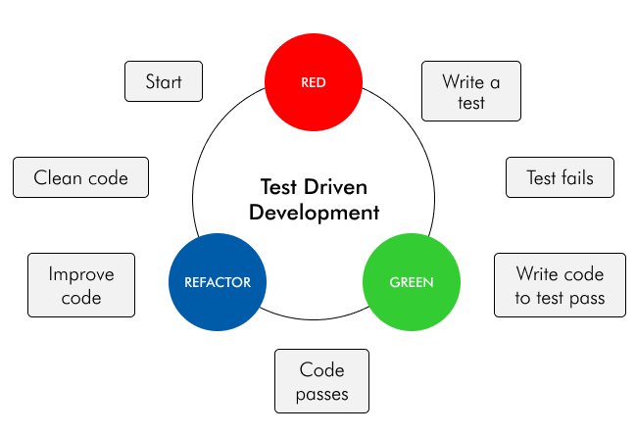
Slide 6: Test-Driven Development (TDD)
Description: Write tests before writing code. Tests verify that the code works as expected.
Key Points:
Write a test.
Write the code to pass the test.
Refactor if needed.
Diagram: Show the TDD cycle:
1.Write a test.
2.Run the test (fail).
3.Write the simplest code to pass the test.
4.Refactor.

Slide 8
.
Slide 7: Continuous Integration
Description: Integrate code into the main codebase frequently (multiple times per day) and run automated tests.
Benefits:
Early detection of integration issues.
Faster feedback on code changes.
Reduces risks associated with large merges.
Diagram: A simple diagram showing the cycle:
Developer -> Commit -> Automated Tests -> Pass/Fail -> Deploy.

Slide 9
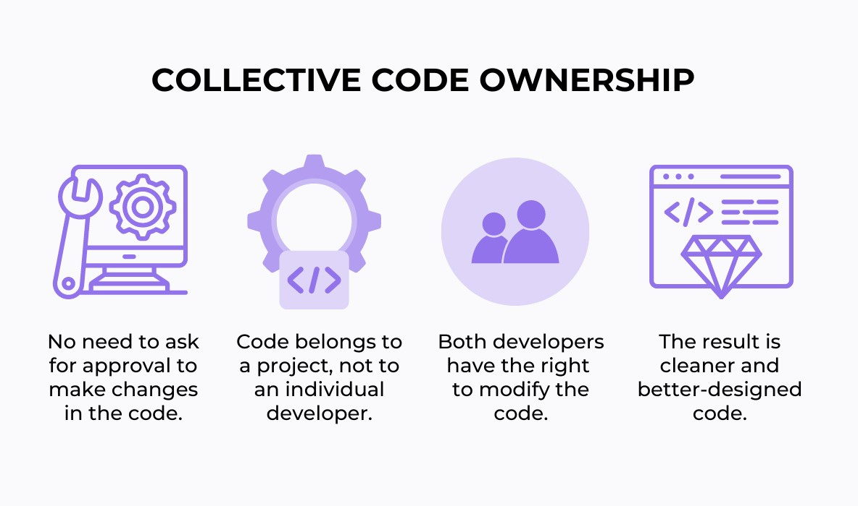
Slide 8: Collective Code Ownership
Description: All team members share responsibility for the entire codebase.
Benefits:
Reduces bottlenecks (no single person is a "gatekeeper").
Encourages collaboration and knowledge sharing.
Increases flexibility in handling code changes.
Diagram: Show a team of developers, all with access to and responsibility for the code.

Slide 10
Slide 9: Small Releases
Description: Deliver small, incremental releases frequently to gather customer feedback and improve the product.
Benefits:
Allows early and regular feedback.
Reduces risk of large-scale failures.
Keeps the team focused on delivering immediate value.
Diagram: Show a timeline with frequent, small releases vs. a large, infrequent release.

Slide 11
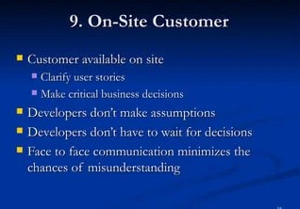
Slide 10: On-Site Customer
Description: Have a customer or representative directly involved with the development team, available to provide ongoing feedback.
Benefits:
Ensures alignment with customer needs.
Reduces misunderstandings and clarifies requirements.
Diagram: Show a circle with the development team and a direct line to the customer for feedback.

Slide 12
Slide 11: Benefits of XP
Key Advantages:
1.Improved Software Quality through continuous testing and code reviews.
2.Increased Flexibility with quick adaptations to changing requirements.
3.Customer Satisfaction due to constant feedback and early releases.
4.Better Team Collaboration through pair programming and collective ownership.
5.Sustainable Pace with a balanced workload (40-hour work week).
Diagram: A diagram or list showing the benefits as a series of interrelated concepts.

Slide 13
Slide 12: Challenges and Considerations
Challenges:
1.Requires Discipline: Adherence to XP practices demands commitment from the whole team.
2.Customer Availability: Constant customer involvement can be difficult to maintain.
3.Learning Curve: New practices like pair programming and TDD can be challenging for teams not accustomed to them.
4.Scaling: XP is best suited for small to medium-sized teams and can be difficult to scale.
Diagram: A simple table showing "Benefits" vs. "Challenges."

Slide 14
Slide 13: Conclusion
Summary:
Extreme Programming is a highly effective agile methodology that focuses on delivering high-quality software, maintaining close communication with the customer, and using practices like pair programming, TDD, and continuous integration.
While it offers many benefits, XP requires strong discipline, collaboration, and customer involvement.
Call to Action: Consider implementing XP practices in your development process for faster, higher-quality results.

Slide 15
Thank You

