Slide 1
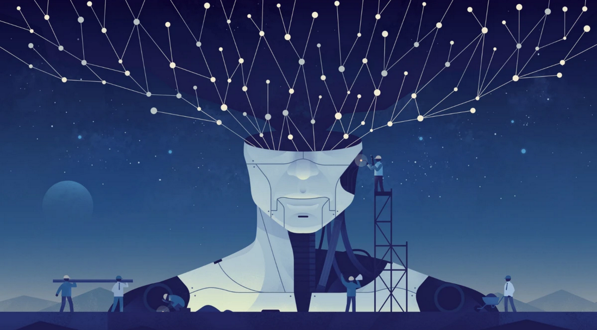
Background neural networks tutorial
Jarek van Dijk
20-03-2020
Image: quantamagazine.org
Notes:
1

Slide 2
Teaching goals
Basic understanding of neural networks
Get familiar with terms
Get some hand on experience (2nd presentation)

Slide 3
Content
Software
Building blocks
Neurons
Loss functions
Back propagation
Practicalities
Architectures
Problems / questions

Slide 4
Software
Software
Building blocks
Neurons
Loss functions
Back propagation
Practicalities
Architectures
Problems / questions

Slide 5



Software
TensorFlow
Keras
Pytorch

Slide 6
Building blocks
Software
Building blocks
Neurons
Loss functions
Back propagation
Practicalities
Architectures
Problems / questions

Slide 7
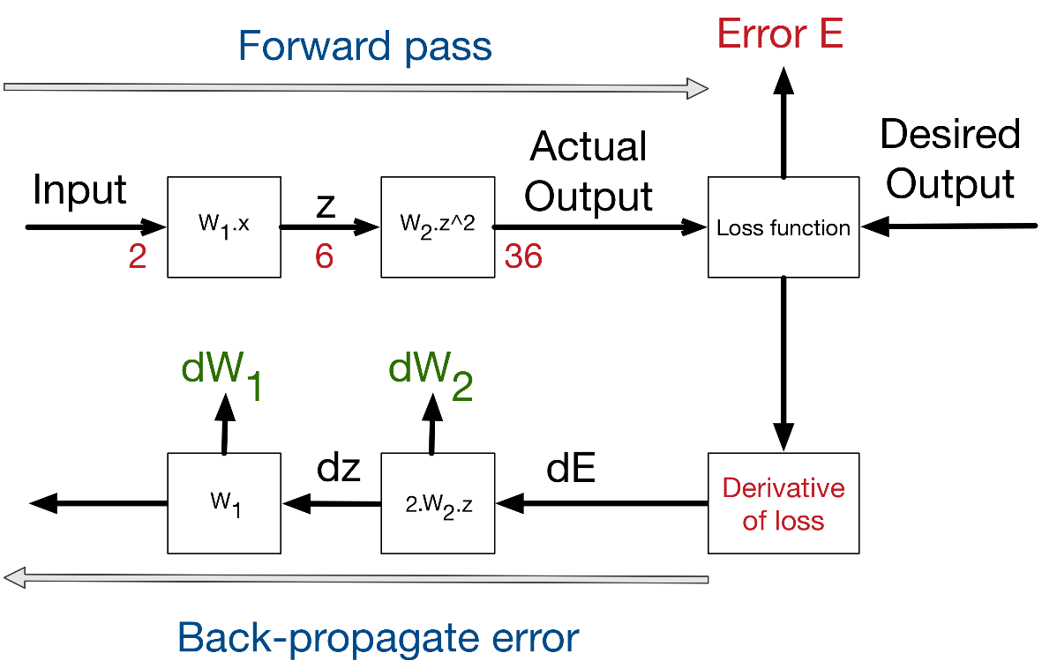
Building blocks
Neurons / networks
Loss function
Back propagation

Slide 8
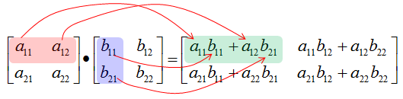
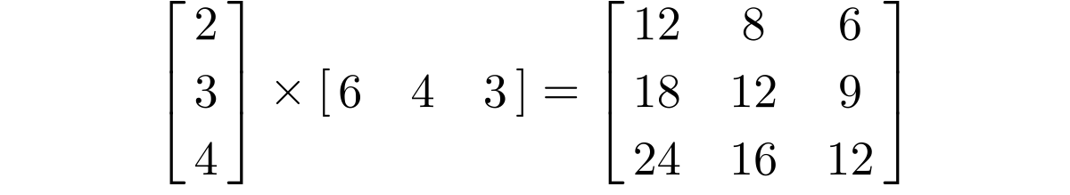
Recap: vectors
Row times column
Vectors to matrix

Slide 9
Building blocks
Software
Building blocks
Neurons
Loss functions
Back propagation
Practicalities
Architectures
Problems / questions

Slide 10
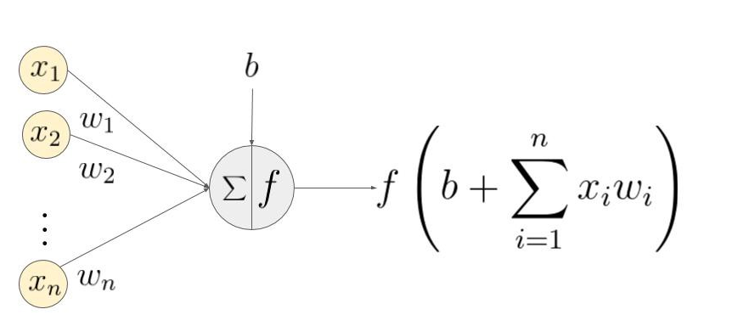
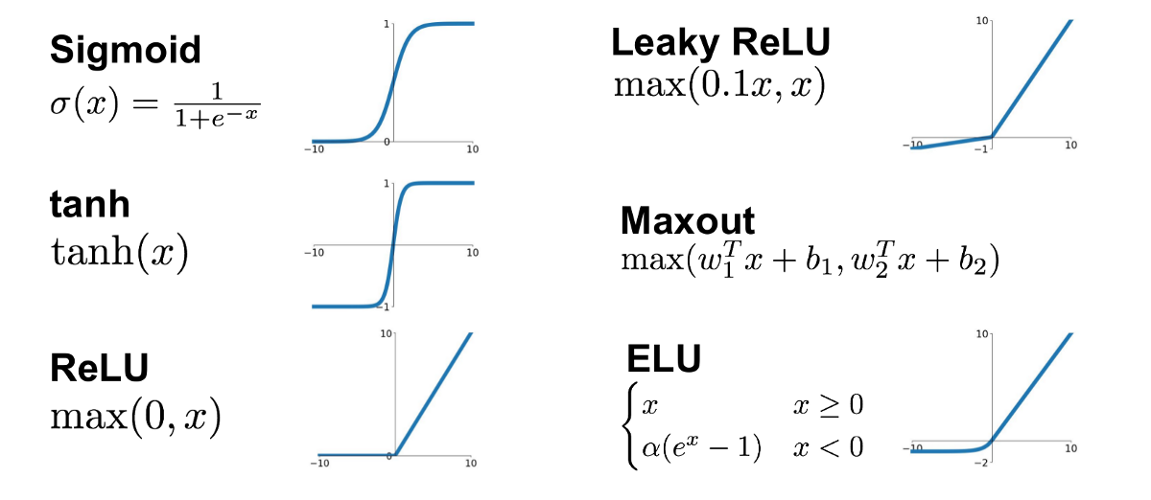

Building block: neuron
Data transformer: input → output
Activation function (Input * Weight + Bias)
Vectors → $Y =f\left(X ∙W+b\right)$
Non-linear
$$y={f(w}_{1}x_{1}+w_{2}x_{2}+…{+ w}_{n}x_{n}+b)$$

Slide 11
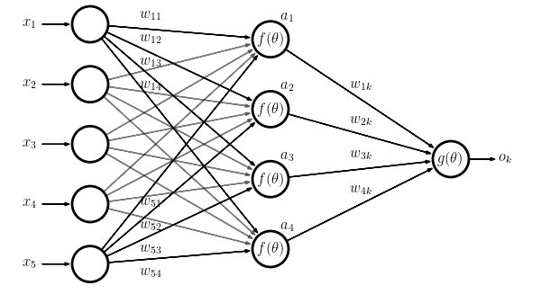
Building block: Neural Network
W1
Network of neurons
b1
b2
b3
b4
W4
X

Slide 12
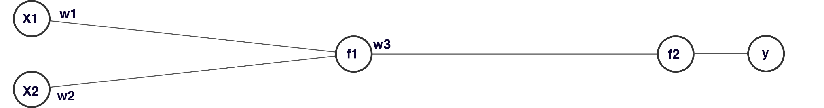

Neural Network – example1
$$y=f_{2}\left( f_{1}\left( x_{1}w_{1}+x_{2}w_{2}+ b_{1 }\right)w_{3}+b_{2}\right)$$
$$y=f_{2}\left(f_{1}(WX+B_{1}\right)w_{3}+B_{2})$$
$$W=\left[w_{1}, w_{2}\right], X=[x_{1};x_{2}]$$

Slide 13
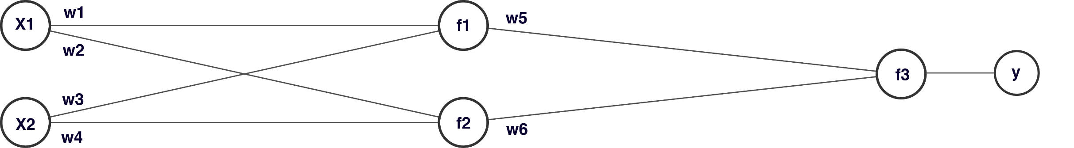

Neural Network – example2
$$y=f_{3}\left( f_{1}\left( x_{1}w_{1}+x_{2}w_{2}+ b_{1 }\right)w_{5}+f_{1}\left( x_{1}w_{3}+x_{2}w_{4}+ b_{2} \right)w_{6}+ b_{3}\right)$$
$$y=f_{3}\left(f_{1}\left(X_{1}W_{1}+B_{1}\right)w_{5}+f_{1}\left(XW_{2}+B_{2}\right)w_{6}+B_{3}\right) \\ W_{1}\left[w_{1},w_{2}\right], X=\left[x_{1};x_{2}\right], W_{2}=\left[w_{3},w_{4}\right]$$

Slide 14
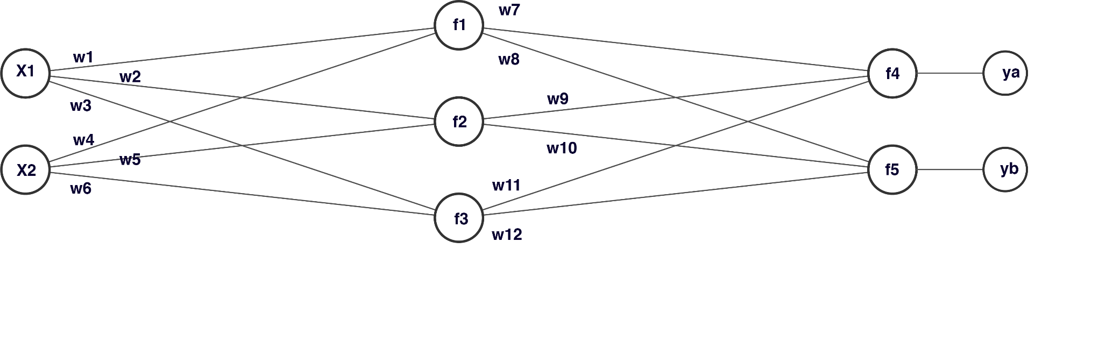
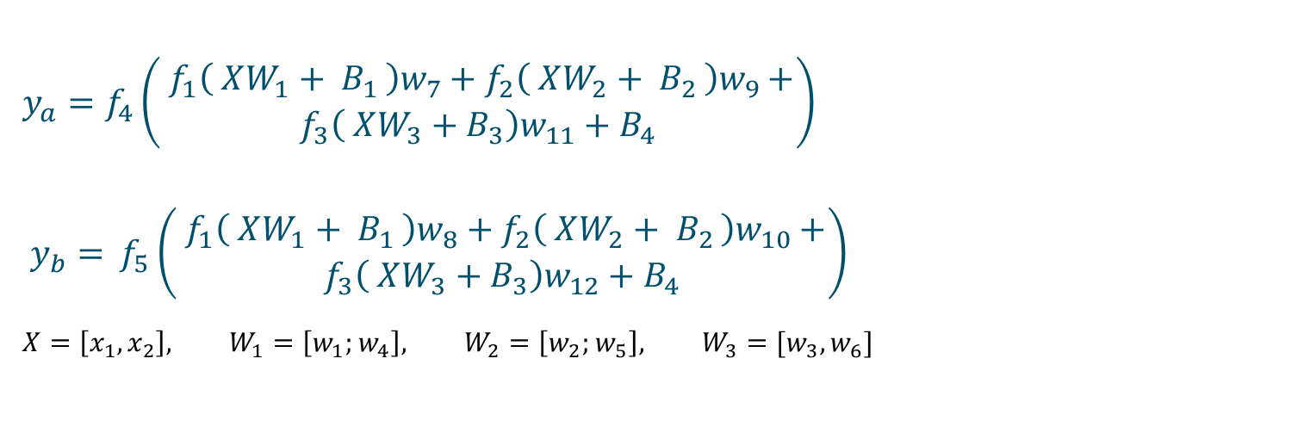
Neural Network – example3
$$y_{a}=f_{4}\left(\begin{aligned} f_{1}\left( XW_{1}+ B_{1 }\right)w_{7}+f_{2}\left( XW_{2}+ B_{2 }\right)w_{9}+ \\ {f_{3}\left( XW_{3}+B_{3}\right)w}_{11}+B_{4}\end{aligned}\right)$$
$y_{b}=$ $f_{5}\left(\begin{aligned} f_{1}\left( XW_{1}+ B_{1 }\right)w_{8}+f_{2}\left( XW_{2}+ B_{2 }\right)w_{10}+ \\ {f_{3}\left( XW_{3}+B_{3}\right)w}_{12}+B_{4}\end{aligned}\right)$
$$X=\left[x_{1},x_{2}\right], W_{1}=\left[w_{1};w_{4}\right], W_{2}=\left[w_{2};w_{5}\right], W_{3}=[w_{3}, w_{6}]$$

Slide 15
Building blocks
Software
Building blocks
Neurons
Loss functions
Back propagation
Practicalities
Architectures
Problems / questions

Slide 16
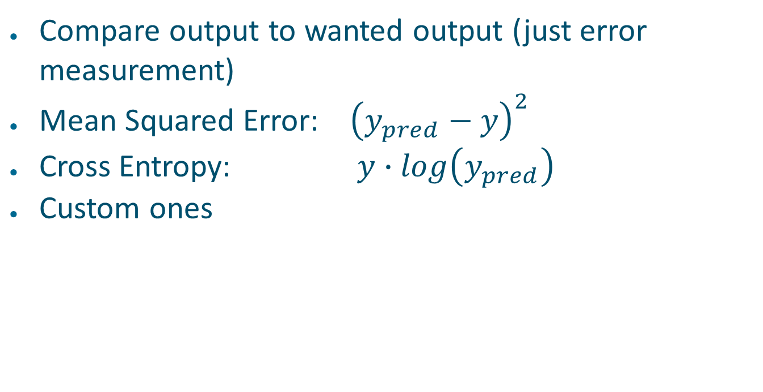
Loss function
Compare output to wanted output (just error measurement)
Mean Squared Error: ${\left(y_{pred}−y\right)}^{2}$
Cross Entropy: $y∙log\left(y_{pred}\right)$
Custom ones

Slide 17
Building blocks
Software
Building blocks
Neurons
Loss functions
Back propagation
Practicalities
Architectures
Problems / questions

Slide 18
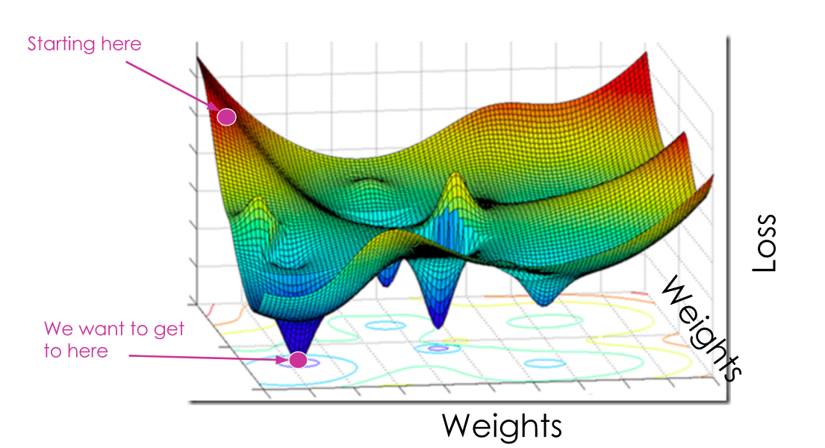
Back propagation
Relate loss to weights
Differentiate loss on weights
Partial derivatives
Image: medium.com
Notes:
18

Slide 19
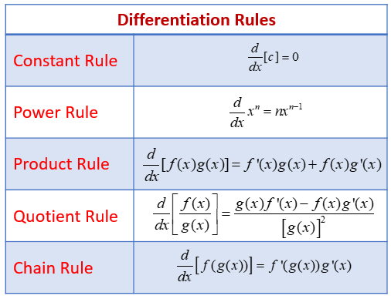

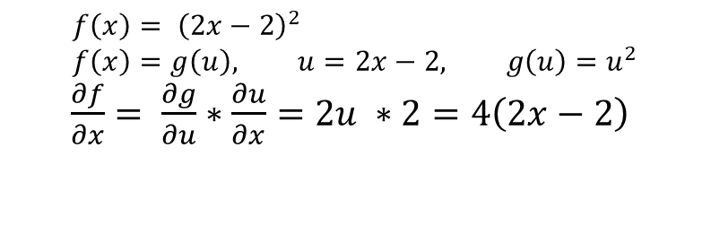
Recap: Differentiation
$$f\left(x\right)= {\left(2x−2\right)}^{2} \\ f\left(x\right)=g\left(u\right), u=2x−2, g\left(u\right)=u^{2}$$ $\frac{∂f}{∂x}= \frac{∂g}{∂u}∗\frac{∂u}{∂x}=2u ∗2=4\left(2x−2\right)$
Notes:
19

Slide 20
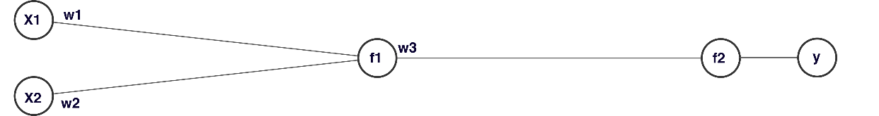

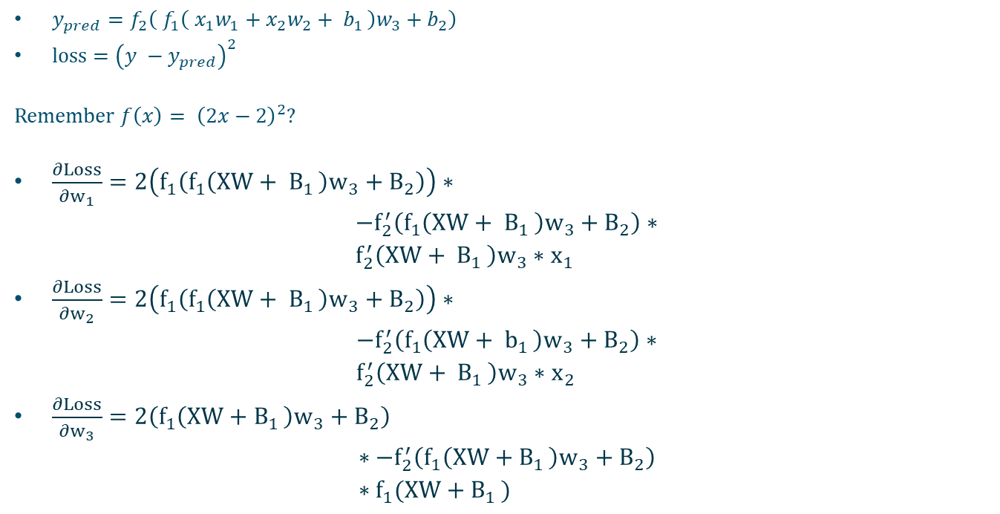
Backpropagation - example
$y_{pred}=f_{2}\left( f_{1}\left( x_{1}w_{1}+x_{2}w_{2}+ b_{1 }\right)w_{3}+b_{2}\right)$
loss $={\left(y −y_{pred}\right)}^{2}$
Remember $f\left(x\right)= {\left(2x−2\right)}^{2}$?
$\frac{∂Loss}{∂w_{1}}=2\left(f_{1}\left(f_{1}\left(XW+ B_{1 }\right)w_{3}+B_{2}\right)\right)∗$ $−f_{2}^{′}\left(f_{1}\left(XW+ B_{1 }\right)w_{3}+B_{2}\right)∗$ $f_{2}^{′}\left(XW+ B_{1 }\right)w_{3}∗x_{1}$
$\frac{∂Loss}{∂w_{2}}=2\left(f_{1}\left(f_{1}\left(XW+ B_{1 }\right)w_{3}+B_{2}\right)\right)∗$ $−f_{2}^{′}\left(f_{1}\left(XW+ b_{1 }\right)w_{3}+B_{2}\right)∗$ $f_{2}^{′}\left(XW+ B_{1 }\right)w_{3}∗x_{2}$
$\frac{∂Loss}{∂w_{3}}=2\left(f_{1}\left(XW+B_{1 }\right)w_{3}+B_{2}\right)$ $∗−f_{2}^{′}\left(f_{1}\left(XW+B_{1 }\right)w_{3}+B_{2}\right)$ $∗f_{1}(XW+B_{1 })$
$$W=\left[w_{1}, w_{2}\right], X=[x_{1};x_{2}]$$

Slide 21
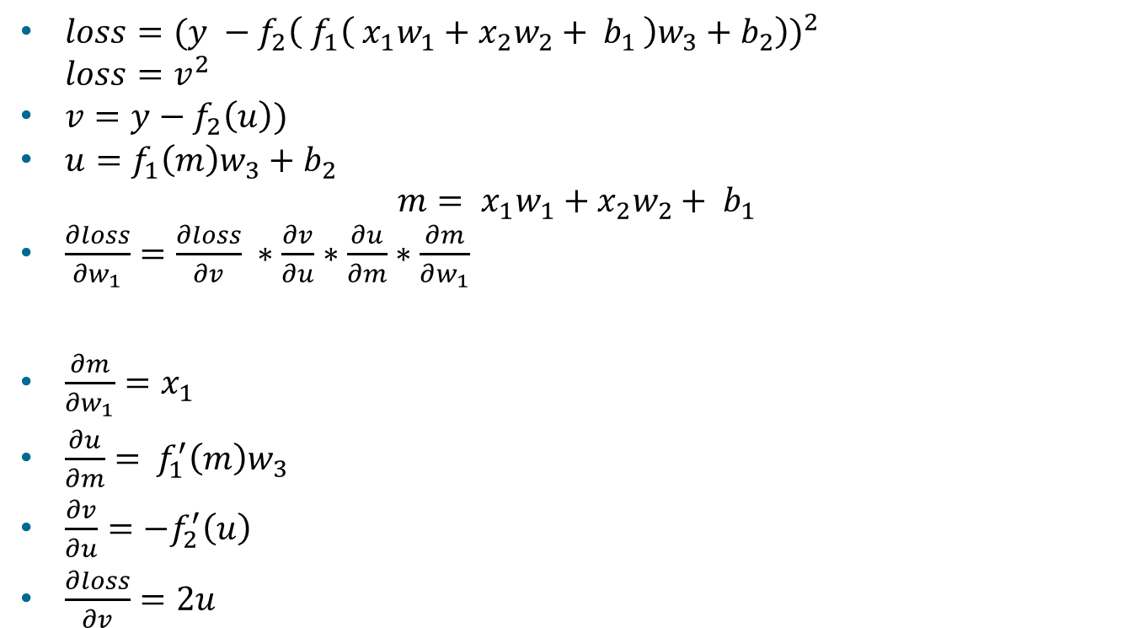
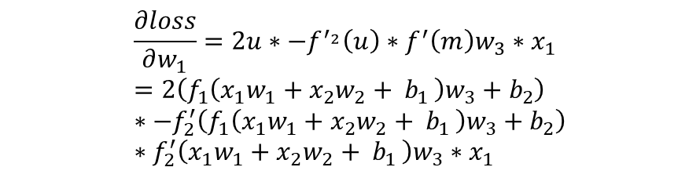
W1 derivative
$loss={(y −f}_{2}{\left( f_{1}\left( x_{1}w_{1}+x_{2}w_{2}+ b_{1 }\right)w_{3}+b_{2}\right))}^{2}$ $loss=v^{2}$
$v={y−f_{2}\left(u\right))}^{ }$
$u=f_{1}\left(m\right)w_{3}+b_{2}$ $m= {x_{1}w}_{1}+x_{2}w_{2}+ b_{1 }$
$\frac{∂loss}{∂w_{1}}=\frac{∂loss}{∂v} ∗\frac{∂v}{∂u}∗\frac{∂u}{∂m}∗\frac{∂m}{∂w_{1}}$
$\frac{∂m}{∂w_{1}}=x_{1}$
$\frac{∂u}{∂m}=$ $f_{1}^{′}\left(m\right)w_{3}$
$\frac{∂v}{∂u}=−f_{2}^{′}\left(u\right)$
$\frac{∂loss}{∂v}=2u$
$$\frac{∂loss}{∂w_{1}}=2u∗−f^{′_{2}}\left(u\right)∗f^{′}\left(m\right)w_{3}∗x_{1} \\ =2\left(f_{1}\left({x_{1}w}_{1}+x_{2}w_{2}+ b_{1 }\right)w_{3}+b_{2}\right)∗−f_{2}^{′}\left(f_{1}\left({x_{1}w}_{1}+x_{2}w_{2}+ b_{1 }\right)w_{3}+b_{2}\right)∗f_{2}^{′}\left({x_{1}w}_{1}+x_{2}w_{2}+ b_{1 }\right)w_{3}∗x_{1}$$

Slide 22
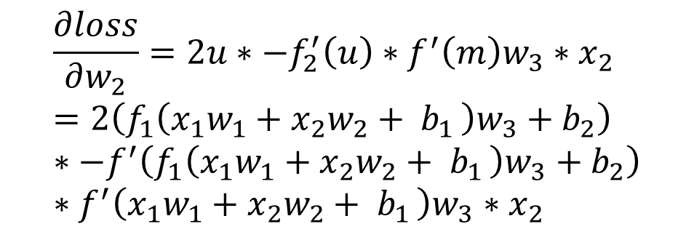
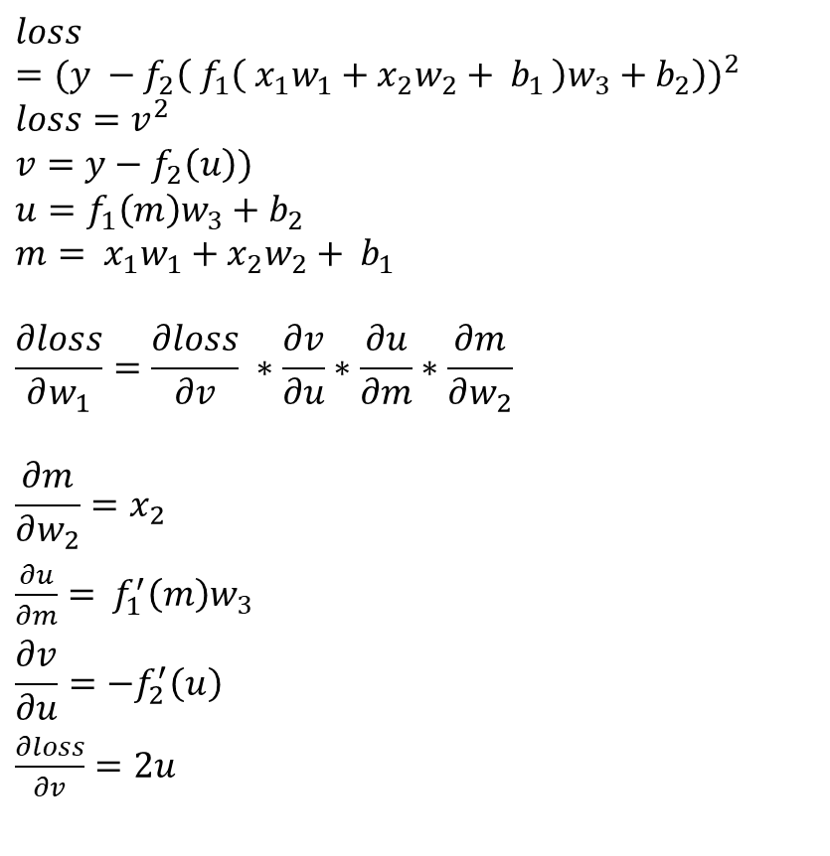
W2 derivative
$$loss={(y −f}_{2}{\left( f_{1}\left( x_{1}w_{1}+x_{2}w_{2}+ b_{1 }\right)w_{3}+b_{2}\right))}^{2}$$ $loss=v^{2}$
$$v={y−f_{2}\left(u\right))}^{ }$$
$$u=f_{1}\left(m\right)w_{3}+b_{2} \\ m= {x_{1}w}_{1}+x_{2}w_{2}+ b_{1 }$$
$$\frac{∂loss}{∂w_{1}}=\frac{∂loss}{∂v} ∗\frac{∂v}{∂u}∗\frac{∂u}{∂m}∗\frac{∂m}{∂w_{2}}$$
$$\frac{∂m}{∂w_{2}}=x_{2}$$
$\frac{∂u}{∂m}=$ $f_{1}^{′}\left(m\right)w_{3}$
$$\frac{∂v}{∂u}=−f_{2}^{′}\left(u\right)$$
$\frac{∂loss}{∂v}=2u$
$$\frac{∂loss}{∂w_{2}}=2u∗−f_{2}^{′}\left(u\right)∗f^{′}\left(m\right)w_{3}∗x_{2} \\ =2\left(f_{1}\left({x_{1}w}_{1}+x_{2}w_{2}+ b_{1 }\right)w_{3}+b_{2}\right)∗−f^{′}\left(f_{1}\left({x_{1}w}_{1}+x_{2}w_{2}+ b_{1 }\right)w_{3}+b_{2}\right)∗f^{′}\left({x_{1}w}_{1}+x_{2}w_{2}+ b_{1 }\right)w_{3}∗x_{2}$$

Slide 23
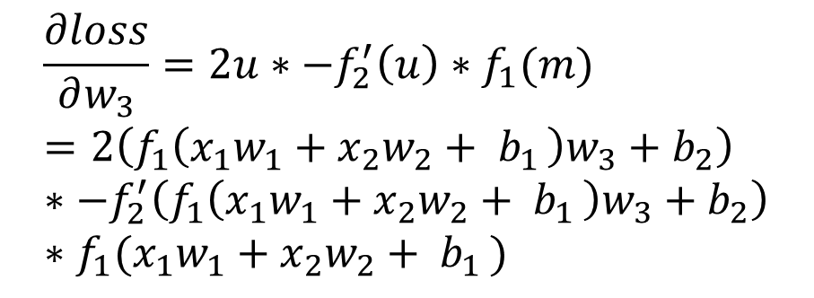
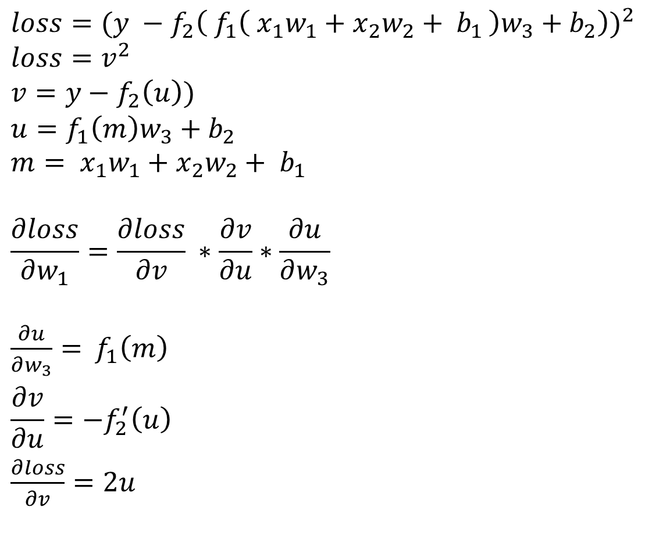
W3 derivative
$$loss={(y −f}_{2}{\left( f_{1}\left( x_{1}w_{1}+x_{2}w_{2}+ b_{1 }\right)w_{3}+b_{2}\right))}^{2}$$ $loss=v^{2}$
$$v={y−f_{2}\left(u\right))}^{ }$$
$$u=f_{1}\left(m\right)w_{3}+b_{2} \\ m= {x_{1}w}_{1}+x_{2}w_{2}+ b_{1 }$$
$$\frac{∂loss}{∂w_{1}}=\frac{∂loss}{∂v} ∗\frac{∂v}{∂u}∗\frac{∂u}{∂w_{3}}$$
$\frac{∂u}{∂w_{3}}=$ $f_{1}\left(m\right)$
$$\frac{∂v}{∂u}=−f_{2}^{′}\left(u\right)$$
$\frac{∂loss}{∂v}=2u$
$$\frac{∂loss}{∂w_{3}}=2u∗−f_{2}^{′}\left(u\right)∗f_{1}(m) \\ =2\left(f_{1}\left({x_{1}w}_{1}+x_{2}w_{2}+ b_{1 }\right)w_{3}+b_{2}\right)∗−f_{2}^{′}\left(f_{1}\left({x_{1}w}_{1}+x_{2}w_{2}+ b_{1 }\right)w_{3}+b_{2}\right) \\ ∗f_{1}({x_{1}w}_{1}+x_{2}w_{2}+ b_{1 })$$

Slide 24
Practicalities
Software
Building blocks
Neurons
Loss functions
Back propagation
Practicalities
Architectures
Problems / questions

Slide 25
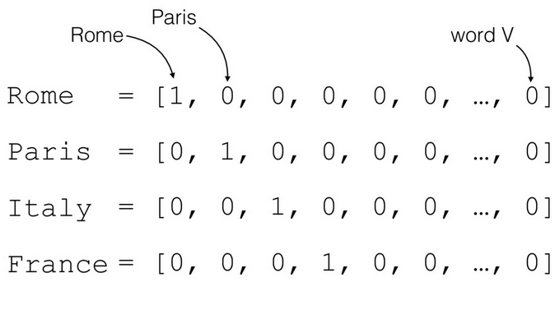
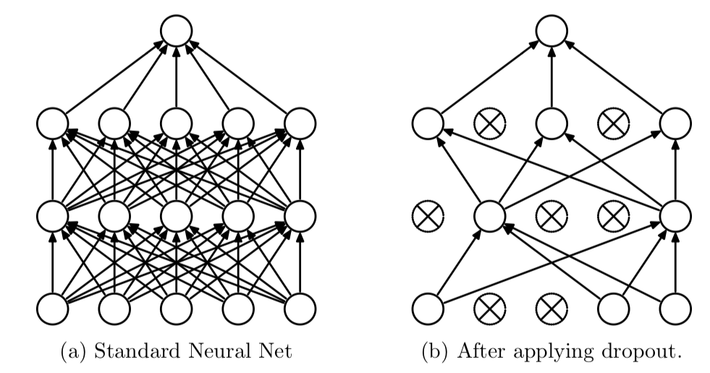
Practicalities
One hot encoding
Dropout
Batch normalization
Padding
Notes:
25

Slide 26
Architectures
Software
Building blocks
Neurons
Loss functions
Back propagation
Practicalities
Architectures
Problems / questions

Slide 27
Architectures
Fully Connected
Auto encoder
Recurrent Neural Network (RNN)
Convolutional Neural Network (CNN)
Generative Adversarial Network (GAN)
Notes:
27

Slide 28
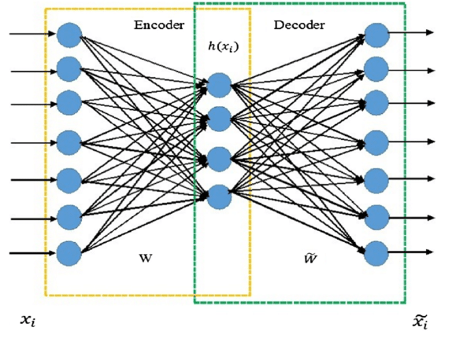
Auto encoder
Input = output
Compress data
Notes:
28

Slide 29
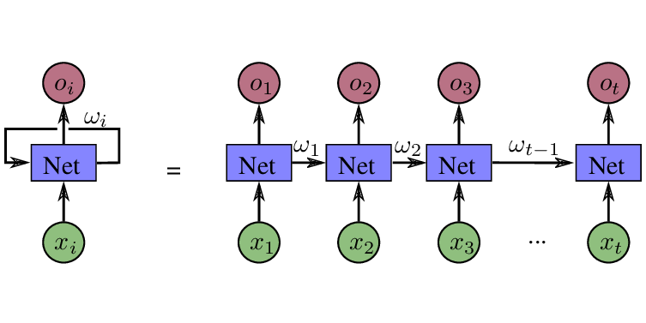
Recurrent neural network
Memory
Variable input length
Same amount of features!
Variable output length
Notes:
29

Slide 30
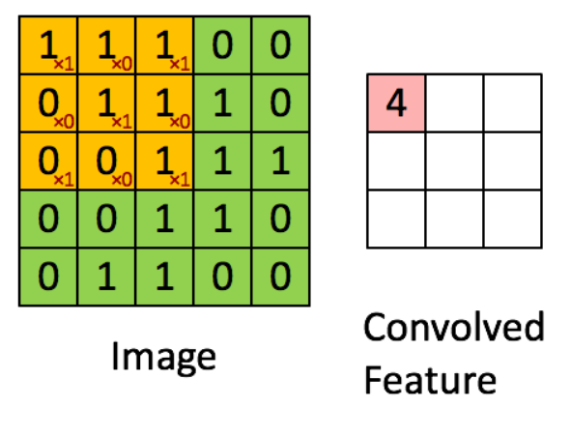
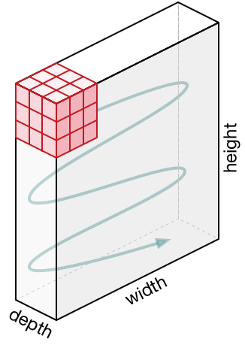
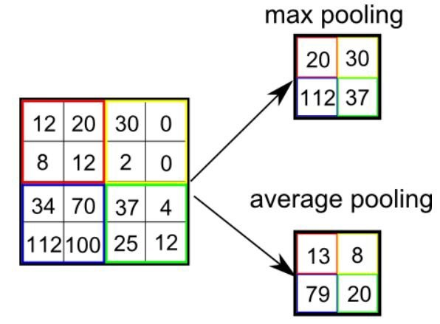
Convolutional neural network
Windows
Re-usable patterns
Depth = amount of filters
Pooling
https://towardsdatascience.com/a-comprehensive-guide-to-convolutional-neural-networks-the-eli5-way-3bd2b1164a53
Notes:
30

Slide 31

Convolutional neural network
Filters on filters
New data representation
https://towardsdatascience.com/a-comprehensive-guide-to-convolutional-neural-networks-the-eli5-way-3bd2b1164a53
Notes:
31

Slide 32
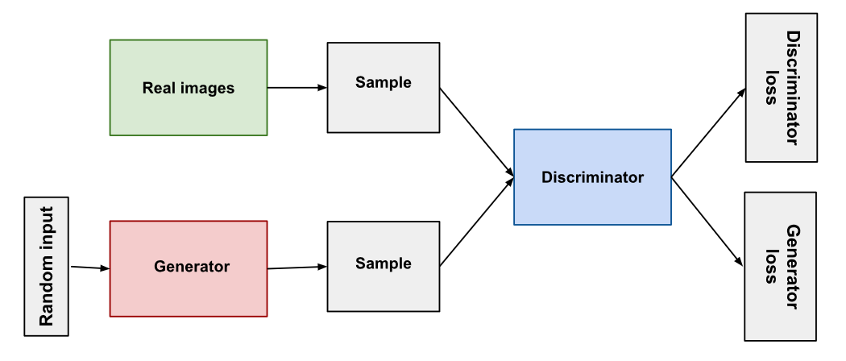
GANS
Network vs network
Notes:
32

Slide 33
Problems / questions
Software
Building blocks
Neurons
Loss functions
Back propagation
Practicalities
Architectures
Problems / questions

Slide 34
Problems
Get right input (represent features)
Get good loss function (no problem vs youre welcome)
Check output (no shortcuts? Overfitting?)
Get good architecture
Need domain knowledge
Notes:
34

Slide 35
Further reading
Links I used:
https://leonardoaraujosantos.gitbooks.io/artificial-inteligence/content/
https://towardsdatascience.com/getting-started-with-pytorch-part-1-understanding-how-automatic-differentiation-works-5008282073ec
https://www.digitalvidya.com/blog/types-of-neural-networks/
https://blog.floydhub.com/long-short-term-memory-from-zero-to-hero-with-pytorch
https://towardsdatascience.com/illustrated-guide-to-lstms-and-gru-s-a-step-by-step-explanation-44e9eb85bf21
https://blog.floydhub.com/gru-with-pytorch/
https://towardsdatascience.com/understanding-gru-networks-2ef37df6c9be
https://medium.com/udacity-pytorch-challengers/a-brief-overview-of-loss-functions-in-pytorch-c0ddb78068f7
https://playground.tensorflow.org/
Papers:
“Convolutional Neural Network Architectures for Matching Natural Language Sentences”
“Deep Visual-Semantic Alignments for Generating Image Descriptions”
Papers by D.T. Rademaker

Slide 36
Questions

