Slide 1
Workshop deep learning
Jarek van Dijk
20-03-2020
Follow up on background presentation

Slide 2
Goal of workshop
Get some hand on experience
Know where to start with your own project
Less magic, more understanding

Slide 3
Overview
Getting started
Python/Pytorch
Tensors: core of pytorch
Building a ‘network’
Linear layer
Activation function
Batchnorm
Dropout
Softmax
Loss function
Optimizer
Build a network
Fully connected network
Recurrent network
Convolution network

Slide 4
Getting started

Slide 5
Pytorch
Python 3
https://pytorch.org/get-started/locally/
pip install torch torchvision
conda install pytorch torchvision -c pytorch

Slide 6
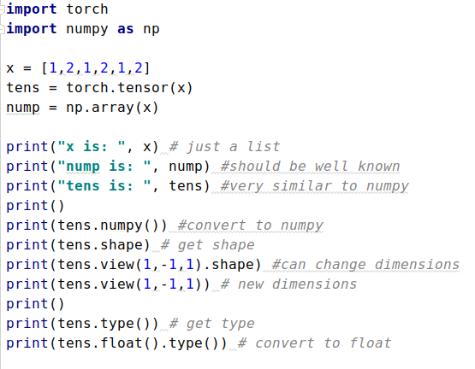
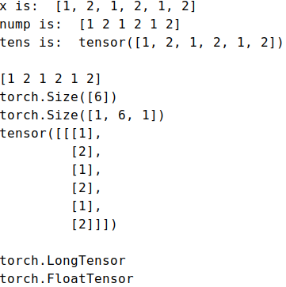
Tensors
Pytorch works with tensors
Just like numpy or a list
Can easily swap between numpy and tensor

Slide 7
(over)Train a layer

Slide 8
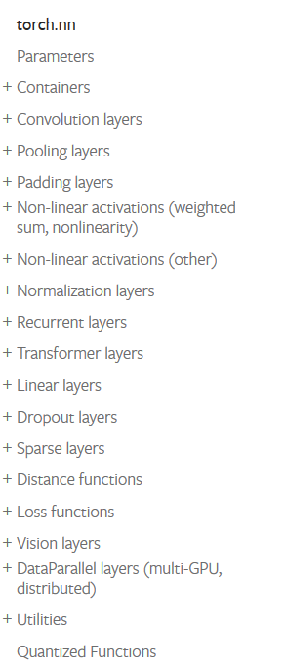
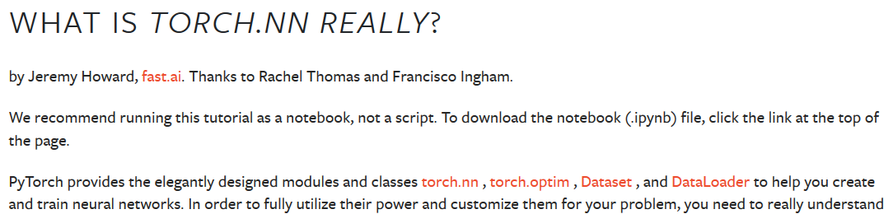
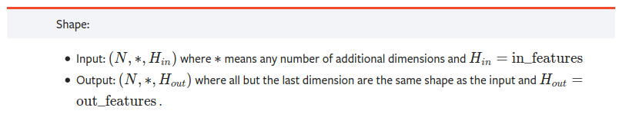
Torch.nn

Slide 9
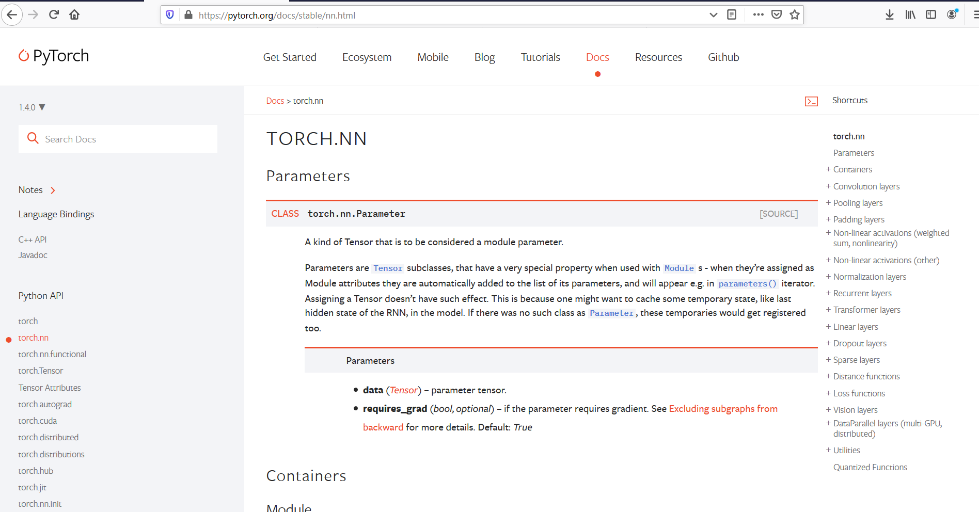
Torch.nn

Slide 10
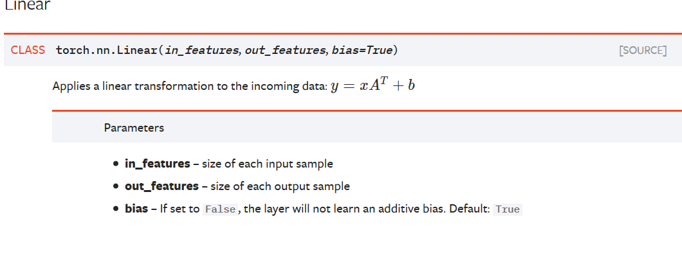
Torch.nn.Linear
Torch.nn (build a basic network)
Linear
Activation functions
Batchnorm
Dropout
Softmax
Loss
Optimizer

Slide 11
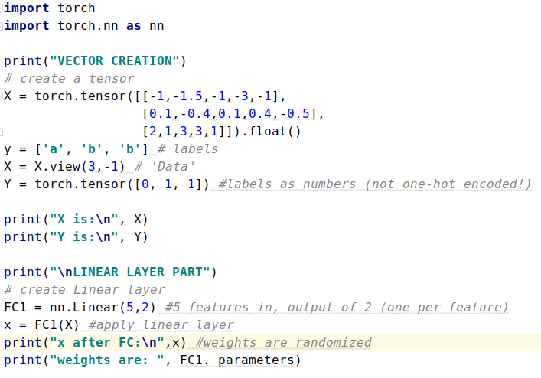
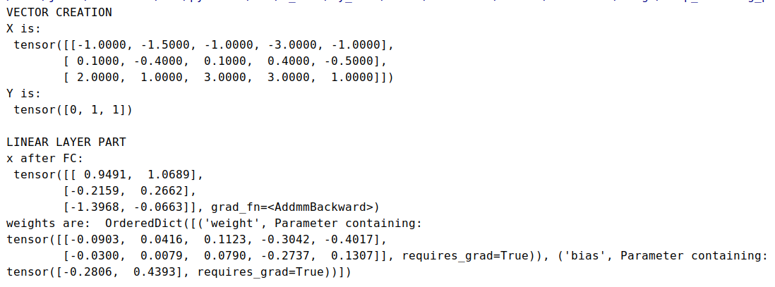
Torch.nn.Linear

Slide 12
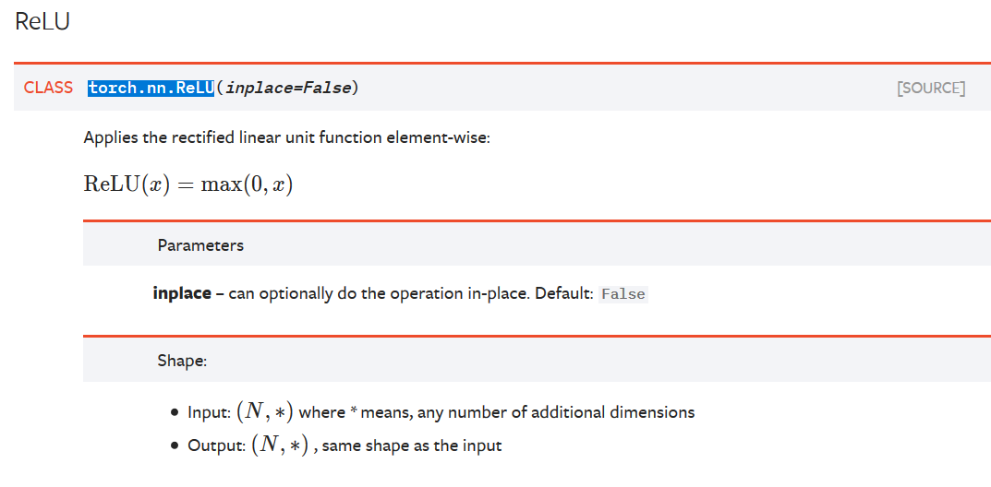
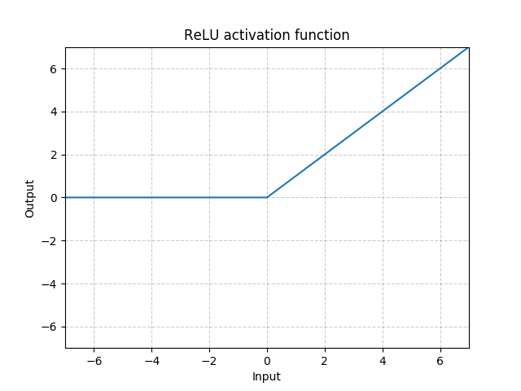
Torch.nn.ReLU
Torch.nn (build a basic network)
Linear
Activation function
Batchnorm
Dropout
Softmax
Loss
Optimizer

Slide 13
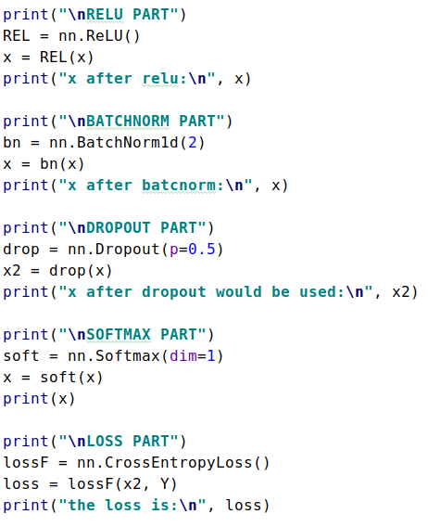
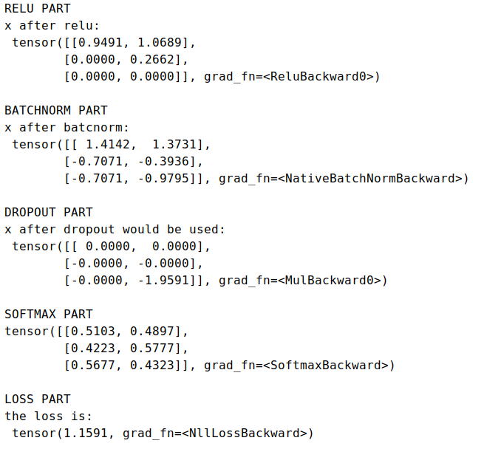
Torch.nn.ReLU

Slide 14
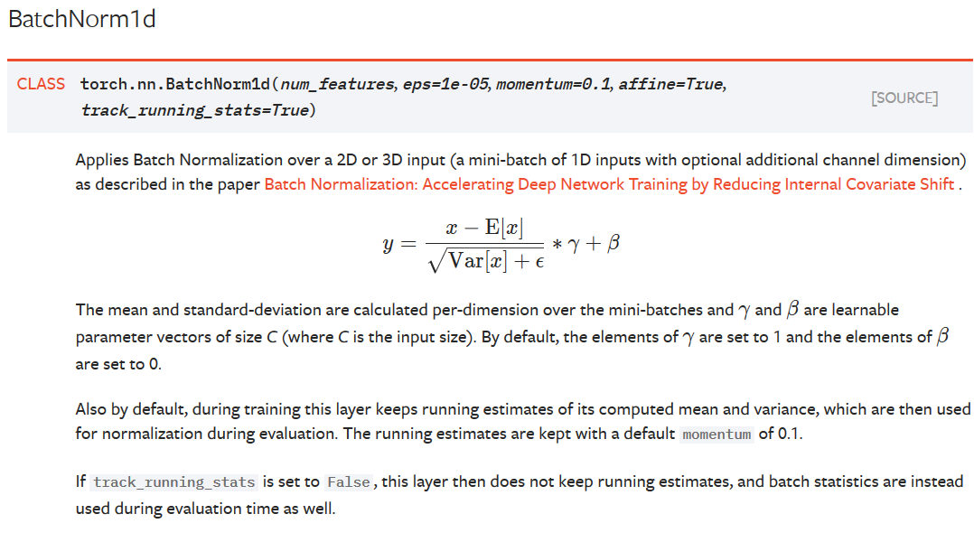
Torch.nn.Batchnorm1D
Torch.nn (build a basic network)
Linear
Activation functions
Batchnorm
Dropout
Softmax
Loss
Optimizer

Slide 15
Torch.nn.Batchnorm1D

Slide 16
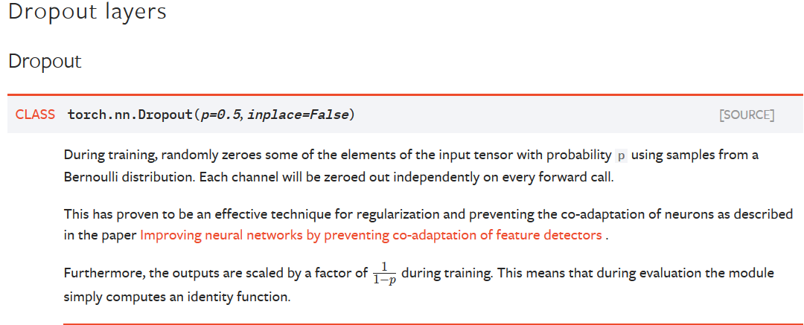
Torch.nn.Dropout
Torch.nn (build a basic network)
Linear
Activation functions
Batchnorm
Dropout
Softmax
Loss
Optimizer

Slide 17
Torch.nn.Dropout

Slide 18
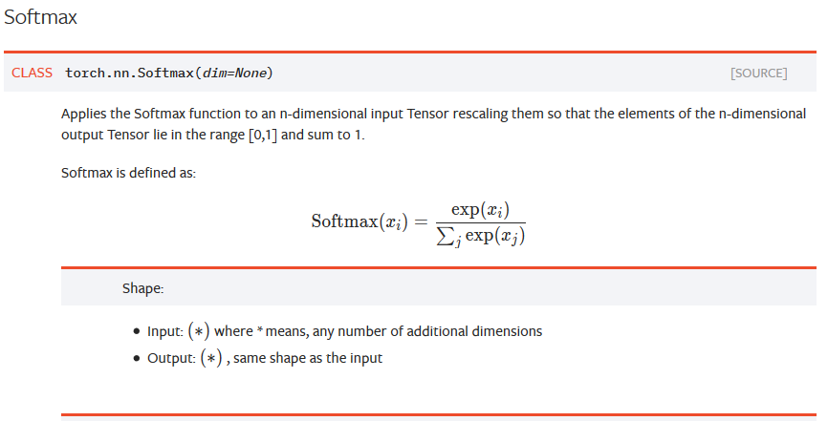
Torch.nn.Softmax
Torch.nn (build a basic network)
Linear
Activation functions
Batchnorm
Dropout
Softmax
Loss
Optimizer

Slide 19
Torch.nn.Softmax
19

Slide 20
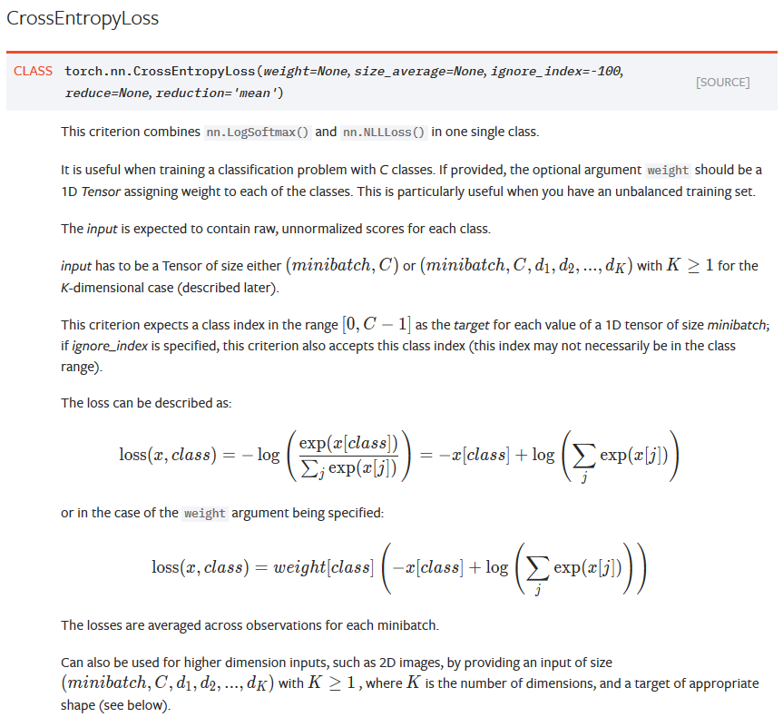
Torch.nn.CrossEntropyLoss
Torch.nn (build a basic network)
Linear
Activation functions
Batchnorm
Dropout
Loss
Optimizer

Slide 21
Torch.nn.CrossEntropyLoss

Slide 22
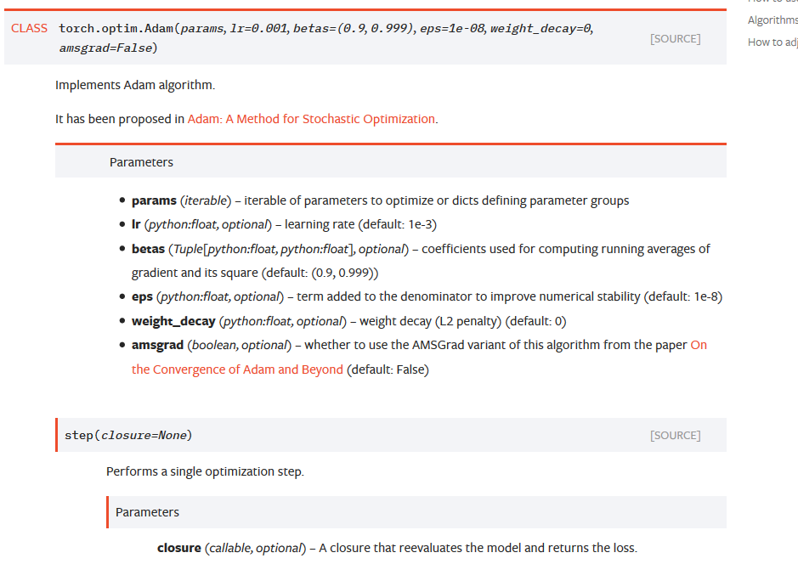
Torch.optim.Adam
Torch.nn (build a basic network)
Linear
Activation functions
Batchnorm
Dropout
Softmax
Loss
Optimizer

Slide 23
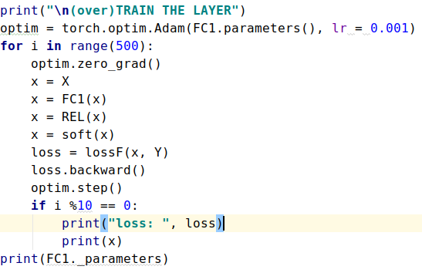
Torch.optim.Adam

Slide 24
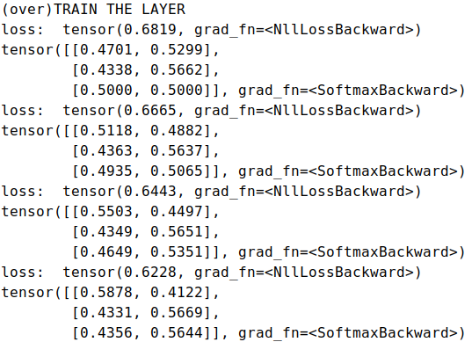
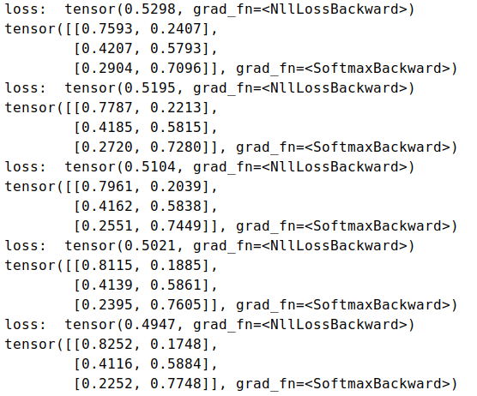
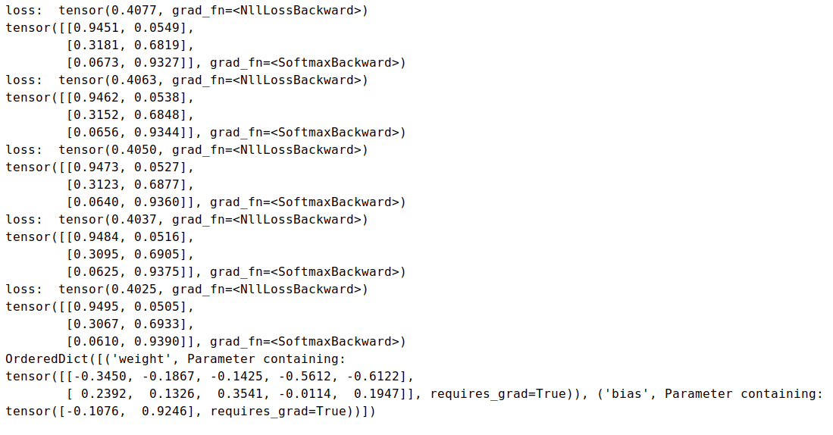

Slide 25
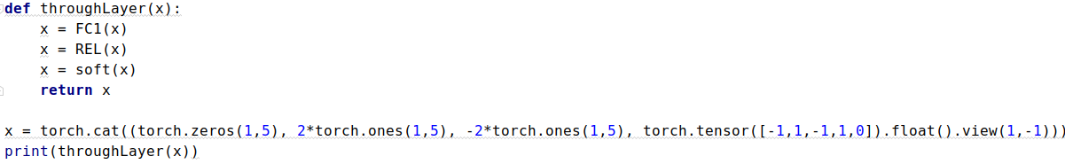
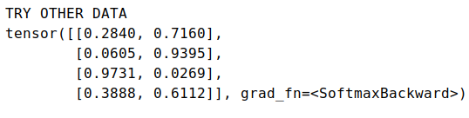

Slide 26
Networks

Slide 27
Fully connected
As old: layer, activation, normalization
Real life: test, train and eval set
https://archive.ics.uci.edu/ml/datasets/Adult

Slide 28
Fully connected – wine dataset
Goal 1: classification of type
Goal 2: regression of quality

Slide 30
RNN
Build in functions exist
Add memory
No batchnorm (unless fancy)
30

Slide 31
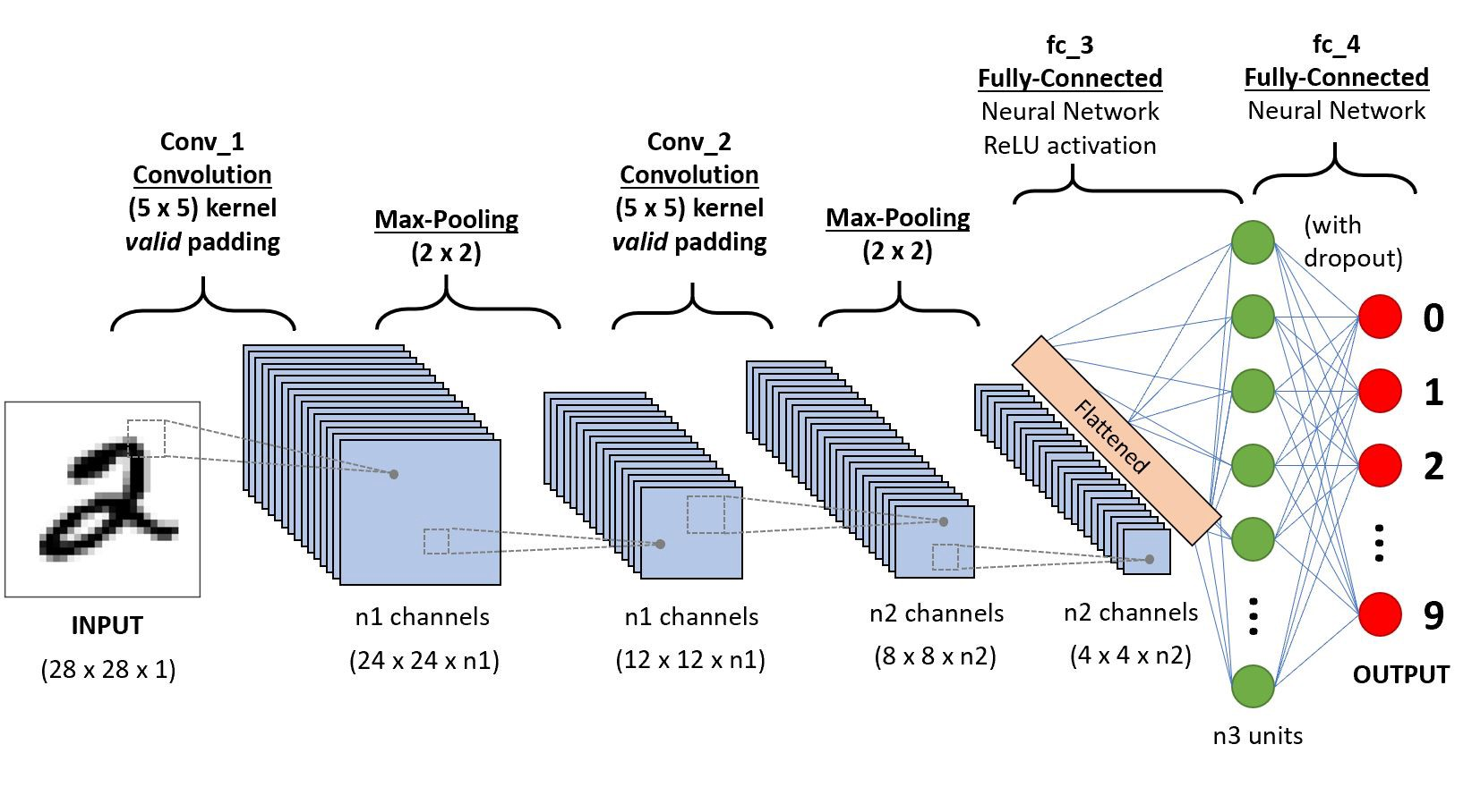
CNN
Windows over your data
Re-using filters
https://towardsdatascience.com/a-comprehensive-guide-to-convolutional-neural-networks-the-eli5-way-3bd2b1164a53
31

Slide 32
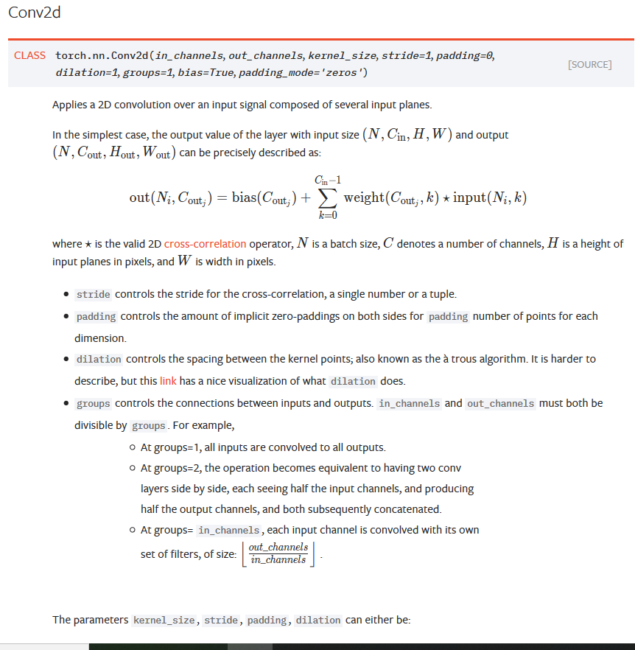
CNN
32

Slide 33
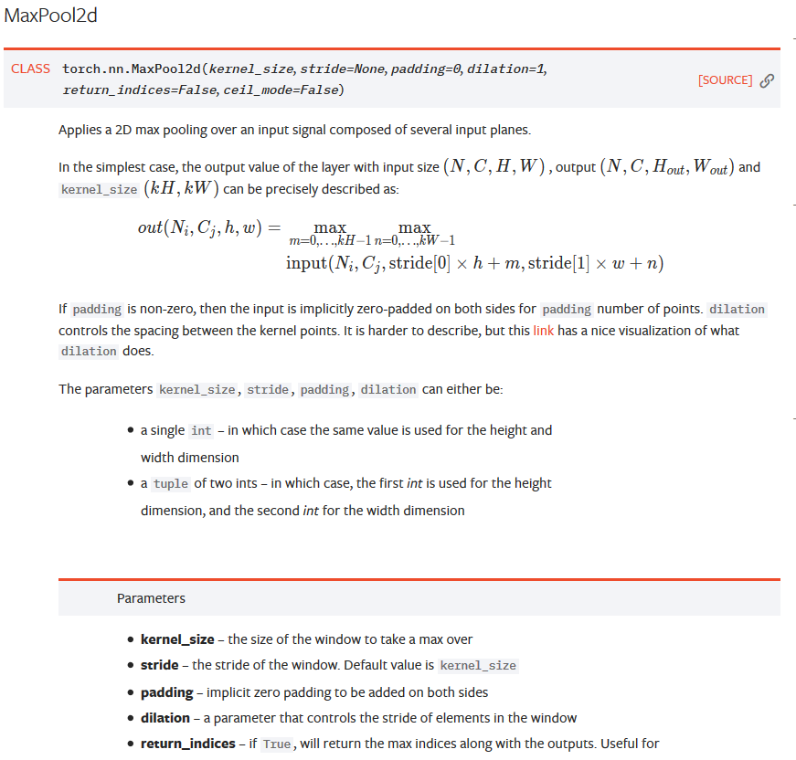
CNN
33

Slide 34
CNN - dataset
34

Slide 35
Take home
Layer, activation, normalization
Be creative
Try it out
Torch.nn.Functional
More datasets: https://archive.ics.uci.edu/ml/index.php
35

Slide 36
36

