Slide 1
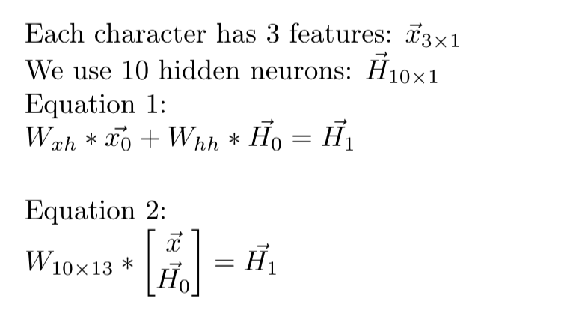
10 x 3 3 x 1 10 x 10 10 x 1 10 x 1
So Eq. 1 and Eq. 2 are equivalent and we optimize the same set of 130 parameters.

