Slide 1
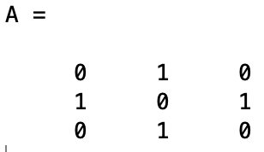
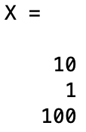
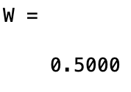
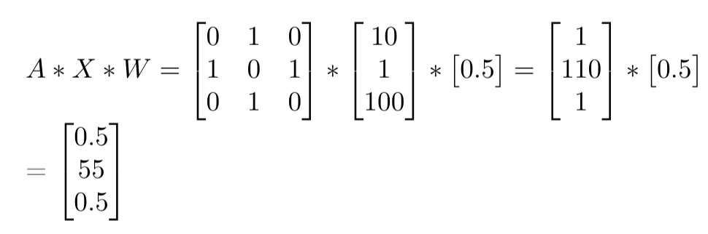
Scenario: each node has one feature
[1]
Feature for node 1
Feature for node 2
2
Feature for node 3
[10]
1
3
[100]
Sum of the neighbor nodes
The new feature of each node is the average of the neigh nodes
Note:
Input of a graph NN is a graph with n node, and the output is the same graph with updated node labels.
Each node has different number of unordered neighbors, thus a symmetric function is needed to integrate the neighbor info. Here, the symmetric function is the average function.
Other symmetric function could also be used.

Slide 2

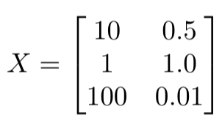
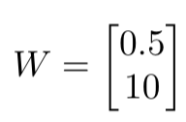
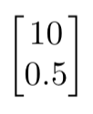
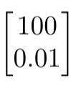
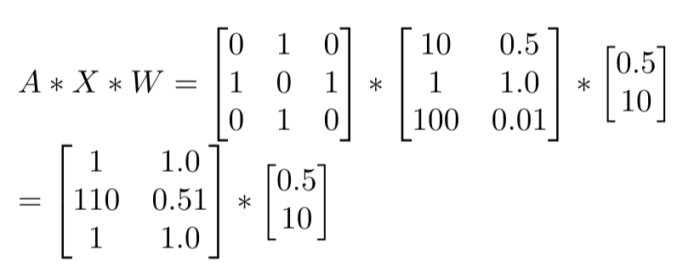
Scenario: each node has multiple features
Learnable parameters
F1
F2
Feature for node 1
weight for feature 1 (F1)
Feature for node 2
weight for feature 2 (F2)
2
Feature for node 3
1
3
The new features of each node then become weighted sum of F1 and F2 of the neighbor nodes
Sum of F1 of the neighbor nodes
Sum of F2 of the neighbor nodes
Note:
The new features of each node is the weighted sum of F1 and F2 of its neighbor nodes
The same feature share the same weight (because we want to deal with the unorderness of neighbors)
Different features have different weights (so that graph NN can try many different combinations of features)

