Slide 2
Cystic Fibrosis
Of 22, use:
GDS2111, GDS1941, GDS1844, GDS1843, GDS1469, GDS588, GDS567

Slide 3
Cytomegalovirus Infections
Of 7, GDS3547, GDS1530, GDS476, GDS177

Slide 4
Acanthosis Nigricans

Slide 5
Diabetic Nephropathies
5:
GDS961, GDS887

Slide 6
Diarrhea
4
GDS2048, GDS1516

Slide 7
Autoimmune Disease
Of 5 choose: GDS167, GDS3577, GDS828
Too few instances to make a model

Slide 8
Gastritis
4
GDS625, GDS2103, GDS3346

Slide 9
Graft Rejection
2
GDS999, GDS724

Slide 10
Helicobacter Infection
3
GDS3434, GDS3346, GDS625

Slide 11
Hypertension
40
GDS1011, GDS1251, GDS1264, GDS1372, GDS1464, GDS1928, GDS2070, GDS2172, GDS2361, GDS2710, GDS3018, GDS3074, GDS3109, GDS3483, GDS3661, GDS3689, GDS504, GDS574, GDS742, GDS859

Slide 12
Learning Disorders
3
GDS1111, GDS604

Slide 13
Lupus Erythematosus
4
GDS2460, GDS2013, GDS2012, GDS2011

Slide 14
Mitochondrial Disease
5
GDS3452, GDS1065, GDS3616

Slide 15
Multiple Myeloma
12
GDS3578, GDS2643, GDS2640, GDS2321, GDS1284, GDS1067, GDS5331
same

Slide 16
Myelodysplastic Syndrome
4
GDS2118, GDS1392

Slide 17
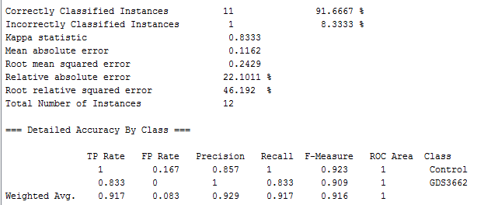
Myocardial Ischemia
2
GDS3662, GDS2772

Slide 18
Marfan Syndrome
5
GDS2960, GDS856, GDS244, GDS243, GDS242

Slide 19
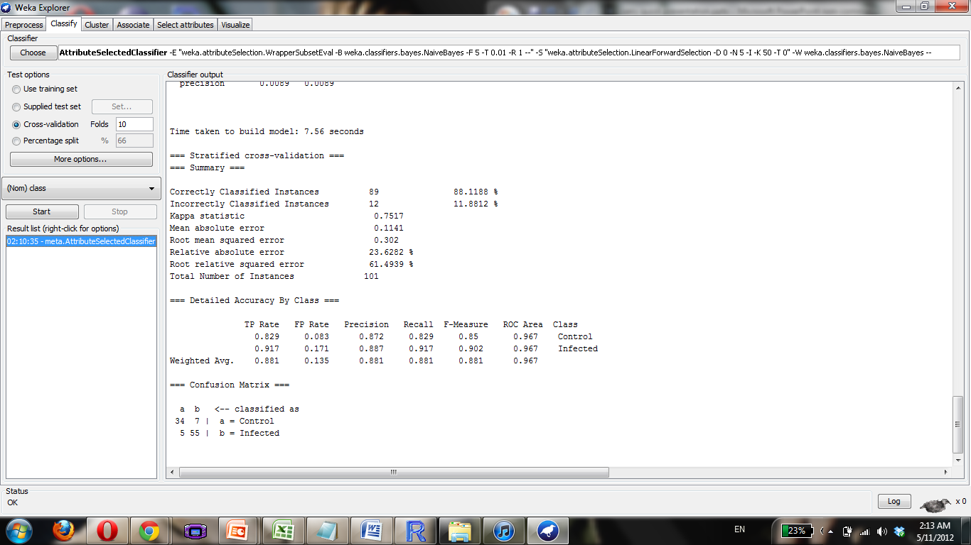
Marfam Syndrome -both

Slide 20
Autistic Disorder
Of 3 choose: GDS2824

Slide 21
Brain Neoplasm
Of 13 choose:
GDS1096, GDS1380, GDS1730, GDS1813, GDS1815, GDS1816, GDS1975, GDS1976, GDS2728
Nothing

Slide 22
Bronchitis
Of 2 Choose 2: GDS2535, GDS2372
System discarded 1, so multinet and singlenet same

Slide 23
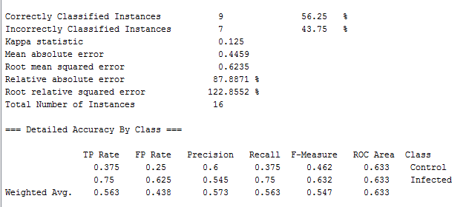
Bronchitis Singlenet

Slide 24
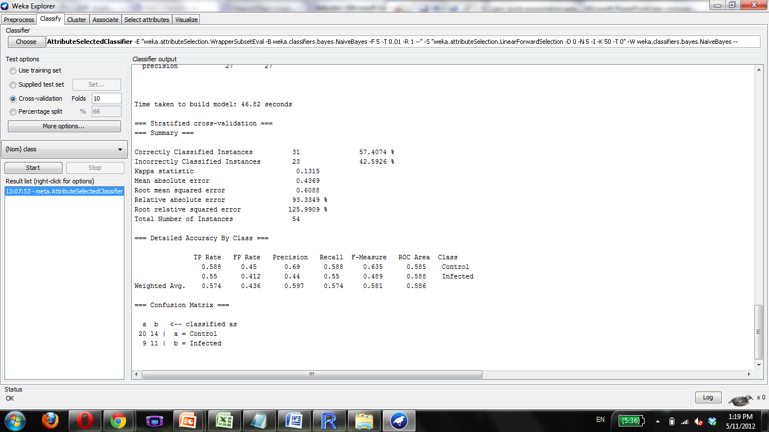

Slide 25
Carcinoma, Hepatocellular
Of 19 use: GDS1096, GDS2006, GDS2213, GDS274, GDS3087, GDS3091, GDS3148

Slide 26
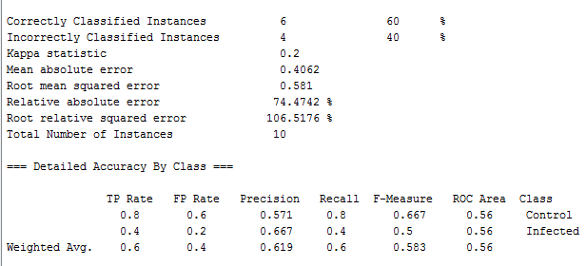
Carcinoma, Hepatocellular Singlenet

Slide 27
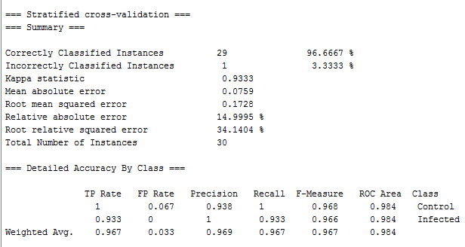
Autistic Disorder Singlenet

Slide 28
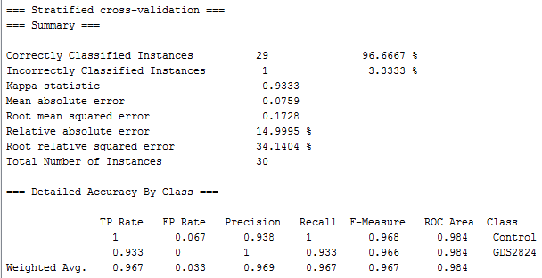
Autistic Disorder Mutlinet

Slide 29
Ataxia
7 possible, used all:
GDS3545, GDS3544, GDS2464, GDS2060, GDS1756, GDS1661, GDS1544
Nothing

Slide 30
Fibrosarcoma
3
GDS2007, GDS1209

Slide 31
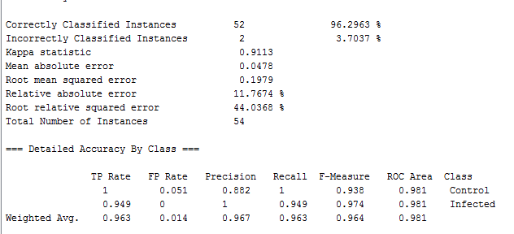
Fibrosarcoma Singlenet

Slide 32
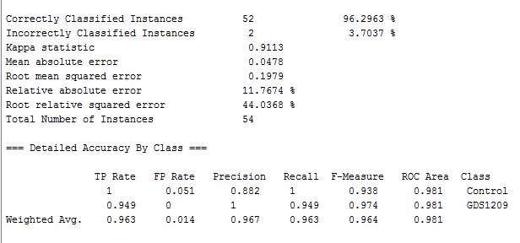
Fibrosarcoma Multinet

Slide 33
Influenza
6
GDS3595, GDS3522, GDS3188, GDS2762, GDS2165

Slide 34
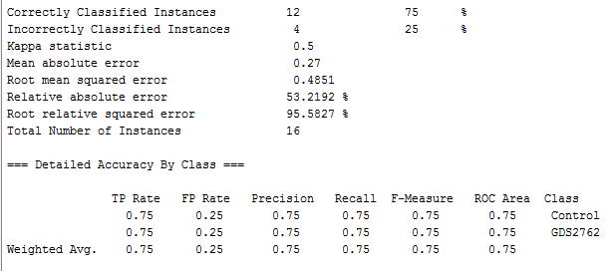
Influenza both

Slide 35
Infertility
47
GDS2923,

Slide 36
Pneumonia
20
GDS3573, GDS3522, GDS3393, GDS3360, GDS2651, GDS2650, GDS2165, GDS2023,

Slide 37
Prostatic Neoplasm
35
GDS3634, GDS3289, GDS3155, GDS3111, GDS3095, GDS2971, GDS2865, GDS2782, GDS2547, GDS2546, GDS2545, GDS2443, GDS2384, GDS2171, GDS2034, GDS1746

Slide 38
Pulmonary Disease, Chronic Obstructive
16
GDS2866, GDS1436, GDS1304, GDS737, GDS534, GDS289

Slide 39
Pulmonary Emphysema
9
GDS3548, GDS1874, GDS1269. GDS670, GDS244

Slide 40
Ovarian Neoplasm
9
GDS3592, GDS3297, GDS2975, GDS2963, GDS2785, GDS1523, GDS1381

Slide 41
Acute Disease
None possible! All taken out in pipeline

Slide 42
Adenocarcinoma
Also nothing

Slide 43
Adenoma
Also nothing!

Slide 44
Carcinoma, Adenoid Cystic
Of 1 choose 1: GDS2193
nothing

Slide 45
Carcinoma, Basal Cell
Of 1 choose 1: GDS1477
Nothing

Slide 46
Carcinoma, Ductal
Of 3 choose: GDS2046, GDS2045
Nothing

Slide 47
Carcinoma, Non-Small-Cell Lung
Of 10 choose:
GDS3101, GDS2902, GDS2777, GDS2705, GDS2358, GDS2298, GDS2297, GDS1772, GDS1761
Not enough data for weka

Slide 48
Carcinoma, Renal Cell
Of 12 choose: GDS3603, GDGS3274, GDS2881, GDS2880, GDS2860, GDS1772, GDS1344, GDS507, GDS505
nothing

