Slide 1
Scenario Week 3
Team L

Slide 2
Research
Lynda course: “Amazon Web Services Essential Training”
Django for creating the web app
Bootstrap for the front-end
Bash scripting for server-side automation

Slide 3
Best practices for Cloud Web Services
Design for failure
Implement elasticity
Decouple components
Keep things secure

Slide 4
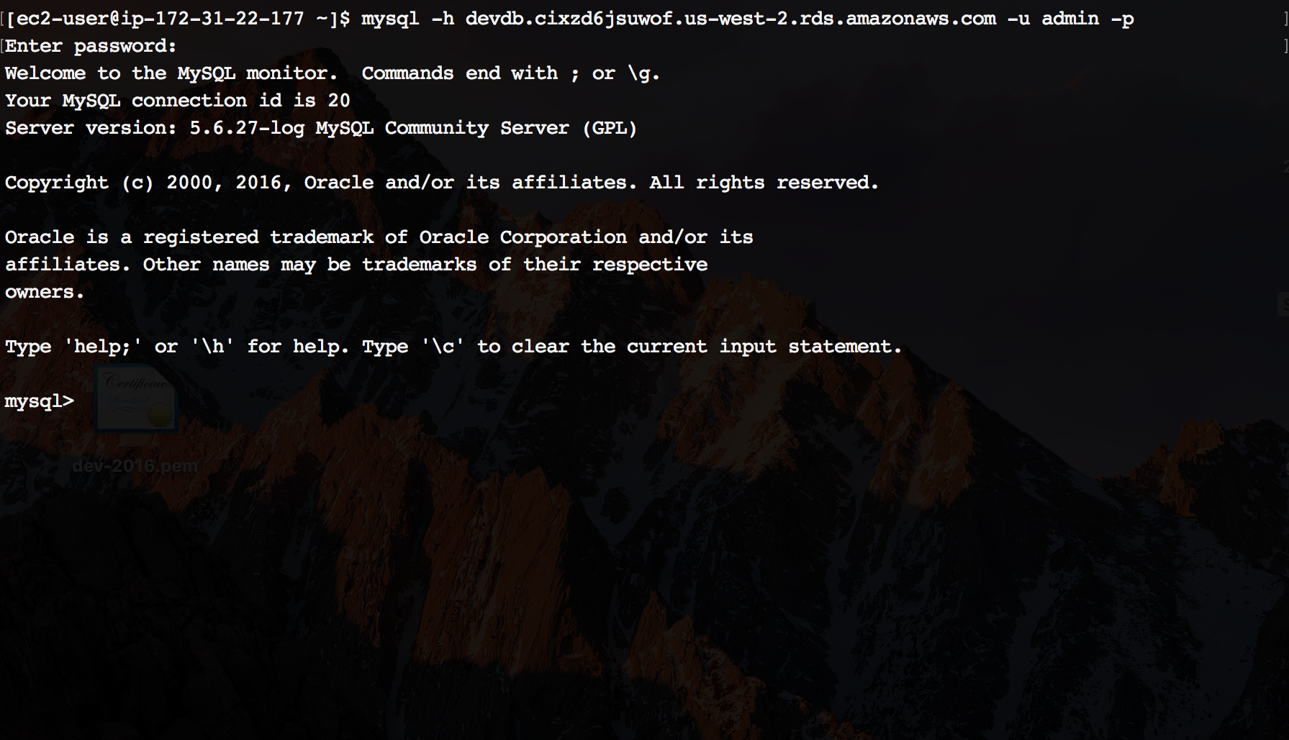
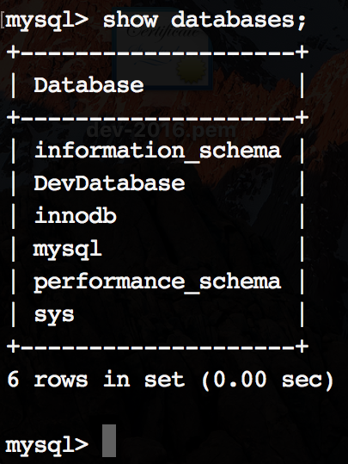
Creating a dev DB instance…

