Slide 1
Economic Populism in the United States: Trump and Sanders
Dean Baker
Co-Director
Center for Economic and Policy Research

Slide 2
Main Points
1) Large segments of the population in the United States have seen few economic gains in recent years due to weak growth and rising inequality.
2) Economic anxiety has fed the growth of populism in both major parties.
3) Right-wing populism is likely at a dead end with Trump, left-wing populism less clear.

Slide 3
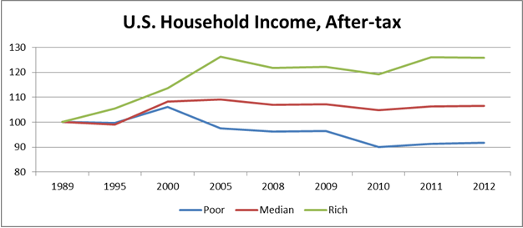

Source: OECD.

Slide 4
U.S. Household Income, After-tax
Source: OECD.

Slide 5
Hourly wages of men, by education, 1973–2011 (2011 dollars)
 | Real Hourly Wage:
Year | Less than high school | High school | Some college | College degree | Advanced degree
1973 | $17.45 | $20.69 | $21.15 | $28.54 | $31.70
1979 | 17.13 | 20.08 | 20.88 | 27.29 | 31.06
1989 | 14.39 | 17.95 | 19.80 | 27.93 | 34.73
1995 | 12.61 | 17.08 | 19.03 | 28.30 | 36.65
2000 | 13.08 | 18.09 | 20.62 | 31.77 | 39.71
2007 | 13.37 | 18.03 | 20.45 | 32.78 | 41.17
2011 | 12.71 | 17.53 | 19.45 | 31.81 | 41.34
Source: Economic Policy Institute.

Slide 6
Hourly wages of women, by education, 1973–2011 (2011 dollars)
 | Less than high school | High school | Some college | College degree | Advanced degree
Real hourly wage
1973 $10.53 $13.03 $14.08 $19.50 $25.82
1979 11.00 13.04 14.00 17.73 22.71
1989 9.98 12.91 14.96 20.24 26.38
1995 9.63 13.04 14.92 21.72 28.56
2000 10.06 13.77 15.97 24.04 30.37
2007 10.52 14.08 16.34 24.59 31.34
2011 10.32 13.83 15.82 24.31 31.76
Source: Economic Policy Institute.

Slide 7
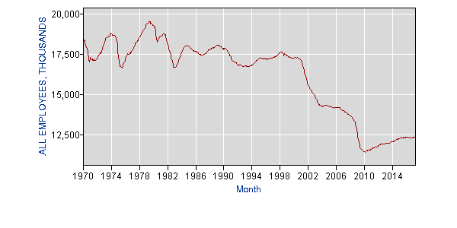
Trade and Manufacturing Employment

Slide 8
Senator Bernie Sanders Primary Challenge to Hillary Clinton
1) Sanders – 74-year-old Jewish, socialist, independent
2) Campaign Issues
Free College
Universal Medicare
Break Up Large Banks
Get Money Out of Politics
3) Sanders gets 40% of Democratic delegates, wins overwhelming majority of young and white working class votes

Slide 9
Clinton v. Trump
1) Issues
E-mails and Clinton foundation – “crooked Hillary”
Trade – NAFTA, China, and Trans-Pacific Partnership
Immigration – wall with Mexico
Affordable Care Act
Wall Street
Climate change
Support Social Security, Medicare, Medicaid
2) Results –
Clinton wins popular vote 48.2% to 46.1%
Loses Electoral College 304 -227
Flip of Midwest Industrial States Key
Huge Trump margin among white working class (non-college educated)

Slide 10
 |  | Democratic Margin
 | 1992 | 1996 | 2000 | 2004 | 2008 | 2012 | 2016
Michigan | 7.4 | 13.2 | 5.1 | 3.4 | 16.5 | 9.5 | -0.2
Minnesota | 11.6 | 16.1 | 2.4 | 3.5 | 10.2 | 7.7 | 1.5
Ohio | 1.8 | 6.4 | -3.5 | -2.1 | 4.6 | 3 | -8.1
Pennsylvania | 9 | 9.2 | 4.2 | 2.5 | 10.3 | 5.4 | -0.7
Wisconsin | 4.4 | 10.3 | 0.2 | 0.4 | 13.9 | 6.9 | -0.8

Slide 11
Explanations
“Fundamental” models – economy/incumbency
Sexism, racism, xenophobia
3) Analyses of Results
a) Monnat, 2016 – Trump outperformed most in counties with high rates of death due to drug overdoses, suicides, and alcohol.
b) Gub, 2016 – In Republican primaries, Trump did best in counties with largest increase in mortality rates.
c) Autor, Dorn, Hason, Majelsi, 2016 – Largest shift to Trump in commuter zones with greatest exposure to Chinese imports.
d) Baker and Rawlins, 2017 – If college graduation rates had grown at 1959-79 rate, Clinton would have won decisive victory.

Slide 12
Prospects for Populism Under Trump
Right Wing – Mass Disenchantment
a) health care – fewer insured, much higher costs
b) little progress on trade deficit, few manufacturing or mining jobs
c) Wall Street gets richer
d) Little noticeable difference on immigration, no wall
2) Left Wing – Democrats move left
Universal Medicare
Free college
$15 an hour minimum wage
Stronger financial regulation

