Slide 1
Grade Book Project
Electronic Gradebook System
Technology Project Overview
Notes:
This slide introduces the Grade Book Project, a Java-based electronic gradebook system designed for academic use.

Slide 2
Project Overview
• JavaFX-based electronic gradebook application
• Supports teacher and student logins
• Allows grade entry, calculation, and display
• Designed for usability and academic record management
Notes:
This slide explains the purpose and core functionality of the Grade Book Project, highlighting its role as a digital solution for managing student grades.

Slide 3
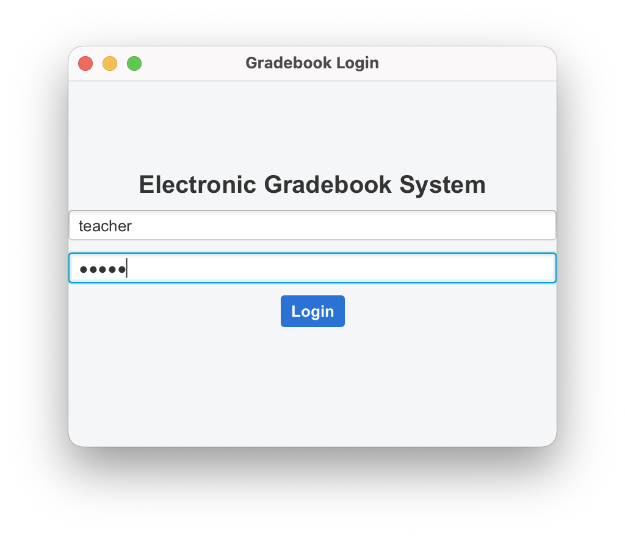
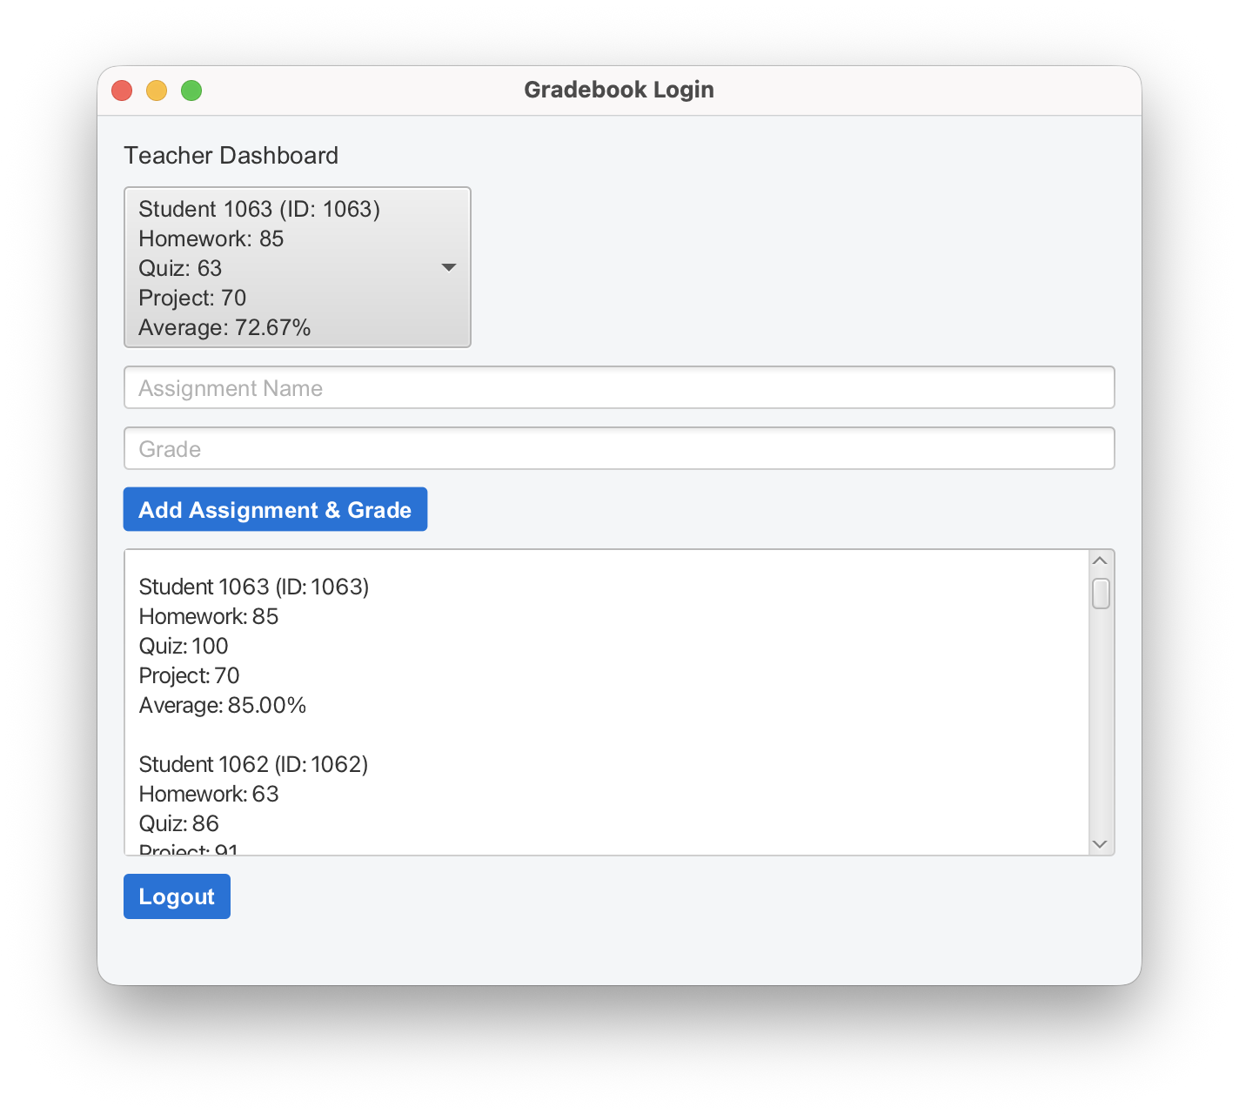
Login Interface
Notes:
These images show the login screen of the application. Users authenticate as either teachers or students before accessing their respective dashboards.

Slide 4
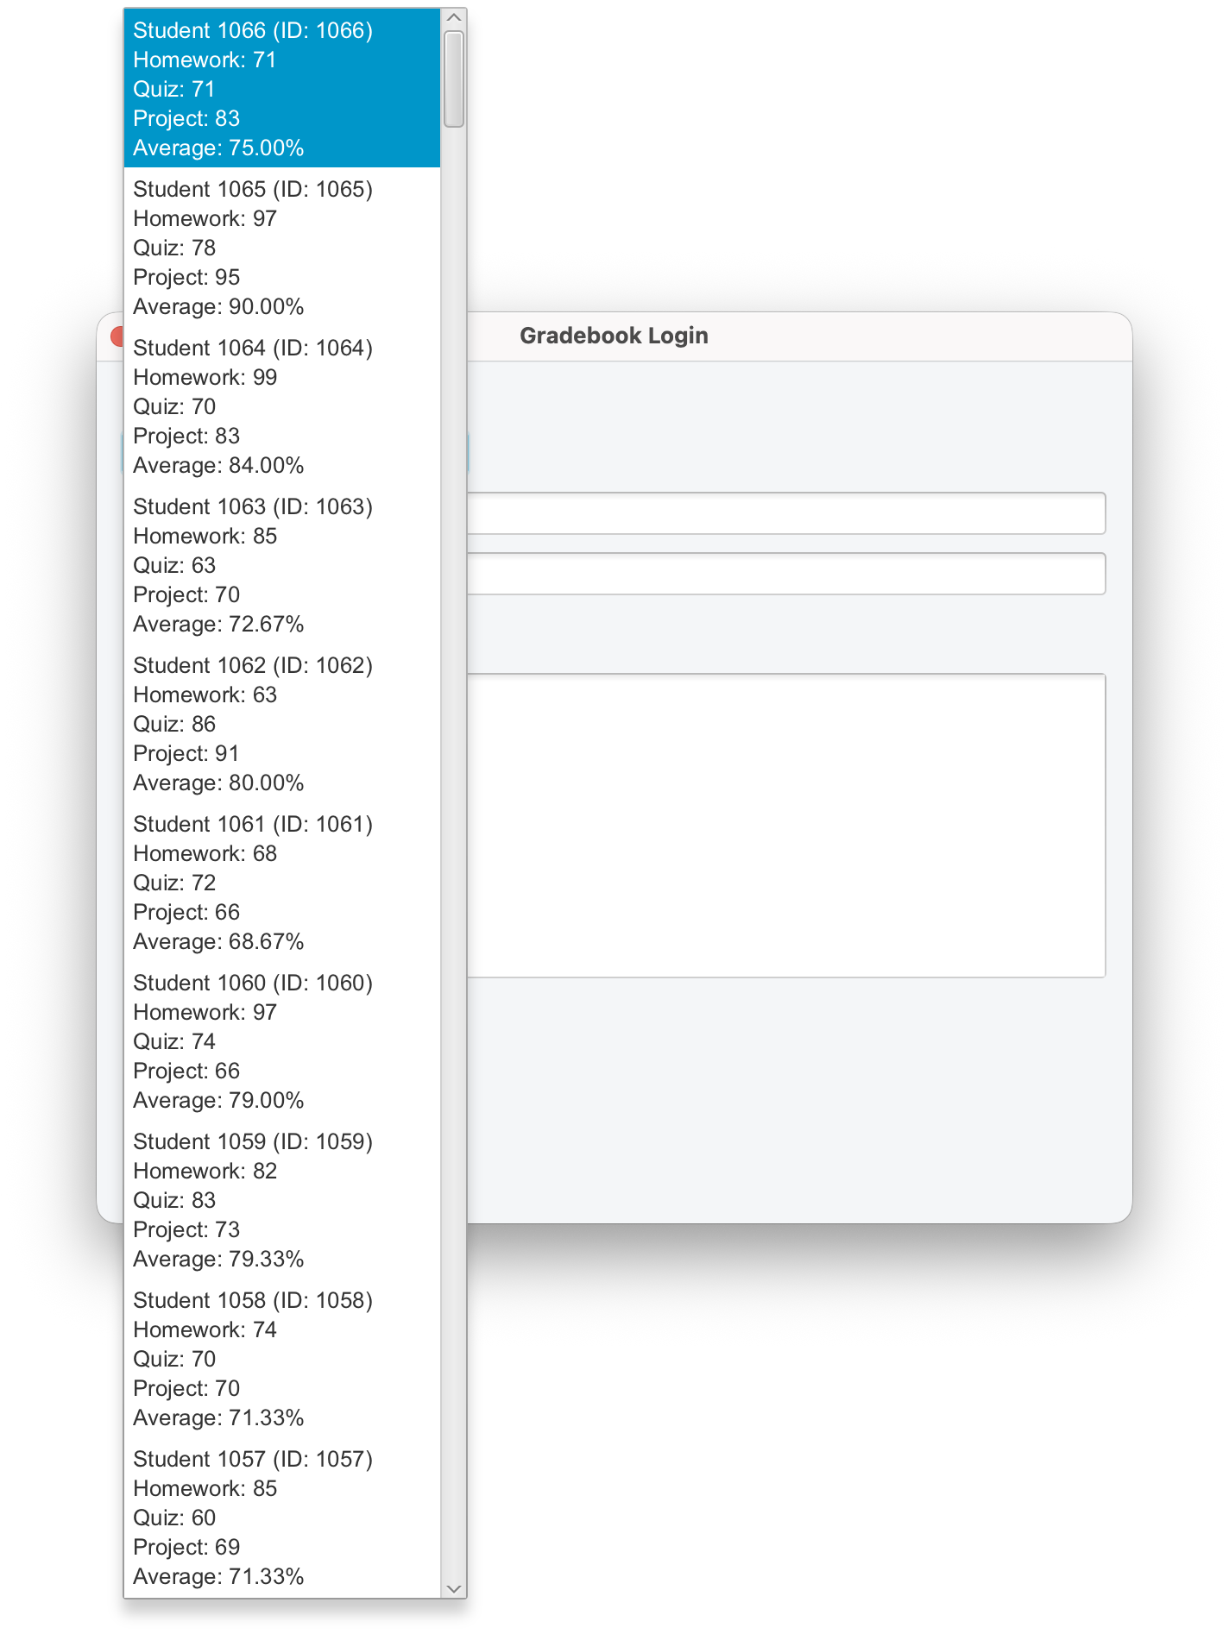
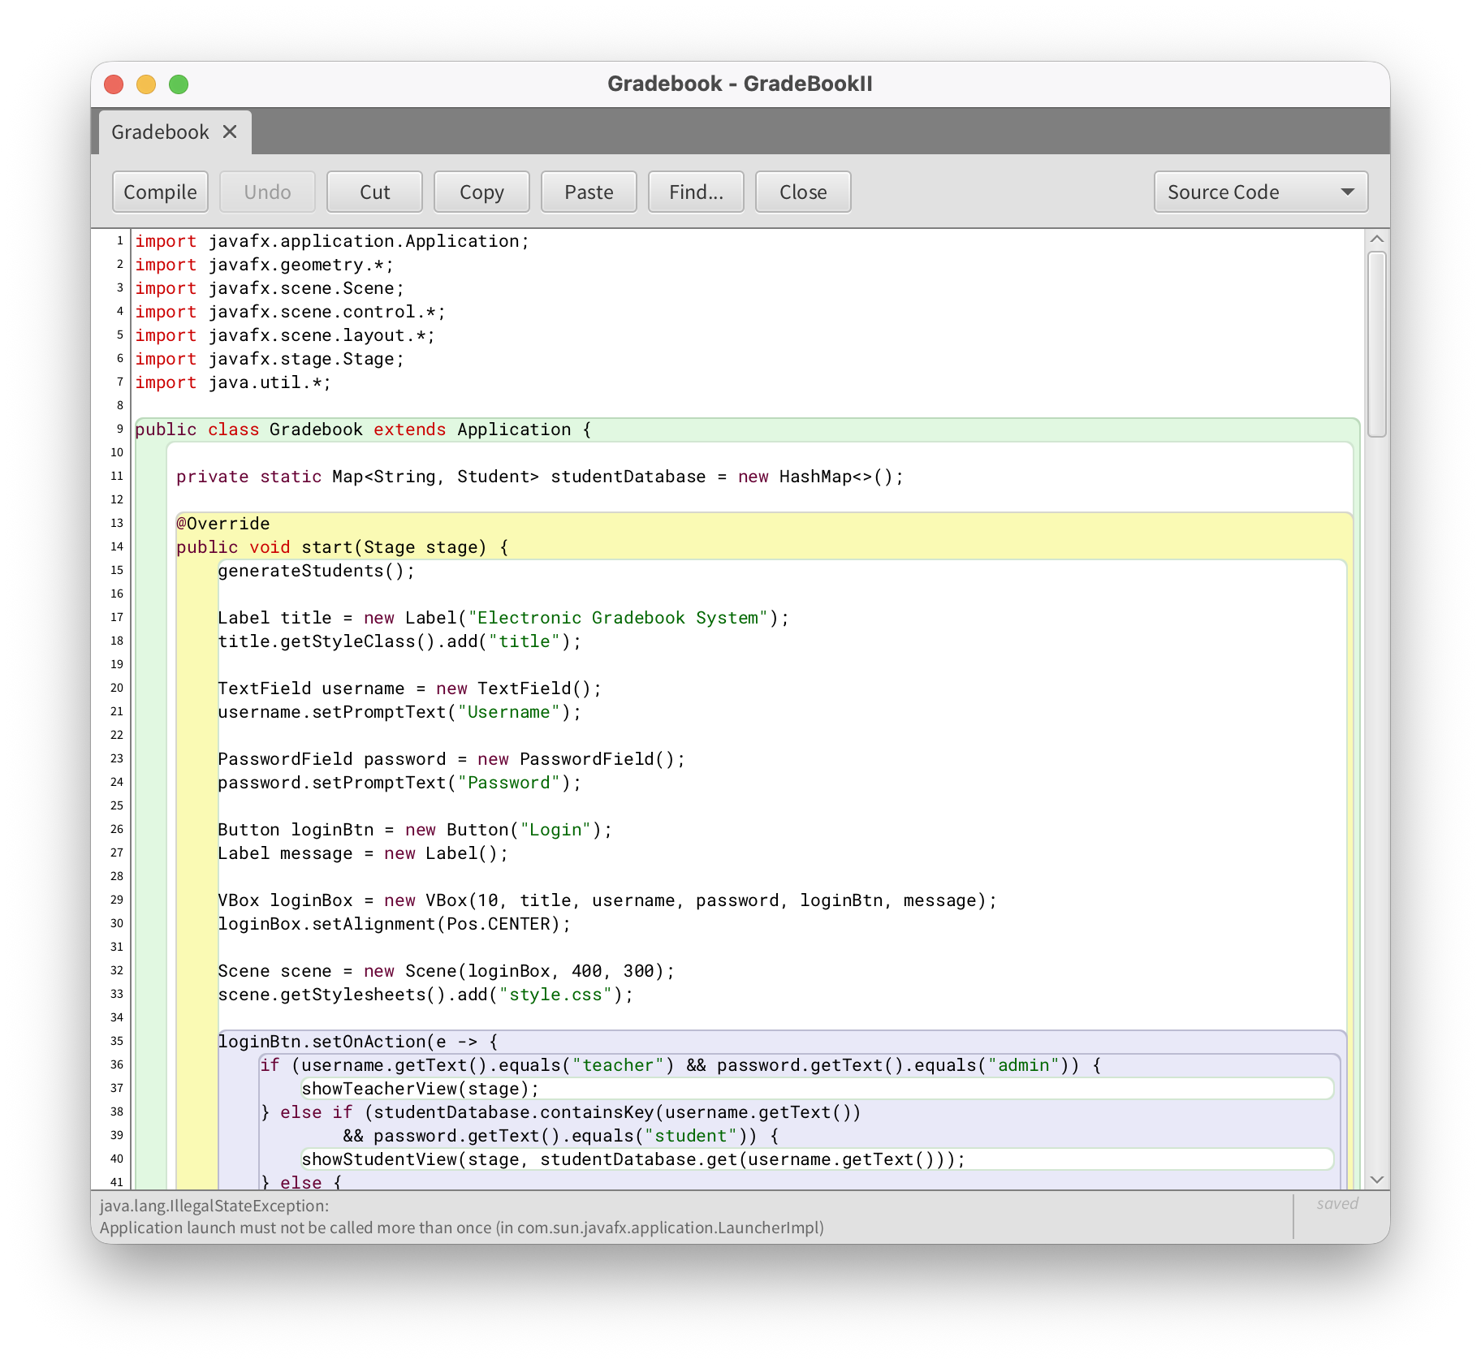
Teacher Dashboard & Grade Management
Notes:
This slide highlights the teacher dashboard. Teachers can view student records, add assignments, update grades, and automatically recalculate student averages.

Slide 5
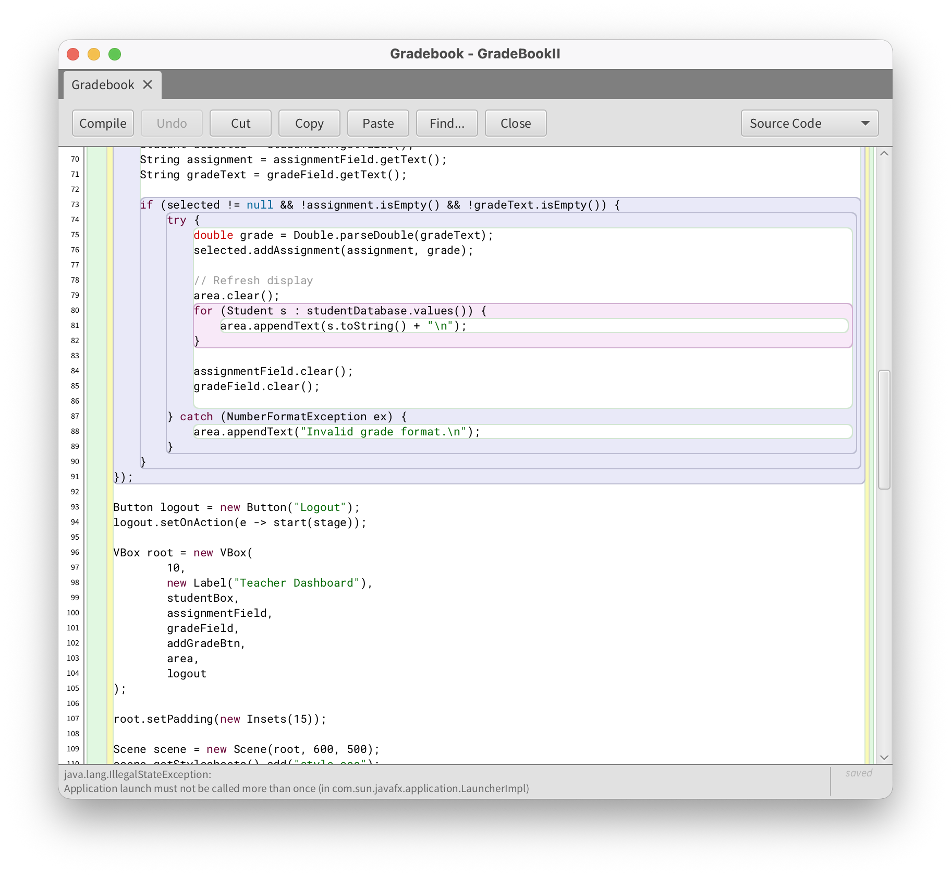
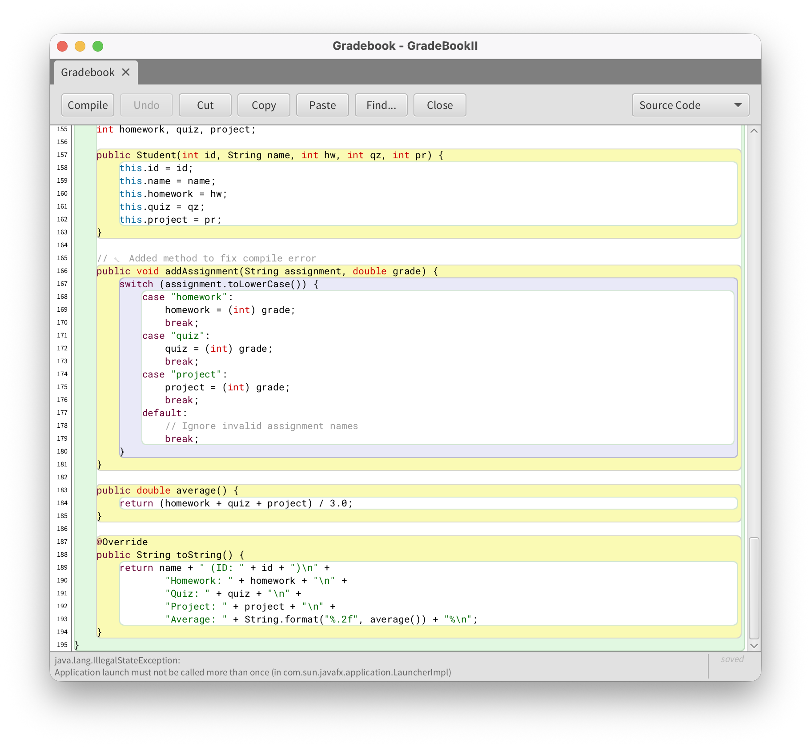
Code Implementation
Notes:
These screenshots show the Java source code behind the application. They demonstrate the use of JavaFX, object-oriented design, event handling, and data structures to manage student grade information.

Slide 6
Project Timeline
• Planning & Design: October – November 2025
• Initial JavaFX UI Development: November 2025
• Core Logic & Data Structures: December 2025
• Testing & Refinement: January 2026
• Final Submission & Presentation: February 3, 2026
Notes:
This timeline outlines the development phases of the Grade Book Project, ending with final submission and presentation on February 3, 2026.

