Slide 1
EventNXT: Event360
Anirith Pampati, Pavan Kaushik Aduri, & Rakesh Kumar Pothineni

Slide 2
About EventNXT
EventNXT is an app aimed at improving guest list management for live events.
Goals:
Provide event organizers with real-time ticket data, enabling efficient management of seating capacities and maximizing ticket sales.
Key features:
Central login using Event360 (CRM Integration), Event creation and management, box office data uploads, guest management and email communication.

Slide 3
FEATURES
Central login authentication system (CRM integration (Event360) with EventNXT)
Manage Events – Create, Edit, Delete Events
Manage Seating levels for an Event
Manage Guests for an Event
Seating Summary Information
RSVP email service and templates

Slide 4
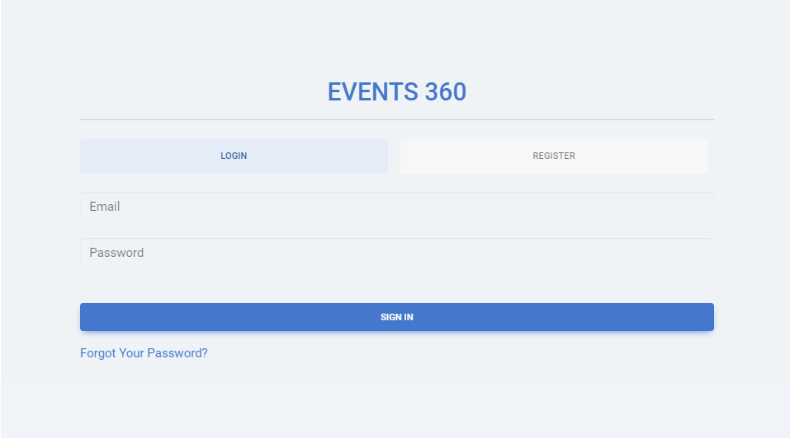
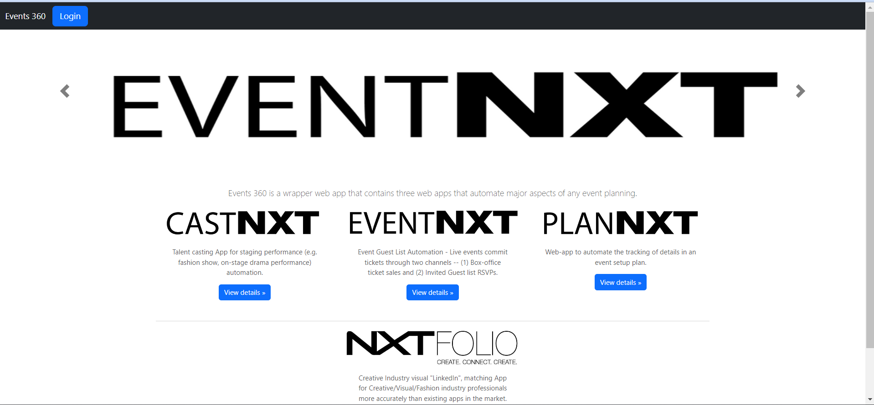
CRM Integration
Developed seemless CRM login mechanism (with Events360) for EventNXT app.
When User clicks on “Sign in with Events360”, user will be redirected to events360 login page.
Upon successful login with Events360, user will be automatically Logged into EventNXT app.

Slide 5
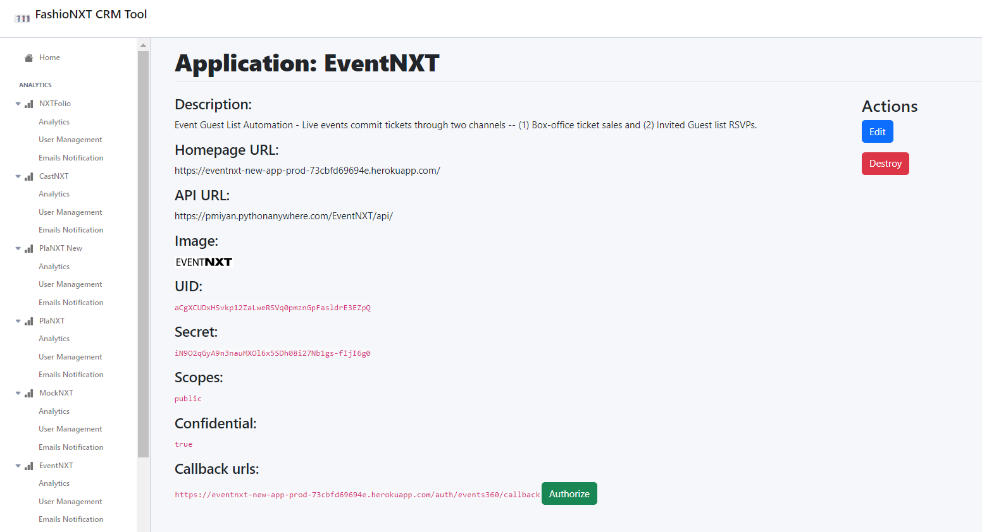
CRM Integration
Registering EventNXT application with Event360 using oauth.

Slide 6
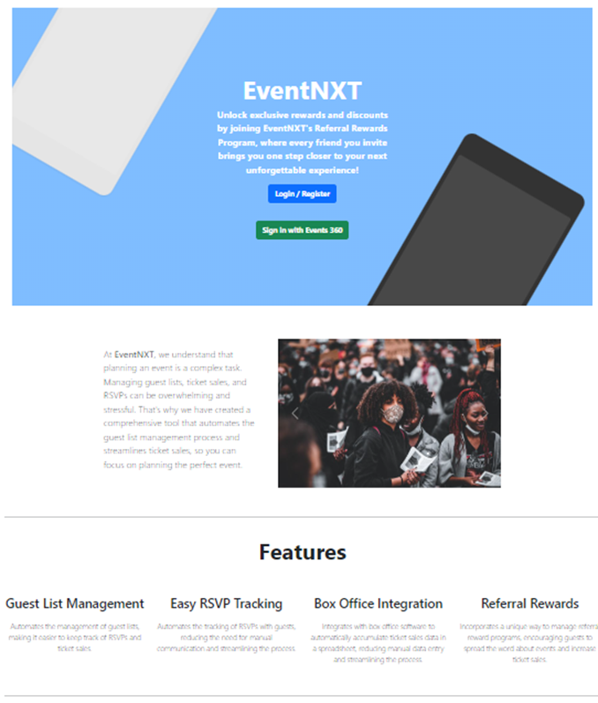
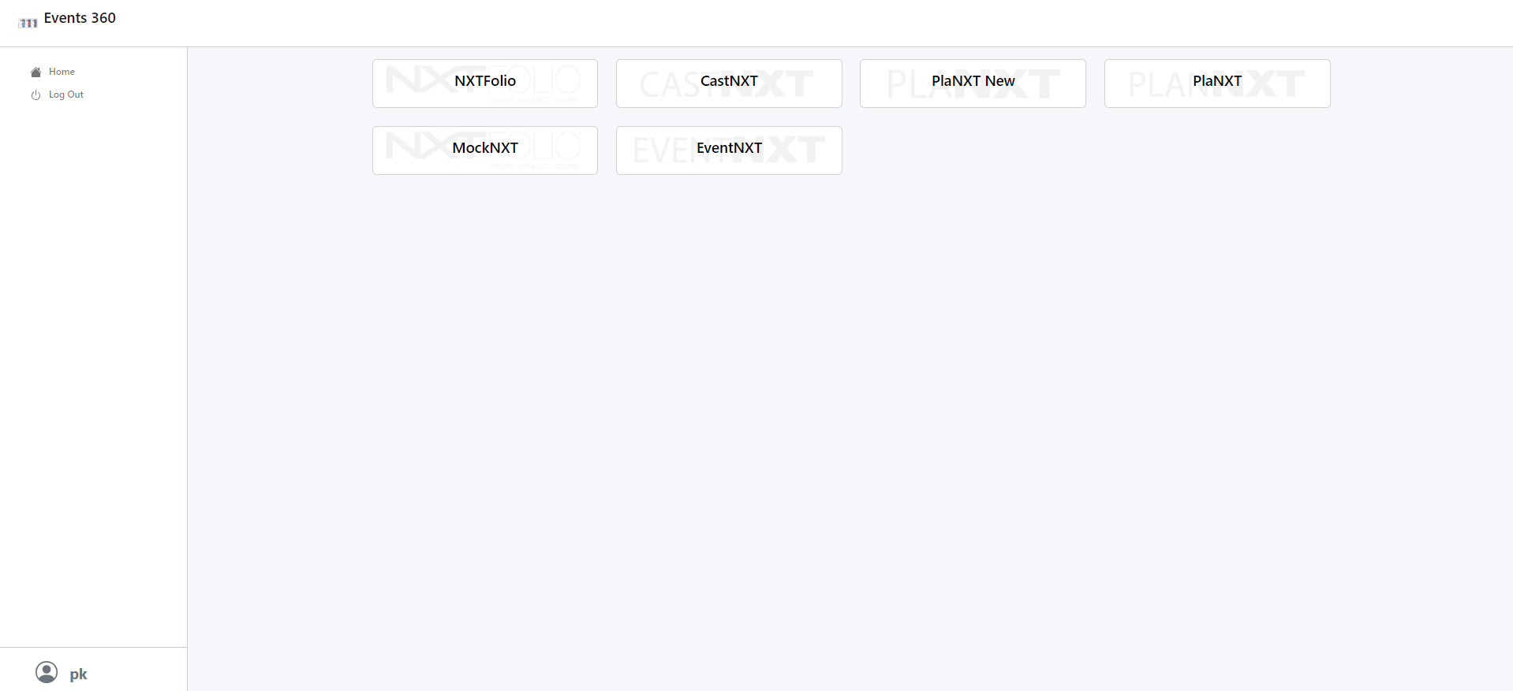
CRM Integration
Logging to EventNXT through centralized login mechanism using Event360.

Slide 7
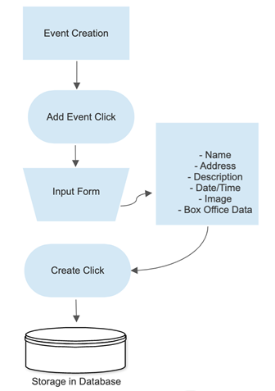
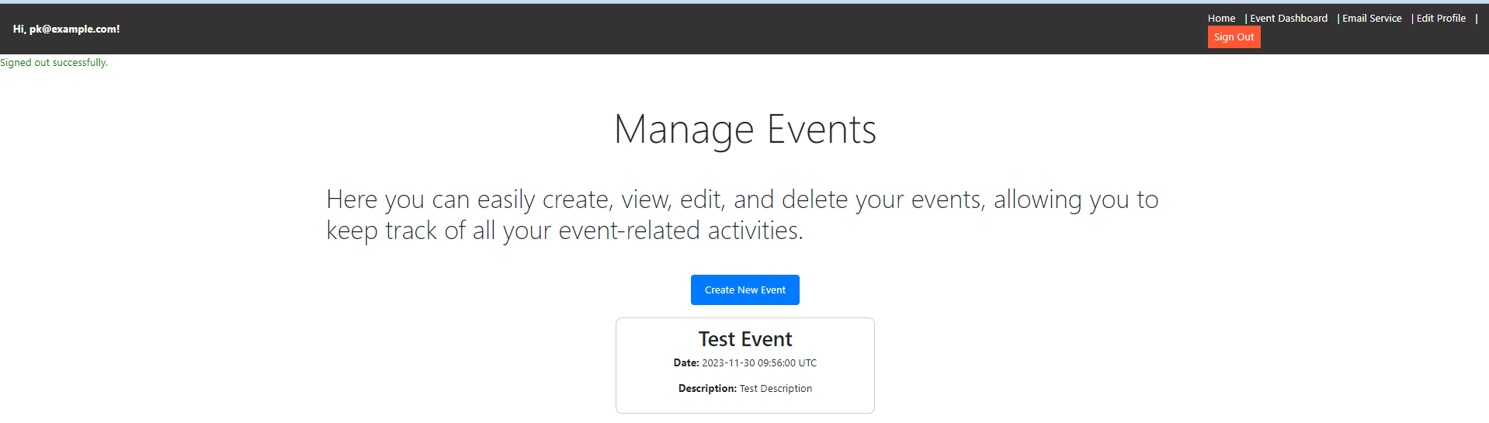
Manage Events
Functionalities are as follows:
Create Event
Edit Event
Delete Event

Slide 8
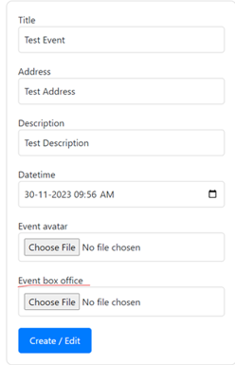
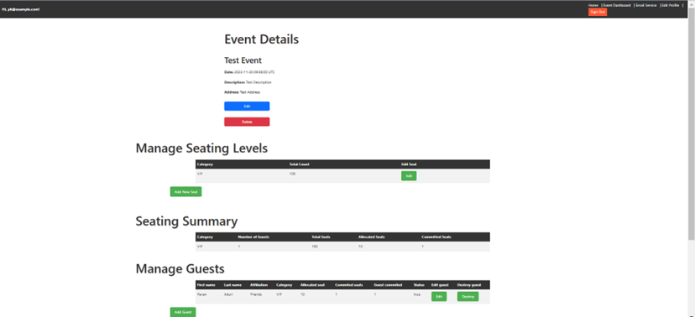
Manage Seating Levels
Upload box office data via spreadsheet or add guests manually in UI
App displays seating categories automatically
Edit seating count, initially set at 0
Add or delete seating categories as needed

Slide 9

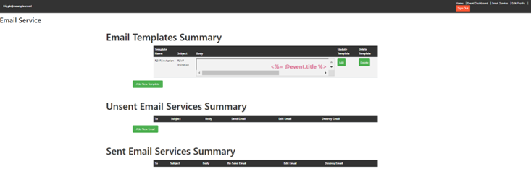
Manage Guests
User can import guest list from csv file upload.
User can manually add guests and perform actions such as sending RSVP invitations.

Slide 10
Seating Summary Information
It shows all the seating categories, count of seats allotted to guests and tentative free seats after allotment.

Slide 11

RSVP Email Feature
Using this feature, users can send invitation emails to guests.
Custom templates for emails can be defined.

Slide 12
Front-End Revamp
In the latest version of the EventNXT app, we've created the UI design entirely from the ground up.
Our team has crafted the user interface for the landing page, registration page, events page, and email services page.
Each story was assigned a single point, reflecting the time-intensive nature of front-end work.
We have developed UI for following pages:
Landing Page
Login Page
Registration Page
Manage Events Page
Event Details Page
Email Services Page
Seating categories and Add Guest Pages.

Slide 13
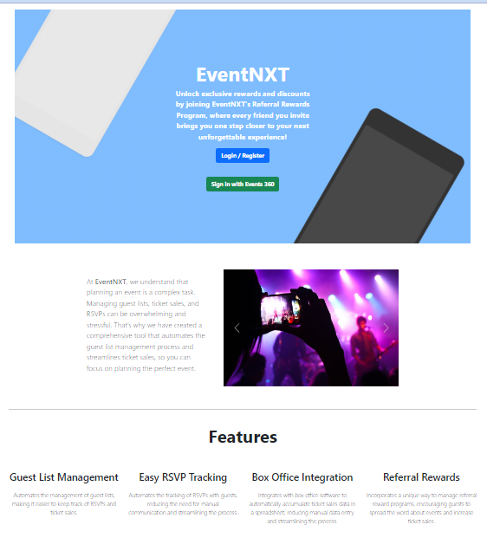
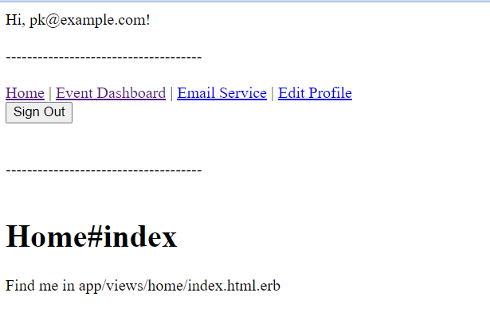
Front-End Developments
Landing Page:

Slide 14
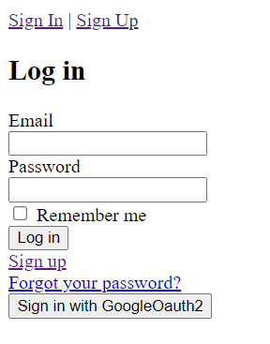
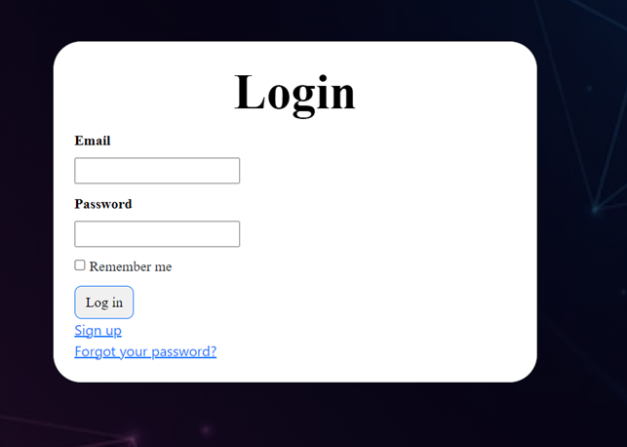
Front-End Developments
Login Page:

Slide 15
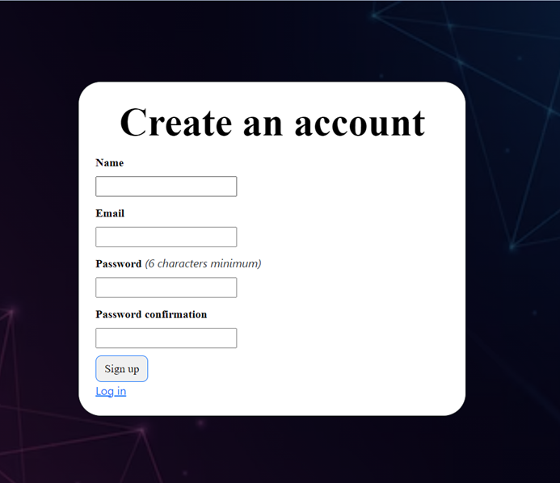
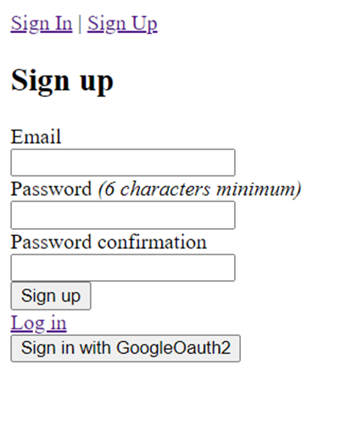
Front-End Developments
User Registration Page:

Slide 16
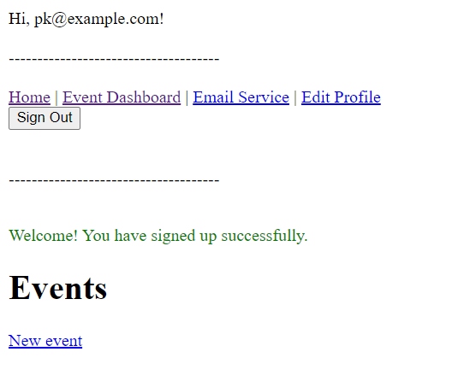
Front-End Developments
Manage Events Page:

Slide 17
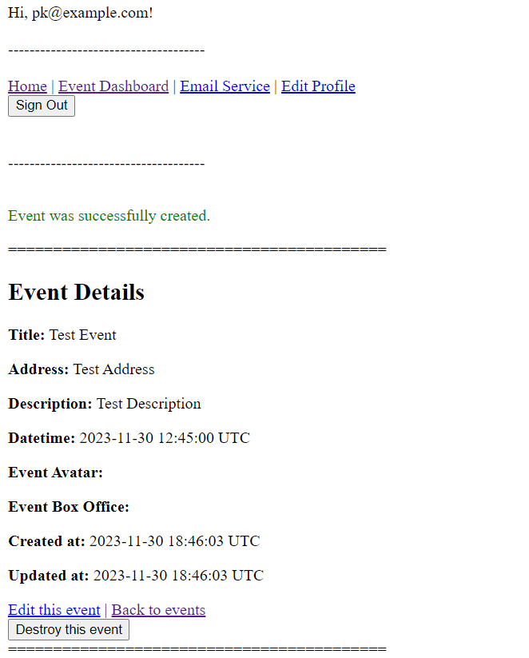

Front-End Developments
Event Details Page:

Slide 18
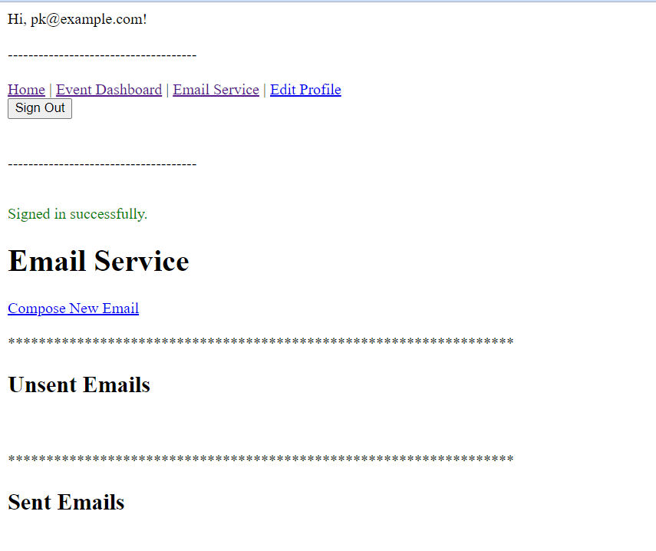

Front-End Developments
Email Services page:

Slide 19

Challenges
Learning Ruby and Rails including Testing using Rspec.
Difficulty in understanding legacy app code base and new app code base.
Difficulty in understanding Documentation
Difficulty in understanding compatibilities between few gems.

Slide 20
THANK YOU

Slide 21
The End!

