Slide 1
EventNXT
Team Members: Casey Quinn, Amin Isazadeh, Jakob Kirby, Vaibhav Bajaj, Sushmita PattanaikAmin Isazadeh

Slide 2
EventNXT Application Overview
EventNXT is an app aimed at improving guest list management for live events.
Goals:
Provide event organizers with real-time ticket data, enabling efficient management of seating capacities and maximizing ticket sales.
Key features:
Event creation and management, box office data uploads, guest management, email communication, referral rewards programs, and integration with third-party ticket platforms.

Slide 3
Features

Slide 4
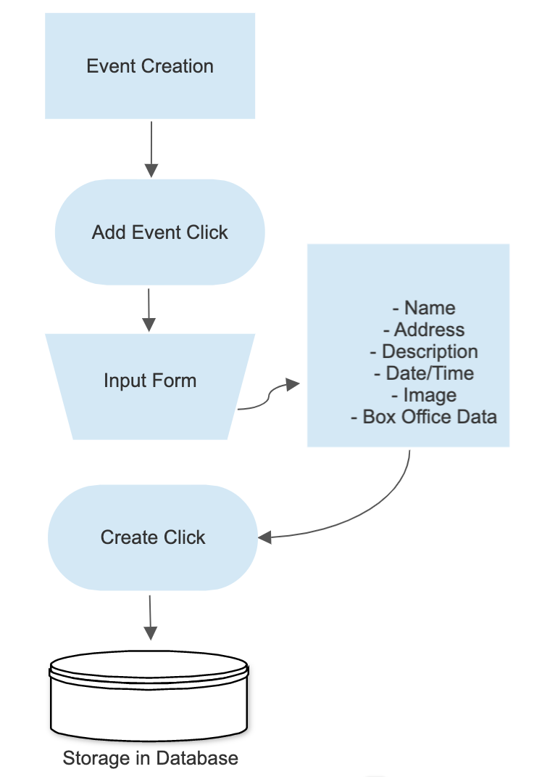
Event Creation

Slide 5
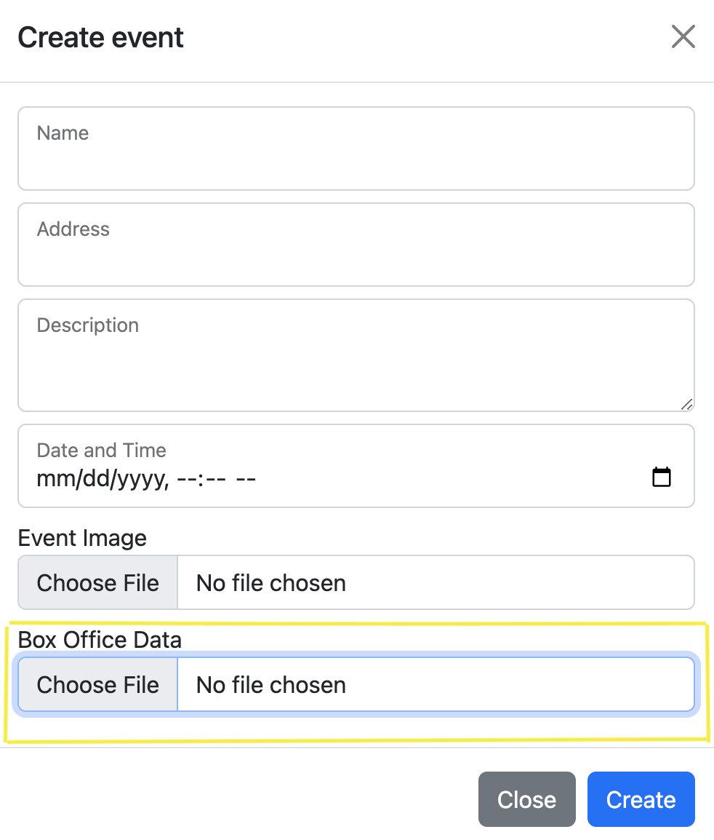
Managing Seating Levels for an Event
Upload box office data via spreadsheet
App displays seating categories automatically
Edit seating count, initially set at 0
Add or delete seating categories as needed

Slide 6
Managing Guests
User can import guest list from csv file upload.
User can export guests and it will have guest details with seats allotted/committed in different categories
Seating Summary Information
It shows all the seating categories, count of seats allotted to guests and tentative free seats after allotment

Slide 7
Referral Invitations & Rewards
- Send referral invitation emails to guests
- Guests provide referral emails via unique link
- Referral data updates in Manage Referrals table
- Referred guest receives email with purchase link
- Reward options: per ticket or percentage of spend

Slide 8
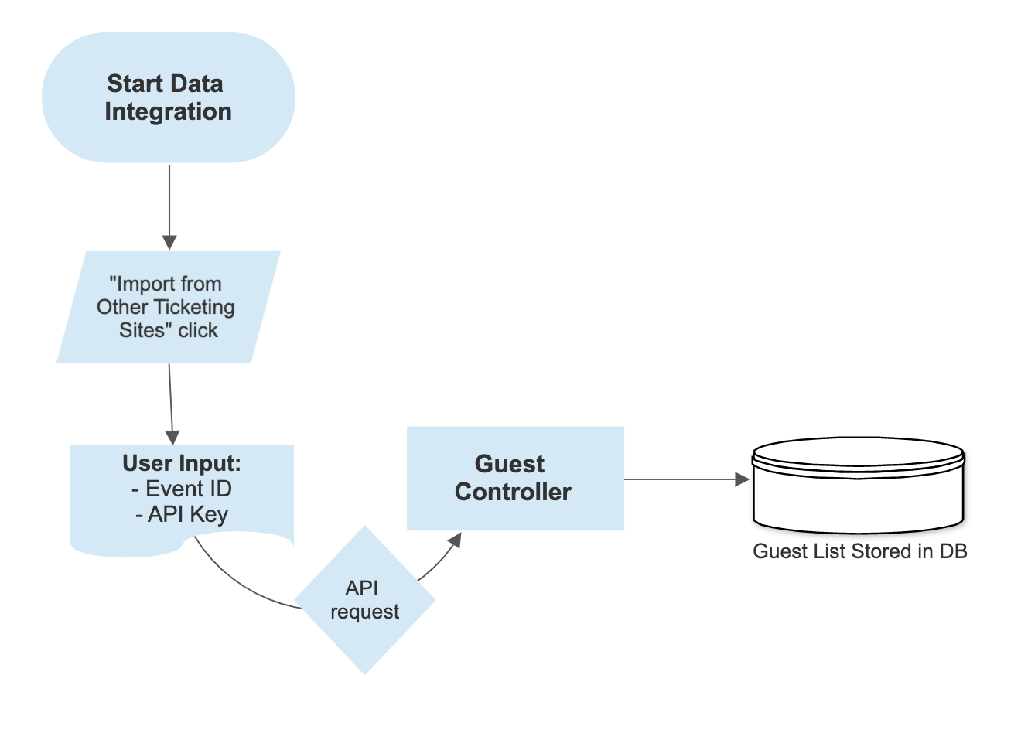
Integrating with Third-Party Ticketing Platforms

Slide 9
Front-End Revamp
The client requested a complete front-end overhaul, articulated through several user stories.
Each story was assigned a single point, reflecting the time-intensive nature of front-end work.
Emphasis on application being mobile-friendly as over half of web traffic is through mobile devices
Front-end user stories included:
Restyling landing page
Restyling registration page
Restyling events page
Restyling event detail page (needs further work once functional features are complete)

Slide 10
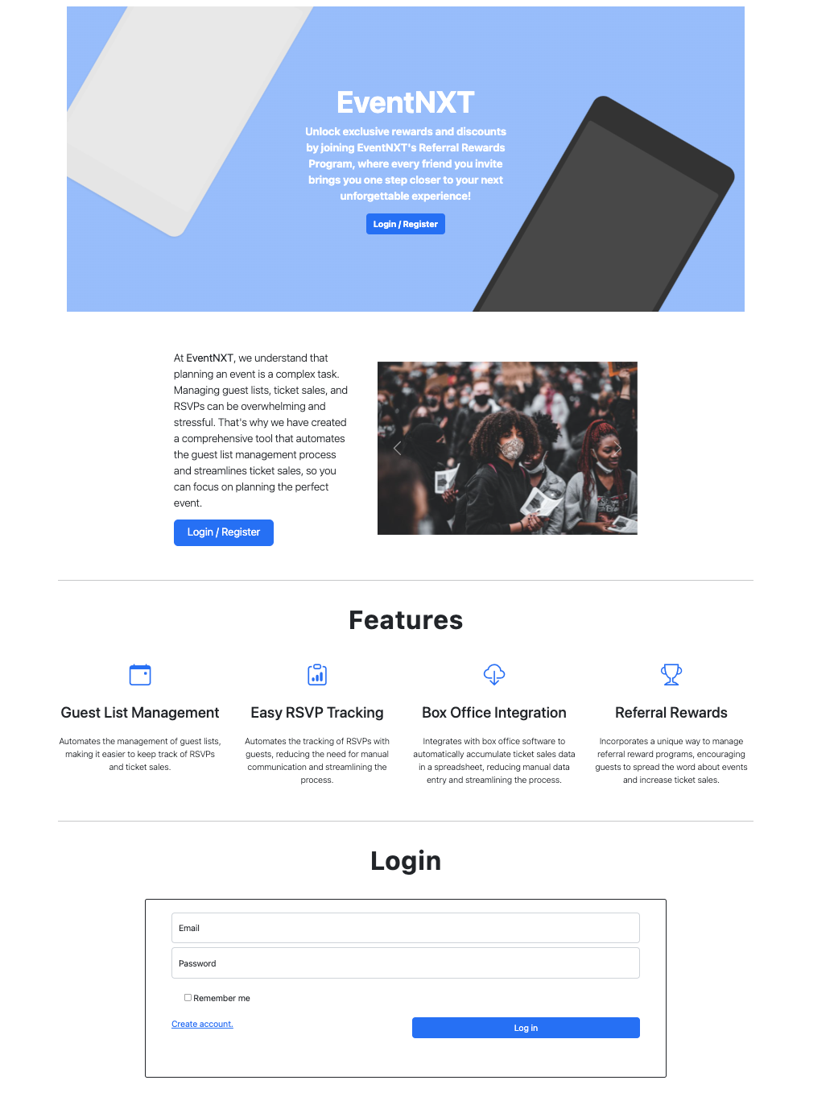
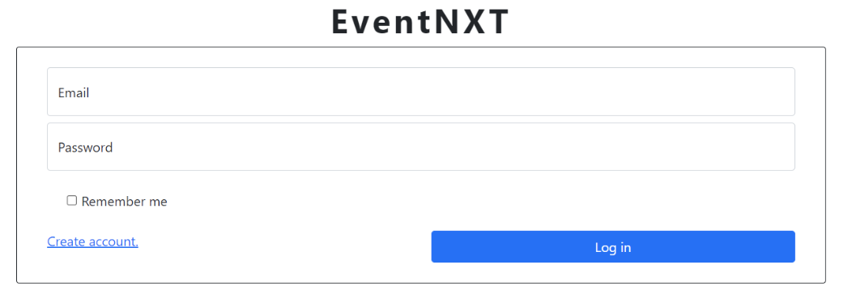
Landing Page

Slide 11
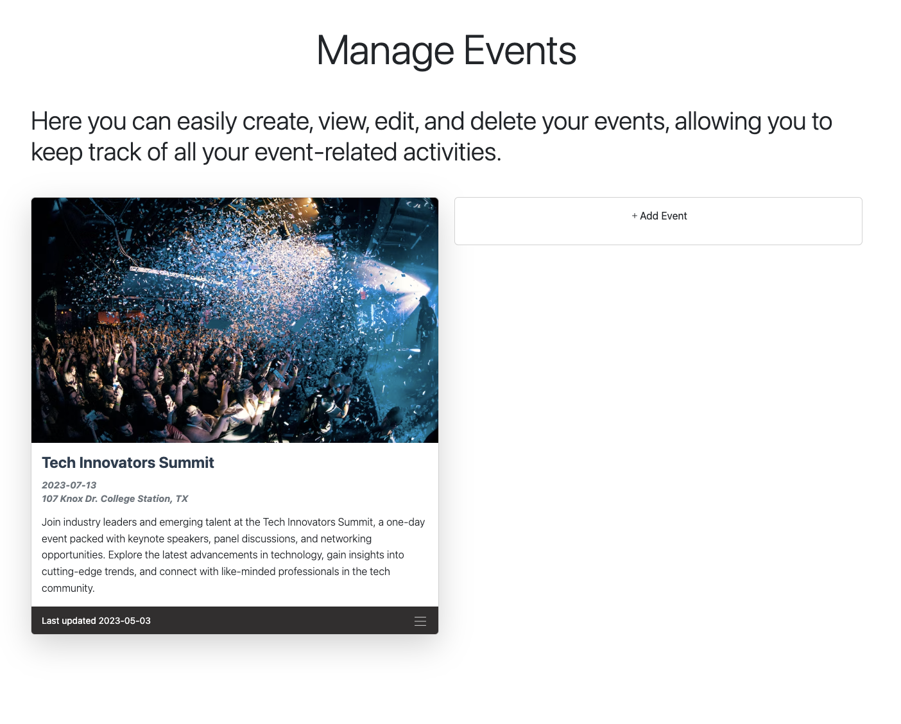
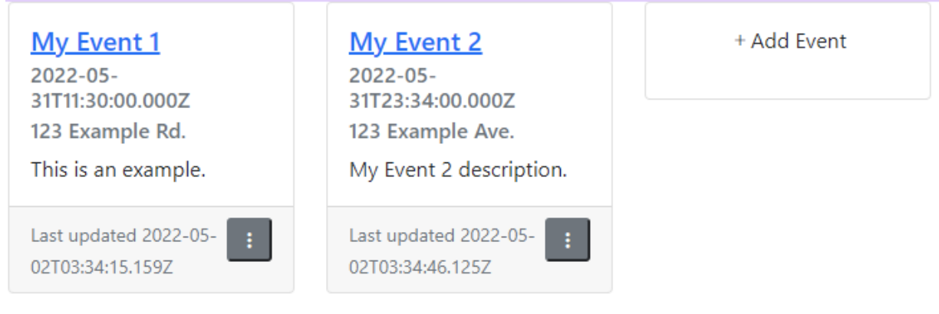
Events Page

Slide 12

Challenges
Learning Ruby and Rails
Lack of Documentation
Learning Legacy Code
Version Control Management

Slide 13
Time to Rebuild
Rebuilt app due to authentication issues, bugs, and complexity
Enhanced authentication and security with multiple registration options (EventNXT, Google)
Seamless CRM integration
Improved app performance
Clean and consistent Ruby codebase
Comprehensive documentation
Focused on feature implementation

