Slide 1
PlaNXT: Fall 2024
Govind Joshi, Ankitha Prasad,
Mahima Ganni, Rohit Tirumalasetti

Slide 2
Introduction
PlanXT is a part of Events360, a central platform for all event planning applications under the FashioNXT umbrella.
The goal of this application is to streamline the setup and teardown of events for event planners through a chronological floorplan visualizer in both 2D and 3D
The key feature which sets this application apart from other venue planning applications is the chronological component of event planning.

Slide 3
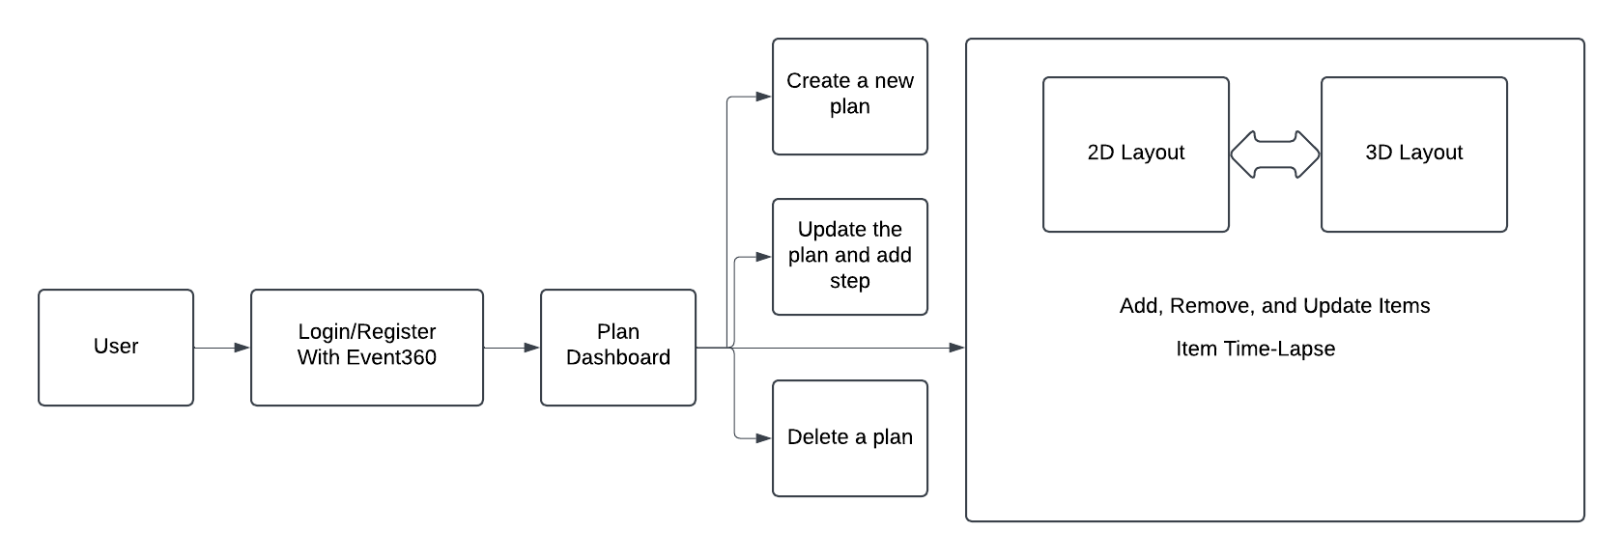
Application Flow

Slide 4
3D Library
furnishup/blueprints3d
ThreeJS based library
ThreeJS Version 0.69 (Current is 0.171)
PlaNXT uses a modified version of an older commit of the library

Slide 5
Fall 2024 Key Improvements
The goals for this semester were to bring the application closer to production by implementing certain key features. Our key contributions were
3D Timeline Bar
Integration between 2D and 3D Views
Item Dependencies and Updating Times of Dep. Items
Item Table Utilities (Ex. Search, sort)
Several UI/UX Changes

Slide 6
Images

Slide 7
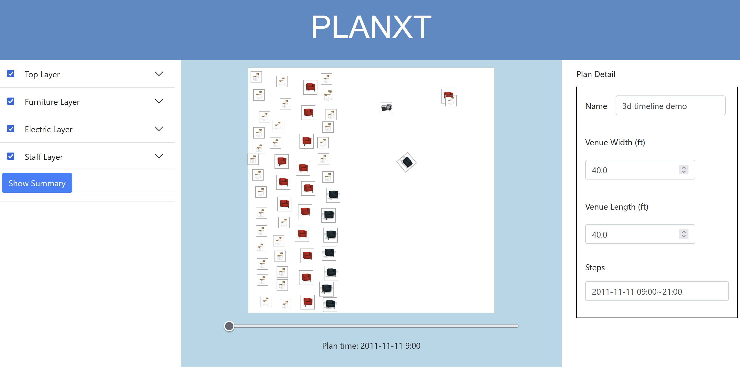
2D Layout

Slide 8
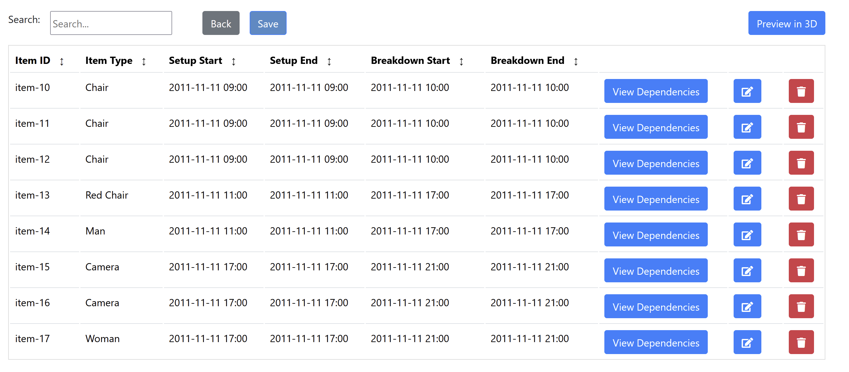
Table

Slide 9
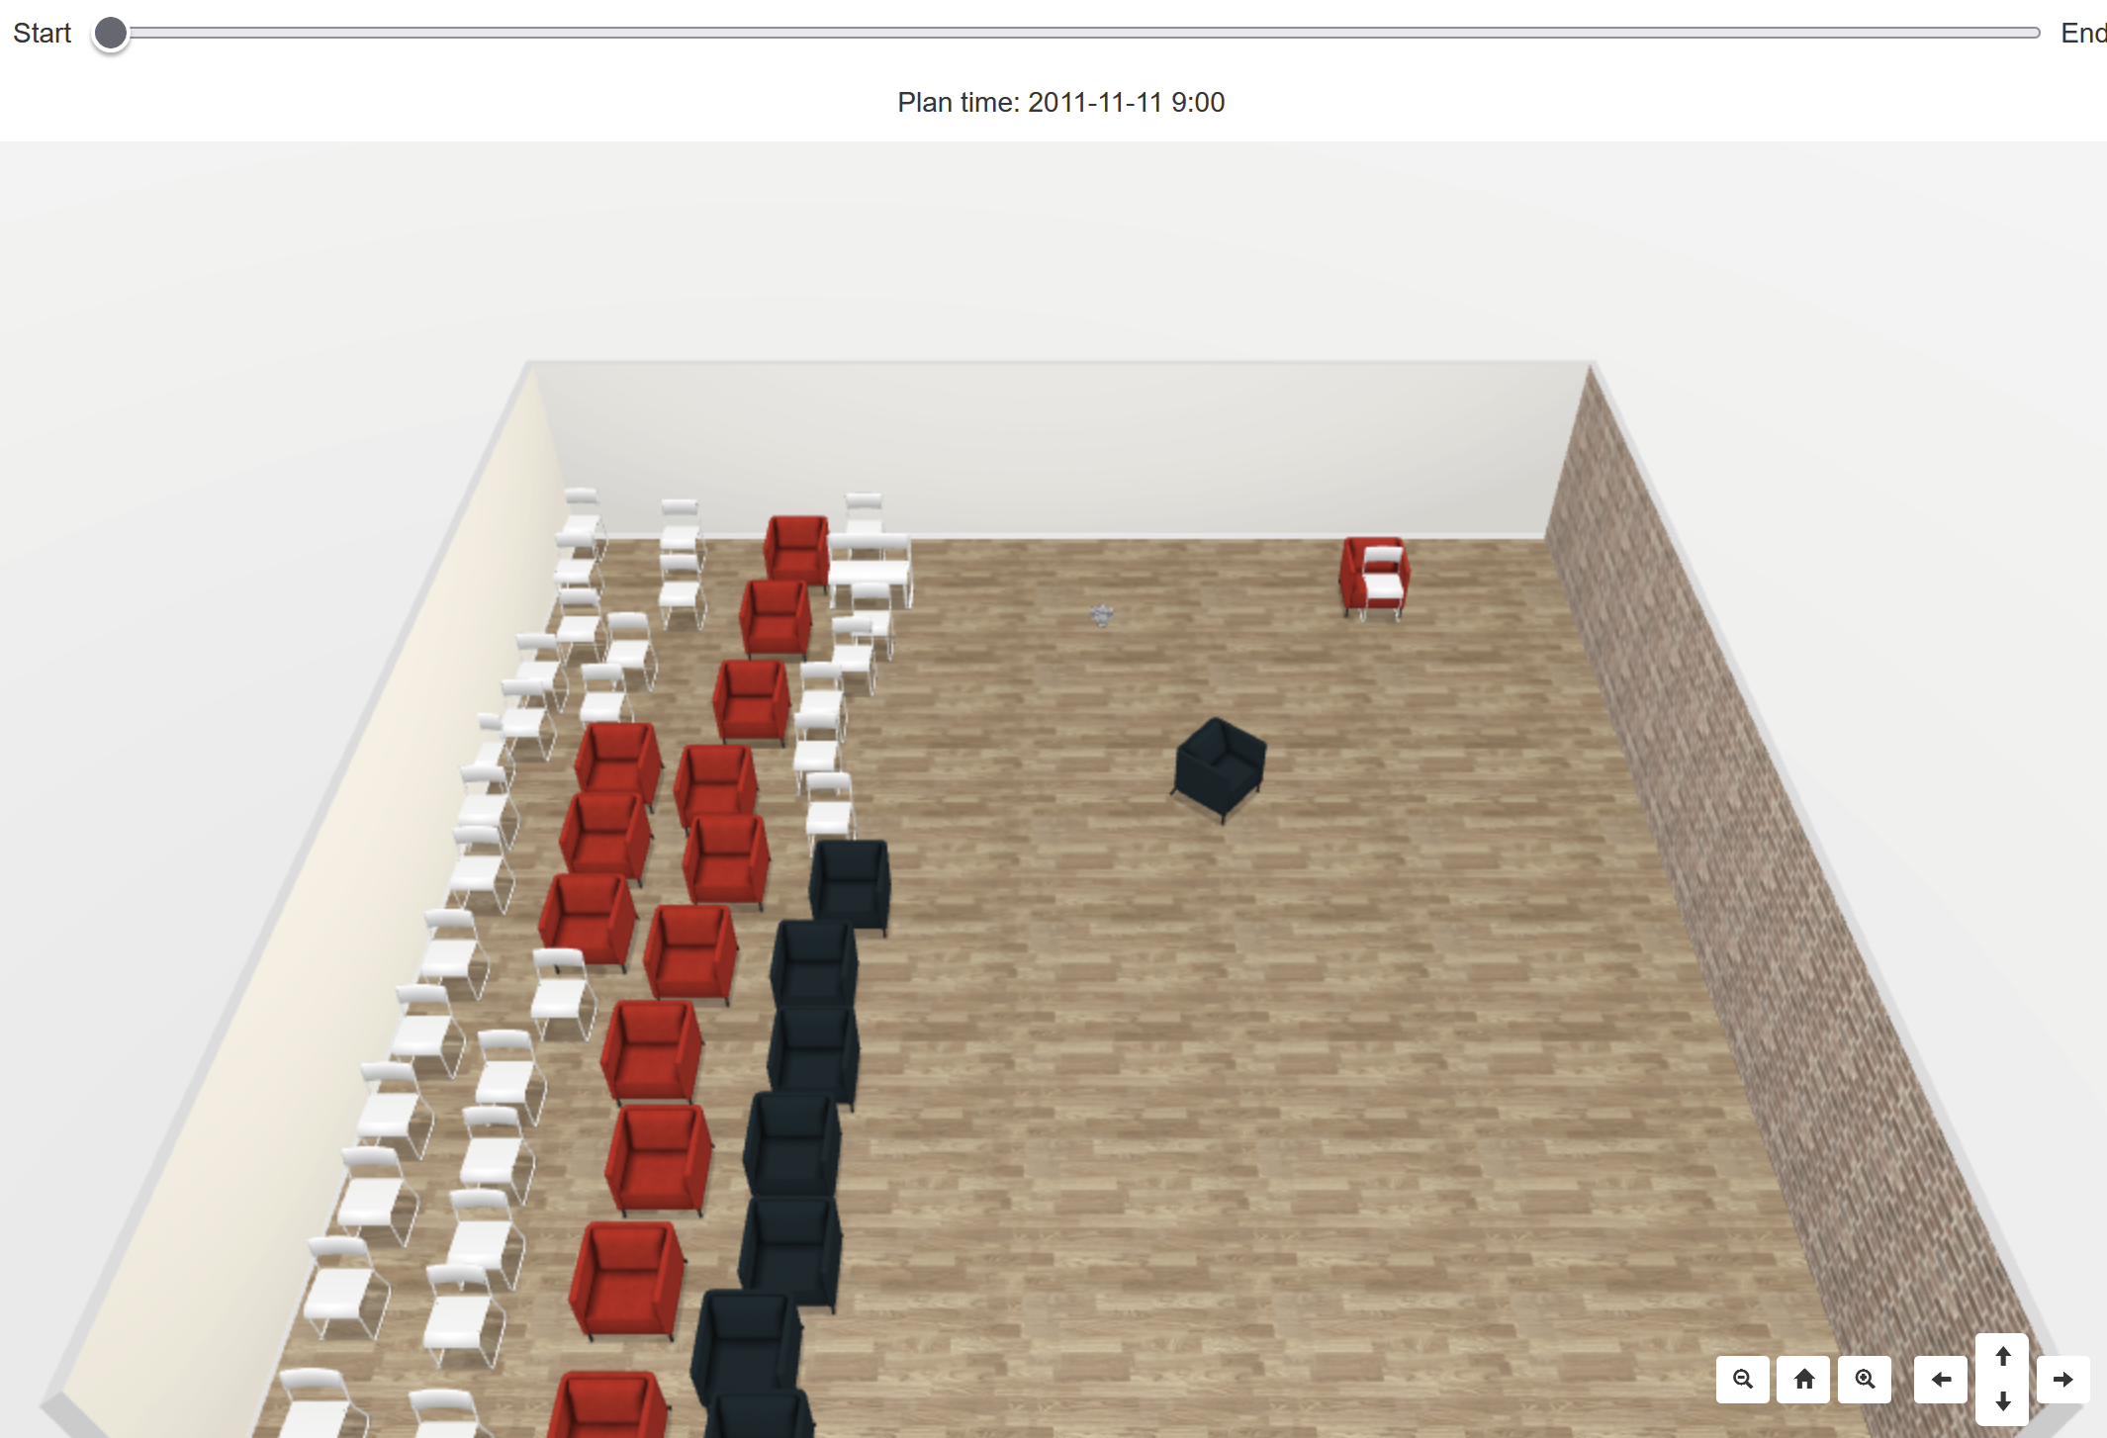
3D Layout with Timeline Bar

Slide 10
Insights

Slide 11
Difficulties
The 3D Rendering method did not have any documentation and it was difficult to make changes to the underlying library at the beginning.
The library snapshot used by the previous teams and the modifications they made are not fully clear, but we have added documentation on updating the underlying library.
JavaScript for features in the 2D view is written in long script tags in *.html.erb files with global methods and variables used across files without clear documentation

Slide 12
Future Development
Access control for different users
Commenting on different items and aspects
Chat feature in the app
Adjustable walls
Hovering over items in the table highlights the item and its dependencies in the 2D and 3D canvas
Seamless integration between the 2D and 3D view (To prevent developing same features like the table twice, once for each view).
For example, create an Orthographic Camera for viewing 2D Projection of 3D scene to use as the new 2D view
Being able to stack items vertically (Ex. Stacking a table on a stage)
Upgrade the 3D library (Upgrade the ThreeJS version to 0.171 and document the existing library)
Pair a front-end framework with rails (Ex. React-on-Rails)

Slide 13
The End

