Slide 1
PLANXT
Amory Doerr
Ashish Kumar
Tian Liu
Stefan Wu
Huixin Zhang
CSCE 606, Spring 2023 @TAMU

Slide 2
About
PLANXT is a Venue Floor Planning application that aims to provide:
Form to tabulate their event planning.
Enable Users to share and re-use existing plan.
UI to arrange event venue using drag and drop.
Timing dependencies checks for different events.
3D Preview the whole settings (Experiment).

Slide 3
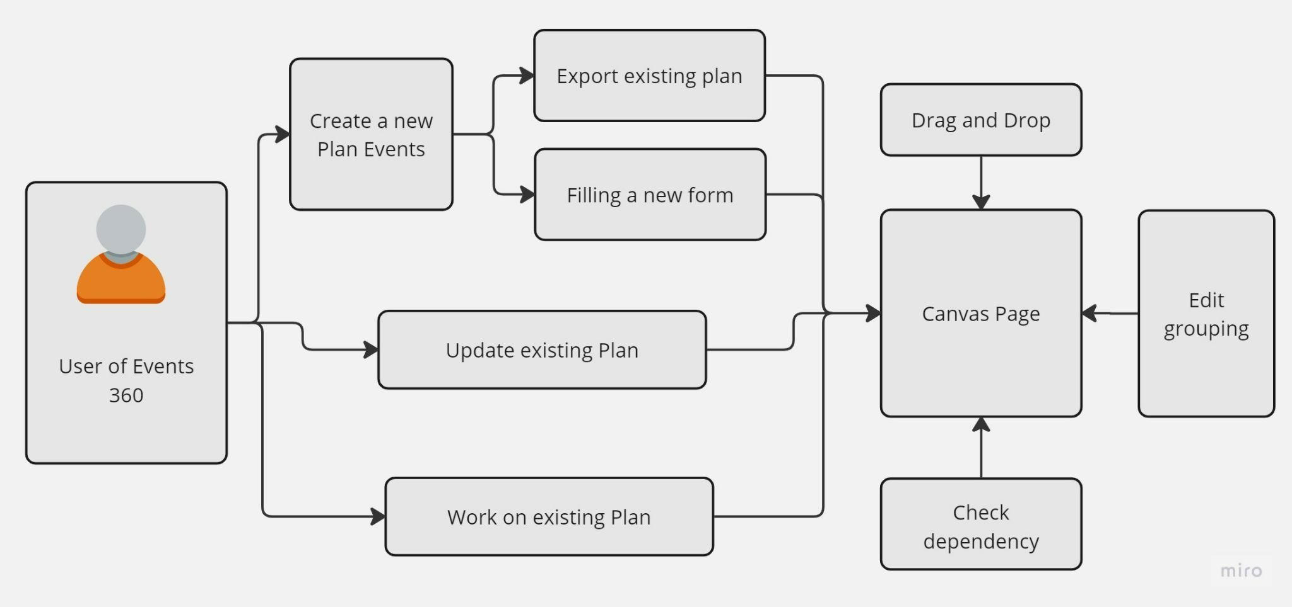
Project Flow

Slide 4
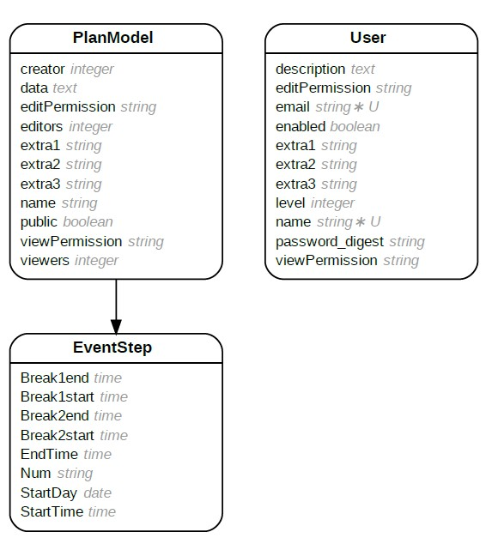
Class Diagram

Slide 5
Project Validation : Testing Approaches
BDD coverage( Cucumber Testing)
User login/Signup.
Plan sharing.
Event creation and update.
TDD ( RSpec Testing)
Unit test cases for all data models such as plan and event days.

Slide 6
Problem Faced
Legacy Project Issue:
Overhead to understand existing code.
Initial Heroku Deployment.
Upgrade Ruby Version.
No Existing Test cases.
Development Issues:
Integration with Plan 360.
Deploying and maintaining two Heroku and Github.

Slide 7
The End
Thank you !
Amory Doerr
Ashish Kumar
Tian Liu
Stefan Wu
Huixin Zhang

