Slide 1
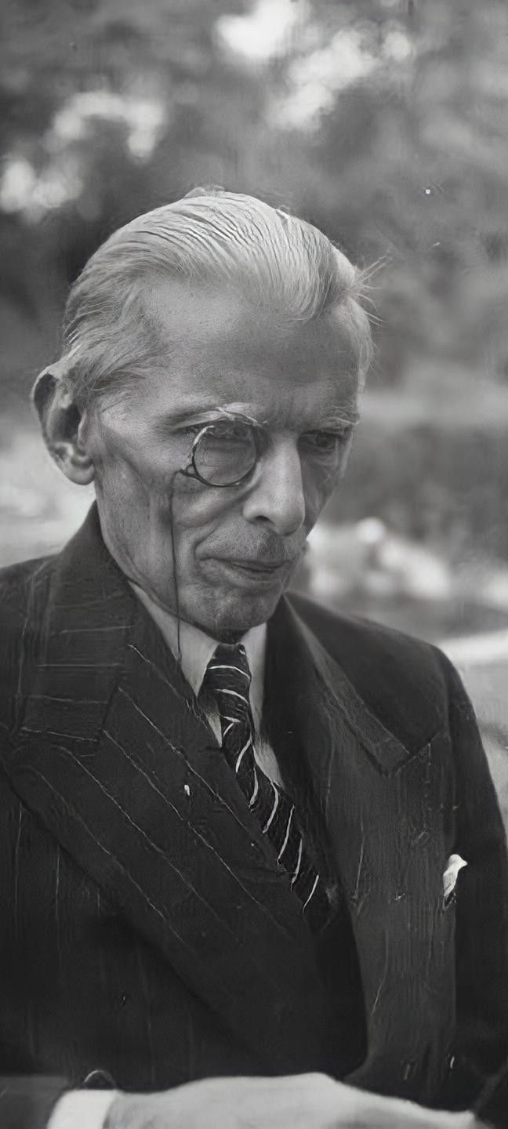
Quaid-e-Azam
Muhammad Ali Jinnah
Single Page Tribute Website
Final AICT Project

Slide 2
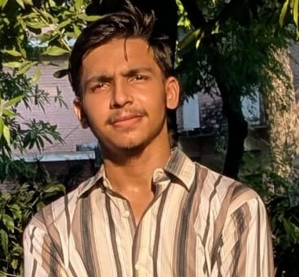
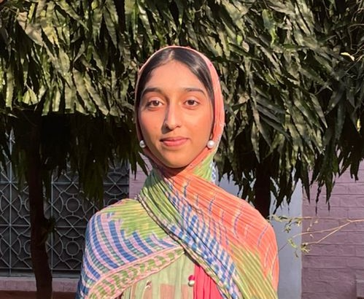
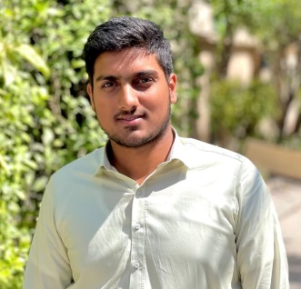
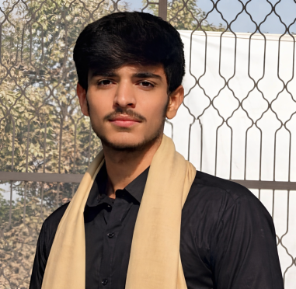
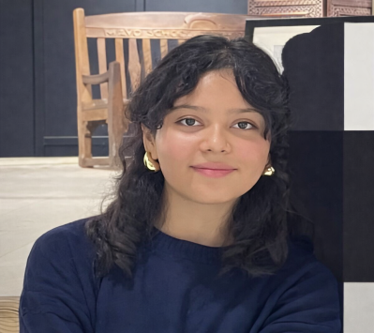
GROUP MEMBERS
01
02
03
Fasih Ullah
Laiba Akram
Hamza Zahid
(2025-CS-243)
(2025-CS-249)
(2025-CS-264)
04
05
M. Abubakar
Sahar Rabbani
(2025-CS-254)
(2025-CS-287)

Slide 3
PROJECT OBJECTIVE
To create a tribute website using HTML
and CSS only
01
To present the life, leadership, and legacy
of Quaid-e-Azam
02
03
To practice basic web design and content organization
04
To integrate website, Excel, Word, and presentation into one project

Slide 4




WEBSITE OVERVIEW
HOME
Introduction of the tribute website
HIGHLIGHTS
ABOUT
Historical images and moments
SECTIONS
Brief life and vision of
Quaid-e-Azam
DOCUMENTARY
Visual overview of
Quaid-e-Azam’s life

Slide 5
EXCEL CHARTS

Slide 6
EXCEL CHARTS
Most achievements of Quaid-e-Azam fall under Very High and High impact levels, reflecting his significant contributions to Pakistan’s creation.

Slide 7





TOOLS AND TECHNOLOGIES
HTML
CSS
EXCEL
Structure
Styling
Data Analysis
GIT HUB
GIT PAGES
Version Control
Deployment

Slide 8
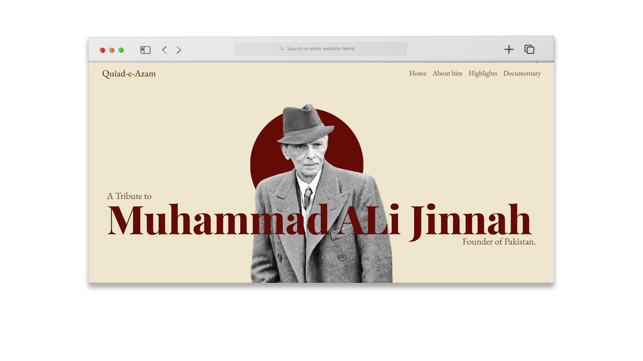
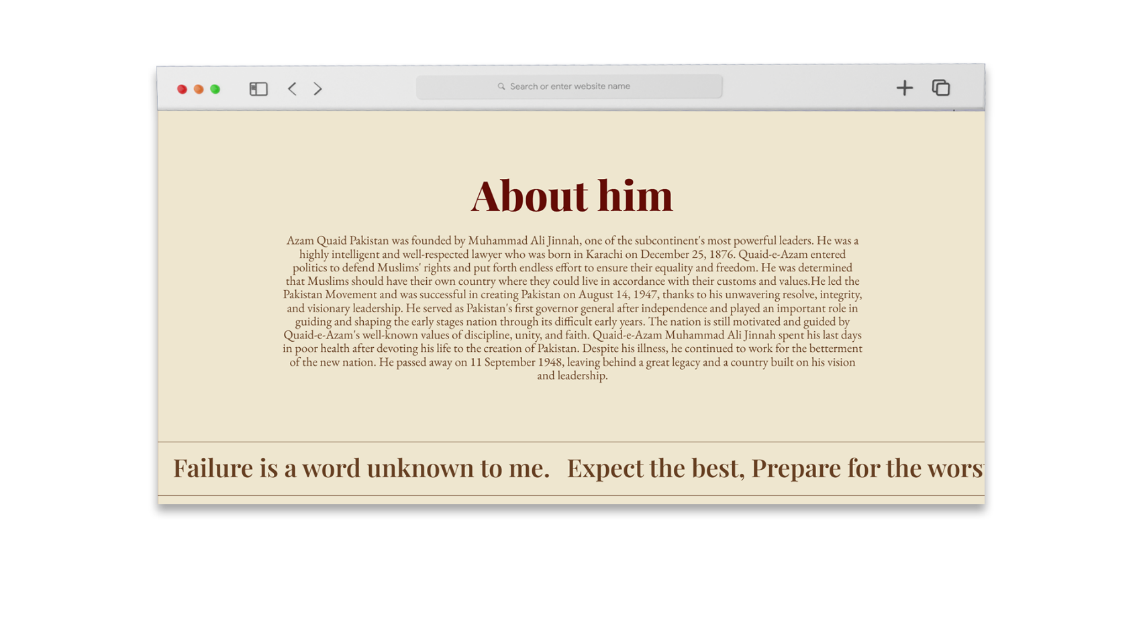
SCREENSHOTS

Slide 9
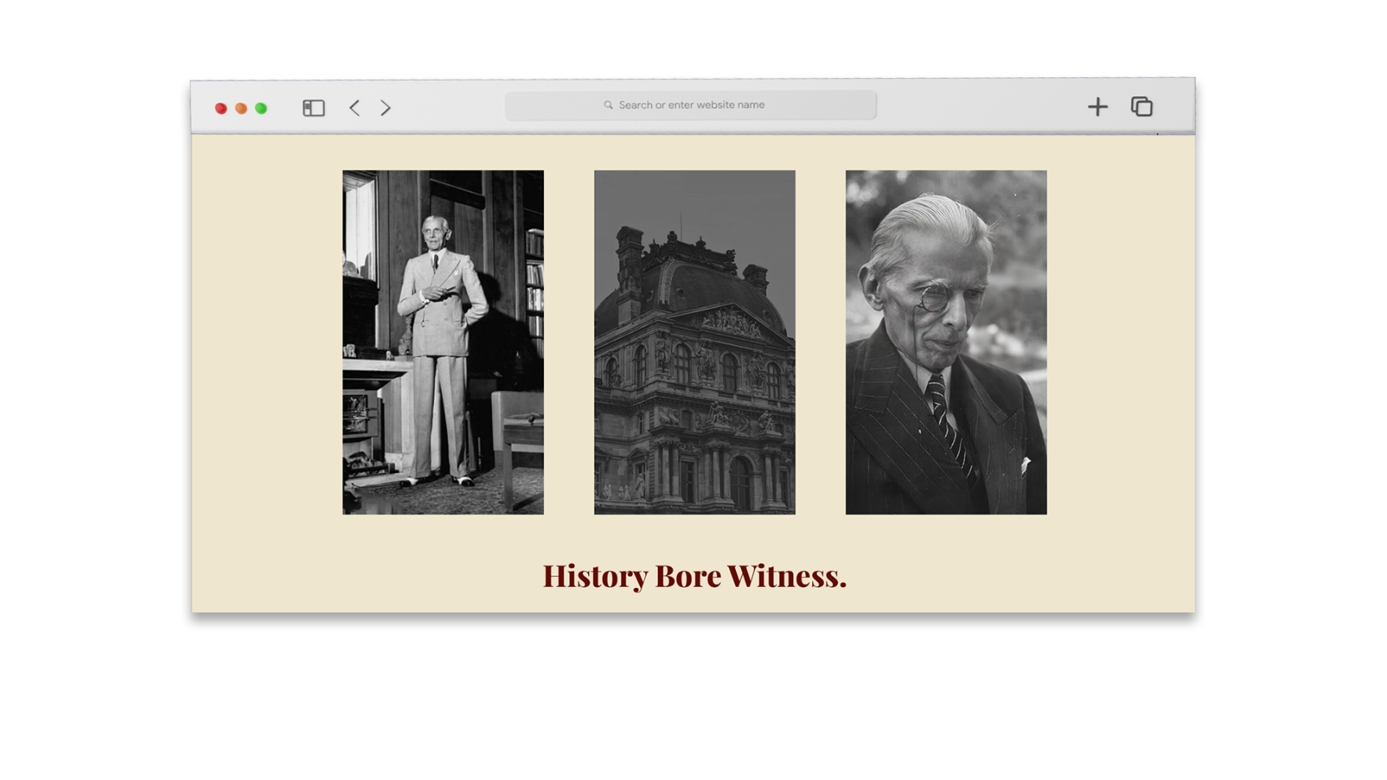
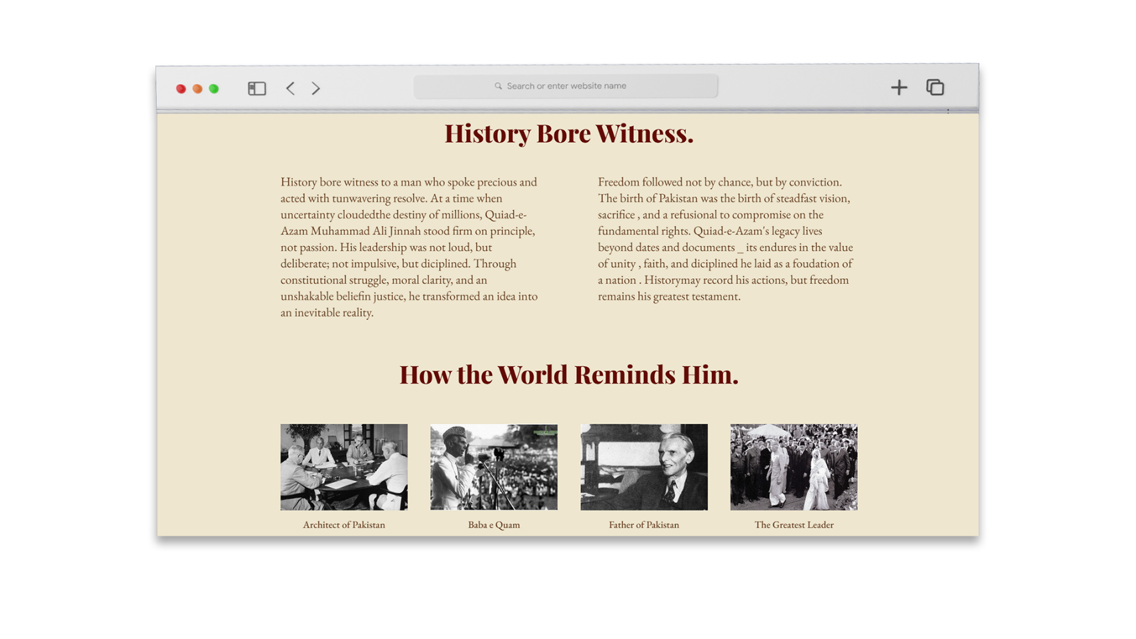
SCREENSHOTS

Slide 10


ACCESS THE PROJECT
LIVE WEBISTE
Visit the tribute website hosted on GitHub Pages
Visit Live Site
SOURCE CODE
Explore the complete project repository on GitHub
Visit Repository

Slide 11
DESIGN DECISION
COLOR
#640b06
#eee6cf
#640b06
TYPOGRAPHY
Fairplay Display
For Headings
Eb Garamond
For Text

Slide 12
REFLECTION & LEARNING
1
Structuring content using HTML
2
Styling layouts using CSS
3
Using consistent color themes
4
Presenting projects professionally
5
Understanding real-world project workflow

Slide 13
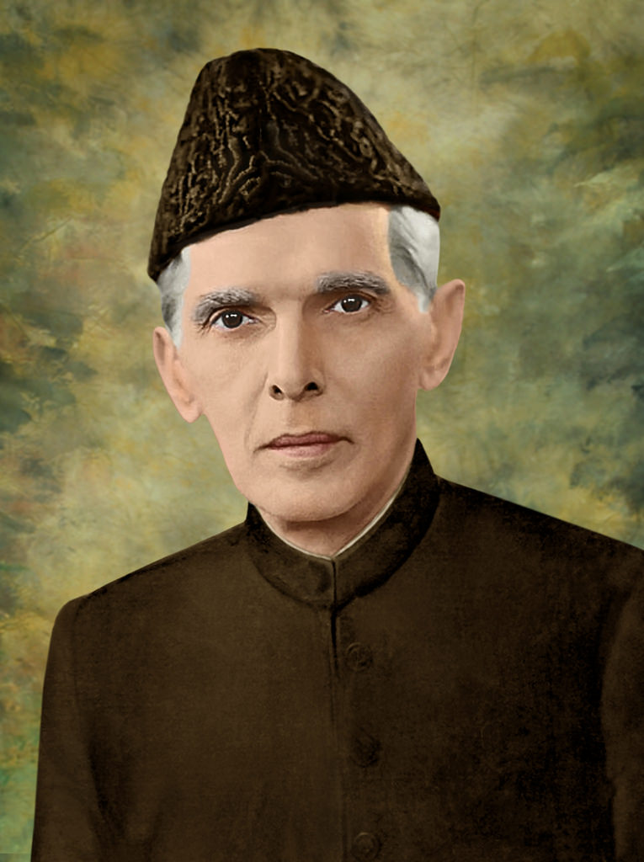
THANK YOU

