Slide 1
NERM
2/28/2018
Geena Ildefonso, Mike Irvin, Carlos Lopez

Slide 2
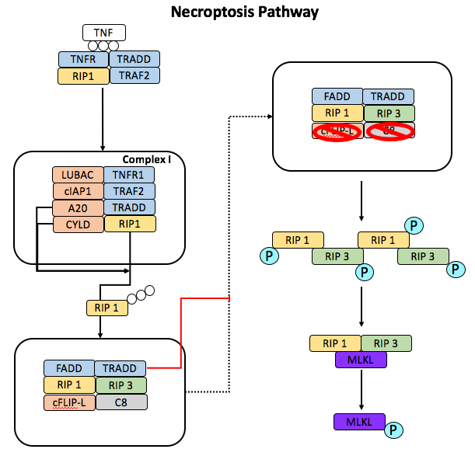
NERM Topology
Model Parameters: 53
Model Rules: 36
Model Odes/Species: 39

Slide 3
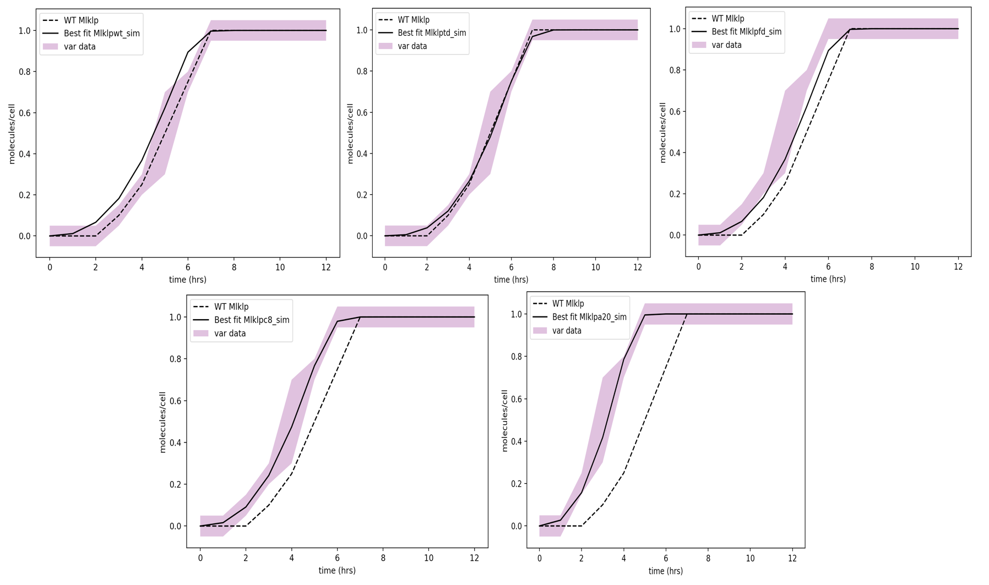
Model Calibration Results
Calibrator: PSO
Iterations: 15,000
Particles: 50
Time to finish: ~2 days

Slide 4
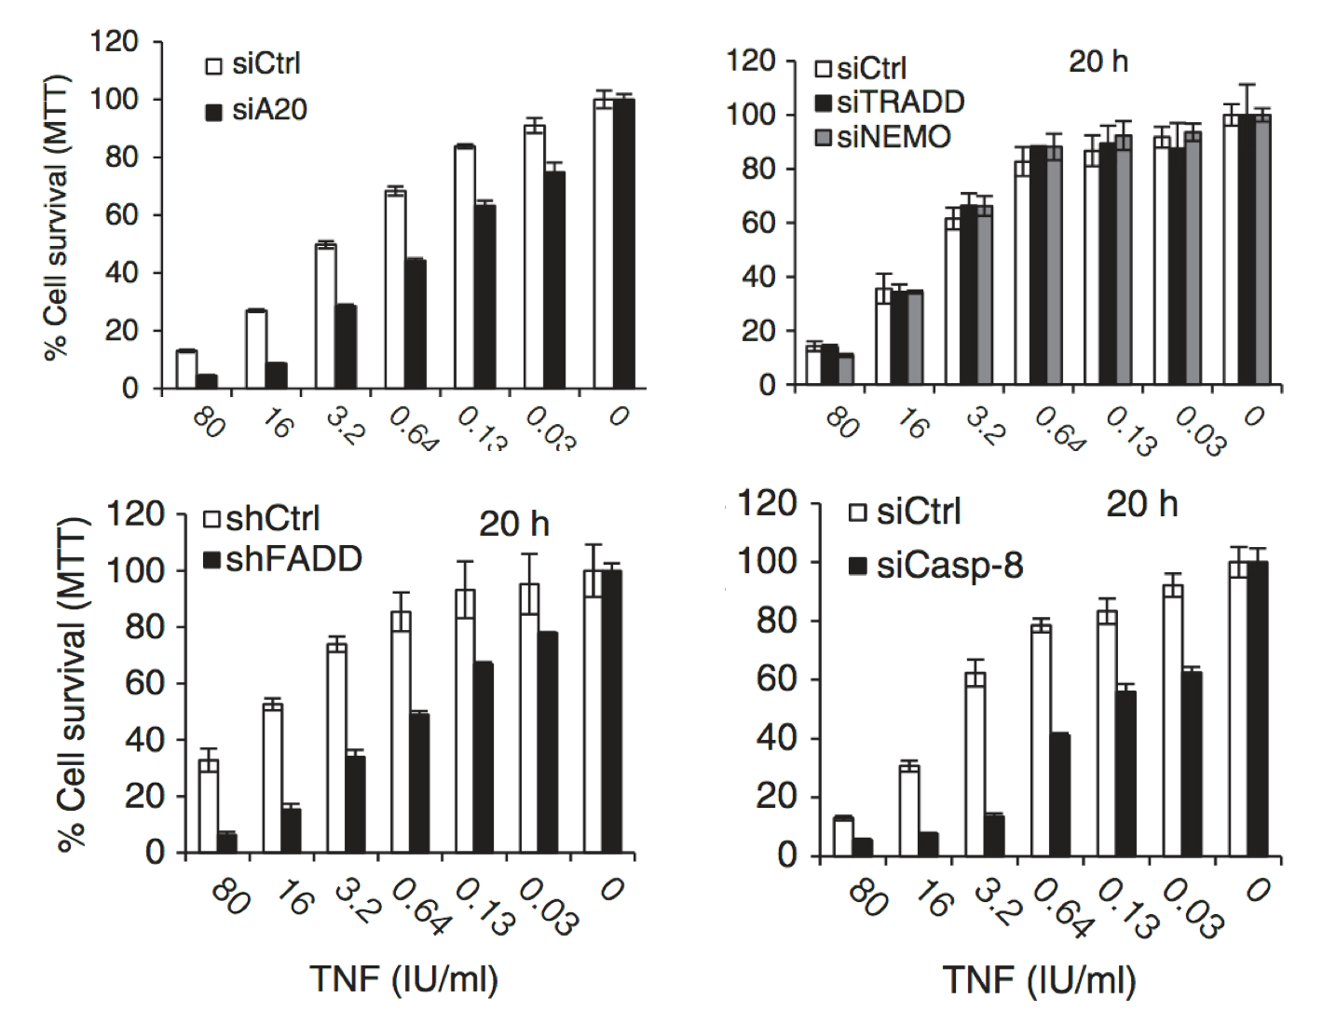
L929 Data, Vanlangenakker et al.

Slide 5
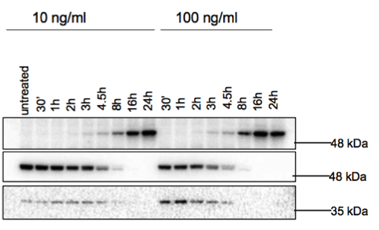
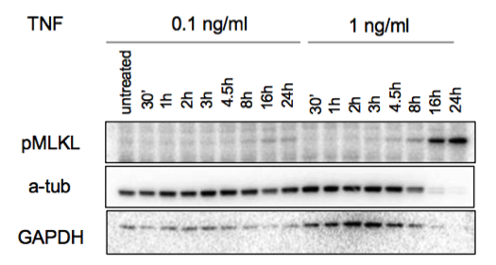
Experimental Data L929 cells

Slide 6
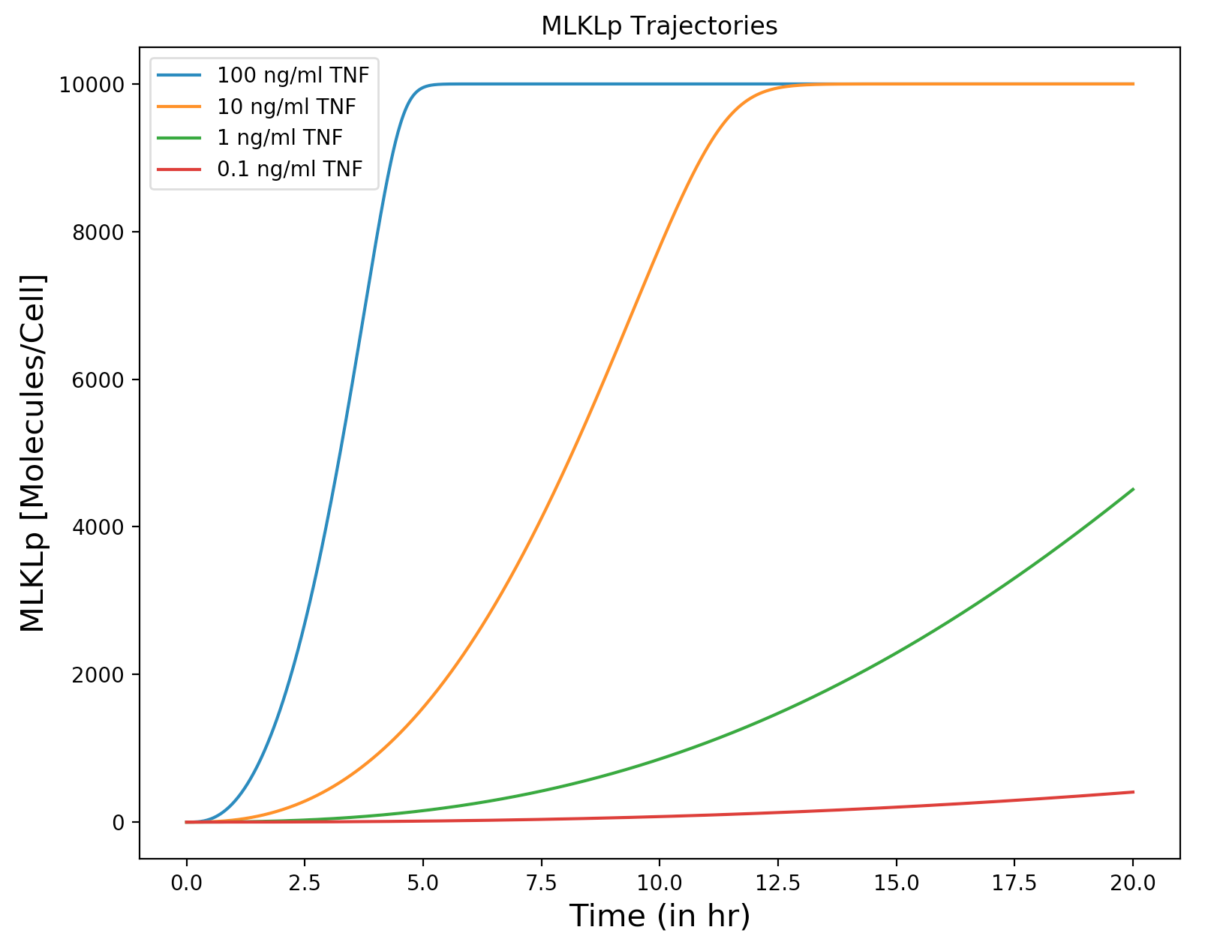
Model sensitivity to MLKLp under TNF doses

Slide 7
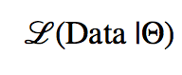
Calibration Algorithm
slow
convergence
slow
Simulate Experimental Conditions
$$X_{t=0}$$
Model the Dynamics
$$X(t)$$
Preprocessing &
Dimensionality Reduction
$$Θ_{rate}$$
$$Θ_{classification}$$
Generate New
Rate Parameters
Classification
On-going
Replacing scipy solver with a GPU based solver.
Rewriting objective function to make it more generalizable to various measurement types.
Probabilistic Interpretation

